Slide 1

Tools for engagement
Anne Guerry
TNC Climate Risk & Resilience 2013

Slide 2
Tools shaped by engagement are better
Engagements are better when shaped by tools

Slide 3
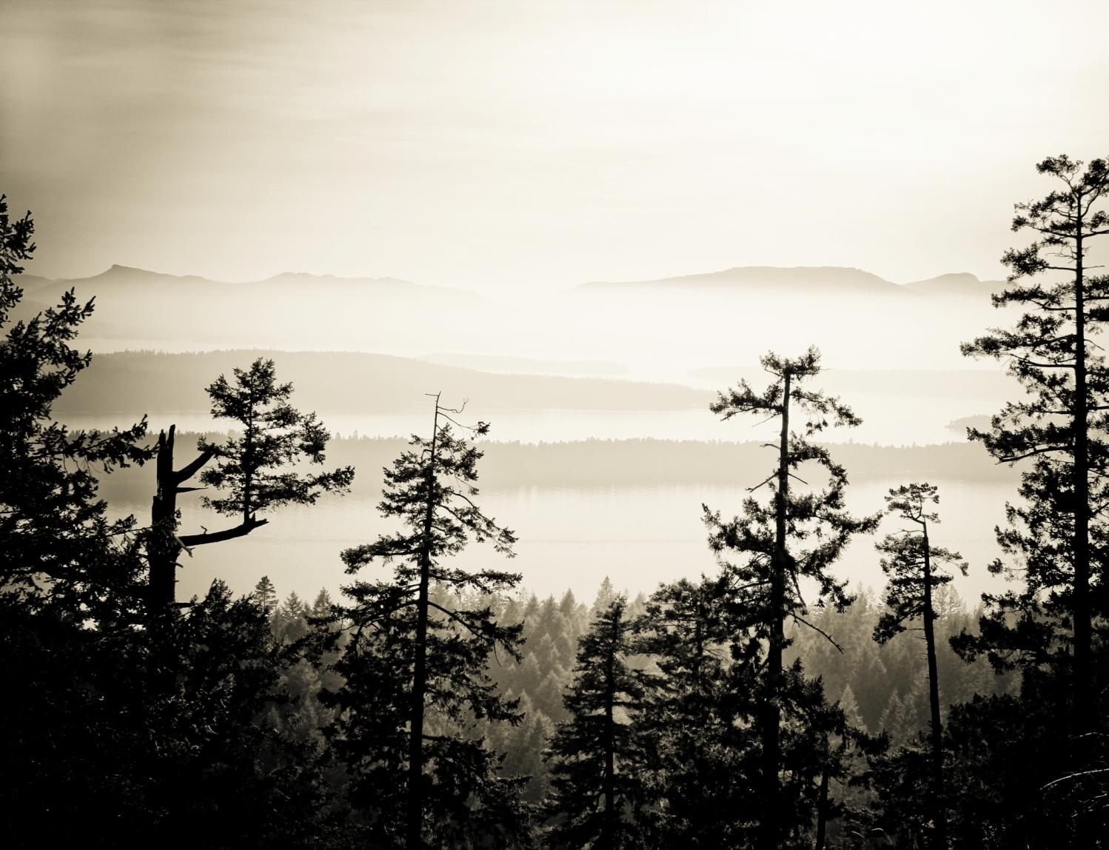
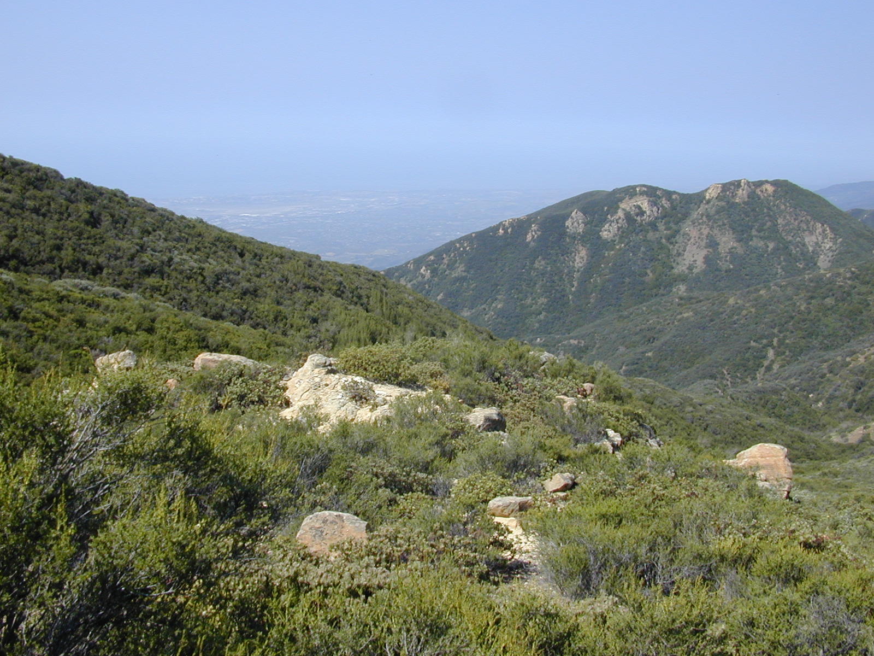




The Natural Capital Project

Slide 4
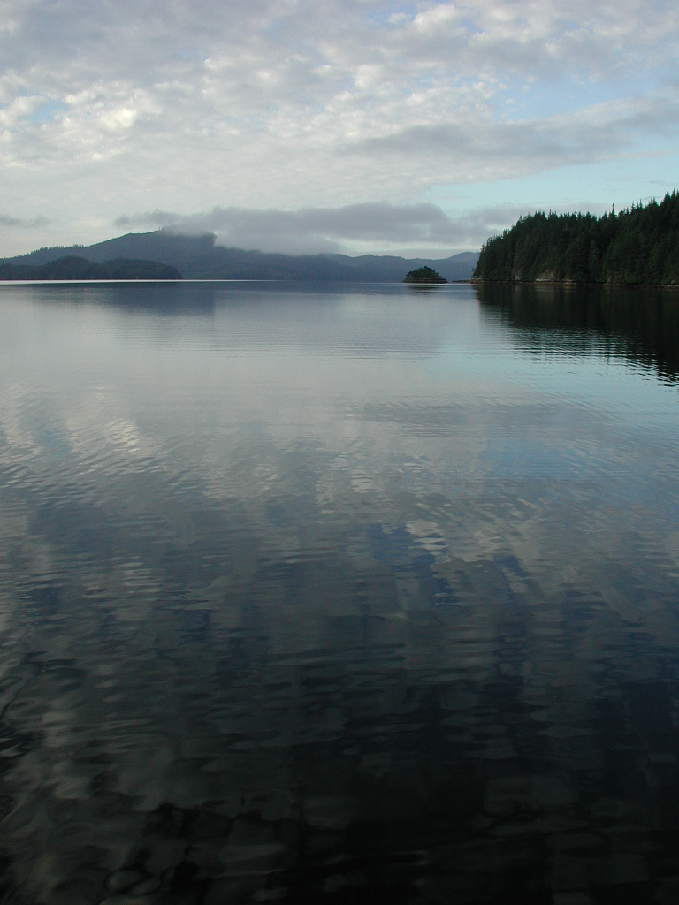

Mary Ruckelshaus, Steve Polasky, Gretchen Daily, Peter Kareiva, Taylor Ricketts, Jon Foley, Heather Tallis, Anne Guerry, Becky Chaplin-Kramer, Guy Ziv, Rich Sharp, Emily McKenzie, Liz Rauer, Brian Robinson, Gail Kaiser, Stacie Wolny, Jodie Toft, Katie Arkema, Greg Guannel, Gregg Verutes, Spencer Wood, CK Kim, Mike Papenfus, James Douglass, Joey Bernhardt, Martin Lacayo-Emery, Derric Pennington, Amy Rosenthal, Yonas Ghile, Rob Griffin, Suzanne Langridge, Lula G-Michael, Nasser Olwero, Doug Denu, Nirmal Bhagabati, Bonnie Keeler, Mike Anderson, Kris Johnson, Peter Hawthorne, Shan Ma, Jess Silver, Adrian Vogl, Jen Burke, Mike Carey, Joe Faries
Support from:
Gordon and Betty Moore Foundation, David and Lucile Packard Foundation, Rockefeller Foundation, Summit Foundation, MacArthur Foundation, Google/Tides Foundation
NOAA, NSF, DoD, EPA
Private Individuals
TNC, WWF, Stanford, UMN
www.naturalcapitalproject.org

Slide 5


Slide 6
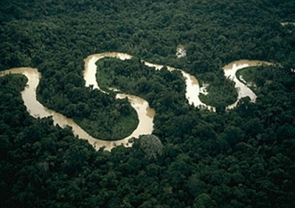
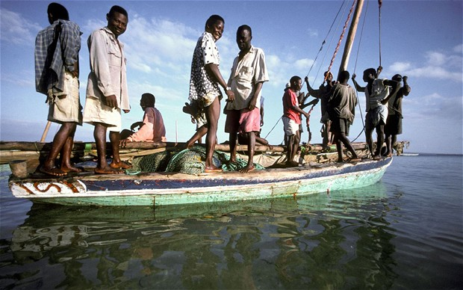

NatCap’s mission
Develop and apply a credible ecosystem service approach to support decision makers with dual development and conservation goals
Learn what works, train users, and disseminate useful approaches and lessons
Create an informed community of leaders and practitioners who will enable large-scale policy changes

Slide 7
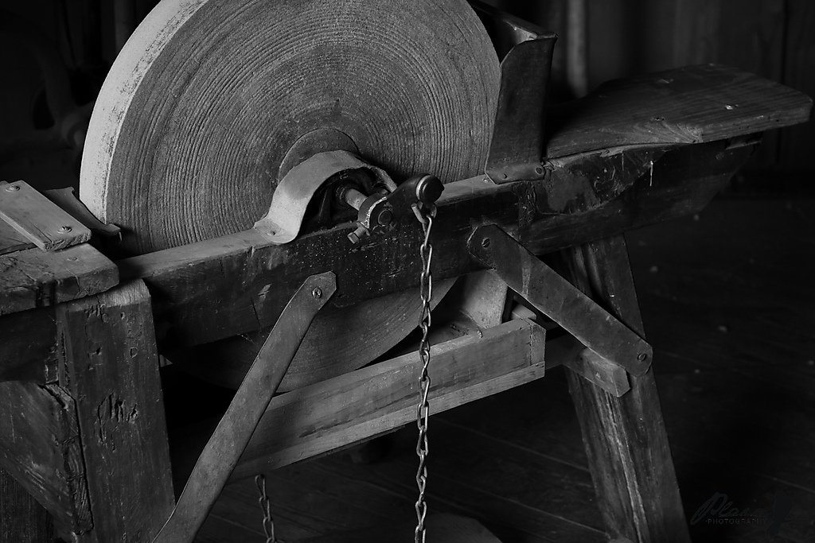
Tools shaped by engagement are better

Slide 8
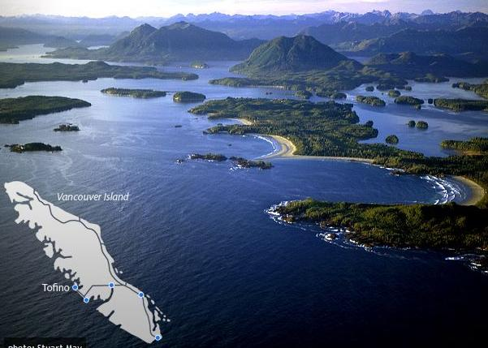
Notes:
This is the west coast of Vancouver Island, where people’s identity and well-being is closely tied to the ocean.

Slide 9
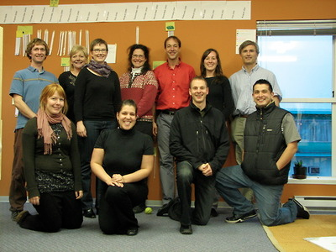

West Coast Aquatic Management Board
Federal, Provincial, First Nation, and local governments

Slide 10
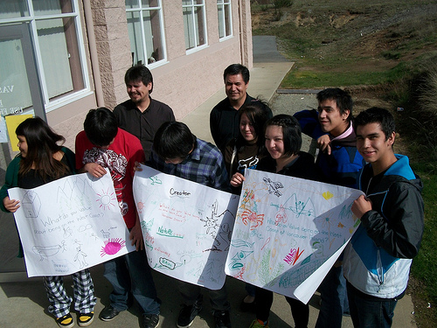
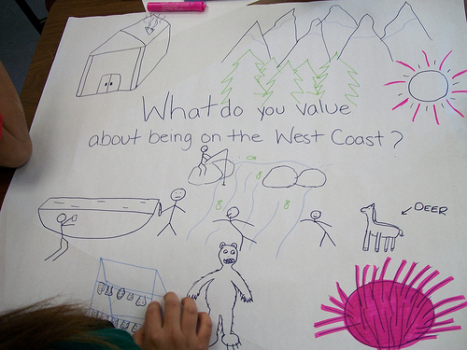
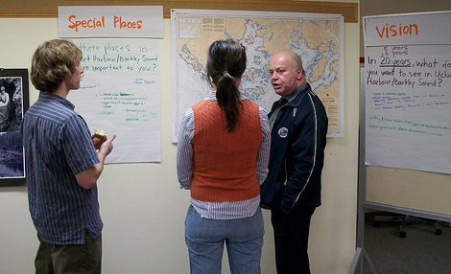
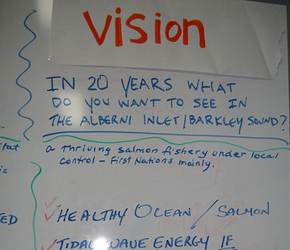
Extensive stakeholder engagement

Slide 11
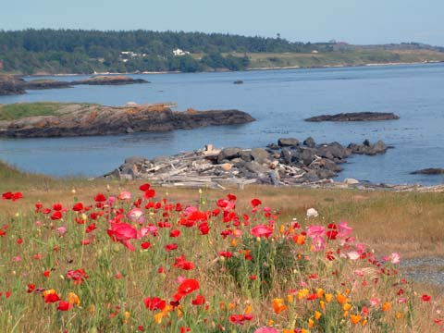
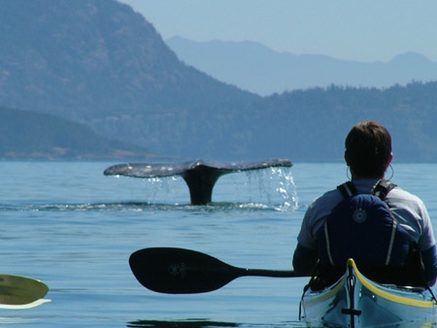
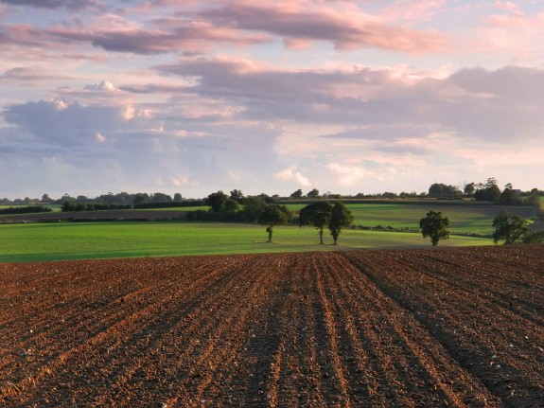
Changes in ecosystem → Changes in ecosystem services and their values
Notes:
To show how changes in ecosystems lead to changes in ecosystem services and their values.

Slide 12
Coastal protection
Forcing
Conditions
Waves
Baseline tide
Long-term sea-level rise
Currents
Wind

Slide 13

Coastal protection
Forcing
Conditions
Attenuation
Waves
Baseline tide
Long-term sea-level rise
Currents
Wind
Biogenic habitat
Abiotic morphology
‘Hard’ structures

Slide 14
Coastal protection
Forcing
Conditions
Attenuation
Hydrodynamic
Output
Wave height
Mean water level
Runup
Storm surge
Waves
Baseline tide
Long-term sea-level rise
Currents
Wind
Biogenic habitat
Abiotic morphology
‘Hard’ structures

Slide 15
Coastal protection
Forcing
Conditions
Attenuation
Hydrodynamic
Output
Wave height
Mean water level
Runup
Storm surge
Erosion
Flooding
Near property
and people
Waves
Baseline tide
Long-term sea-level rise
Currents
Wind
Biogenic habitat
Abiotic morphology
‘Hard’ structures

Slide 16
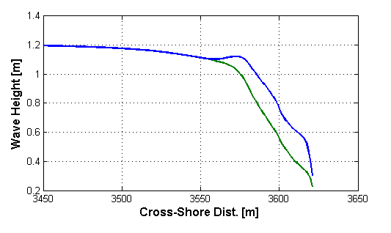
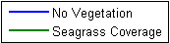
15 hrs Storm
H_{max}=1.5m
T=4s
Run Wave Model
Beach
Offshore
Erosion Difference: 1.5m

Slide 17
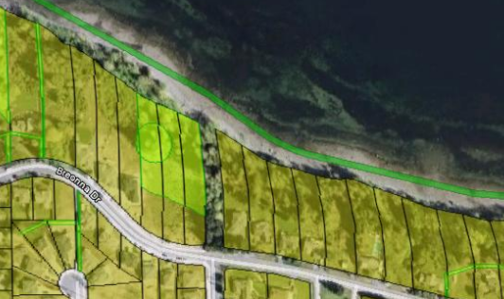
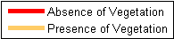
Coastal protection
NOT TO SCALE
Avoided re-nourishment cost
Avoided property damages
Avoided people displaced

Slide 18


Slide 19
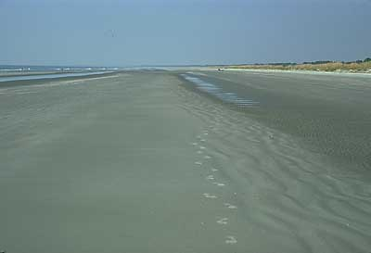
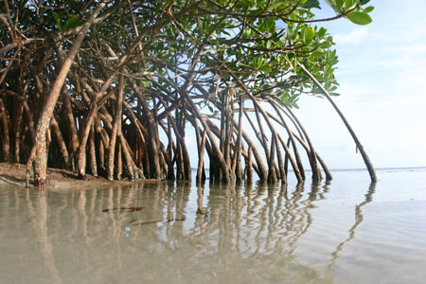
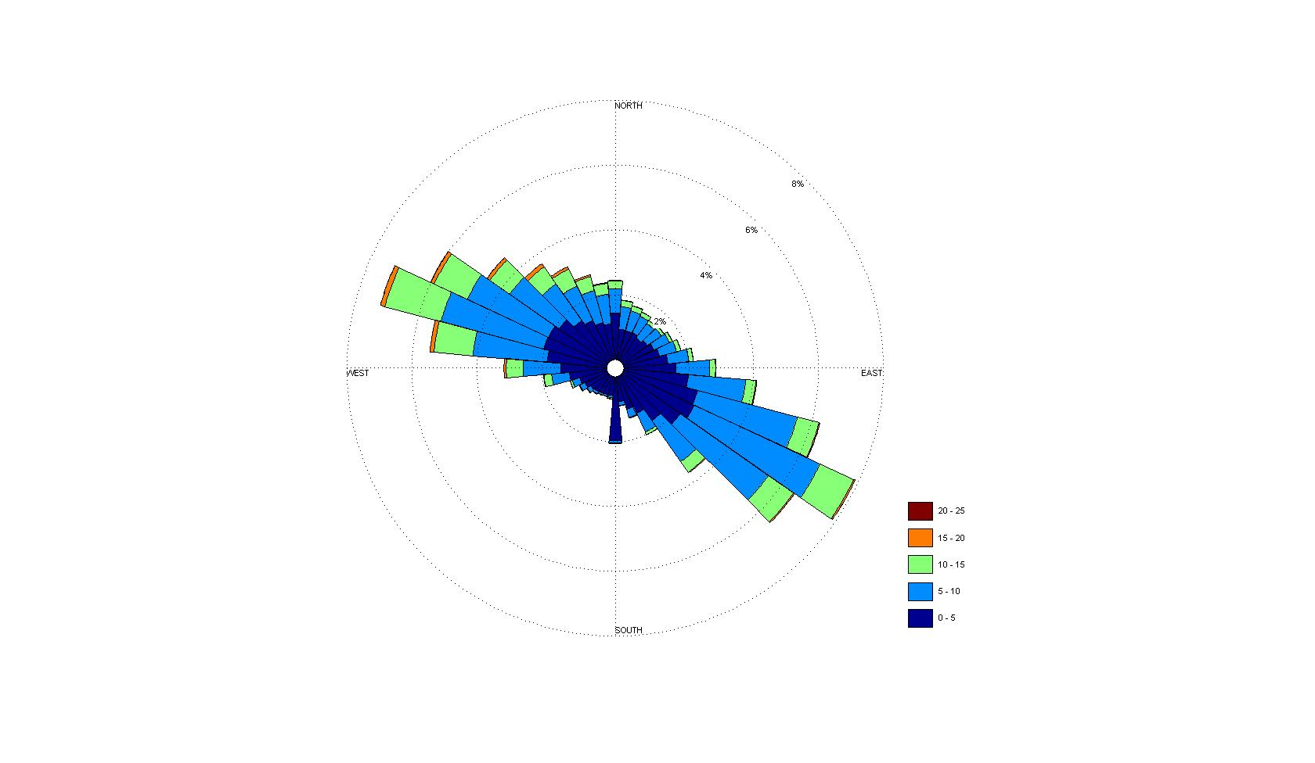
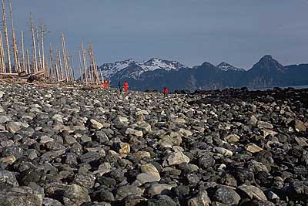
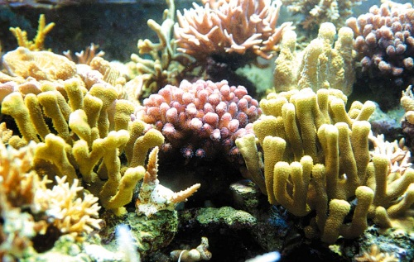
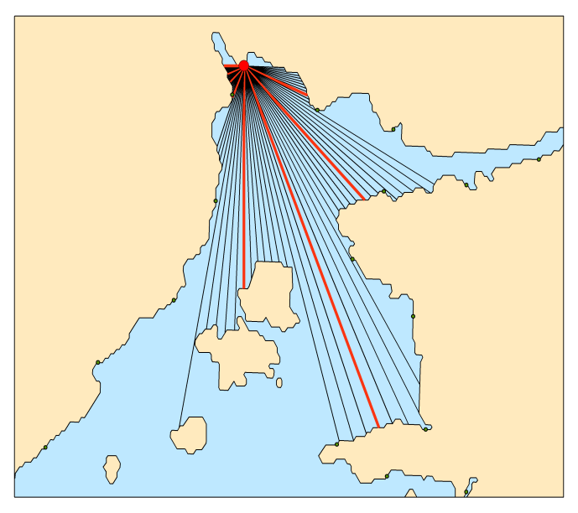
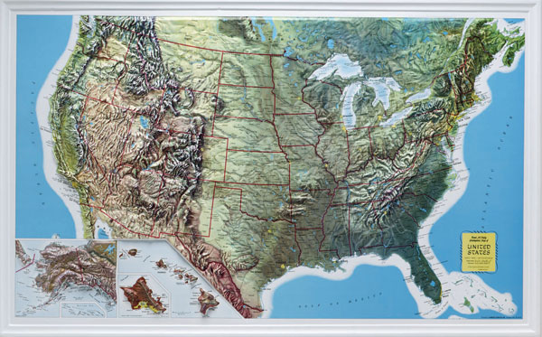
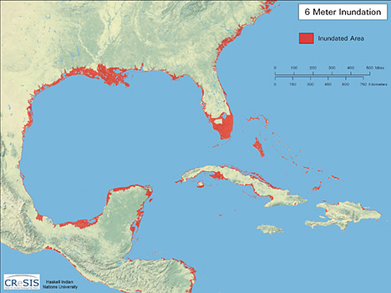
Coastal hazard index and data layers
1
2
3
Sandy
Beach
Rocky Coast
GEOMORPHOLOGY
NATURAL HABITATS
WIND EXPOSURE
4
5
6
WAVE EXPOSURE
RELIEF
SEA LEVEL RISE
Notes:
RANKED 1 – 5!

Slide 20
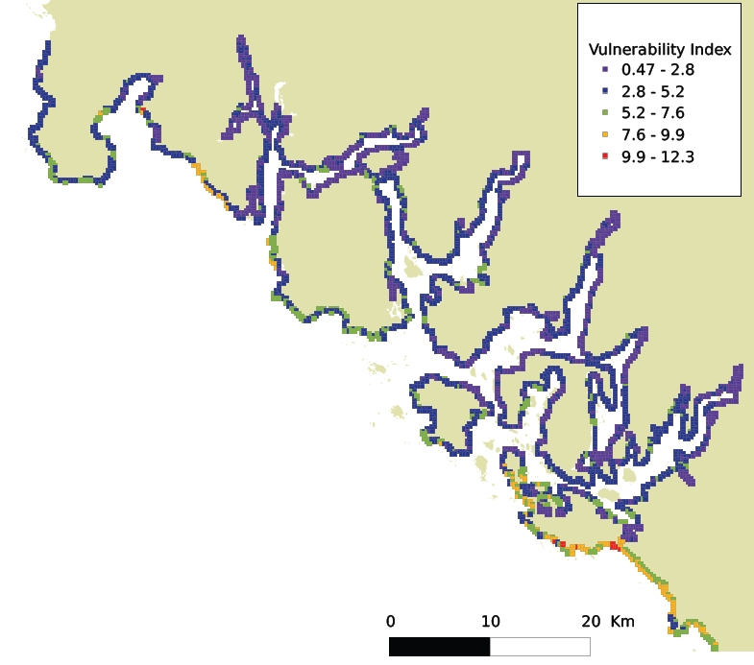
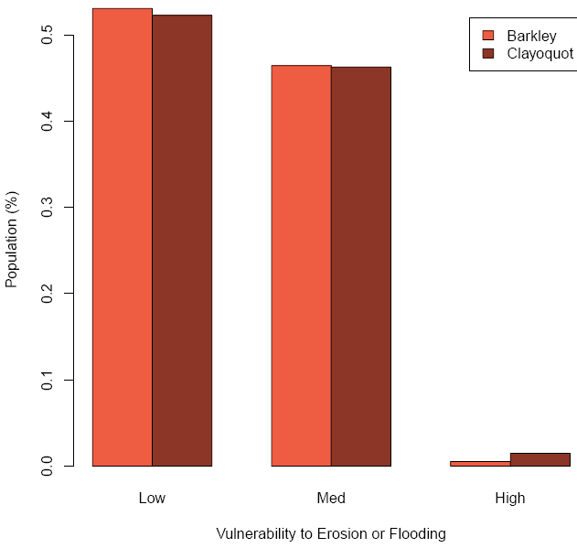

Vulnerability of
population
Notes:
The percent of total people living within 0.25 km of the shoreline, who reside within a shoreline segment ranked as having high, medium, or low vulnerability (the top, middle, or bottom 33%, respectively).

Slide 21
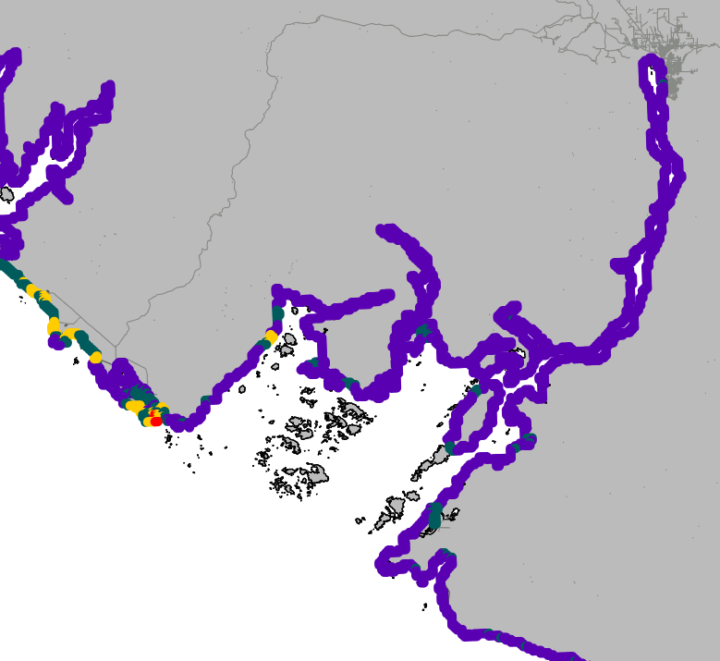
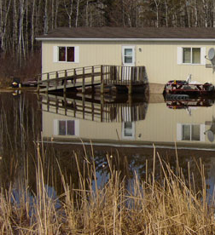
PERCENT OF SHORELINE AT RISK TO EROSION OR FLOODING THAT HAS ACTIVITIES
BAR CHARTS,
LEGEND, ETC.
Barkley Sound
Barkley Sound
13% of shoreline highest coastal
risk with activities
X% of the shoreline is at high risk
Key
0 activities
1 activity
Safe Waterways and Modern Infrastructure
2 activities
>3 activities
Notes:
Percent of Shoreline that is at high risk and has activities
Usually a problematic concept.

Slide 22
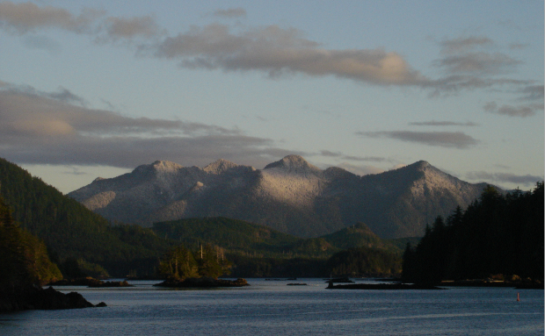
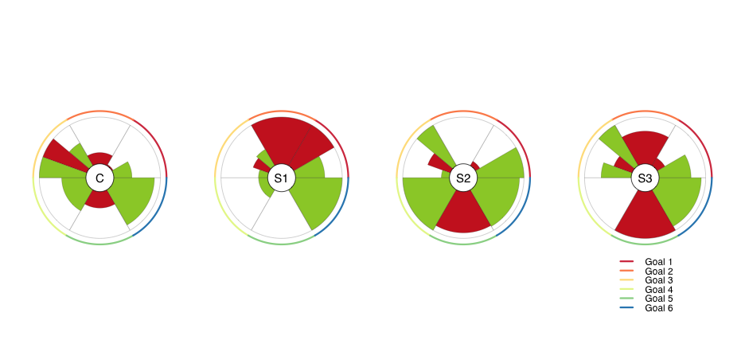
Assess scenarios against ‘Common Goals’
Healthy environment
Access to local seafood
Sustainable local jobs
Safe waterways
Vibrant communities and culture
Adaptive management
Notes:
WCA developed 6 “Common Goals” for the region. We worked with them to match up indicators that we can output from our tools to help them assess various planning scenarios (their goals in different colors around the outside; wedges show model outputs with red being risks to minimize and green being benefits to maximize. See wedges grow and shrink across different scenarios). Rather than our running models to compare scenarios now, we trained WCA staff to use our tools and they are now able to run relevant tools on their own to inform future iterations of scenarios.

Slide 23
Arkema et al. press,, Nature Climate Change

Slide 24
15 hrs Storm
H_{max}=1.5m
T=4s
Run Wave Model
Beach
Offshore
Erosion Difference: 1.5m

Slide 25

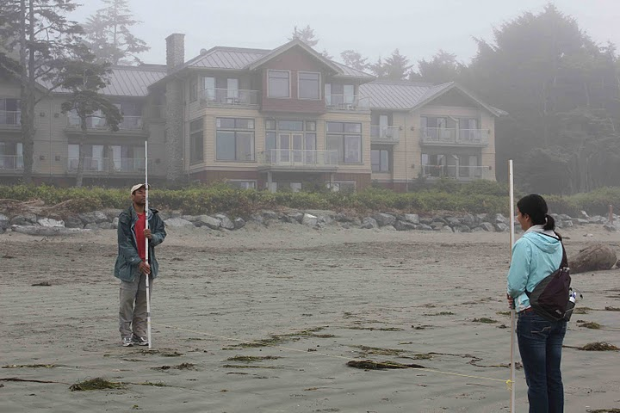
Stanford researchers bring new marine tool to West Coast
Yasmin Aboelsaud, Special to Westerly News Published: Thursday, January 13, 2011
Councillors and Tofino mayor John Fraser were among attendees at the presentations on coastal erosion hosted by the District of Tofino and West Coast Aquatic on January 10.
Notes:
DPA for foreshore of Tofino—designating areas that need a permit…helping define permitting process

Slide 26
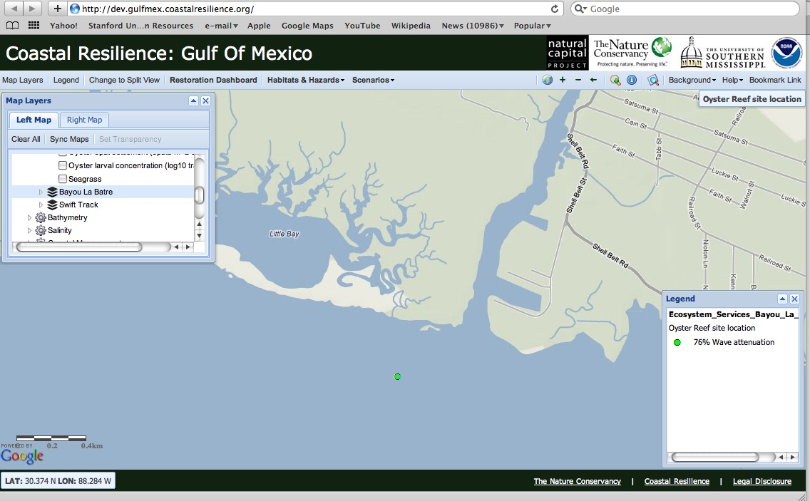
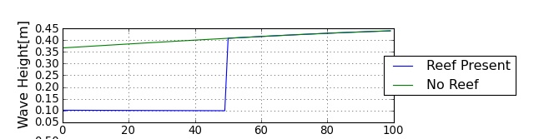
Model Results

Slide 27


Slide 28
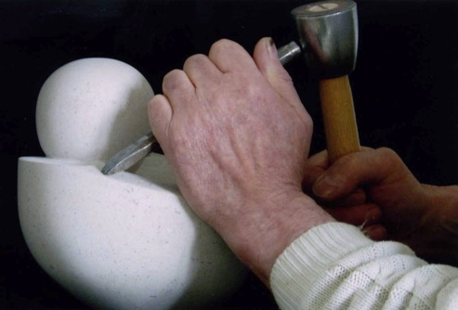
Engagements are better when shaped by tools

Slide 29
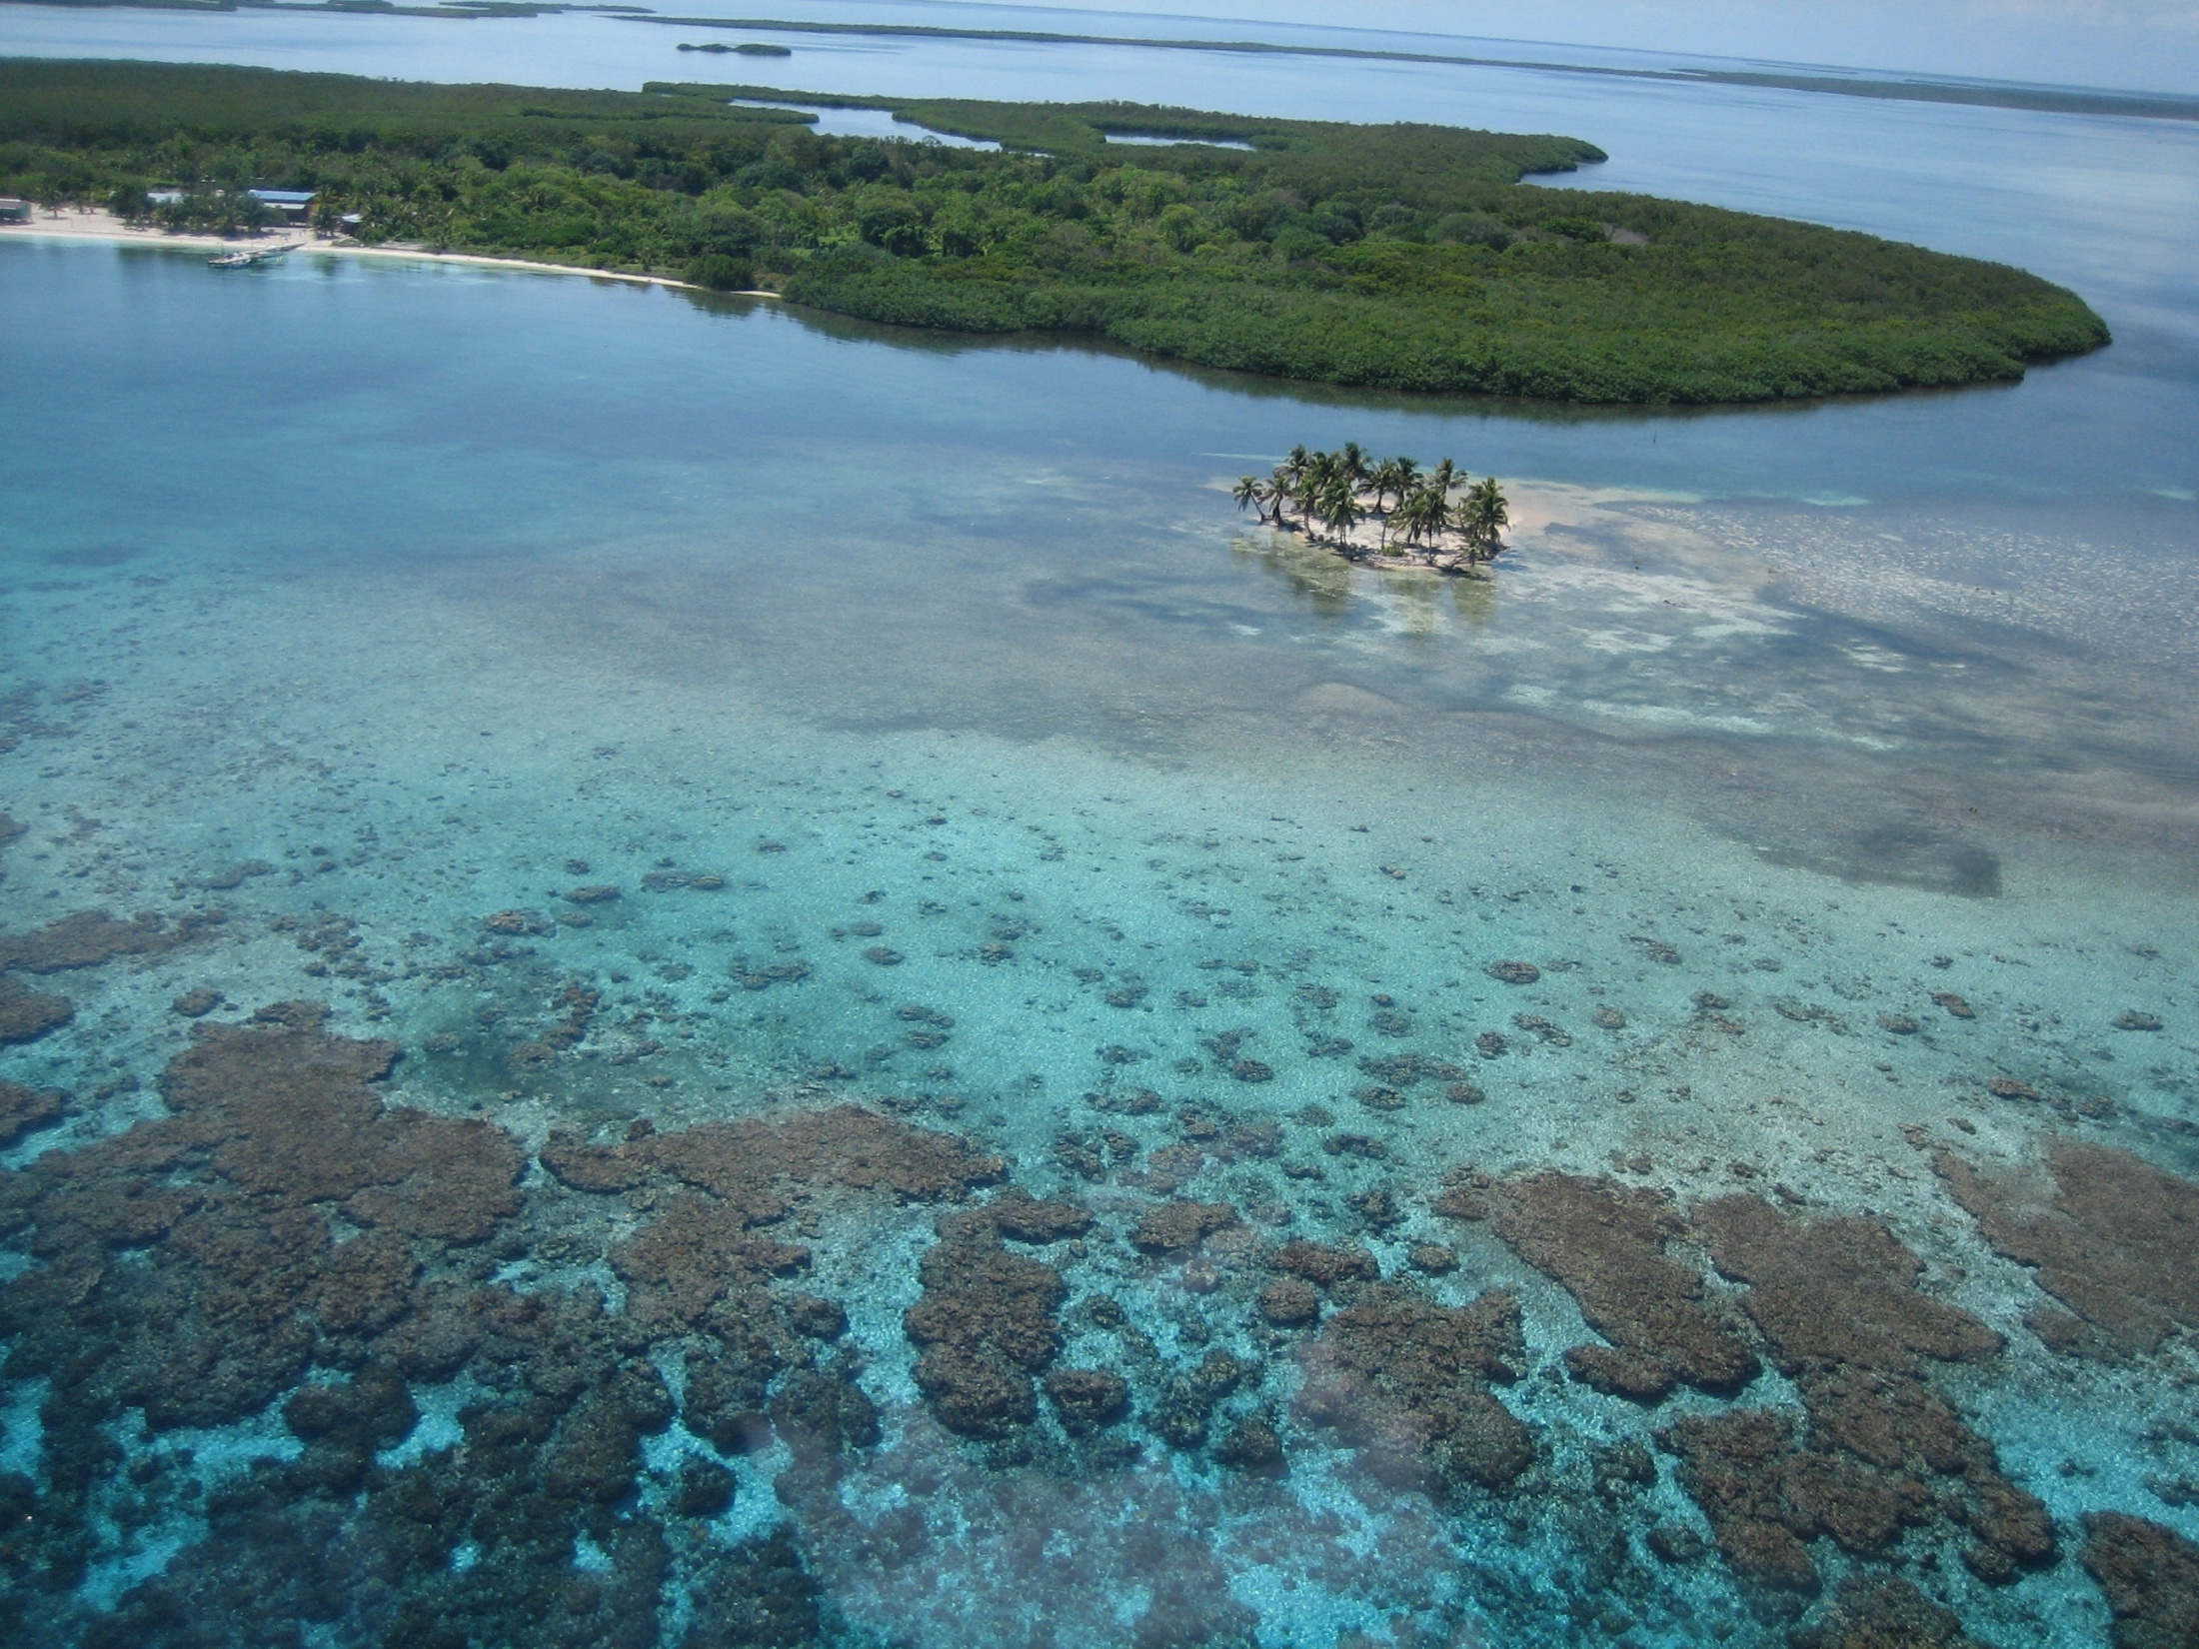
How can we balance sustainable use of the coastal and marine environment for the benefit of Belizeans and the global community?

Slide 30
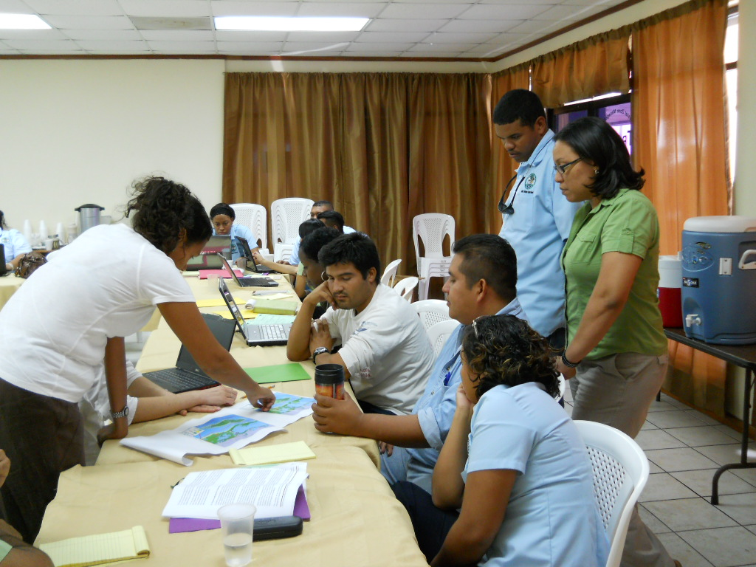
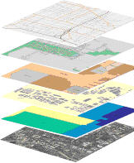
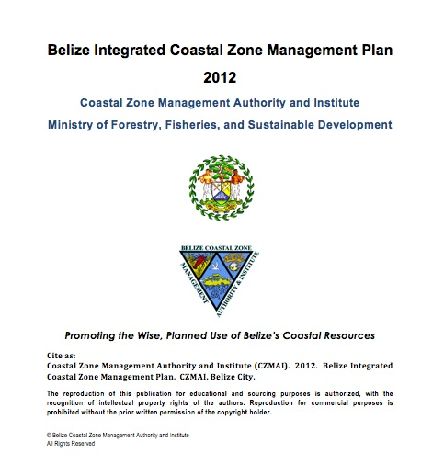
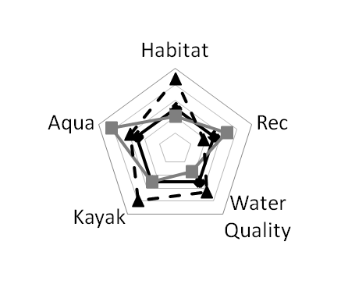
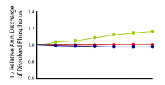
1
2
3
Define Partnerships, Roles & Objectives
Compile Data
Generate Baseline & Scenarios
4
Iterate & Build Capacity
Assess Outcomes
6
7
Inform
Decisions
5
Synthesize Results
Notes:
Recap approach here.

Slide 31
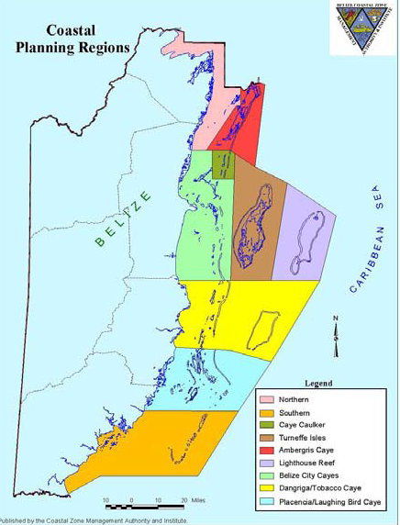
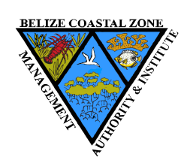

Slide 32
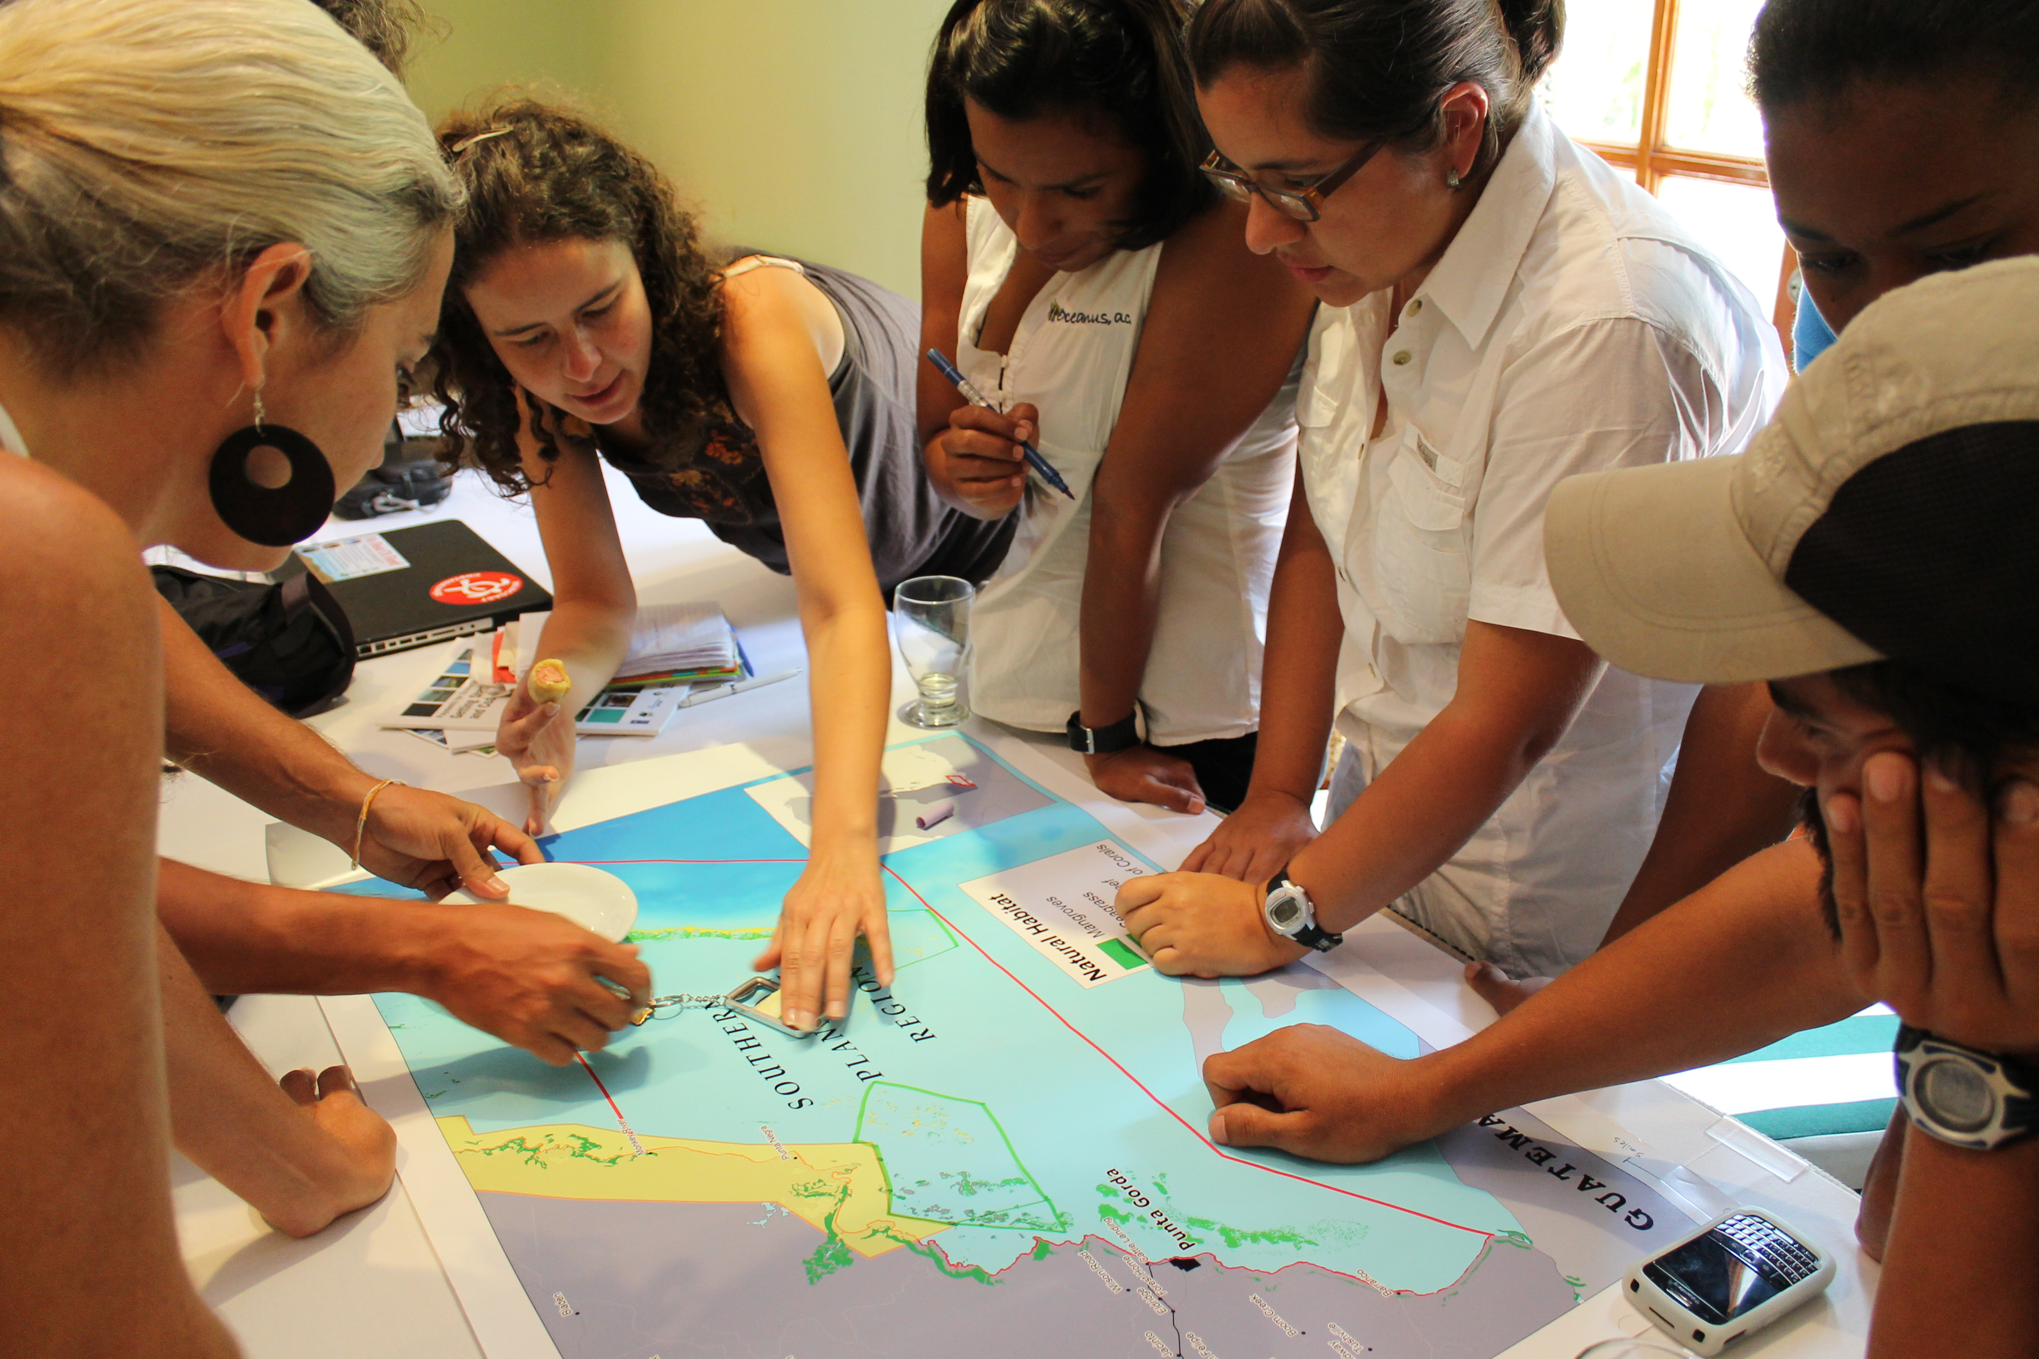
CZMAI Advisory Council/Board of Directors
Cabinet-level ministers
Notes:
Something here about all the iterations of plans and the back and forth between NatCap and CZMAI and stakeholders and ministers

Slide 33
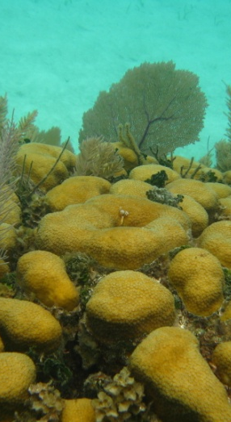
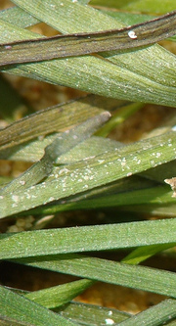
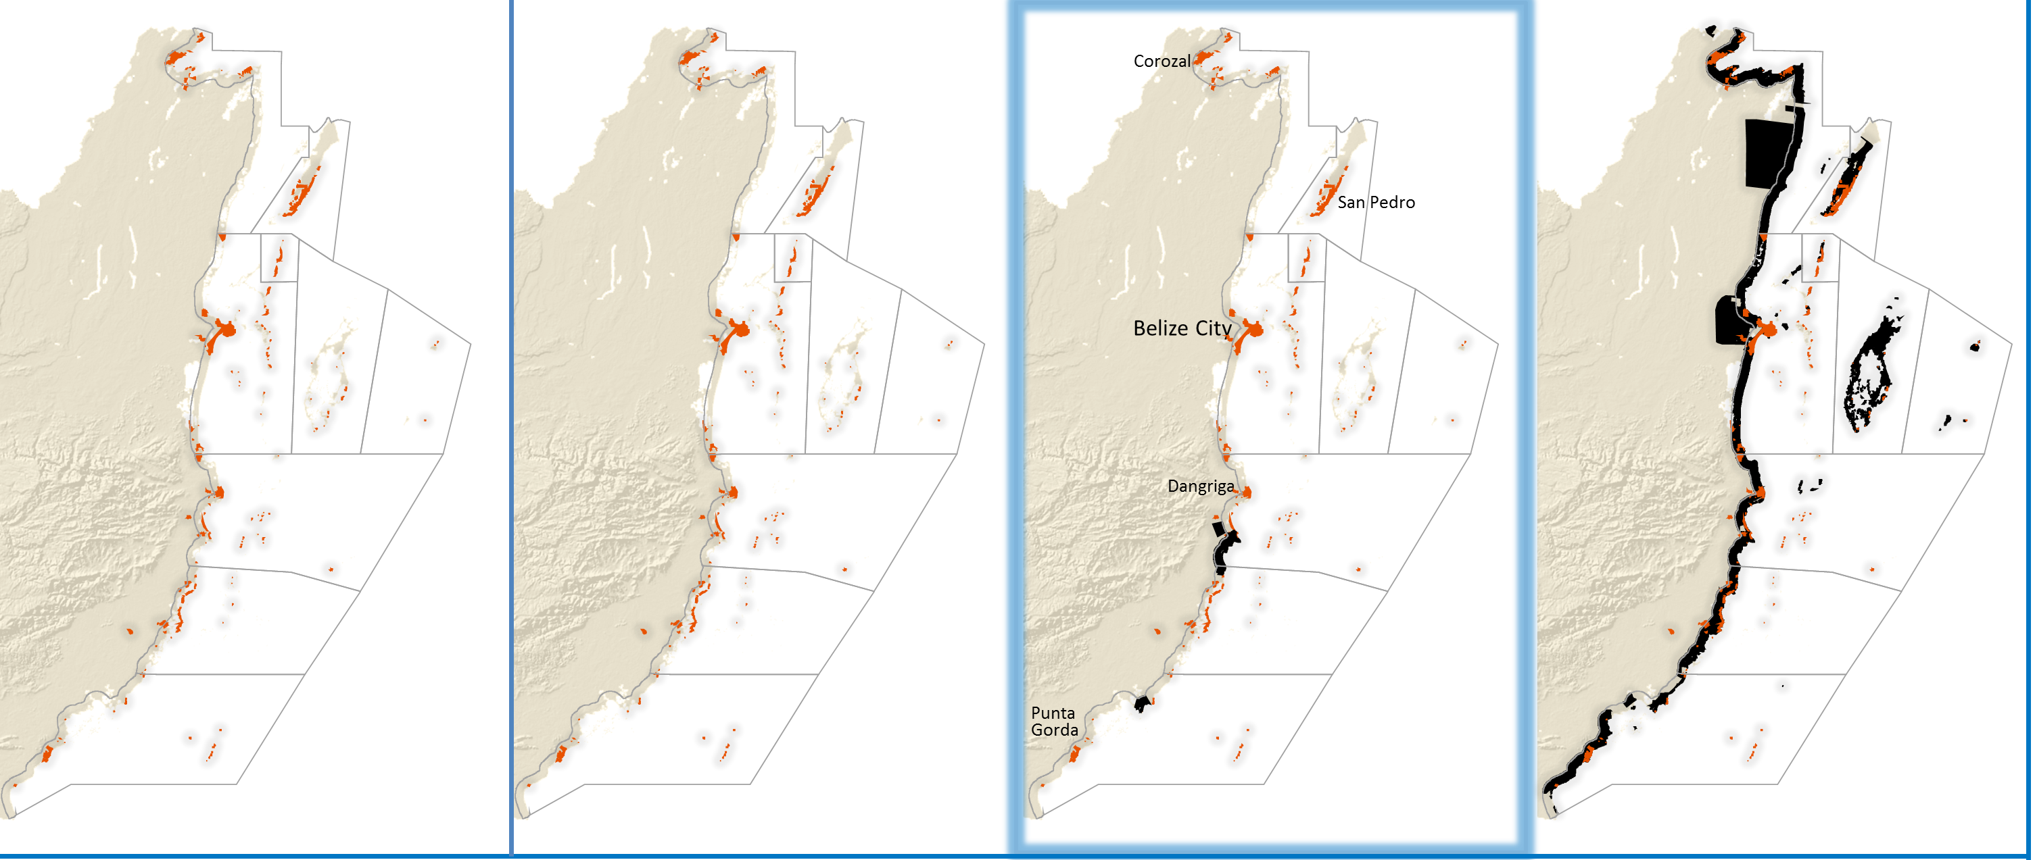
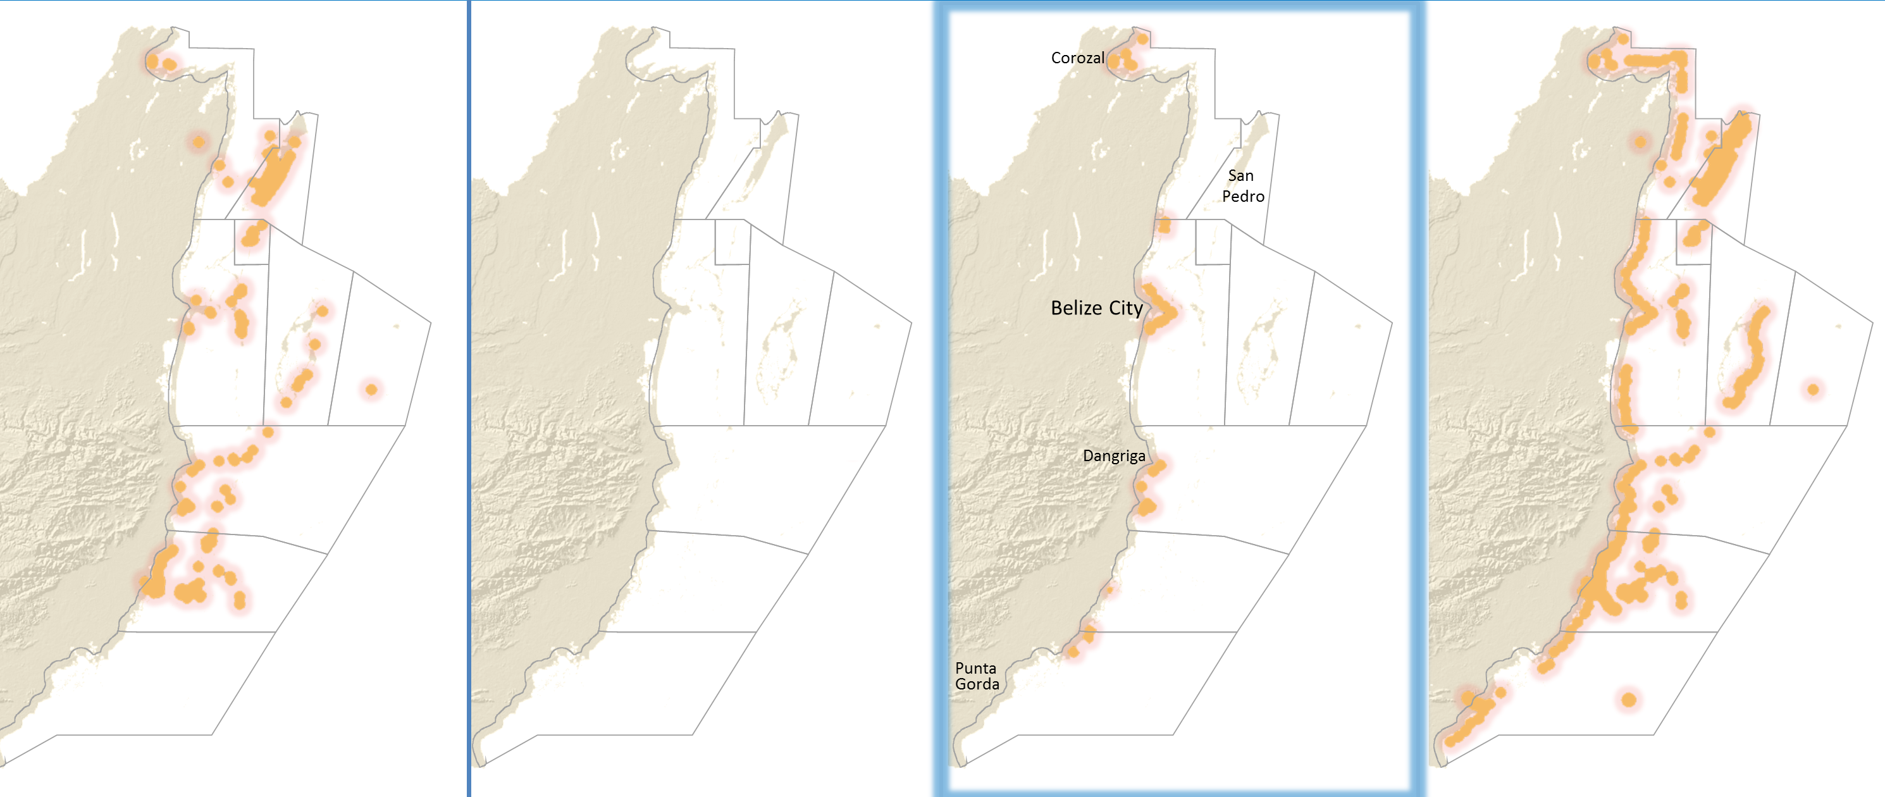




Habitats
Recreation
Fisheries
Storm protection

Slide 36



How is the outcome different than it would have been without
ecosystem service information?
Stakeholder engagement
InSEAM
+
Models

Slide 37



What are the costs and benefits of alternative climate adaptation options?
‘Green’
‘Grey’
Value suite of services
Scenarios for climate change and adaptation options

Slide 38
Integrated
Reactive
Protection of coastal mangroves and littoral forest
Some restoration of mangroves
Establishment of MPAs
Strategic construction of sea walls to avoid undeveloped and conservation areas and beaches that are used for tourism
Construction of sea walls along all coastlines with development
Some protection of mangroves and littoral forest
$275M greater net benefit

Slide 39

Tools—used by us and by our partners:
  Helped engage stakeholders
    Incorporate local knowledge
    Envision alternate management scenarios
  Provided accessible science to planners
  Generated compelling outputs for decision-makers
  Improved outcomes compared to status quo

Slide 40
Tools shaped by engagement are better
Engagements are better when shaped by tools

Slide 41





The Natural Capital Project
Incorporating ecosystem services in decisions
S
S
S
C
P
C
S
R
S
M
S
S
S
D
P
S
P
P
D
P
S
Spatial Planning
Payment for Ecosystem Services (PES)
Climate Adaptation Planning
Development Impacts and Permitting
Restoration Planning
Ruckelshaus et al. in review
Corporate Risk Management

