Slide 1


WWF’s Market Transformation Initiative
Full -Cycle Adaptive Management of a Large Non-Place Based Program

Slide 2
About Foundations of Success
Our Structure
Non-profit organization
Our Mission
To improve the practice of conservation
Our Strategy
Work with practitioners of all kinds to improve the design, management, monitoring, and learning from conservation projects and programs
We don’t implement conservation projects,
we make conservation projects better!

Slide 3
WWF Project and Program Standards

Slide 4
Commodity Production is a
Major Threat to Biodiversity
55% of all habitable land is currently being used by agriculture and ranching
76% of global fisheries are fished at or beyond capacity
Aquaculture has grown nearly 10% per year for the past 30 years and now represents more than half of seafood
Global consumption of round wood is forecast to increase to 2.5 billion m³ by 2050
Biofuels could increase by 50% the amount of land in agriculture and forest plantations by 2050

Slide 5
MTI’s Conceptual Model
Promote Sustainable Production
Retailers
Brands
Manufacturers
Traders
Producers
Commodity Production
Priority Places

Slide 6
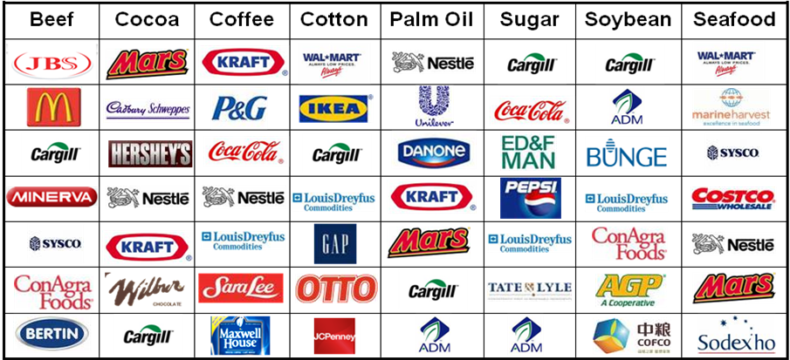
MTI Prioritized
Key Commodities & Companies

Slide 7
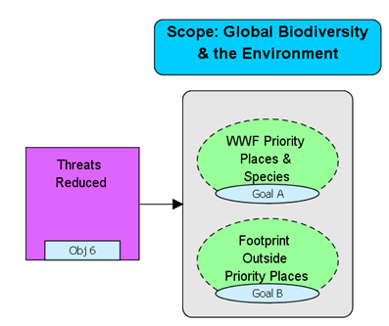
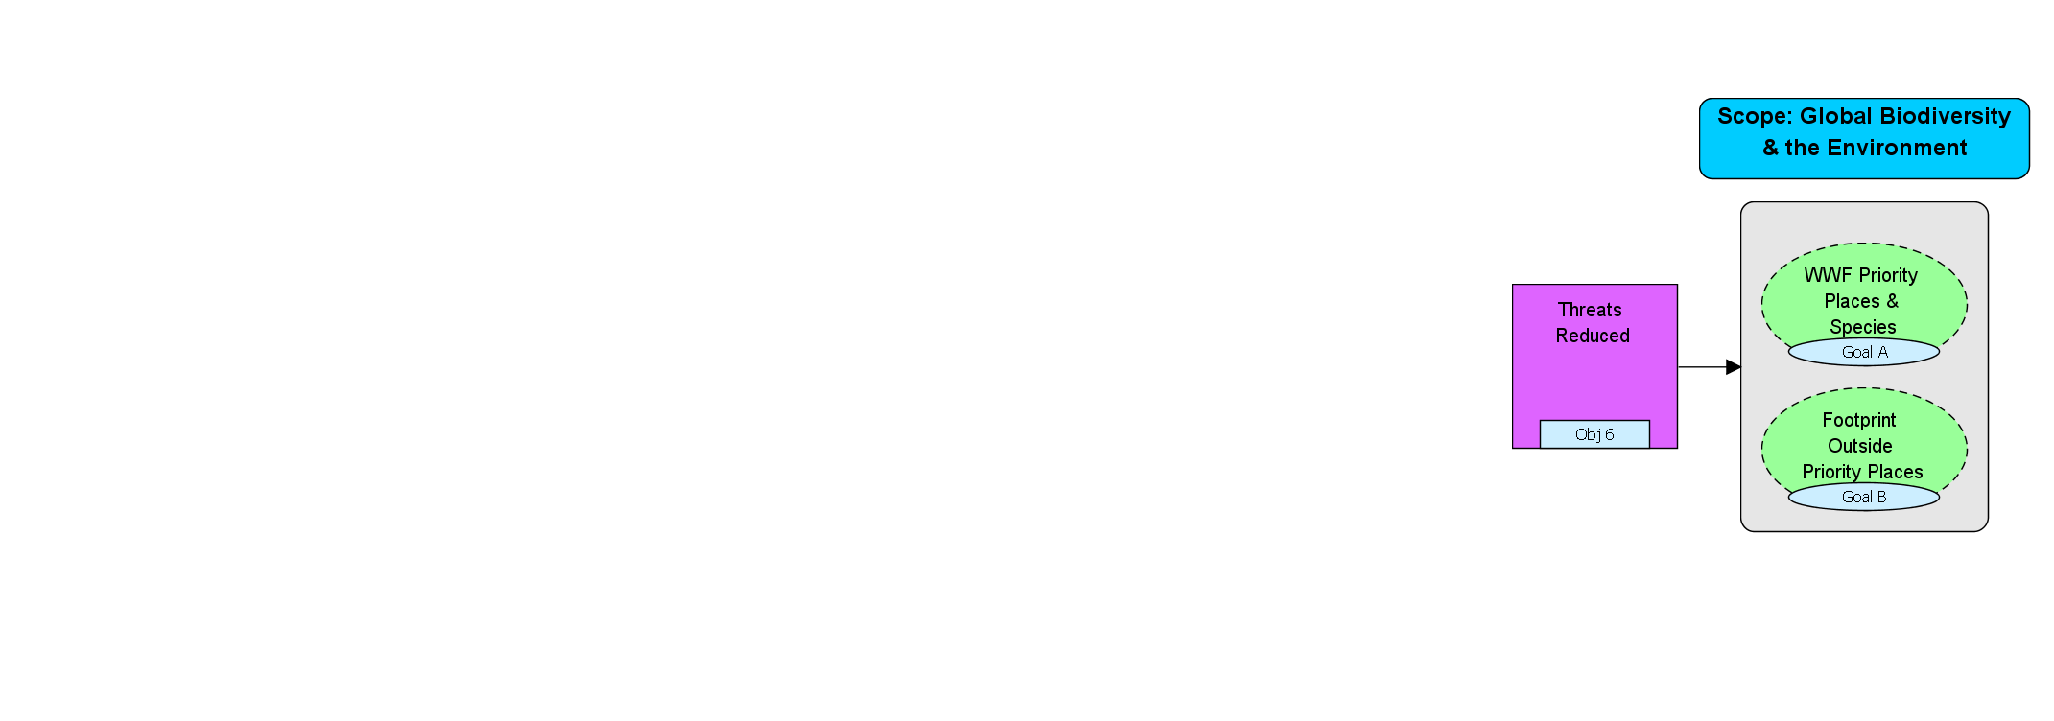
Generic MTI Commodity Results Chain
Leverage
Point Established
ID Key Companies
Develop
Standards
Credible Standards in Place

Slide 8
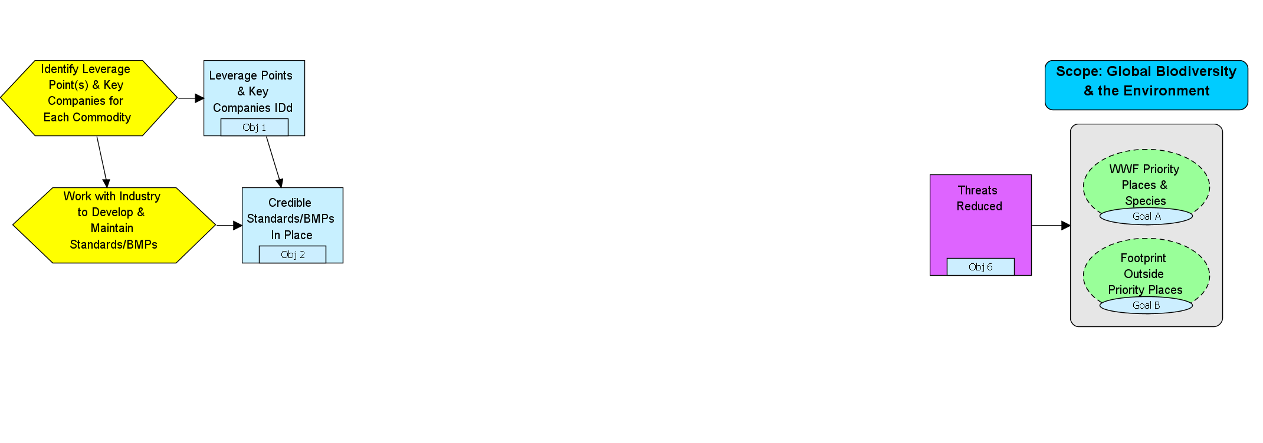
Generic MTI Commodity Results Chain
Key Companies Aware of Standards
Key Companies Set Internal Policies
Key Companies Implement
Standards
Work with Industry
Work with Financial Institutions

Slide 9
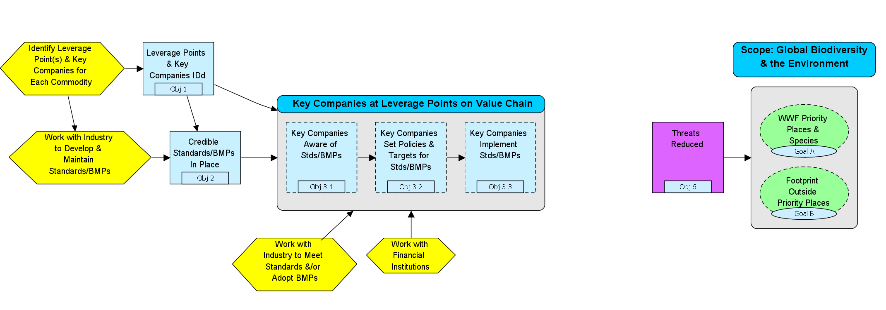
Generic MTI Commodity Results Chain
Commodity Production Meets Standards
Companies Pressure Supply Chain

Slide 10
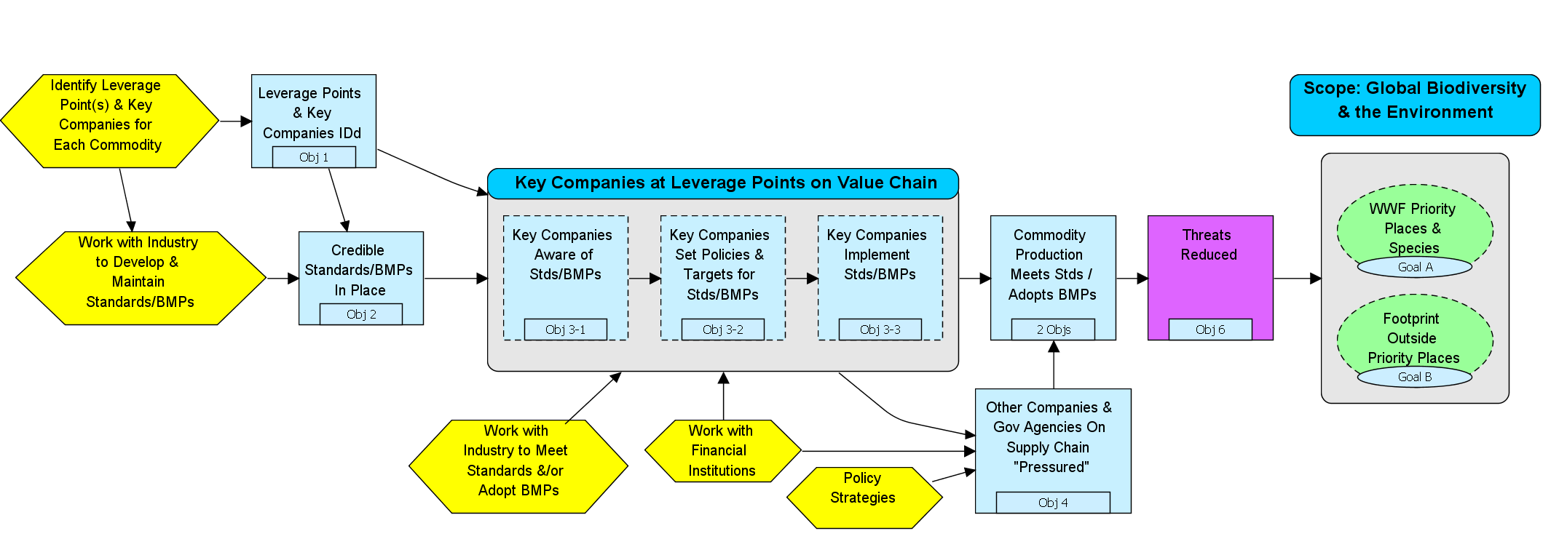
Generic MTI Commodity Results Chain

Slide 11
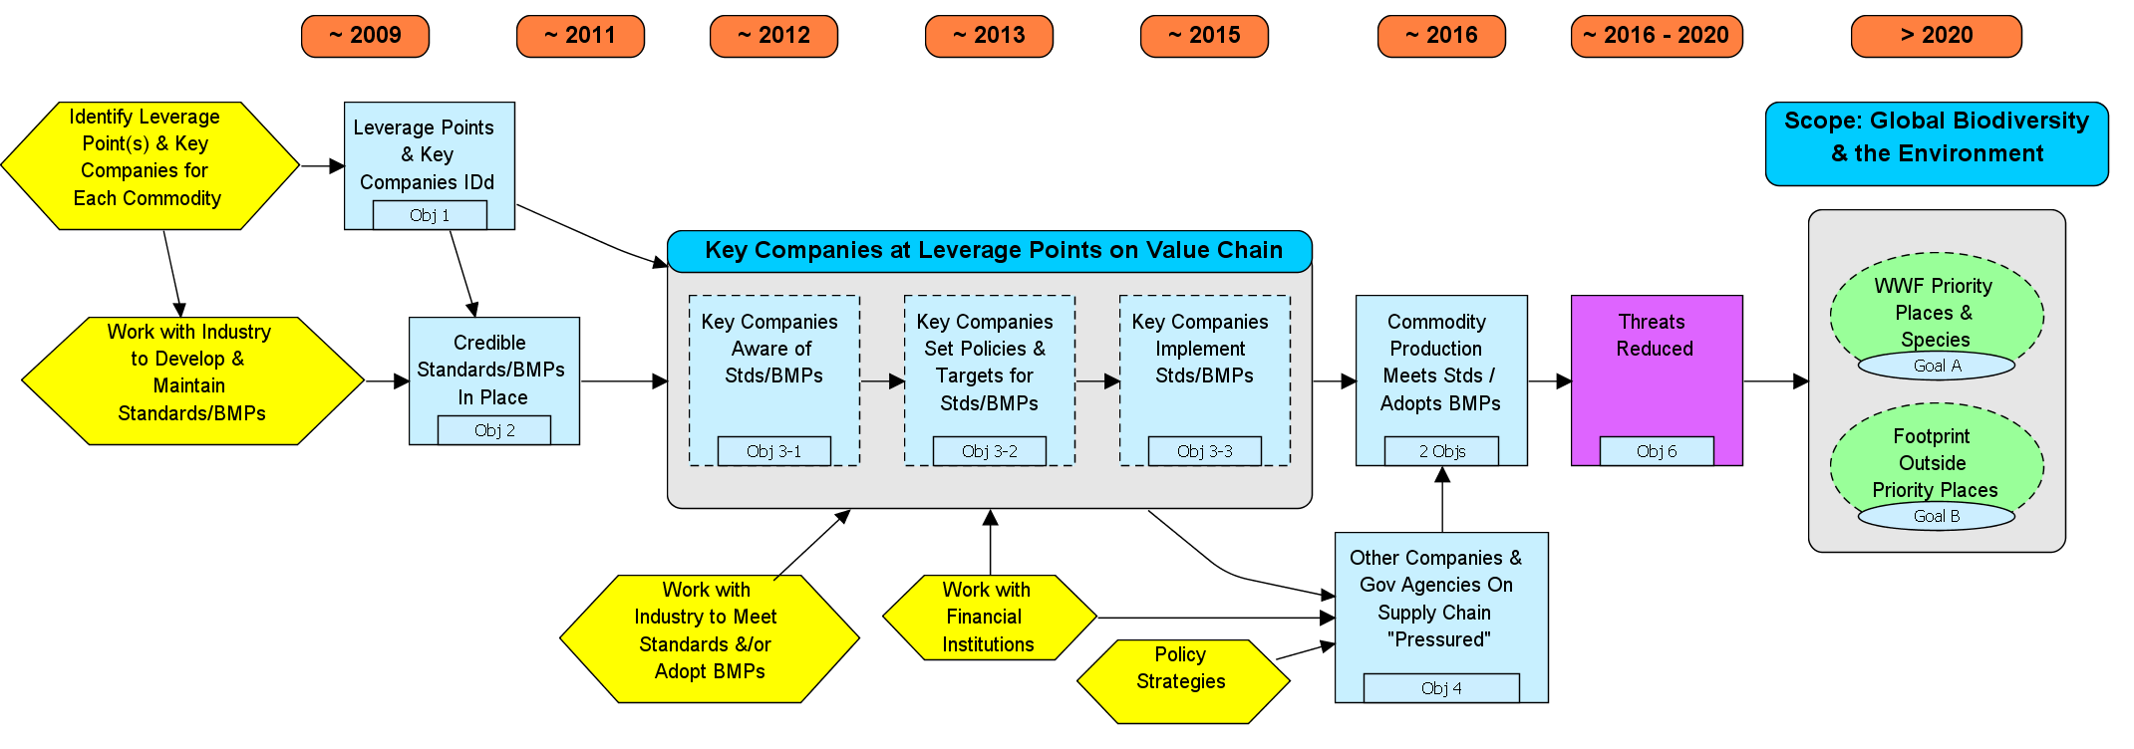
Generic MTI Commodity Results Chain
Obj 3-2. Key Companies Design Policies
By 2013, companies with a market share of at least 25% of the commodity have adopted written policies that call for the implementation Standards and/or Better Management Practices.
Obj 1. Leverage Points & Key Companies Identified
By the end of 2009, critical leverage points along the supply chain have been identified and the key companies and fisheries, if applicable, at each point have been identified.
Goal B. Reduce Impact of Commodity Production Globally
By 2020, 25% of global priority commodity production is produced according to standards approved by WWF.
Obj 2. Credible Standards Developed and Functioning
By 2011, "credible" standards and/or better management practices have been developed for each priority commodity. Criteria for "credible" include: a) Sufficient Impact on Targets, b) Support from Industry,
c) Standards Institution in Place, d) Broader Stakeholder Support
.
Goal A. Impact of Commodity Production on WWF Priority Places
By 2020, 75% of commodities produced in priority places are produced according to standards approved by WWF.
Obj 6. Threats Reduced
By 2020, key threats related to species, habitats, pollution, water use, and global warming have been meaningfully reduced in WWF Priority Places and the rest of the world.
Obj 5-2. Commodity Production in Rest of World Meets Standards
By 2016, at least 25% of the commodity production affecting the entire world is produced according to the Standards and/or Better Management Practices.
Obj 5-1. Commodity Production in Priority Places Meets Standards
By 2016, at least 75% of the commodity production affecting WWF priority places is produced according to the Standards approved by WWF.
Obj 4. Other Companies & Gov Agencies on Supply Chain “Pressured”
By 2015, companies put explicit pressure on their supply chain to adopt standards/certifications.
Obj 3-1. Key Companies Aware of Standards/Certifications
By 2012, companies with a market share of at least 25% of the commodity are aware of the need to implement Standards and/or Better Management Practices.
Obj 3-3. Key Companies Implement Standards
By 2015, companies with a market share of at least 25% of the commodity have fully implemented Standards and/or Better Management Practices across at least 90% of their production.

Slide 12
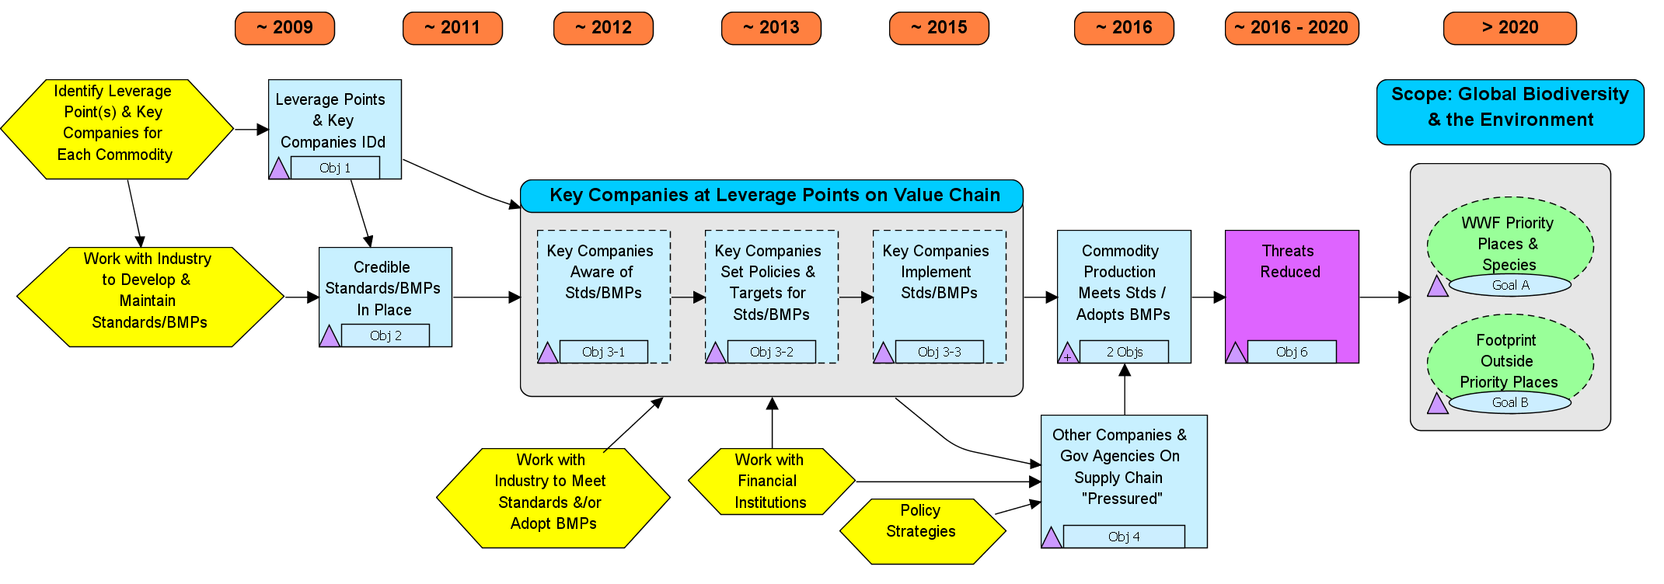
Generic MTI Commodity Results Chain
Obj 1. Leverage Points & Key Companies Identified
By the end of 2009, critical leverage points along the supply chain have been identified and the key companies and fisheries, if applicable, at each point have been identified.
Ind 1a – Results Chain
For each prioritized commodity: 1) Results chain not completed 2) Results chain partially completed 3) Results chain good but needs more attention 4) Results chain very good or complete

Slide 13
M&E Project Timeline
Mid 2010:
M&E System Revised and Tested with MTI
April 2008: Initial Team Meeting
Mid 2009: M&E Process Developed & Tested at WWF-US
February 2009: MTI Strategic Plan
Late 2009 / Early 2010:
Database Developed
Present:
First
Iteration Completed

Slide 14
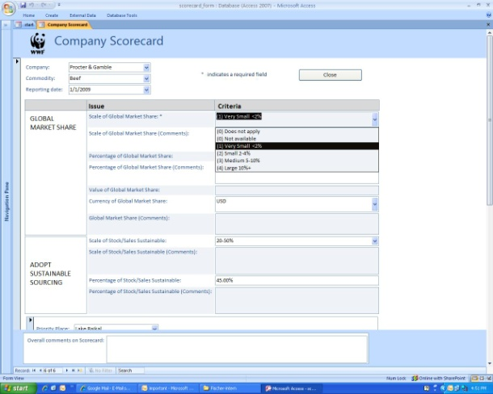
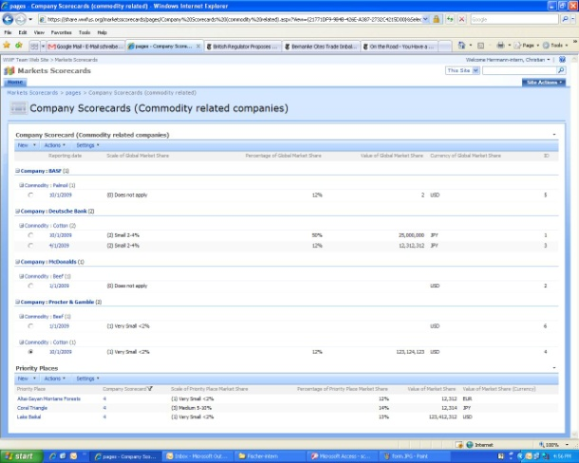
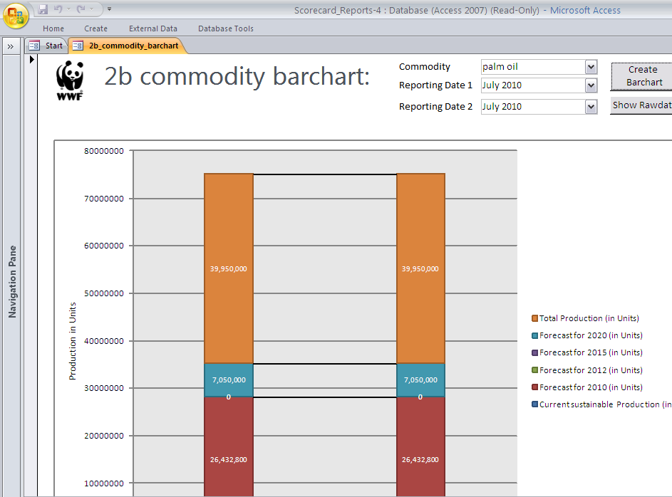


System Overview
1 Access File
SharePoint
1 Access File
INPUT
STORAGE
OUPUT

Slide 15
Excerpt From Commodity Scorecard
Objective | Indicators
Credible Standards Developed & Functioning (Objective 2) | 2c. Standards Institution in Pace 1 = Institution does not exist / not global 2 = Institution is weak and/or competing 3 = Institution is recognized globally 4 = Institution widely recognized and financially stable
Commodity Production meets Standards / Adopt BMPs & Global Trade (Objective 5) | 5a. Current Global Sustainable Commodity Production Unit (ha, tons, fisheries) Total Current Commodity Production (units) Sustainable Current Commodity Production (units) % Sustainable Current Commodity Production (can be calculated from above or entered directly) Confidence in Production Estimates (rough guess, educated guess, some data, precise data) Trend in Global Production (steep decline, shallow decline, flat, shallow increase, steep increase, unknown) Notes (text field)
Qualitative
Quantitative

Slide 16
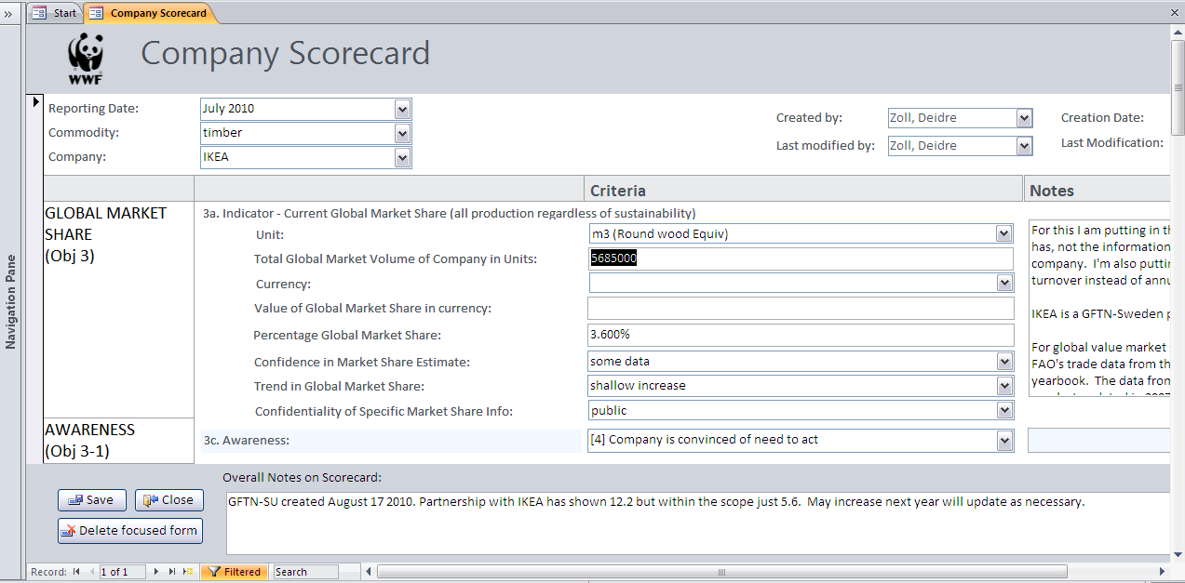
Data Entered in Access Form
Advantages
Use of standard software (MS Access)
High usability
Online/Offline work

Slide 17
System Overview
1 Access File
SharePoint
1 Access File
INPUT
STORAGE
OUPUT

Slide 18
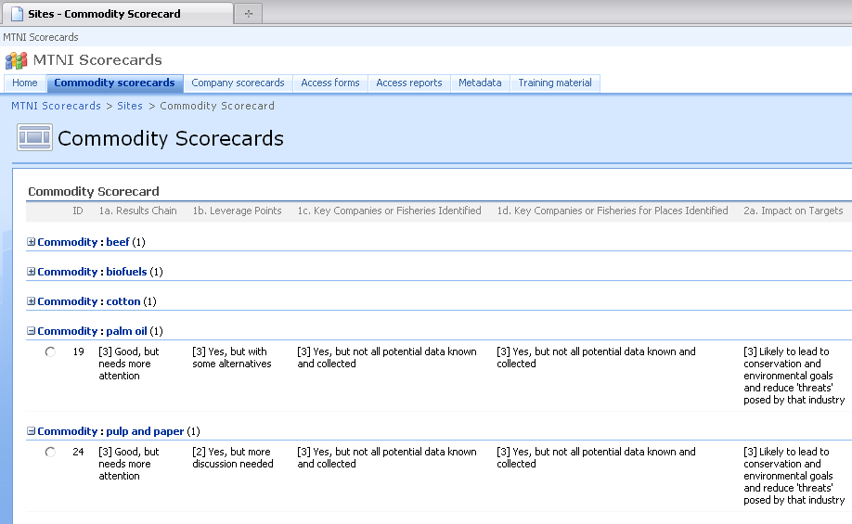
Master Data Set Stored in Sharepoint
Advantages
Central data storage
Worldwide access
Mature permission and user concept
Overview of data

Slide 19
System Overview
1 Access File
SharePoint
1 Access File
INPUT
STORAGE
OUPUT

Slide 20
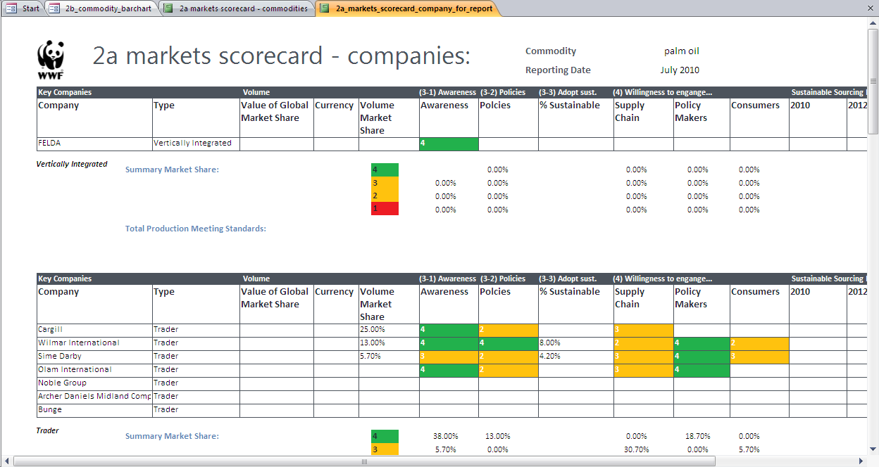
Reports that Meet Management Needs: Company Scorecard Output Table

Slide 21
Example of Future Commodity Report
Palm Oil Market 2010
Palm Oil Market 2015
(Not to Scale)
(Not to Scale)
2020
60%
2020
30%
Total
Production
Total
Production
Sustainable Production
25%
Mars
2015
15%
P&G
Other companies
Sustainable Production
8%

Slide 22
Initial Results
Commodity and company leads now expected to report on progress towards indicators
Leads now adjusting strategies based on monitoring system results
Results used for cross-commodity learning
WWF-US Board very impressed with strategy and now calling for a 10x increase in Markets Work
Need to develop metrics of ultimate impacts both for WWF purposes AND to improve certification schemes (e.g. HCV habitat concept)

Slide 23
Key Lessons
The Open Standards can be applied to complex
non-place based program strategies, but requires highly experienced coaching support
Scorecards very powerful when tied to results chains
Approximate answers to right questions rather than exact answers to meaningless questions
Rapid “agile” iterations instead of “waterfall” design
Develop mockups of reports and collect only data that will be used for management decisions (the Luz rule)
Senior management buy-in is essential

