Slide 1
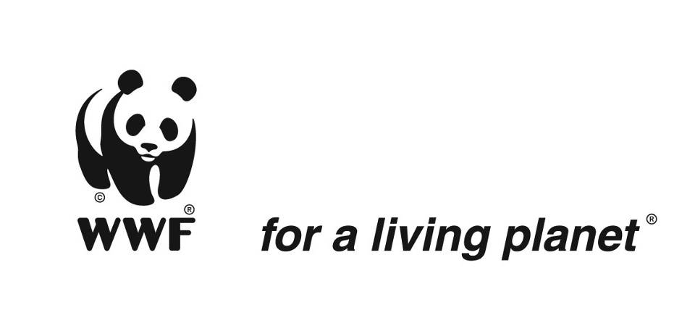

Conservation Coaches Network Rally 2010
WWF Showcase Presentation
WWF-Australia
Palm Oil Campaign

Slide 2
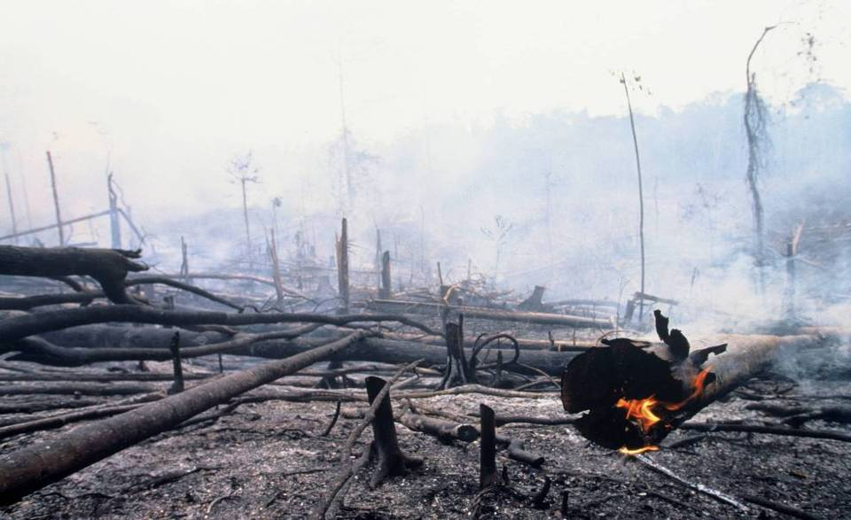
Environmental issues in oil palm cultivation
Forest, peatland conversion
Biodiversity loss
Climate change
Soil, water and air pollution
Notes:
2
What is the problem with Palm Oil?
Palm oil only grows in the tropics, where, if cultivated in an unsustainable way can have negative impacts on people and the environment. These include indiscriminate forest clearing, habitat loss of threatened and endangered species, poor air quality from burning forests and peatlands, and disregard for the rights and interests of local communities. A report published in 2007 by the United Nations Environment Programme (UNEP) acknowledges that palm oil plantations are now the leading cause of rainforest destruction in Malaysia and Indonesia. Of even more concern is the fact that demand for palm oil is predicted to increase, and most of the remaining suitable areas for plantations are forests
Australia
Palm oil is in approximately 50% of packaged products on our shelves
Australia imports approximately 130,000 tonnes of palm oil annually
An area of plantation 5½ times the size of Manhattan is needed to produce that much palm oil for Australians each year
Global
The RSPO is an industry lead, not-for-profit association of the palm oil industry, with stakeholders from all sectors of the industry involved
RSPO members account for 40% of the global palm oil industry
There is 300-700 million hectares of abandoned land that can potentially be used for oil palm plantations
Despite there being a much as 20 Million hectares of available land that has already been cleared for timber or has been degraded through the invasion of grass species the Indonesian Government and the PO industry persist in targeting forests for conversion – with more than half of PO expansion being at the expense of forests in Indonesia and Malaysia;
In particular peat forests are favoured because they are flat and more easily suited to cultivation…
An intact and extensive forest habitat is essential to the survival of wildlife in the region – not only for iconic and endangered species like the orang-utan, the tiger, elephants and rhinos – but for the whole ecosystem;
Research shows that in Malaysia healthy forest supports up to 80 species of mammals, whereas disturbed forest carries only 30 – but PO plantations allow as few as 12 to thrive;
Fragmentation of the forest by plantations not only destroys core habitats but also leads to greater conflicts between people and nature – elephants are destroyed because they can feed on palm fruits and orang-utan are hunted widely for meat by plantation workers;
Forests and peatlands are not only key wildlife habitats but they are also massive stores of carbon. Felling and burning them releases huge volumes of carbon dioxide driving climate change – globally almost 20% of emissions are from deforestation – mostly in Indonesia and the Amazon;
PO cultivation is also a major cause of pollution. Burning of land to prepare it for PO causes huge smog clouds in South East Asia but the use of pesticides against rats in particular damages soils and water resources.
In 2001 Malaysia's production of 7 million tons of palm oil generated 10 million tons of solid oil wastes, palm fiber, and shells, and 10 million tons of palm oil mill effluent, a polluted mix of crushed shells, water, and fat residues that has been shown to have a negative impact on aquatic ecosystems as well as emissions of methane a powerful GHG when it decomposes.

Slide 3
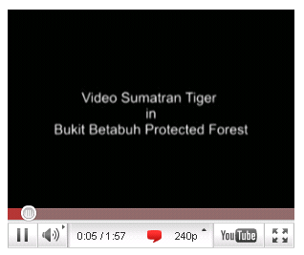
Sumatran tiger – camera trap footage
Note: The video shown during the presentation can be viewed here: http://wwf.panda.org/?uNewsID=195632

Slide 4
This presentation – steps for discussion
Step 1: Define
  Stakeholder Analysis
  Context Analysis
Step 2: Design
  Goals & Objectives
  Strategies
  Monitoring
Step 3: Implement
Step 4: Analyse & Adapt
Step 5: Share
  Lessons learned
  Recommendations
Notes:
In 2009 WWF-Australia began to define and design a Palm Oil Campaign. A core team of WWF-Australia staff used the WWF Project and Programme Management Standards to plan and implement this campaign that started in 2010.

Slide 5
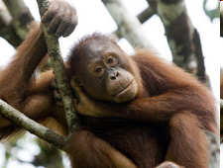
But being Australian we started at the end… Step 5 – Share
Lessons Learned from previously shared information:
  In order to determine Australia’s Palm Oil Footprint, its role in the palm oil industry and whether WWF-Australia should enter into a Palm Oil campaign, a period of 3-4 months of research and initial stakeholder analysis was undertaken.

Slide 6
Research and Stakeholder Analysis
Of the 26 countries that export palm oil/palm kernel oil and its derivatives to Australia for the period FY2003-FY2008 three countries constituted 99.4% of the total Import.
Country | Avg Import in Tonnes per Year | Percentage of the Total
Indonesia | 2680 | 2%
Malaysia | 127298 | 95%
Singapore | 2796 | 2%
All Other Countries | 844 | 1%
Total | 133618 | 100%
Importantly, it was from the informal personal conversations directly with stakeholders in the industry that key information was obtained including but not restricted to:
Approximately 80-85% of the palm oil brought into the country is used in food and food processing.
70% of all of the palm oil brought into Australia is imported by one company.
Labelling of palm oil on product ingredients is not mandatory in Australia

Slide 7
Stakeholders
Industry both Australian and those multi-national with operations in Australia In particular the following six companies
  Unilever – as a first mover on palm oil, founder member of the RSPO and palm all user
  Cadbury – vocal member of the RPSO and a leader on the palm oil issue
  Nestle - member of the RSPO
  Goodman Fielder – Australia company, member of the RSPO and largest manufacturer using palm oil
  Woolworths – Brand owner and largest retailer in Australia
  Coles – Brand owner and second largest retailer in Australia
NGOs
  Palm Oil Action Group – run a palm oil campaign targeting Woolworths
  Zoos Victoria – run the “Don’t Palm Us Off Campaign” to persuade the federal government to enact laws for mandatory palm oil labelling
Association groups
RSPO – a stakeholder association who’s mission to promote and grow a sustainable palm oil industry.
At the beginning stage of the campaign it was recognised that the federal government, AFGC and Australian consumer were key stakeholders but were not able to influence change until they were provided with information and empowered to do so.
Notes:
During the period of the campaign the Australian consumer became more and more important in influencing both the federal government and industry, to affect change.

Slide 8
Roundtable on Sustainable Palm Oil
WWF has worked on palm oil since 2001
RSPO started in 2003, with 7 members
Industry wide stakeholder group – 300+ ordinary members
Growers, traders/processors, manufacturers, retailers, Environmental NGOs, Social NGOS and investors
To promote the growth and use of sustainable oil palm products through global standards
RSPO
Notes:
8
It is because of these globally significant impacts that WWF has been working with the PO industry since 2001 on trying to find practical solutions;
We quickly realised that no single company or even sector of the industry would be able to find and implement all the solutions needed – which is why we established the RSPO in 2003 as a broadly based dialogue within the industry;
It now includes more than 250 members which between them account for 40% of global PO production – and in Europe at least a high proportion of PO consumption;
All steps in the PO supply chain are represented – so that all perspectives and resources are brought to bare on the problems – and all parts of the PO chain are committed to producing and using sustainable PO;
Whilst that has made the process relatively slow it has made it credible and it has retain a remarkable level of support from across the Industry – and increasingly from Governments.
The Malaysian Government has recently announced that it wants all Malaysia PO to be certified and the UK Government has accepted the RSPO as a sustainability standards for biofuels.

Slide 9
Goals and Objectives
WWF 2020 goals
  Halt and ultimately reverse the loss of High Conservation Value (HCV) habitat due to commodity Production in WWF priority places;
  Ensure that humanity’s footprint related to key commodities falls below its 2000 level.
The more specific palm oil commodity objectives as determined by the WWF palm oil working group:
WWF Palm Oil 2012 goals
  25% of global palm oil production is from RSPO-certified sustainable source
  75% of global production is represented in RSPO membership
  50% of targeted manufacturers and retailers have committed to procure sustainable palm oil, and 50% of the palm oil they procure is from sustainable sources
  All top 20 companies procure 100% sustainable palm oil
WWF-Australia Palm Oil Campaign Objectives 2011-2012
  CSPO commitments from six targeted major industry stakeholders in-line with WWF, RSPO and Zoos Victoria recommendations
  Legislation to be tabled for mandatory labelling of palm oil that would include recommended use of certified sustainable palm oil
Notes:
9
Again using information and the lessons learned by the internal WWF global palm oil working group we, WWF-Australia took the work/objectives/goals and global situational analysis that they had created and using the information from our stakeholders and research we created our campaign objectives that would contribute to.
The mission of WWF is to promote a healthier planet for people and nature by:
•Conserving biological diversity;
•Encouraging more sustainable use of natural resources; and
•Promoting ways to reduce pollution and wasteful consumption
WWF believes that effective engagement with businesses is KEY to achieving this mission AND can have real business benefits for companies.

Slide 10
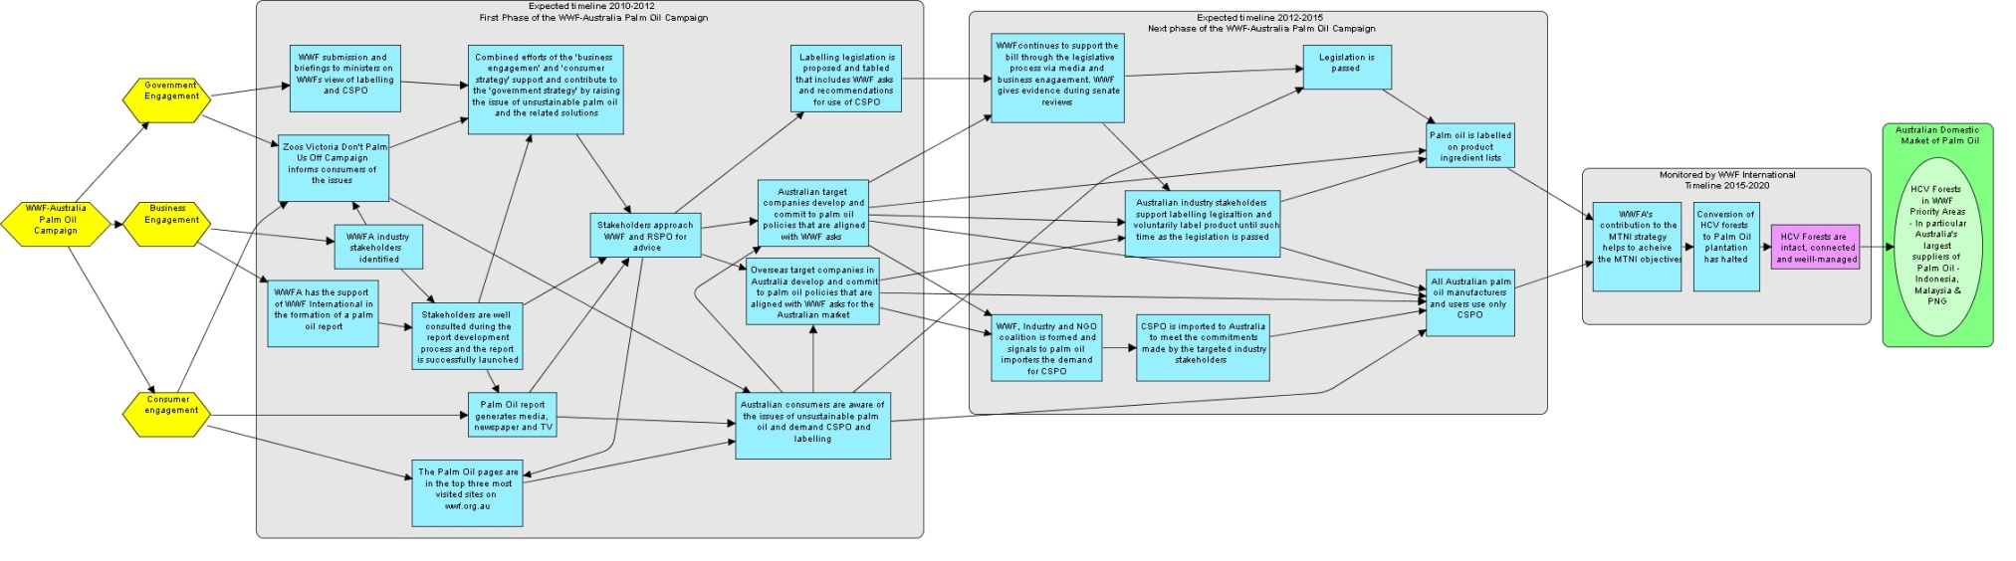
Strategies
The palm oil campaign used three major strategies:
Business engagement – Lead by WWF
Government engagement – Lead by Zoos Victoria
Consumer engagement – WWF and Zoos Victoria^{[1]}
^{[1]} Whilst WWF-Australia and Zoos Victoria worked on the above strategies, occasionally together but often separately the objectives were different for each organisation, the previous slide reflects WWF-Australia’s objectives. No formal partnership or MoU was in place between Zoos Victoria and WWF-Australia
Notes:
10
By the end of 2008 specific standards were finalized for Indonesia, Malaysia and PNG which are in operation now. Colombia and Brazil have been working on their standards for a while, while Ghana and the Solomon Islands are just launching into the process now
There will also be 12 companies accredited to carry out the audits.
As of mid-2008, 1.75 Million tonnes of PO is available;

Slide 11
Indicators / Measures of Success
WWF-Australia committed to the first phase of the campaign to delivered by end 2011-2012, the main indicators for successful completion of the first phase would be:
CSPO commitments from the six major industry stakeholders in-line with WWF, RSPO and Zoos Victoria recommendations
Legislation to be tabled for mandatory labelling of palm oil that would include WWF’s asks and recommend use of certified sustainable palm oil
Increased consumer awareness of the issues of unsustainable palm oil – note that this indicator is not in itself an indicator of success of the campaign but more a progress indicator. As consumer awareness helps to create pressure on government and increase market demand. This indicator is highly resource intensive to monitor and was only monitored by WWF through anecdotal evidence.

Slide 12
Progress Indicators
Meetings with WWF specifically on palm oil initiated by target stakeholders
Targeted and none targeted industry stakeholders seeking advice on the palm oil issue, in particular WWF’s perspective and solutions i.e. invitations to speak at sustainability committees and industry lead palm oil forums
Minister or senator advisors approaching WWF for advice on palm oil i.e. telephone calls, requests for briefings
Information on palm oil and WWF’s view available for supporters and the public i.e. palm oil page on WWF-Australia website, WWF’s view covered in the media
WWF-Australia use palm oil as a basis for supporter appeals, including major donor appeals
Industry stakeholders applying to be members of RSPO
Number of hits on the WWF-Australia website pages related to palm oil
Notes:
You are all thinking where are the measures attached to the target. Well that’s true we haven’t directly measured forest hectares or numbers of tigers as a measure for this project. For a number of reasons:
Resources – the cost involved to monitor that was beyond the campaign limits
Other parts of WWF who measure the objectives a level above ours are monitoring that, we need to monitor our contribution to that whole.
Timing, our campaign was short it would take time to trickle through to on ground changes
Apportioning how much our campaign affects the target is difficult to quantify

Slide 13
Analyse and Adapt
Step 4 before Step 3
A palm oil tracking report – a shipment of palm oil would be tracked from an unsustainable palm oil plantation and an RSPO plantation through to end-user, describing the significant differences in each supply chain
An Australian and New Zealand palm oil scorecard report - would include only companies headquartered in New Zealand and Australia and would encompass all Palm Oil Products including Palm Kernel Oil for feedstock (Australia and New Zealand are ranked in the top three importers of PKE for cattle)
An Australian palm oil buyers scorecard report - would score Australia’s three targeted companies along side three companies from the European scorecard that have operations in Australia, to be used for comparison and to focus closer on these multinational companies specific Australian market policies.
The result of the analysis
After reassessing the original business engagement results chain and testing our assumptions, the core team determined that the report was an essential activity to the objectives of the campaign strategy. Whilst the direction of the report had altered the reasons for this strategy and the outcomes to be gained from it had not therefore we did not adapt the overall strategy.
Notes:
Initially this report was to be run by of WWF International as a Global Palm Oil Buyers Scorecard, which would score companies globally and would include the three Australian headquartered companies and the three multinationals with operations in Australia. Due to an internal change in direction the global scorecard was adapted to focus exclusively on the European market.
Option 1 was a determined to be a viable option however due to sensitivities attached to using specific plantations as case studies it was determined a generic case study could be a better option. This would however would only be useful as part of a larger report of a report and not a report in itself.
Option 2 was determined too be difficult to complete adequately in the timeframe required due to lack of resources and specific knowledge of the PKE market. It was also not as well aligned the other two strategies of the campaign, consumer engagement and palm oil labelling.
Option 3 was determined to be the optimum choice with the inclusion of option 1 as a generic case sturdy within the report.

Slide 14

Implementation – The Scorecard
A major component of the business engagement strategy of the palm oil campaign was the research and release of the WWF Palm Oil Buyer’s Scorecard Australia 2010. The scorecard brought together each stakeholder group
The objective of the scorecard is to encourage the three Australian companies to take action on the issue of unsustainable palm oil and to publicly commit to moving to 100% Certified Sustainable Palm Oil (CSPO) before 2015.
NGOs - Zoos Victoria provided consumer research used in the scorecard
Industry – All six industry stakeholders were involved through constant communication from WWF to them
Government – the Truth in Labelling Bill – Palm Oil Bill 2009 was referenced in the scorecard
WWF Network – were heavily involved in information sharing, advice and peer review
Notes:
14

Slide 15
Success
25% of global palm oil production is from RSPO-certified sustainable source
  Monitored by WWF International
75% of global production is represented in RSPO membership
  Woolworths and Coles applied to be members of the RSPO in 2010, along with other Australian companies including Metcash, Australia’s 3 largest grocery retailer ^{[1]}
50% of targeted manufacturers and retailers have committed to procure sustainable palm oil, and 50% of the palm oil they procure is from sustainable sources
  March 2010 Woolworths publically announce their sustainable palm oil policy – All private label brands containing palm oil will use 100% CSPO by 2015^{[2]}
  Goodman Fielder in March announced commits to 100% CSPO by 2015 for their retail brand products^{[3]}
All WWF’s top 20 companies procure 100% sustainable palm oil
  Unilever announced in 2010 all products containing palm oil sold within Australia and New Zealand will be covered by Greenpalm certificates^{[4]} -
  This same commitment was made by Cadbury^{[5]} and Nestle^{[6]} in 2010 &
  Goodman Fielder committed to Greenpalm certificates to cover the palm oil used in it’s retail brands ⁶
Notes:
15
^{[1]} http://www.rspo.org/?q=countrystat/Australia
^{[2]} http://www.woolworths.com.au/wps/wcm/connect/website/woolworths/about-us/woolworths-news/news-content/palmoilactionplan
^{[3]} http://www.goodmanfielder.com.au/index.php?q=node/134
^{[4]} http://www.unilever.com.au/aboutus/mediacentre/pressreleases/Unilevers_Palm_oil_covered_sustainably_in_Australia_NewZealand_and_Europe.aspx
^{[5]} http://worldisgreen.com/2009/08/17/cadburys-sustainability-statement-on-palm-oil/
^{[6]} http://www.ausfoodnews.com.au/2009/10/28/nestle-next-to-issue-palm-oil-pledge.html

Slide 16
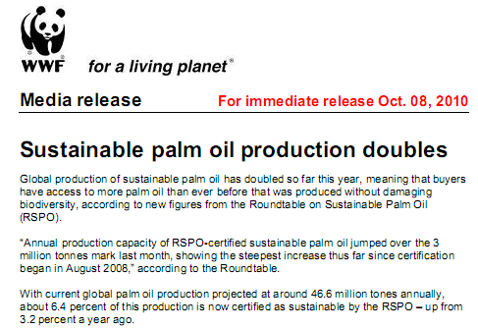
Measures of RSPO
21 plantation companies have so far been awarded RSPO certification, with 630,000 hectares of land now under RSPO certification.
75 mills have so far been certified, resulting in 3.2 million tonnes of CSPO and 740,000 tonnes of PKO produced.
With 16 companies currently undergoing 39 certification audits, it is projected that 12 million tonnes of CSPO should be available by 2016.

Slide 17
Lessons from the campaign
Stakeholder Analysis
A full and comprehensive stakeholder analysis was key to the success of this campaign.
Lessons learned
By using the lessons learned at the start of the planning process the core team was able to successfully research the Australian market using information from stakeholder and public documents.
Analyse and Adapt
A major lesson learned was that the power of the PPMS is that it is a cycle and not static, that at any point within the cycle the team could go back, re-assess and test its assumptions..
Workplan
A good workplan with each team member identified next to an assigned task with deadlines was a great tool.
PPMS can be used for a Footprint and Advocacy campaign
This campaign was entirely an advocacy campaign and based on footprint issues, the team used the steps within the PPMS to plan and implement the campaign, understanding that they would have to alter and adapt certain aspects of the cycle in order to fit their project. The team feels that PPMS was important in helping them to create a well managed and targeted plan that delivered the successful outcomes they were looking for and ahead of the timeframe they were expecting. The team would like to comment that having a good understanding of the PPMS cycle and process was helpful and allowed them to be creative and adapt the steps to fit their footprint campaign. The team would recommend the use of PPMS in developing footprint and advocacy campaigns and projects.
Notes:
Stakeholder Analysis
A full and comprehensive stakeholder analysis was key to the success of this campaign. Using the stakeholder analysis the core team was able to identify the main industry stakeholders to target in order to achieve its desired outcomes. It was also possible to identify NGOs that would be working on the issue during 2010, determining if their campaign complemented the proposed WWF campaign and how we could use each others strengths to support each other to achieve their outcomes where relevant.
Lessons learned
By using the lessons learned at the start of the planning process the core team was able to successfully research the Australian market using information from stakeholder and public documents.
Importantly the team were able to use a lot of valuable information including situational analyses, strategies and objectives previously identified as crucial to the success of any palm oil campaign. This great work by the MTNI team and Palm Oil Working Group ensured that the WWF-Australia team was not reinventing the wheel, saving time and more importantly contributing to WWFs global vision for this commodity – speaking with one voice.
Analyse and Adapt
A major lesson learned was that the power of the PPMS is that it is a cycle and not static, that at any point within the cycle the team could go back, re-assess and test its assumptions. Because of this, throughout the duration of the campaign, the team was able to adapt and positively feedback into the planning process and avoid magnifying any issues that would continue if not discovered without continually testing your assumptions.
Workplan
A good workplan with each team member identified next to an assigned task with deadlines was a great tool. This ensured that everyone was working towards the same activities and the scorecard was released on time with all stakeholders feeling consulted and part of the process.
PPMS can be used for a Footprint and Advocacy campaign
The team would like to note that they had to be creative in certain areas of the cycle to ensure that they could monitor their project effectively including choosing measures of success that were linked to their objectives but not necessarily directly linked to their biodiversity targets. They identified that a large amount of resources would be required to monitor the biodiversity targets and that there would be significant difficulty in drawing a clear link between this campaign and any direct change in the biodiversity. The team therefore chose to monitor the objectives that would contribute to the larger MTNI.
This campaign was entirely an advocacy campaign and based on footprint issues, the team used the steps within the PPMS to plan and implement the campaign, understanding that they would have to alter and adapt certain aspects of the cycle in order to fit their project. The team feels that PPMS was important in helping them to create a well managed and targeted plan that delivered the successful outcomes they were looking for and ahead of the timeframe they were expecting. The team would like to comment that having a good understanding of the PPMS cycle and process was helpful and allowed them to be creative and adapt the steps to fit their footprint campaign. The team would recommend the use of PPMS in developing footprint and advocacy campaigns and projects.

