Slide 1
Project Vision
Photo: P.N. Cascada de Basaseachic - CONANP

Slide 2
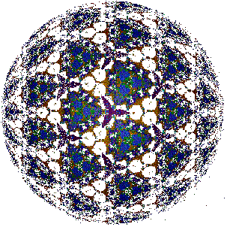
What do we envision for our project?
Notes:
Our project can be compared to a kaleidoscope. While the little colorful pieces and shapes inside may be arrangedin a certain form, different people may see things quite differently. This is why it is important to work together to define a joint vision, when we begin our planning process. If the vision speaks to our common interests, this allows us to stay inspired (and to inspire others to join!) and it gives us a sense of direction.

Slide 3
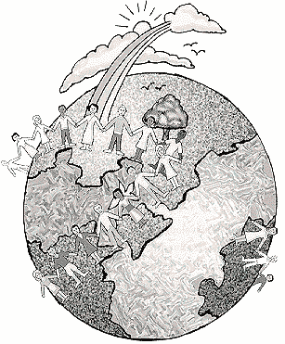
Vision:
A fairly general statement that describes the desired status or desired condition which we strive for.
Should be a source of inspiration , pride and unity among individuals.

Slide 4
A good vision statement is...
Visionary:
It is a source of inspiration when it describes the desired state for our project’s assets or conservation resources.
Relatively general:
Comprised of a fairly ample definition which encompasses the sum of your project’s objectives or primary activities.
Brief:
Succinct and simple - all participants should be able to remember it.

Slide 5
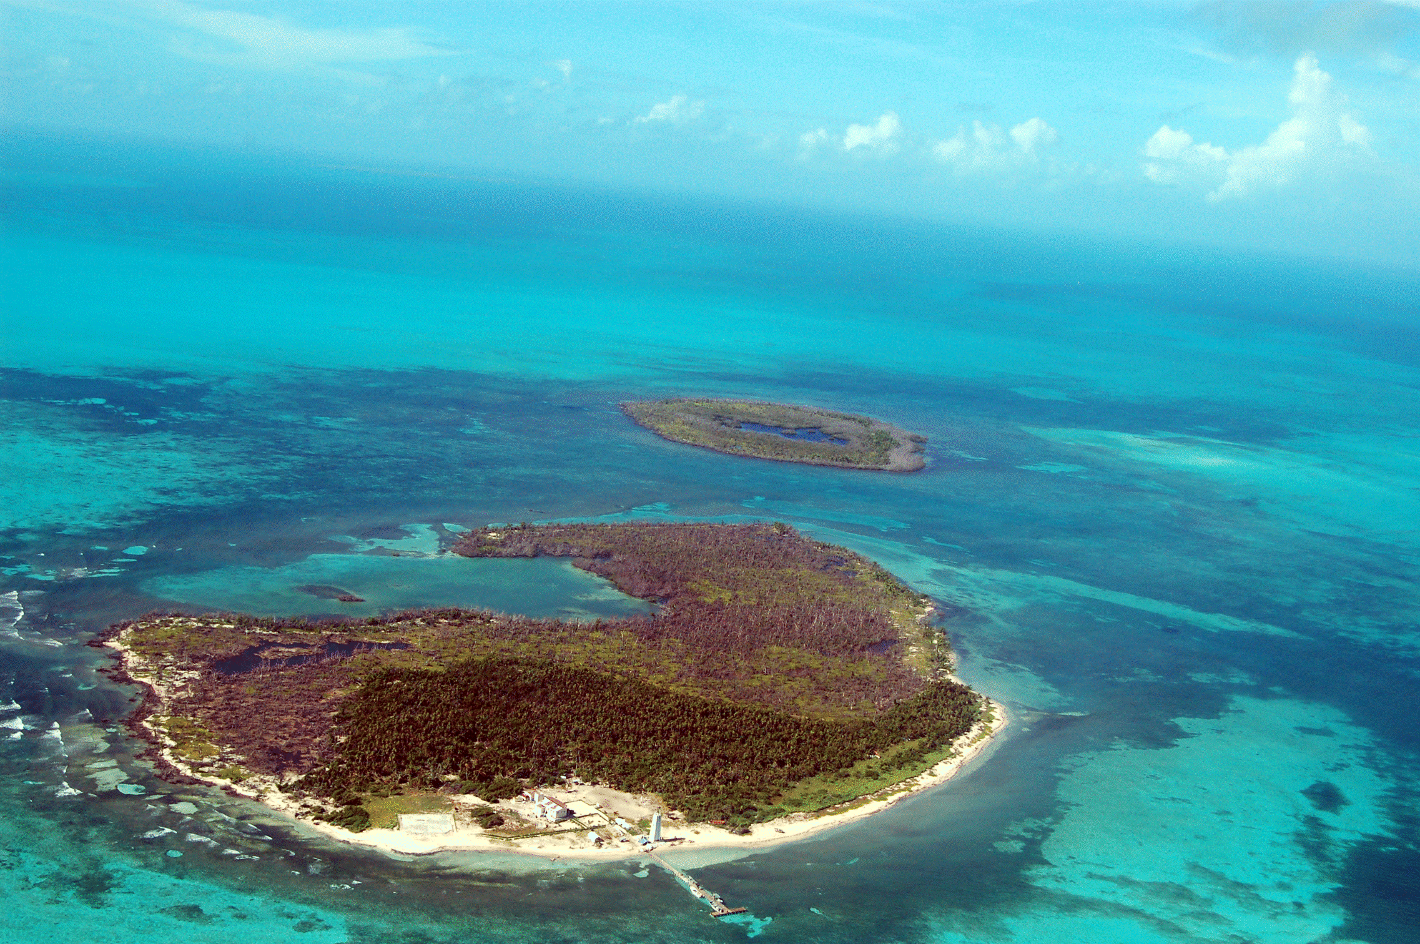
Example: Vision from the Banco Chinchorro Biosphere Reserve, Mexico
(Public Reserve)
The management of the Banco Chinchorro Biosphere Reserve ensures the equilibrium and continuity of ecological evolution processes, guaranteeing compatibility among the use and conservation of the Reserve’s natural resources.
Photo: CONANP – Alejandro Vega
Notes:
This is an example from a public protected area. Let’s remember our three criteria for a good vision – anyone? Is it short? Is it inspiring? Visionary? Relatively general?
How good do you consider this example?

Slide 6
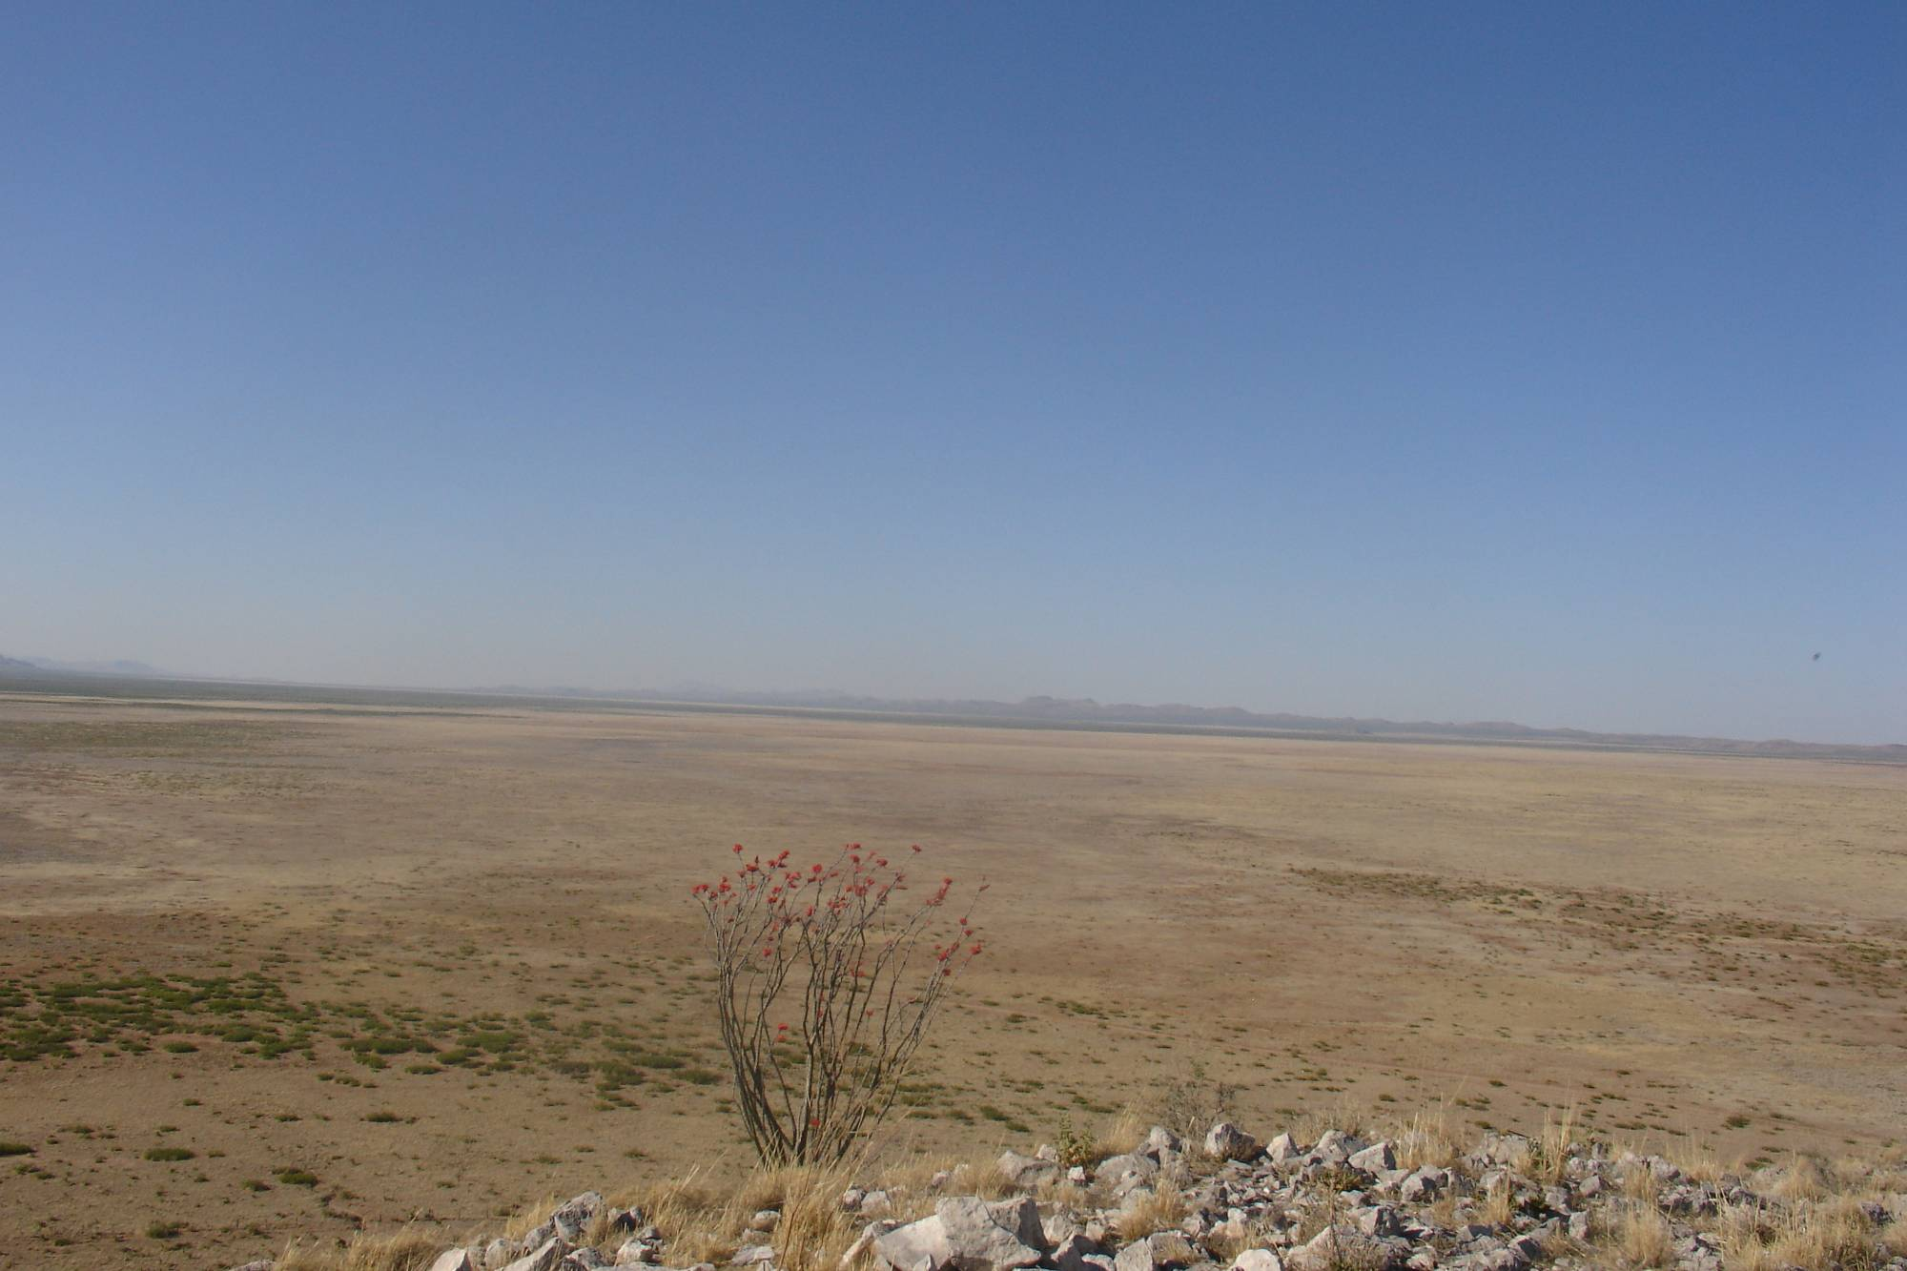
Example: Vision from El Uno Ecological Reserve, Mexico (Private Reserve)
The El Uno Ecological Reserve carries out adaptive management actions which increase the structural and ecological composition diversity through the implementation of good practices for grazing, fire management and restoration techniques.
Photo: TNC – N. Barajas
Notes:
Now let’s look at this example from a private reserve. How good is this one?

Slide 7
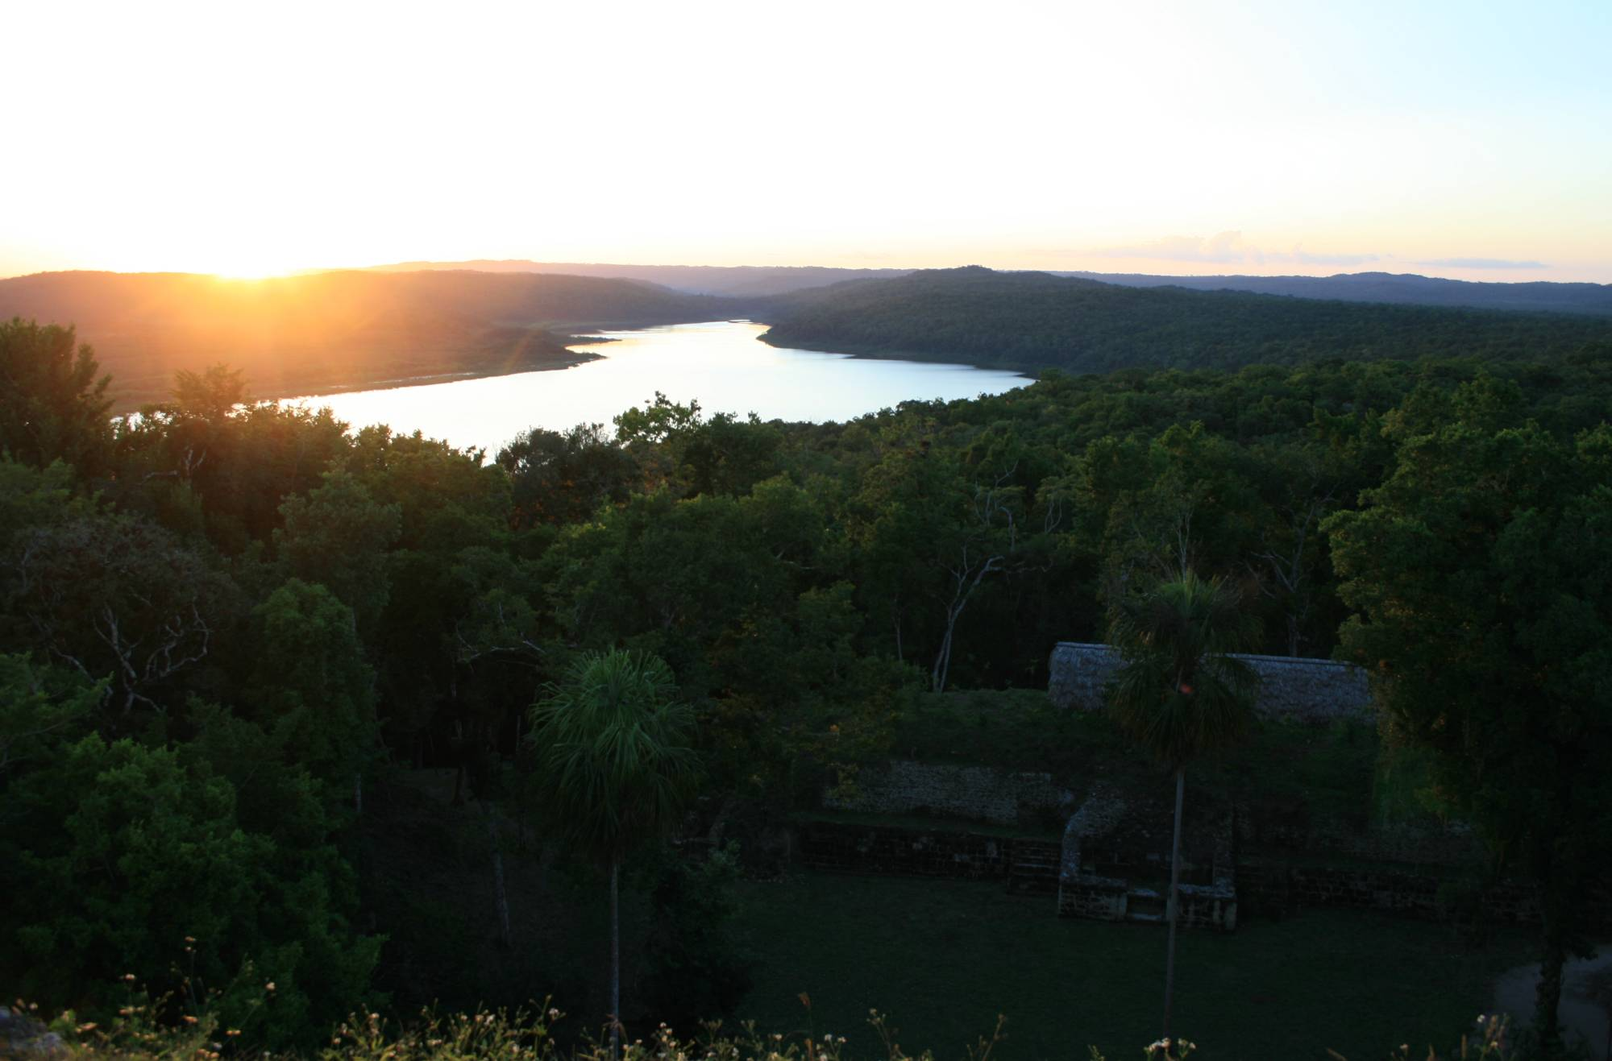
Example: Vision from Yaxhá-Nakum-Naranjo National Park, Guatemala (Public Reserve)
The Yaxhá-Nakum-Naranjo National Park - the best kept secret of the Maya World - contains a lagoon system, flora, fauna and ancient Maya cities which are unique to the region, which we conserve and manage sustainably in a participatory way for the beneft and inspiration of present and future generations, both for the region’s communities as for vistors.
Photo: C. Lasch
Notes:
Here’s another example for a public protected area that protects both natural and cultural resources. How do we find this one? Is it short? Is it inspiring? Visionary? Relatively general?

Slide 8
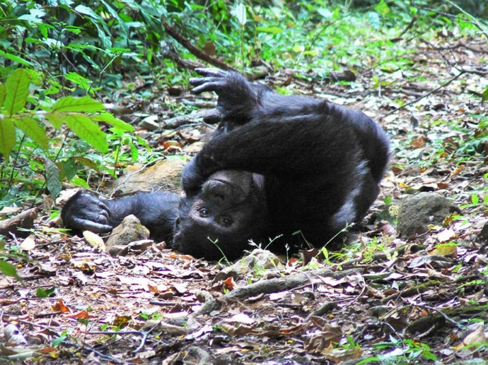
Example: Vision from Tanzania Chimpanzee Conservation Action Plan (Species Range )
Chimpanzee populations in Tanzania are thriving and they and their habitats are being effectively conserved by communities, government, NGOs and researchers working together to guarantee chimpanzee long-term survival as a unique endowment of Tanzania’s current and future generations.
Photo: TNC – T. Cook
Notes:
And lastly, here we have an example for a project that focused on a species – the chimpanzees of Tanzania. How do you find this vision?
What can we learn from these examples?
It’s not so easy to write a good vision, especially when you have to work with many stakeholders who value different things. But it is important to agree on some of the things that everyone values.

