Slide 1
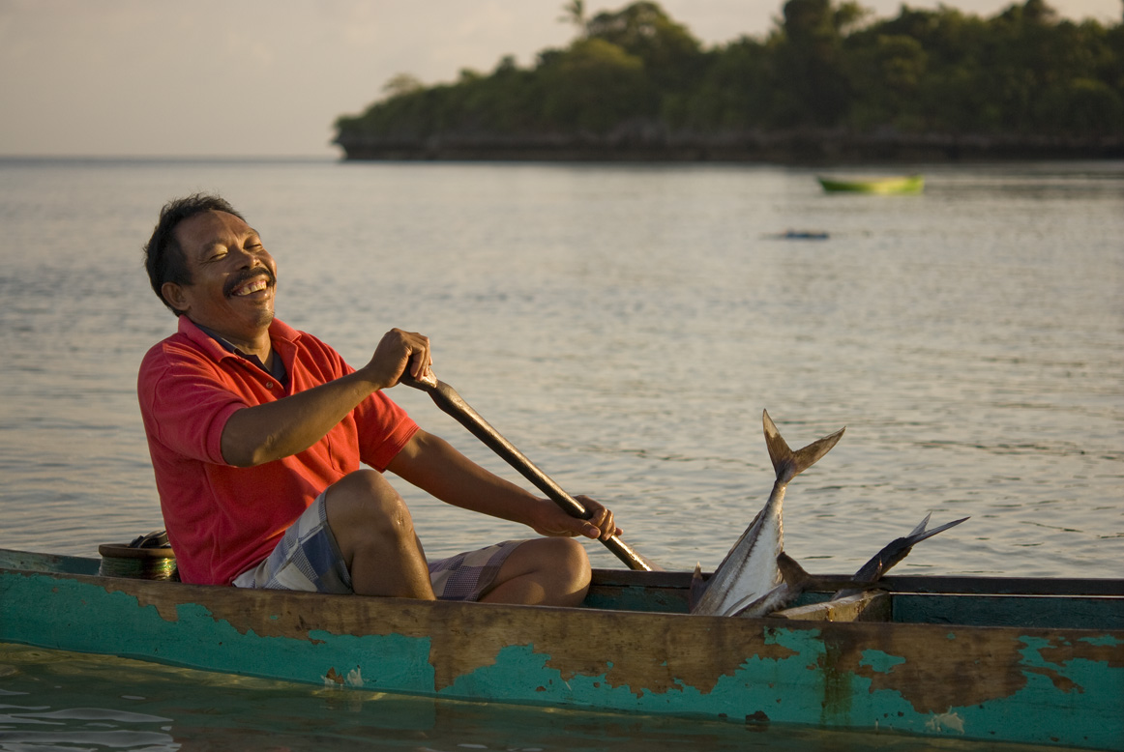

Scaling up Open Standards:
Asia Pacific Marine Program
Annick Cros
Santa Cruz
November 18, 2010
Notes:
Introduction:
Thanks you Matt for the introduction and Jora for this invitation to present this project.
Today I will talk to you about scaling up the CAP process and how The Nature Conservancy has adapted the Open Standards to redefine the strategy of our Asia Pacific Marine Program.
It’s the first time TNC has done this at a regional focal (Marine) area scale.
First, let me introduce you to our Asia Pacific Marine Program
It has two large geographic components to it:

Slide 2
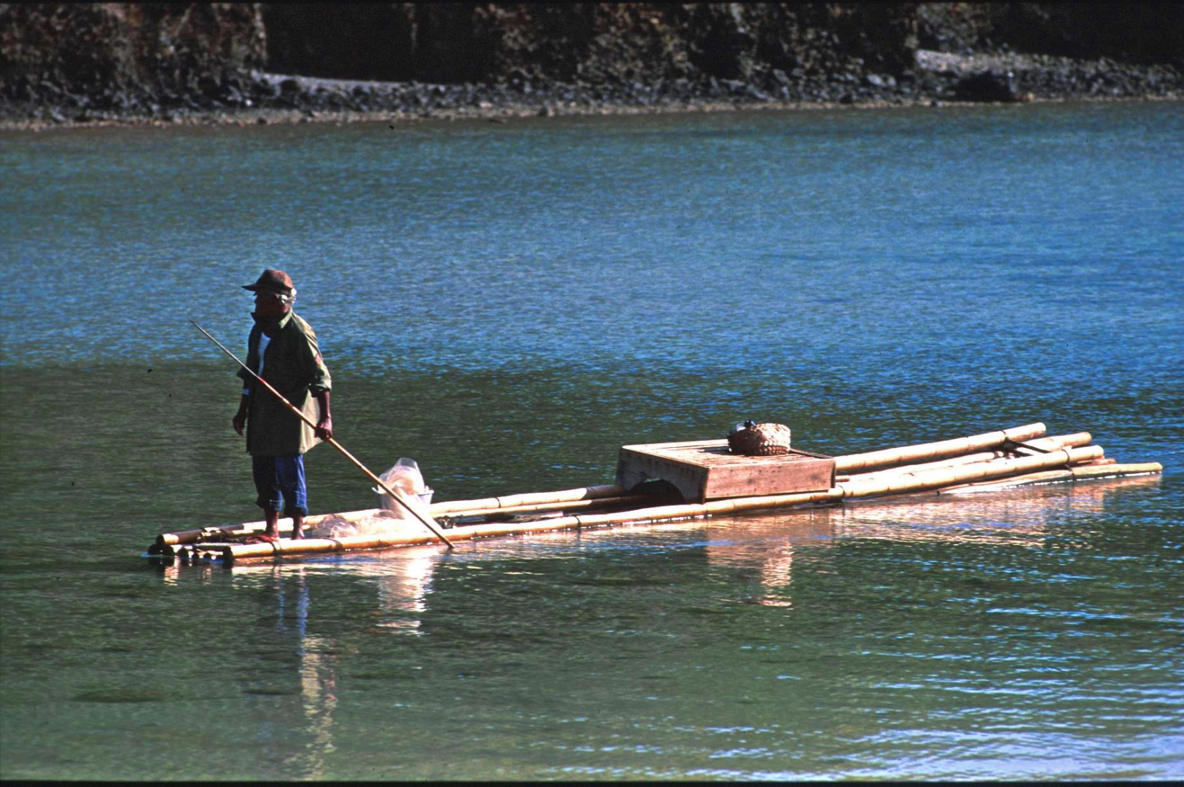
The Asia Pacific Conservation Region
Notes:
20 years ago in the Republic of Palau , the Nature Conservancy engaged at our first site in the Asia Pacific Conservation Region. Since then, our marine program and approach has grown and evolved significantly.

Slide 3
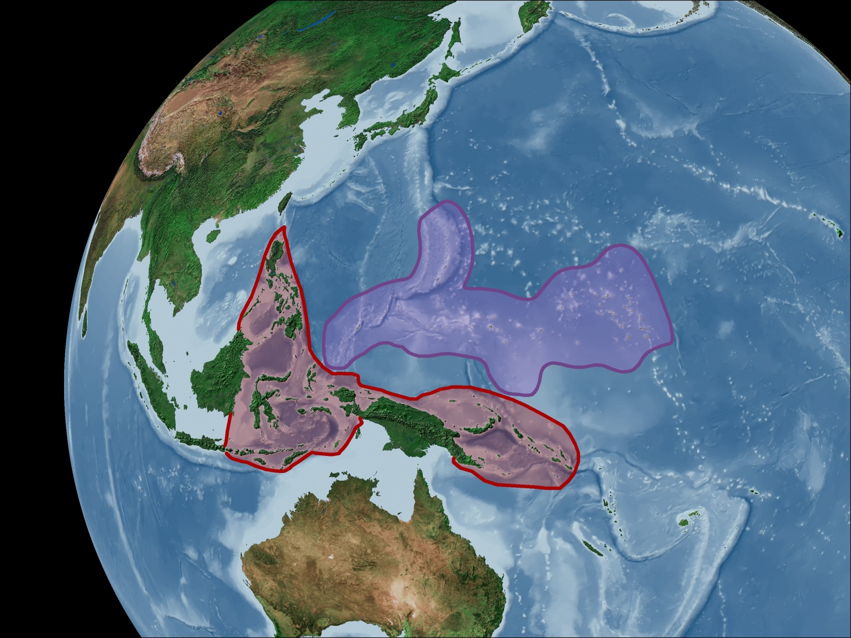
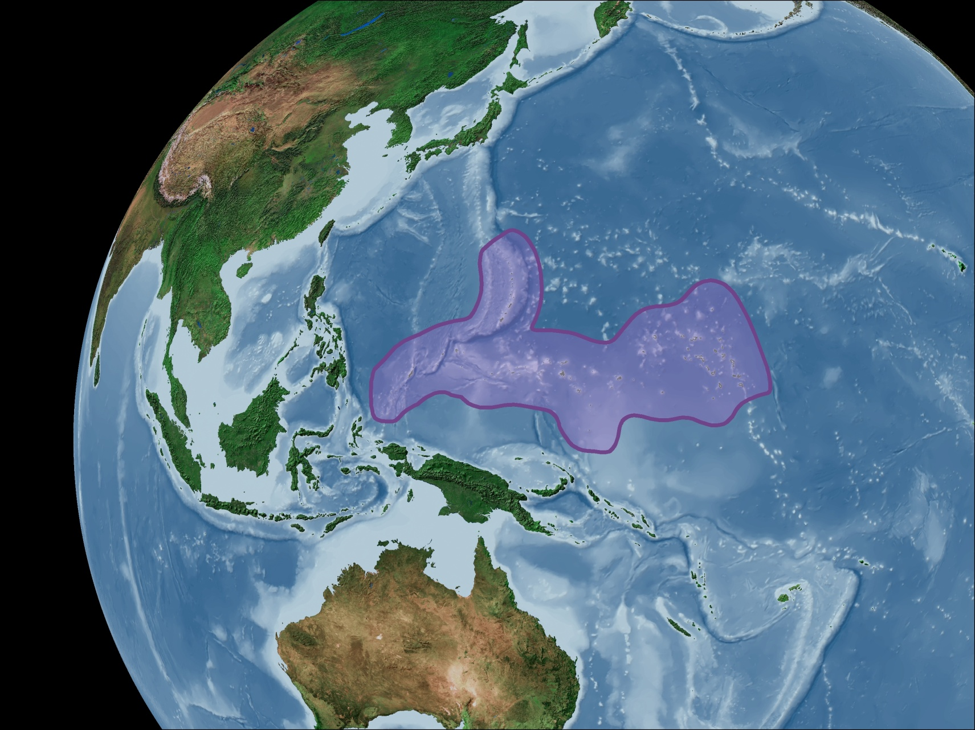
Micronesia
and the Coral Triangle
Notes:
We focused in the first decade on demonstrating conservation success at sites in two geographies: Micronesia and what is now know at the Coral Triangle, believing that we had a lot to learn about doing biodiversity conservation in this part of the world.
Micronesia, represents
2200 islands spread across 3 million square miles of ocean (about the size of the US), populated by about 650,000 people speaking 14 languages and living in seven distinct political jurisdictions – 5 independent countries and two U.S.-affiliated territories (we work in 3 countries and the 2 territories). Micronesia is most well-known for being the global center for tuna spawning and migration. Micronesians are heavily dependent on marine resources for food, livelihoods and tourism revenue.
And the Coral Triangle
is best known because it is regarded as the global epicenter of marine biodiversity.
The area stretches over 2.3 Million sq miles (Half the US)
and links six countries: Indonesia, the Philippines, Malaysia, Timor-Leste, Papua New Guinea and the Solomon Islands.
Over 150 million people live within the Coral Triangle, of which an estimated 2.25 million fishers are dependent on marine resources for their livelihoods.
It is home to an incredible 76 percent of the world’s coral species
37 percent of the world’s reef fish species.

Slide 4
Growing changes in the Asia Pacific region
Expanding population
Economic growth
International trade
Climate Change
Increasing pressure of marine resource
Notes:
But the Asia Pacific Region sits at a crossroads of rapidly expanding populations, economics and international trade.
Fish and other marine resources are the principle source of income, food, livelihood and export revenues, generating increasing pressures on marine and coastal resources.

Slide 5
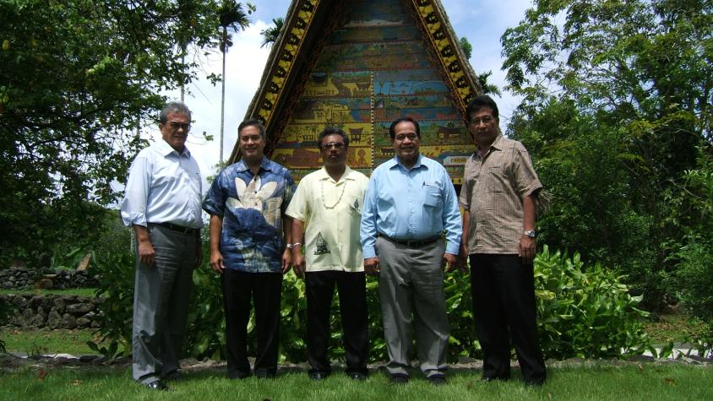
Micronesia Challenge
Notes:
Fortuiously, growing regional concern regarding marine resources and coastal communities has spurred political processes that for the first time offer the opportunity to fundamentally change the way in which the region’s coastal and marine environment is managed and sustained.
In 2006, five Micronesian governments —Palau, the Federated States of Micronesia, the Marshall Islands, Guam and Northern Mariana Islands –committed to “effectively conserve at least 30 percent of the near-shore marine resources and 20 percent of the terrestrial resources across Micronesia by 2020” – the now well-known Micronesia Challenge.

Slide 6
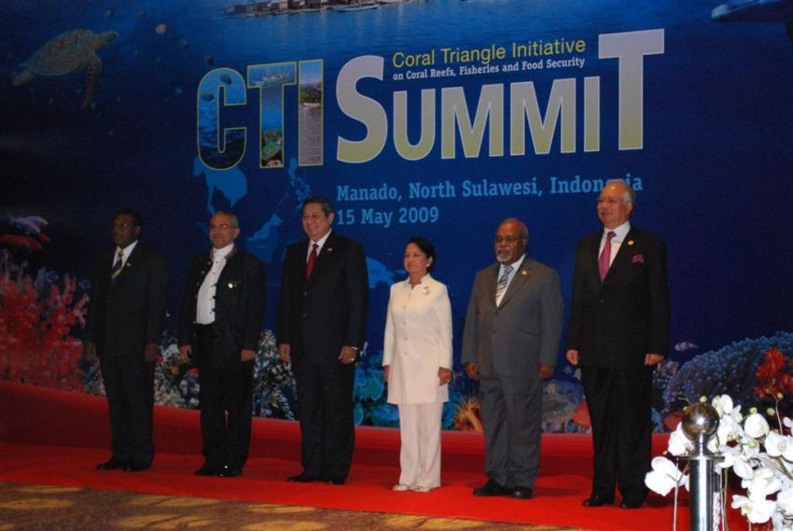
Coral Triangle Initiative
Notes:
Inspired by the Micronesia Challenge, The Coral Triangle Initiative on Coral Reefs, Fisheries, and Food Security (CTI) was launched in 2009. Each of the 6 governments in the Coral Triangle have now made unprecedented conservation commitments. Signing the Regional Plan of Action (RPoA) The RPoA is an ambitious ten-year plan that will address five overall goals: (i) priority seascapes; (ii) ecosystem approach to managing fisheries and other marine resources; (iii) marine protected areas; (iv) climate change adaptation; and (v) threatened species.

Slide 7
Adapting to a new context
Context had changed from 20 years ago
TNC must scale up conservation actions
Already big, financially challenging to scale up
New direction: leverage policy, regulatory framework and funding
Need to revise program’s strategy
Notes:
ADD something about new strategic direction to be less about sites and more about leveraging what we have done at sites at the regional scales, especially policy, regulatory framework and funding.
Needed to get that high strategy level to be in place.
Coincided with a TNC AP Marine change in direcion…

Slide 8
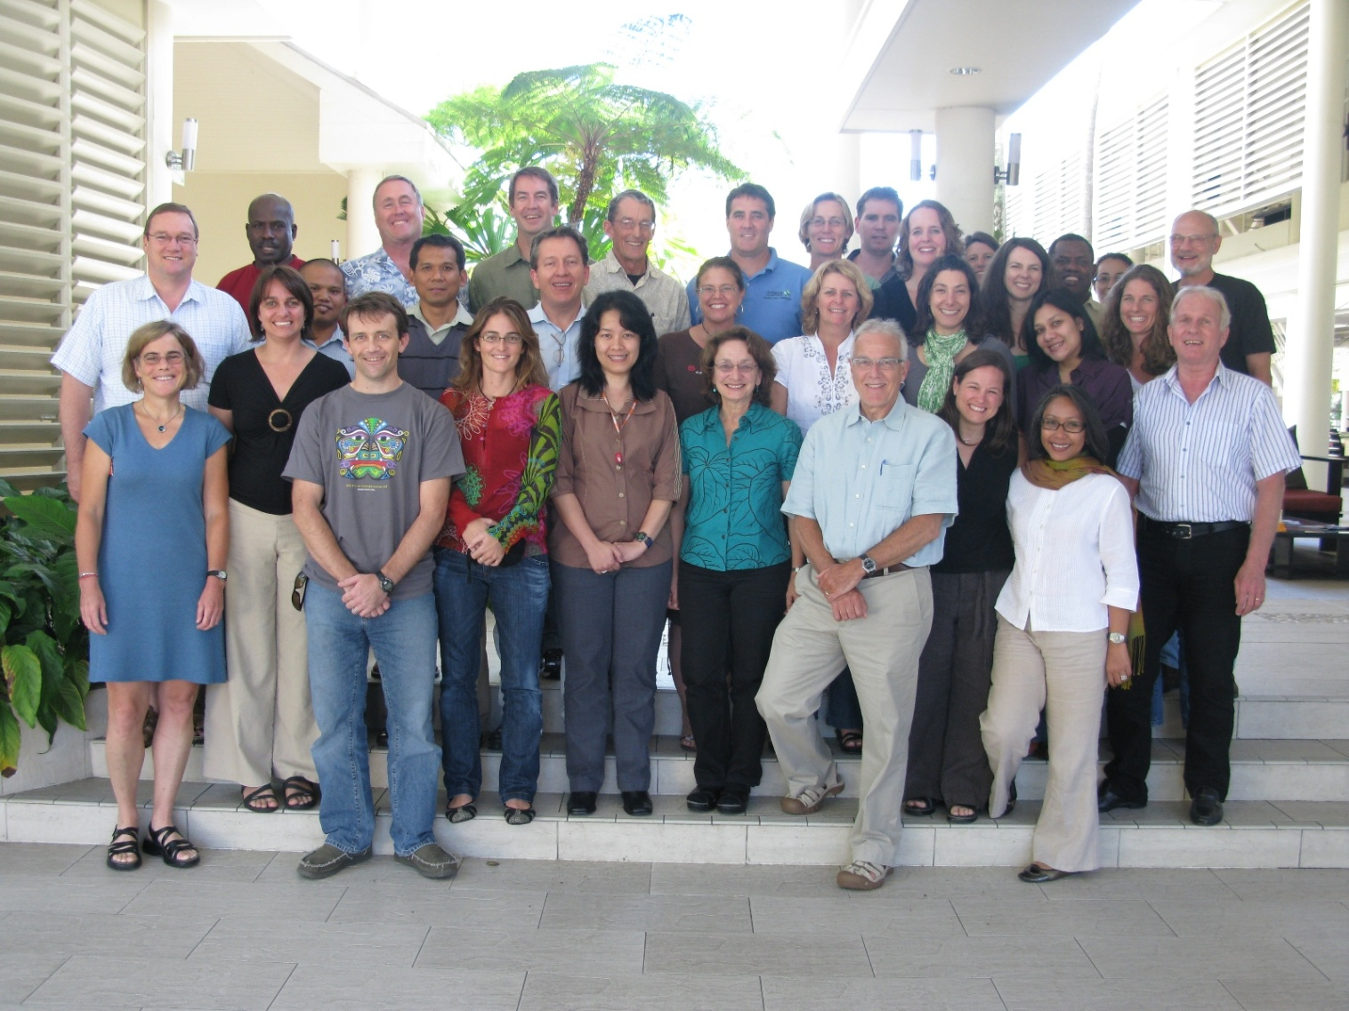
Getting the right team together
Notes:
53 team members
Building from the bottom up:
Country directors and portfolio managers,
Program directors,
Regional directors
Senior management (Managing director of the Asia Pacific Conservation Region)
Coaches!!!

Slide 9
Establishing parameters
New goals aligned to the two initiatives
5 year timeline (to 2015)
A flat lined budget through FY12

Slide 10
The team / sub- strategies
3 Enabling sub-strategies
  External Affairs (policy, sustainable finance and public funding)
  Communication
  Capacity Building
3 conservation sub-strategies:
  Marine Protected Area
  Fisheries Management
  Ecosystem Based Adaptation
Notes:
Each sub strategies had to come up with a ‘business plan”:
Conceptual model
The most important steps in their strategy presented in a result chain
Narrative
Key outputs/outcomes and timelines
Key linkages

Slide 11
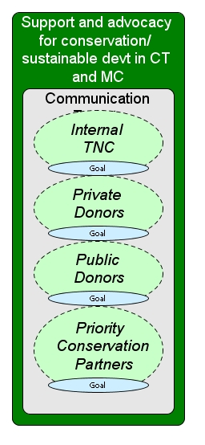
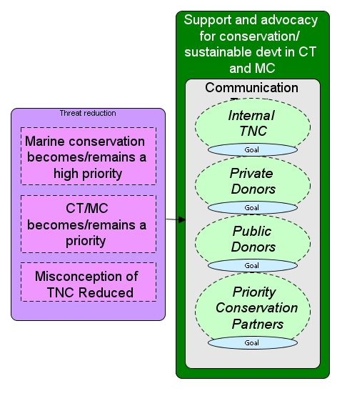
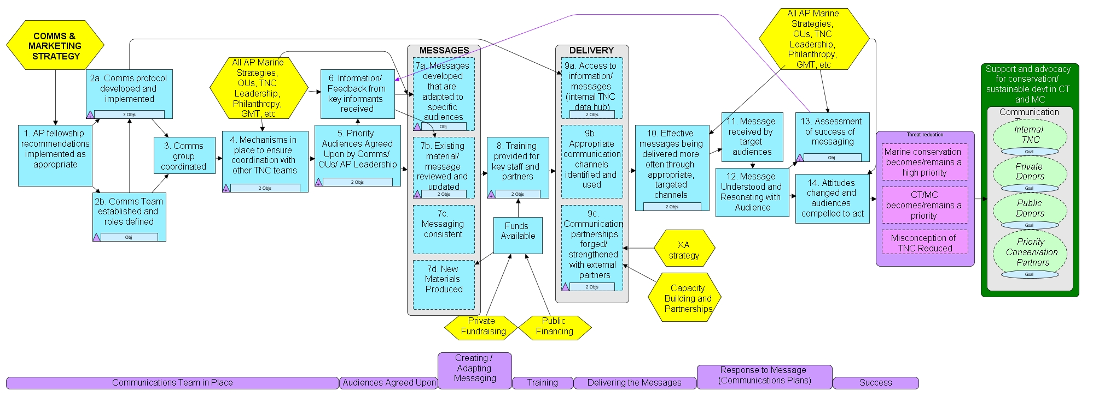
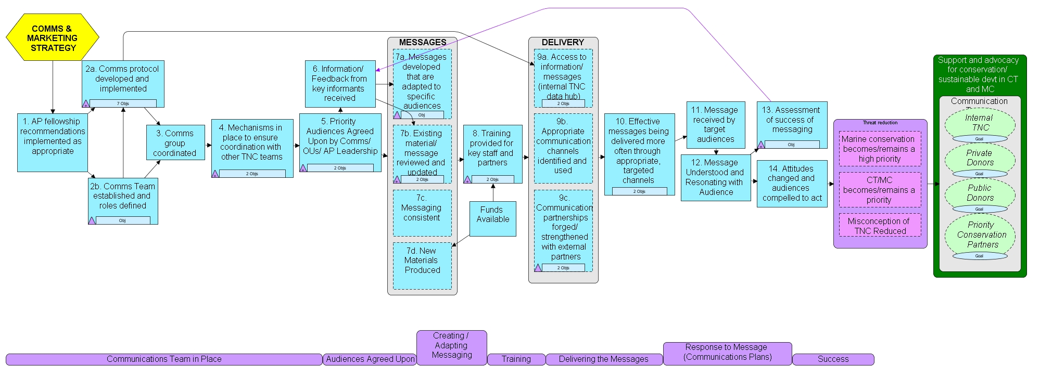
e.g. Communication sub-strategy
Notes:
Innovative

Slide 12
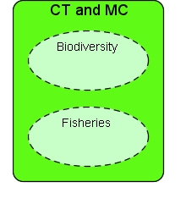
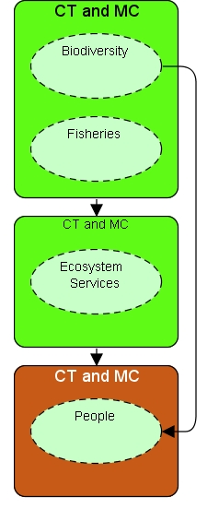
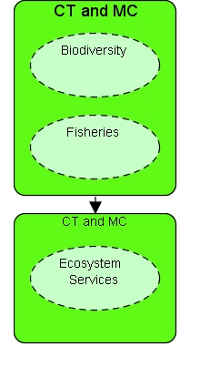
Scaling up: targets
Healthy Reefs
Coastal Ecosystems
Healthy Communities
Notes:
Over the last several months, as a group we have clarified our “conservation targets” – what is the ultimate goal of our work – and we agreed that we want to continue to work towards our goal of healthy reefs. But we realized that healthy reefs need to be supported in the context of larger healthy ecosystems – in effect, stretching our work from reefs back towards the land and looking at healthy coastal ecosystems, including mangroves, rivers, and watersheds, since many of the threats to our marine systems come from land-based activity. Then we went a step further, recognizing that the only way to keep ecosystems healthy in the long-run is to support healthy human communities – through assuring that they can continue to benefit from “Ecosystem Services” in a changing world. Both our healthy ecosystem and healthy human communities targets must be on a par with and equal in importance to “biodiversity” if we are to be successful in the long-term.

Slide 13
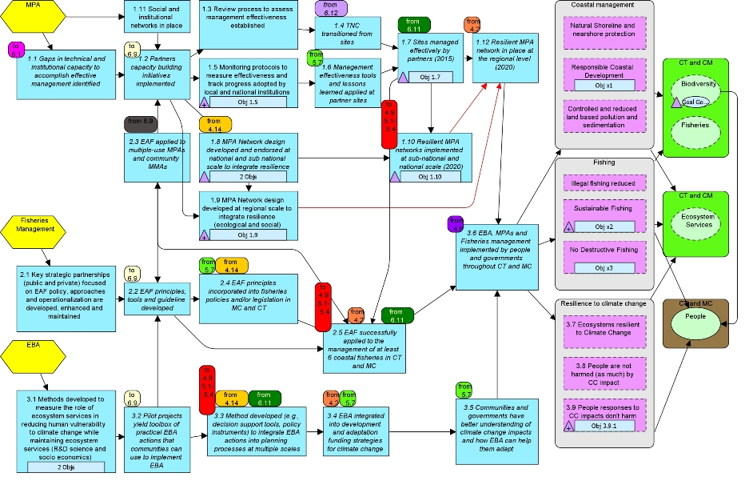
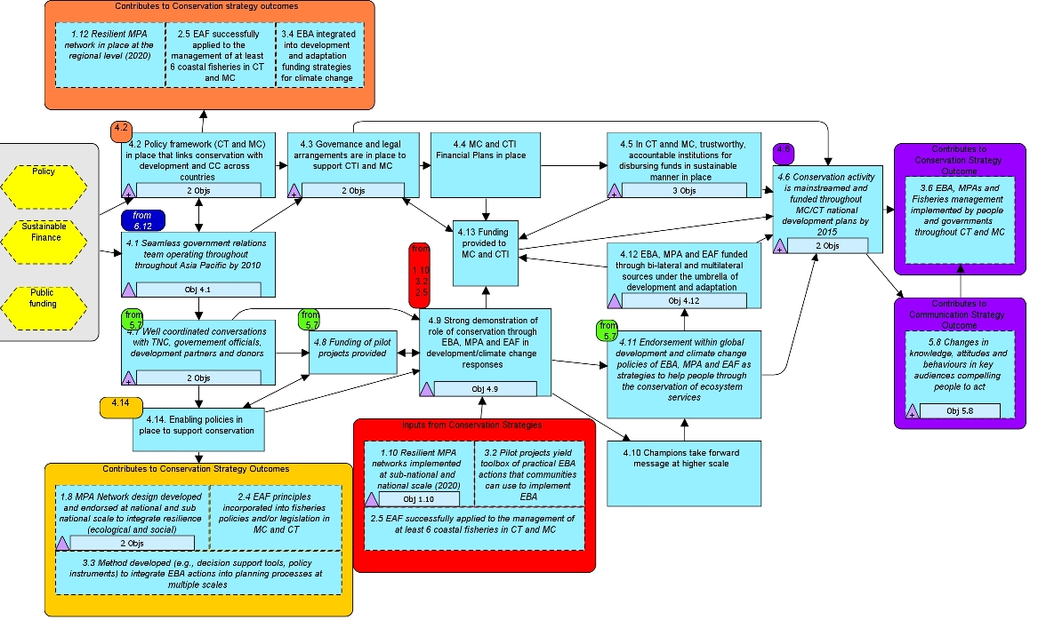
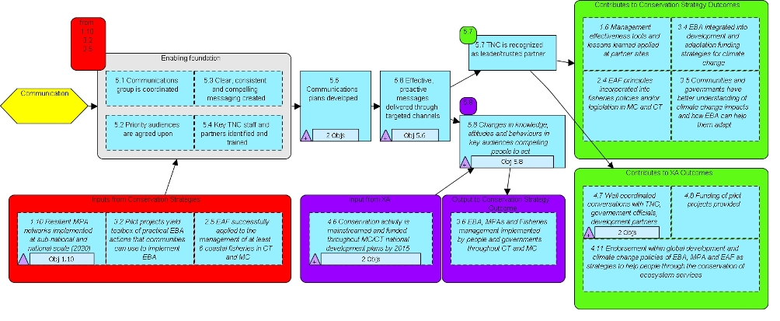
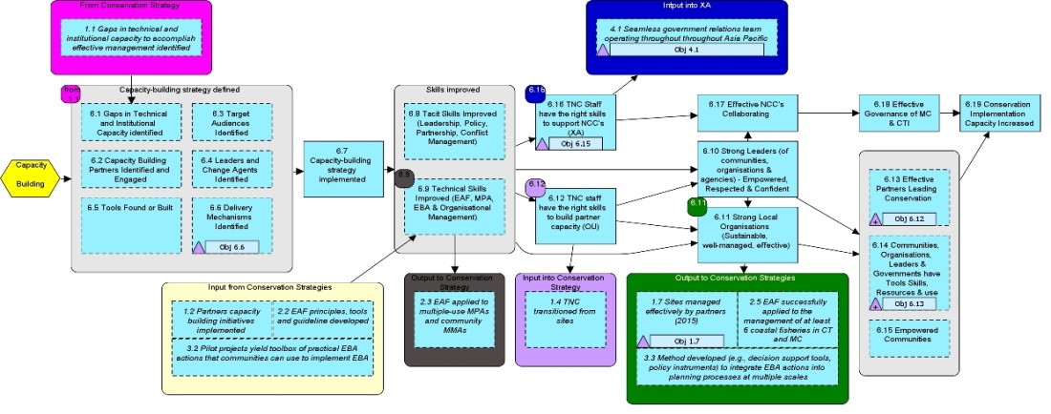
CONSERVATION STRATEGIES
Threats
Conservation
Targets
MPAs
Fisheries
EBA
ENABLING STRATEGIES
External Affairs
Communications & Marketing
Capacity Building
Notes:
Spaghetti diagram showing all six sub-strategies. Don’t try to read this!
Note: coloured squares denote connection points among strategies.

Slide 14
Monitoring and Calendar
Monitoring plan:
  Integrated into workplans
  Accountability to management
  Managers responsible for success
Calendar of Key events:
  Provides the basis for Senior Managers to track the overall progress of the AP marine strategy over the next 5 years

Slide 15
Lessons learned and Successes
1st iteration failed: top down approach and revision “in a vacuum”
Senior Manager ownership
Real collaborations between teams
From Field staff to Senior management: all responsible for the success of the strategy
Notes:
X 1st iteration was too top down approach (not people in project in the field) – in a vacuum

Slide 16
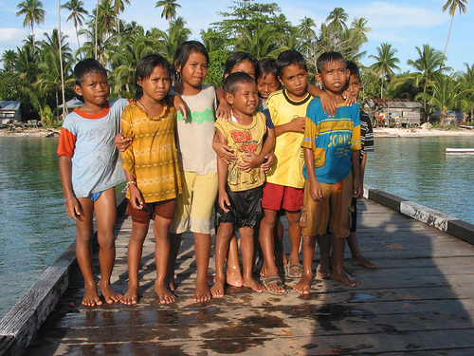
THANK YOU!

