Slide 1

歡迎 Aloha Bienvenidos Welkom Bem-vindo Welcome Wilkommen में आपका स्वागत है Kaselehlie Mogethin Ran Annim Lenwo Alii Yokwe Hafa Adai Mauri Bienvenue 欢迎 Сайн байна уу Selamat حيب Menyambut สวัสดี 歡迎 Aloha Bienvenidos Welkom Bem-vindo Welcome Wilkommen में आपका स्वागत है Kaselehlie Mogethin Ran Annim Lenwo Alii Yokwe Hafa Adai Mauri Bienvenue 欢迎 Сайн байна уу Selamat حيب Menyambut สวัสดี 歡迎 Aloha Bienvenidos Welkom Bem-vindo Welcome Wilkommen में आपका स्वागत है Kaselehlie Mogethin Ran Annim Lenwo PaAlii Yokwe Hafa Adai Mauri Bienvenue 欢迎 Сайн байна уу Selamat حيب Menyambut สวัสดี 歡迎 Aloha Bienvenidos Welkom Bem-vindo Welcome Wilkommen में आपका स्वागत है Kaselehlie Mogethin Ran Annim Lenwo Alii Yokwe Hafa Adai Mauri Bienvenue 欢迎 Сайн байна уу Selamat حيب Menyambut สวัสดี 歡迎 Aloha Bienvenidos Welkom Bem-vindo Welcome Wilkommen में आपका स्वागत है Kaselehlie Mogethin Ran Annim Lenwo Alii Yokwe Hafa Adai Kiribati – Mauri Bienvenue 欢迎 Сайн байна уу Selamat حيب Menyambut สวัสดี 歡迎 Aloha Yokwe Menyambut Bienvenidos
Welcome
to the fourth Training Session
on Social Science and Conservation
April 18, 2012

Slide 2
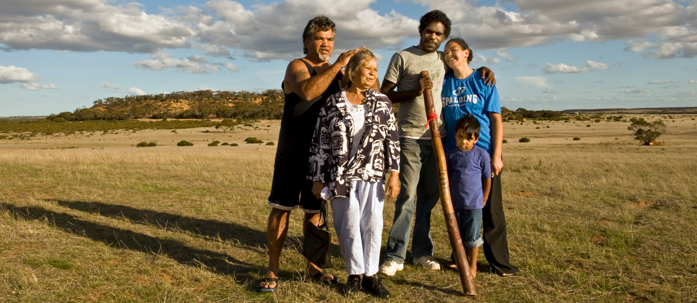

Social Objectives and
Social Indicators
Photo Credit: Amy Vitale

Slide 3
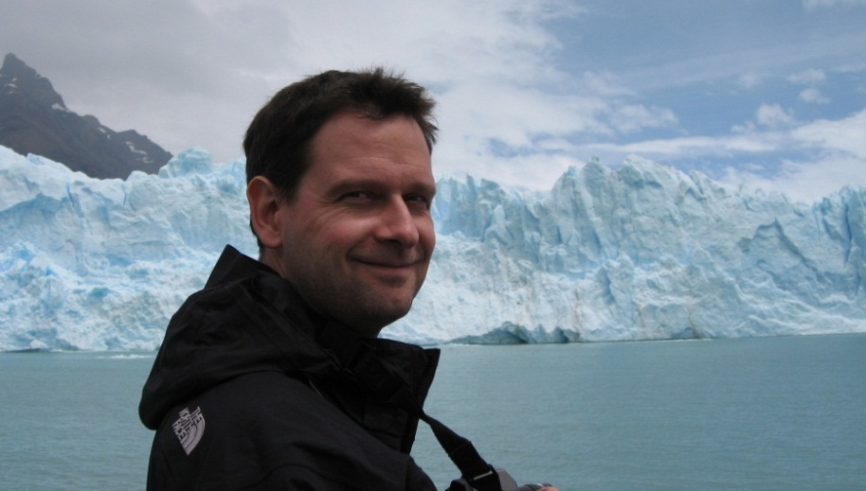
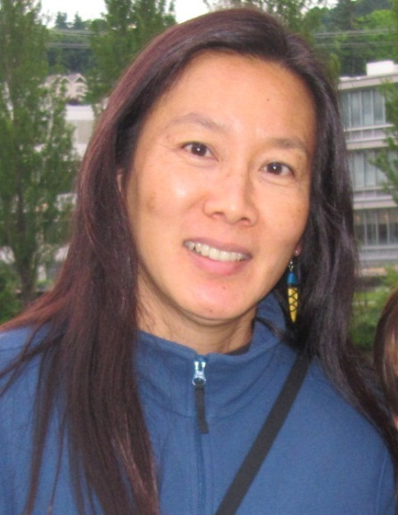
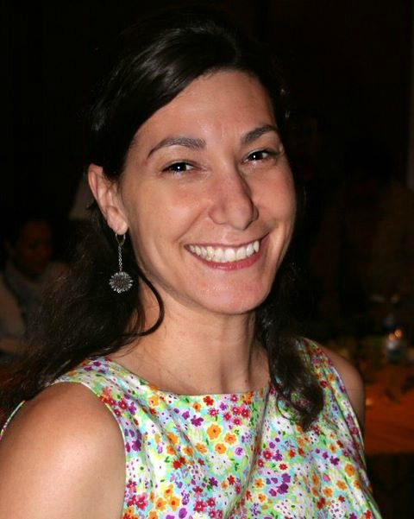
Your speakers and host
Timm Kroeger
Senior Environmental Economist
Sustainability Science, Central Science
Supin Wongbusarakum
Senior Social Scientist
Conservation Methods Central Science
Nina Hadley
Social Science Coda Fellow
Manager, Conservation Partnerships & Capacity Building
Asia Pacific

Slide 4
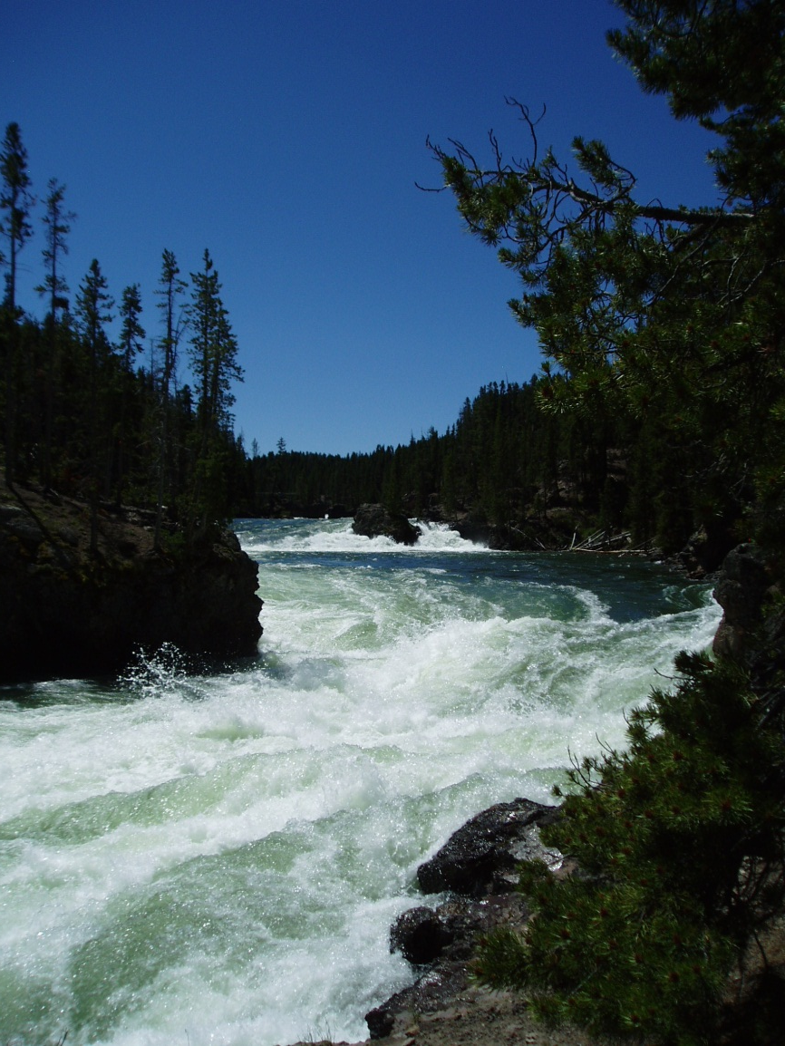
Today’s Flow (Rapid)
Social objectives and how to make them SMART – 15 mins
Social indicators & good characteristics -15 mins
Examples (ecosystem services/REDD+) - 15 mins
Q&A – 15 mins

Slide 5
Learner’s Objectives
Understand what social objectives are and how to develop SMART ones
Understand what social indicators are and characteristics of good indicators
Learn more about indicators that are used to measure human well-being from different examples

Slide 6
Questions
To ask the presenters a question, please send your question
  via the WebEx chat window to Nina Hadley, OR
  email to nhadley@tnc.org
If your question is directed to a specific speaker, please indicate Timm or Supin.

Slide 7
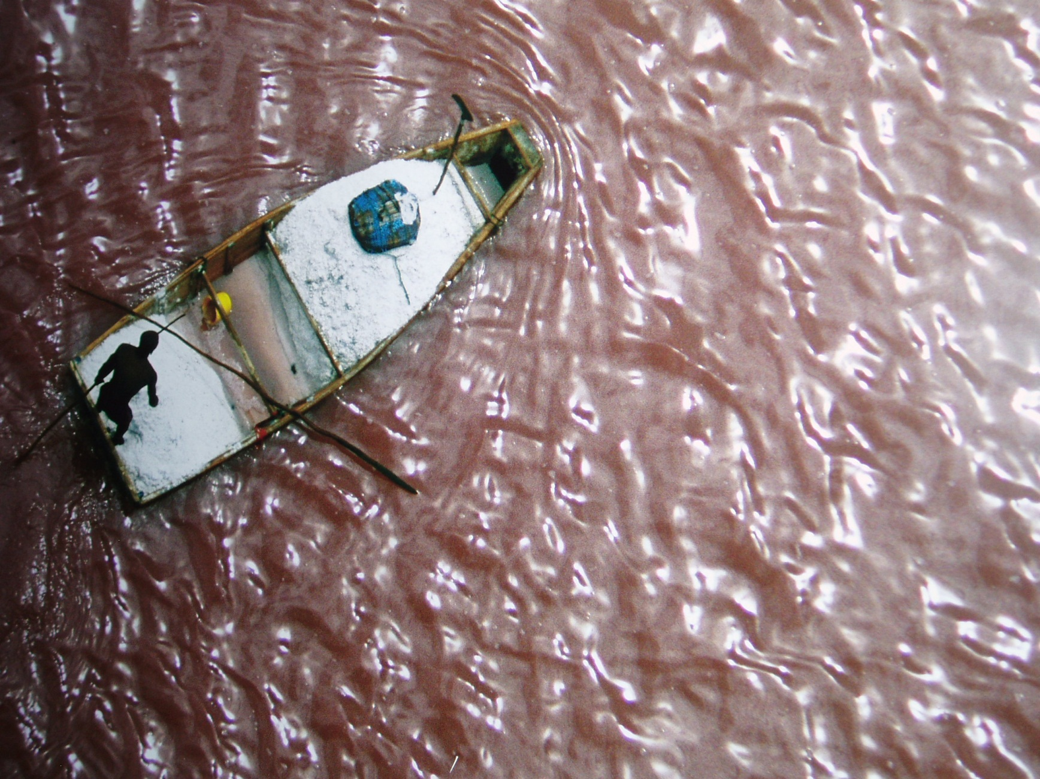
Social Objectives
Photo Credit:
Robert B. Hass
Notes:
Reasons for having social objectives:
Having a human related goal (requested by program vision goal, addressing priority of local community or stakeholders, responding to funder’s requirement).
Having a strategy where social objectives will help increase chances of conservation to become successful, enhance or broaden conservation impacts.

Slide 8
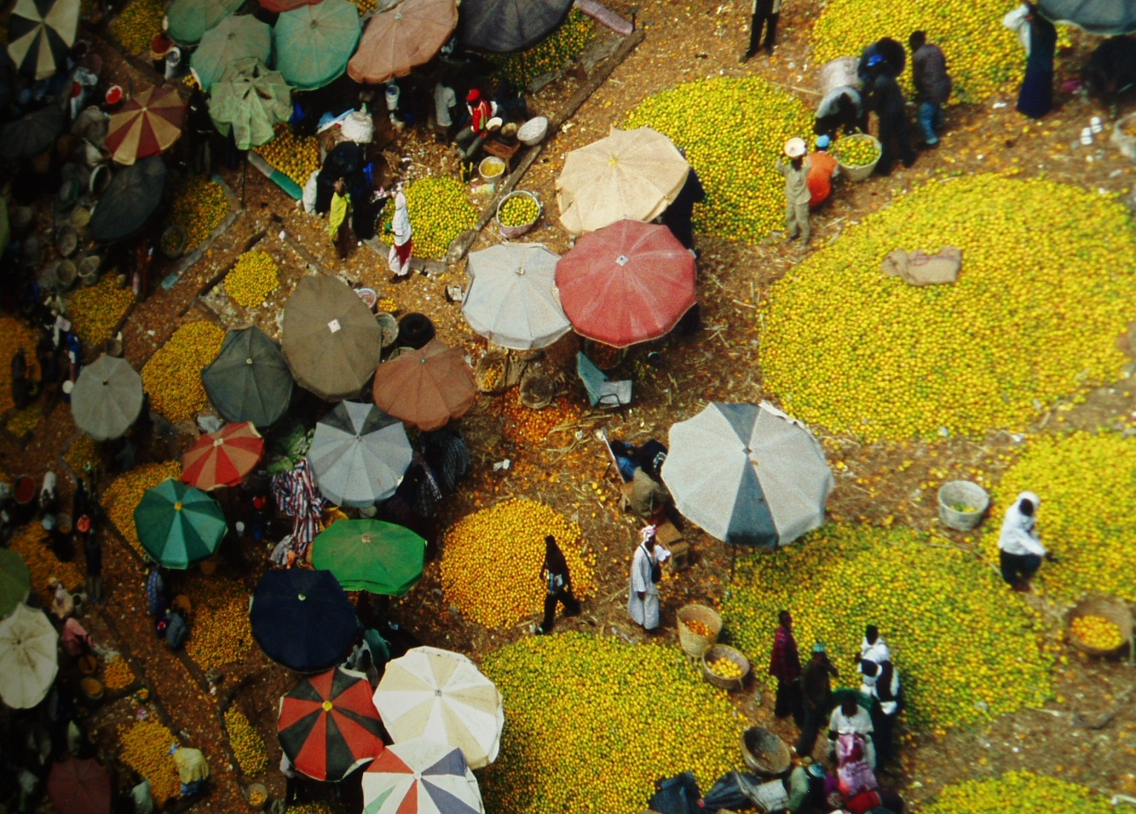
What is “social”?
Social = anything of or relating to the interaction of the individuals, groups, and institutions within a society.
Photo Credit:
Robert B. Hass
Notes:
A person doing an activity alone is not “social”
Infrastructure or man-made things are not “social”
But they are human-related.

Slide 9
Social/Human Related/Human Wellbeing
“Social” has been used in a broader sense to encompass different dimensions that are human-related.
Human wellbeing has multiple constituents. They are situation-dependent, reflecting local geography, culture, and ecological circumstances.
Notes:
“Social” has been used in a broader sense to encompass different dimensions that are human-related, including livelihood, socio-cultural, economic, governance, institutional, education, health, infrastructure, and more.
Human wellbeing has multiple constituents, including basic material for a good life, freedom and choice, health, good social relations, and security.
Some see human well-being as an opposite end of a continuum from poverty, which has been defined as a “pronounced deprivation in well-being.” (not just materials, but it could be access/rights)

Slide 10
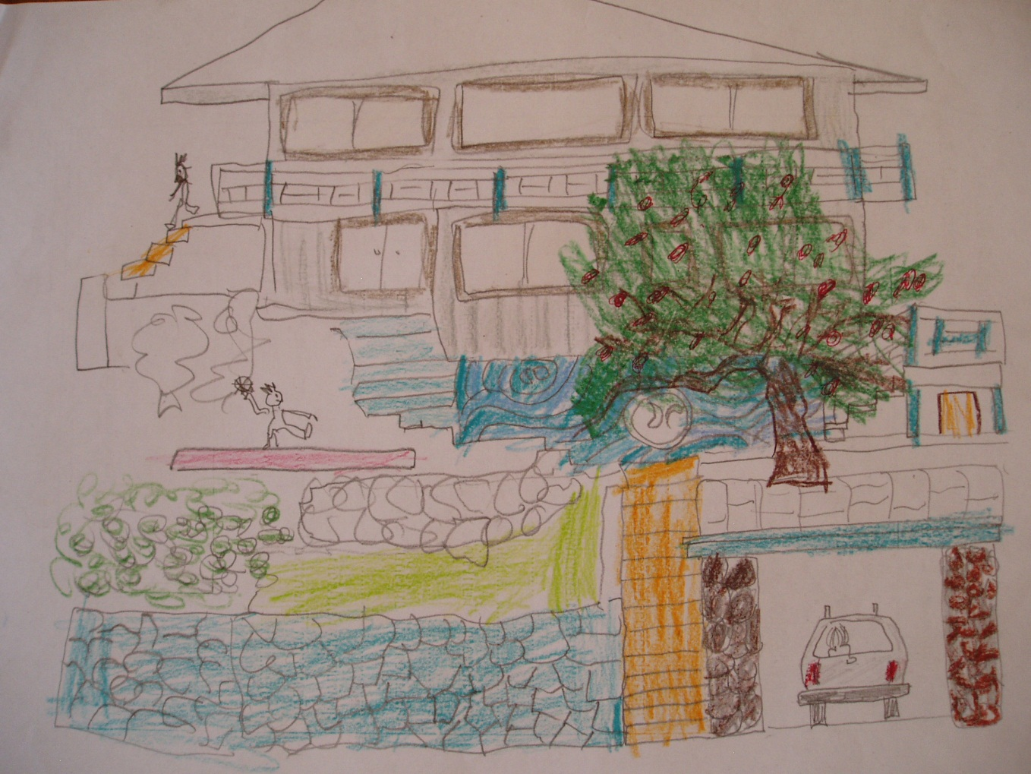
What is an objective?
A statement that details a specific desired outcome of a project. (National Audubon Society, Tools of Engagement, 2011)

Slide 11
Social + Objective
A statement that details a specific desired project’s outcome related to human well-being.
Objective = a statement that details a specific desired outcome of a project.
Social = anything of or relating to the interaction of the individuals, groups, and institutions within a society.
Social objectives are also called:
Human welfare/wellbeing target
Human development goal
Social welfare outcome

Slide 12

SMART Objectives

Slide 13
SMART objectives
Specific
✓Is it specific?
Measurable
✓ Is it measurable?
  Achievable/Action-oriented
  ✓ Can it be met by your team or other feasible means?
  ✓ Is it impact-oriented?
Realistic/practical
✓ Is it well linked to your conservation target?
✓ Is it of importance for the impacted communities?
Time bound
✓ Does it have a completion date?

Slide 14
SMART objective example
  By 2015, increased income by at least 10% for a minimum of 500 households in Wonderland by creating markets for locally produced non-timber forest products.
Specific - says what the project will do, where and how
(increase income of households in Wonderland by marketing non-timber forest products)
Measurable - states how much of income increase (15%) and how many households (500)
Achievable – project activities have the necessary policies, partners, and relevant resources to market and support the
non-timber forest products
Relevant - links with the program goal to conserve forest and important for communities who want to diversify and secure their livelihoods
Timely - indicates that this will happen by 2015.

Slide 15
Defining appropriate social objectives
Finding the link between conservation target of our program goal and benefits to people, e.g. through conceptual model (S, R, M)
Understanding local context/community
Considering synergy or trade offs and related impacts (T, A)
Assessing our capacity and resources to meet the objectives and knowing how to fill gaps (A, M)

Slide 16
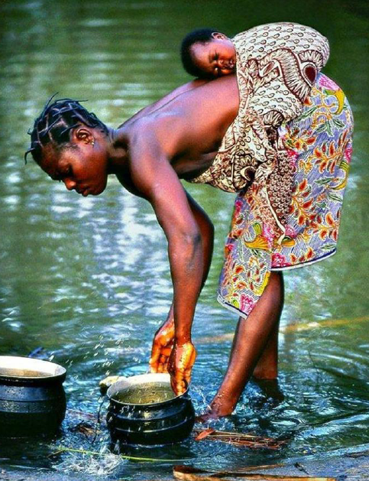
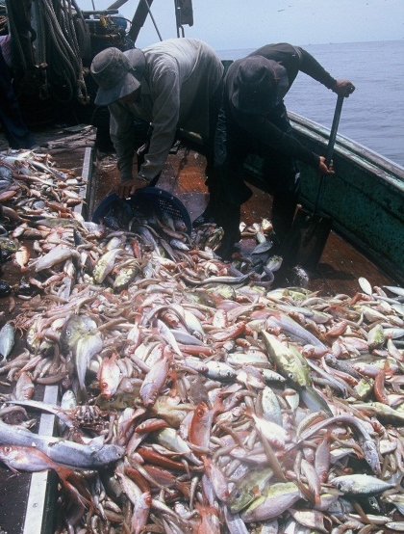
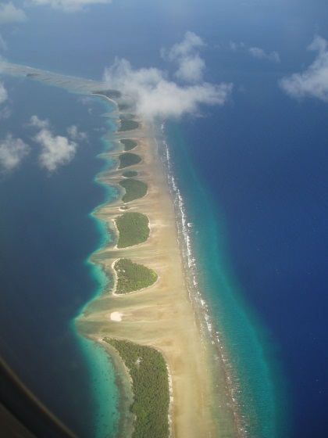
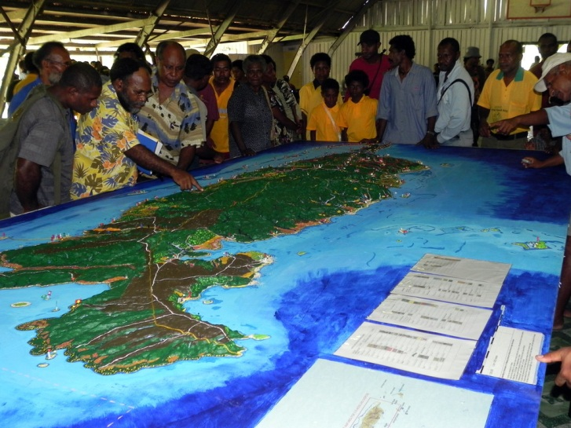
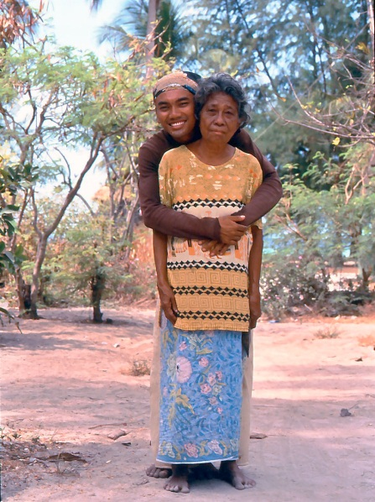
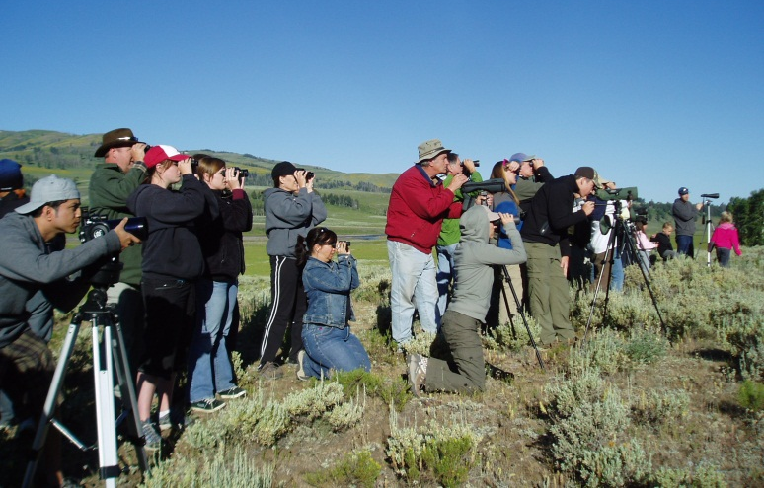
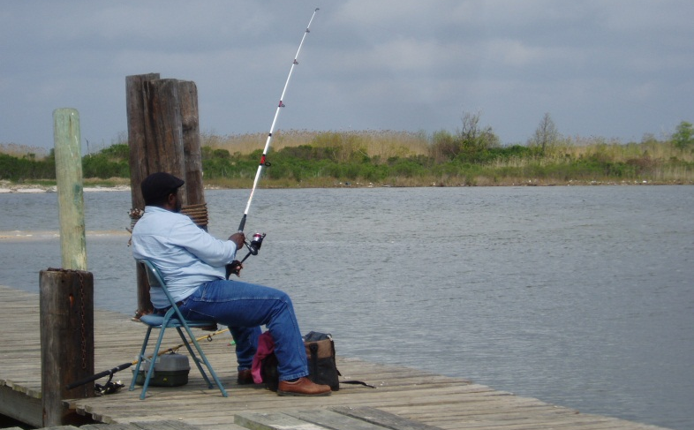
What is the link between people and our conservation target?
Notes:
In some cases, you might want to do a community assessment to find out more about the situation.
For example, you might want to find out more about the root causes of the
problems facing your targets.
Links are often related to root causes/drivers/indirect threats
Mike Matarasso, from Conservation International, defines root causes as the reasons
people conduct a particular behavior. For example, if hunting is identified as a harmful behavior that is
causing the decline of a species, the root causes of hunting (why people do it) might be: consumption
(people need the food), income (people need the money), trophies (people want to show others what
they’ve done), or social norms (families have been hunting for generations—it’s a way of life).

Slide 17
Understanding local context & people
Who are we benefiting (unit of analysis, scale)?
What are their basic community characteristics?
What kind of relationship do they have with what we want to conserve? What is the (local) context?
What do they identify as making their lives better? And how that could be related to our conservation effort?
  Local consultation and ground truthing
Notes:
Define “Who” because communities are not homogenous. There are different socioeconomic groups in one community. Who is our social target?
The costs and benefits of conservation are not evenly spread over all peoples, places, and times (Chan et al, 2008).
“Two problems confound the evaluation of social impacts of conservation projects, however. First, the costs and benefits of conservation are not evenly spread over all peoples, places, and times. The “winners” might be distant in space and time from the “losers,” necessitating analyses at multiple scales. For example, the benefits of conserving a Madagascar forest were estimated to accrue at both global and local scales, but with a significant opportunity cost of foregone logging concessions for the national government (Kremen et al. 2000). More generally, Balmford and Whitten (2003) argue that future generations and the global community typically benefit most from tropical conservation, whereas local communities and nations bear the costs. Conservation efforts intended to dissipate development or resource extraction pressures necessarily entail costs to those local people who rely on such activities (Gadgil & Guha 1993; Salafsky et al. 2001). Second, it is likely that impacts that are damped locally will simply shift to another location.”
Source: Chan et al. 2008. When Agendas Collide: Human Welfare and Biological Conservation. Conservation Biology.
Community characteristics:
• Community boundaries
• Community capacity and activism
• Community interaction and information flow
• Demographic information
• Economic conditions and employment
• Education
• Environmental awareness and values
• Governance
• Infrastructure and public services
• Local identity (and culture)
• Local leisure and recreation
• Natural resources and landscapes
• Property ownership, management, and planning
• Public safety and health
• Religious and spiritual practice
Gerry Ellis
From Community Characteristics (U.S. EPA, 2002 in Audubon 2011)
Do we understand “enabling conditions”?

Slide 18
Program goal
Steps in measuring social impacts
Planning
Local context
Define social objectives
Assessing our capacity and fill the gaps
Design
Indicators
Data collecting methods
Data analysis
Adapting
Use in adaptive or results-based management
© Supin
Notes:
Social measures are a part of a large process in conservation planning and adapting/management.
Measuring social impacts can be both quantitative and qualitative.

Slide 19
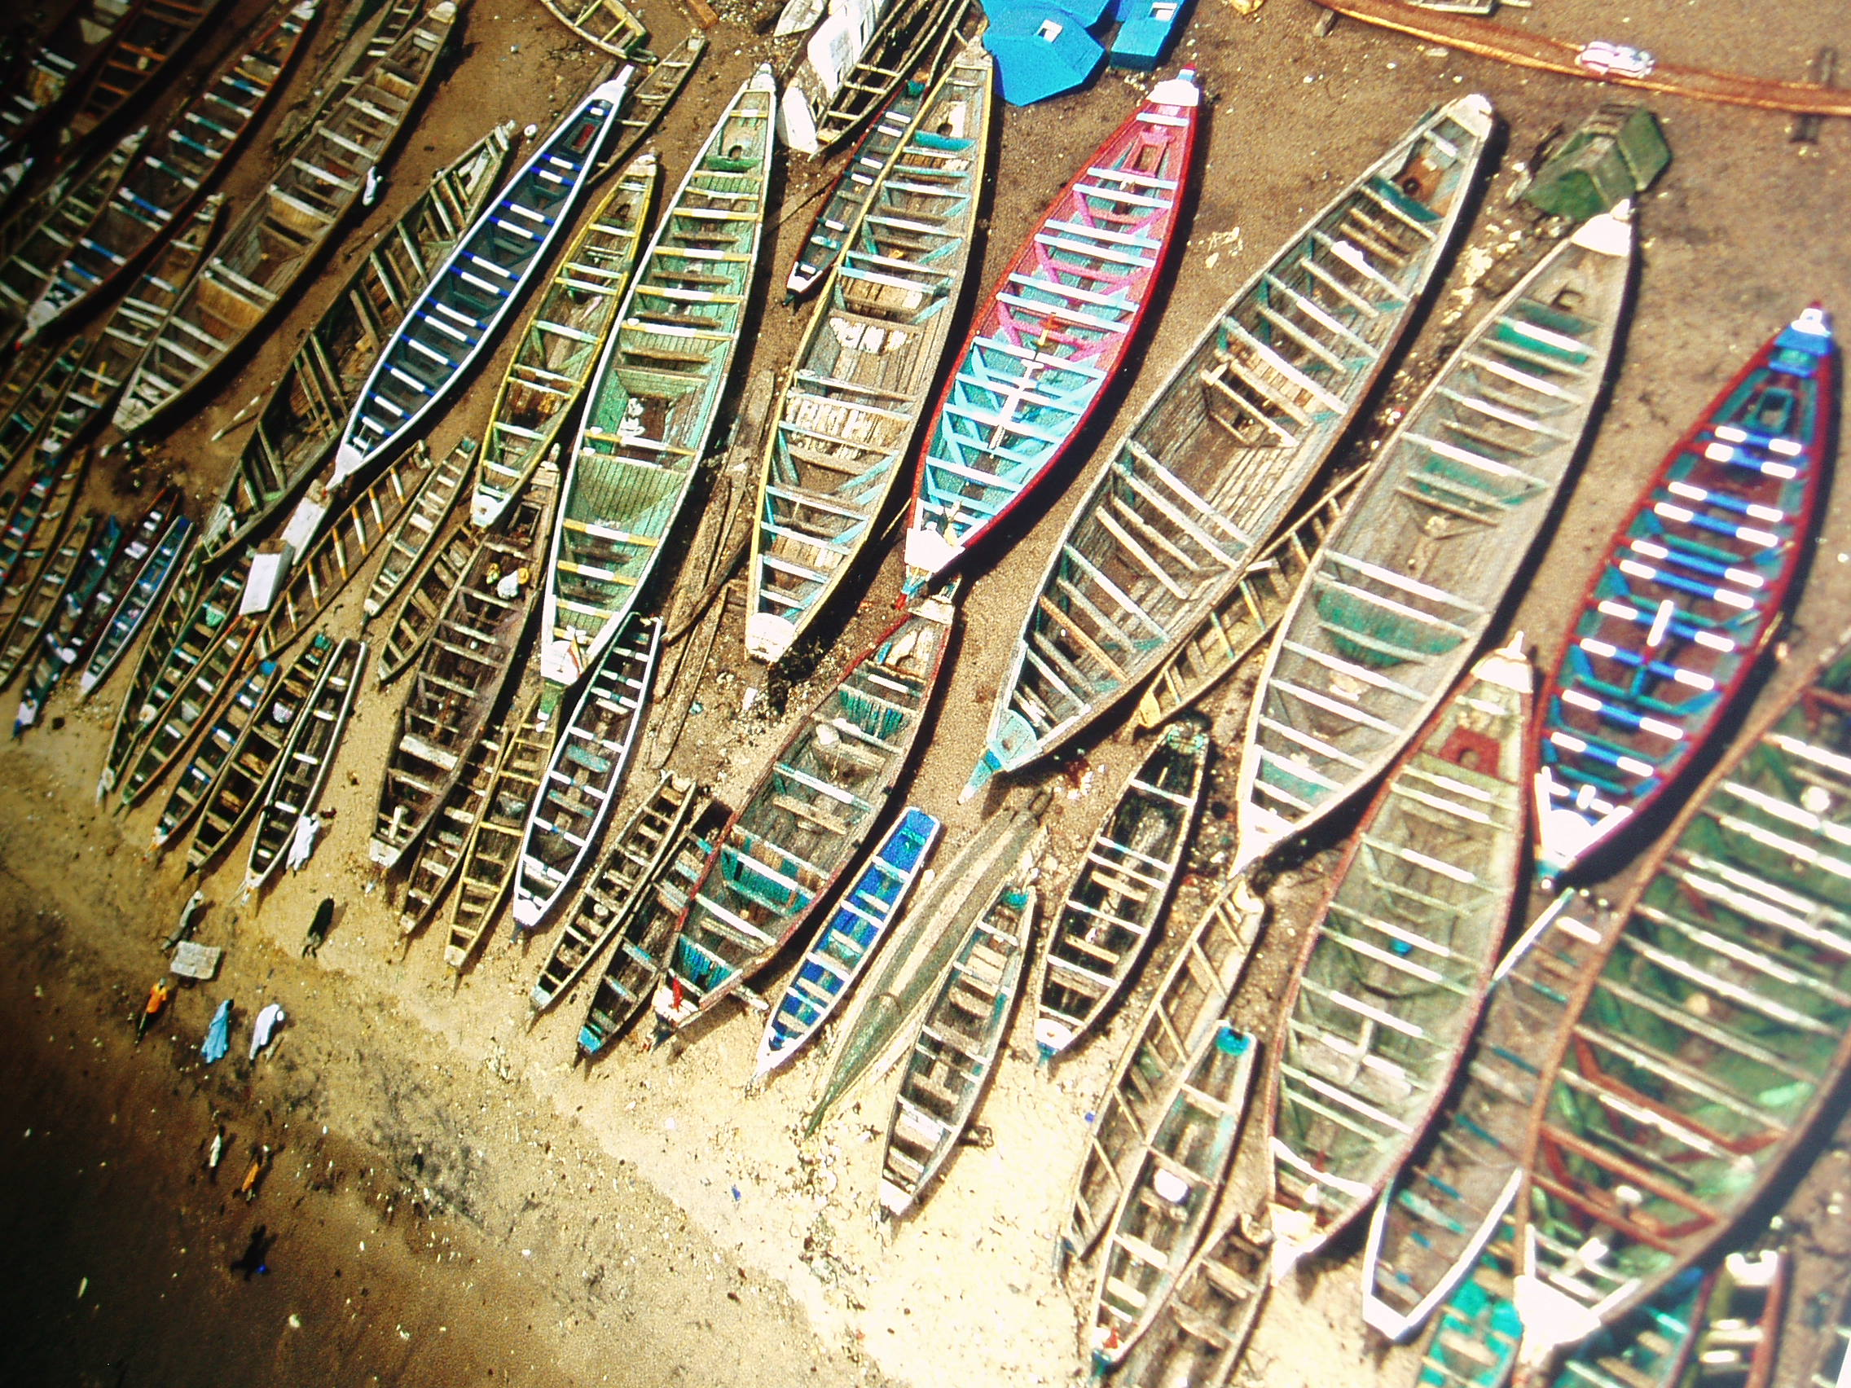
Social indicators
Photo credit:
Robert B. Hass

Slide 20
Social indicator?
An indicator is a quantitative or qualitative factor or variable that provides a simple and reliable means to measure how well a desired outcome or criterion is being achieved or fulfilled (OECD/DAC, 2002)
A social indicator enables measuring and monitoring changes of a specific dimension of human well being.
Notes:
Quantitative indicators are numerical (e.g. number of jobs created by a protected
area) while qualitative indicators are described in text or visual form (e.g.
the impact of a protected area on community cohesion or sense of home/place).
OECD/DAC (2002) Glossary of key terms in evaluation and results based
management. The DAC Working Party on Aid Evaluation, OECD, Paris.
http://www.oecd.org/dataoecd/29/21/2754804.pdf

Slide 21
Social indicator characteristics
direct or proxy (indirect, used when no direct measurement is possible)
tangible/material (e.g. natural resources, people) or intangible (value, attitude, knowledge)
objective (social facts, e.g. migration, unemployment, or mortality rates); or subjective (perception, satisfaction, happiness)
a single variable (e.g. income) or multiple indicators combined to construct composite indicators, or indices (e.g. Human Development Index, Multidimensional Poverty Index, Gross National Happiness Index).
Notes:
The HDI combined three dimensions up until its 2011 report:
Life expectancy at birth, as an index of population health and longevity
Knowledge and education, as measured by the adult literacy rate (with two-thirds weighting) and the combined primary, secondary, and tertiary gross enrollment ratio (with one-third weighting).
Standard of living, as indicated by the natural logarithm of gross domestic product per capita at purchasing power parity.
Human Wellbeing Index (HWI)
“The HWI is a more realistic measure of socioeconomic conditions than narrowly monetary indicators such as Gross Domestic Product per capita and covers more aspects of human wellbeing than the United Nations’ Human Development Index. It is the average of:
Health and population. How long people may expect to live in good health [1 indicator]. The
stability of family size [1 indicator].
Wealth. How well needs are met for income, food, safe water, and sanitation [6 indicators]. The
size and condition of the national economy, including inflation, unemployment, and the debt
burden [8 indicators].
Knowledge and culture. Education (primary, secondary, and tertiary school enrollment rates) and
communication (accessibility and reliability of the telephone system and use of the Internet) [6
indicators]. Lack of a suitable indicator prevented coverage of culture.
Community. Freedom and governance (political rights, civil liberties, press freedom, and
corruption) [4 indicators]. Peacefulness (military expenditure and deaths from armed conflicts and
terrorism) [2 indicators]. Violent crime rates [4 indicators].
Equity. Household equity: the difference in income share between the richest and poorest fifths of
the population [1 indicator]. Gender equity: disparities between males and females in income,
education, and parliamentary decision-making [3 indicators].”

Slide 22
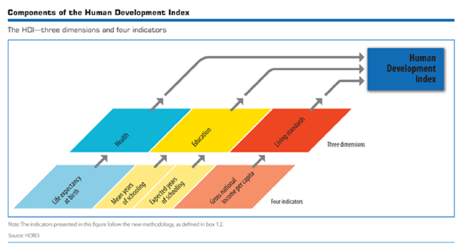
Human Development Index
Source: Source: http://hdr.undp.org/en/statistics/mpi/
Notes:
Three indices on which the Human Development Index is built.
Number of years a newborn infant could expect to live if prevailing patterns of age-specific mortality rates at the time of birth stay the same throughout the infant’s life
Mean years of schooling (of adults) and expected years of schooling (of children). See Expected years of schooling and Mean years of schooling. For details on how the index is calculated, see Technical note 1.
GNI per capita in PPP terms (constant 2005 international $)
Aggregate income of an economy generated by its production and its ownership of factors of production, less the incomes paid for the use of factors of production owned by the rest of the world, converted to international dollars using purchasing power parity (PPP) rates, divided by midyear population.

Slide 23
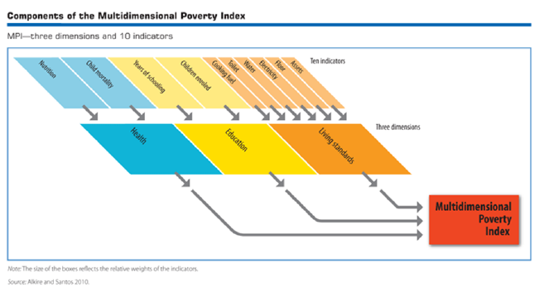
Multidimensional Poverty Index
Source: http://hdr.undp.org/en/statistics/mpi/
Notes:
The Multidimensional Poverty Index (MPI) identifies multiple deprivations at the individual level in health, education and standard of living. It uses micro data from household surveys, and—unlike the Inequality-adjusted Human Development Index—all the indicators needed to construct the measure must come from the same survey. Each person in a given household is classified as poor or nonpoor depending on the number of deprivations his or her household experiences. These data are then aggregated into the national measure of poverty.
The MPI reflects both the incidence of multidimensional deprivation, and its intensity—how many deprivations people experience at the same time. It can be used to create a comprehensive picture of people living in poverty, and permits comparisons both across countries, regions and the world and within countries by ethnic group, urban or rural location, as well as other key household and community characteristics. The MPI builds on recent advances in theory and data to present the first global measure of its kind, and offers a valuable complement to income-based poverty measures. The 2011 Human Development Report (HDR) presents estimates for 109 countries with a combined population of 5.5 billion (79% of the world total). About 1.7 billion people in the countries covered—a third of their entire population—lived in multidimensional poverty between 2000 and 2010.
The MPI replaced the HPI, which had been published since 1997. Pioneering in its day, the HPI used country averages to reflect aggregate deprivations in health, education, and standard of living. It could not identify specific individuals, households or larger groups of people as jointly deprived. The MPI addresses this shortcoming by capturing how many people experience overlapping deprivations (incidence) and how many deprivations they face on average (intensity). The MPI can be broken down by indicator to show how the composition of multidimensional poverty changes for different regions, ethnic groups and so on—with useful implications for policy.

Slide 24
Gross National Happiness, Bhutan
The concept implies that sustainable development should take a holistic approach towards notions of progress and give equal importance to non-economic aspects of wellbeing. The concept of GNH is composed of 9 domains, 33 indicators:
  living standards
  Health
  education
  psychological wellbeing
  time use
  cultural diversity and resilience
  good governance
  community vitality
  ecological diversity and resilience
Standard Domains
New Domains
Innovative Domains
Source: Centre for Bhutanese Studies
http://www.grossnationalhappiness.com/articles
Notes:
GNH offers a complementary but more holistic way of measuring development
Legal code of 1629 “ if the government cannot create happiness for its people, then there is no purpose for government to exist.”
4th King of Bhutan, 1972 “Gross National Happiness is more important than Gross National Product”.

Slide 25
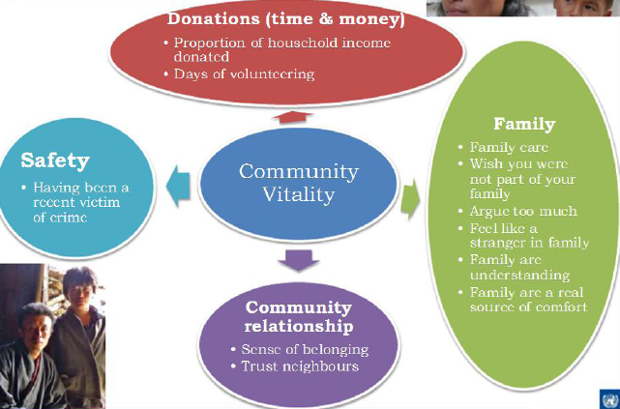
Source: Centre for Bhutanese Studies
http://www.grossnationalhappiness.com/articles/

Slide 26
Defining appropriate indicators
Step 1. Make sure we have a well-defined social objective
Step 2. Determine the key end users and the kinds of indicators they need.
Step 3. Based on 1 &2, prioritize the key factors and variables to be assessed. What is most relevant, most effective, and efficient to monitor these factors and variables?
See also Schreckenberg et al 2010. Social Assessment of Conservation Initiatives, Chapter 5
Notes:
Schreckenberg, K., Camargo, I., Withnall, K., Corrigan, C., Franks, P.,
Roe, D., Scherl, L. M. and Richardson, V. (2010) Social Assessment of Conservation
Initiatives: A review of rapid methodologies, Natural Resource Issues No. 22. IIED,
London.
Step 2: If the only users are local protected area managers and communities, indicators
can be very locally specific and defined in a highly participatory process.
If, however, the users include higher-level planners and government
officials, then there will be a need for at least some indicators that can
be easily and usefully aggregated to higher scales.

Slide 27
A good indicator is….
relevant (telling what you want to know, respond to the objectives, and generate data useful for decision-making)
direct
sensitive to changes/responsive to intervention in the project time
precise (defined the same way by different people)
reliable (consistent when measured repeatedly)
feasible and cost-effective to obtain
practical (easy to use, interpret and communicate)
Notes:
After this next slide would be a good place to insert my watershed conservation example of good indicators for ecosystem services. Of course, it could also fit after your following sequence of slides (14-20) although I think that delves quite a bit into specific discussions (definitions of livelihood and empowerment) that make it harder to reconnect back to slide 13 (“good indicators”). Whatever you think is best. I think I would need about 3-4 slides and 6 minutes for the watershed protection example.

Slide 28
How many indicator do we need?
Efficiency rule applies.
The smallest number of indicators that can generate the most needed data to help understand the extent to which the objectives are met.

Slide 29
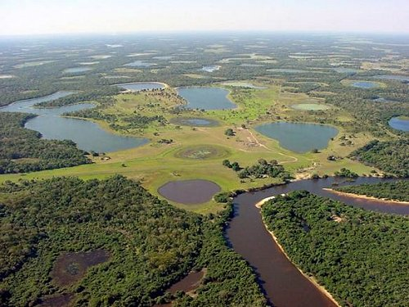
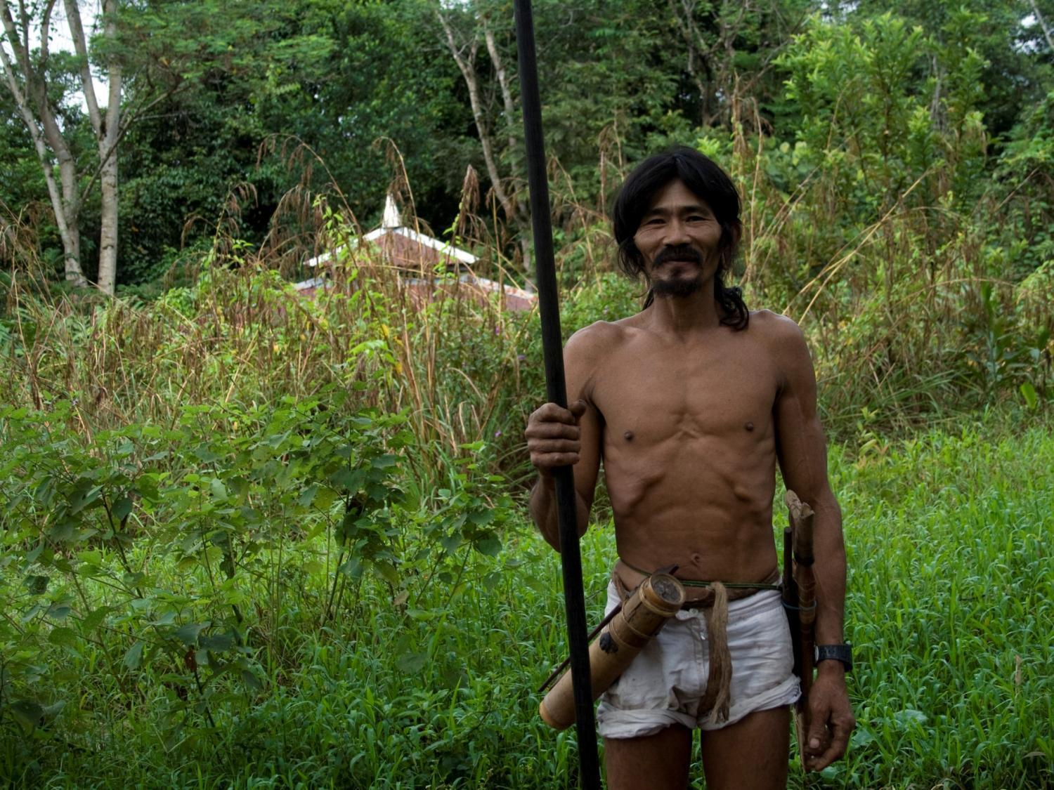
Examples of cases with social wellbeing indicators
Ecosystem Services
REDD+
REDD+

Slide 30
Social wellbeing indicators:
The case of ecosystem services
ES = “Outputs or activities of nature that benefit humans”
→ ES ≠ Ecosystem functions (= all flows of energy/matter in nature)
    water in a remote lake with no human uses
Notes:
Many definitions of ES have been proposed (best-known: Daily 1997; Daily et al. 1997; MEA 2003; National research Council, 2005; many others); while they differ in important aspects, the generally agree that ES are “things nature does that benefit humans.” The benefits to humans aspect is important, as it separates ES from ecosystem functions, or the flows between components of nature.

Slide 31
Overlaps (Double-counting)
MEA (2003)
Notes:
This rather broad definition is useful as it provides a broad overview of the many ways in which Nature supports human well-being.
However, for economic purposes - measuring and tracking ES over time, and valuing them - it is not ideal. Most importantly, it leads to
double-counting due to overlap among supporting, regulating and provisioning services. E.g.: primary production is an input to food, fiber, fuelwood provision; water regulation and purification are an input to fresh water provision.

Slide 32
Social wellbeing indicators:
The case of ecosystem services
ES = “Outputs or activities of nature that benefit humans”
→ ES ≠ Ecosystem functions (= all flows of energy/matter in nature)
    1 L of water in a remote lake with no human uses
FINAL ES = Components of nature that are directly enjoyed, consumed or otherwise used to yield human wellbeing
    Benefit-specific: 1 L of water available for drinking, irrigation, swimming etc.
Notes:
Perhaps the most useful definition of ES for economic analysis purposes is the one proposed by Boyd and Banzhaf (Resources for the Future). They define FINAL ES as…..
They also suggest defining ES in benefit-specific terms: for example, water provides many human uses: for drinking, swimming, fishing, irrigation, boating, scenic views, religious or spiritual purposes, habitat for particular species, hydropower etc.. To really account for the full suite of services a given water body provides, we need to differentiate these uses. This is important because – in general – a unit of a given ES has different value in different uses. Ex: 1 liter of water for drinking in general is more valuable than one L of water for irrigation.
Focus on final Vs. INTERMEDIATE ES: intermediate services (of course have value as they underpin final services; but their value is embedded (incorporated) in the value of the final services. Ex.: healthy populations of fish used by humans depend on good water quality. But to value the benefits humans get from those fish in the form of recreational angling for example, we need not worry about how much water quality contributes to that value - the value of that water quality for fish production is part of the value of the final ES in question – the fish. Of course, water quality in that same water body also has value for people who swim in that water or drink it, but those values of water quality are captured in the value of those particular uses (i.e., water for drinking, water for swimming).
Note : Directly is not the same as extractive or consumptive! E.g., existence values are direct benefits people receive from knowing certain species exist, without ever coming into contact with those species).

Slide 33
Why focus on final ES expressed in benefit-specific terms?
→tangible; →no double-counting; → facilitates comprehensiveness and valuation
Nitrogen concentrations in water used for drinking (fishing, swimming, boating)
Population size of a species used commercially (or for subsistence or recreation)
vs.
Nutrient cycling
Habitat provision
vs.
  Would most people understand how a change in these might affect their wellbeing?
Probably yes
Probably not
Notes:
Another reason for focusing on final ES is that – because these are the units directly related to people’s wellbeing, they are often intuitively understandable to people. This makes it much easier to assign economic values to changes in the provision of ES. Especially if we ask people directly how much they value a given change. After all, people do not value “nutrient cycling” per se; but they do value lower nutrient levels in particular water bodies.

Slide 34

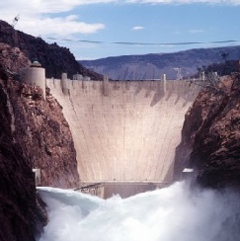
Service metrics must reflect spatial realities
(“A ton of sediment is not a ton of sediment”)
Benefit-specific (drinking water; irrigation water; …)
Location-specific (site of service demand)
  Ex.: sediment reduction for hydropower generation
Sediment reduction: 1 mt
Sediment reduction: 1 mt
Sediment reduction: 0.7 mt
Notes:
The functional change (reduced sediment input) upstream of the hydro facility in the watershed may result in an ecosystem service for the facility (i.e., directly benefit its performance, and thus directly benefit people) or not. To determine this, we need to know how much of this reduction makes it downstream to the actual site of service demand/delivery: the hydro power reservoir.
In this case, only 70% of the upstream reduction makes its way downstream to the user.
Two lessons: 1) upstream functional change (reduced sediment input) is not an appropriate indicator of service flow; 2) Final, benefit-specific definition of ES facilitates identification of more cost-effective sites for service provision and makes trade-offs explicit.
Reducing sediment below the wetland would have generated more benefits for hydropower

Slide 35
Social wellbeing indicators related to ecosystem services:
Some examples
Notes:
These indicators (benefit metrics) possess all or most of the characteristics of good indicators Supin just discussed:
sensitive to changes/responsive to intervention
telling what you want to know
relevant and useful to decision-making
precise (defined the same way by different people)
reliable (consistent when measured repeatedly)
feasible and cost-effective to obtain
easy to interpret
easily communicated to a target audience
Note that the intermediate ES listed in the last column tell which are the assets in nature that produce the respective target ES flows. These are the management targets if you want to affect service provision and resulting benefits.

Slide 36
Social wellbeing indicators related to ecosystem services:
Some examples

Slide 37
Social wellbeing indicators related to ecosystem services:
Some examples

Slide 38
REDD+ Working Indicators
https://connect.tnc.org/Conservation/priorities/GChallenges/Reducing%20the%20Impacts%20of%20Climate%20Change/Key%20Resources/Forms/Front%20page.aspx
CONNECT → Conservation→ Global Priorities & Effectiveness→ Global Challenges→Reducing the Impacts of Climate Change→Key Resources→ REDD Social Objectives Presentation_S.Wongbusarakum
Social Scinece and Conservation in Gateway

Slide 39
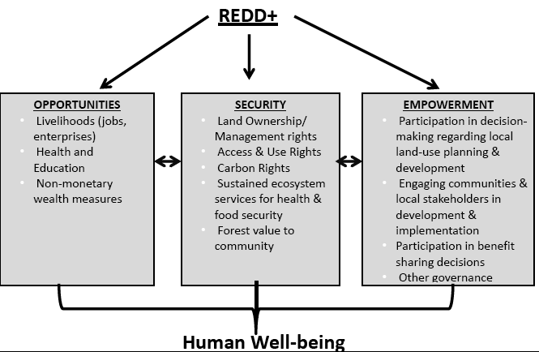
The case of REDD+

Slide 40
Livelihood
Livelihood is the level of household engagement in strategies and activities that support subsistence and generate income.

Slide 41
Livelihood Indicators
Income (extent to which a household is able to meet consumption needs or to save)
Proportion of household income sources (forest and non-forest related)
Proportion of household subsisting activities (forest and non-forest resources)
Proportion of household with ownership/possession of assets needed to pursue livelihood options
Proportion of households with alternative livelihoods
Proportion of households with supplementary livelihoods
Level of sustainability of livelihoods
Level of commercial viability of livelihoods
Level of institutional support on livelihoods
Level of satisfaction on alternative livelihoods

Slide 42
Empowerment Indicators
Empowerment is a process through which people are able to take more control over their own life and secure better livelihood.
(Chambers 1983. Putting the Last First)
Level of local involvement in the REDD+ project design
Level of local involvement in the REDD+ project implementation
Level of local involvement in forest management and governance
Degree to which the community members feel that they are able to impact change.
Proportion of forest management initiatives coming from local community members

Slide 43
Areas of process-oriented indicators
Indicators to assess the processes or actions taken to achieve objectives and move toward outcomes.
Project staff’s understanding of local context (communities and their relationship to forest)
Stakeholder involvement
Stakeholder consent
Effectiveness of strategies
Ethical practice
Social and cultural appropriateness
Accountability
Equity
Efficiency
Transparency

Slide 44

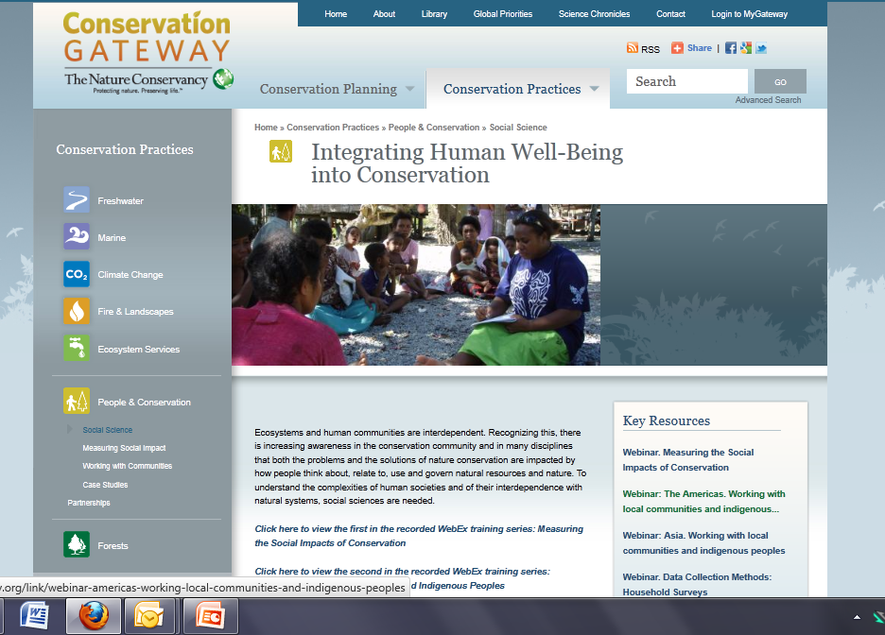
www.ConservationGateway.org +
+ Social Science

