Slide 1
Developing Strategy Effectiveness Measures
Conservation Strategies & Learning Team
April 12, 2012

Slide 2
Topics
Using Results Chains as a tool for strategy effectiveness measures
Indicator selection
Level of monitoring investment

Slide 3
Results Chains - Basics
The Basic Components of a Results Chain:

Slide 4
Results Chains - Basics
Implicit Assumptions:

Slide 5
What is a Results Chain?
Results Chains - Basics
Is a diagram of a series of “if…then” statements (“causal”)
Defines how we think a project strategy or activity is going to contribute to achieving desired results
Focuses on the achievement of results – not the execution of activities
Is composed of assumptions that can be tested

Slide 6
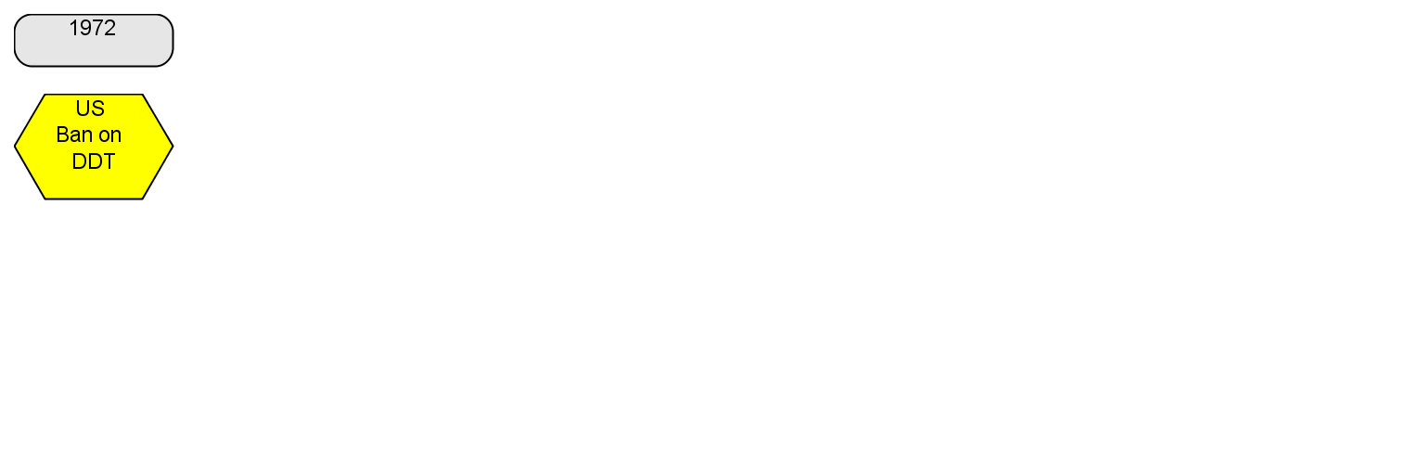
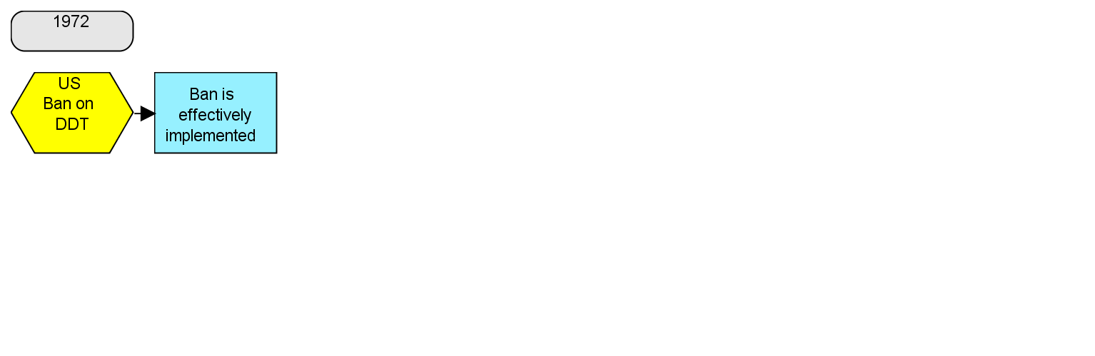
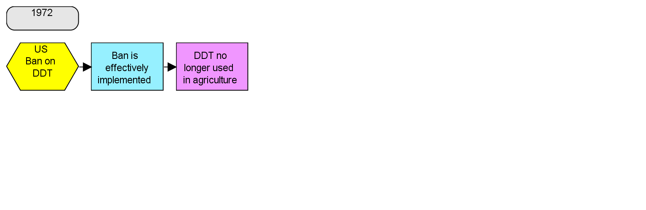
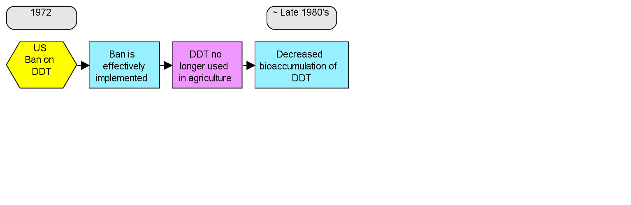
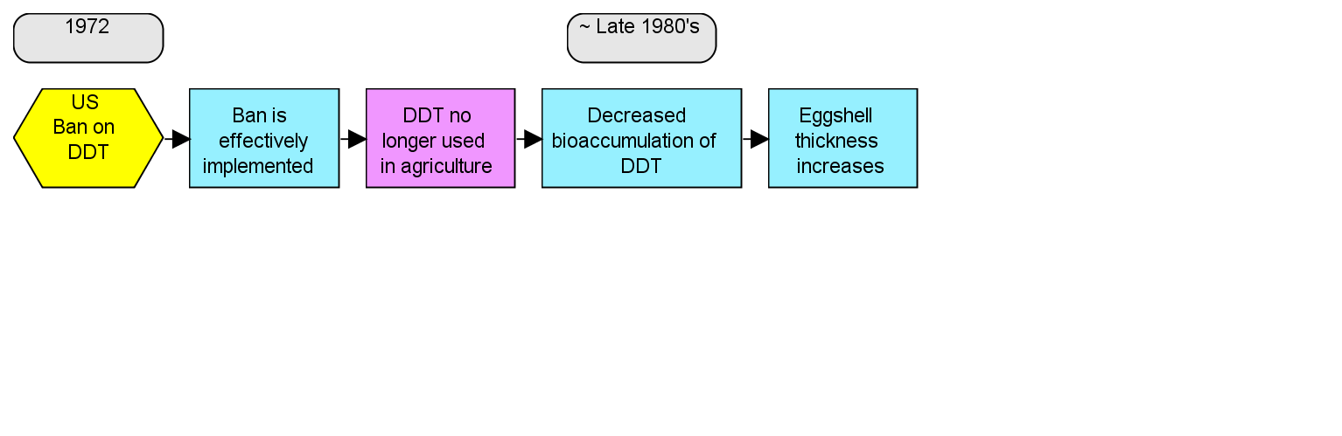
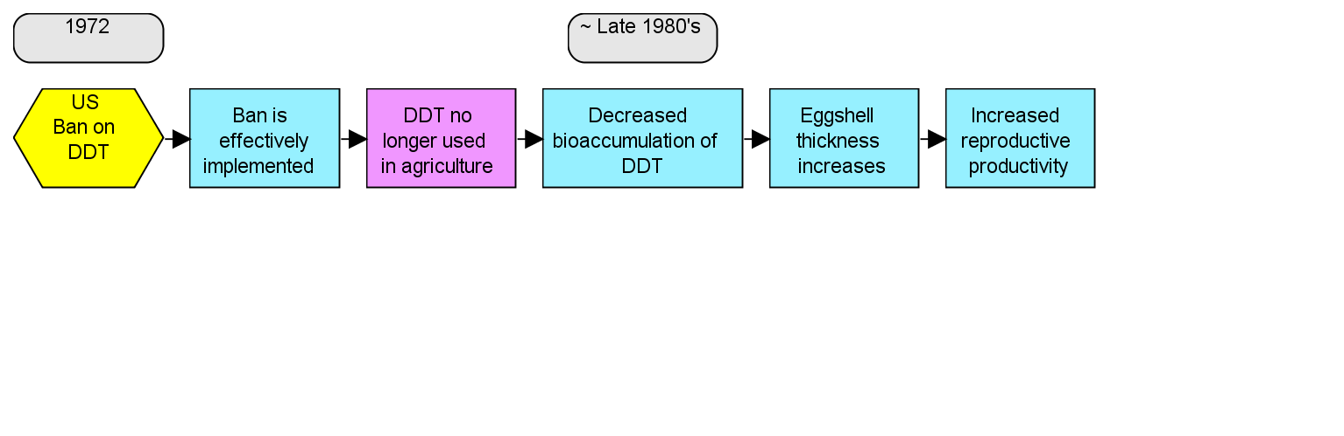
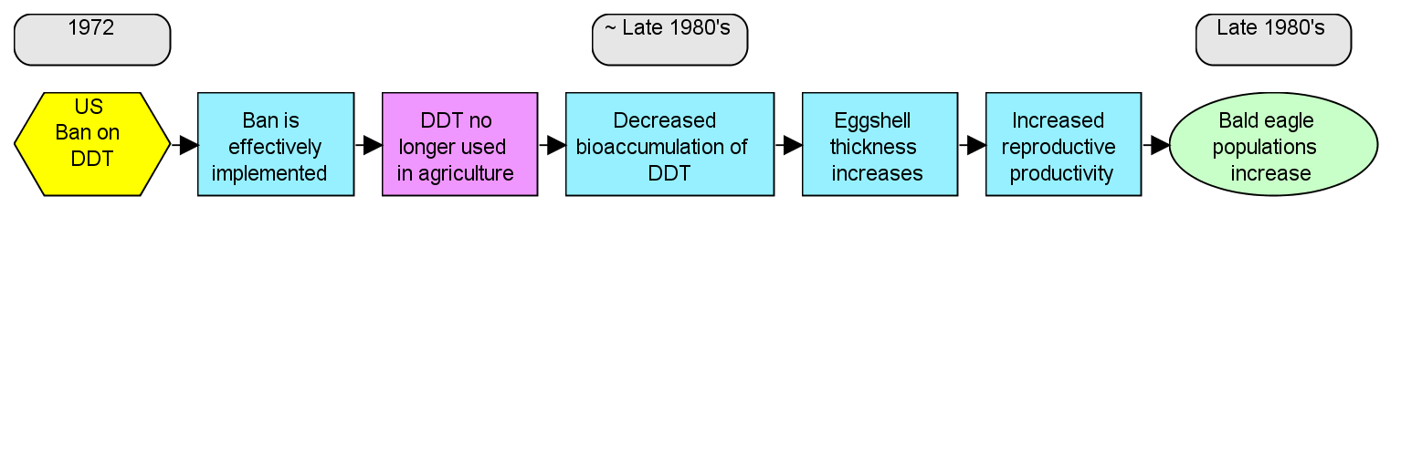
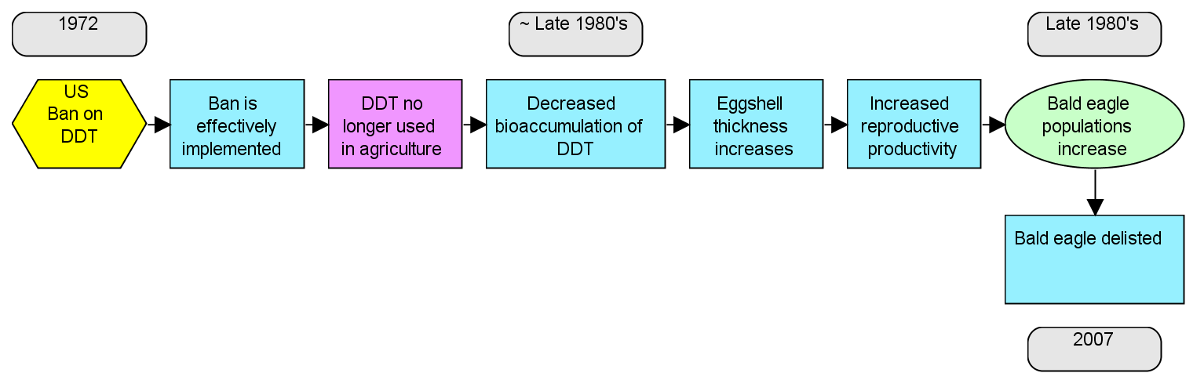
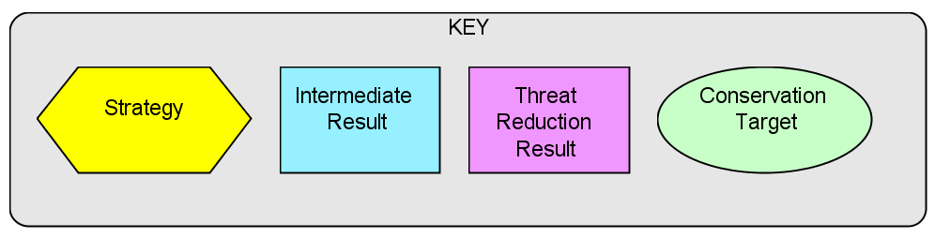
DDT Bald Eagle Example

Slide 7
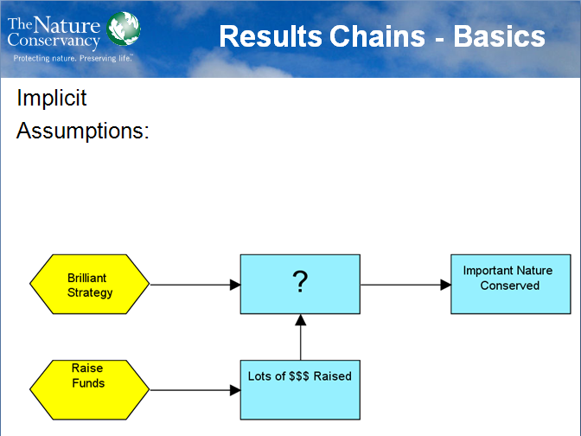
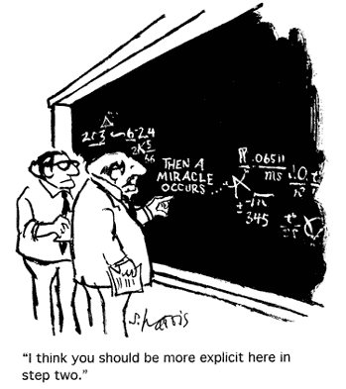
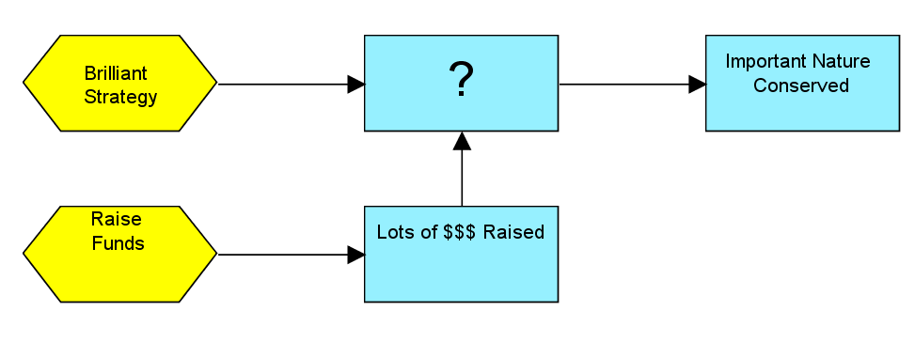
Results Chains - Basics
Implicit
Assumptions:
Notes:
Facilitates peer review – uncover leaps of logic

Slide 8
Characteristics of Good Results Chains
Results oriented
Connected in a “causal” manner
Demonstrate changes
Relatively complete
One result per box
Notes:
Results oriented: Boxes contain desired results (e.g., reduction of hunting), and not activities (e.g., conduct a study).
Connected in a “causal” manner: There are clear connections of “if…then” statements between each pair of boxes.
Demonstrate changes: Each box describes how you hope the relevant factor will change (e.g.,increase or decrease).
Relatively complete: There are sufficient boxes to construct logical connections but not so many that the chain becomes overly complex.
Simple: There is only one result per box.

Slide 9
Conceptual Model vs. Results Chain
Results Chains - Basics
Conceptual Model (i.e., Situation Analysis)
  Show the situation today
  Identify strategies
Results Chains:
  Shows the desired future condition
  Start with selected strategies → show desired results

Slide 10
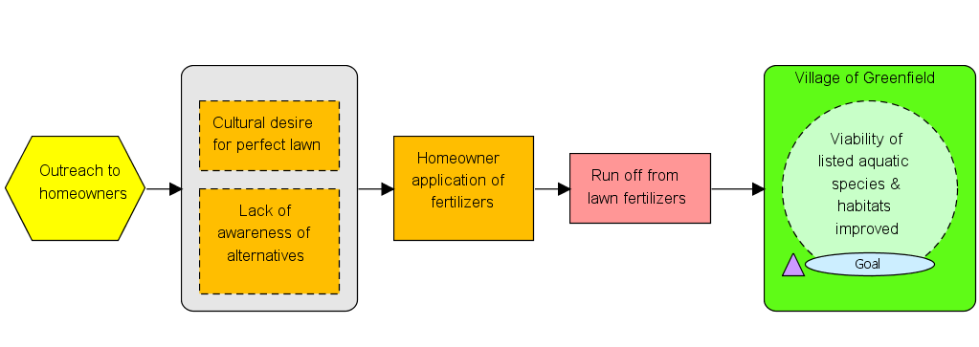
Outreach & Education to Reduce Fertilizer Impacts
Conceptual Model

Slide 11
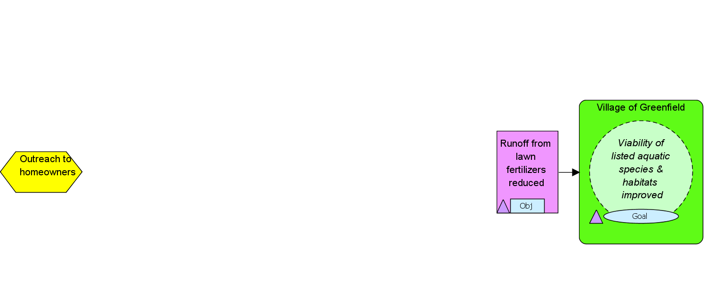
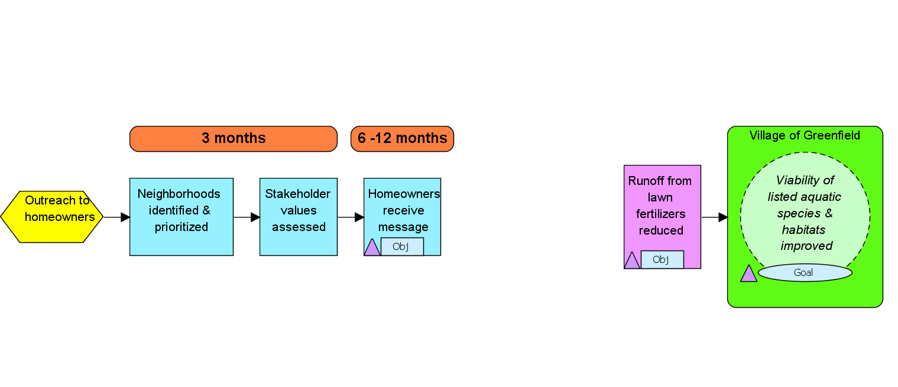
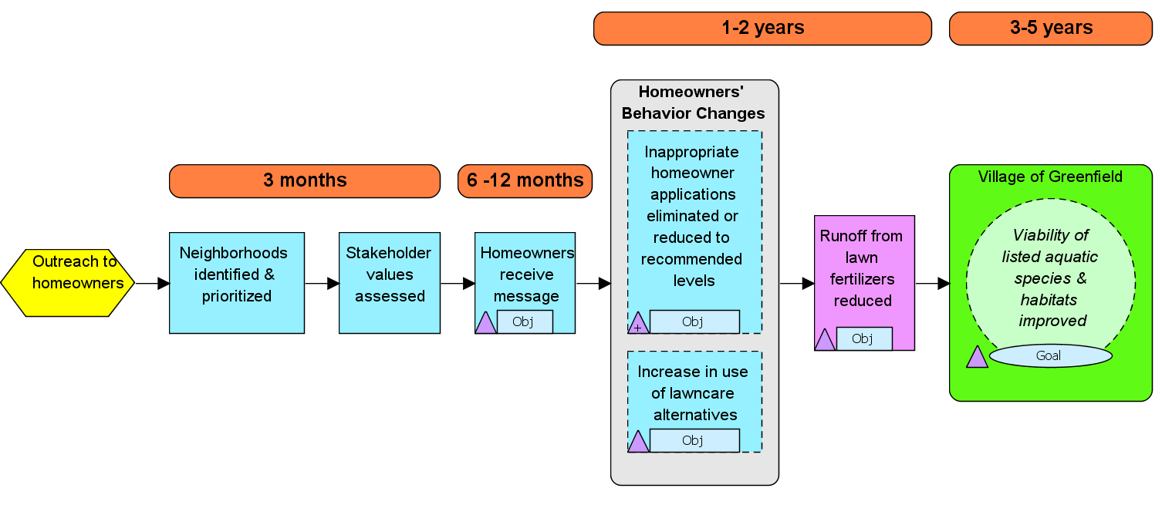
Outreach & Education to Reduce Fertilizer Impacts
A
B
C
D
E
Which link has the biggest “leap of faith”?

Slide 12
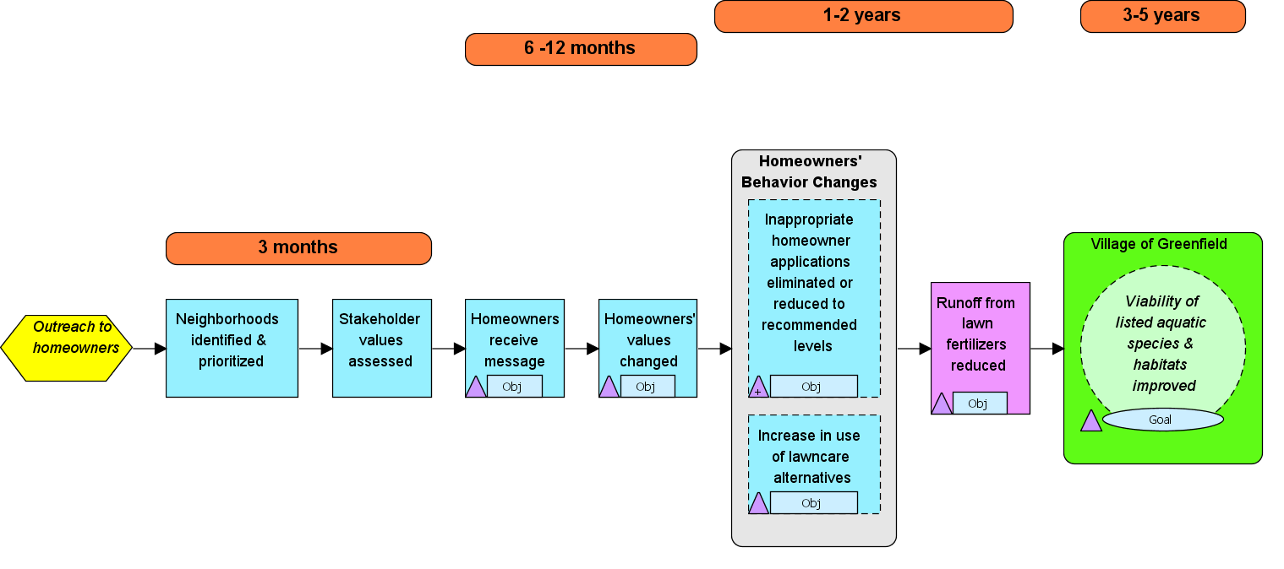
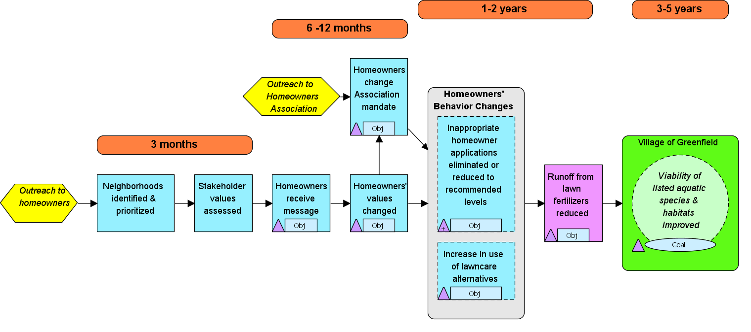

Slide 13
Results Chains serve as a framework for strategy effectiveness measures
Framework for Measures
Indicators
Objectives
Notes:
Start by showing you examples where indicators have been added to results chains.
Then I’ll show you some examples that contain a combination of objectives at specific locations along with measures indicators

Slide 14
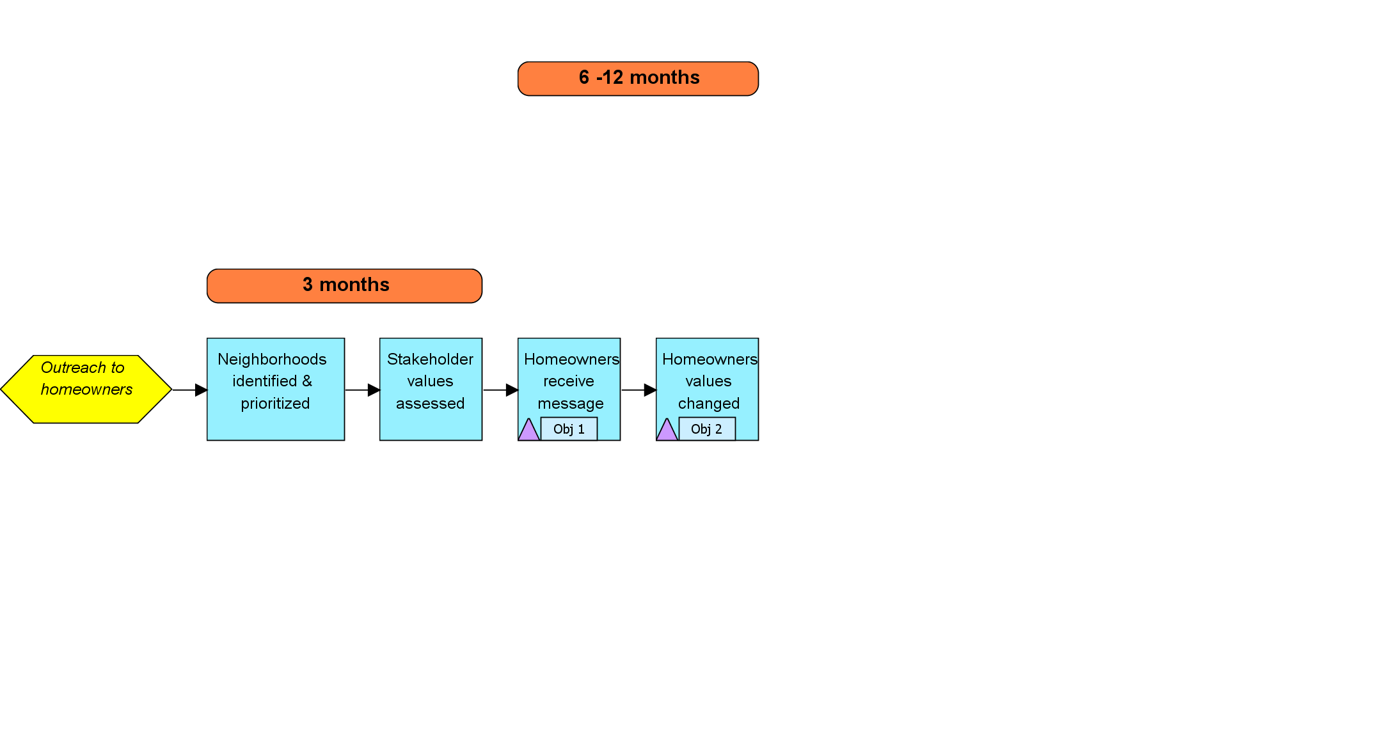
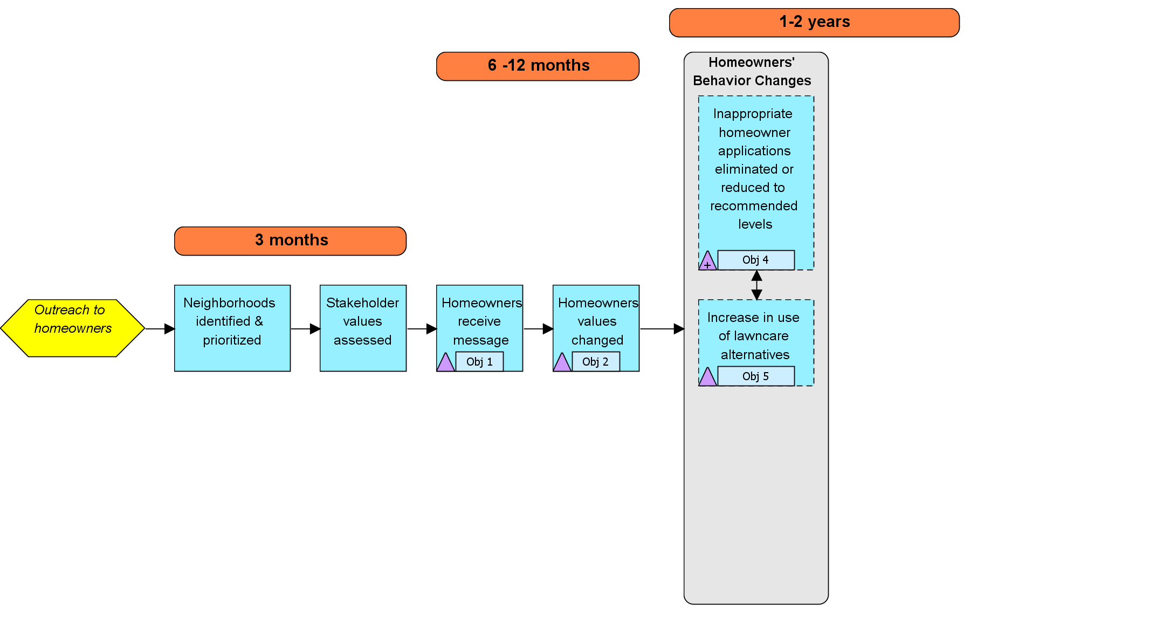
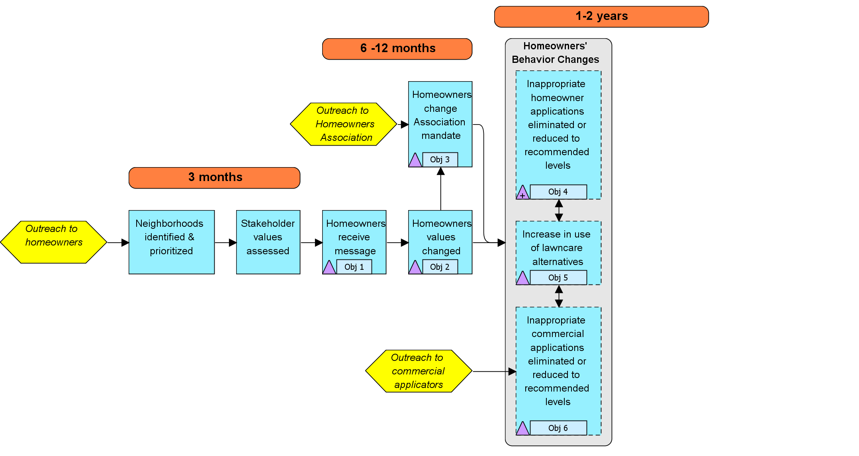
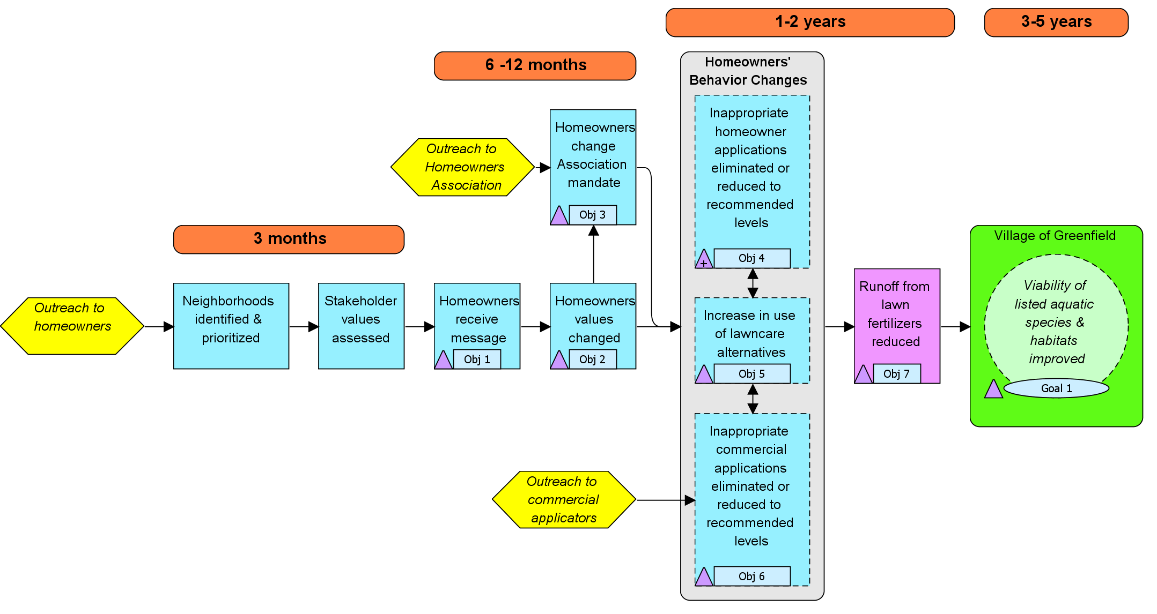
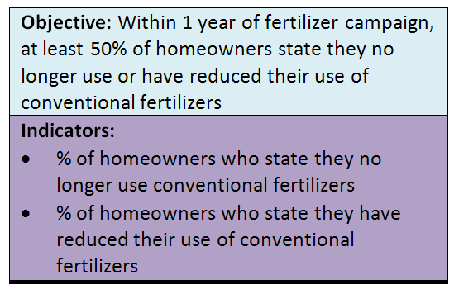
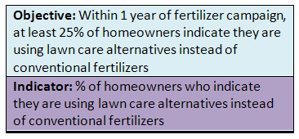
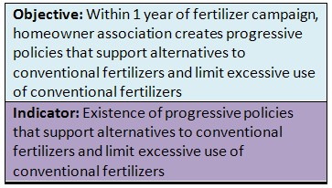
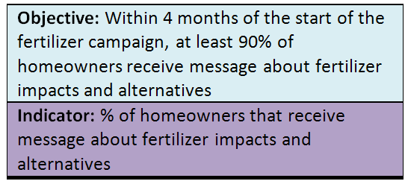
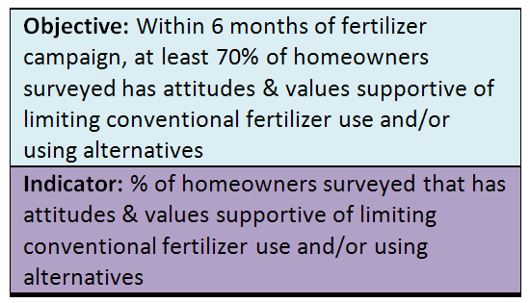
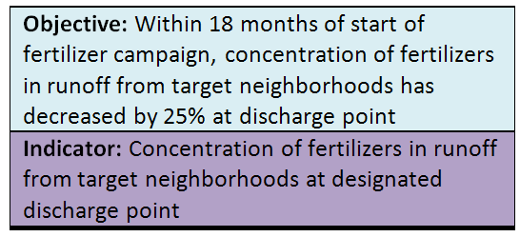
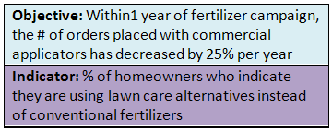
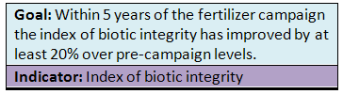
Theory of Change Example – Reducing Fertilizer Impact
Results Chain
Outreach & Education Strategies

Slide 15
What is NOT a Results Chain?
It is not an implementation flow diagram…
Notes:
In comparison, what is NOT a results chain? It is not an implementation flow diagram.
An implementation flow diagram might look like this:
I'm going to implement a media campaign. First, I'm going to implement a media campaign. So, first I’m going to identify my target audience, then I'm going to produce educational materials, then I'm going to distribute educational materials. This is a series of activities. If you try to read this chain in an if=then manner, you will see there are not causal linkages between the boxes. For example, if I identify my target audience, then I will produce educational materials? No, this is not a direct causal result of identifying my target audience.
Reading your chain as a series of if-then relationships is a good way to make sure that components of your results chain are not an implementation chain. This is a very common mistake.

Slide 16
Which of the Following is NOT a Results Chain?
Your turn…
Notes:
Now, it’s your turn to determine which of these three chains does not meet the criteria for good results chains. Please look at these chains and then select one of the following responses. Be sure to click the “submit” button when you are done.
CORRECT ANSWER: Chain A is not a results chain. It mixes implementation steps with results. For the most part, it shows a series of activities the team will do. These activities, or implementation steps, include: identify key decision makers, educate decision makers, and research and develop regulations. The chain does include a few boxes that are more results-oriented. These include: decision makers pass laws, no wildlife trade, and jaguar populations increased.

Slide 17
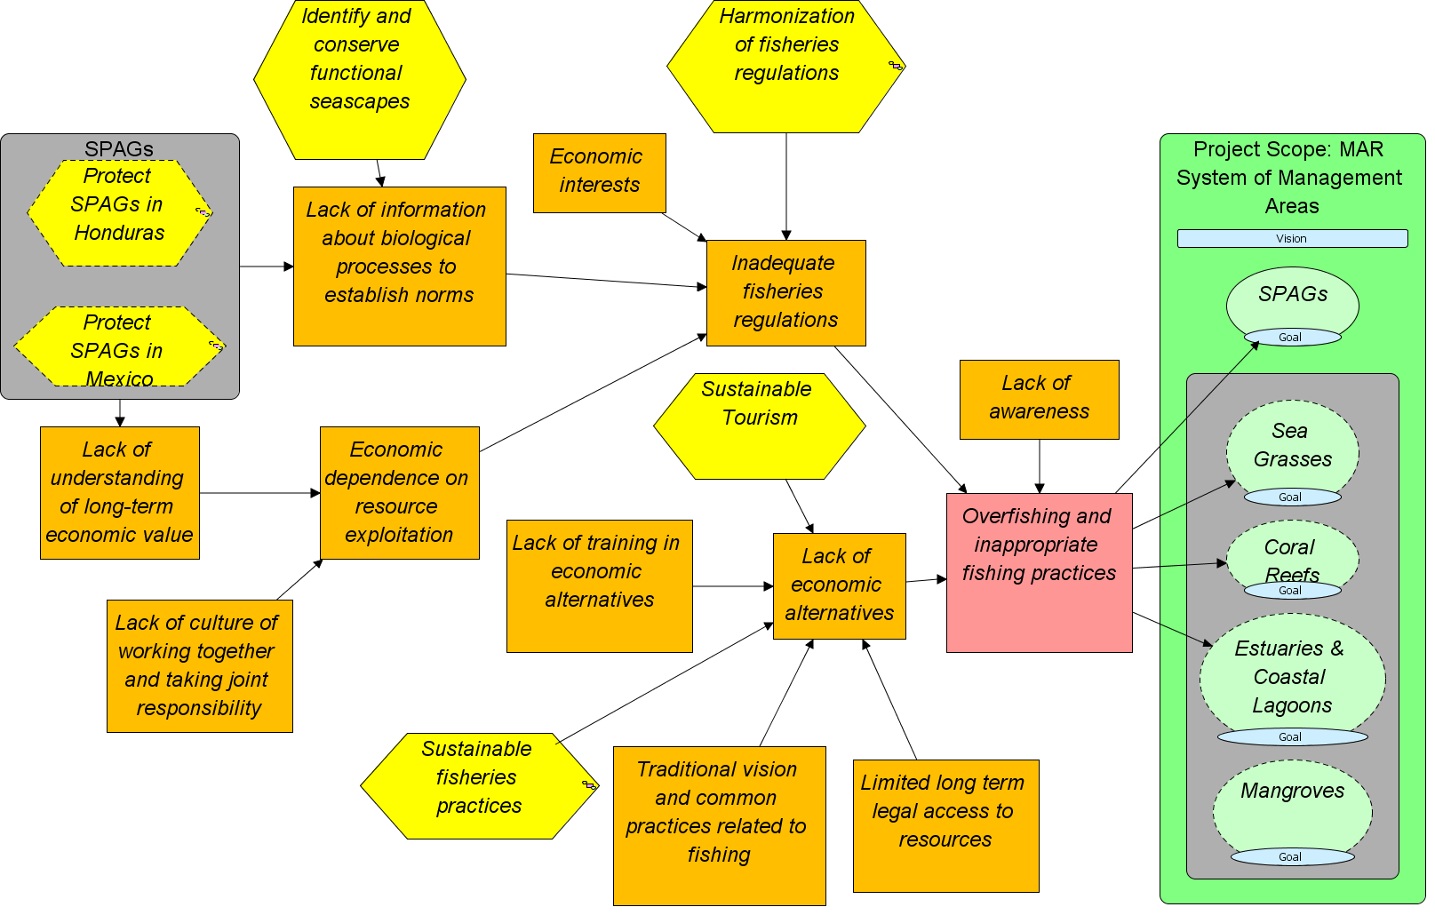
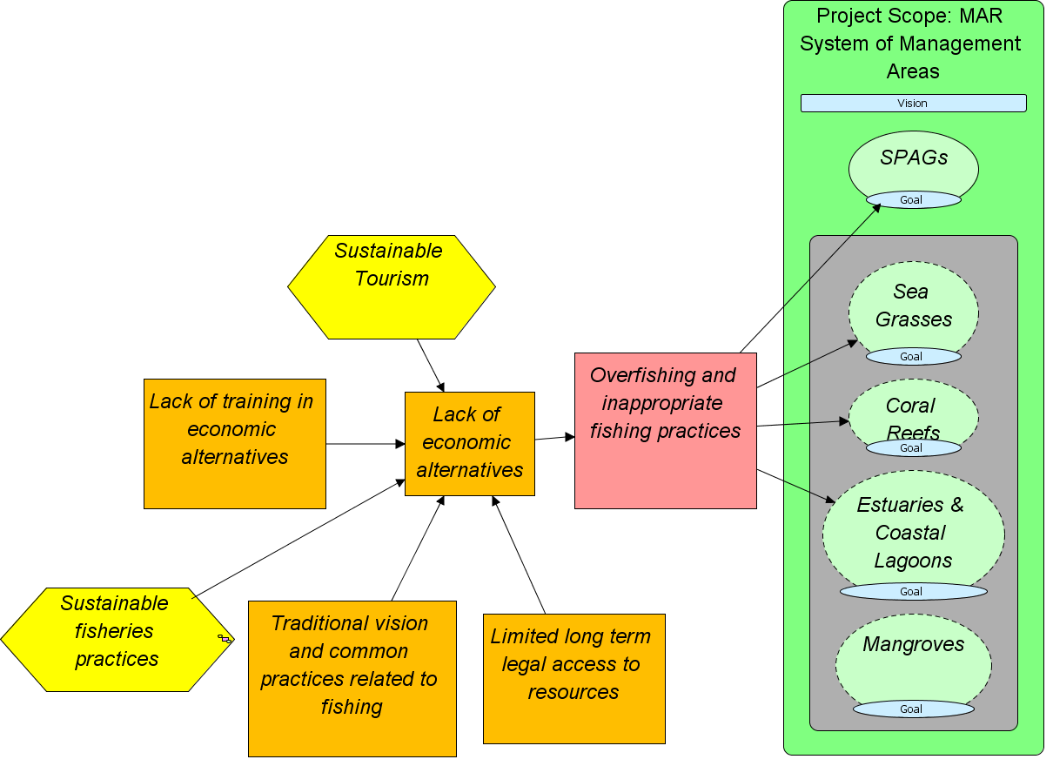
Examples of Conceptual Model and Results Chains
MAR Fisheries Conceptual Model

Slide 18
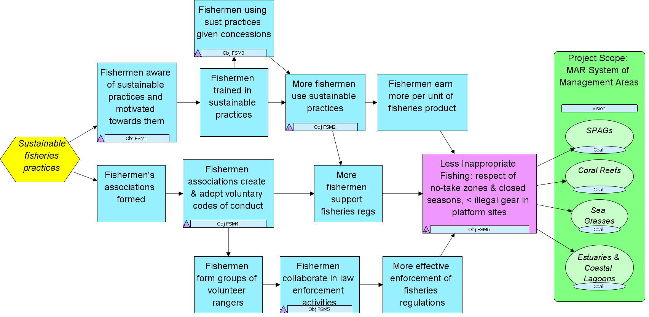
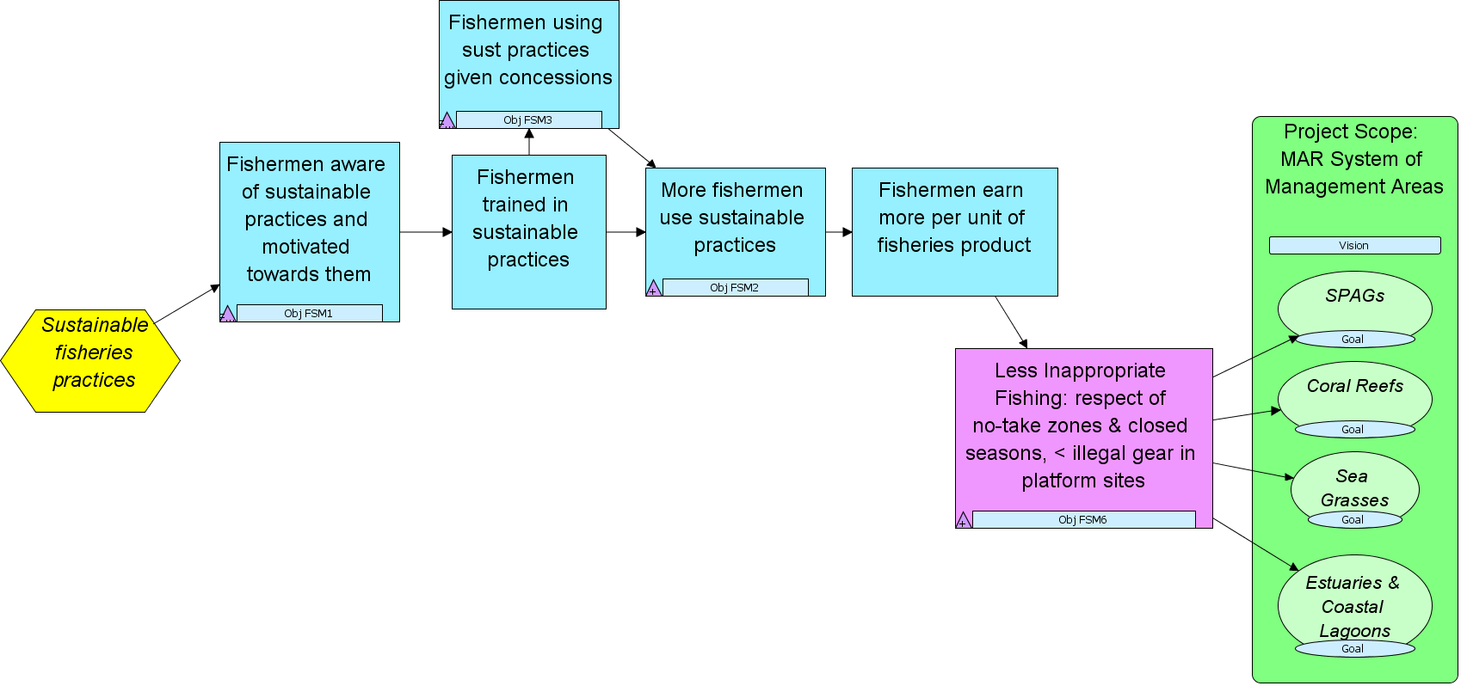
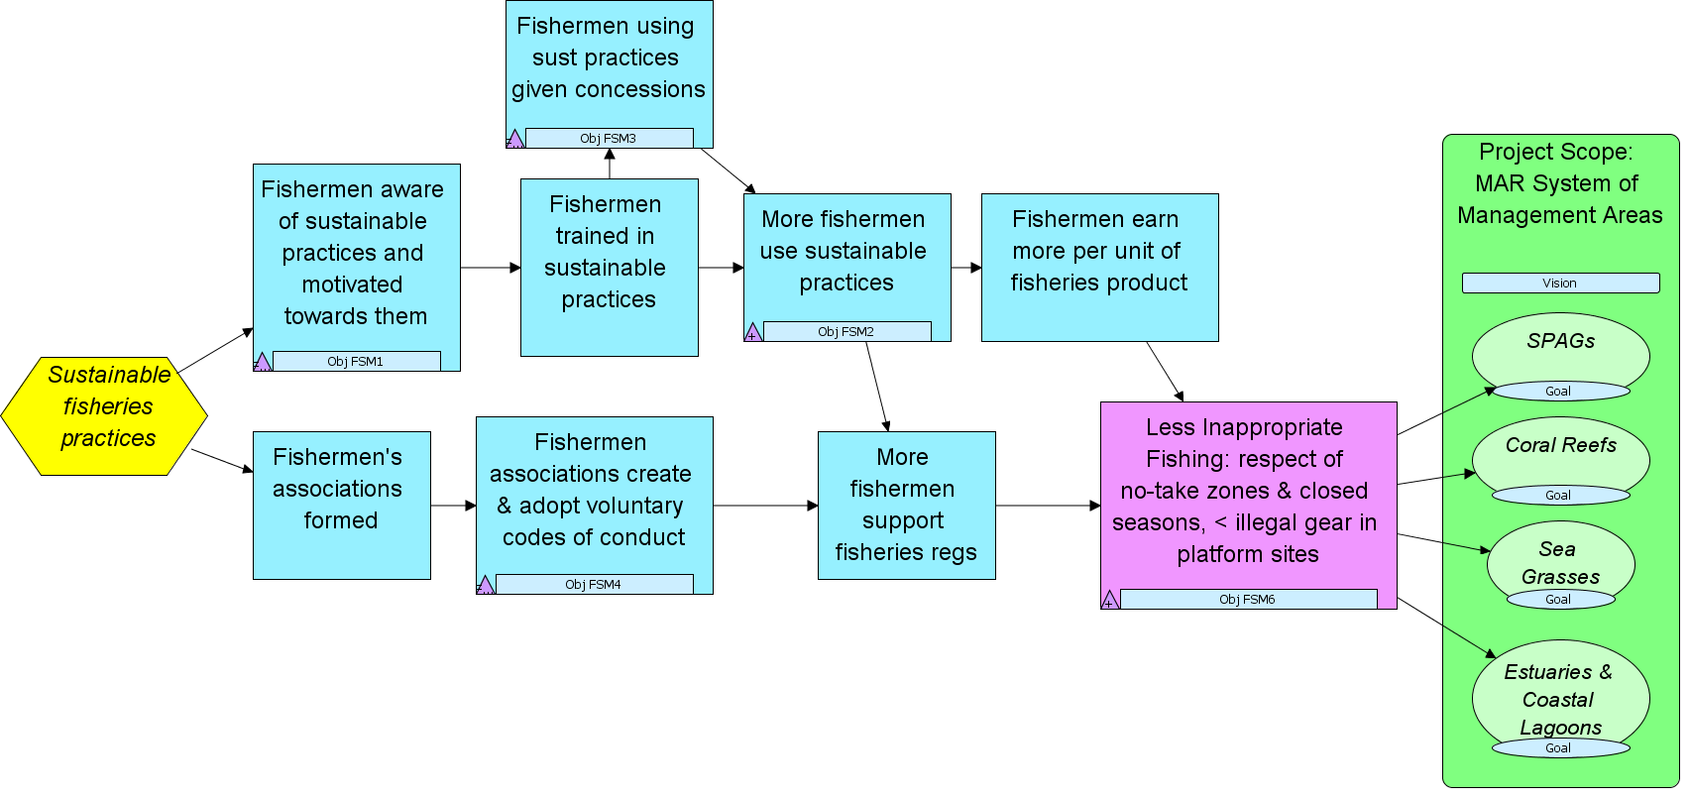
Mesoamerican Reef Fisheries Results Chain
Objective FSM3: By 2012 there is at least one concession given to fishermen in Honduras using sustainable practices to have exclusive fishing rights to some species / areas in the priority sites.
Indicator FSM3-I1:# of concession agreement drafts prepared and approved by government and the fishermen of the priority sites
Objective FSM2: By 2012 30% of the fishermen in the relevant priority sites are aware of and capable of using the sustainable fishing practices identified in FSM1.
Indicators: FSM2-I1: % of fishermen aware of sustainable fishing practices; FSM2-l2: % of priority sites fishermen trained in sustainable fishing practices
Goal: By 2018, all validated and ecologically functional SPAG sites will maintain the conditions necessary to preserve the species (composition, abundance, proportion of sexes) documented during validation.
Indicators: (1) # of species that aggregate in specific periods; (2) # of individuals of each species during the peak of the aggregation period;
Goal: By 2018, more than 25% of all coral reef habitat types in the MAR are effectively conserved.*
Indicators: (1) Abundance of herbivore species; (2) Abundance of surgeon fish and parrot fish
* Working definition of effective conservation exists with multiple components
Objective FSM6: By 2018, at least 80 % of the fishermen in 8 MAR Program priority sites comply with all fishing regulations (no-take zones, closed seasons, gear.
Indicator FSM6-I1: # of infractions; & FSM6-I2: # of law enforcement actions (warnings, fines, confiscation, jail)
Objective FSM1: By 2011, at least 4 sustainable fisheries practices are identified that could be applied in and around priority sites.
Indicator FSM1-I1: # of sustainable fisheries products identified around priority sites for which there is demand
Intermediate Results
Ultimate Outcomes
Objective FSM5: By 2017, fishermen are collaborating actively in law enforcement activities in 6 priority sites.
Indicator FSM5-I1: # of law enforcement activities (patrolling, reports of infractions) where participation of fishermen is documented

Slide 19
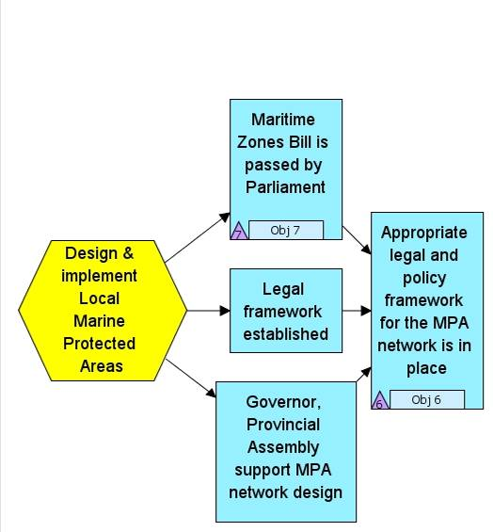
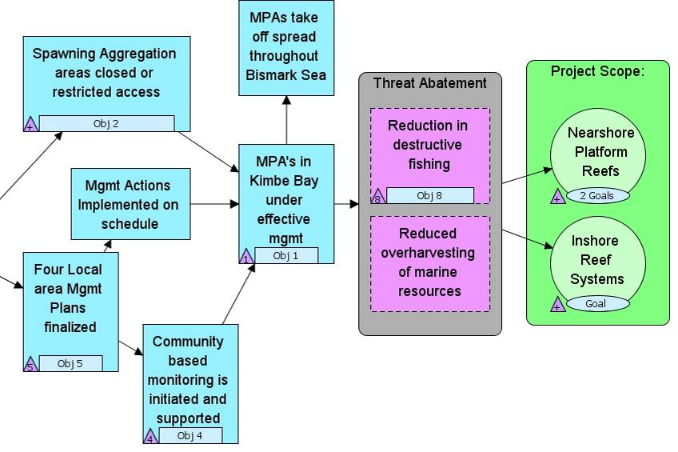
Managing Conservation Projects
Results Chain with Strategy, Objectives, Indicators
Kimbe Bay
Ultimate Outcomes
Intermediate Results
Objective: By FY09, Section 38 of the Maritime Zones bill is expanded to establish marine protected areas
Indicator: Bill passed/failed
Objective: By FY 12, live coral cover of reef systems increased to over 50%
Indicator: % cover live coral
Objective: By FY10, design and legally secure a functionally-connected network of LMMAs and MPAs in Kimbe Bay covering 250,000 ha.
Indicator: Area (ha) designated as LMMA
Objective: By FY12, 4 active spawning aggregation sites closed or with restricted fishing practices
Indicator: # of SPAGs closed to fishing
Objective: By FY17, 250,000 ha of LLMA's under effective management in Kimbe Bay
Indicator: ha with acceptable Mgmt Effectiveness Scores

Slide 20
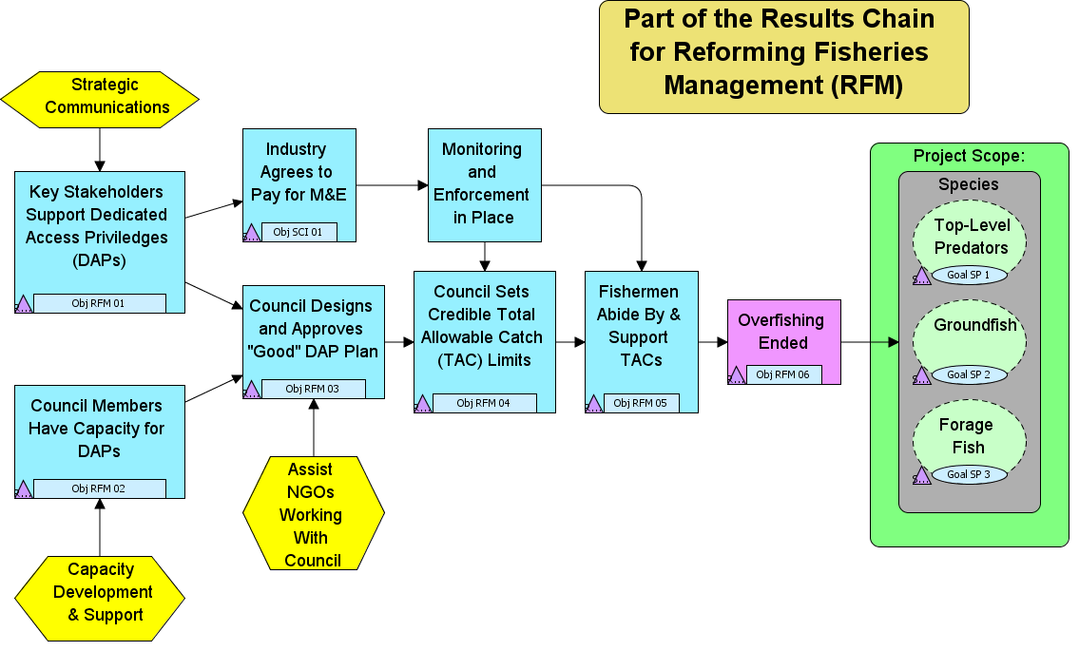
Objective: By the end of 2009, Council staff have the knowledge and capacity to implement a pilot test of DAPs.
Indicator: Assessment of Capacity of Council
Objective: By the end of 2009, the council approves a "good" DAP plan. Criteria include: 1. Comprehensiveness; 2. Minimal Proccessor Quota; 3. Adaptive Management Trust; 4. Gear Switching Provisions
Indicator: Quality of DAP Plan Approved (specific criteria established)
Objective: By 2010, the council has set Total Allowable Catch (TAC) limits for each stock that are within scientifically credible "sustainable" limits.
Indicator: # of Stocks with Credible Catch Limits
Objective: By 2012, there are no more than 10 incidences per year of fishermen violating the TAC Limits.
Indicator: # of Incidences of TAC Violations
Objective: After 2012, all 37 fish stocks in the Ecoregion are fished at levels consistent with an ecolocially sustainable harvest.
Indicator: # of Fish Stocks at Sustainable Limit
Goal: By 2015, have at least 5.0 groundfish per hour from average party boat CPUE measurements.
Indicator: CPUE Levels for Groundfish
Intermediate Results
Ultimate Outcomes

Slide 21
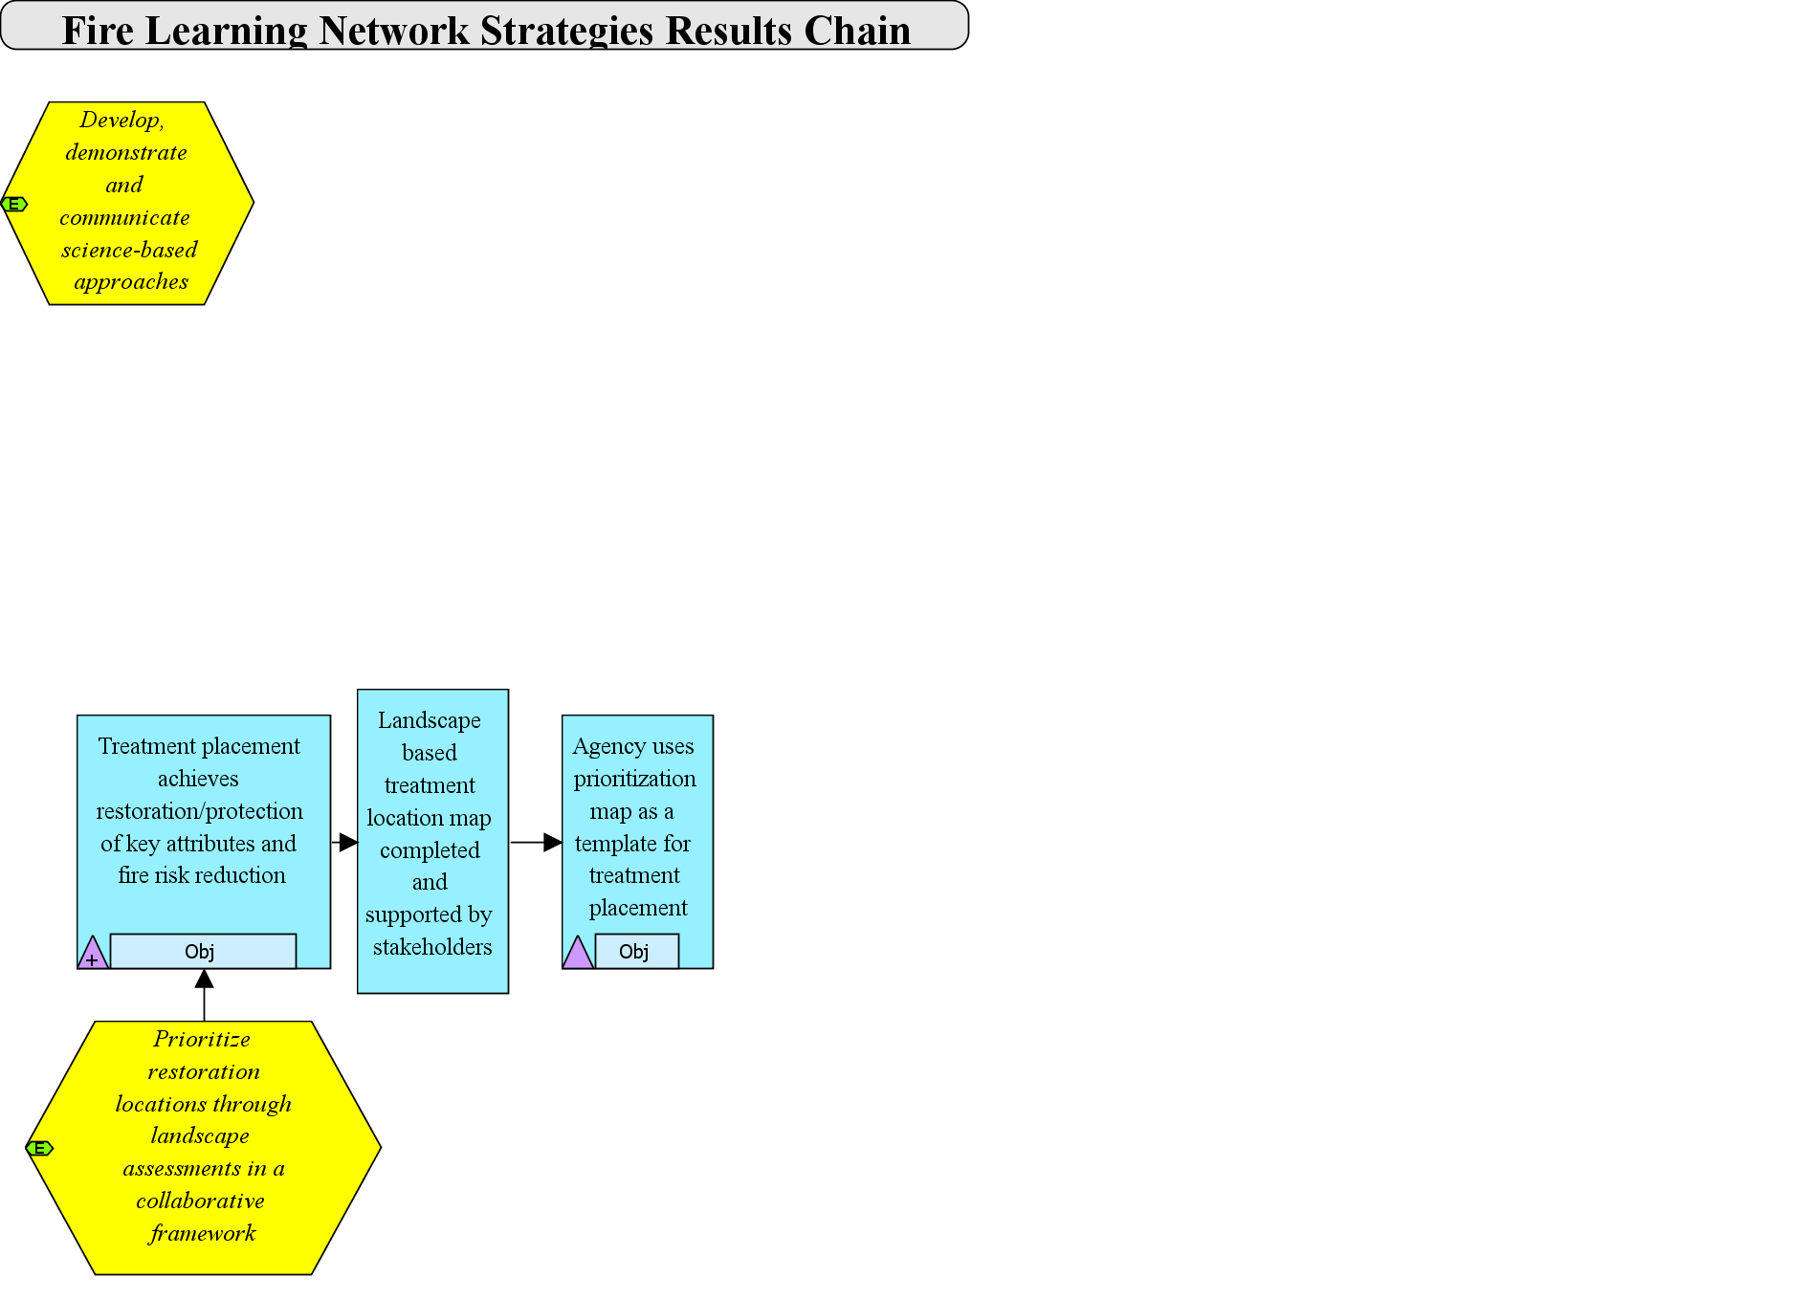
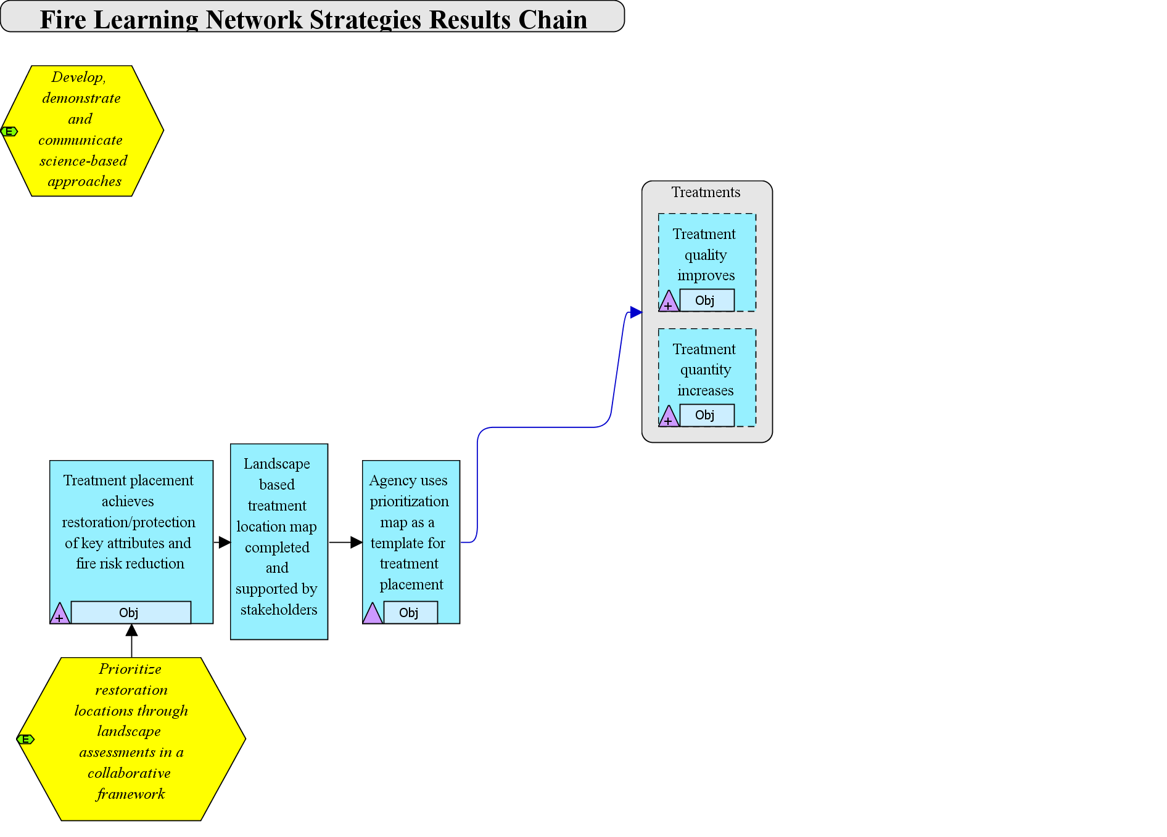
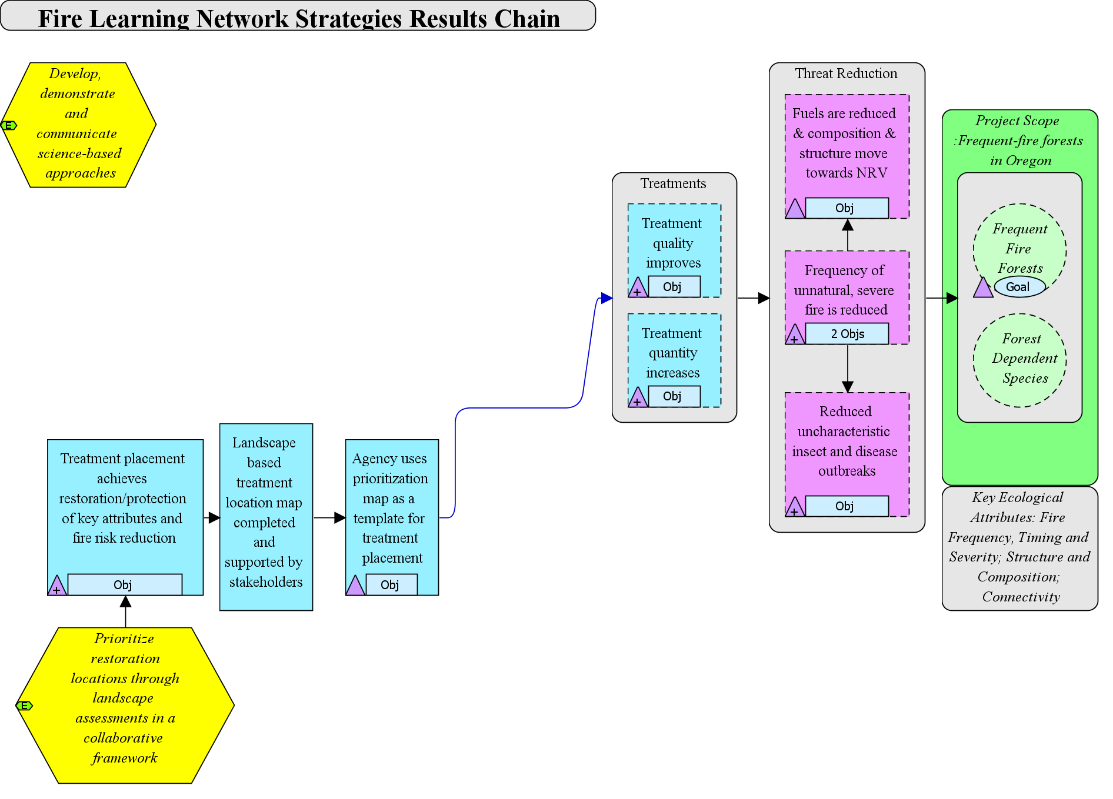
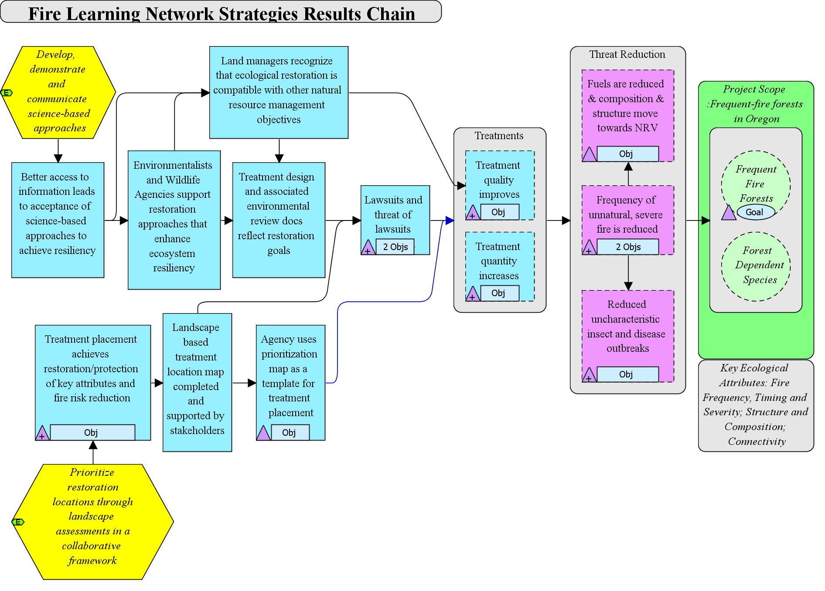
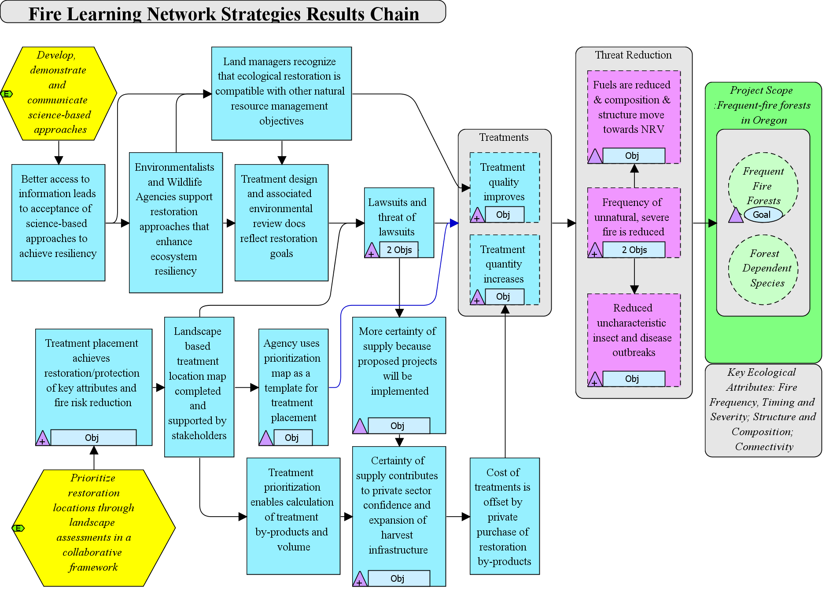

Fire Learning Network – Central Oregon
Objective: # of NEPA approved projects increases by a third by 2020.
Indicator: # of NEPA approved projects
Objective: # of acres treated increases by 30% by 2015
Indicator: # of acres treated
Objective: 75% Reduction in acres of severe fire and/or unnatural mortality due to insects and disease by 2030
Indicator: # acres of severe fire and/or unnatural mortality
Goal: 20-30% of Frequent Fire forests on public are in Condition Class I.
Indicator: % Departure from NRV
Objective: By 2020 the percent of restoration projects appealed reduced to 25%.
Indicator: # of appeals/# of projects
Intermediate Results
Ultimate Outcomes

Slide 22
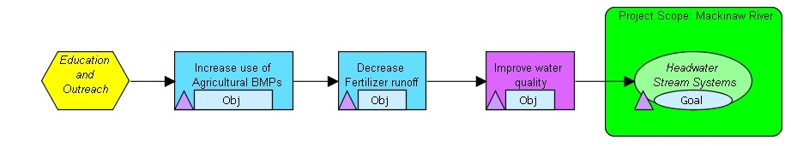

Mackinaw River – paired watershed study
Intermediate Results
Ultimate Outcomes
No detectable improvement in water quality or conservation targets in treated watershed as compared to the control.
Results demonstrate increased use of Best Management Practices in the treated watershed as compared to the control
Notes:
Here we see the same results chain with objectives and indicators illustrated.
They gathered information to show that they reached more farmers in their outreach program than were reached in the control watershed, and these farmers in turn adopted more ag BMPs than the farmers that were not contacted via the outreach program
CLICK1 – Here you see data from three of the indicators – each one an agricultural best management practice. The blue lines are the treatment watershed where the outreach program was directed, the red lines are from the control watershed where there was no outreach program. The middle figure shows the amount of land put into one type of Ag BMP – filter strips. These filter strips are supposed to intercept surface runoff, and reduce the amount of soil and excess fertilizer running into the stream.
This far into the results chain, this strategy iwas achieving its desired results – for all three BMPs.
CLICK2 – Fade out
CLICK3 – They also tracked changes in water quality. In this case, you see graphs of nitrogen concentrations, from the upper and lower sections of the subwatersheds, and there was no significant difference between the two subwatersheds.
CLICK4 - As for the conservation targets – there was also no change. These two graphs track mussel richness and abundance over time. Information was collected on other biota – like macroinvertebrate insects and fish – and they revealed no difference as well.
In both cases, for threat reduction and improving the status of the targets, they did not find that the Ag BMPs were enough to achieve the desired results. So what did this mean? How could they use this information to improve their conservation efforts?

Slide 23
Indicator Selection
Focus on indicators that will help to evaluate strategy effectiveness
Include indicators for both shorter-term intermediate results and longer-term ultimate outcome (target/threat abatement) results
Include the minimum necessary (# & effort)
Don’t invest in monitoring that you never intend to act on

Slide 24
General Guidance
Test key assumptions behind strategies
Invest more when uncertainty / assumptions and risk are high
Low effort monitoring when confident about outcome to ensure that known relationships still hold
Monitor selected intermediate results and target response
Scale of indicator and monitoring need to be at scale of strategy
Seek easy, inexpensive monitoring methods

Slide 25
Tips to reduce monitoring costs
Consider low-cost, qualitative options rather than no monitoring
Consider less frequent monitoring rather than no monitoring
Use partner data whenever possible
Consider combining qualitative with quantitative monitoring
Engage local people & volunteers in monitoring efforts

Slide 26
Selecting Indicators & Methods
We need to invest the “right” amount of effort in measuring the “right” things
What is “right”?
It depends…

Slide 27
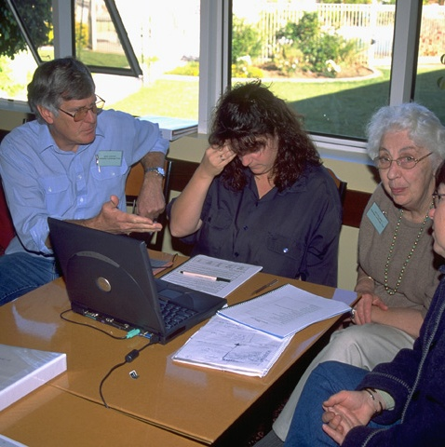
Zero is never enough
Even a tried-and-true strategy must:
Track the budget
Make a work plan
Check off activities
Discuss progress
with key audiences

Slide 28
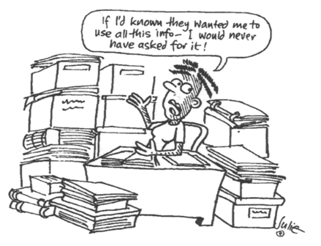
“Everything” is never right
Data
kleptomania

Slide 29
Avoiding data kleptomania
Select the fewest indicators needed for:
Strategy evaluation: select only those that answer your question(s)
Managing risk and uncertainty
Invest based on how“good” your answer needs to be.
Risk
Leverage
Your audiences

Slide 30
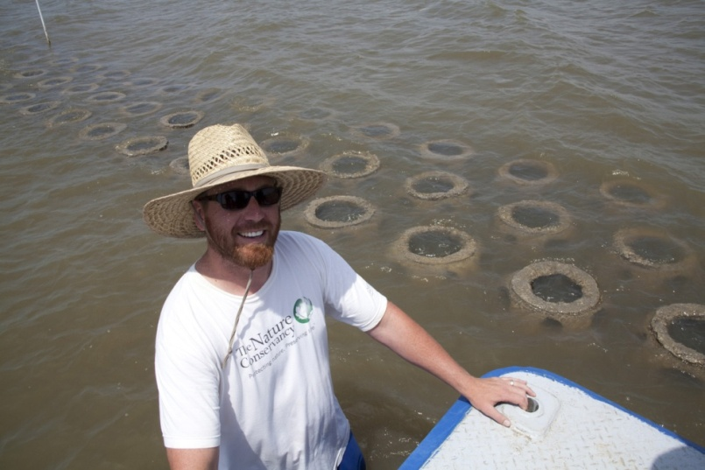
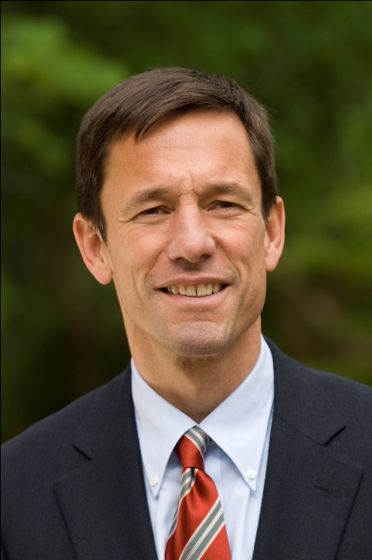

Internal Audiences
You
Your project team
Senior managers
Boards
Donors

Slide 31
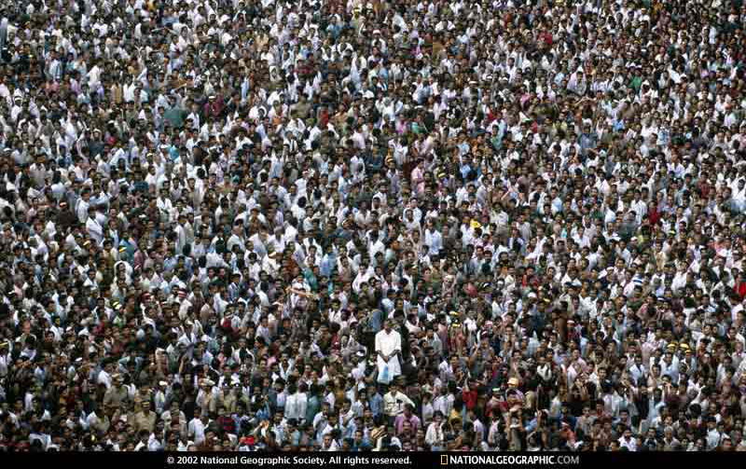
External Audiences
If the project is successful, then what?
Who needs to be persuaded?
What “proof” do they need?

Slide 32
Determining Monitoring Investment
Platform site/ Pilot project;
Institutional Learning Potential
LEVERAGE
Ecological,
Reputational,
Legal,
Uncertainty
RISK

Slide 33
Invested Monitoring Effort
Noel Kempff Mercado [Bolivia] Climate Action Project
Monitoring Cost: >$100,000/yr
HIGHER
HIGHEST
LEVERAGE
Ft. Hood, Texas Invasive Species Control by Fire
Monitoring Cost: <$500/yr
LOW
HIGHER
RISK
Monitoring investment surface is: Conceptual, highest value, 10k m view
Notes:
These projects have equivalent annual costs.

Slide 34
Leverage
Yangtze
Savannah
new pilot
Green
River
1000’s of
Army Corps
rivers
Connecticut
leverage
Willamette
new pilot
Zambezi
Model: W. Ginn

Slide 35
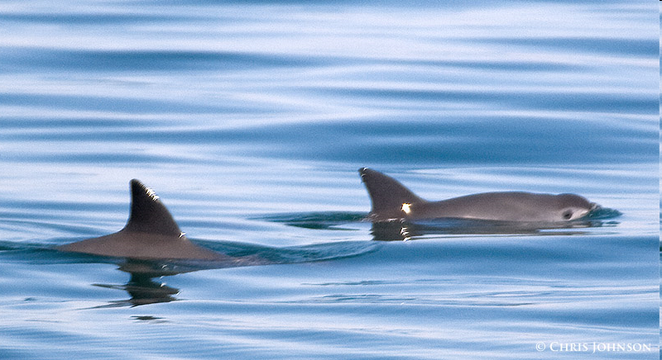



Risk
Ecological
Reputational
Photo: Vaquita, C. Johnston
Photo: Wyoming’s Jonah Field
J. Gearino, Star-Tribune
Legal
Uncertainty
Photo: Conserva Colombia
Photo: Mid-Atlantic Seascape

Slide 36
Strength of Inference and Monitoring Effort
inference
=
effort

Slide 37
Getting more help
All things measures - guidance, tools (results chains), case studies:
  http://www.conservationgateway.org/topic/conservation-measures
Borrow measures and monitoring expertise
  Monitoring Fellows - Coda Global Fellows Program (Jolie Siebert)
Online training: www.conservationtraining.org
  Monitoring fundamentals course (March 2011)
  Virtual measures course (July 2011)

