Slide 1
Strategy Effectiveness Measures
Conceptual Model & Results Chain Examples

Slide 2
Results Chains - Basics
The Basic Components of a Results Chain:

Slide 3
What is a Results Chain?
Results Chains - Basics
Is a diagram of a series of “if…then” statements (“causal”)
Defines how we think a project strategy or activity is going to contribute to reducing a threat and conserving a target
Focuses on the achievement of results – not the execution of activities
Is composed of assumptions that can be tested

Slide 4
Conceptual Model vs. Results Chain
Results Chains - Basics
Conceptual Model (i.e., Situation Analysis)
  Show the situation today
  Identify strategies
Results Chains:
  Shows the desired future condition
  Start with selected strategies → show desired results

Slide 5
Condor Bioreserve
Conceptual Model
Who are the key stakeholders with vested interest in the project, what factors are driving critical threats, and what opportunities exist?
Notes:
We use probing questions to identify key stakeholders and motivations driving the direct threats.
We often use box and arrow diagrams to map the causal relationships that connect the focal targets to the direct threats to the underlying causes. Here’s an example from the Condor Bioreserve in Ecuador where one of the targets, the Andean Bear, is killed because of bear-cattle conflicts in the area. Economic losses are driving the bear killing and stem from the co-occurrence of productive grasslands used for cattle grazing and the habitat area of the Andean Bear. There is also a weak institutional response to the killings as another contributing cause.
The situation analysis documents our assumptions regarding the drivers behind critical threats. This transparency is particularly helpful in projects involving multiple stakeholders because it provides a basis for peer-review to catch and correct faulty thinking.
These diagrams clearly layout assumptions that drive our selection of actions and set the basis for what evidence we need to collect to inform our progress

Slide 6
Condor Bioreserve
What factors in our situation analysis warrant action?
Notes:
Project teams can use their situation analysis diagrams to brainstorm the relative advantages of intervening in different locations. For example, they might decide to initiate….
a participatory process leading to the zoning of areas of recognized conservation value and separate zones for livestock grazing
Or they may explore ways to compensate ranchers for cattle killed by bears.

Slide 7
Condor Bioreserve
Results Chain

Slide 8
Lake Alexander – Fire Threat
Situation Analysis
Notes:
Here is an example of a situation analysis recently developed for the Lake Alexander Project in Minnesota, related to the threat of Fire.
Four targets (green ovals) - were associated with a fire threat - insufficient fire (the red box).
Three factors were identified as playing a key role (the orange boxes).
Three strategies were identified to address these three factors – labeled strategy 1a, 1b, and 1 c.

Slide 9
Lake Alexander – Fire Threat
Results Chain
Notes:
The Lake Alexander Results chain identified a measurable objective in the blue box (X hectares burned by 2012) resulting from more prescribed burns (yellow hexagon). This was achieved by successfully implementing the three strategies (1a-1c). Each of these strategies had at least one, often two indicators that demonstrate the strategy is en route to achieve its objective for threat reduction.

Slide 10
NW Yunnan, China – Fuel wood threat
Objective: To reduce by 75% the consumption of fuel wood collected from biologically sensitive forests in the project area in 10 years
Notes:
Once the plan is identified, teams must commit to follow through.
Here is an example from NW Yunnan in China, where they developed an ambitious objective of reducing by 75% the consumption of fuel wood collected from biologically sensitive forests in the project area in 10 years
I’ve used this classification scheme to summarize the measures efforts for the fuel-reduction strategy in NW Yunnan where TNC is working with the Chinese government to cut fuel wood collection.
The simplified results chain to support this strategy is indicated in the diagram… that we will step through in the following slides…

Slide 11
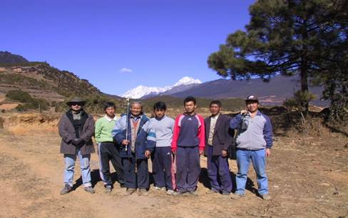
NW Yunnan, China – Fuel wood threat
Resources spent on Alternative Energy Strategy
  FY 2001 $50,000
  FY2002 $150,000
  FY2003 $350,000
  Total $550,000
NW Yunnan, China
Notes:
The total investment in resources – or inputs - is just over ½ million dollars.

Slide 12
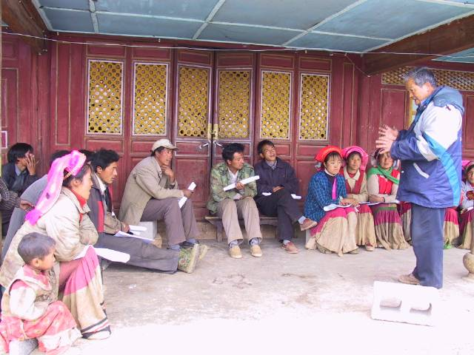
NW Yunnan, China – Fuel wood threat
Record of activities completed (e.g., proposals written, grants received, # presentations made, number of household surveys completed).
Training on Fireplace, Biogas, and Greenhouse Use in Village
Notes:
There has been a lot of activity associated with this strategy, including writing and receiving grants, presentations to local communities, household surveys.

Slide 13
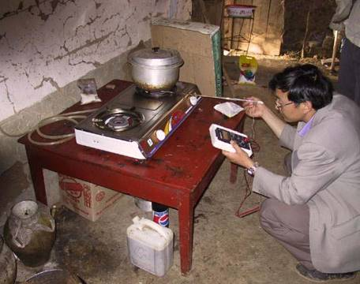
NW Yunnan, China – Fuel wood threat
Alternative energy installations completed (as of June 2003)
1,491 Household Scale Biogas Units
20 Biogas-Greenhouse Units
97 Improved Fireplace/Cookstoves
129 Solar Water Heating Units
9 Energy demonstration project at schools
Notes:
Outputs include counts of the alternative energy installations completed.
# of biogas units
# of biogas-greenhouse combinations
# of improved cookstoves
# of solar units
# of energy demonstrations at schools

Slide 14
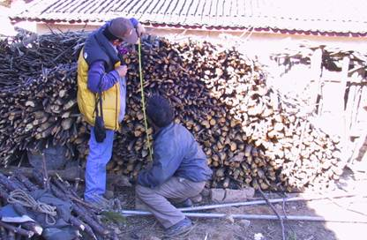
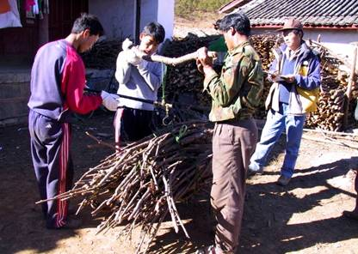
NW Yunnan, China – Fuel wood threat
Threat abatement measured by measuring changes in volume of wood consumed in a sample of households
Also, household surveys to collect details on # people, fuel wood uses
Notes:
Outputs are measured by tracking the rate of wood consumption by measuring changes in the size of wood piles outside of villagers homes along with household surveys on how they are using wood and much time they are spending gathering it.

Slide 15
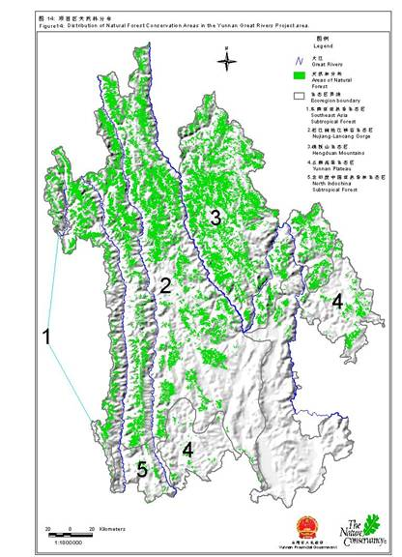
NW Yunnan, China – Fuel wood threat
Changes in forest cover calculated from changes in satellite-derived forest-cover maps
Notes:
The Impacts to the conservation targets are assessed through a combination of periodic forest cover maps.

Slide 16
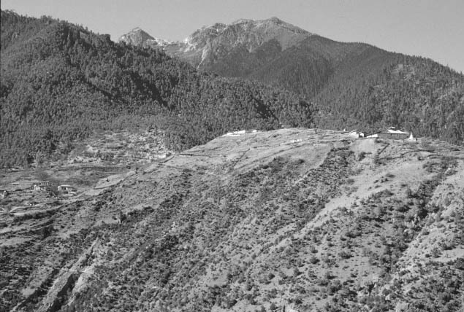
NW Yunnan, China – Fuel wood threat
Changes in forest cover recorded from permanent photopoints along ridge top trails
Notes:
And by a series of ground-based permanent photopoints along ridge tops.

Slide 17
NW Yunnan, China – Fuel wood threat
Notes:
Here is the results chain with the indicators that are tracked to show what progress is or is not being made.
These terms like outputs and impacts are all used in different ways by different organizations – which is a cause of confusion when we share results. C.I. for example, refers to their ultimate biodiversity condition as their outcomes.
It doesn’t really matter what the steps are called. What is important is recognizing the need to track more than just the species or habitats we’re concerned about when we’re trying to figure out whether our actions are achieving their intented results.
Measures of the activities implemented and measures of threat abatement are critical to understanding whether strategies are working.

Slide 18
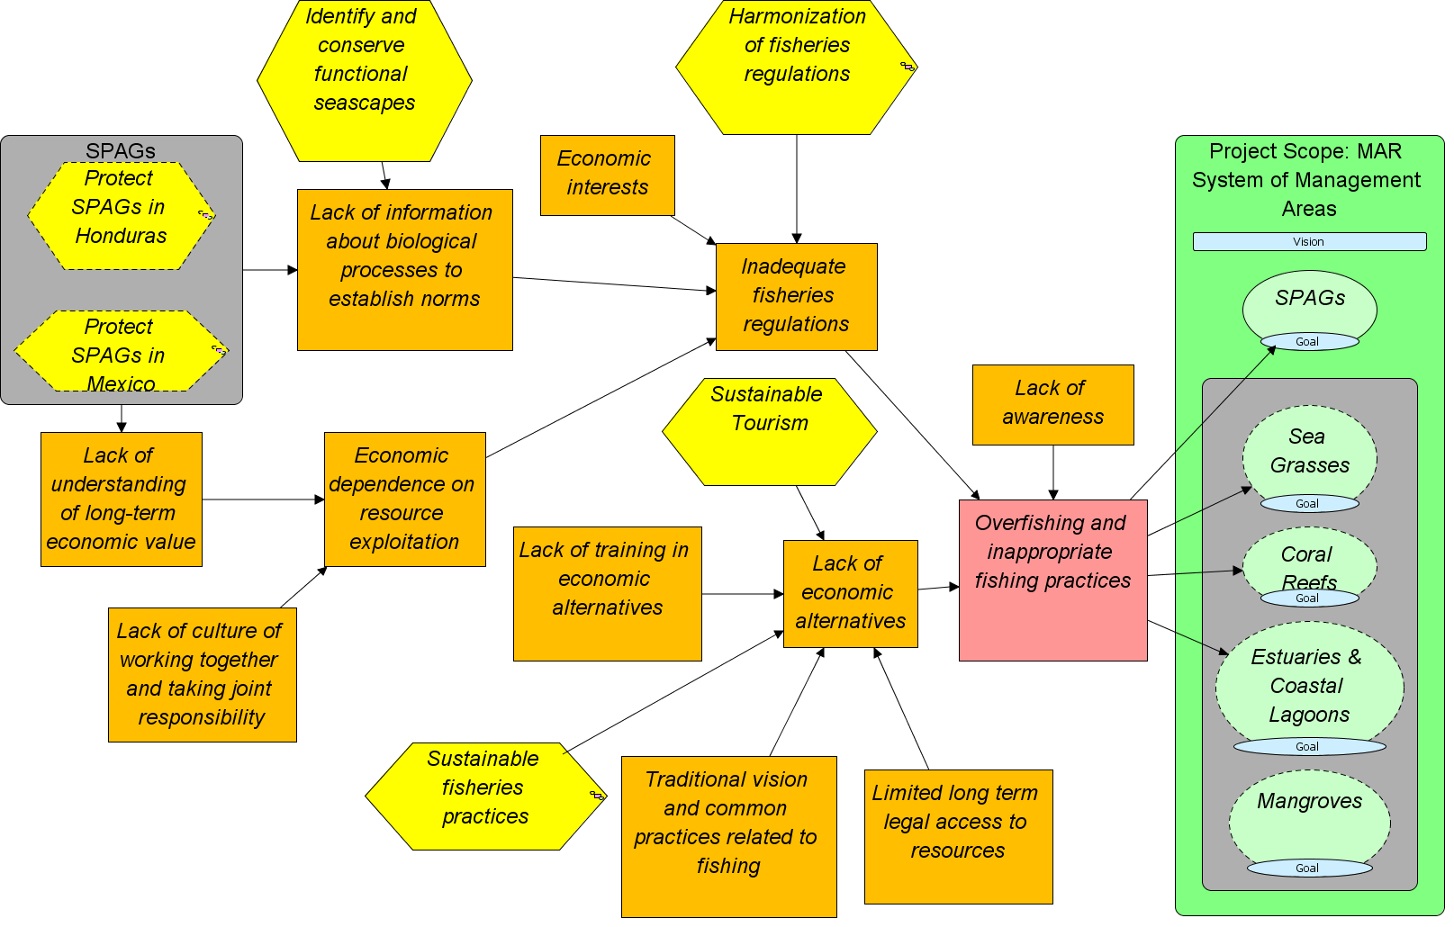
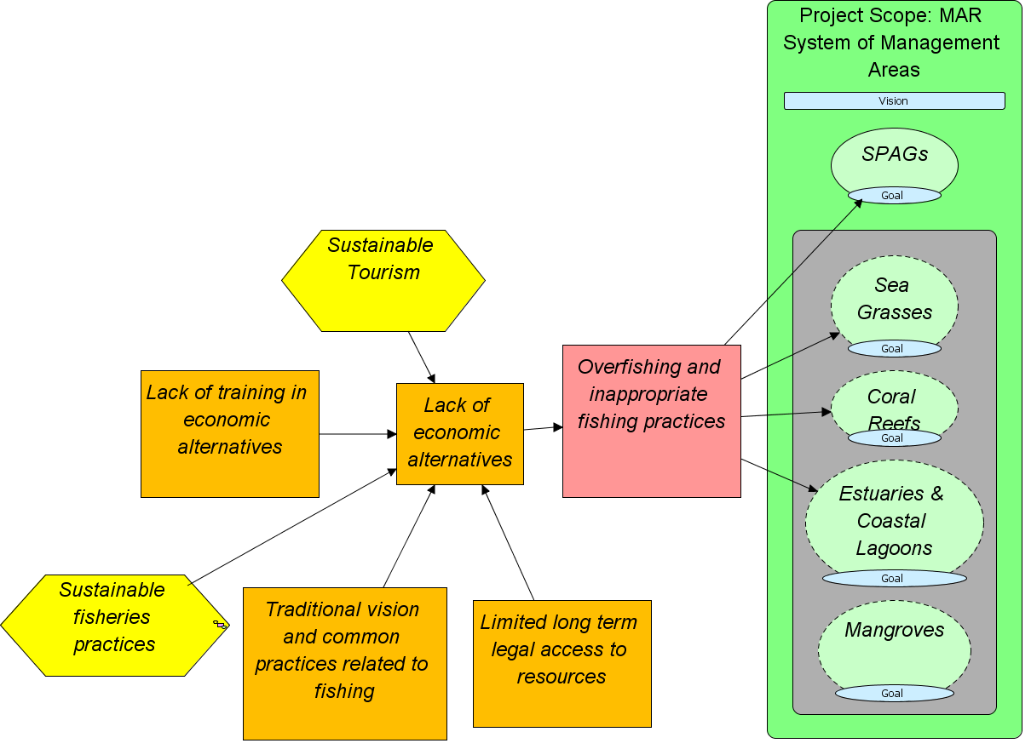
Watch this & remaining slides in Slide Show mode
Mesoamerican Reef Fisheries
Conceptual Model

Slide 19
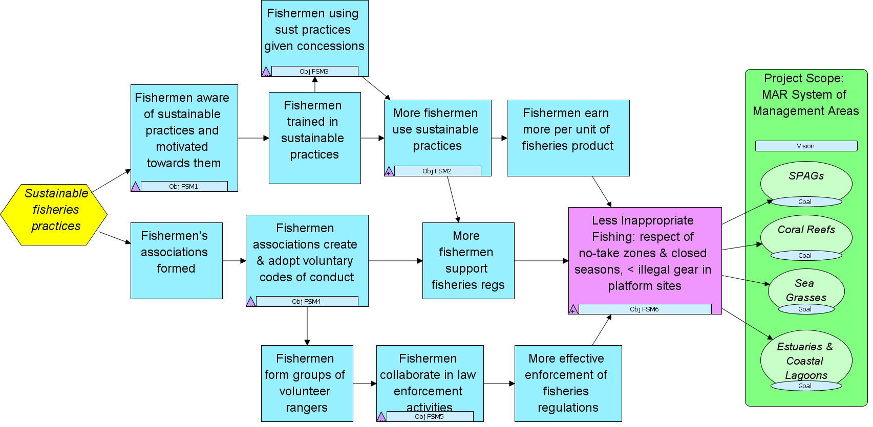
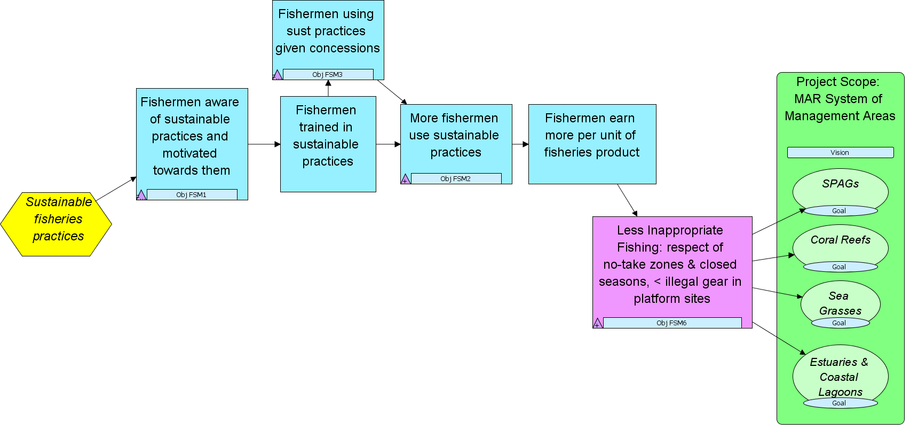
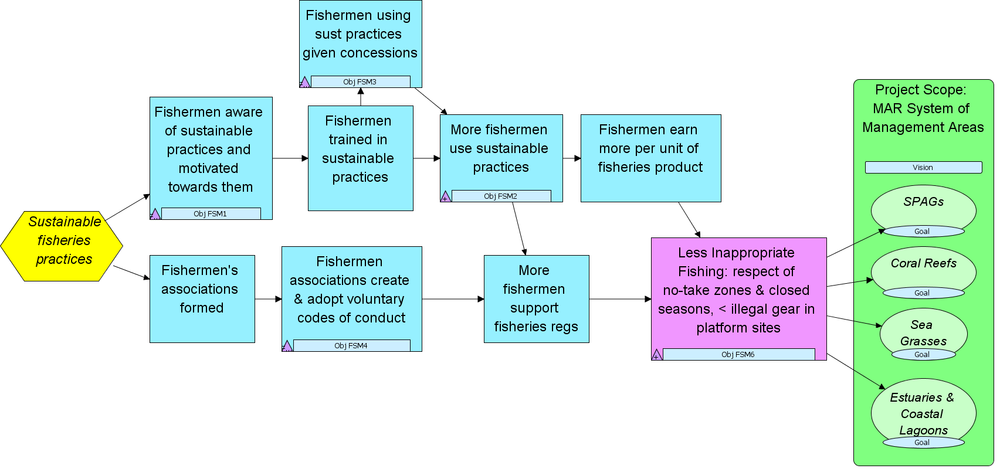
Mesoamerican Reef Fisheries Results Chain
Objective FSM3: By 2012 there is at least one concession given to fishermen in Honduras using sustainable practices to have exclusive fishing rights to some species / areas in the priority sites.
Indicator FSM3-I1:# of concession agreement drafts prepared and approved by government and the fishermen of the priority sites
Objective FSM2: By 2012 30% of the fishermen in the relevant priority sites are aware of and capable of using the sustainable fishing practices identified in FSM1.
Indicators: FSM2-I1: % of fishermen aware of sustainable fishing practices; FSM2-l2: % of priority sites fishermen trained in sustainable fishing practices
Goal: By 2018, all validated and ecologically functional SPAG sites will maintain the conditions necessary to preserve the species (composition, abundance, proportion of sexes) documented during validation.
Indicators: (1) # of species that aggregate in specific periods; (2) # of individuals of each species during the peak of the aggregation period;
Goal: By 2018, more than 25% of all coral reef habitat types in the MAR are effectively conserved.*
Indicators: (1) Abundance of herbivore species; (2) Abundance of surgeon fish and parrot fish
* Working definition of effective conservation exists with multiple components
Objective FSM6: By 2018, at least 80 % of the fishermen in 8 MAR Program priority sites comply with all fishing regulations (no-take zones, closed seasons, gear.
Indicator FSM6-I1: # of infractions; & FSM6-I2: # of law enforcement actions (warnings, fines, confiscation, jail)
Objective FSM1: By 2011, at least 4 sustainable fisheries practices are identified that could be applied in and around priority sites.
Indicator FSM1-I1: # of sustainable fisheries products identified around priority sites for which there is demand
Intermediate Results
Outcome Results
Objective FSM5: By 2017, fishermen are collaborating actively in law enforcement activities in 6 priority sites.
Indicator FSM5-I1: # of law enforcement activities (patrolling, reports of infractions) where participation of fishermen is documented

Slide 20
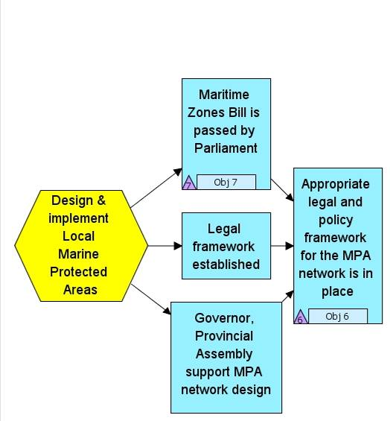
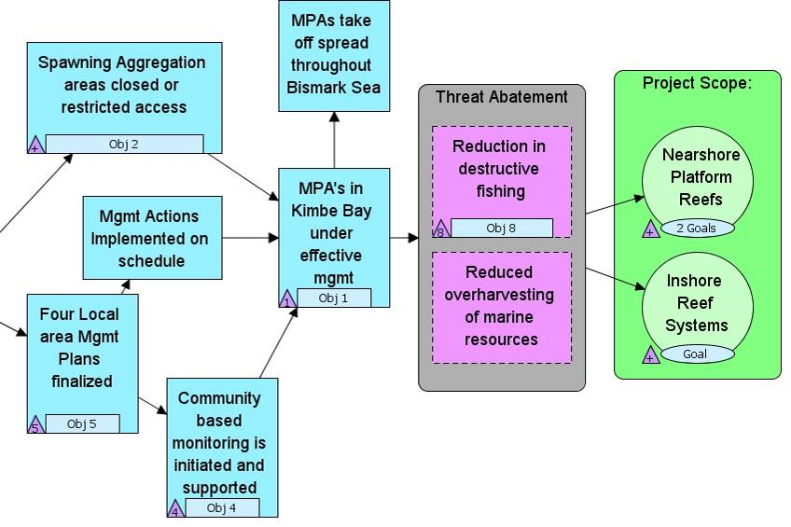
Managing Conservation Projects
Results Chain with Strategy, Objectives, Indicators
Kimbe Bay
Outcome Results
Intermediate Results
Objective: By FY09, Section 38 of the Maritime Zones bill is expanded to establish marine protected areas
Indicator: Bill passed/failed
Objective: By FY 12, live coral cover of reef systems increased to over 50%
Indicator: % cover live coral
Objective: By FY10, design and legally secure a functionally-connected network of LMMAs and MPAs in Kimbe Bay covering 250,000 ha.
Indicator: Area (ha) designated as LMMA
Objective: By FY12, 4 active spawning aggregation sites closed or with restricted fishing practices
Indicator: # of SPAGs closed to fishing
Objective: By FY17, 250,000 ha of LLMA's under effective management in Kimbe Bay
Indicator: ha with acceptable Mgmt Effectiveness Scores

Slide 21
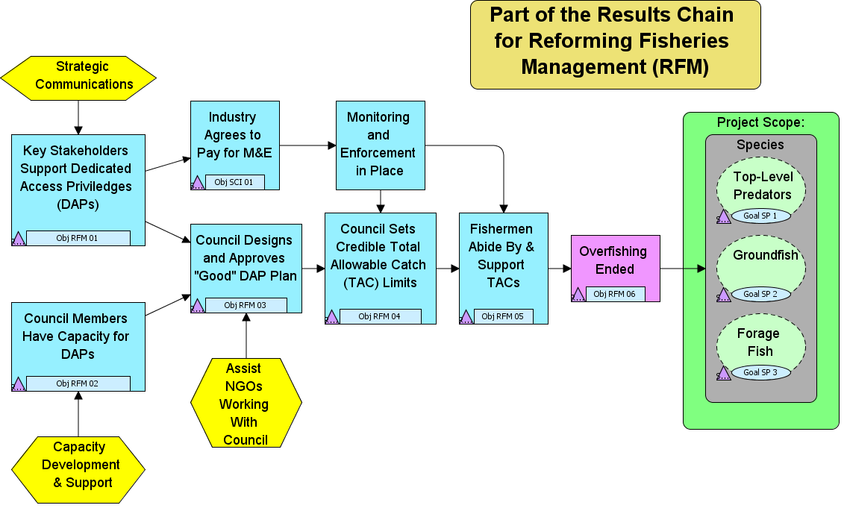
Objective: By the end of 2009, Council staff have the knowledge and capacity to implement a pilot test of DAPs.
Indicator: Assessment of Capacity of Council
Objective: By the end of 2009, the council approves a "good" DAP plan. Criteria include: 1. Comprehensiveness; 2. Minimal Proccessor Quota; 3. Adaptive Management Trust; 4. Gear Switching Provisions
Indicator: Quality of DAP Plan Approved (specific criteria established)
Objective: By 2010, the council has set Total Allowable Catch (TAC) limits for each stock that are within scientifically credible "sustainable" limits.
Indicator: # of Stocks with Credible Catch Limits
Objective: By 2012, there are no more than 10 incidences per year of fishermen violating the TAC Limits.
Indicator: # of Incidences of TAC Violations
Objective: After 2012, all 37 fish stocks in the Ecoregion are fished at levels consistent with an ecolocially sustainable harvest.
Indicator: # of Fish Stocks at Sustainable Limit
Goal: By 2015, have at least 5.0 groundfish per hour from average party boat CPUE measurements.
Indicator: CPUE Levels for Groundfish
Intermediate Results
Outcome Results

Slide 22
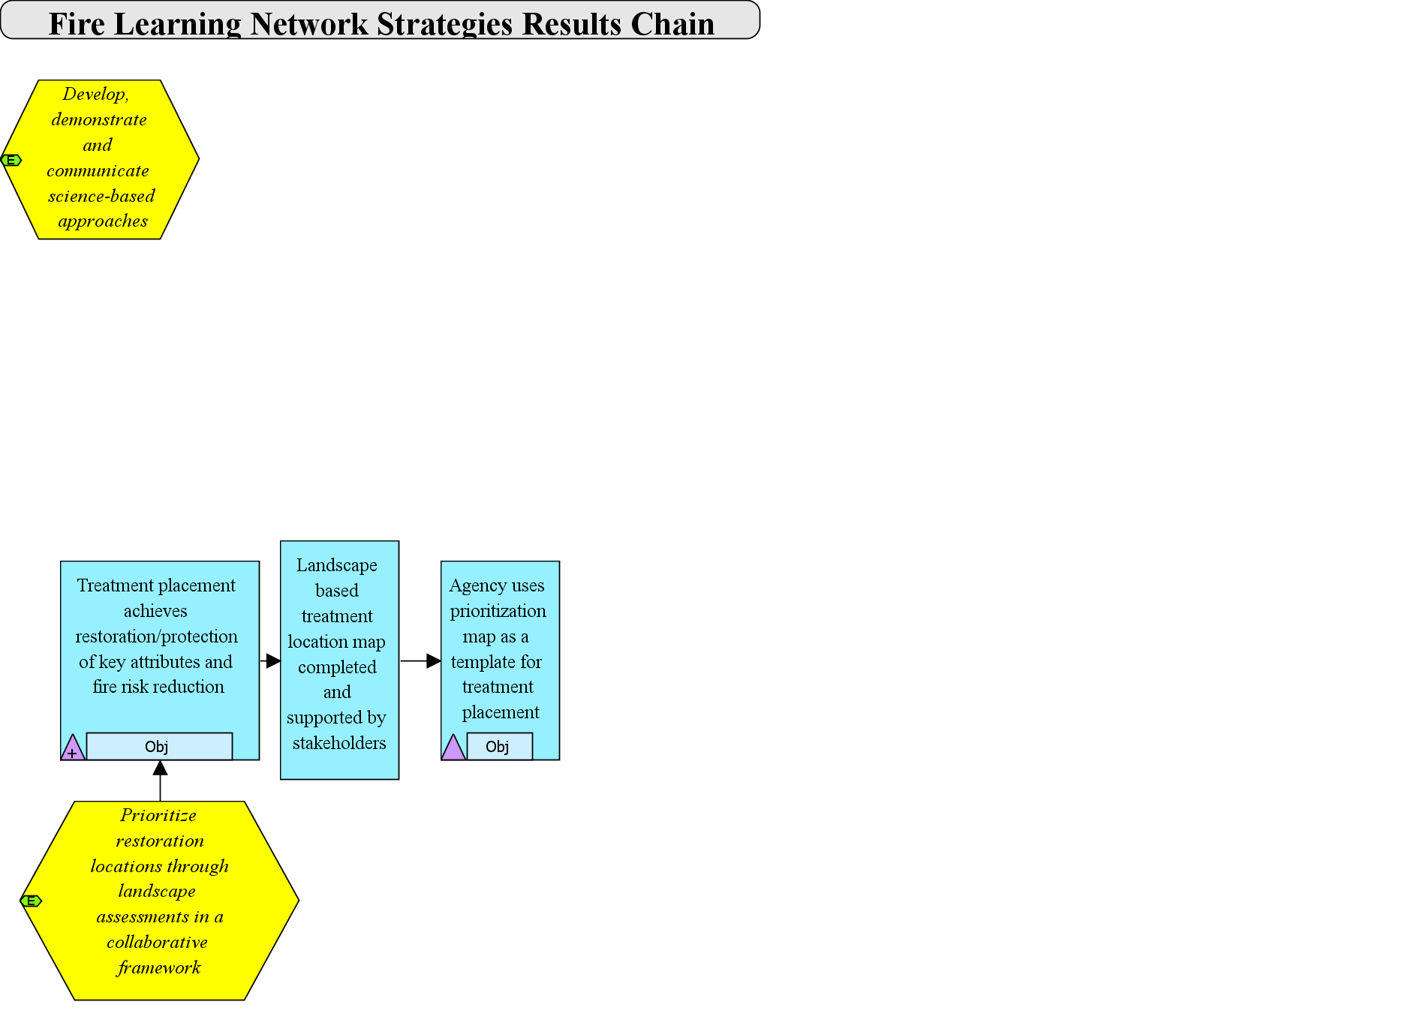
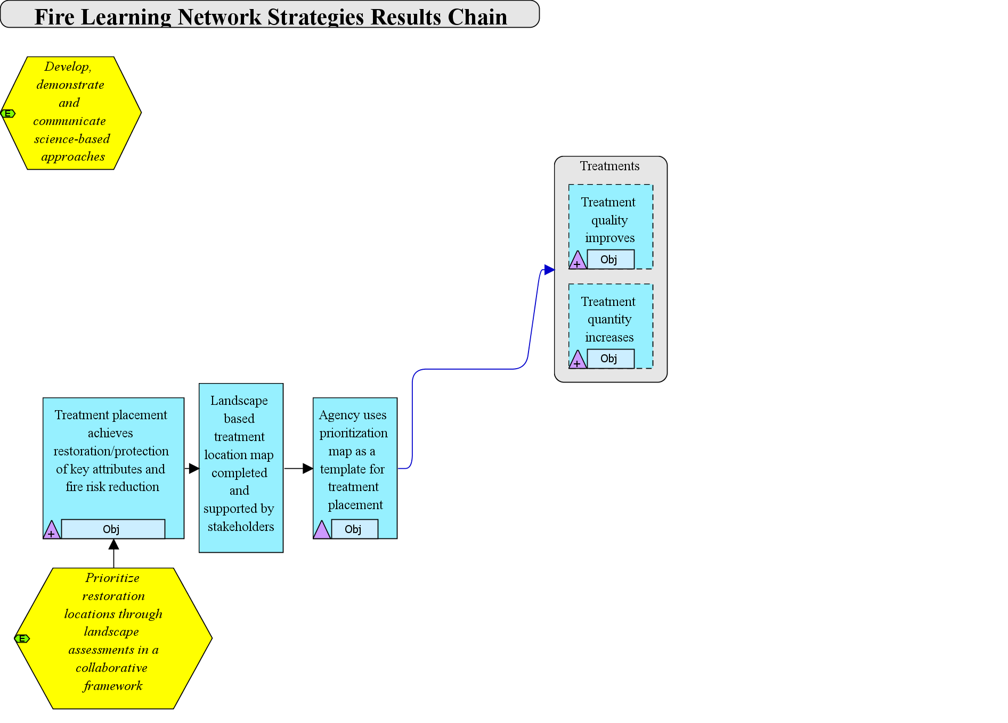
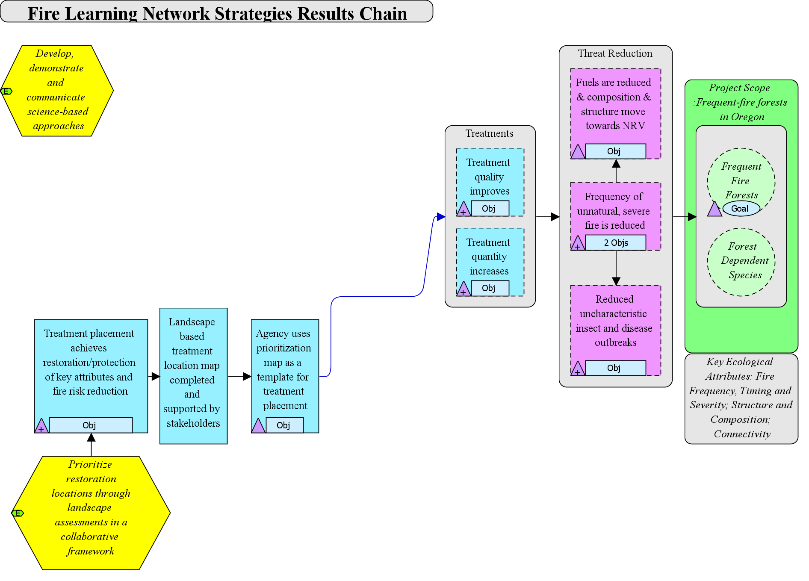
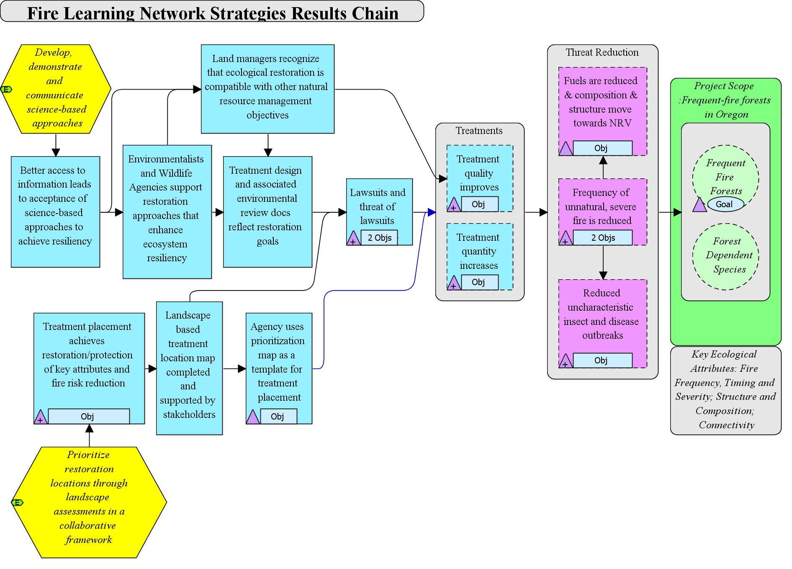
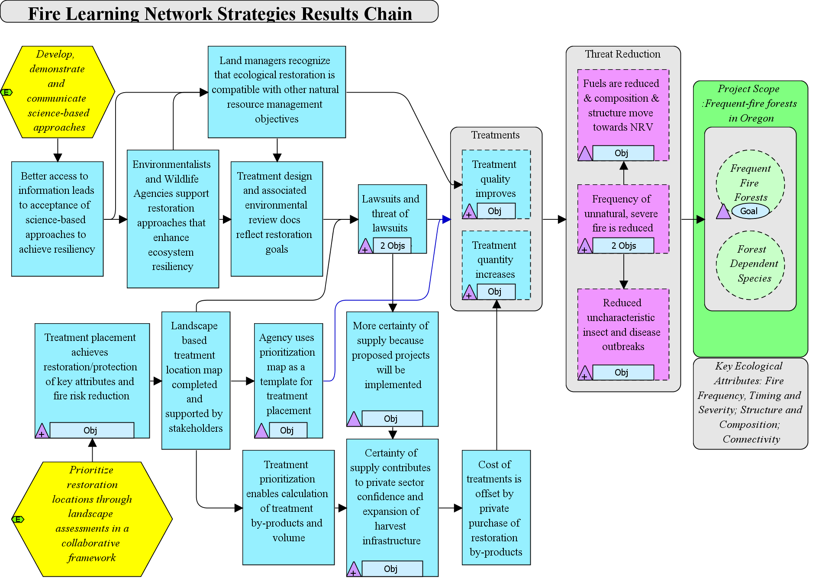
Fire Learning Network – Central Oregon
Objective: # of NEPA approved projects increases by a third by 2020.
Indicator: # of NEPA approved projects
Objective: # of acres treated increases by 30% by 2015
Indicator: # of acres treated
Objective: 75% Reduction in acres of severe fire and/or unnatural mortality due to insects and disease by 2030
Indicator: # acres of severe fire and/or unnatural mortality
Goal: 20-30% of Frequent Fire forests on public are in Condition Class I.
Indicator: % Departure from NRV
Objective: By 2020 the percent of restoration projects appealed reduced to 25%.
Indicator: # of appeals/# of projects
Intermediate Results
Outcome Results

Slide 23
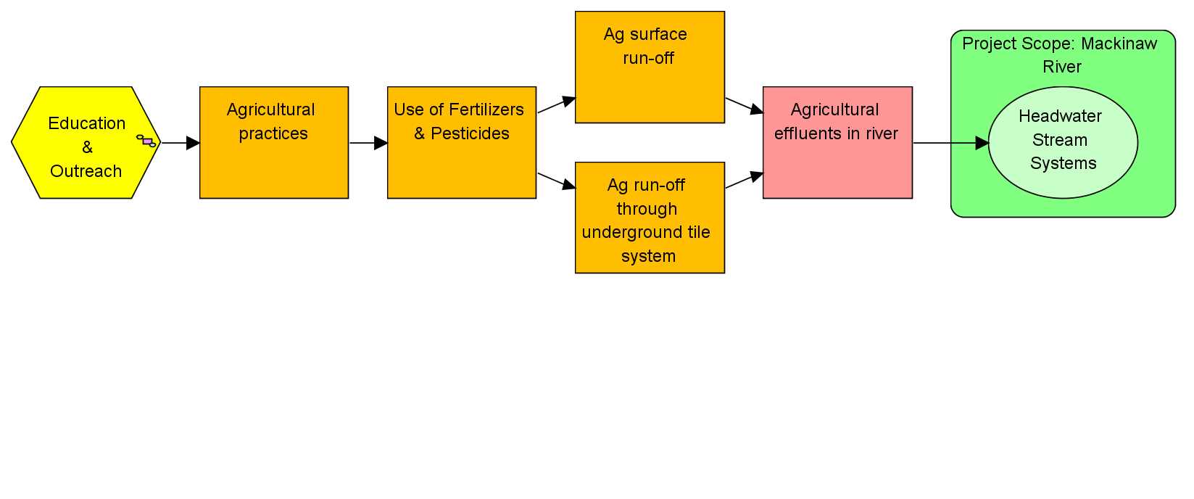
Mackinaw River
Initial Conceptual Model with Outreach Strategy

Slide 24
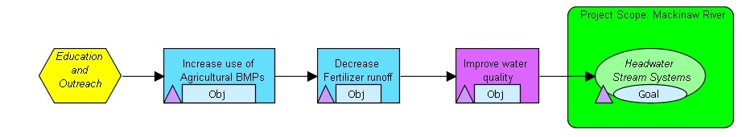

Mackinaw River – paired watershed study
Intermediate Results
Outcome Results
No detectable improvement in water quality or conservation targets in treated watershed as compared to the control.
Results demonstrate increased use of Best Management Practices in the treated watershed as compared to the control
Notes:
Here we see the same results chain with objectives and indicators illustrated.
They gathered information to show that they reached more farmers in their outreach program than were reached in the control watershed, and these farmers in turn adopted more ag BMPs than the farmers that were not contacted via the outreach program
CLICK1 – Here you see data from three of the indicators – each one an agricultural best management practice. The blue lines are the treatment watershed where the outreach program was directed, the red lines are from the control watershed where there was no outreach program. The middle figure shows the amount of land put into one type of Ag BMP – filter strips. These filter strips are supposed to intercept surface runoff, and reduce the amount of soil and excess fertilizer running into the stream.
This far into the results chain, this strategy iwas achieving its desired results – for all three BMPs.
CLICK2 – Fade out
CLICK3 – They also tracked changes in water quality. In this case, you see graphs of nitrogen concentrations, from the upper and lower sections of the subwatersheds, and there was no significant difference between the two subwatersheds.
CLICK4 - As for the conservation targets – there was also no change. These two graphs track mussel richness and abundance over time. Information was collected on other biota – like macroinvertebrate insects and fish – and they revealed no difference as well.
In both cases, for threat reduction and improving the status of the targets, they did not find that the Ag BMPs were enough to achieve the desired results. So what did this mean? How could they use this information to improve their conservation efforts?

Slide 25
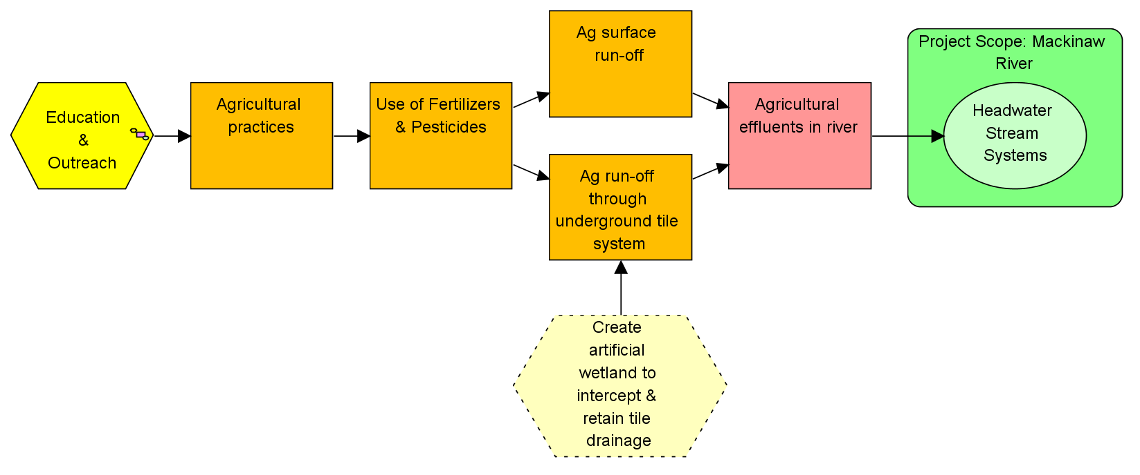
Mackinaw River
Revised Conceptual Model with new Tile-Drainage Abatement Strategy

