Slide 1
Examples for REDD+ Human Wellbeing Indicators

Slide 2
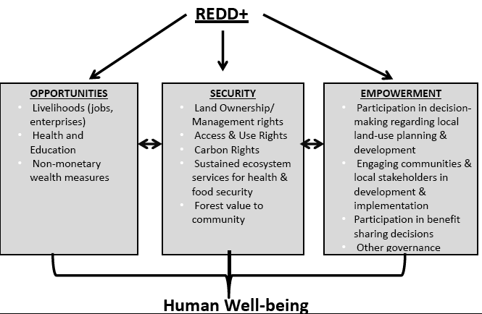

Slide 3
Livelihood
Livelihood is the level of household engagement in strategies and activities that support subsistence and generate income. Household livelihood diversity may be shaped by the availability of resources, social norms and institutions, local customs related to resource access, traditional and local tenures, and social relations (social norms related to gender and age groups), as well as economic opportunities (availability of demand, and access to market).

Slide 4
Example of indicators for livelihood
Increase livelihoods
Income (extent to which a household is able to meet consumption needs or to save)
Proportion of household income sources (forest and non-forest related)
Proportion of household subsisting activities (forest and non-forest resources)
Proportion of household with ownership/possession of assets needed to pursue livelihood options
Proportion of households with alternative livelihoods
Proportion of households with supplementary livelihoods

Slide 5
More on livelihoods……
Level of sustainability of livelihoods
Level of commercial viability of livelihoods
Level of institutional support on livelihoods
Level of satisfaction on alternative livelihoods

Slide 6
Example of indicators for access and use right
Proportion of households who have access to use forest (sub-groups in household?)
Proportion of households with formal (informal) land rights or ownership of land/trees
Areas of land protected for local or indigenous peoples
Level of inclusion of local/traditional land tenure in formal/official land management
Other indicators related to traditional/local land tenure
Other indicators relevant to local regulatory framework (legal, institutional, policy-related)

Slide 7
Empowerment
Empowerment is a process through which people are able to take more control over their own life and secure better livelihood.
(Chambers 1983. Putting the Last First)

Slide 8
Example of sets of indicator in the area of empowerment
Level of local involvement in the REDD+ project design
Level of local involvement in the REDD+ project implementation
Level of local involvement in forest management and governance
Degree to which the community members feel that they are able to impact change.
Proportion of forest management initiatives coming from local community members

Slide 9
Areas of process-oriented indicators
Indicators to assess the processes or actions taken to achieve objectives and move toward outcomes.
Project staff’s understanding local context (communities and their relationship to forest)
Stakeholder involvement
Stakeholder consent
Effectiveness of strategies
Ethical practice
Social and cultural appropriateness
Accountability
Equity
Efficiency
Transparency

