Slide 1
Effective Conservation
Northern Tropical Andes Conservation Program
South America Conservation Region
January, 2007

Slide 2
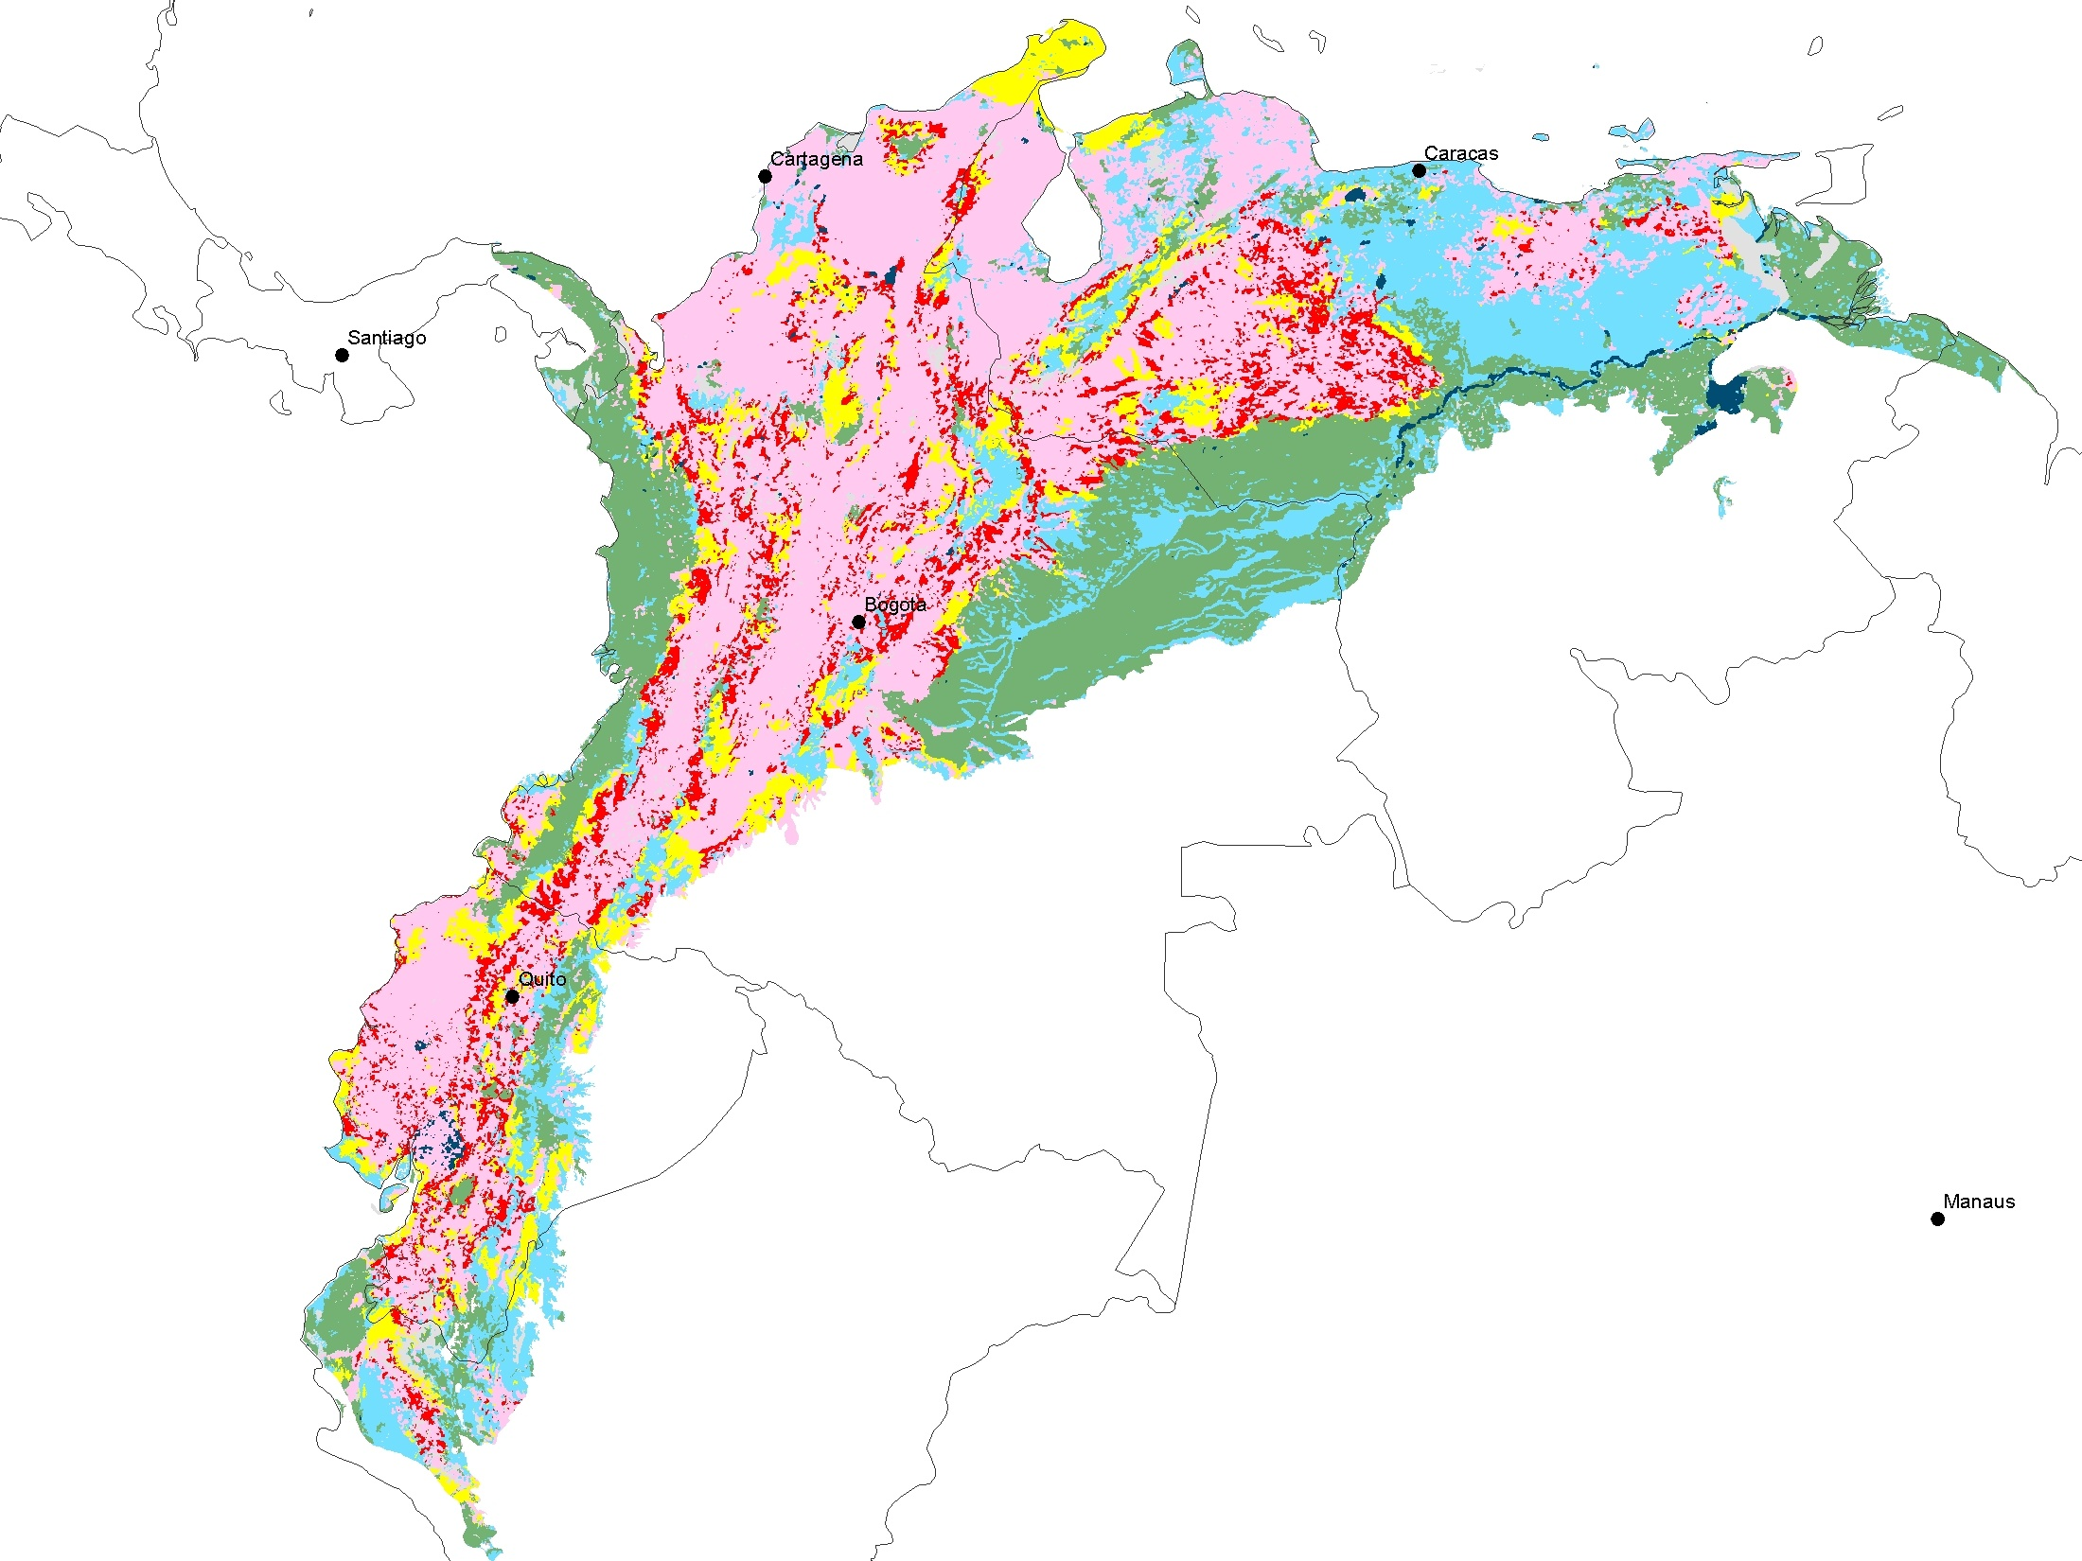
Northern Tropical Andes – Viability
 | Viability Categories
 | Very Good
 | Good
 | Fair
 | Poor
 | Converted/Degraded
 | Unknown
 | Water

Slide 3
Viability
 | Viability Categories | Hectares
 | Very Good | 32,051,358
 | Good | 25,672,296
 | Fair | 12,252,913
 | Poor | 11,753,231
 | Converted/Degraded | 59,725,579
 | Unknown | 4,969,353
 | Water | 1,253,687
 | TOTAL | 147,678,416

Slide 4
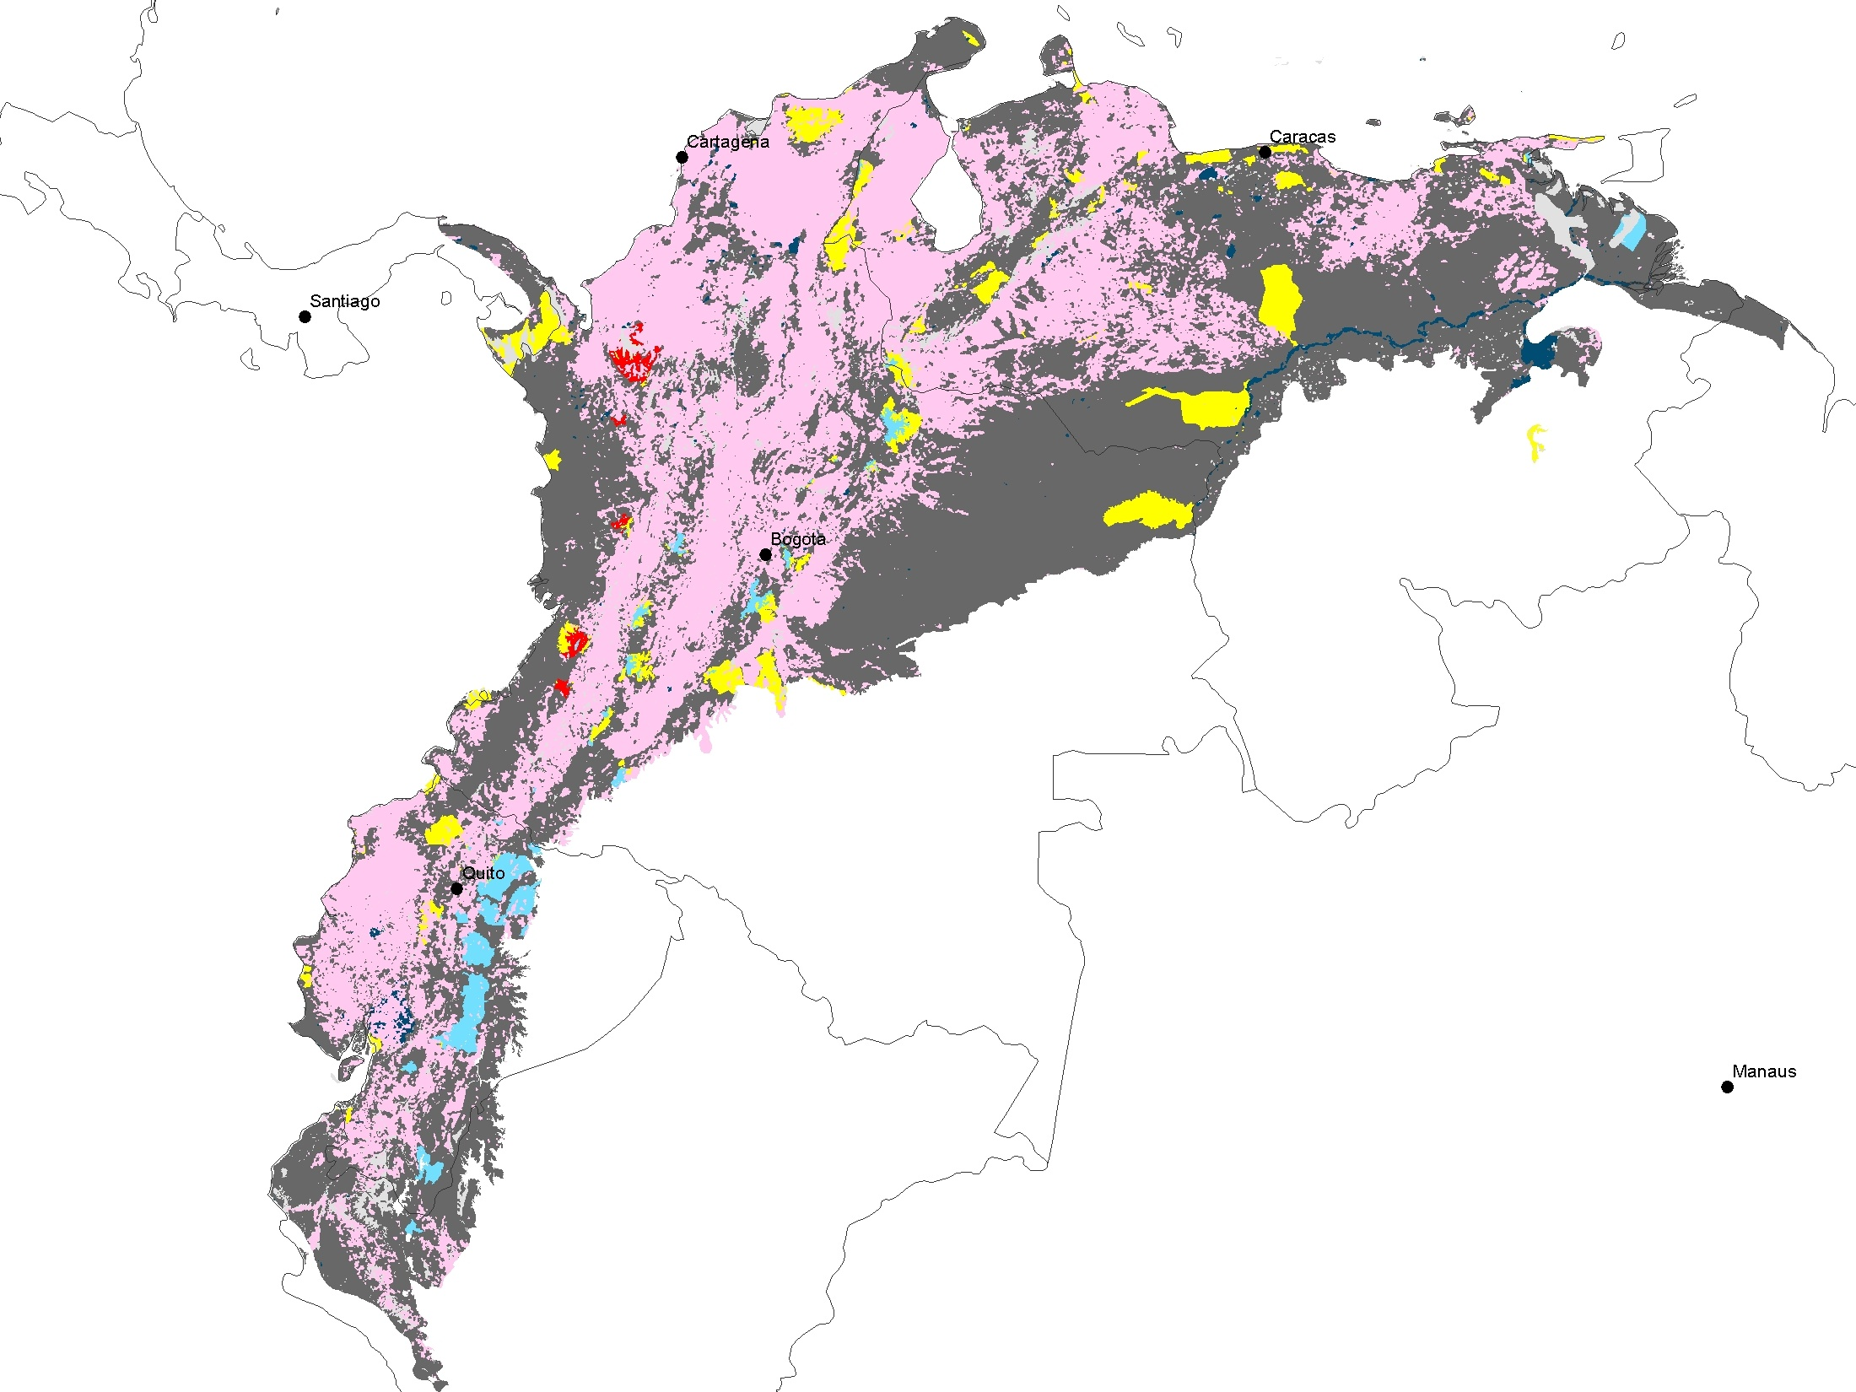
Northern Tropical Andes – Management*
 | Status Categories
 | Very Good
 | Good
 | Fair
 | Poor
 | No Management *
 | Converted/Degraded
 | Unknown
 | Water
* IUCN Categories I – IV ONLY
* IUCN Categories I – IV ONLY

Slide 5
Management Status*
 | Status Categories | Hectares
 | Very Good | 0
 | Good | 2,195,432
 | Fair | 5,608,008
 | Poor | 420,974
 | No Management * | 73,505,383
 | Converted/Degraded | 59,725,579
 | Unknown | 4,969,353
 | Water | 1,253,687
 | TOTAL | 147,678,416
* IUCN Categories I – IV ONLY

Slide 6
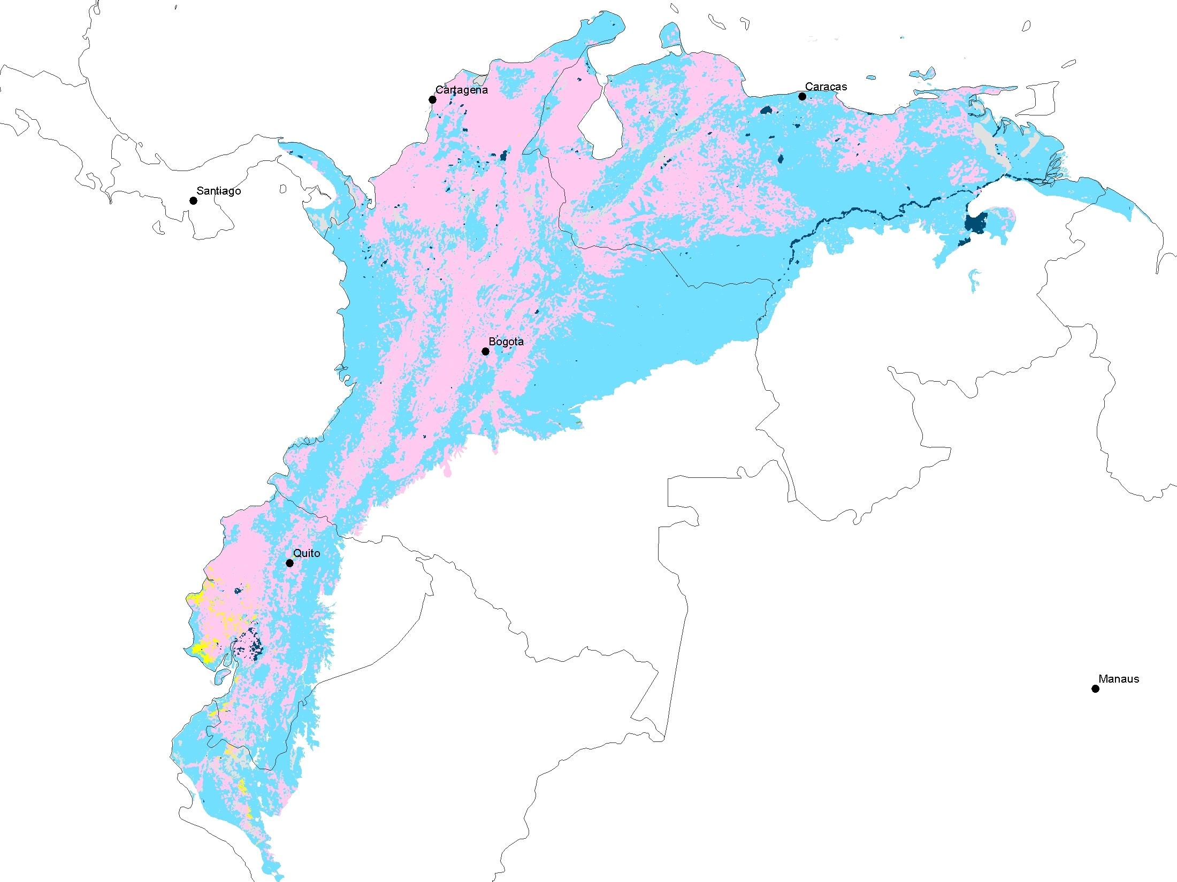
Northern Tropical Andes – Threat
 | Threat Categories
 | Low
 | Medium
 | High
 | Very High
 | Converted/Degraded
 | Unknown
 | Water

Slide 7
Threat
 | Threat Categories | Hectares
 | Low | 23,912
 | Medium | 81,034,166
 | High | 503,980
 | Very High | 0
 | Converted/Degraded | 59,725,579
 | Unknown | 5,137,092
 | Water | 1,253,687
 | TOTAL | 147,678,416

Slide 8
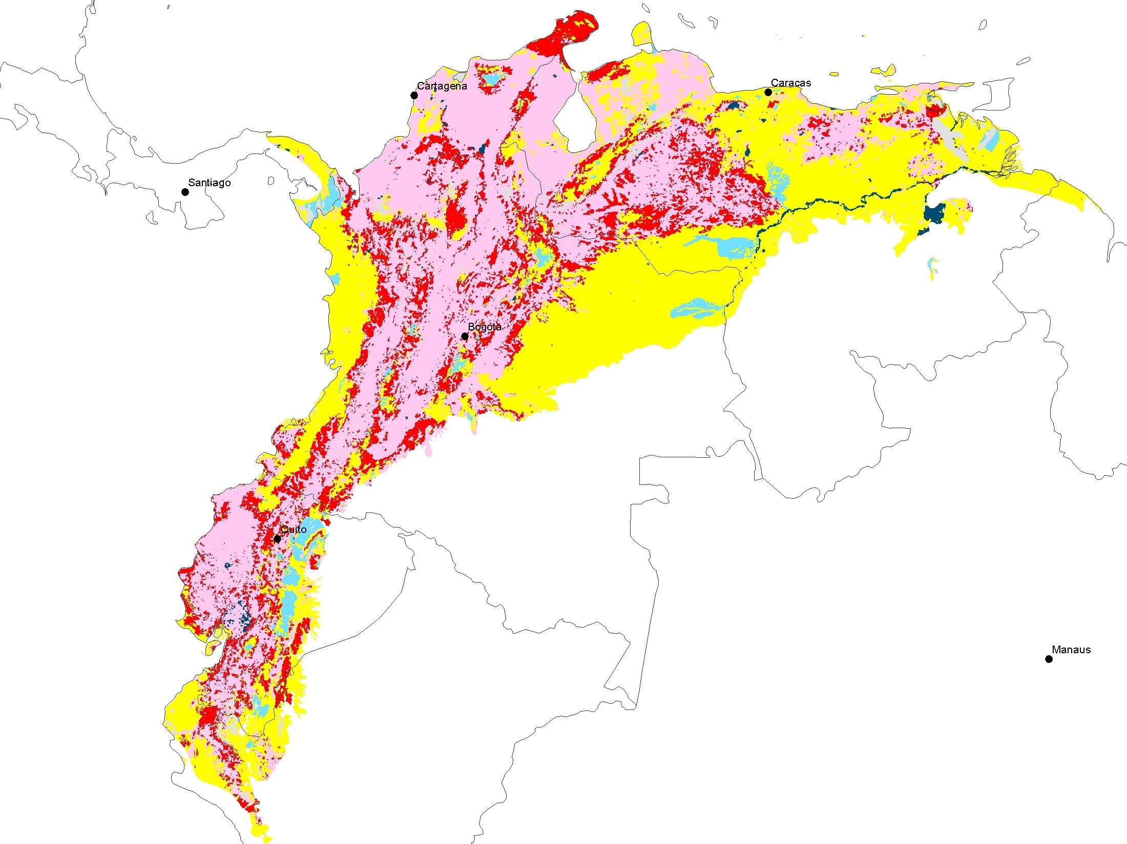
Northern Tropical Andes
Effective Conservation
 | Effective Conservation
 | Very Good
 | Good
 | Fair
 | Poor
 | Converted/Degraded
 | Unknown
 | Water

Slide 9
Effective Conservation
 | Effective Conservation | Hectares
 | Very Good | 0
 | Good | 3,877,765
 | Fair | 55,121,569
 | Poor | 22,562,724
 | Converted/Degraded | 59,725,579
 | Unknown | 5,137,092
 | Water | 1,253,687
 | TOTAL | 147,678,416

Slide 10
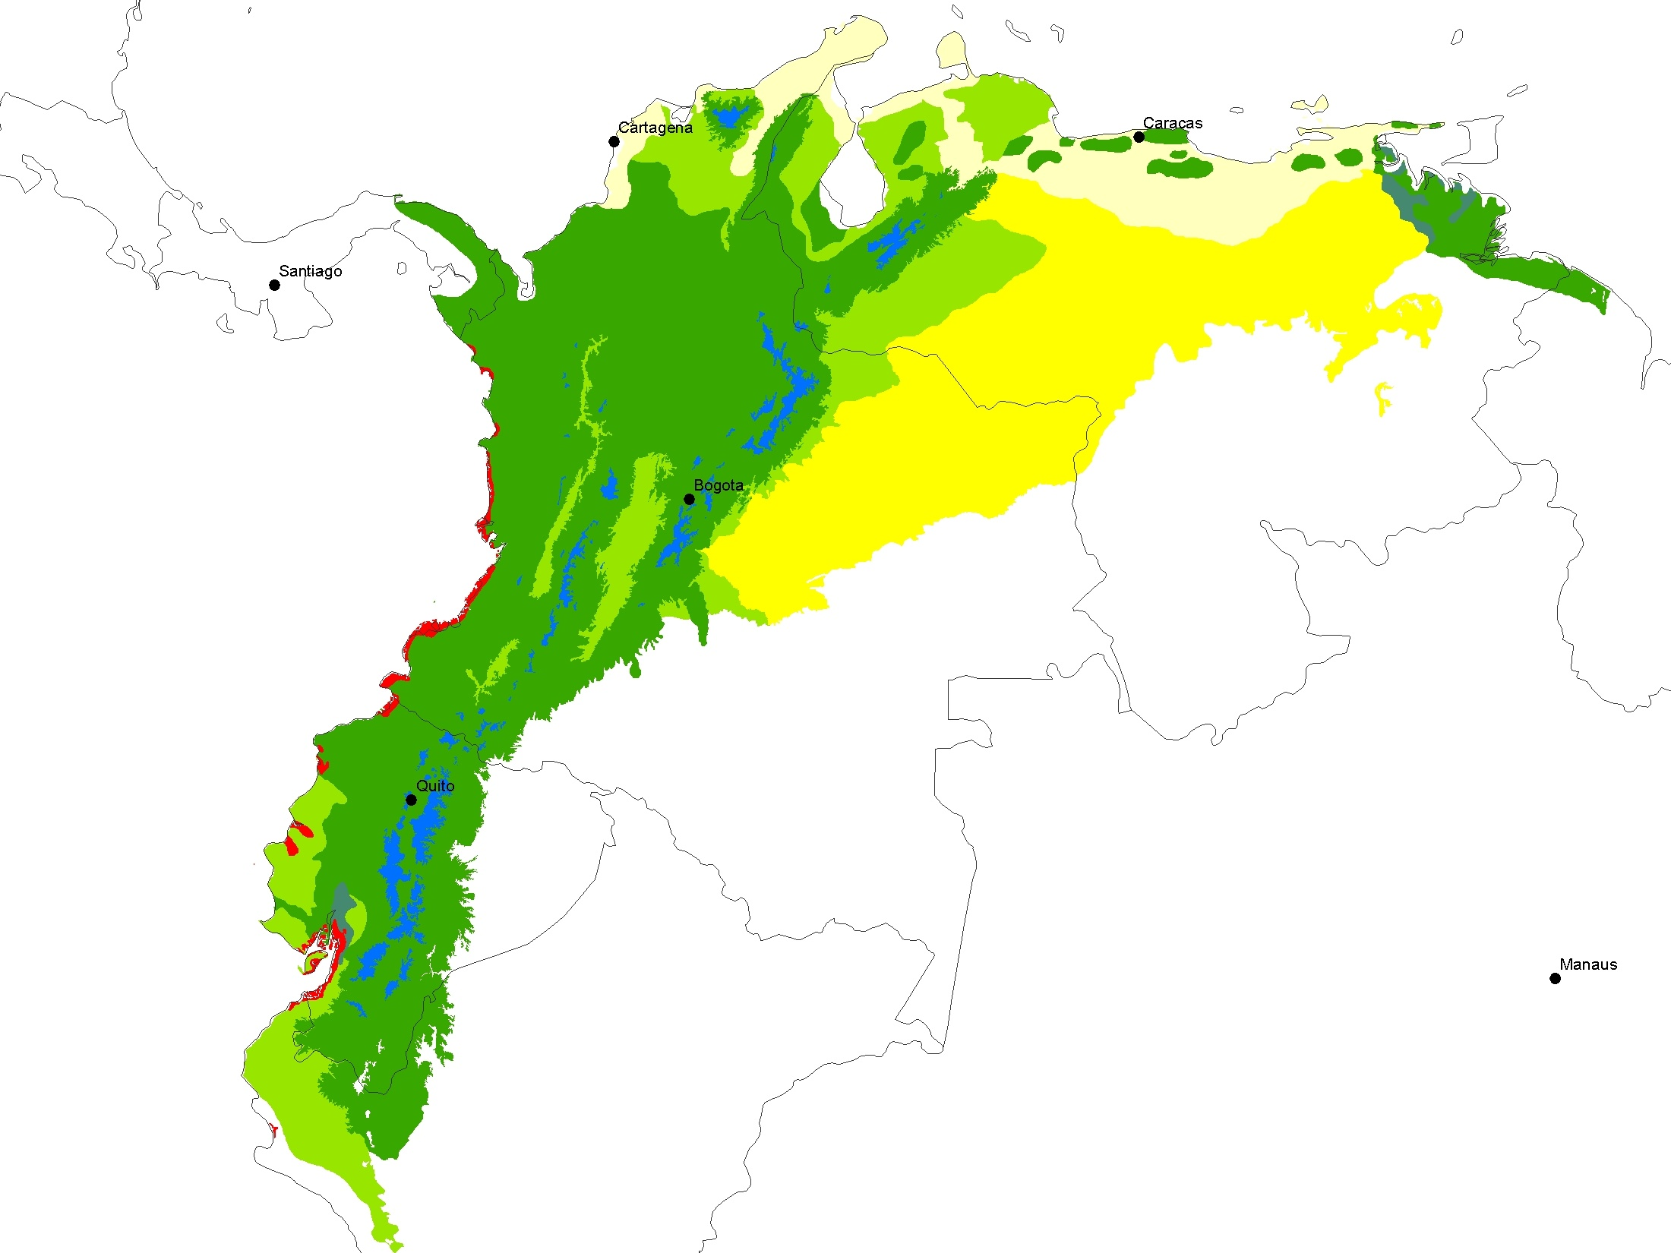
 | Major Habitat Types of the Northern Tropical Andes
 | Deserts and Xeric Shrublands
 | Flooded Grasslands and Savannas
 | Mangroves
 | Montane Grasslands and Shrublands
 | Tropical and Subtropical Dry Broadleaf Forests
 | Tropical and Subtropical Grasslands, Savannas and Shrublands
 | Tropical and Subtropical Moist Broadleaf Forests

Slide 11
Major Habitat Types in the Northern Tropical Andes Conservation Program
 | Major Habitat Types of the Northern Tropical Andes | Hectares
 | Deserts and Xeric Shrublands | 12,112,996
 | Flooded Grasslands and Savannas | 895,068
 | Mangroves | 2,735,804
 | Montane Grasslands and Shrublands | 3,399,789
 | Tropical and Subtropical Dry Broadleaf Forests | 23,243,071
 | Tropical and Subtropical Grasslands, Savannas and Shrublands | 37,728,873
 | Tropical and Subtropical Moist Broadleaf Forests | 67,490,638
 | Grand Total | 147,606,238

Slide 12
Effective Conservation by Major Habitat Type for the Northern Tropical Andes Conservation Program

Slide 13
Effective Conservation by Major Habitat Type for the Northern Tropical Andes Conservation Program
Area in Hectares of the Effective Conservation Categories by Major Habitat Type in the Northern Tropical Andes Conservation Program
 | Very Good (HA) | Good (HA) | Fair (HA) | Poor (HA)
Deserts and Xeric Shrublands | 0 | 91,462 | 4,747,202 | 1,712,615
Flooded Grasslands and Savannas | 0 | 0 | 4 | 30,679
Mangroves | 0 | 2,544 | 1,475,344 | 410,902
Montane Grasslands and Shrublands | 0 | 731,056 | 1,074,355 | 736,019
Tropical and Subtropical Dry Broadleaf Forests | 0 | 2,784 | 3,540,229 | 2,954,261
Tropical and Subtropical Grasslands, Savannas and Shrublands | 0 | 1,312,551 | 26,585,256 | 3,317,207
Tropical and Subtropical Moist Broadleaf Forests | 0 | 1,711,175 | 17,668,714 | 13,400,931
Percentage of Effective Conservation Categories by Major Habitat Type in the Northern Tropical Andes Conservation Program (see chart in slide 12)
 | Very Good | Good | Fair | Poor
Deserts and Xeric Shrublands | 0% | 1% | 72% | 26%
Flooded Grasslands and Savannas | 0% | 0% | 0% | 100%
Mangroves | 0% | 0% | 78% | 22%
Montane Grasslands and Shrublands | 0% | 29% | 42% | 29%
Tropical and Subtropical Dry Broadleaf Forests | 0% | 0% | 54% | 45%
Tropical and Subtropical Grasslands, Savannas and Shrublands | 0% | 4% | 85% | 11%
Tropical and Subtropical Moist Broadleaf Forests | 0% | 5% | 54% | 41%

