Slide 1

Overview & tutorial with screen shots
View in Slide Show Mode
NEW VERSION OCT 21, 2012
Notes:
This PowerPoint provides a short introduction to Miradi – a new software program for managing conservation projects <click>
It covers general overview and navigation features including entering basic project information <click>
It covers how to create a situation analysis diagram to help guide the selection of strategies <click>
And building results chains to explicitly show the results you are trying to achieve by implementing certain strategies
It covers how to add Objectives, Indicators, Monitoring Methods, as well as additional detail on the Activities being implemented<click>
Once the data is entered, you can view or edit within the Planning View <click>
You can generate a number of standard reports and export data from Miradi <click>

Slide 2
Miradi tutorial with screen shots
Basic Features
Basic Navigation, Summary View, data entry slides 3-6
Situation Analysis → Result Chain example
Objective data entry
Indicator/Measurement data entry
Activity data entry
Strategic Plan View – Standard
Strategic Plan View – Custom
Work Plan View – Layout
Work Plan – Project Settings
Work Plan – Work Unit Data Entry
Work Plan – Expense Data Entry
Reports & Exporting data
 ➔
 ➔
 ➔
View in Slide Show Mode
 ➔
 ➔
 ➔
Proceed to next slide to walk through this sequence or click on the mouse icons to jump to a particular topic (in Slide Show Mode). Each topic includes a button to come back here.
 ➔
 ➔
 ➔
 ➔
 ➔
 ➔
Viability & Threats
 ➔
Target Viability - Simple approach
Target Viability - KEA approach
Threat Ranking – Simple mode
Threats Ranking – Stress-based mode
 ➔
 ➔
 ➔

Slide 3
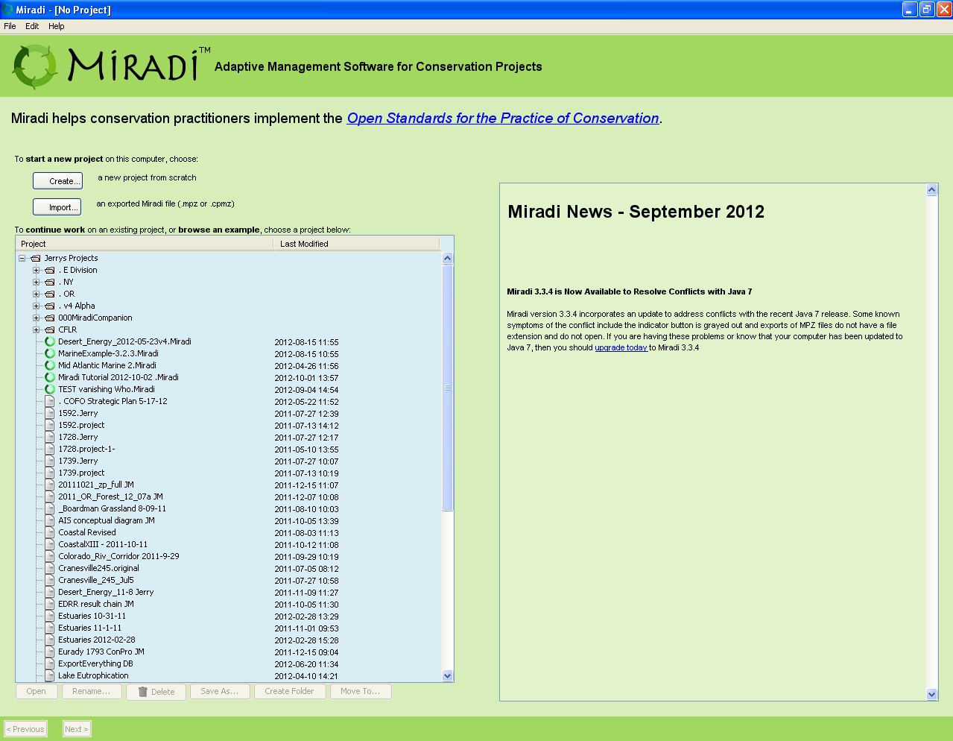
Intro - 1 of 4
Click this button in any screen to return to directory
⬅
Start by:
1. Creating a new project
2. Importing a file
3. Opening an existing file
Notes:
Miradi is available free of charge to all TNC staff and to partners we are working with on joint projects – the final slide of this presentation includes a download link for TNC staff
Once you download and install Miradi, you can do one of 3 things:<click>
Create a new project <click>
Import a Miradi zipped file that someone sent to you<click>
Open an existing project file from the list

Slide 4
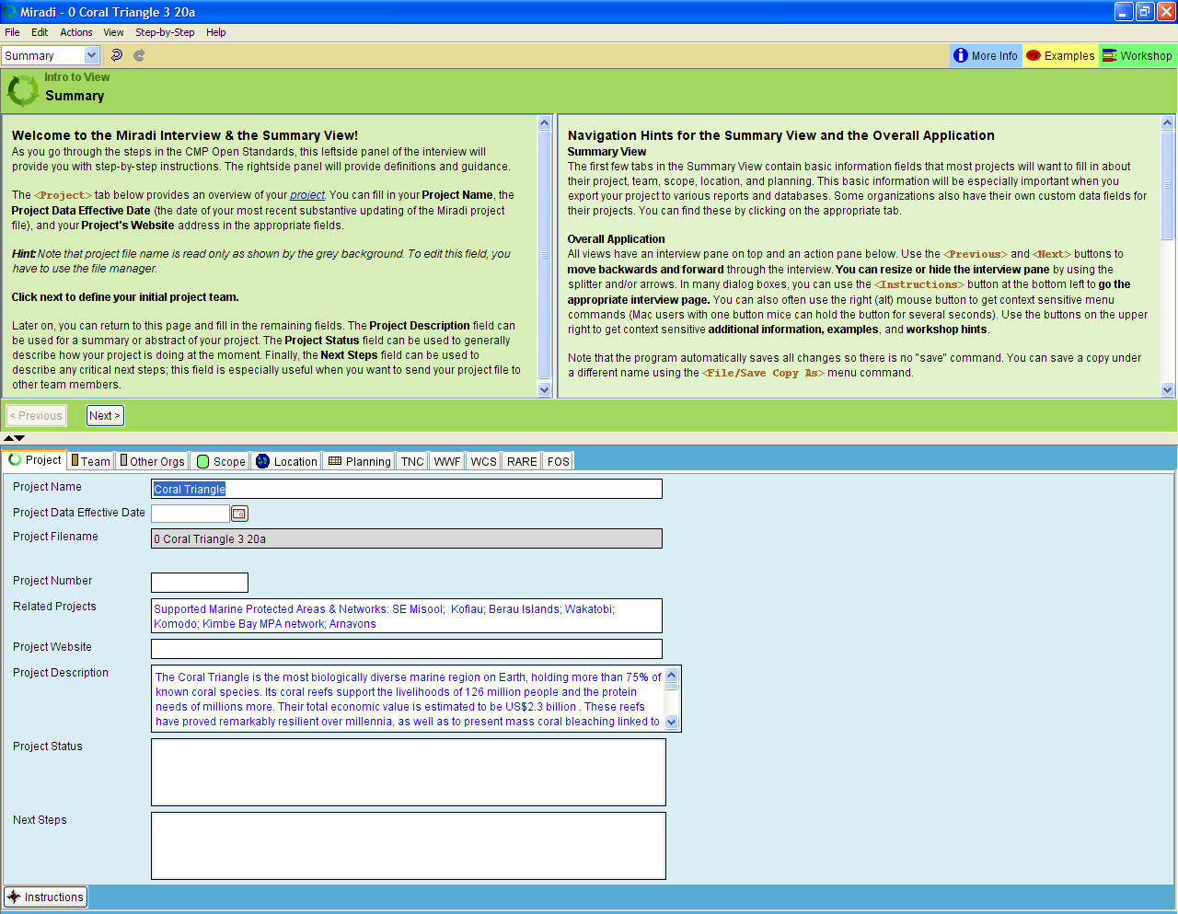
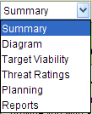
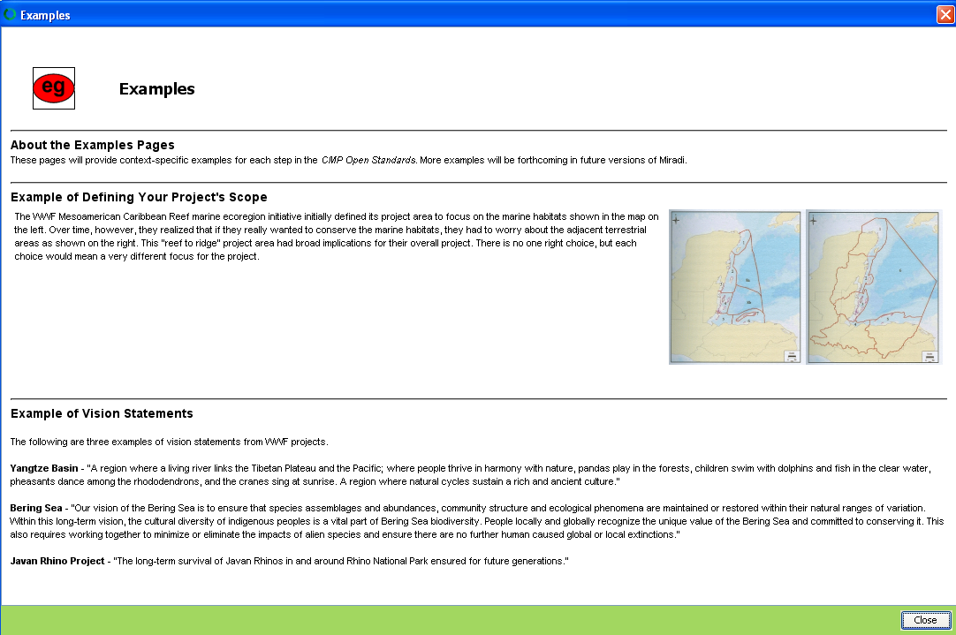
Intro - 2 of 4
⬅
Summary view (pull-down menu to switch to other views)
Instructions walk you through data entry, step-by-step
Access More Info, Examples, Workshop Tips
Move splitter to adjust size of upper/lower panels
Tabs with fields for entering basic project information, team, location, etc.
Notes:
Miradi has 6 main views, which you access via this pull-down menu in the upper left of the screen <click> -- It will open to the Summary view, where you enter basic project information like name, description, team members<click>
The upper portion of the screen includes an set of instructions for entering information for that view, you can scroll forward and backward through each step by clicking Next or Previous buttons <click>
There are a number of tabs for entering different types of information like other organizations involved, project scope, location, <click>
The buttons in the upper right take you to more information, bring up examples, or provide hints for carrying out steps in a workshop setting <click>
You can easily adjust this splitter to change the screen area devoted to the instructions versus the data entry section

Slide 5
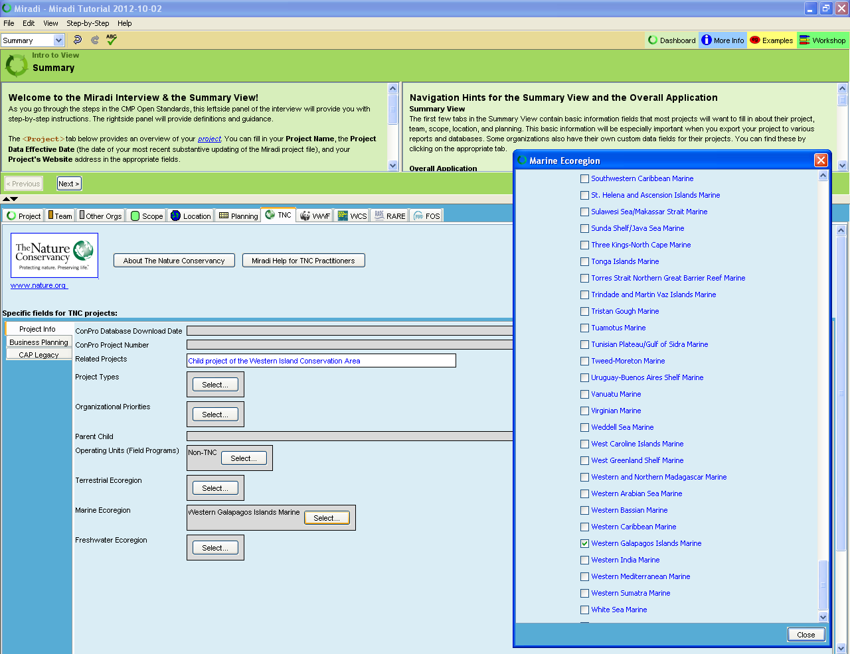
Organization-specific tab & fields for Miradi sponsors
⬅
Intro - 3 of 4
Buttons for standard pick lists – TNC Operating Unit and Terrestrial, Marine, & Freshwater Ecoregions
Notes:
On the TNC tab, you can get Miradi help via email and enter or view TNC-specific information (some to be transferred from ConPro) <click>
There are standard pick lists for TNC Operating Units and Terrestrial, Marine, and Freshwater ecoregions

Slide 6
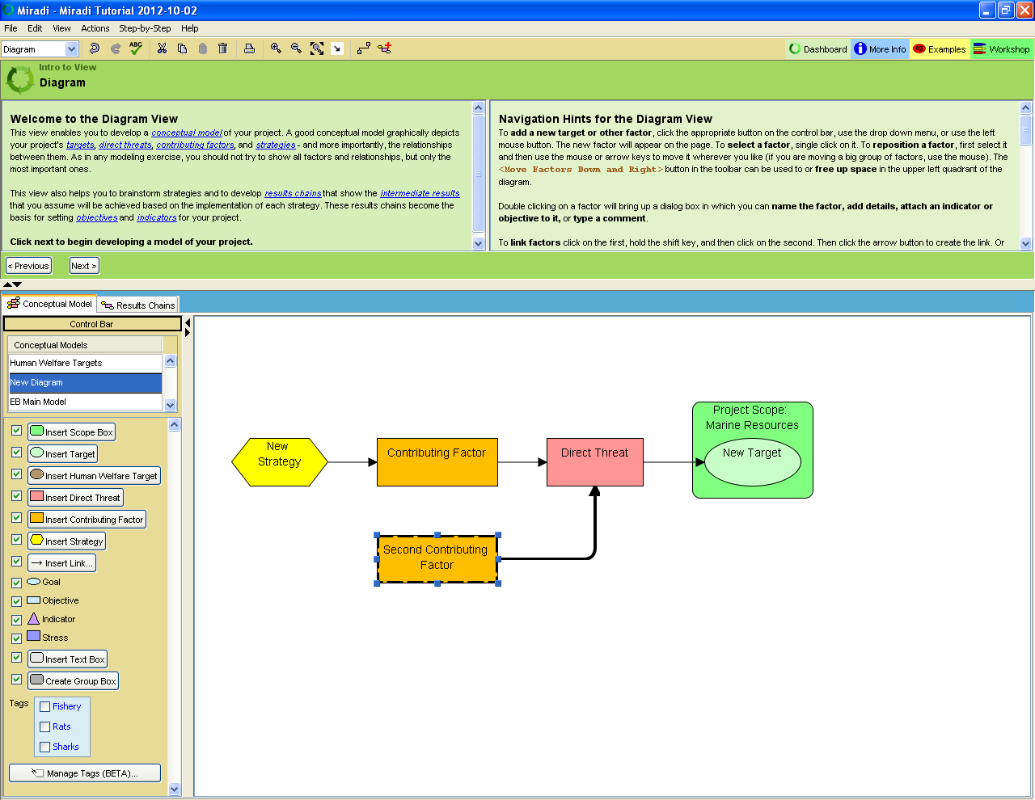
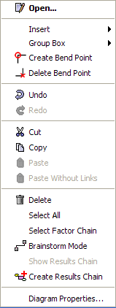

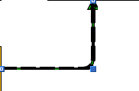


Diagram View is the main data entry view in Miradi
⬅
Zoom settings, including “Zoom to fit”
Intro - 4 of 4
Miradi automatically saves – use “undo” to discard changes
Tabs for Conceptual Model Diagrams & Results Chains – right click to create new diagrams or to rename existing diagrams
Click on a factor before adding a new one to automatically link the 2 factors
Click on buttons to add factors, check boxes to turn layers on or off
Right-mouse click to pull up menu for many functions, including creating & deleting bend points and creating Group Boxes
Splitter can move bar left/right
Double-click on factors to open properties & add objectives, indicators & more
Notes:
The Diagram View is the main data entry view for Miradi <click>
You can insert different types of objects into the diagram by clicking on the buttons in the control bar <click>
There are 2 tabs, one for Conceptual Models (situation analysis diagrams) and another for Results chains, and you can have as many separate diagrams on each tab and easily copy or move information between the diagrams <click>
When you highlight a factor BEFORE clicking on another factor, it will automatically establish a link between the two for you. Otherwise, hold the shift key while clicking on 2 factors then click on the “Insert Link” button <click>
The right-mouse button will bring up a powerful set of options including creating and deleting bend points, modifying Group Boxes, entering a Brainstorm mode <click>
You can double-click on factors to enter information on objectives, indicators, and other information (you’ll see this shortly) <click>
You can create more space for your diagram area by adjusting this splitter <click>
There are zoom tools to zoom in and out, including a Zoom-to-Fit button that will scale the diagram to fill the diagram area <click>
Miradi automatically saves as you work, you can use a very robust undo feature to discard changes (you can go WAY back)

Slide 7
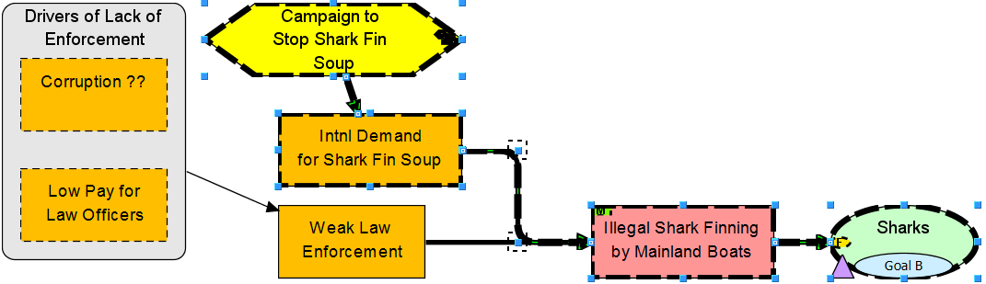
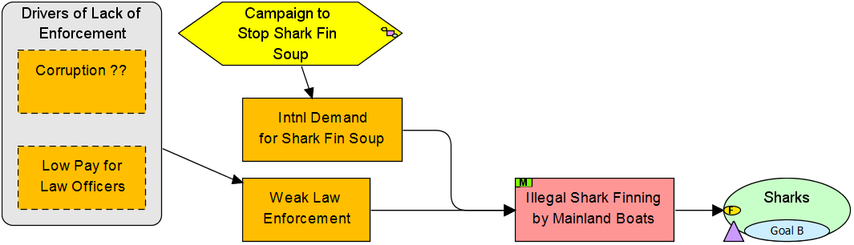
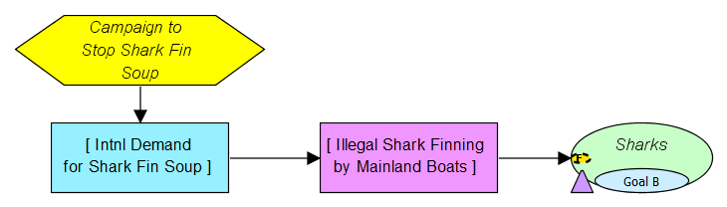
Highlight strategy then right-click & select to build a draft Results Chain for a specific chain from your Conceptual Model (or alternatively, build a Result Chain from scratch, directly from Control Bar menu)
⬅
Conceptual Model
Contributing Factors
& Strategies
Direct Threats
Target
Results Chain
Notes:
This shows the building of a situation analysis for a couple of the threats to coral reefs <click>
These are some of the direct threats <click>
And the contributing factors behind the direct threats, as well as opportunities (like the Indonesian Government’s Coral Triangle Challenge) <click>
Add the addition of strategies, directed in this case towards some of the contributing factors <click>
Miradi allows you to convert a situation analysis diagram into a results chain by highlighting one or more strategies and right-clicking and selecting the Create Results Chain option – <click>
You can then re-word the factors to convey desired results, as you can see here.
You can also enter Results Chains directly, in the same way you create situation analysis diagrams

Slide 8
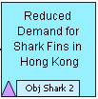
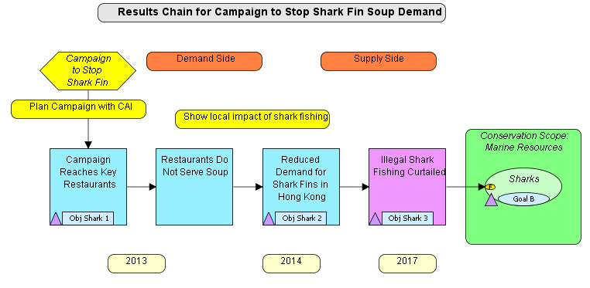
Add Measurable Objectives to the Results Chain(s)
⬅
See next slide for the Dialog Box for that comes up when you Double-click on this factor to enter or edit Objectives
Notes:
You can add details such as objectives, indicators and other information to any of the factors in the diagram, by double-clicking on the factors
The Intermediate Results provide a short summary of desired changes but it’s a good idea to have more detailed objective statements associated with many of the factors in the diagram <click>
Here you can see that specific goals have been added for the target and 5 objectives where added to other factors in the diagram <click>
The next slide will show you the objectives associated with the “Increase in MPAs” intermediate result

Slide 9
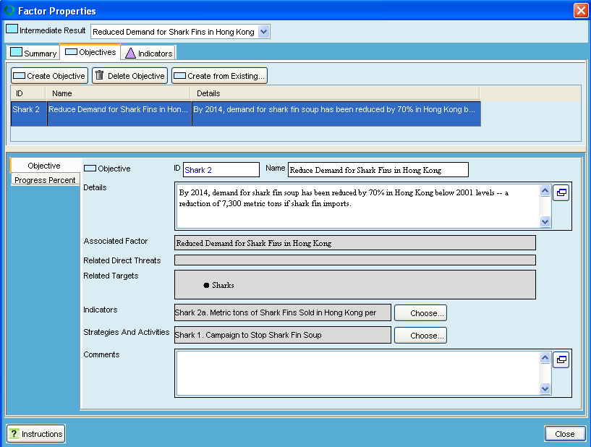
⬅
Adding/Editing Objectives for an Intermediate Result
1 Objective entered
User assigned ID code
Short name
Full Objective name
Shows details for the highlighted row
Gray cells show relationships established in the diagram
Adjust default Miradi associations between Objectives and Indicators or Strategies/Activities
Notes:
You can add and delete objectives or make exact copies (clones) of existing objectives (something you might do to save data entry time if you have a similar objective already entered)
Here you can see 2 objectives have entered <click>
The lower panel shows details for whatever row is highlighted in the upper table
If you’d like the user can assign ID codes to any objective <click>
The name field is intended to capture a short version of the objective <click>
Whereas the Text field provides a place to write a full, SMART objective statement <click>
The cells with gray backgrounds show you relationships established within the diagram <click>
You can adjust the default association between objectives and indicators or objectives and strategies by clicking on these buttons

Slide 10
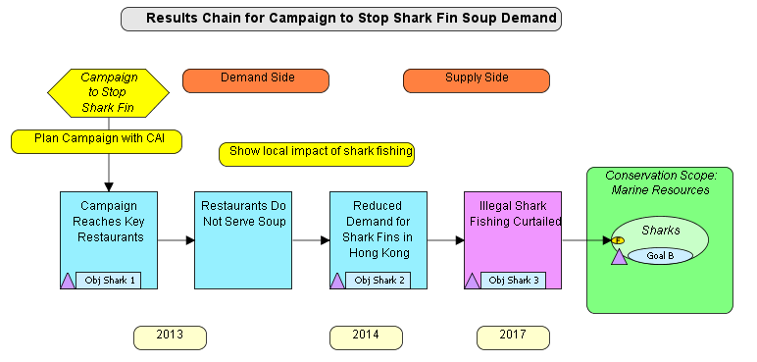
⬅
Add Indicators & Indicator Measurement information
See next slide for the Dialog Box that comes up when you Double-click on the Indicator icon for this factor to enter or edit Indicators & Measurements
Notes:
For every factor that has an objective, you should also add indicators that will be tracked to measure progress towards achieving the objectives <click>
Here you can see that a variety of indicators have been added to the results chain <click>
The next slide will bring up the indicator properties associated with this intermediate result

Slide 11
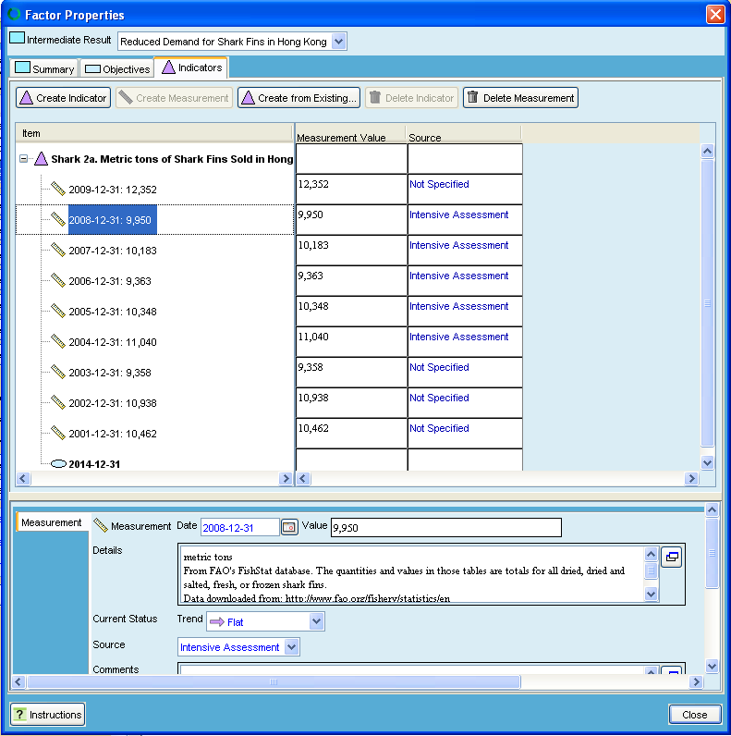
Indicator & measurements over time (actual measures information)
⬅
Indicator for Objective
Most recent indicator measurement information
Past measurement information
Desired future result value & date
Shows details for the highlighted row
Trend (Flat – no major changes)
Indicates data from quantitative sources
Notes:
We are now looking at the indicators tab.
The buttons allow you to create or delete indicators or measurement values (or make exact copies of an existing indicator) <click>
The triangle denotes the indicator – here the ha’s of MPAs that have been designated <click>
Older indicator measurement information is reported here <click>
The most recent measurement information from Sept 07 is reported here <click>
If you want, you can also enter the desired future status (information from the objective) to clearly show the difference between indicator measurements and the results you are trying to achieve
The lower panel shows details for the highlighted row where you can assign dates using a little calendar widget, enter the indicator value, and provide any details that you want (here, it shows the size of each of the individual designated MPAs).
You can specify a trend assignment using a drop-down menu (here assigned as a “Strong Increase” based on the big jump since the last measurement, in fact exceeding the June 2008 desired result)
There is also a pull-down for the data source – labeled “Intensive Assessment” here because this indicator is calculated via GIS analyses

Slide 12
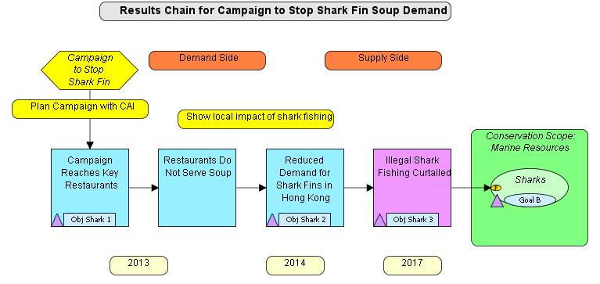
⬅
Add Activities & high-level work plan information for Strategies
Results Chain Diagram
See next slide for the Dialog Box that comes up when you Double-click on this factor to enter or edit Activities
Notes:
You can also add more details at the level below the Strategies – entering Activities and who, when, and cost information <click>
The next slide will show you the properties associated with this Strategy hexagon

Slide 13

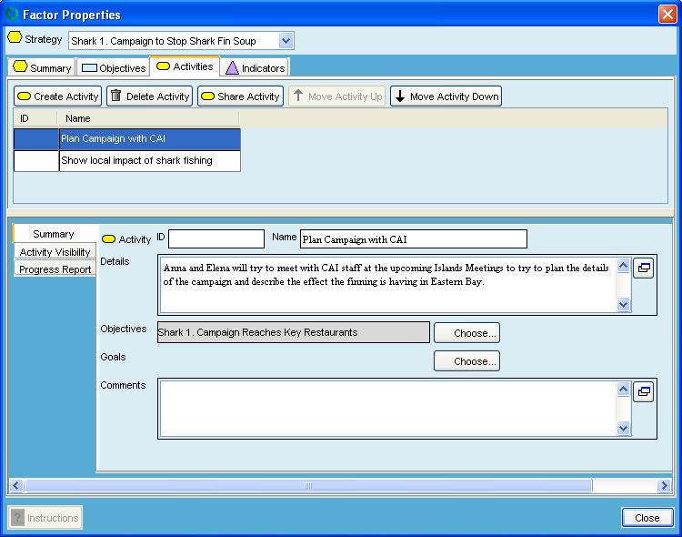
⬅
Activity data entry
Activities tab on the Strategies Dialog Box
Name of Strategy
2 Activities Entered
Shows details for the highlighted row
Notes:
You can see the name of the Strategy at the top <click>
We’re looking at the Activities tab (you can see there are also Objectives and Indicators tabs) <click>
There are 4 Activities entered for this strategy <click>
The lower panel shows details for the highlighted Activity – you can specify cost information, <click>
or who is responsible for implementing this activity

Slide 14
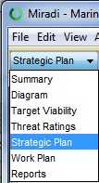
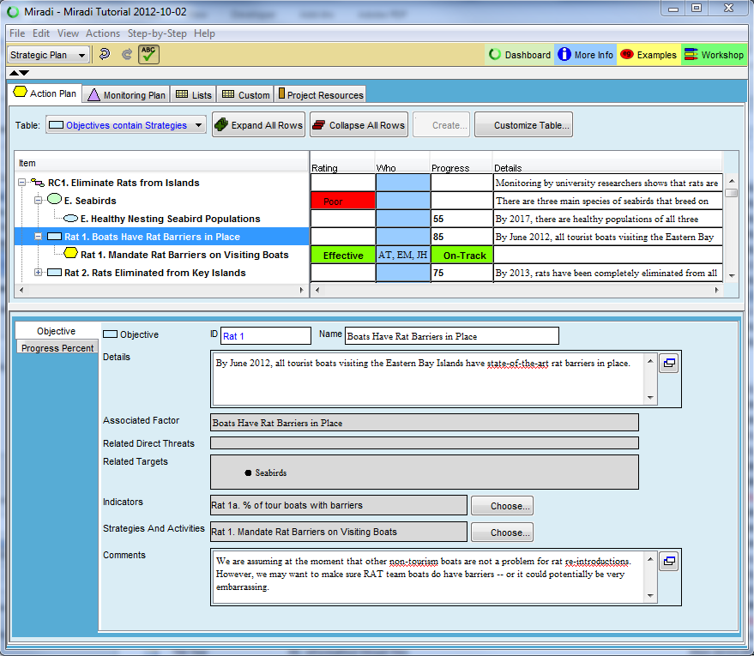
Strategic Plan View – standard view displays
⬅
Custom View (see next slide)
Click “-” or “+” to collapse/expand tree
Expand or collapse all rows
Standard Planning Views (Action Plan selected)
Toggle control for Objective – Strategy relationship
Details for the selected row are displayed in the lower panel where they can be edited
Side tabs to access additional fields

Slide 15
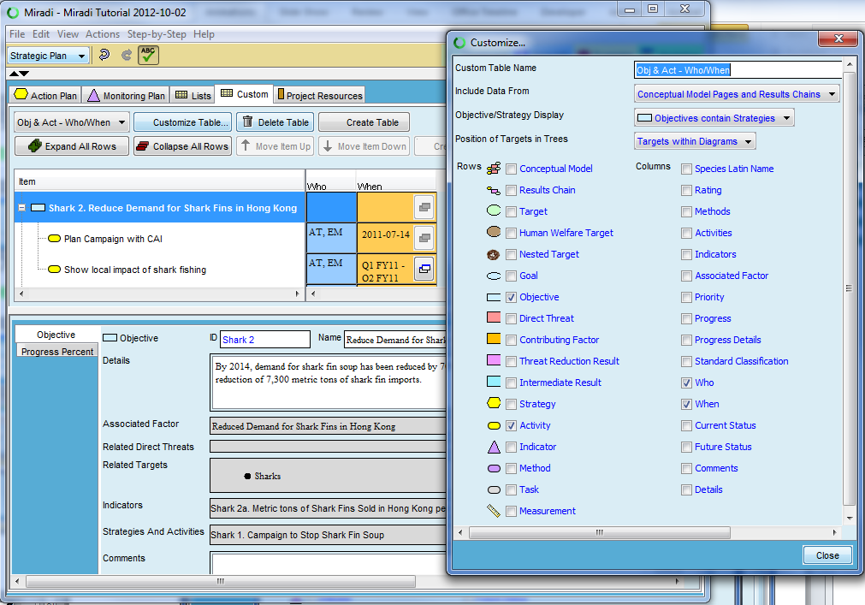
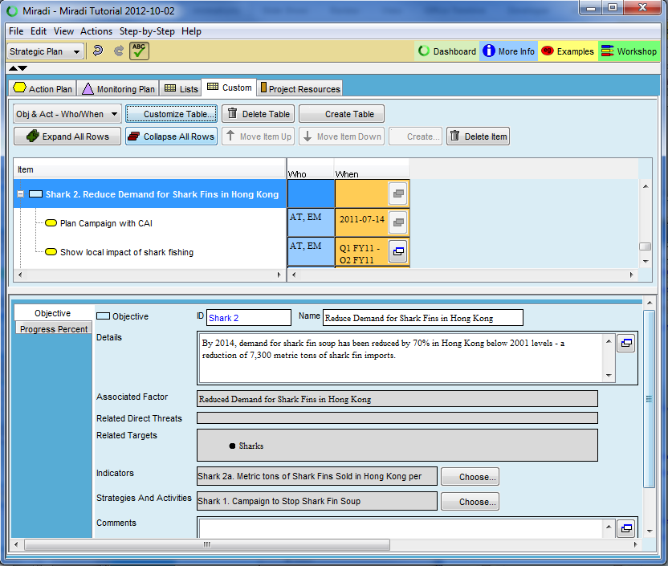
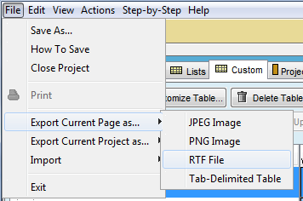
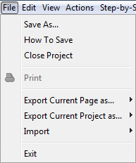

Strategic Plan View – Custom view display
⬅
Custom View
Can start with current or blank view
Assign name to the custom view
Any table can be exported to Word – use RTF File option
Check boxes for the rows you want in the table
Check boxes for the columns you want in the table

Slide 16
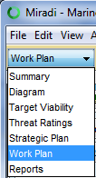
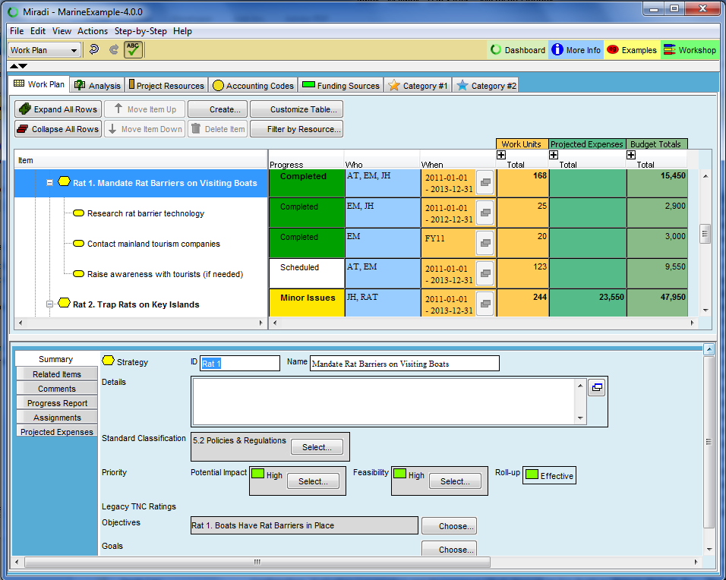
Work Plan View - Layout
⬅
Create pivot table like summaries
Enter people
Enter Account Codes
Enter Budget Centers
Optional Category 1
Optional Category 2
Progress Ratings
Staff assignments
When
Work days
Expenses
Totals
Work Plan table
Create Activities or Tasks
Details for the selected row are displayed in the lower panel where they can be edited
Side tabs to access additional fields

Slide 17
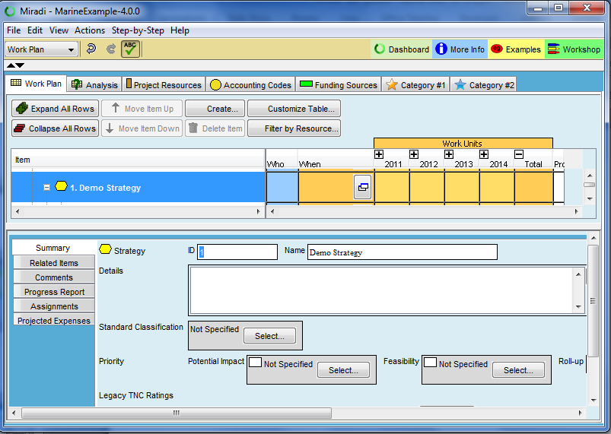
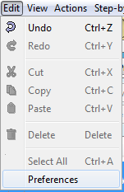
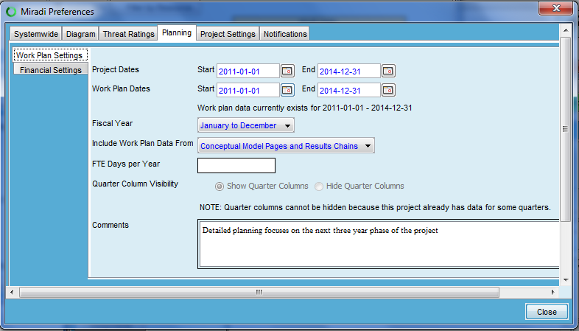
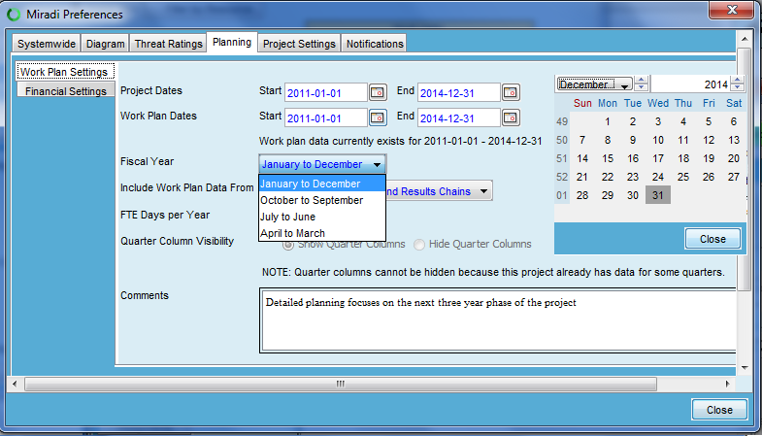
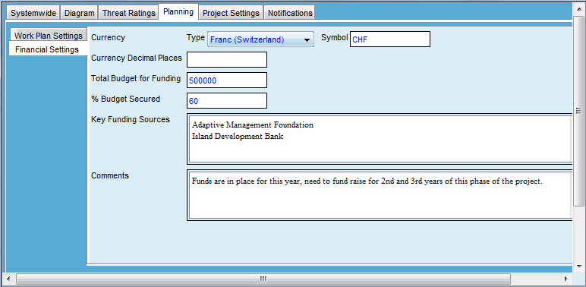
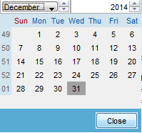

Work Plan – Project Settings
⬅
Specify Start and End dates using date widget
Select “Edit” – “Preferences”
Additional Financial Settings
Specify currency
Specify fiscal year
Specify key financial information

Slide 18
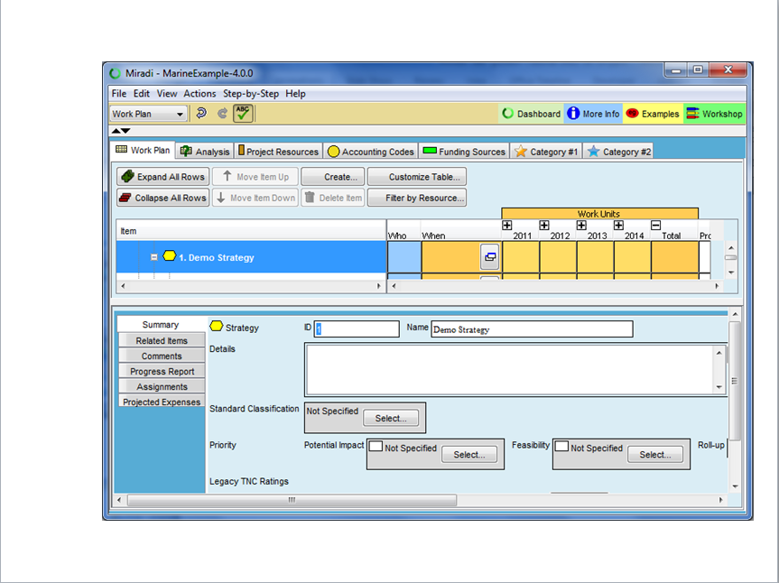
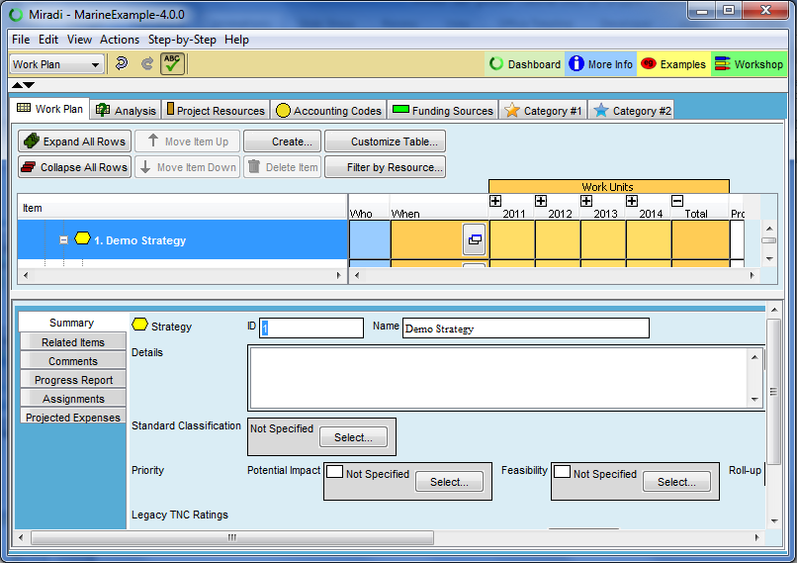

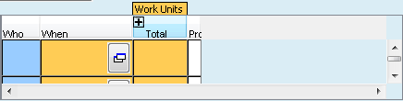
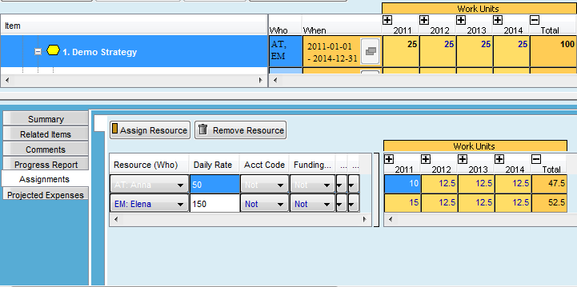
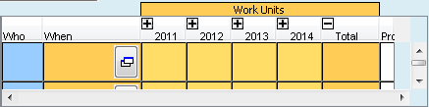
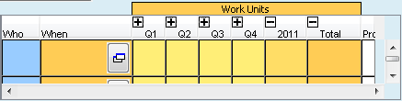




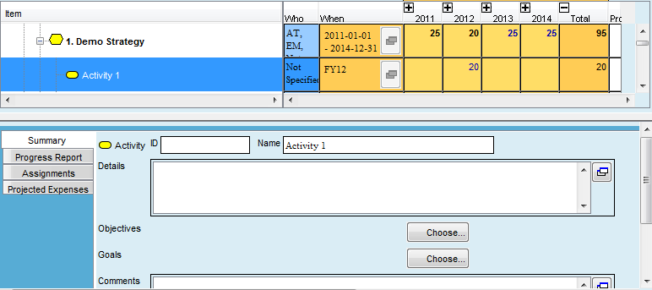

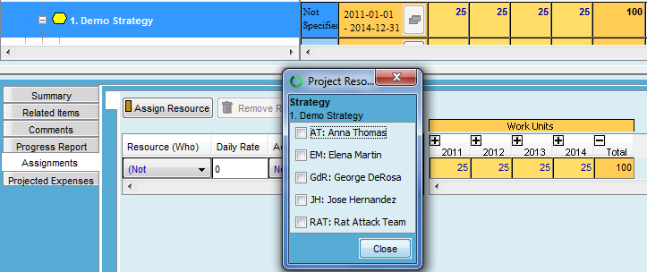
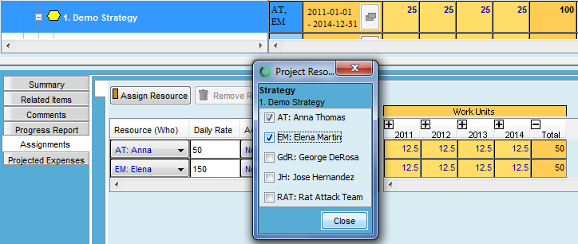
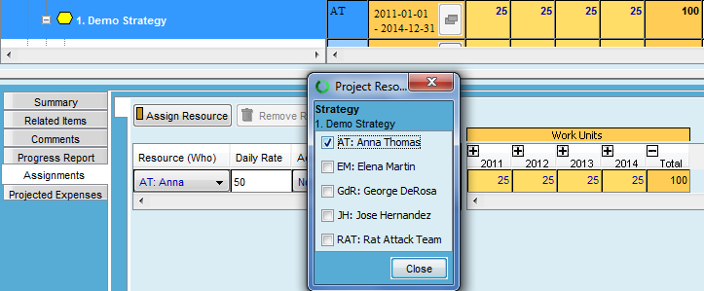
Work Plan – Work Effort Data Entry
⬅
Double-click in “Who” to open pick-list of people (add people in Project Resources tab)
Can shift to finer level of actions via the “Create…” button
Click “+” to show more detailed dates
Clicking “+” will continue to show more detail
Click “-” to collapse dates
100 days entered as total across 4 years (Note blue text – editable)
Initials appear in top panel, Assignment entry appears in bottom panel
“When” column automatically filled out – reflects 4 years
When work days entered at finer grain (blue text - editable) – Total shifts to a roll-up field (not editable)
Data entered for rest of years (Note changing “Total” & “When”)
Watch in Slide Show Mode
If second person is added, work days entered in top panel are split evenly in bottom panel. Top panel work days still blue & editable as long as even split between people.
If work days are added at Activity level – Miradi honors this finer-grain data as the new, improved estimate, Strategy row now rolls up Activity data and is no longer editable.
If asymmetrical work day entry is entered in lower panel, additional edits must be made here (top panel no longer blue text, not editable).

Slide 19
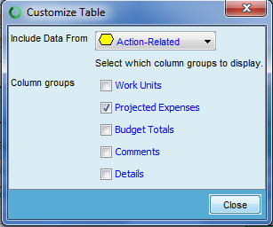
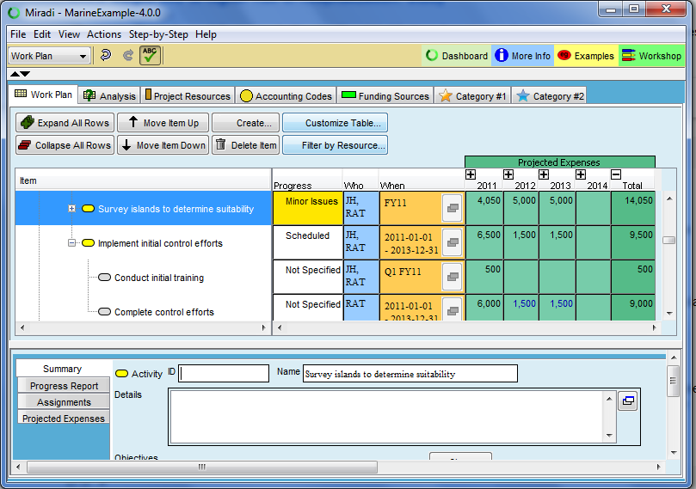
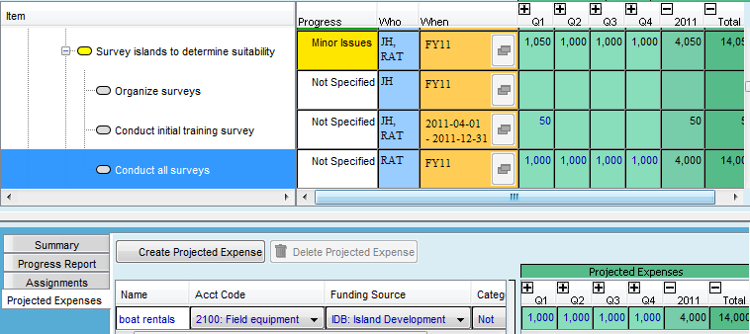
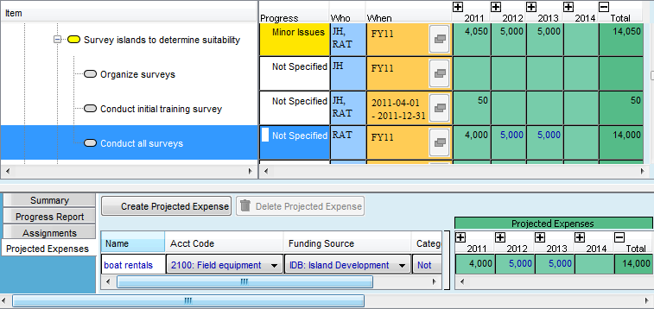
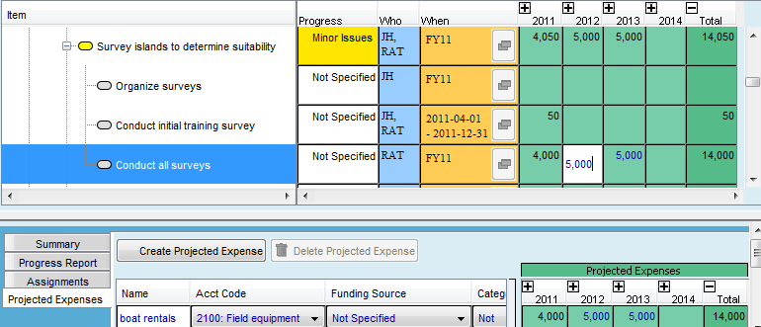
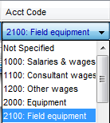

Work Plan – Expense Data Entry
Switched display to show Expense columns instead of work day columns
⬅
Expense assigned to 2012 (editable in top or bottom panel – blue text)
Click “-” to collapse
Because 2011 expense is not editable – indicates finer scale expense exists – click “+” to expand
User-entered expense description
Assigned to account code
Assigned to Funding Source (could be budget center)
Expenses entered (and editable) at Quarter-level

Slide 20
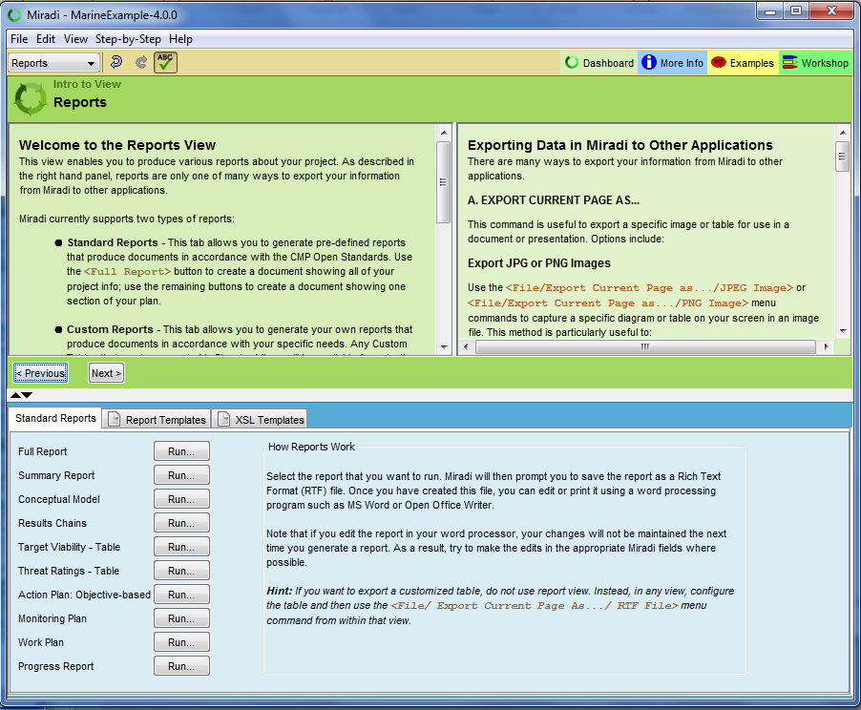
Reports & Exporting Data
⬅
Reports View
Full Report
Reports for individual sections
Notes:
The Reports View allows you go generate and save standard reports (for example, you can export a project plan and results in a pdf file to share with partners) <click>
From within any view in Miradi, you can export a small compressed Miradi file (has an .MPZ suffix) <click>
You can export a full report with all content or <click>
Generate reports for individual sections of Mirad <click>
Reports can be saved as PDF files, or Open Office documents, diagrams and tables can be saved as JPEG or PNG files (you can increase diagram image quality by first zooming in closer). You can also export tables as images or as as tab-delimited tables
We are working with Miradi and TIS programmers to get develop ConPro-Miradi data exchanges

Slide 21
The remaining slides describe target viability and threat ranking views in Miradi

Slide 22
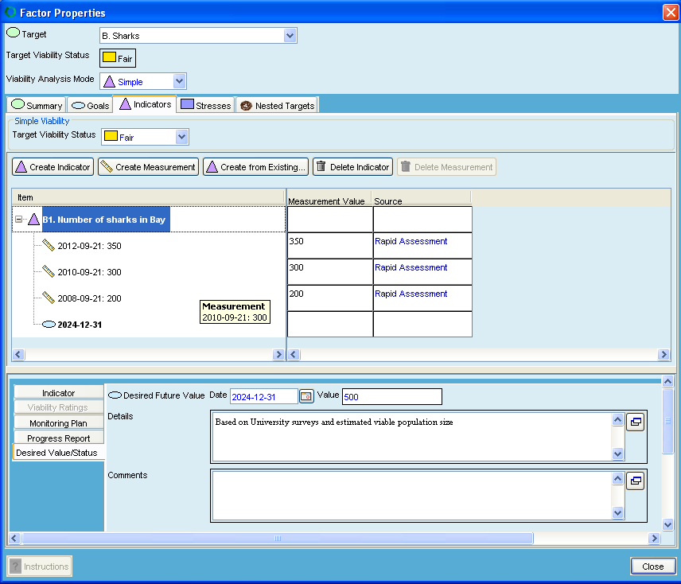

Simple Viability Mode – Indicator & Desired Status
Target name
⬅
Viability Analysis Mode: Simple
Overall target viability status
Create an indicator
Set desired future status
Shows details for the highlighted row

Slide 23

⬅
Simple Viability Mode – Indicator Measurements
Most recent indicator measurement information
Past measurement information
Shows details for the highlighted row
Assign Trend category
Document how measurements were obtained

Slide 24


Key Attribute Viability Mode – Indicator & Desired Status
⬅
Target name
Viability Analysis Mode: Key Attribute
Create a KEA
Create an indicator
Shows details for the highlighted row
Add one or more indicator rating descriptions
Set desired future status
Document how ratings and measurements were obtained

Slide 25

Key Attribute Viability Mode – Indicator Measurements
⬅
Most recent indicator measurement information
Past measurement information
Shows details for the highlighted row
Assign Trend category
Document how measurements were obtained

Slide 26


Miradi supports 2 Threat Ranking Modes
⬅
Simple Threat Ranking - Severity, Scope, & Irreversibility assigned to Direct Threats (Sources of Stress)

Slide 27


Simple Threat Ranking Mode
⬅
First enter targets and threats in Diagram
Wizard will walk you through threat ranking
Produces TNC style Threat Summary Table (uses TNC roll-up rules)
Assign Scope, Severity, and Irreversibility Ratings

Slide 28


Miradi supports 2 Threat Ranking Modes
⬅
Option (1) - Threat View (after Direct Threats [Sources] are entered)
Option (2) - Enter Stresses & Ranks via Target Properties in Diagram View (can be entered before Direct Threat entry)
Stress-based Threat Ranking - traditional TNC threat ranking:
Stress → Severity/Scope
Source → Contribution /
Irreversibility
2 Options
for data
entry/editing

Slide 29


Stress-based Threat Ranking Mode
⬅
Option (1) - Threat View (after Direct Threats [Sources] are entered)
Wizard provides instructions
Create/Delete Stresses
Select cell in table
Assign Severity & Scope ranks
Click to enter/edit stresses & stress ranks
Assign Direct Threat (i.e., Source) Contribution & Irreversibility Ranks

Slide 30


Stress-based Threat Ranking Mode
Option (2) - Enter Stresses & Ranks via Target Properties in Diagram View (can be entered before Direct Threat entry)
⬅
Create/Delete Stresses
Double-click on Target then click on Stresses Tab
Assign Severity & Scope ranks
Assign Direct Threat (i.e., Source) Contribution & Irreversibility Ranks using Options (1) or (2) – see previous 2 slides

