Slide 1
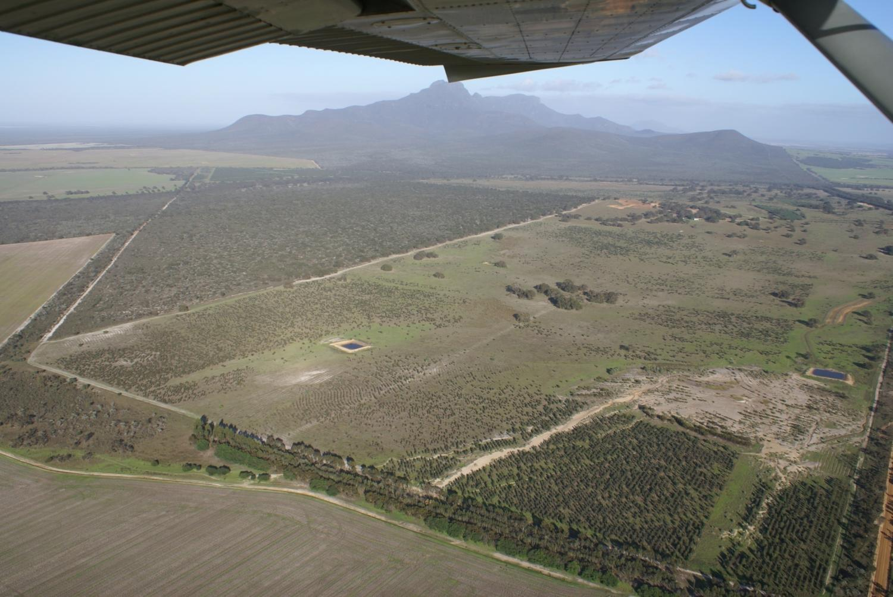
The Fitz-Stirling Functional Landscape Plan in Action – A CAP story

Slide 2
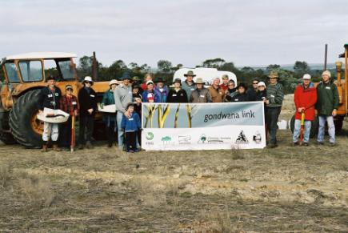

1a) Project Team - I’m just the story-teller
Partners:
  The Nature Conservancy
  Bush Heritage Australia
  Gondwana Link Ltd
  Fitzgerald River Biosphere Group
  South Coast NRM (early on)
Corporate Donors
  Shell
  Lottery West
  WesFarmers
  Mirabella
  Others….

Slide 3
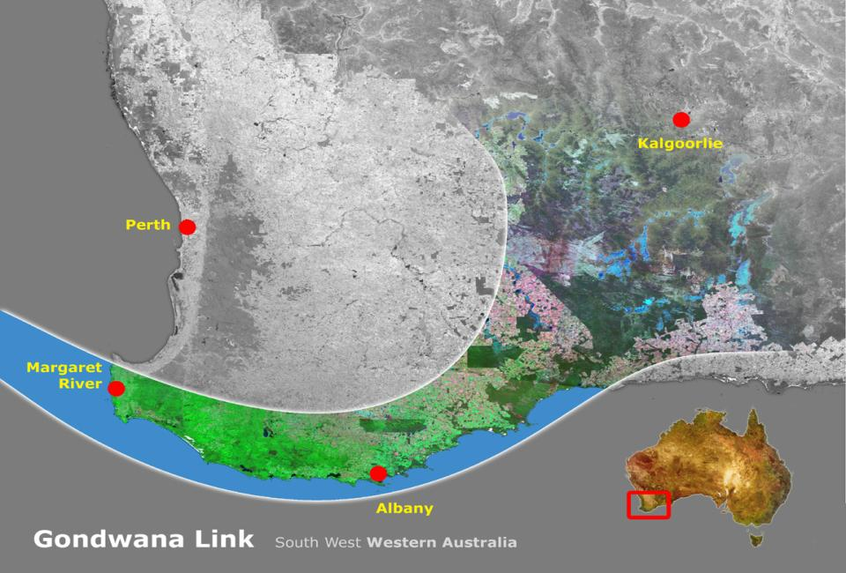
1b) Conceptualize – Project Scope – Multiple scales

Slide 4
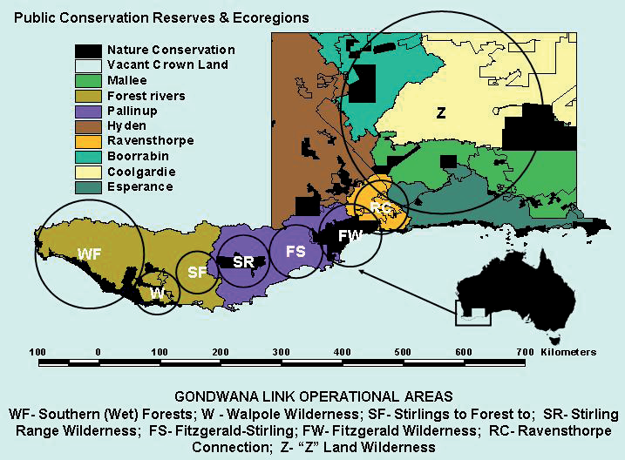

Slide 5
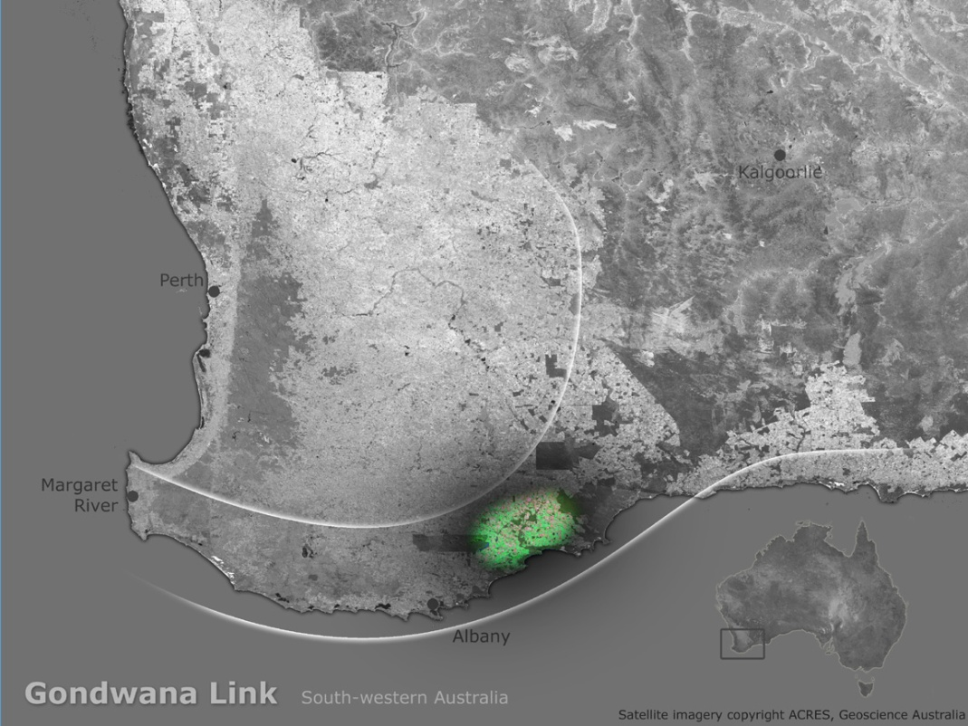

Slide 6
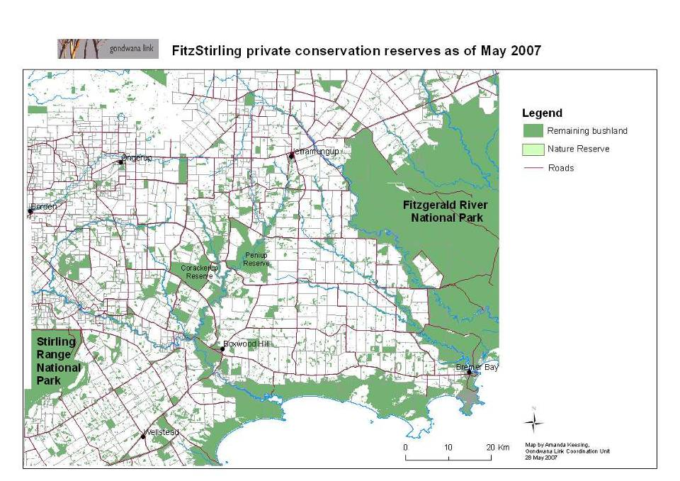
Fitz-Stirling:
area of main focus is within 10 kilometres of a line between Ellen Peak to Wangup Well.
70 km link
Notes:
6

Slide 7
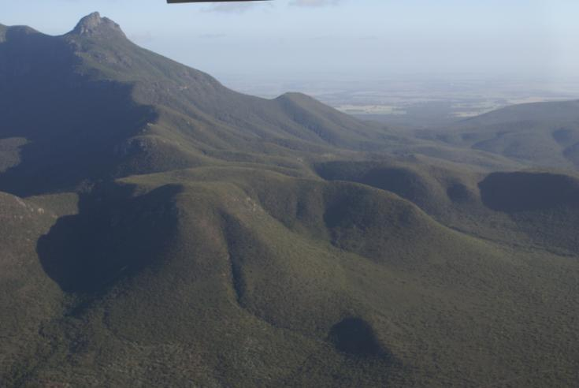
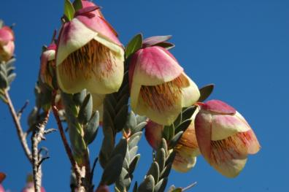
Conservation Targets

Slide 8
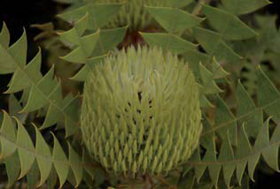
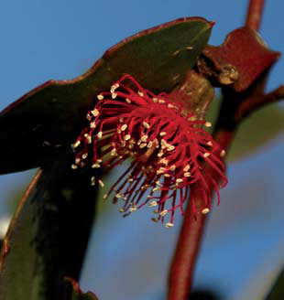
Proteaceous Rich Communities
Mallet And Moort Woodlands

Slide 9
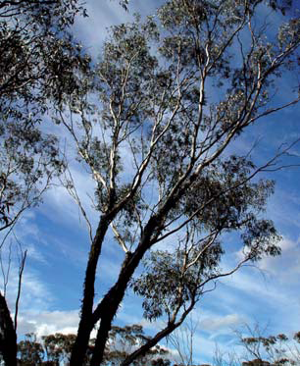
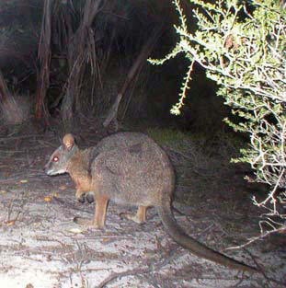
3. Flat-topped Yate (Or Swamp Yate)
Woodlands
4. Tammar And Black-gloved Wallabies

Slide 10
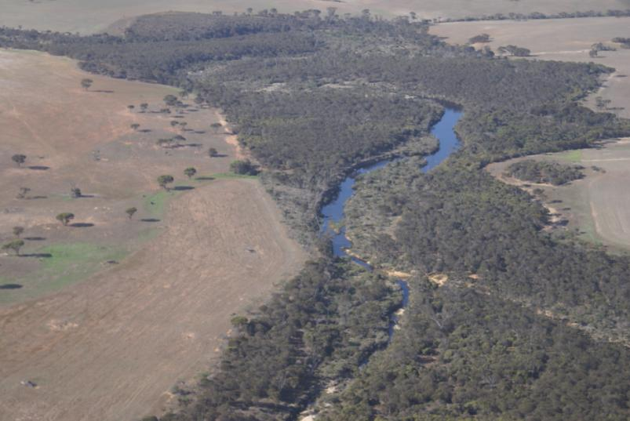
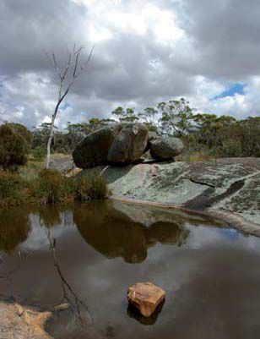
5. Creeks
6. Freshwater Systems

Slide 11
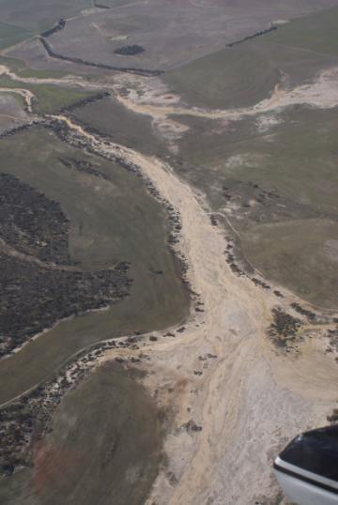
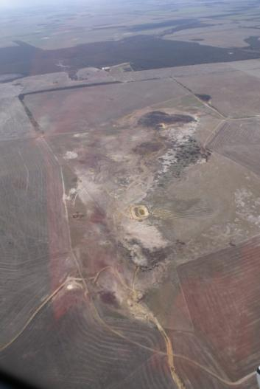
The sustainability imperative

Slide 12
Fitz-Stirling Objectives*
Restore 16,000 ha of native vegetation….
Protect and enhance 60,000 ha of remnant vegetation…
Improve the condition of 60% of creeks within 3 catchments
Increase the population of wallabies by 30%
To be achieved by 2013-2017
*From The Fitz-Stirling Functional Landscape Plan V 2.0

Slide 13
2a) Fitz-Stirling Strategies*
Land acquisition
Ecological restoration
Long-term ecological management
Native plant-based enterprises
Noongar Cultural Corridor (reconnecting communities)
Bush University
*Greening Australia’s priorities

Slide 14
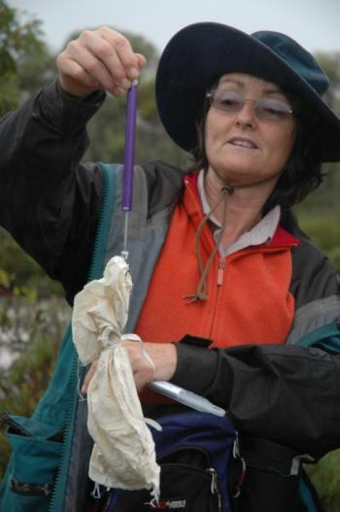
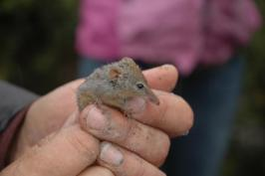
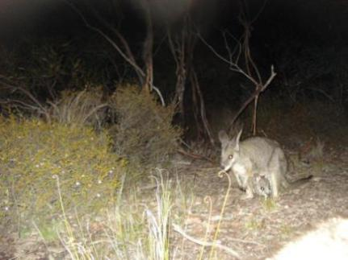
2b. Measures – Biodiversity, creek health and livelihoods
Outcomes monitoring conducted by Bush Heritage Australia
  Birds
  Reptiles
  Small mammals
  Creek condition (baseline)
Greening Australia
  Revegetation success

Slide 15
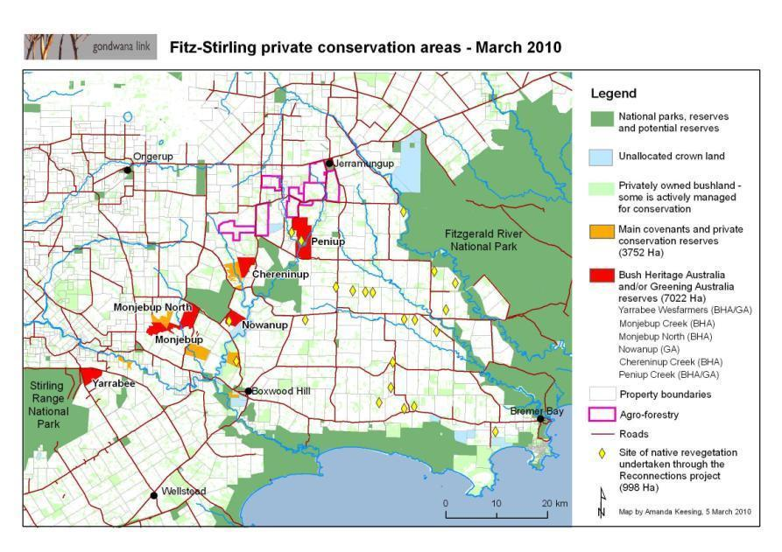
3. Implement & Monitor – Indicators of Success – THE MAP

Slide 16
Property acquisitions through time
Past 7 or so years
Closing the landscape gap!
Compiled by Amanda Keesing, Gondwana Link Ltd

Slide 17
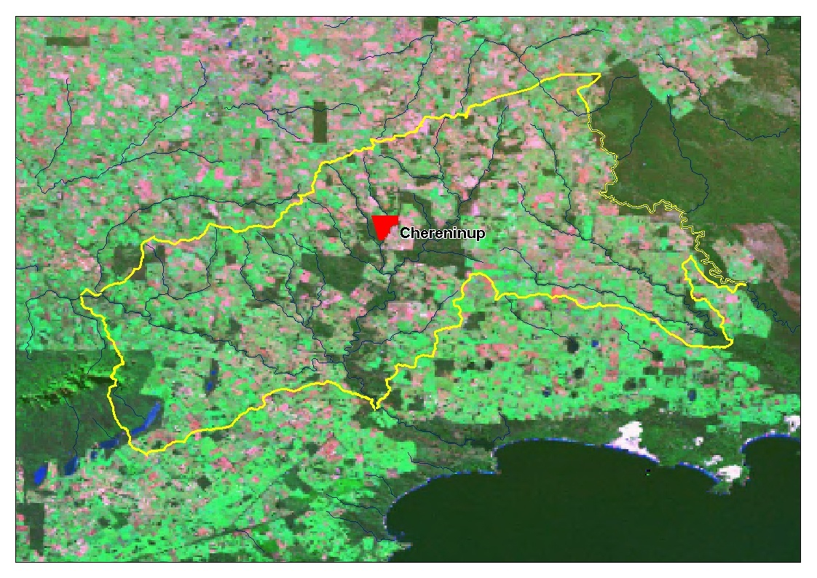

Slide 18


Slide 19


Slide 20


Slide 21
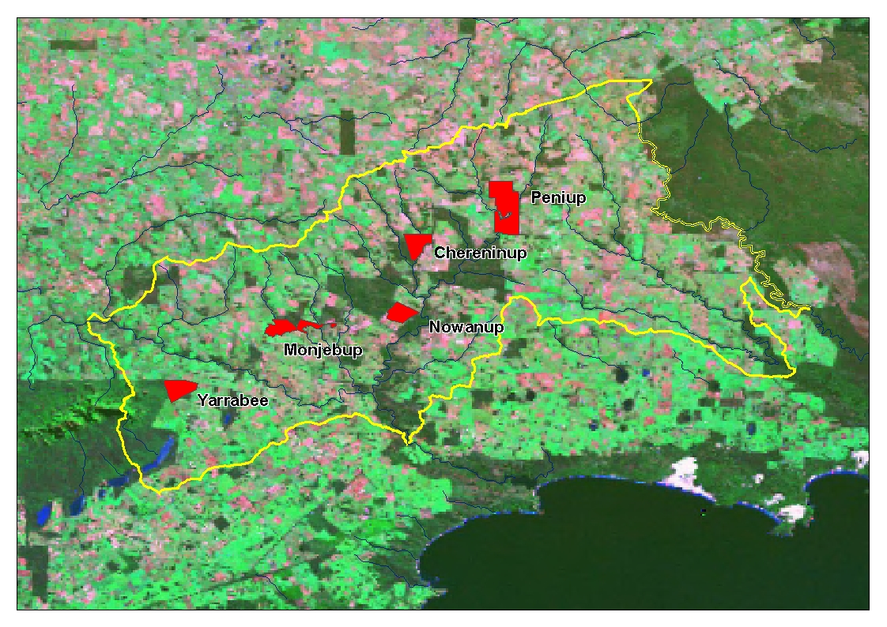

Slide 22
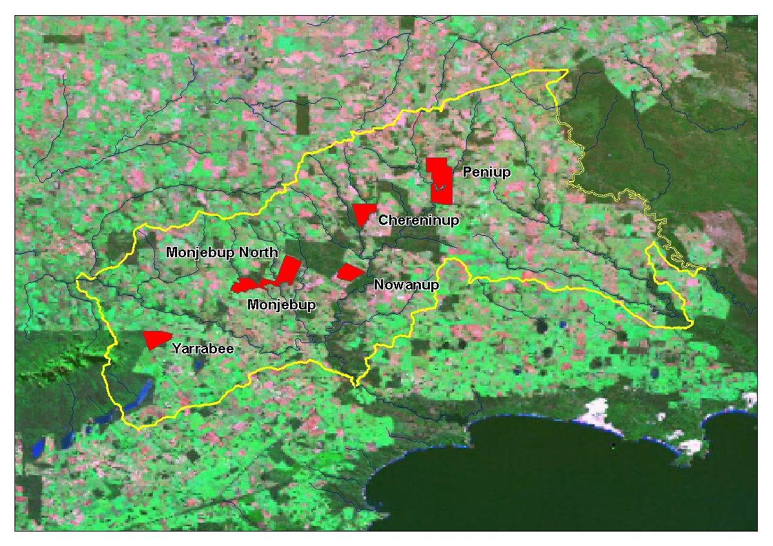

Slide 23
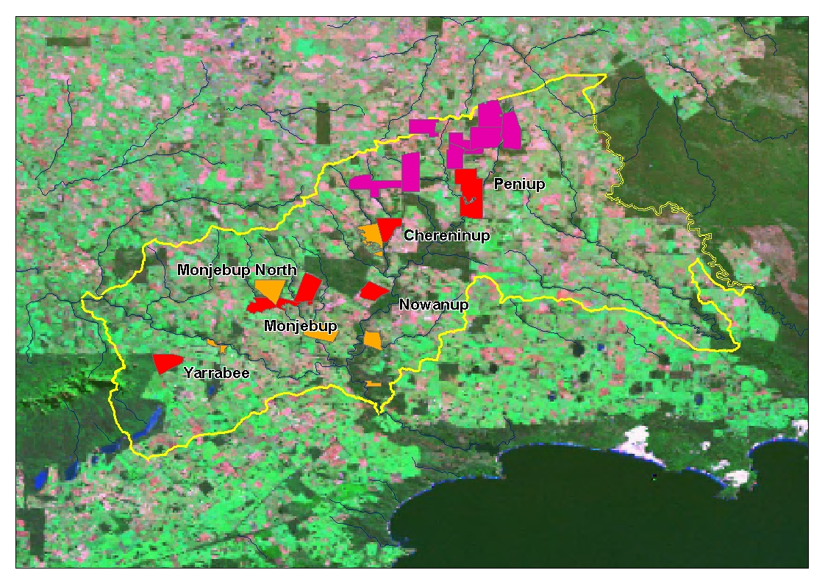

Slide 24
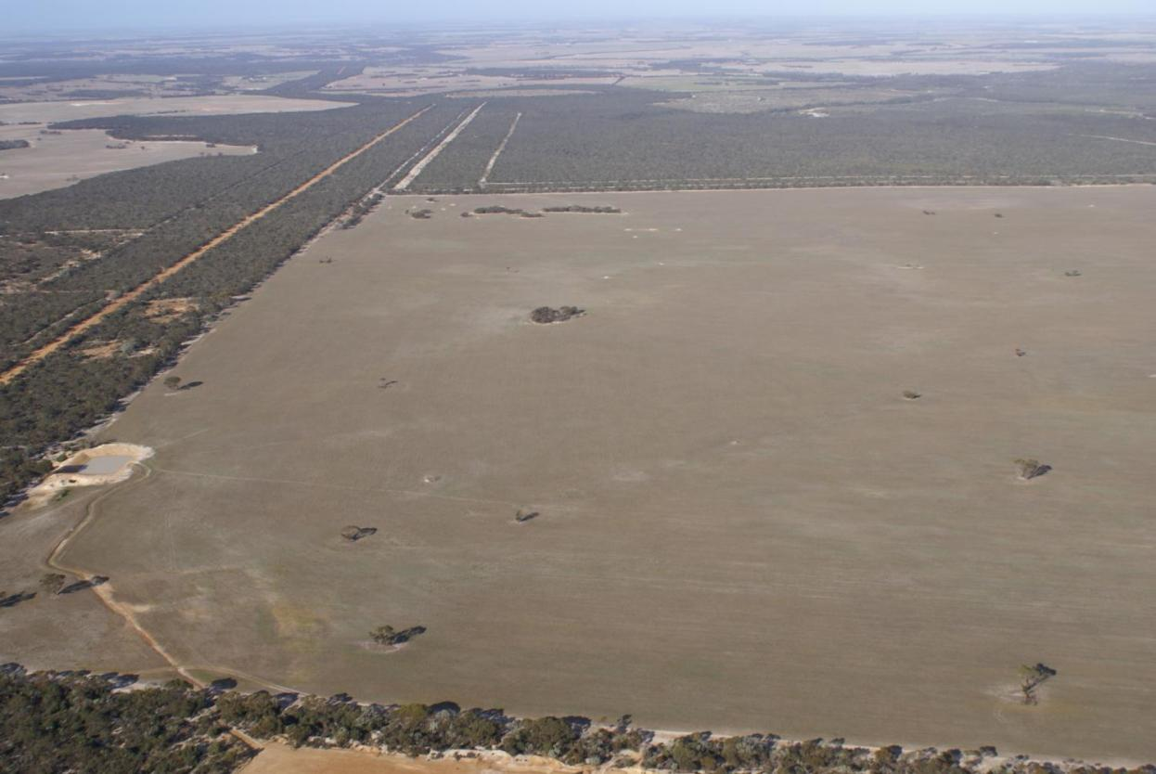
The latest acquisition
‘Monjebup North’- Bush Heritage Australia
(April 2010)

Slide 25
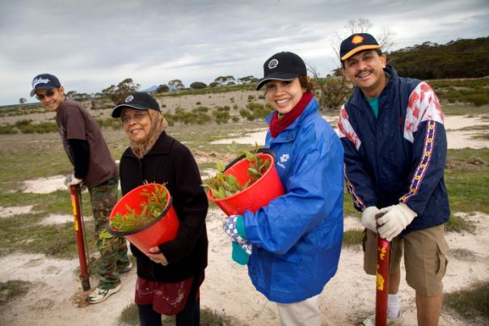
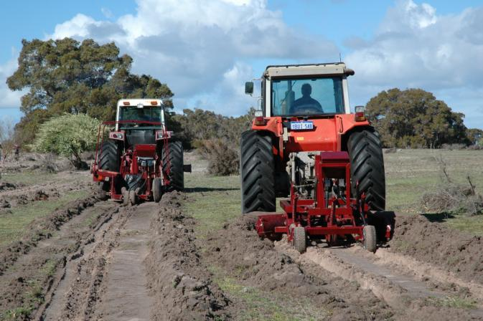
Implement & Monitor - Restoration Successes
1600 ha revegetated (objective 10% completed)
996 ha of this reveg on private farms
(Shell Reconnections Project)
Aril 2010

Slide 26
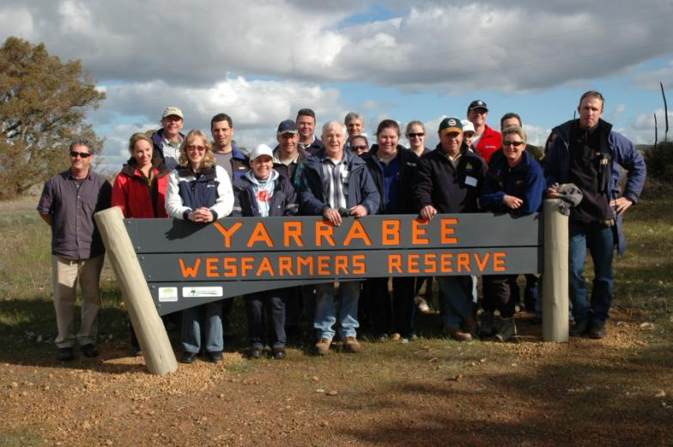

Slide 27
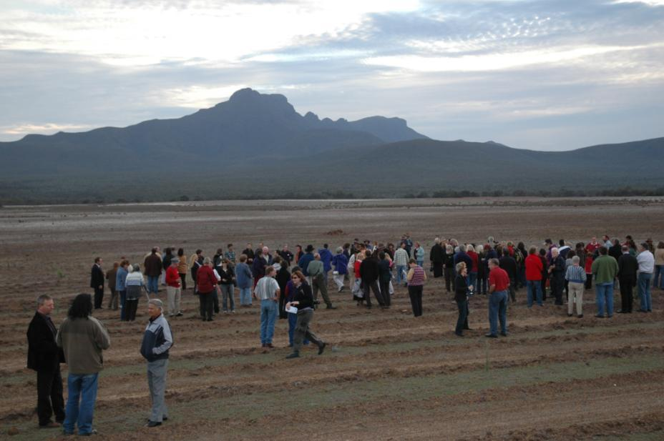
Yarrabee June 2007

Slide 28
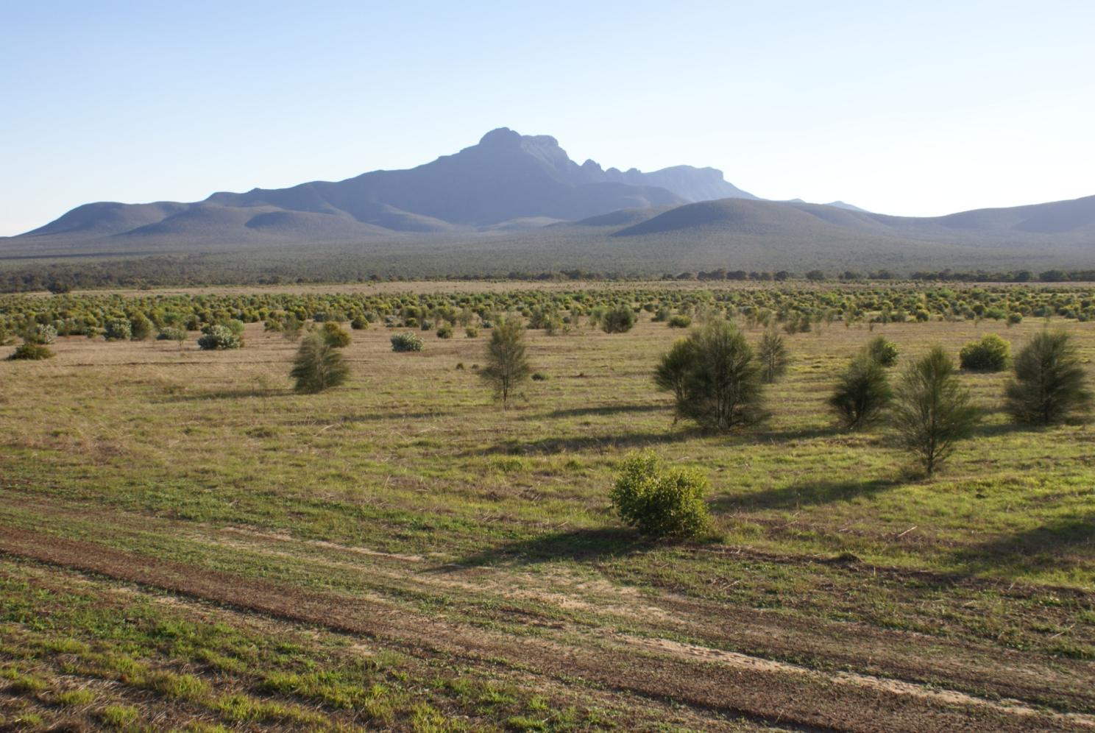
April 2010

Slide 29
April 2010

Slide 30
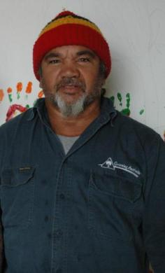
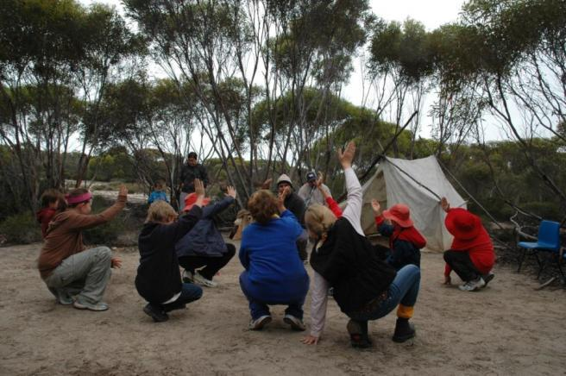
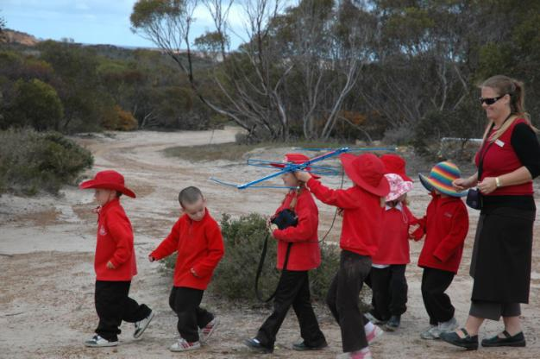
Implement & Monitor
Reconnecting Communities: Noongar Cultural Corridor
  Education
  Youth rehabilitation
  Noongar Elder Eugene Eades – Award winner

Slide 31
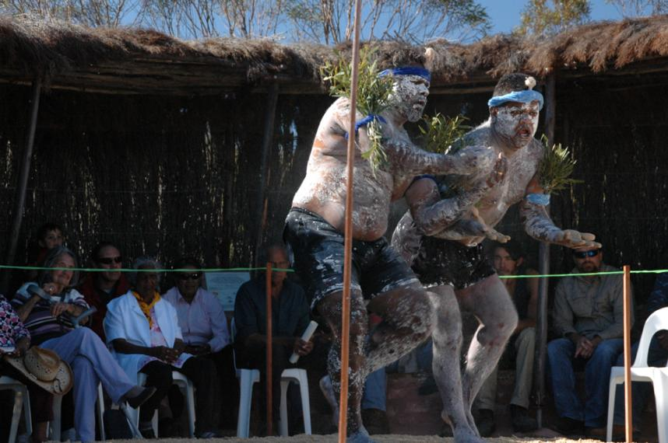
Celebrating on-country

Slide 32
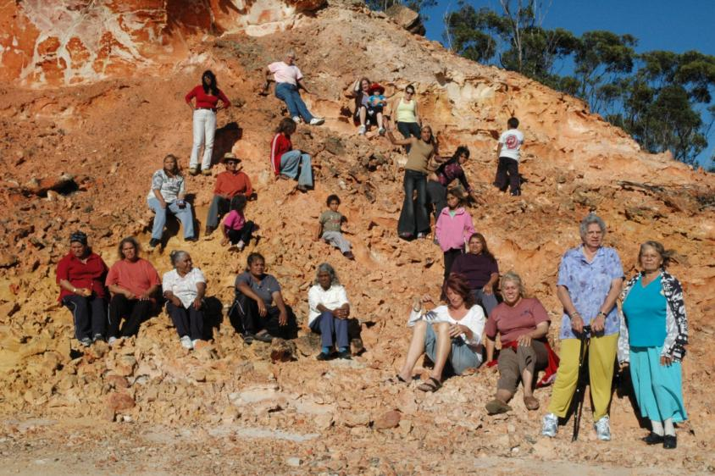
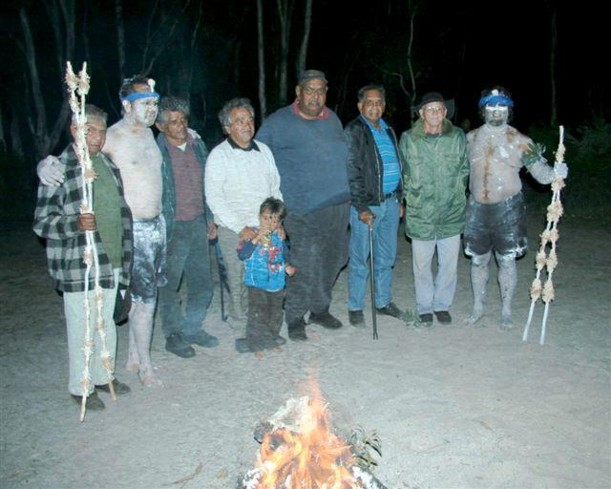
Multiple generations reconnecting to country & culture

Slide 33
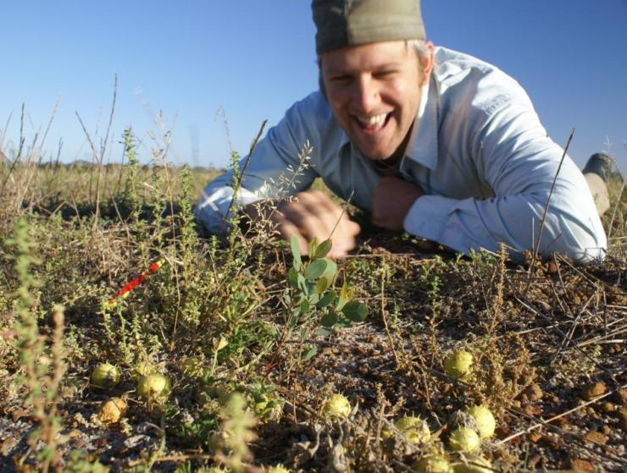
4. Adapt & Improve; from the beginning!
Have a good look around….

Slide 34
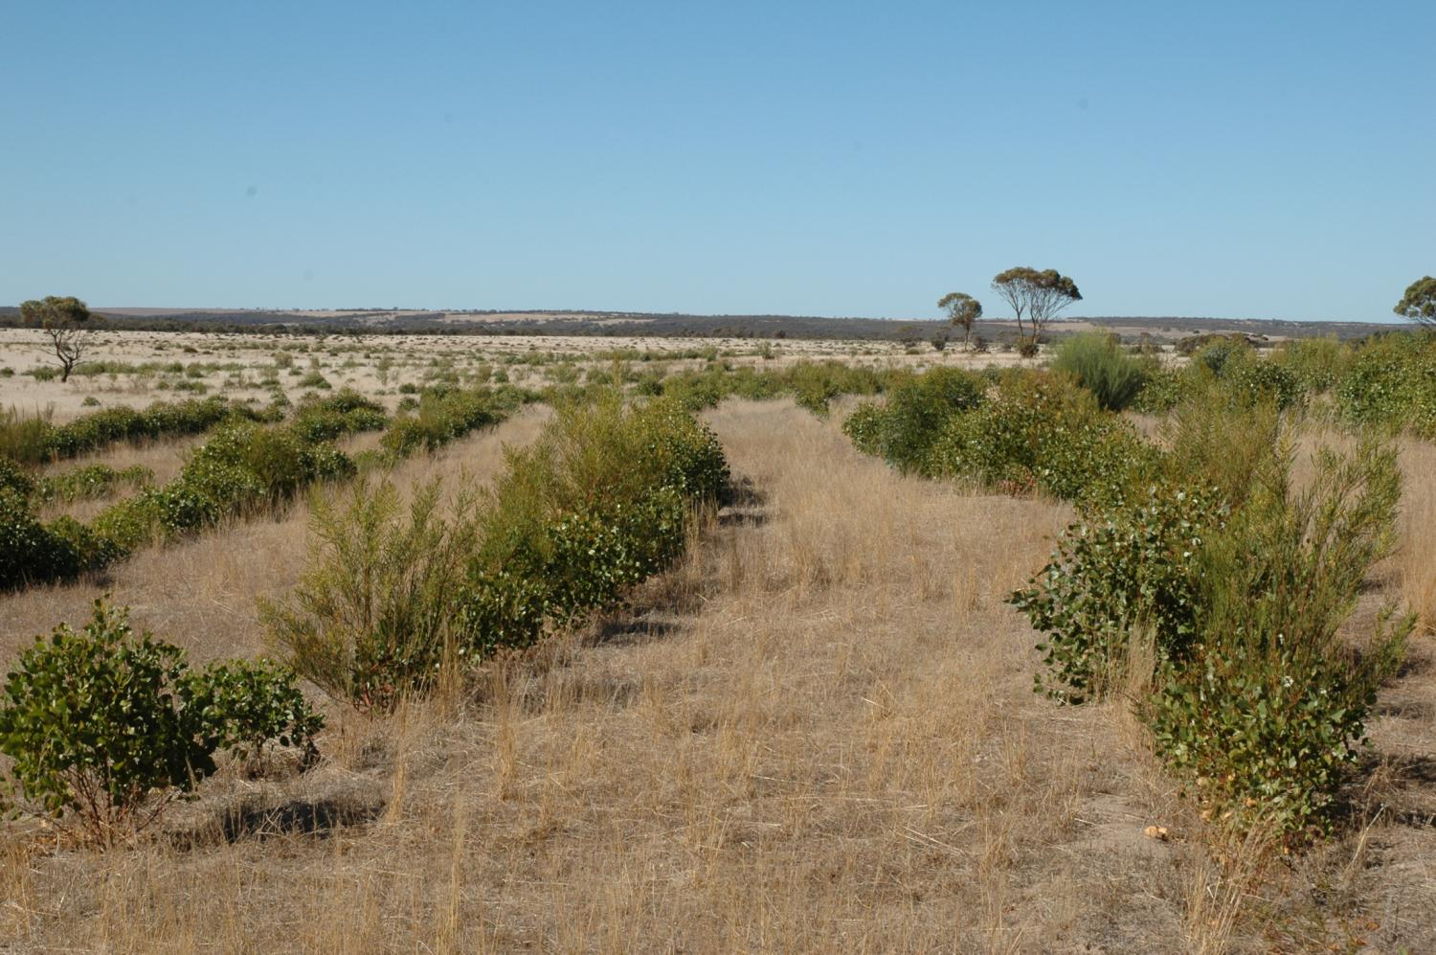
3.5m

Slide 35
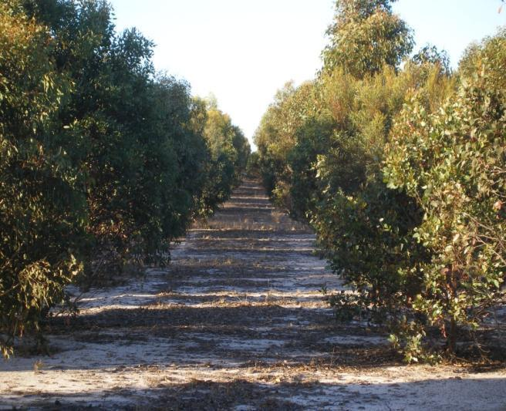
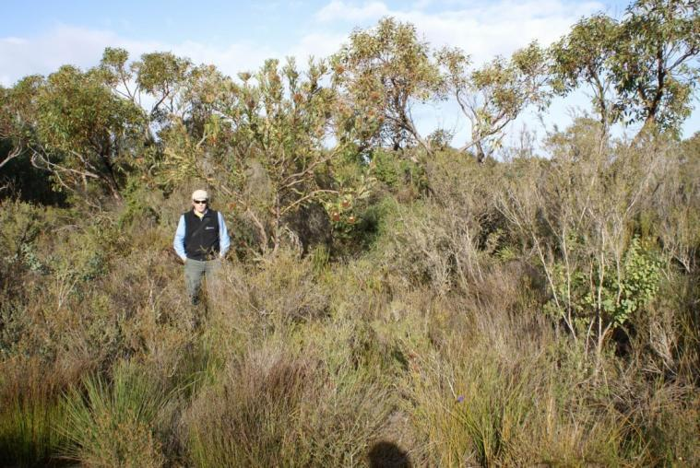
Traditional plantings
Remnant Vegetation Benchmark

Slide 36
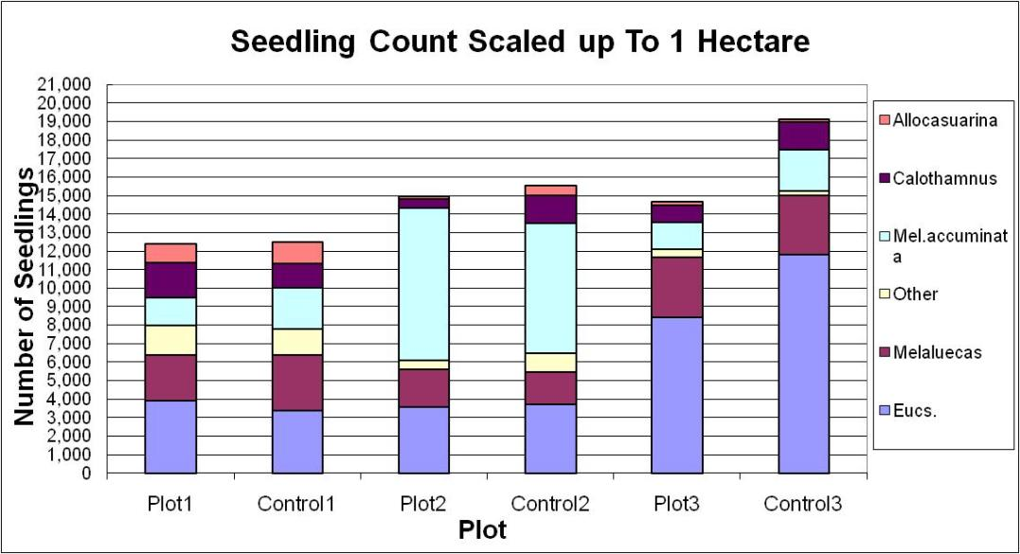

Too dense, bare understory

Slide 37

3.5m

Slide 38
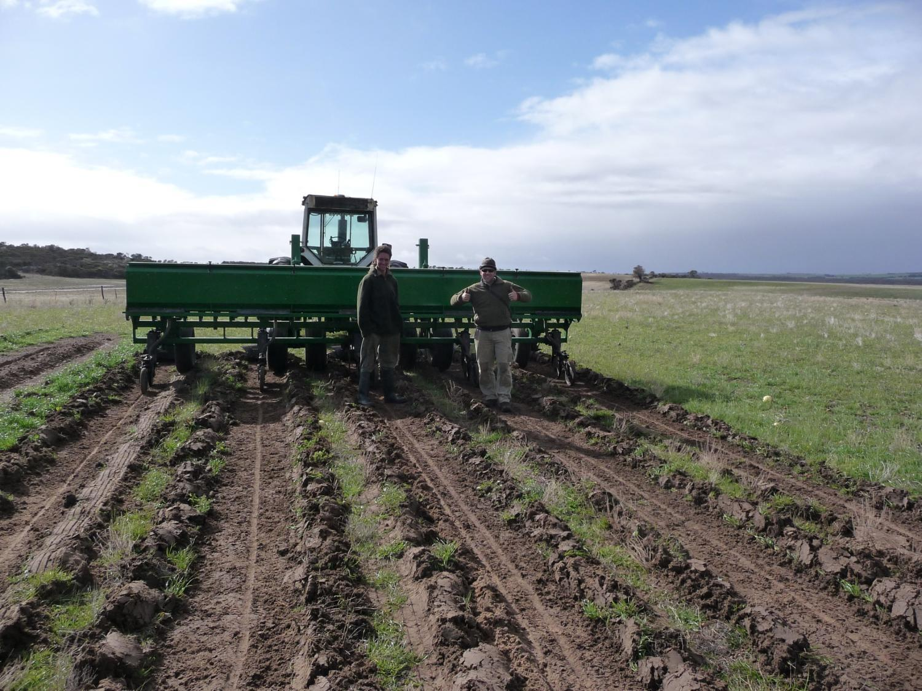
Learn and adapt:
GreatPlains5 ‘habitat seeder’; 7m pass; ~40ha/day
1.4m
1.4m
1.4m
1.4m

Slide 39
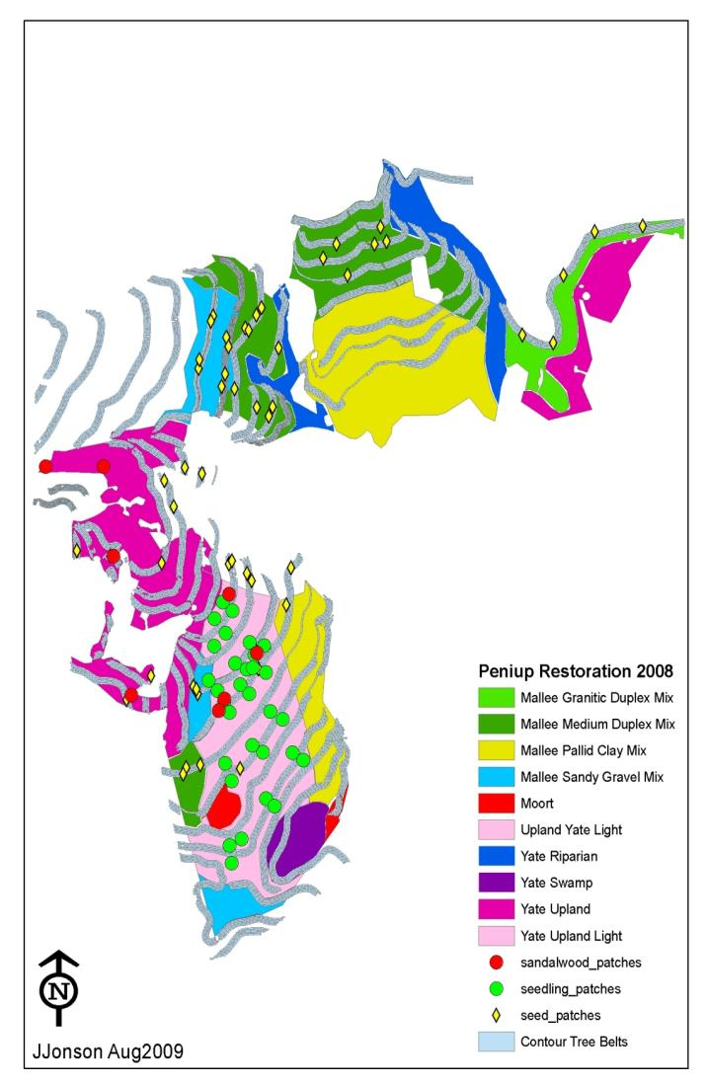
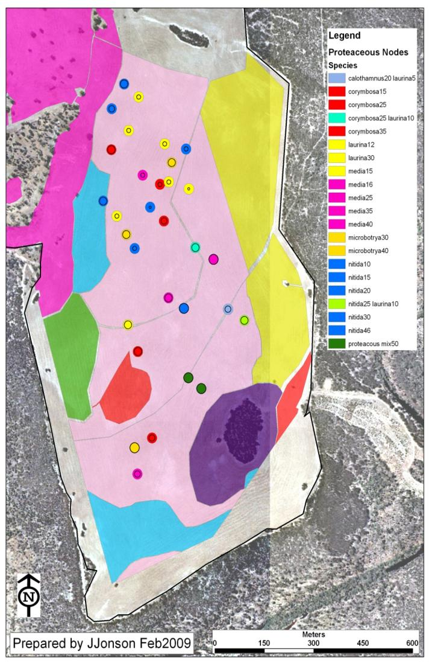
Learn and adapt

Slide 40
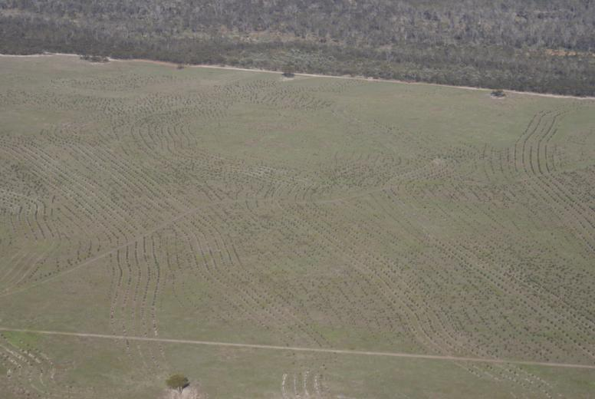
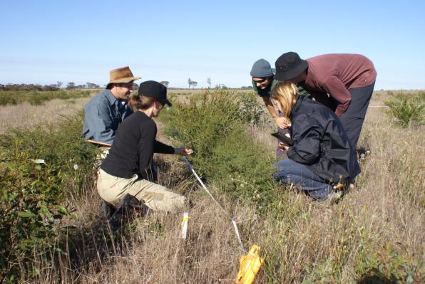
  Monitoring – a structured way of learning
In collaboration with UWA

Slide 41
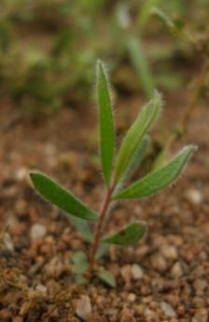
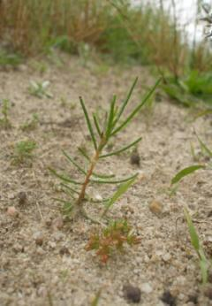
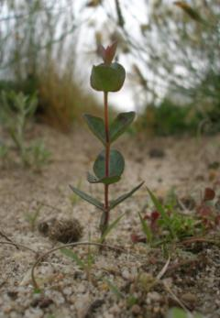
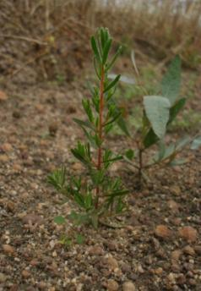




Monitoring: 42 plots (20 x 14m) across 6 vegetation associations
50 species identified to date
Notes:
41

Slide 42

4. Adapt and Improve
Much improved !
Traditional planting

Slide 43

Courage to learn and improve
‘Lifting the Bar’
‘Old school’

Slide 44


Still much to learn and improve…
Peniup, April 2010

Slide 45

5) Capture and Share learnings – closing the loop

Slide 46
1) Conservation takes time
Partner capacity
Impact
Implementation
Pilot
Planning
Time
20 years
Notes:
We are doing a lot of learning and thinking about what is needed to build effective landscape programs.
This is an ideal progression but we know in the real world it can sometimes look different. One thing we have learnt from out partners the Nature Conservancy is that there are some key ingredients – and the most important of these is having the right set of leadership skills and a great team.
So when I talk about having credible lunatics and passionate visionaries what do i really mean?
Do I need just one per landscape ?
No I need people at all levels developing these leadership capabilities
And what are these capabilities? Are they things you learn at business school or university? No – not really. The are qualities that all of us can focus on and keep developing
Our partner - the TNC after evaluating which programs succeeded and which did not have distilled the qualities they look for as
Alignment with Values.
Composure. someone doesn’t show frustration when resisted or blocked.
Dealing with Ambiguity. Can cope with change; shifts gears;; can comfortably handle risk and uncertainty.
Drive for Results. Bottom-line oriented; steadfastly pushes self and others for results; takes initiative to make concrete results happen – a deal maker.
Interpersonal Savvy. Relates well to all kinds of people; builds constructive and effective relationships; uses diplomacy and tact.
Learning on the Fly. Learns quickly when facing new problems; open to change; analyzes successes and failures for clues to improvement; tries to find solutions.
Partnering.; active listener; collaborative; recognizes value of distinct strengths; shares credit.
Patience. sensitive to due process and proper pacing.
Perseverance. seldom gives up before finishing, especially in the fact of resistance or setbacks.
Strategic Thinking. puts the trivial aside and focuses on the critical; can hold on to a vision; Can craft competitive and breakthrough strategies

Slide 47

Great leadership needs a great team
~2005

Slide 48

Adaptation should drive conception
“Past efforts, necessary but insufficient”
- Robert Lambeck

Slide 49
Monitoring starts at the beginning
1. Objectives & Strategies
2. Inputs
(actions)
3. Outputs
(consequences)
4. Outcomes
(consequences)
Start here!!
Measured and reported at 4 scales:
National
State/Territory
Landscape
Site/project
*GA Board May ‘09

Slide 50

TNC Audit – Bring it ON!!
‘Love tough love’

Slide 51

CAP/Open Standards as glue
FLP 3.0
GA
BHA
FBG
TNC
GLink Ltd
August 2010

Slide 52


The Fitz-Stirling – our CAP/OS story
To be continued....!

