Slide 1
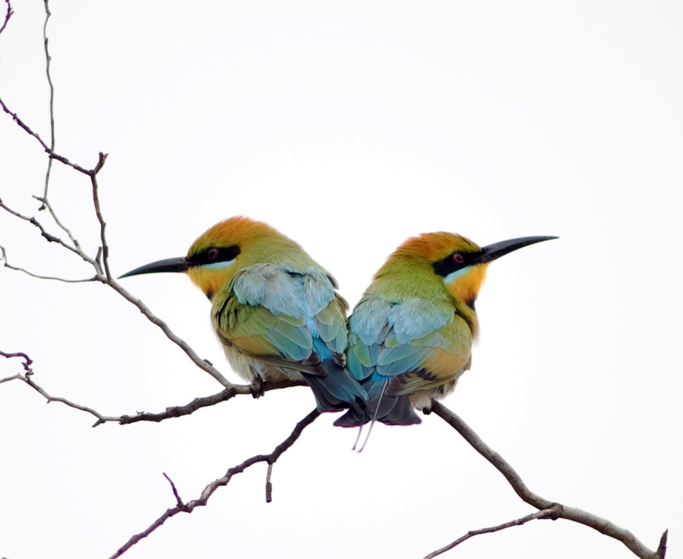
Building Conservation Partnerships through the CAP Process in Australia
A 10 Step Guide to the Perfect Relationship
Lessons from CCNet Coaches in Australia
Todd Berkinshaw, Greening Australia, 2011

Slide 2
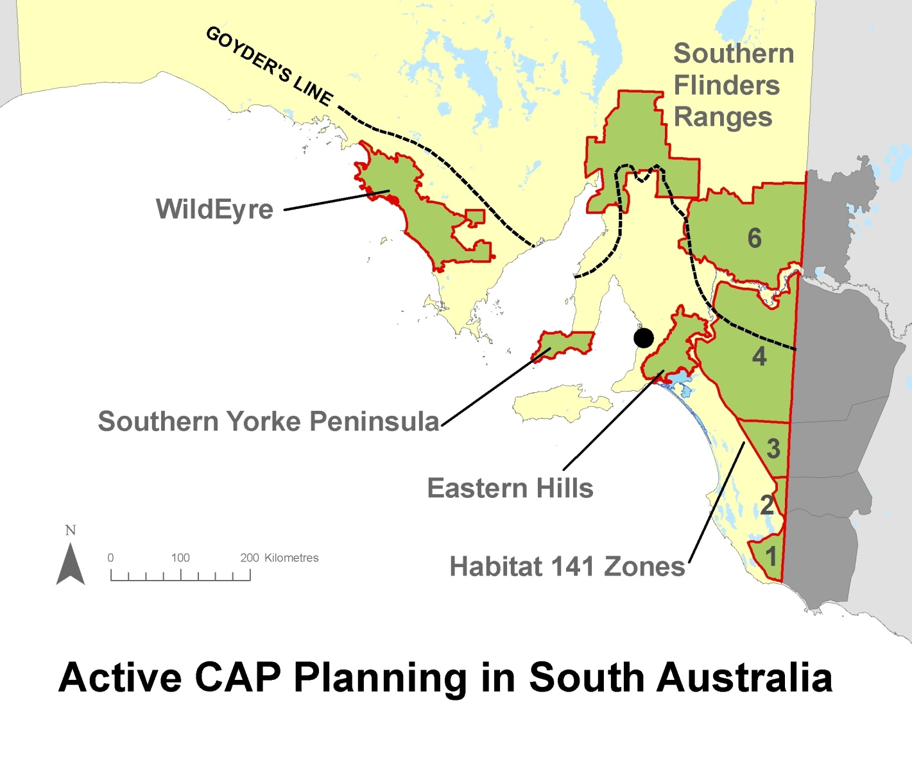
Eastern Mount Lofty Ranges CAP Group
CAP Partner Organisations: Greening Australia, Department for Environment and Natural Resources, The Wilderness Society, The Nature Conservation Society of South Australia, Australian Wildlife Conservancy, Rural Solutions, Adelaide Zoo / Conservation Ark, Monarto Zoo, Eyre Peninsula NRM Board, Northern and Yorke NRM Board, SA Murray Darling Basin NRM Board, Goolwa to Wellington LAP, Eastern Hills and Murray Plains LAP, Murray Mallee LAP, Mid Murray LAP, Threatened Plant Action Group, University of SA, Local Government, Aboriginal Lands Trust, Trees for Life, Private Landholders

Slide 3
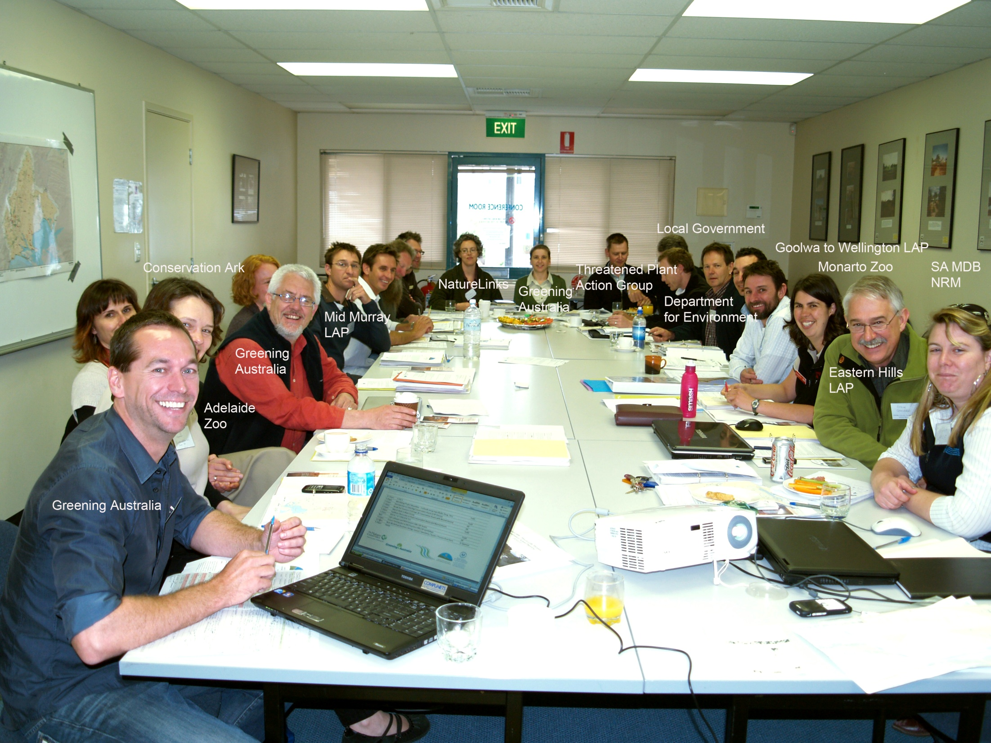
Step 1: Getting to Know Each Other - Pack 25 people from 18 organisations who rarely talk to each other into a small room for 8 days
Eastern Mount Lofty Ranges CAP Group

Slide 4
Step 2: Group Exercise 1: Practice keeping your elbows at your side so you can all fit into the crowded market for conservation funding
Eastern Mount Lofty Ranges CAP Group

Slide 5
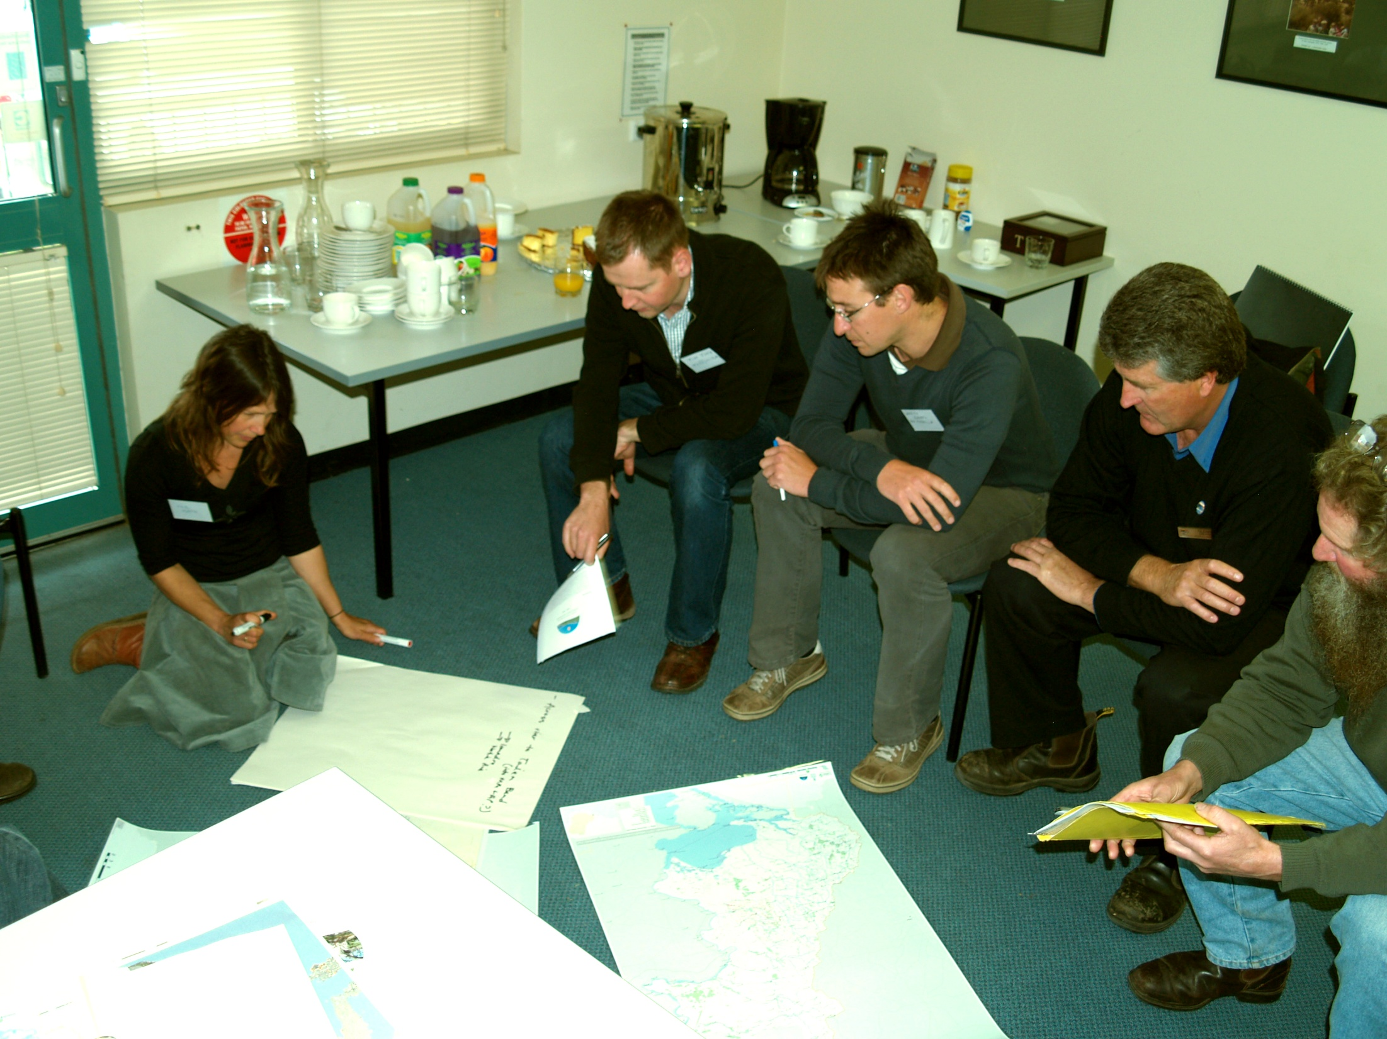
Step 3: Add Essential Ingredients: Butchers Paper, Maps, Party Pies and Coffee

Slide 6
Step 4: Group Exercise 2 - Speed Dating
Eastern Mount Lofty Ranges CAP Group

Slide 7
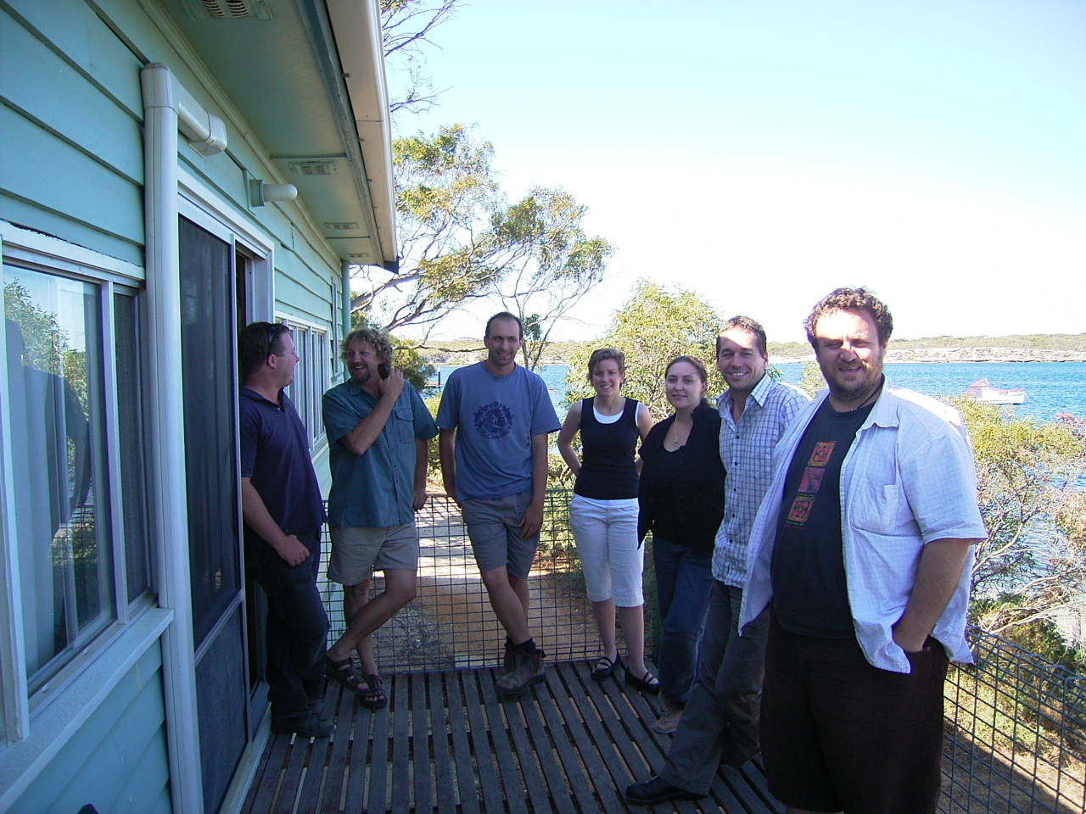
Step 5: The 2nd Date – Go somewhere nice, hire a beach house,
all stay together and spend the savings on a night out.
WildEyre CAP Group

Slide 8
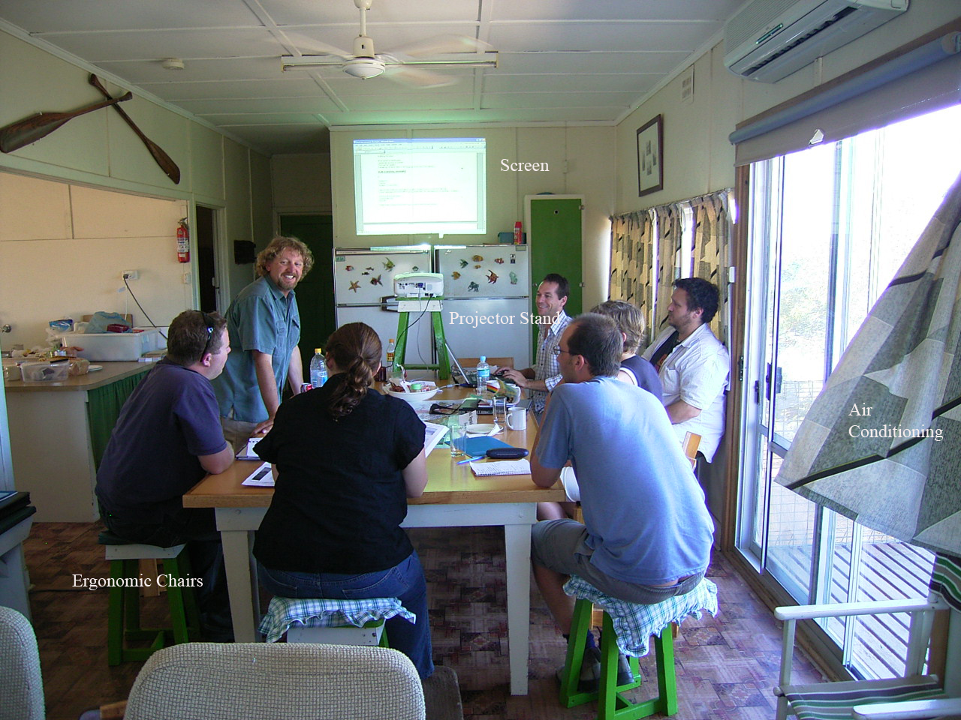
Step 6: Accept Nothing But the Best – Ensure you have all the ingredients for that perfect CAP get away
WildEyre CAP Group

Slide 9
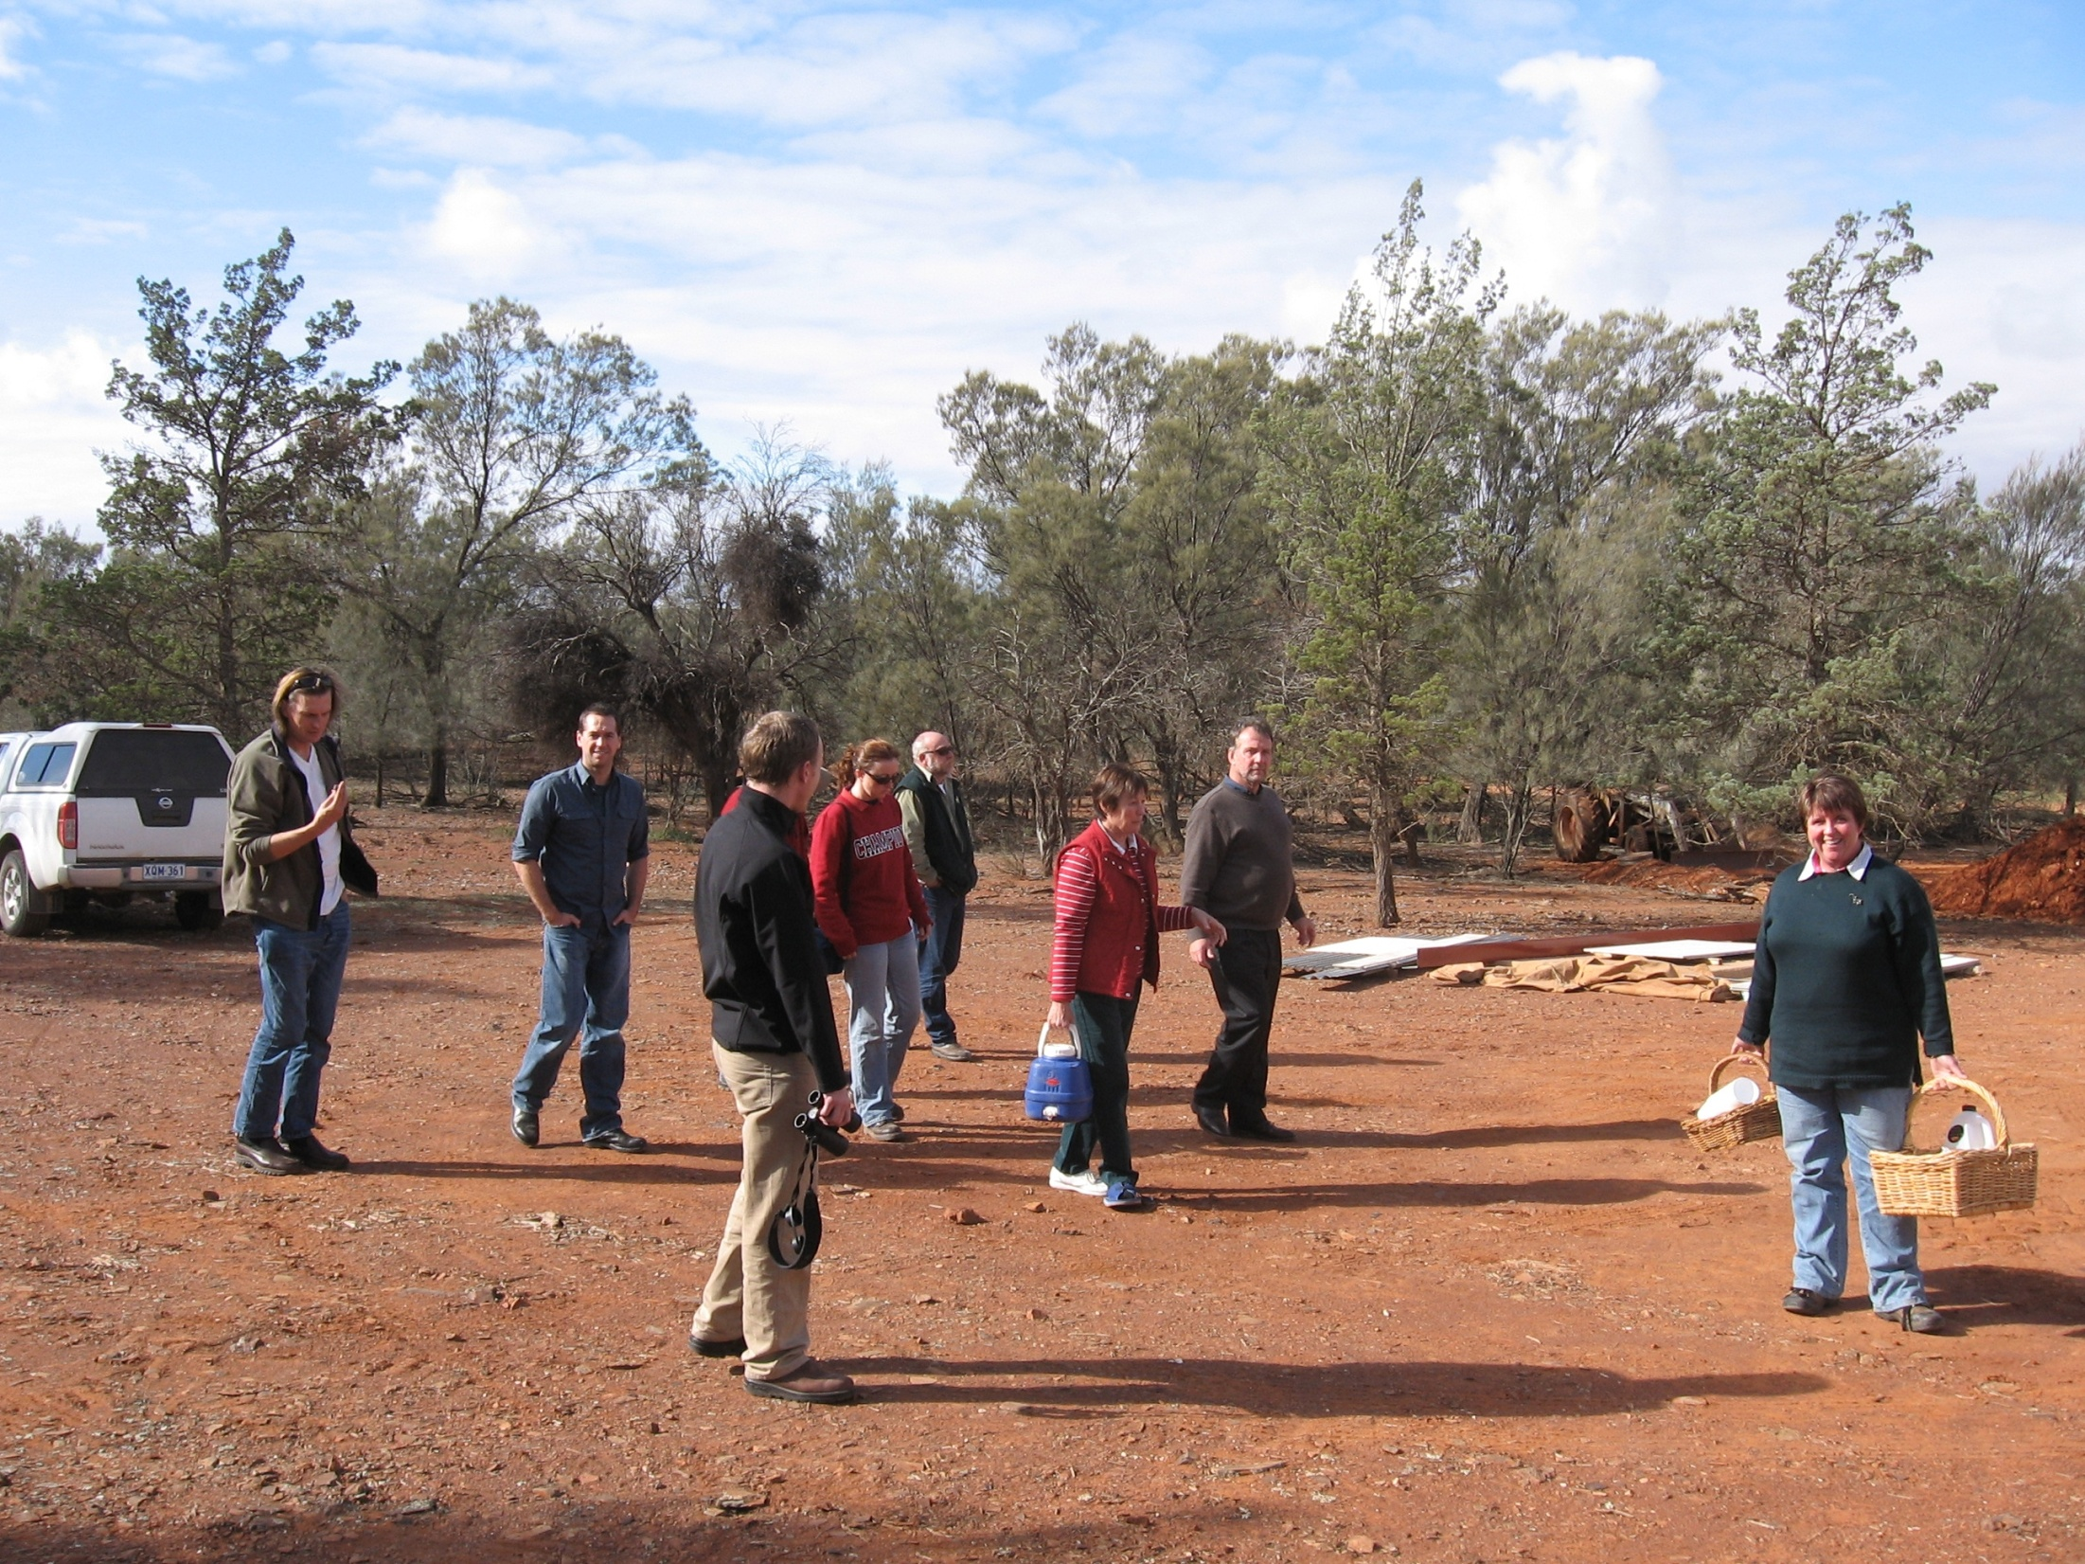
Step 7: Nurture the Relationship - Why not think about a romantic picnic?
Southern Flinders Ranges CAP Group

Slide 10
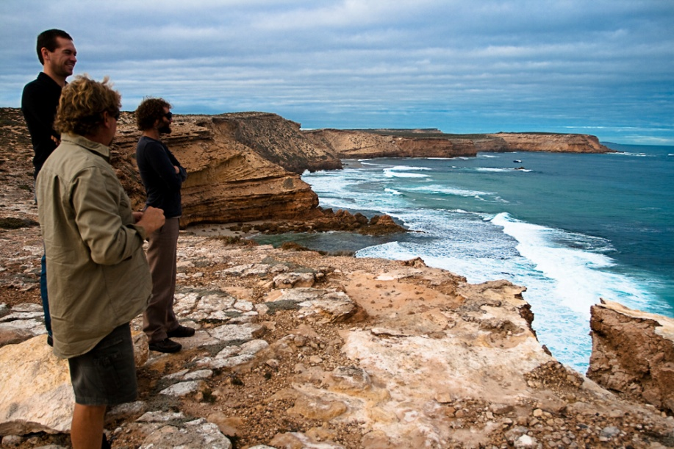
Step 8: Go to beautiful places together
WildEyre

Slide 11
Step 9: Learn to walk together, before you run
WildEyre CAP Group

Slide 12
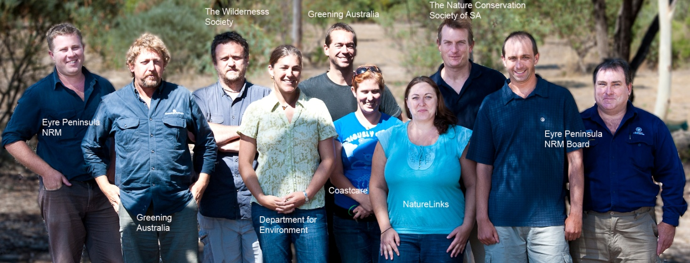
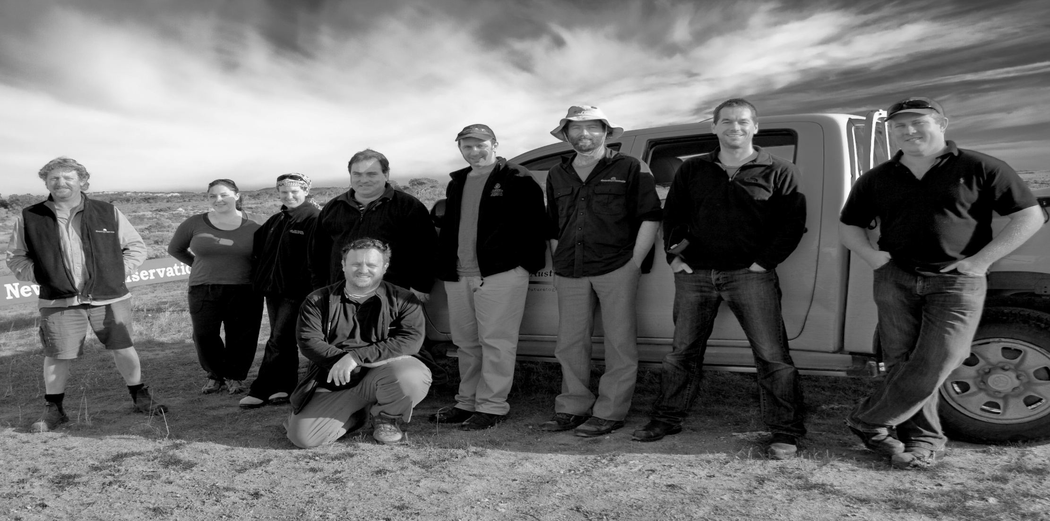
WildEyre CAP Group
Step 10: Stand Side-by-Side, through the Good Times and the Bad
WildEyre CAP Group

