Slide 1
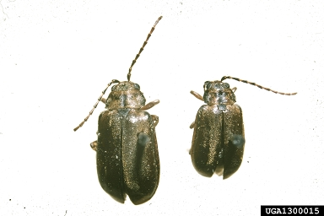
Viburnum Leaf Beetle
Identifying Characteristics:
Adult beetles are 1/4 to 1/3 of an inch long
Dark brown body and wings
Females deposit up to five eggs in holes dug in young trees. Holes are visible in the summer, fall, and winter months.
Young larvae are greenish-yellow and can grow to about 1/3 of an inch long, darken and develop a series of dark spots.

Slide 2
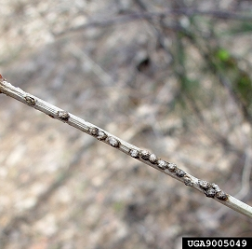
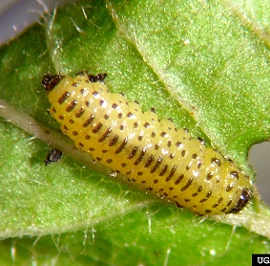
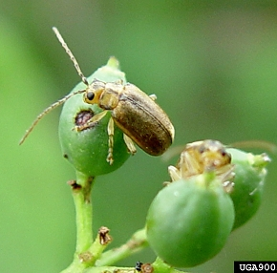
Viburnum Leaf Beetle Host Trees
Egg
Larva
Adult

Slide 3
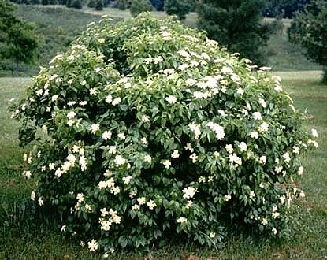
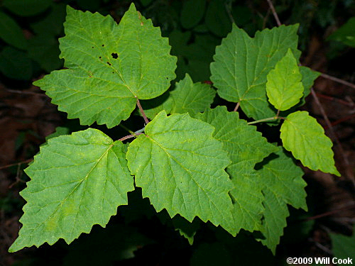
Viburnum Leaf Beetle Common Host Trees
Arrowwood viburnum
European cranberrybush viburnum
Mapleleaf viburnum
Arrowwood Viburnum
Mapleleaf Viburnum
Notes:
Known to only target one plant genus (Viburnum)

Slide 4
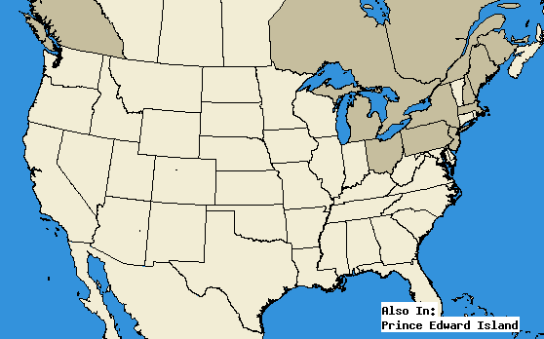
Viburnum Leaf Beetle Map – Pest Distribution
Shaded regions indicate locations where viburnum leaf beetles have been identified.

Slide 5
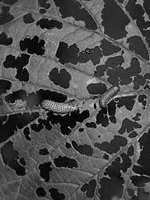
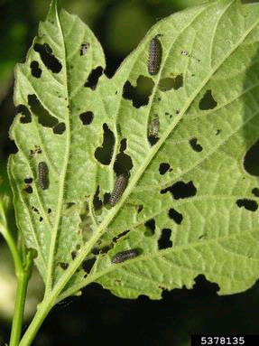
Viburnum Leaf Beetle What to Look For
Larvae feed on the areas between leaf veins, leaving "skeletonized" leaves
‘Skeletonization’ usually starting with lower leaves and leaving only midribs and major veins intact
Adult feeding damage consists of irregular circular holes, and severe feeding can nearly defoliate shrubs
When disturbed, the beetles will fly away or drop to the ground
1
2
3
4

Slide 6
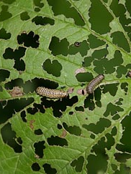
Viburnum Leaf Beetle What to Look For
Larvae feed on the areas between leaf veins, leaving "skeletonized" leaves
‘Skeletonization’ usually starting with lower leaves and leaving only midribs and major veins intact
Adult feeding damage consists of irregular circular holes, and severe feeding can nearly defoliate shrubs
When disturbed, the beetles will fly away or drop to the ground
1
2
3
4

Slide 7
Viburnum Leaf Beetle What to Look For
Larvae feed on the areas between leaf veins, leaving "skeletonized" leaves
‘Skeletonization’ usually starting with lower leaves and leaving only midribs and major veins intact
Adult feeding damage consists of irregular circular holes, and severe feeding can nearly defoliate shrubs
When disturbed, the beetles will fly away or drop to the ground
1
2
3
4

Slide 8
Viburnum Leaf Beetle What to Look For
Larvae feed on the areas between leaf veins, leaving "skeletonized" leaves
‘Skeletonization’ usually starting with lower leaves and leaving only midribs and major veins intact
Adult feeding damage consists of irregular circular holes, and severe feeding can nearly defoliate shrubs
When disturbed, the beetles will fly away or drop to the ground
1
2
3
4

Slide 9
Viburnum Leaf Beetle What to Look For (cont.)
SUMMER:
Heavily chewed leaves
SPRING:
Egg hatch usually occurs in May; Skeletonized leaves
YEAR-ROUND: Skeletonized leaves

Slide 10
Viburnum Leaf Beetle Additional Resources
Bugwood Wiki
http://wiki.bugwood.org/Pyrrhalta_viburni/NJ
Don’t Move Firewood
http://www.dontmovefirewood.org/gallery-of-pests/viburnum-leaf-beetle.html
EDDMaps: Reporting App for Smartphones
http://www.eddmaps.org/

