Slide 1
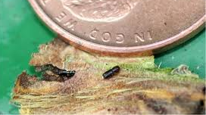
Thousand Cankers Disease – Walnut Twig Beetle
Fungal disease that attacks walnut trees
Transported by the walnut twig beetle, a reddish-brown insect that’s smaller than a grain of rice
Fungal infections spread and prevents growth of the tree by cutting off all sap transport
Black walnut trees die within approximately three years of TCD symptoms being observed

Slide 2
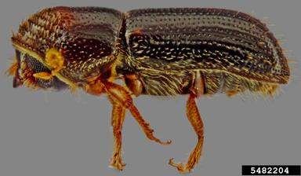
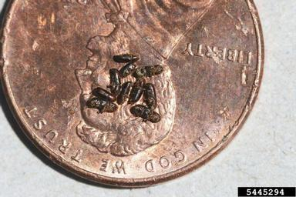
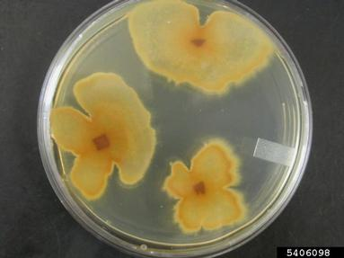
Thousand Cankers Disease Relationship between walnut twig beetle and fungus
The walnut twig beetle is native to western U.S.
A walnut twig beetle infestation is not harmful on its own, but can cause great destruction when it carries TCD
TCD can exist in absence of the Walnut Twig Beetle. In this case, the disease cannot spread to additional trees.

Slide 3
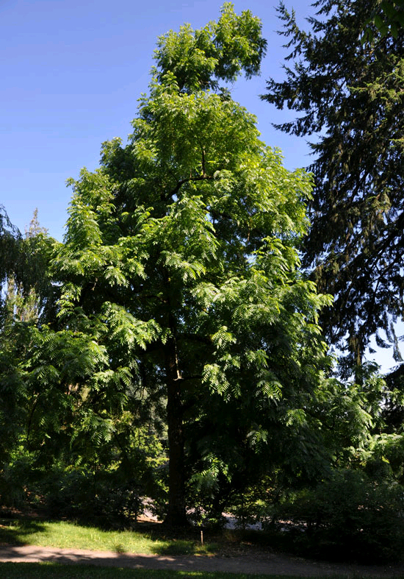
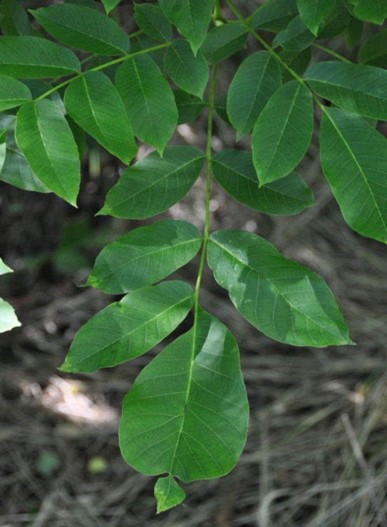
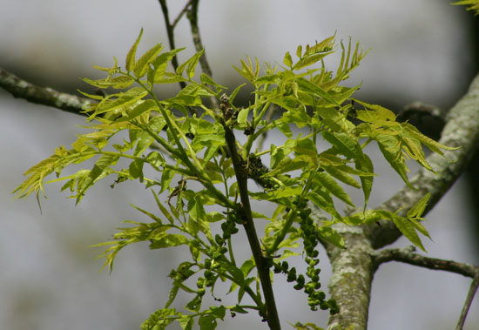
Thousand Canker Disease Common Host Trees
Black Walnut
Black walnut – HIGHLY susceptible
Arizona walnut
English walnut
Arizona Walnut
English Walnut
Notes:
Targets only one plant genus (Juglans)

Slide 4
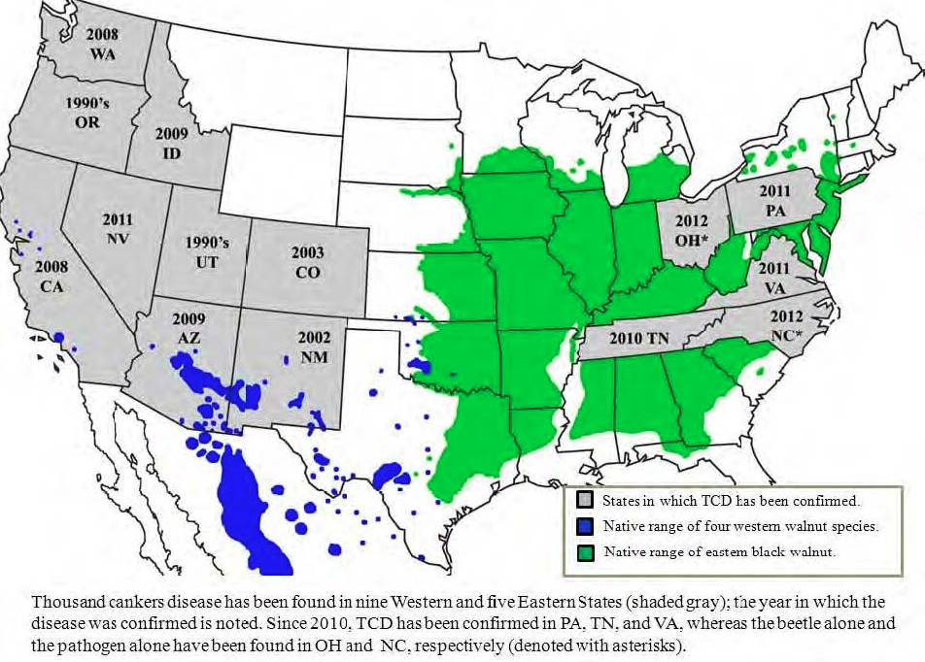
Thousand Canker Disease Map – Range of Thousand Canker Disease and Native Walnuts

Slide 5
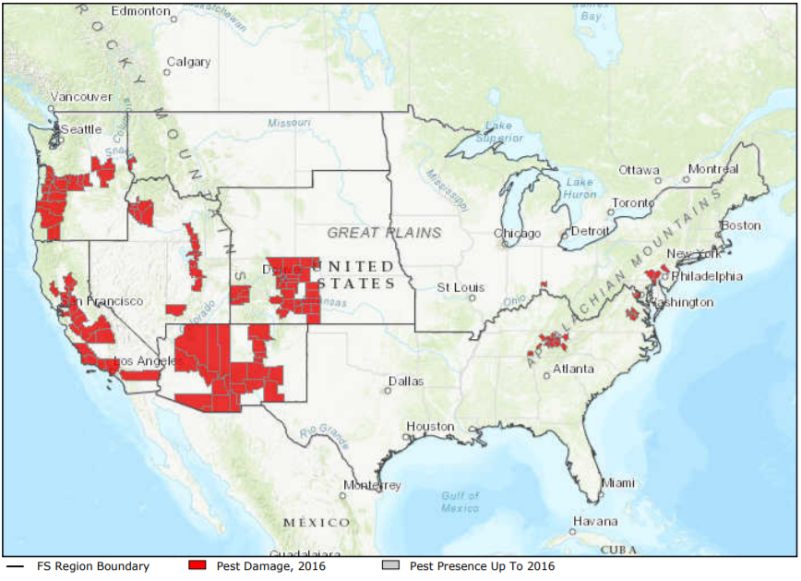
Thousand Canker Disease Map – Range of Thousand Canker Disease

Slide 6
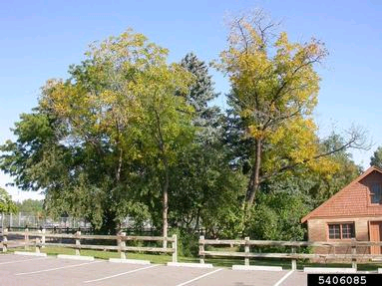
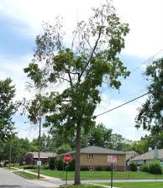
Thousand Canker Disease What to Look For
1
Leaves on upper branches will turn yellow, wilt, and die
Branches die back gradually from the upper crown downward
Browning leaves often remain attached to twigs
New sprouts may grow from tree roots or trunk (giving the tree a bushy appearance below dead branches)
Look for dead or sickly branches
Numerous tiny bark beetle holes and branch cankers developed around them
2

Slide 7
Thousand Canker Disease What to Look For
1
Leaves on upper branches will turn yellow, wilt, and die
Branches die back gradually from the upper crown downward
Browning leaves often remain attached to twigs
New sprouts may grow from tree roots or trunk (giving the tree a bushy appearance below dead branches)
Look for dead or sickly branches
Numerous tiny bark beetle holes and branch cankers developed around them
2

Slide 8
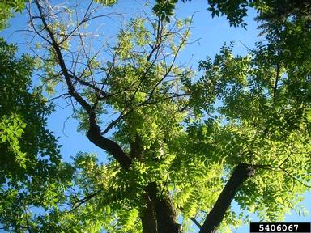
Thousand Canker Disease What to Look For
3
Leaves on upper branches will turn yellow, wilt, and die
Branches die back gradually from the upper crown downward
Browning leaves often remain attached to twigs
New sprouts may grow from tree roots or trunk (giving the tree a bushy appearance below dead branches)
Look for dead or sickly branches
Numerous tiny bark beetle holes and branch cankers developed around them
4

Slide 9
Thousand Canker Disease What to Look For
3
Leaves on upper branches will turn yellow, wilt, and die
Branches die back gradually from the upper crown downward
Browning leaves often remain attached to twigs
New sprouts may grow from tree roots or trunk (giving the tree a bushy appearance below dead branches)
Look for dead or sickly branches
Numerous tiny bark beetle holes and branch cankers developed around them
4

Slide 10
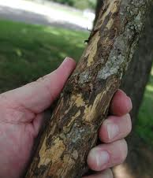
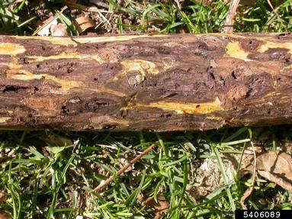
Thousand Canker Disease What to Look For
5
Leaves on upper branches will turn yellow, wilt, and die
Branches die back gradually from the upper crown downward
Browning leaves often remain attached to twigs
New sprouts may grow from tree roots or trunk (giving the tree a bushy appearance below dead branches)
Look for dead or sickly branches
Numerous tiny bark beetle holes and branch cankers developed around them
6

Slide 11
Thousand Canker Disease What to Look For
5
Leaves on upper branches will turn yellow, wilt, and die
Branches die back gradually from the upper crown downward
Browning leaves often remain attached to twigs
New sprouts may grow from tree roots or trunk (giving the tree a bushy appearance below dead branches)
Look for dead or sickly branches
Numerous tiny bark beetle holes and branch cankers developed around them
6

Slide 12
Thousand Canker Disease What to Look For (cont.)
SUMMER:
Beetle activity highest. Discolored, smaller than usual leaves and/or individual branches dying.
WINTER:
Beetles within cavities in the bark of host trunk.
YEAR-ROUND: Thinning crown; Yellowing, wilting leaves; Small, round exit holes

Slide 13
Thousand Canker Disease Additional Resources
USDA
http://www.fs.fed.us/foresthealth/fhm/sp/tcd/tcd.shtml
Don’t Move Firewood
http://www.dontmovefirewood.org/gallery-of-pests/thousand-canker-disease.html
EDDMaps: Reporting App for Smartphones
http://www.eddmaps.org/

