Slide 1
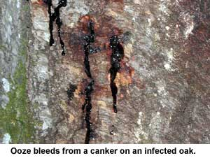
Sudden Oak Death
Identifying Characteristics:
A pathogen that causes red-brown or black cankers form on the trunk
Cankers seep dark black to red or amber sap
Bark under stress can fracture and release sap

Slide 2
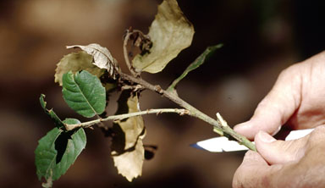
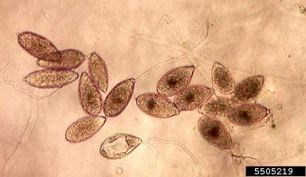
Sudden Oak Death Relationship between tree and pathogen
Pathogen spores spread through the transportation of infected plants or plant parts such as leaves, twigs and soil
These organic materials easily stick to boots, tires, pets, and other equipment that can move the pathogen long distances

Slide 3
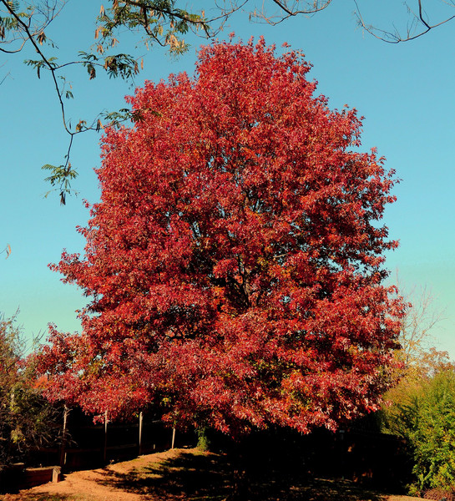
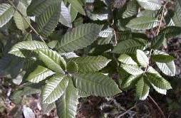
Sudden Oak Death Common Host Trees
Red oak
Tanoak
California black oak
Red oak
Coast live oak
Canyon live oak
Shreve Oak
Rhododendron
Kalmia (Mountain Laurel)
Black locust
Black cherry
Camellia
Flowering dogwood
Pieris (Andromeda)
Sassafras
Viburnum
Madrone
Huckleberry
Bay Laurel
Tanoak
Notes:
Targets over 70 plant genera

Slide 4
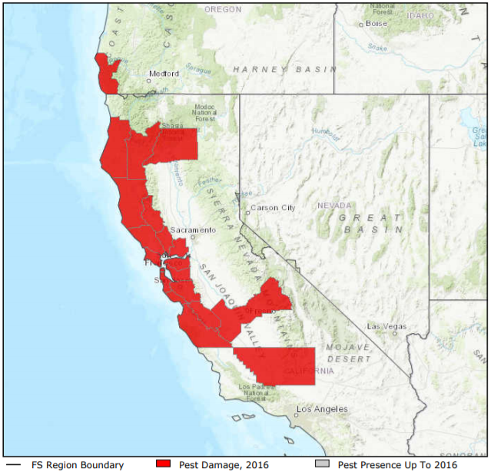
Sudden Oak Death Map – Range of Sudden Oak Death

Slide 5
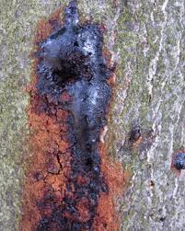
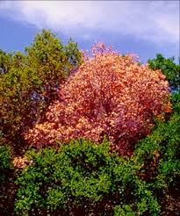
Sudden Oak Death What to Look For
1
2
Cankers form on tree 3-6 ft. off the ground
A black or reddish ooze often bleeds from the cankers
Bark becomes stained
Leaves turn brown and fall off prior to autumn
3
4
Red oak

Slide 6
Sudden Oak Death What to Look For
1
2
Cankers form on tree 3-6 ft. off the ground
A black or reddish ooze often bleeds from the cankers
Bark becomes stained
Leaves turn brown and fall off prior to autumn
3
4
Red oak

Slide 7
Sudden Oak Death What to Look For
1
2
Cankers form on tree 3-6 ft. off the ground
A black or reddish ooze often bleeds from the cankers
Bark becomes stained
Leaves turn brown and fall off prior to autumn
3
4
Red oak

Slide 8
Sudden Oak Death What to Look For
1
2
Cankers form on tree 3-6 ft. off the ground
A black or reddish ooze often bleeds from the cankers
Bark becomes stained
Leaves turn brown and fall off prior to autumn
3
4
Red oak

Slide 9
Sudden Oak Death What to Look For (cont.)
SUMMER:
Foliage dries up and turns brown
SPRING/SUMMER/FALL: Look for symptoms during these seasons as the disease causing pathogen is active during this time

Slide 10
Sudden Oak Death Additional Resources
USDA
http://www.na.fs.fed.us/spfo/pubs/pest_al/sodeast/sodeast.htm
Don’t Move Firewood
http://www.dontmovefirewood.org/gallery-of-pests/sudden-oak-death-syndrome.html
EDDMaps: Reporting App for Smartphones
http://www.eddmaps.org/

