Slide 1
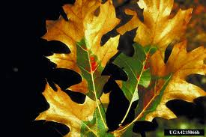
Oak Wilt
Identifying Characteristics:
Disease caused by a fungus can overwinter under the bark of living trees and as fungus mats beneath the bark on dead trees
As fungus mats enlarge, bark splits and releases odor, smelling like apple cider
Odor attracts insects, usually sap beetles, to feed on fungal mats

Slide 2
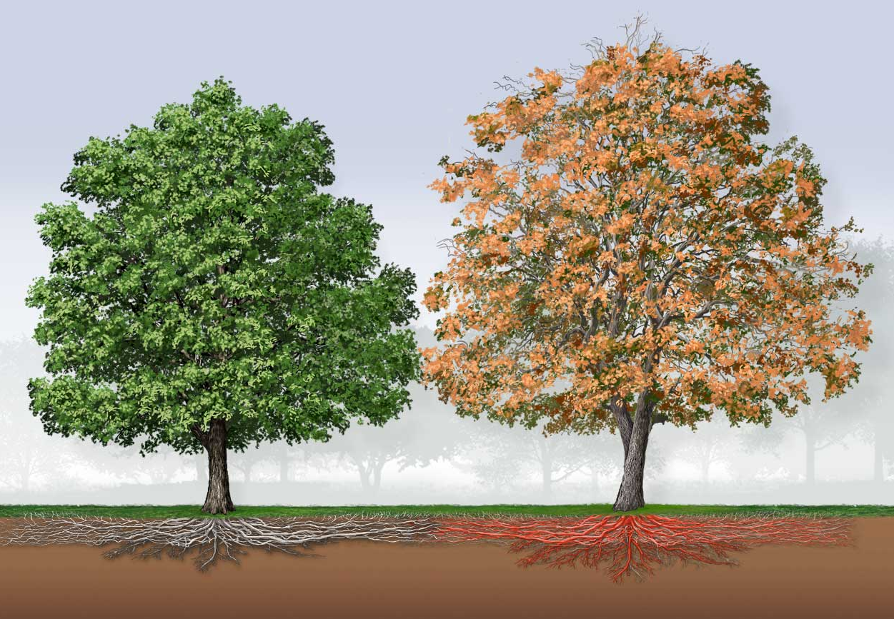
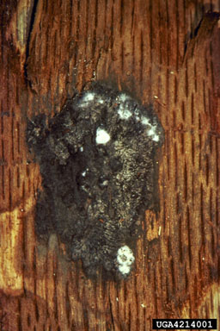
Oak Wilt Transmission of Oak Wilt Fungus
Fungal mats form under the bark of diseased oaks
Fungal mats produce a fruity scent that attracts insects
Fungus can also be transmitted through root connections between a diseased tree and a healthy tree
Insects feed on fungus and then spreads the fungus to new trees

Slide 3
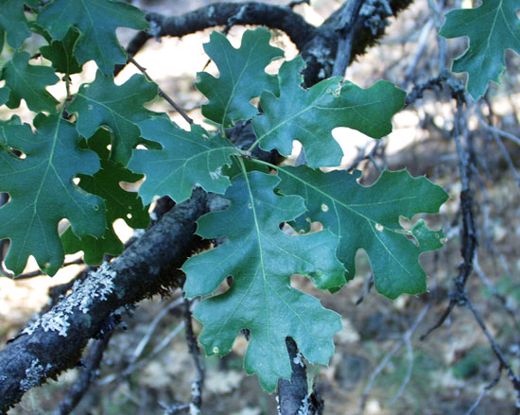
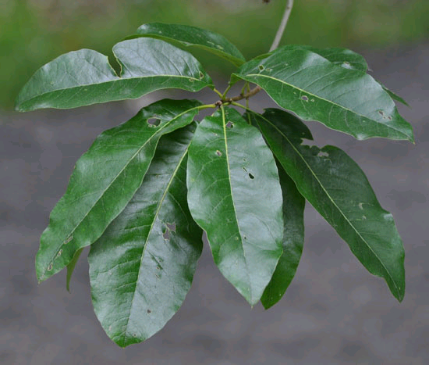
Oak Wilt Common Host Trees
Red Oak
Red oak
White oak
Shingle oak
Post oak
Shingle Oak
Notes:
Targets only one plant genus (Quercus)

Slide 4
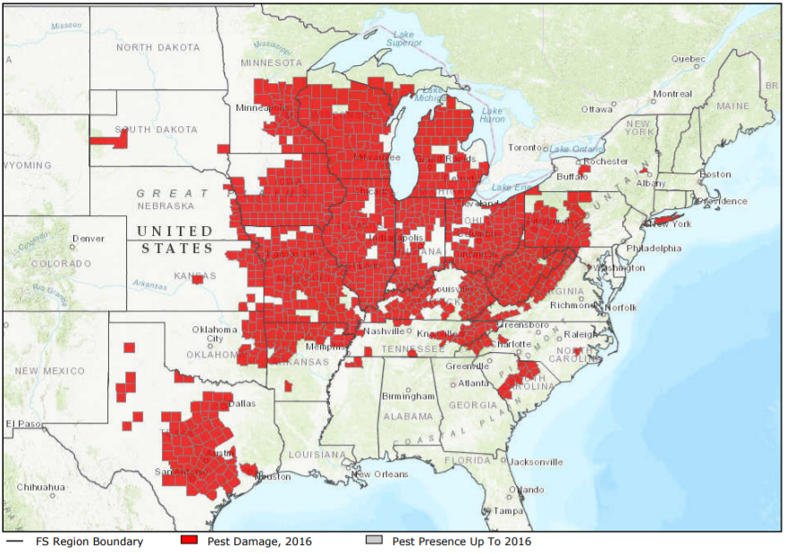
Oak Wilt Map – Range of Oak Wilt

Slide 5
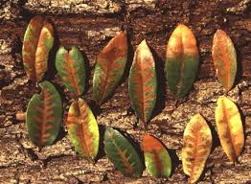
Oak Wilt What to Look For
1
Premature leaf fall – leaves turn dull green or brown before falling off
Symptoms affect leaf tip and margins first then move inwards toward the midrib and leaf base
Presence of black fungal mats
Leaf symptoms intensify within weeks and leaves at end of branches often show heavy defoliation
Tree usually dies within one year
2
Red oak

Slide 6
Oak Wilt What to Look For
1
Premature leaf fall – leaves turn dull green or brown before falling off
Symptoms affect leaf tip and margins first then move inwards toward the midrib and leaf base
Presence of black fungal mats
Leaf symptoms intensify within weeks and leaves at end of branches often show heavy defoliation
Tree usually dies within one year
2
Red oak

Slide 7
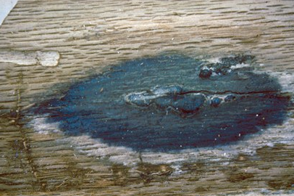
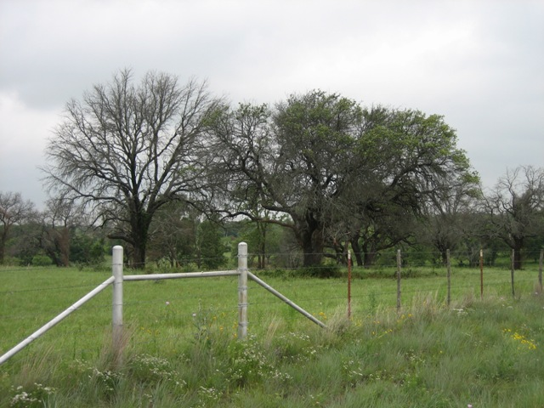
Oak Wilt What to Look For
3
Premature leaf fall – leaves turn dull green or brown before falling off
Symptoms affect leaf tip and margins first then move inwards toward the midrib and leaf base
Presence of black fungal mats
Leaf symptoms intensify within weeks and leaves at end of branches often show heavy defoliation
Tree usually dies within one year
4
Red oak

Slide 8
Oak Wilt What to Look For
3
Premature leaf fall – leaves turn dull green or brown before falling off
Symptoms affect leaf tip and margins first then move inwards toward the midrib and leaf base
Presence of black fungal mats
Leaf symptoms intensify within weeks and leaves at end of branches often show heavy defoliation
Tree usually dies within one year
4
Red oak

Slide 9
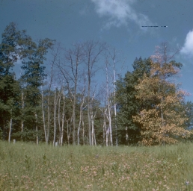
Oak Wilt What to Look For
5
Premature leaf fall – leaves turn dull green or brown before falling off
Symptoms affect leaf tip and margins first then move inwards toward the midrib and leaf base
Presence of black fungal mats
Leaf symptoms intensify within weeks and leaves at end of branches often show heavy defoliation
Tree usually dies within one year
Red oak

Slide 10
Oak Wilt What to Look For (cont.)
WINTER:
Oak bark beetles (Pseudopityophihorus spp.), attracted by fungus scent, overwinter in infected trees. Spread fungus to healthy trees at emergence.
SPRING:
Fungal infection occurs when new wood vessels are growing.
YEAR-ROUND: Leaf discoloration; Curling around midrib; Branch dieback

Slide 11
Oak Wilt Additional Resources
USDA
http://asianlonghornedbeetle.com/
Hungry Pests
http://www.hungrypests.com/the-threat/asian-longhorned-beetle.php
Texas Oak Wilt
http://texasoakwilt.org/
EDDMaps: Reporting App for Smartphones
http://www.eddmaps.org/

