Slide 1
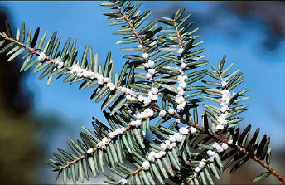
Hemlock Woolly Adelgid
Identifying Characteristics:
Adults and nymphs are 1/16th of an inch long and very hard to find
It produces a white wool-like covering to protect itself and its eggs

Slide 2
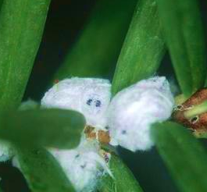
Hemlock Woolly Adelgid Life Cycle
Eggs are protected by woolly sacs that are produced by adult adelgids
Eggs hatch into crawlers; search for suitable feeding sites
Nymphs molt into adults and lay eggs
Nymphs feed on starches stored within the tree

Slide 3
Hemlock Woolly Adelgid Life Cycle
Eggs are protected by woolly sacs that are produced by adult adelgids
Eggs hatch into crawlers; search for suitable feeding sites
Nymphs molt into adults and lay eggs
Nymphs feed on starches stored within the tree

Slide 4
Hemlock Woolly Adelgid Life Cycle
Eggs are protected by woolly sacs that are produced by adult adelgids
Eggs hatch into crawlers; search for suitable feeding sites
Nymphs molt into adults and lay eggs
Nymphs feed on starches stored within the tree

Slide 5
Hemlock Woolly Adelgid Life Cycle
Eggs are protected by woolly sacs that are produced by adult adelgids
Eggs hatch into crawlers; search for suitable feeding sites
Nymphs molt into adults and lay eggs
Nymphs feed on starches stored within the tree

Slide 6
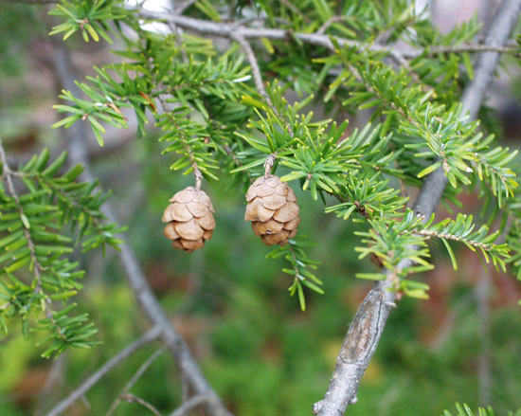
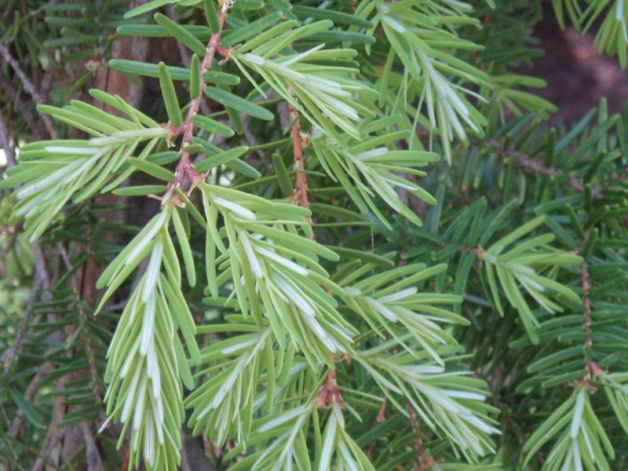
Hemlcok Woolly Adelgid Common Host Trees
Eastern Hemlock
Carolina Hemlock
Eastern Hemlock
Carolina Hemlock
Notes:
Only targets one plant genus (Abies)

Slide 7
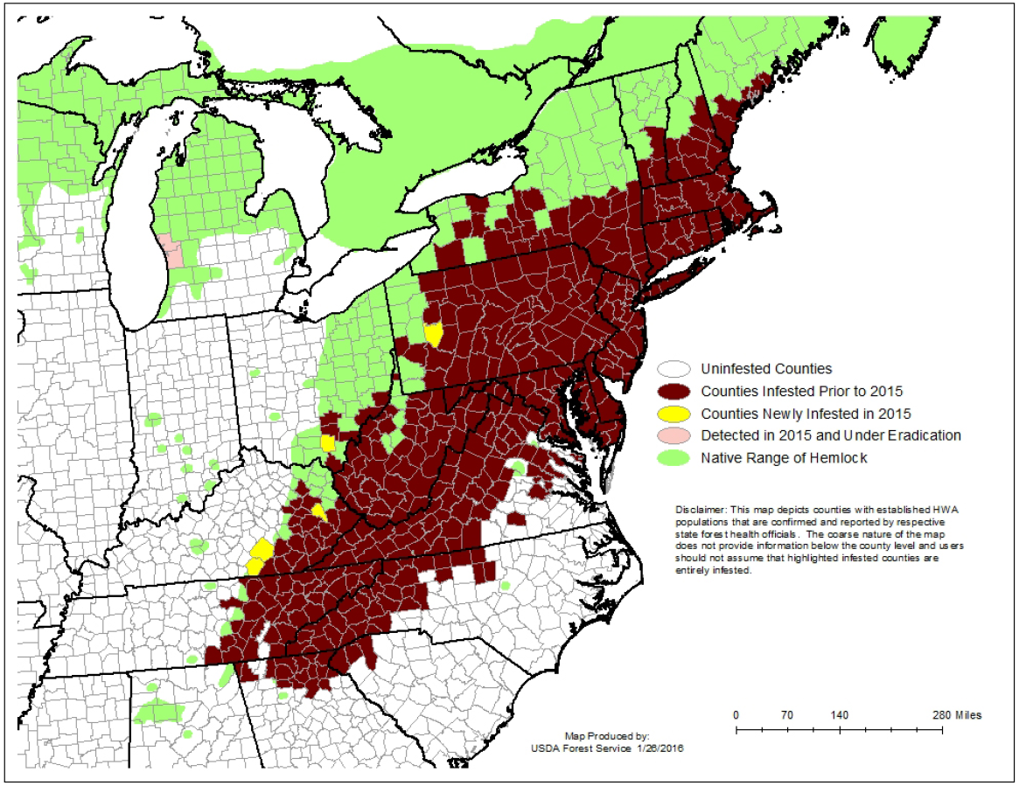
Hemlock Woolly Adelgid Map – Range of Hemlock Woolly Adelgid

Slide 8
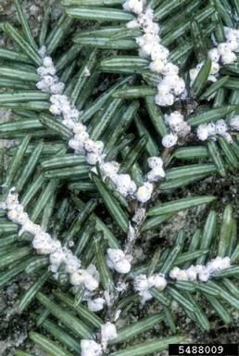
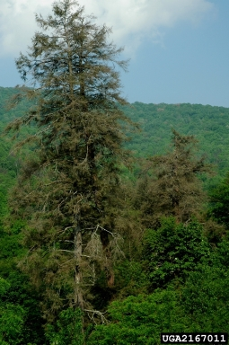
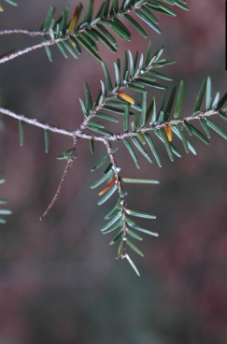
Hemlock Woolly Adelgid What to Look For
1
2
White woolly masses at base of needles
“Wool” is easier to spot on overcast days or in the shade
Branches are graying or dying
Long term effects include off colored needles, needle loss, and crown thinning
3
4

Slide 9
Hemlock Woolly Adelgid What to Look For
1
2
White woolly masses at base of needles
“Wool” is easier to spot on overcast days or in the shade
Branches are graying or dying
Long term effects include off colored needles, needle loss, and crown thinning
3
4

Slide 10
Hemlock Woolly Adelgid What to Look For
1
2
White woolly masses at base of needles
“Wool” is easier to spot on overcast days or in the shade
Branches are graying or dying
Long term effects include off colored needles, needle loss, and crown thinning
3
4

Slide 11
Hemlock Woolly Adelgid What to Look For
1
2
White woolly masses at base of needles
“Wool” is easier to spot on overcast days or in the shade
Branches are graying or dying
Long term effects include off colored needles, needle loss, and crown thinning
3
4

Slide 12
Hemlock Woolly Adelgid What to Look For (cont.)
SUMMER:
Reddish-brown nymphs can be found on twigs at base of needles
LATE FALL/EARLY SUMMER:
Woolly masses most visible on the undersides of the outermost branch tips of hemlock trees
YEAR-ROUND: White woolly masses; Dying and/or dead branches and crowns.

Slide 13
Hemlock Woolly Adelgid Additional Resources
USDA Forest Service
http://na.fs.fed.us/spfo/pubs/pest_al/hemlock/hwa05.htm
Don’t Move Firewood
http://www.dontmovefirewood.org/gallery-of-pests/hemlock-woolly-adelgid.html
Outsmart Invasives
https://www.youtube.com/watch?v=yQP0Tv43mxg
EDDMaps: Reporting App for Smartphones
http://www.eddmaps.org/

