Slide 1
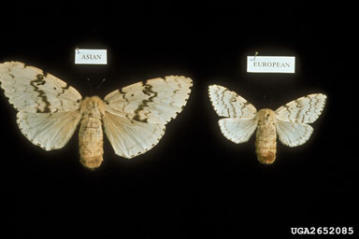
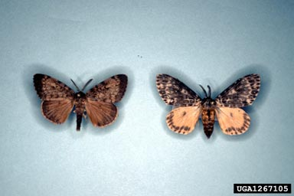
Gypsy Moth (European, Asian and Rosy)
Asian Gypsy Moth (left) and European Gypsy Moth (right)
Rosy Gypsy Moth

Slide 2
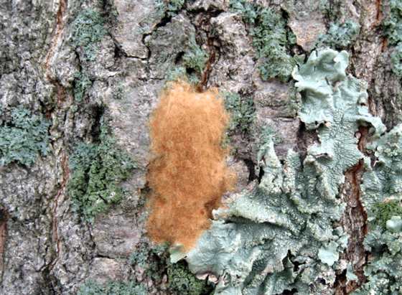
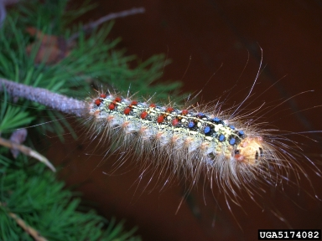
European Gypsy Moth
Blue and red dots on back
1.5 – 2.5 inch body length
Buff-colored egg, velvety texture
Tufts of hair on each segment

Slide 3
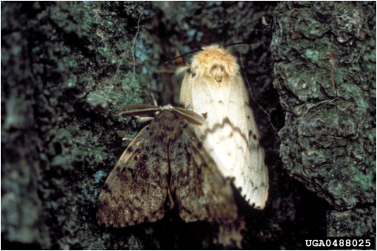
European Gypsy Moth
MALE
FEMALE
1.5 inch wingspan
2.5 inch wingspan
Light tan color with dark wavy bands
Off-white color with dark wavy bands
Cannot fly – slows spread of species

Slide 4
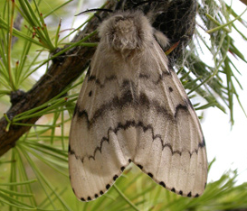
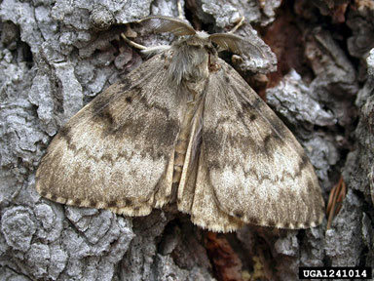
Asian and Rosy Gypsy Moth
Asian Gypsy Moth
Overall differences:
Male wingspan = 2 inches
Female wingspan = 3.5 inches
Males are brown-grey
Females can fly
Rosy Gypsy Moth*
Overall differences:
Male wingspan = 1.5 - 2 inches
Female wingspan = 3 - 3.75 inches
Male forewings are brown and hind wings are yellow
Female forewings are white with dark markings and hind wings are pink
Egg masses are white, fluffy, and flat with irregular edges
Female
Male
* Sometimes referred to as the Pink Gypsy Moth

Slide 5
Asian and Rosy Gypsy Moth
Asian Gypsy Moth
Overall differences:
Male wingspan = 2 inches
Female wingspan = 3.5 inches
Males are brown-grey
Females can fly
Rosy Gypsy Moth*
Overall differences:
Male wingspan = 1.5 - 2 inches
Female wingspan = 3 - 3.75 inches
Male forewings are brown and hind wings are yellow
Female forewings are white with dark markings and hind wings are pink
Egg masses are white, fluffy, and flat with irregular edges
Female
Male
* Sometimes referred to as the Pink Gypsy Moth

Slide 6
Asian and Rosy Gypsy Moth
Asian Gypsy Moth
Overall differences:
Male wingspan = 2 inches
Female wingspan = 3.5 inches
Males are brown-grey
Females can fly
Rosy Gypsy Moth*
Overall differences:
Male wingspan = 1.5 - 2 inches
Female wingspan = 3 - 3.75 inches
Male forewings are brown and hind wings are yellow
Female forewings are white with dark markings and hind wings are pink
Egg masses are white, fluffy, and flat with irregular edges
Female
Male
* Sometimes referred to as the Pink Gypsy Moth

Slide 7
Asian and Rosy Gypsy Moth
Asian Gypsy Moth
Overall differences:
Male wingspan = 2 inches
Female wingspan = 3.5 inches
Males are brown-grey
Females can fly
Rosy Gypsy Moth*
Overall differences:
Male wingspan = 1.5 - 2 inches
Female wingspan = 3 - 3.75 inches
Male forewings are brown and hind wings are yellow
Female forewings are white with dark markings and hind wings are pink
Egg masses are white, fluffy, and flat with irregular edges
Female
Male
* Sometimes referred to as the Pink Gypsy Moth

Slide 8
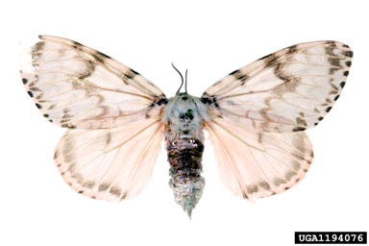
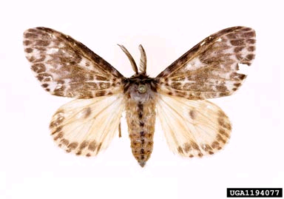
Asian and Rosy Gypsy Moth
Asian Gypsy Moth
Overall differences:
Male wingspan = 2 inches
Female wingspan = 3.5 inches
Males are brown-grey
Females can fly
Rosy Gypsy Moth*
Overall differences:
Male wingspan = 1.5 - 2 inches
Female wingspan = 3 - 3.75 inches
Male forewings are brown and hind wings are yellow
Female forewings are white with dark markings and hind wings are pink
Egg masses are white, fluffy, and flat with irregular edges
Female
Male
* Sometimes referred to as the Pink Gypsy Moth

Slide 9
Asian and Rosy Gypsy Moth
Asian Gypsy Moth
Overall differences:
Male wingspan = 2 inches
Female wingspan = 3.5 inches
Males are brown-grey
Females can fly
Rosy Gypsy Moth*
Overall differences:
Male wingspan = 1.5 - 2 inches
Female wingspan = 3 - 3.75 inches
Male forewings are brown and hind wings are yellow
Female forewings are white with dark markings and hind wings are pink
Egg masses are white, fluffy, and flat with irregular edges
Female
Male
* Sometimes referred to as the Pink Gypsy Moth

Slide 10
Asian and Rosy Gypsy Moth
Asian Gypsy Moth
Overall differences:
Male wingspan = 2 inches
Female wingspan = 3.5 inches
Males are brown-grey
Females can fly
Rosy Gypsy Moth*
Overall differences:
Male wingspan = 1.5 - 2 inches
Female wingspan = 3 - 3.75 inches
Male forewings are brown and hind wings are yellow
Female forewings are white with dark markings and hind wings are pink
Egg masses are white, fluffy, and flat with irregular edges
Female
Male
* Sometimes referred to as the Pink Gypsy Moth

Slide 11
Asian and Rosy Gypsy Moth
Asian Gypsy Moth
Overall differences:
Male wingspan = 2 inches
Female wingspan = 3.5 inches
Males are brown-grey
Females can fly
Rosy Gypsy Moth*
Overall differences:
Male wingspan = 1.5 - 2 inches
Female wingspan = 3 - 3.75 inches
Male forewings are brown and hind wings are yellow
Female forewings are white with dark markings and hind wings are pink
Egg masses are white, fluffy, and flat with irregular edges
Female
Male
* Sometimes referred to as the Pink Gypsy Moth

Slide 12
Asian and Rosy Gypsy Moth
Asian Gypsy Moth
Overall differences:
Male wingspan = 2 inches
Female wingspan = 3.5 inches
Males are brown-grey
Females can fly
Rosy Gypsy Moth*
Overall differences:
Male wingspan = 1.5 - 2 inches
Female wingspan = 3 - 3.75 inches
Male forewings are brown and hind wings are yellow
Female forewings are white with dark markings and hind wings are pink
Egg masses are white, fluffy, and flat with irregular edges
Female
Male
* Sometimes referred to as the Pink Gypsy Moth

Slide 13
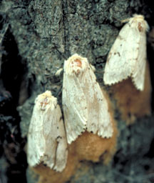
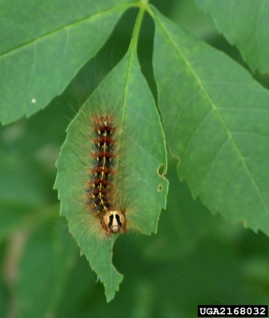
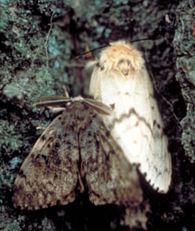
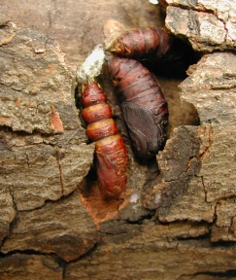
Gypsy Moth (all) Life Cycle
Egg
Larva
Adult
Pupa

Slide 14
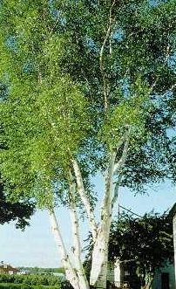
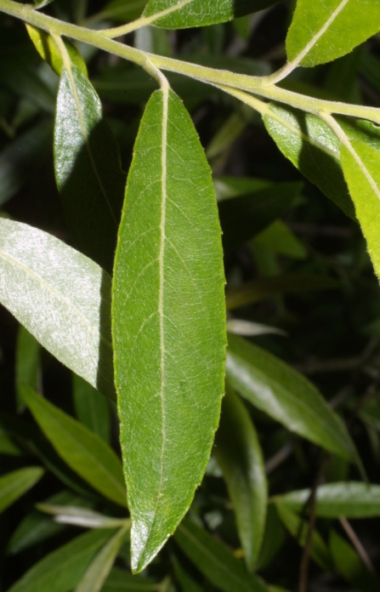
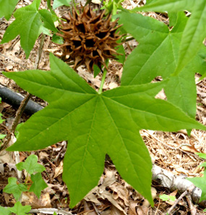
Gypsy Moth Common Host Trees
Oak
Apple
Alder
Basswood
Birch
Poplar
Sweetgum
Willow
Hawthorn
White Alder
Birch
Apple
Willow
Sweetgum
Notes:
Targets over 500 tree species

Slide 15
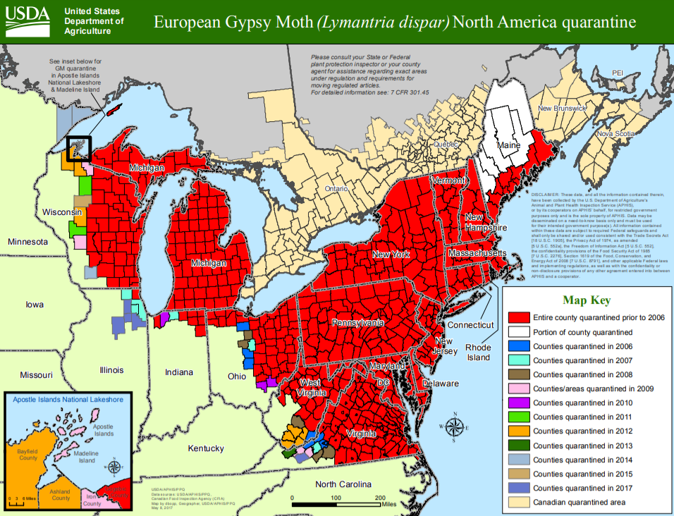
Gypsy Moth Map – Range of Gypsy Moth

Slide 16
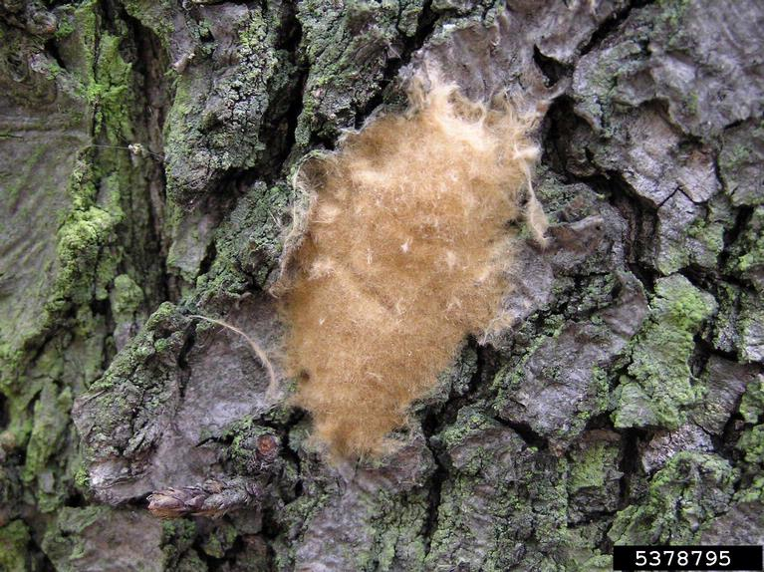
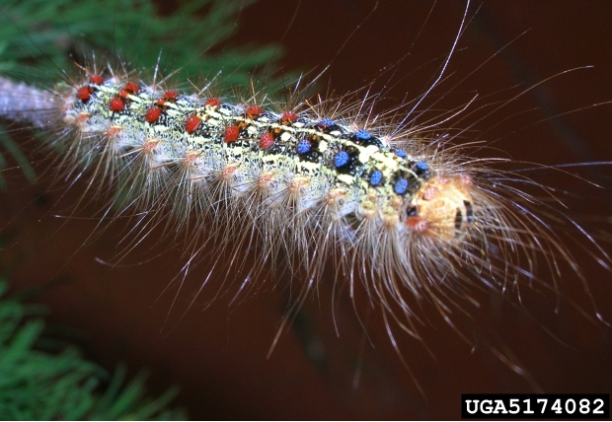
Gypsy Moth What to look for
Adults, caterpillars, or egg masses on trees or objects left outside
Large clusters of caterpillars feeding on trees
Holes in leaves and/or defoliation of the tree
1
2
3
Photos courtesy ForestryImages.org

Slide 17
Gypsy Moth What to look for
Adults, caterpillars, or egg masses on trees or objects left outside
Large clusters of caterpillars feeding on trees
Holes in leaves and/or defoliation of the tree
1
2
3
Photos courtesy ForestryImages.org

Slide 18
Gypsy Moth What to look for
Adults, caterpillars, or egg masses on trees or objects left outside
Large clusters of caterpillars feeding on trees
Holes in leaves and/or defoliation of the tree
1
2
3
Photos courtesy ForestryImages.org

Slide 19
Gypsy Moth What to look for (cont.)
MID-SUMMER:
Female attaches egg masses to outdoor objects
EARLY/MID-SUMMER:
Caterpillars feed on leaves of deciduous trees
SPRING:
Up to 1,000 eggs can hatch
YEAR-ROUND: Eggs on rocks, trees, doors; holes chewed on leaves; defoliation

Slide 20
Gypsy Moth Additional Resources
USDA Forest Service
http://www.fs.fed.us/ne/morgantown/4557/gmoth/
Hungry Pests
http://www.hungrypests.com/the-threat/european-gypsy-moth.php
Don’t Move Firewood
http://www.dontmovefirewood.org/gallery-of-pests/european-gypsy-moth.html
Outsmart Invasives Video Clip
https://www.youtube.com/watch?v=E1WpDS9qoI0
EDDMaps: Reporting App for Smartphones
http://www.eddmaps.org/

