Slide 1
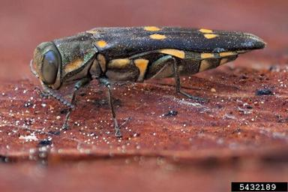
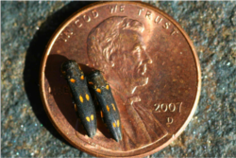
Gold Spotted Oak Borer
Identifying Characteristics
Small, bullet-shaped beetle about 10mm long
Adults are a dark green with metallic sheen and have 6 gold spots on their wings
Native to Arizona, but in California it is invasive and detrimental to the health of specific types of oak trees

Slide 2
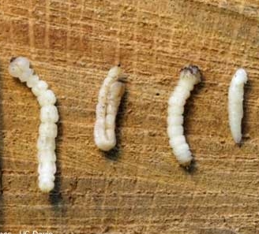
Gold Spotted Oak Borer Lifecycle
Larvae & pupae
Eggs
Adult borer

Slide 3
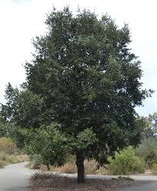
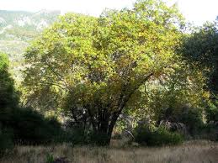
Emerald Ash Borer Common Host Trees
Coast Live Oak
California Black Oak
Canyon Live Oak
Canyon Live Oak
Coast Live Oak
California Black Oak

Slide 4
Gold Spotted Oak Borer Map – Range of Gold Spotted Oak Borer
American Elm

Slide 5
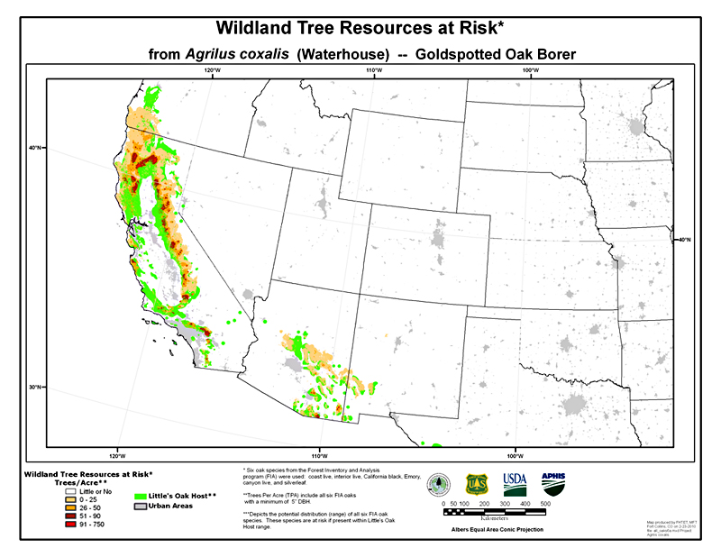
Gold Spotted Oak Borer Map – Range of Gold Spotted Oak Borer
American Elm

Slide 6
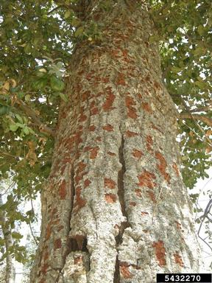
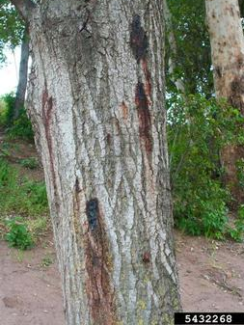
Gold Spotted Oak Borer What to Look For
1
2
Red or black staining on bark
Blistering and oozing on tree surface
Premature leaf loss or damage to leaves
Crown thinning and branch die-back
3
4

Slide 7
Gold Spotted Oak Borer What to Look For
1
2
Red or black staining on bark
Blistering and oozing on tree surface
Premature leaf loss or damage to leaves
Crown thinning and branch die-back
3
4

Slide 8
Gold Spotted Oak Borer What to Look For
1
2
Red or black staining on bark
Blistering and oozing on tree surface
Premature leaf loss or damage to leaves
Crown thinning and branch die-back
3
4

Slide 9
Gold Spotted Oak Borer What to Look For
1
2
Red or black staining on bark
Blistering and oozing on tree surface
Premature leaf loss or damage to leaves
Crown thinning and branch die-back
3
4

Slide 10
Gold Spotted Oak Borer What to Look For (cont.)
SPRING/SUMMER/FALL
Adult borers active and laying eggs
WINTER/FALL:
Split bark; woodpecker damage most obvious on defoliated trees
LATE SPRING:
Mature larvae present in trees
YEAR-ROUND: Stained bark; oozing bark; leaf loss; branch die-back

Slide 11
Gold Spotted Oak Borer Additional Resources
University of California
http://ucanr.edu/sites/gsobinfo/About_Goldspotted_Oak_Borer_930/
Don’t Move Firewood
http://www.dontmovefirewood.org/gallery-of-pests/goldspotted-oak-borer.html
Outsmart Invasives Video Clip
https://www.youtube.com/watch?v=t201pD320w0
EDDMaps: Reporting App for Smartphones
http://www.eddmaps.org/

