Slide 1
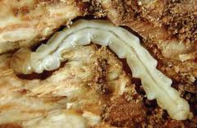
Emerald Ash Borer
Commonly abbreviated EAB
Identifying Characteristics
Small ½” long beetle
Bright metallic green color
Coppery-red underside
Adults usually emerge during late spring and summer
Larvae are flat, white, and around one inch long
David Cappaert, Bugwood.org
David Cappaert, Bugwood.org

Slide 2
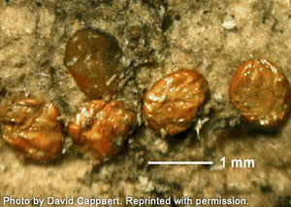
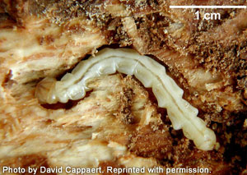
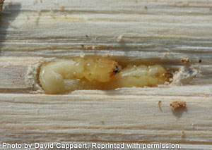
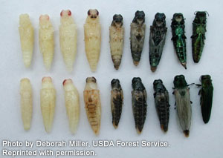
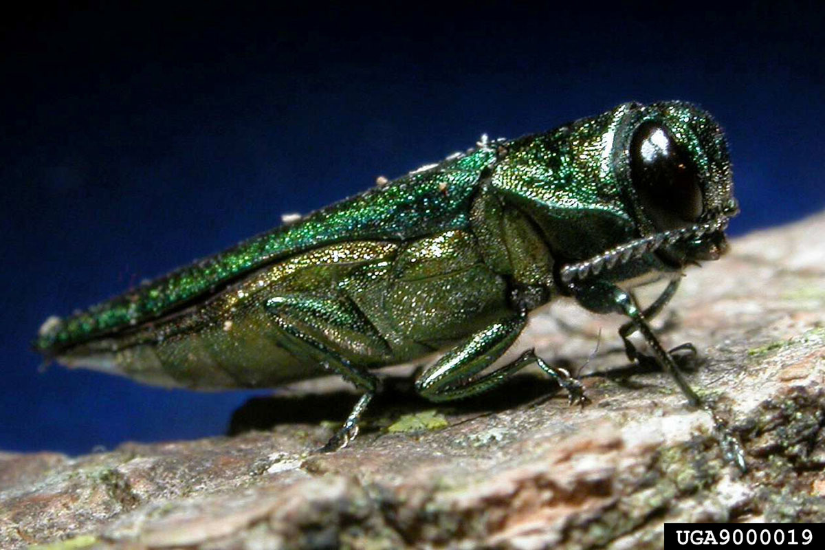
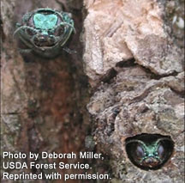
Emerald Ash Borer Lifecycle
David Cappaert, Bugwood.org

Slide 3
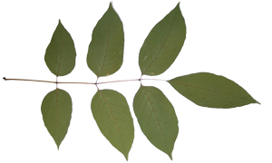
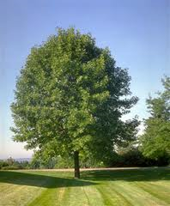
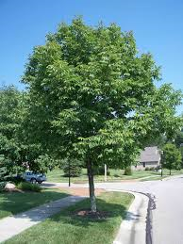
Emerald Ash Borer Common Host Trees
All Species of North American Ash Tree* including:
Green Ash
White Ash
Black Ash
*Please note Mountain Ash (Sorbus americana)
is not a true ash, thus cannot be infested with EAB
White Ash
Green Ash
*In 2014, the Emerald Ash Borer was found to be completing their lifecycle in a White Fringetree

Slide 4
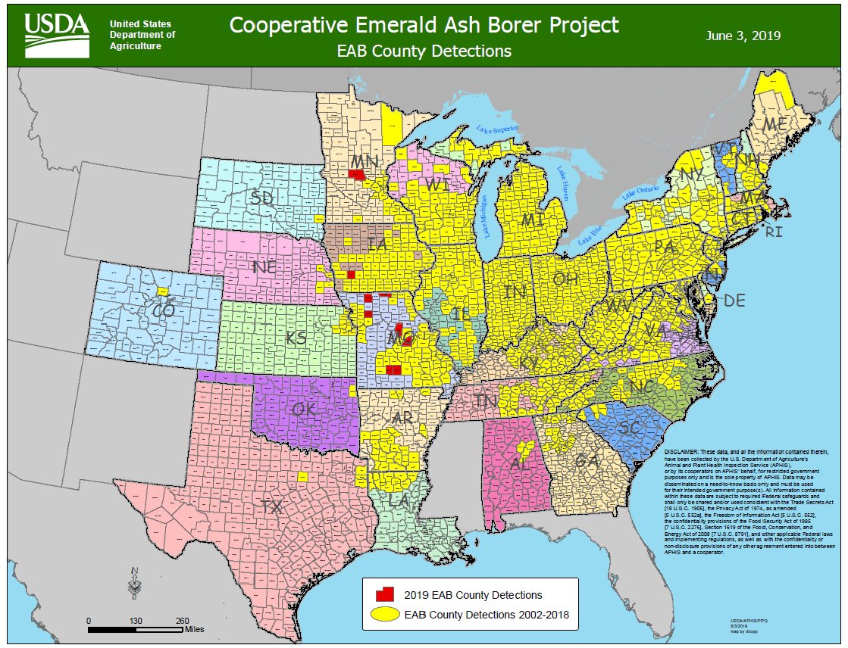
Emerald Ash Borer Map – Range of Emerald Ash Borer
American Elm

Slide 5
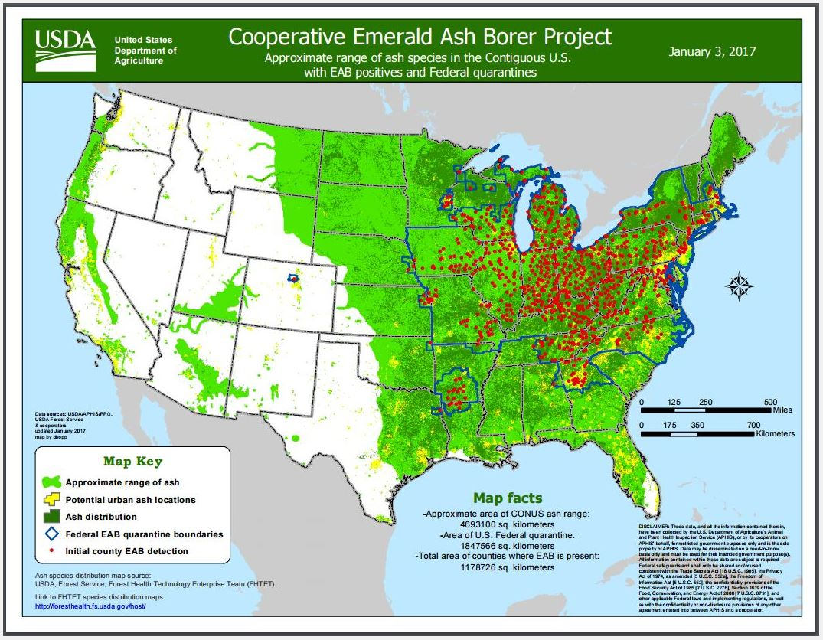
Emerald Ash Borer Map – Range of Ash Trees
American Elm

Slide 6
Emerald Ash Borer What to Look For
1
Crown dieback (dead branches at top of tree)
Live sprouts at base of tree are called “epicormic shoots,” causing trees to appear ‘bushy’ at the base of the tree
Wilting and yellowing leaves
Daniel Herms, The Ohio State University, Bugwood.org

Slide 7
Emerald Ash Borer What to Look For
Crown dieback (dead branches at top of tree)
Live sprouts at base of tree are called “epicormic shoots,” causing trees to appear ‘bushy’ at the base of the tree
Wilting and yellowing leaves
2
Daniel Herms, The Ohio State University, Bugwood.org

Slide 8
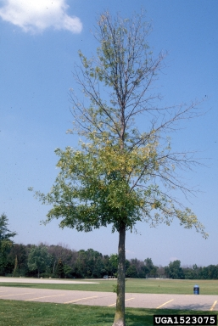
Emerald Ash Borer What to Look For
Crown dieback (dead branches at top of tree)
Live sprouts at base of tree are called “epicormic shoots,” causing trees to appear ‘bushy’ at the base of the tree
Wilting and yellowing leaves
3
Daniel Herms, The Ohio State University, Bugwood.org

Slide 9
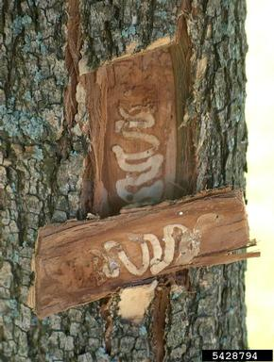
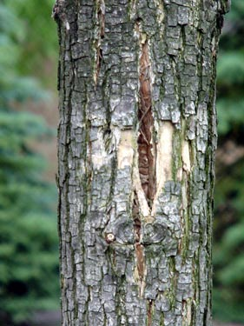
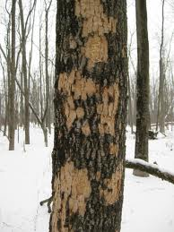
Emerald Ash Borer What to Look For (cont.)
Jared Spokowsky, Indiana Department of Natural Resources, Bugwood.org
S-shaped galleries under outer bark
Splits or cracks in the bark above and below S-shaped galleries
Evidence of woodpecker feeding (small chips of outer bark flicked off)
Characteristic D shaped exit holes (difficult to find)
1
2
3
4

Slide 10
Emerald Ash Borer What to Look For (cont.)
James W. Smith, USDA APHIS PPQ, Bugwood.org
S-shaped galleries under outer bark
Splits or cracks in the bark above and below S-shaped galleries
Evidence of woodpecker feeding (small chips of outer bark flicked off)
Characteristic D shaped exit holes (difficult to find)
1
2
3
4

Slide 11
Emerald Ash Borer What to Look For (cont.)
S-shaped galleries under outer bark
Splits or cracks in the bark above and below S-shaped galleries
Evidence of woodpecker feeding (small chips of outer bark flicked off)
Characteristic D shaped exit holes (difficult to find)
1
2
Tom Bain, GeoEcology Blog
3
4

Slide 12
Emerald Ash Borer What to Look For (cont.)
S-shaped galleries under outer bark
Splits or cracks in the bark above and below S-shaped galleries
Evidence of woodpecker feeding (small chips of outer bark flicked off)
Characteristic D shaped exit holes (difficult to find)
1
2
3
4

Slide 13
Emerald Ash Borer What to Look For (cont.)
SUMMER:
Crown dieback and epicormic sprouting most noticeable
WINTER/FALL:
Split bark; woodpecker damage most obvious on defoliated trees
LATE SPRING/EARLY SUMMER:
Female beetles are actively feeding
YEAR-ROUND: Cracks in bark; D-shaped holes; Wilting, yellowing leaves

Slide 14
Emerald Ash Borer Additional Resources
USDA
http://www.emeraldashborer.info/
Hungry Pests
http://www.hungrypests.com/the-threat/emerald-ash-borer.php
Don’t Move Firewood
http://www.dontmovefirewood.org/gallery-of-pests/emerald-ash-borer.html
Outsmart Invasives Video Clip
https://www.youtube.com/watch?v=wXCynbvf4Lc
EDDMaps: Reporting App for Smartphones
http://www.eddmaps.org/

