Slide 1
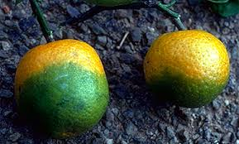
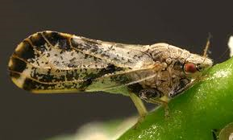
Citrus Greening
Identifying Characteristics
Huanglongbing, a bacteria transmitted by Asian Citrus Psyllid, results in greenish, miscolored, mishapen, and bitter fruits on infected trees
The Asian Citrus Psyllid is close to the size of a gnat
Adults, eggs, larvae or pupae may be on leaves or stems

Slide 2
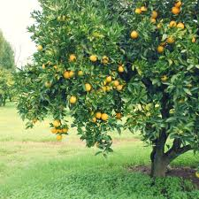
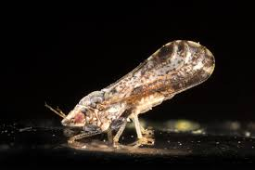
Citrus Greening Relationship between Bacteria and Psyllid
Psyllid feeds on infected tree
Tree infected with huanglongbing (bacteria)
Carries huanglongbing to the next feeding site

Slide 3
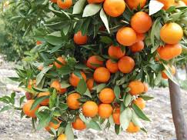
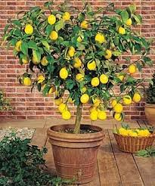
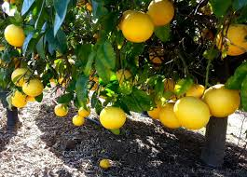
Citrus Greening Common Host Trees
Lemon
Lime
Orange
Grapefruit
Pomelo
Mandarin
Tangerine
Meyer Lemon
Mandarin
Grapefruit
Meyer Lemon

Slide 4
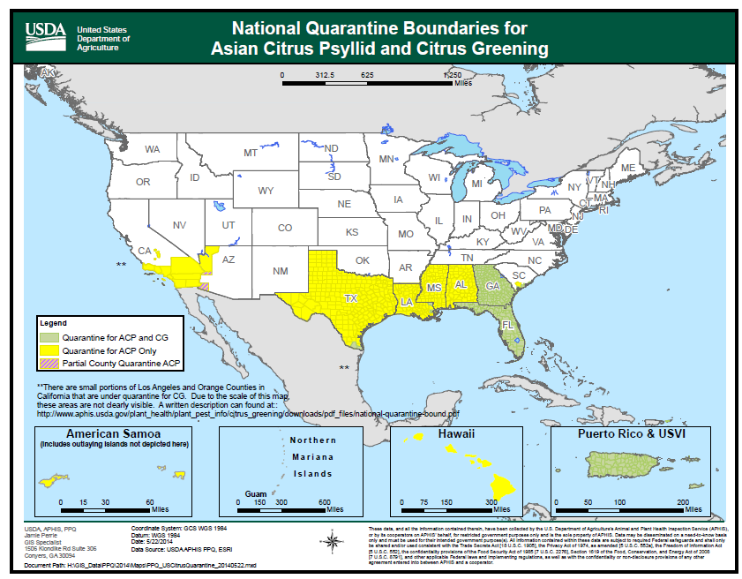
Citrus Greening Map – Range of Citrus Greening
American Elm

Slide 5
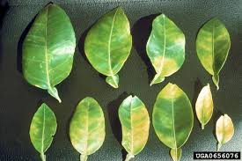
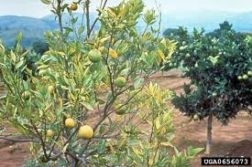
Citrus Greening What to Look For
1
Leaves develop a yellow blotchy appearance
Sparsely leaved branches
Infected citrus trees produce fruits that are green and bitter
White waxy feeding residue from adult psyllids may be present
2

Slide 6
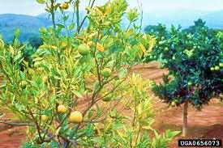
Citrus Greening What to Look For
1
Leaves develop a yellow blotchy appearance
Sparsely leaved branches
Infected citrus trees produce fruits that are green and bitter
White waxy feeding residue from adult psyllids may be present
2

Slide 7
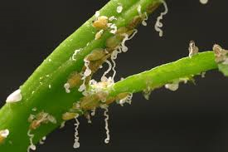
Citrus Greening What to Look For
3
Leaves develop a yellow blotchy appearance
Sparsely leaved branches
Infected citrus trees produce fruits that are green and bitter
White waxy feeding residue from adult psyllids may be present
4

Slide 8
Citrus Greening What to Look For
3
Leaves develop a yellow blotchy appearance
Sparsely leaved branches
Infected citrus trees produce fruits that are green and bitter
White waxy feeding residue from psyllid nymphs may be present
4

Slide 9
Citrus Greening What to Look For (cont.)
YEAR-ROUND: Leaves are blotchy, defoliation, green or bitter fruits, misshapen fruits, white waxy residue

Slide 10
Citrus Greening Additional Resources
USDA
http://www.aphis.usda.gov/publications/plant_health/2011/CG-PestAlert.pdf
Hungry Pests
http://www.hungrypests.com/the-threat/citrus-greening.php
EDDMaps: Reporting App for Smartphones
http://www.eddmaps.org/

