Slide 1
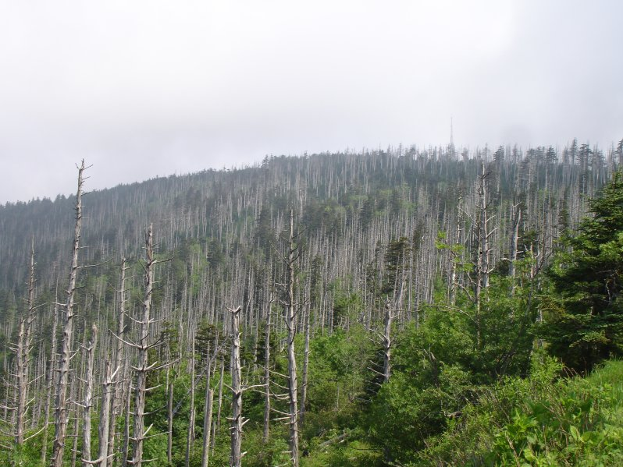
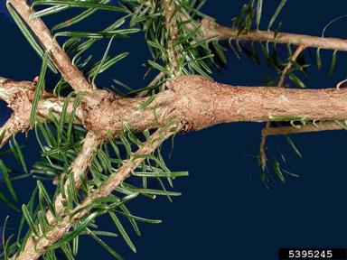
Balsam Woolly Adelgid
Identifying Characteristics:
1mm small wingless insect
Has 2 – 4 generations per year
Injects toxic saliva that damages tree’s vascular tissues, eventually killing the tree
Transported in crawler stage by wind, animals, and people
Creates a white, waxy covering on trees

Slide 2
Balsam Woolly Adelgid Life Cycle
Honey colored eggs are laid in a clutch behind the adult
Eggs hatch and become crawlers; search out suitable feeding site
The crawler molts into a nymph and sinks its feeding tube into the tree
The nymph molts into an adult and lays eggs

Slide 3
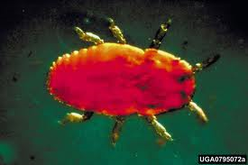
Balsam Woolly Adelgid Life Cycle
Honey colored eggs are laid in a clutch behind the adult
Eggs hatch and become crawlers; search out suitable feeding site
The crawler molts into a nymph and sinks its feeding tube into the tree
The nymph molts into an adult and lays eggs

Slide 4
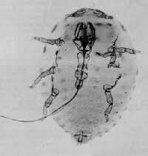
Balsam Woolly Adelgid Life Cycle
Honey colored eggs are laid in a clutch behind the adult
Eggs hatch and become crawlers; search out suitable feeding site
The crawler molts into a nymph and sinks its feeding tube into the tree
The nymph molts into an adult and lays eggs

Slide 5
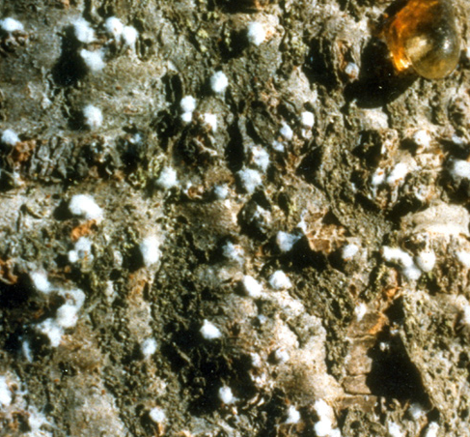
Balsam Woolly Adelgid Life Cycle
Honey colored eggs are laid in a clutch behind the adult
Eggs hatch and become crawlers; search out suitable feeding site
The crawler molts into a nymph and sinks its feeding tube into the tree
The nymph molts into an adult and lays eggs

Slide 6
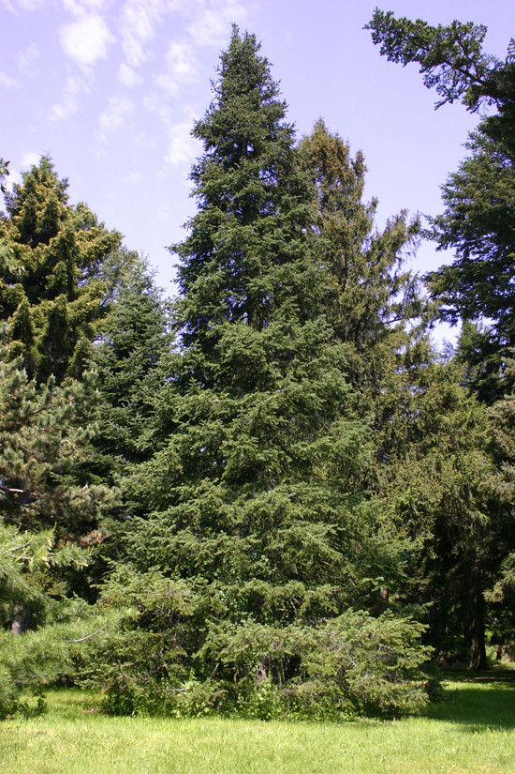
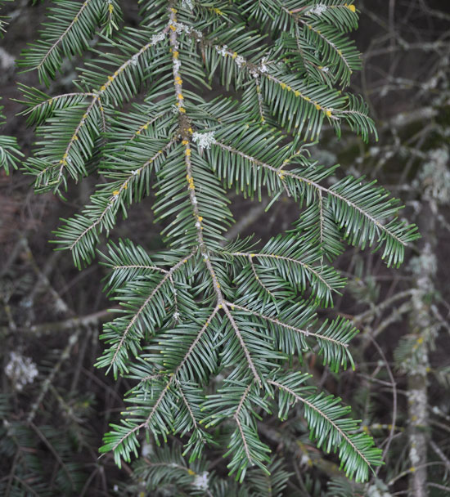
Balsam Woolly Adelgid Common Host Trees
Fraser fir
Subalpine fir
Silver fir
Grand fir
Grand fir
Subalpine fir
Notes:
Only targets one plant genus (Abies)

Slide 7
Balsam Woolly Adelgid Map – Range of Balsam Woolly Adelgid

Slide 8
Balsam Woolly Adelgid What to Look For
1
White, waxy threadlike “wool” covering is visually obvious
Tree symptoms vary, but includes needle loss and death of upper branches and twigs
Feeding at the base of leaf buds also causes “gouting”, or swelling around buds

Slide 9
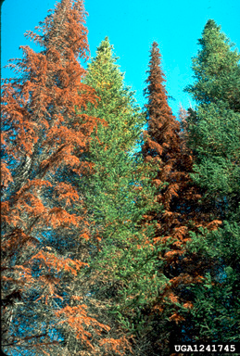
Balsam Woolly Adelgid What to Look For
2
White, waxy threadlike “wool” covering is visually obvious
Tree symptoms vary, but includes needle loss and death of upper branches and twigs
Feeding at the base of leaf buds also causes “gouting”, or swelling around buds

Slide 10
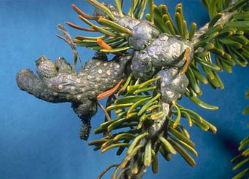
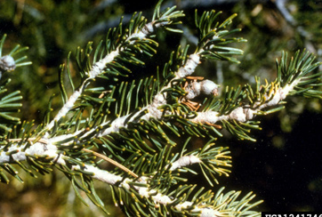
Balsam Woolly Adelgid What to Look For
3
White, waxy threadlike “wool” covering is visually obvious
Tree symptoms vary, but includes needle loss and death of upper branches and twigs
Feeding at the base of leaf buds also causes “gouting”, or swelling around buds
3

Slide 11
Balsam Woolly Adelgid What to Look For (cont.)
SUMMER:
White “wool" covered females on the bark of stems or branches.
LATE SUMMER/FALL:
Egg laying occurs from late August to late October
YEAR-ROUND: White woolly masses; Dying and/or dead branches and crowns.

Slide 12
Balsam Woolly Adelgid Additional Resources
USDA Forest Service
http://www.na.fs.fed.us/pubs/fidls/bwa.pdf
Don’t Move Firewood
http://www.dontmovefirewood.org/gallery-of-pests/balsam-woolly-adelgid.html
EDDMaps: Reporting App for Smartphones
http://www.eddmaps.org/

