Slide 1
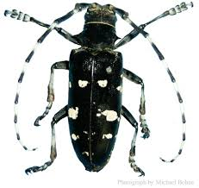
Asian Longhorned Beetle
Identifying Characteristics:
Large 1” – 1 ½” long body
Shiny black outer wings with around 20 white spots
Very long white and black striped antennae
Six legs
Can have blue-ish feet
Beetles most often seen in late summer

Slide 2
Asian Longhorned Beetle Identification
Blue-ish Legs and Feet
White Banded Antenna
Bright White Spots
.75 - 1.5 inch body length
Shiny Black Body

Slide 3
Asian Longhorned Beetle Lifecycle
3

Slide 4
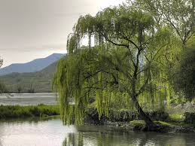
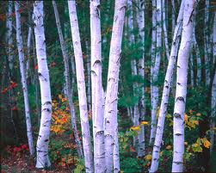
Asian Longhorned Beetle Common Host Trees
Willow
Maples*
Willows*
Aspen
Birch
Elm
Box Elder
Buckeye
Horsechestnut
Katsura
London Planetree
Mountain Ash
Poplar (Cottonwood)
Ash
*Most Preferred
Birch
Maple
Notes:
Targets 15 different plant families

Slide 5
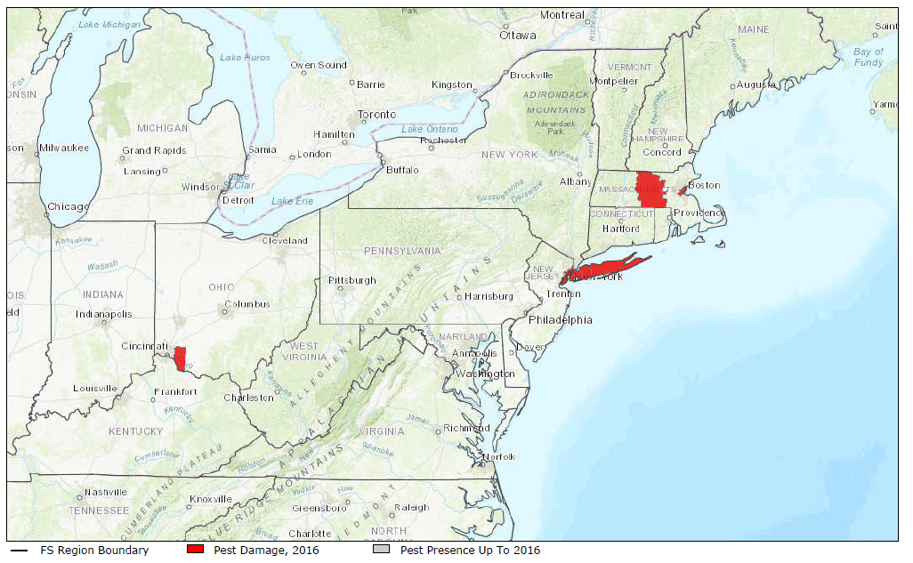
Asian Longhorned Beetle Map – Range of Asian Longhorned Beetle
American Elm

Slide 6
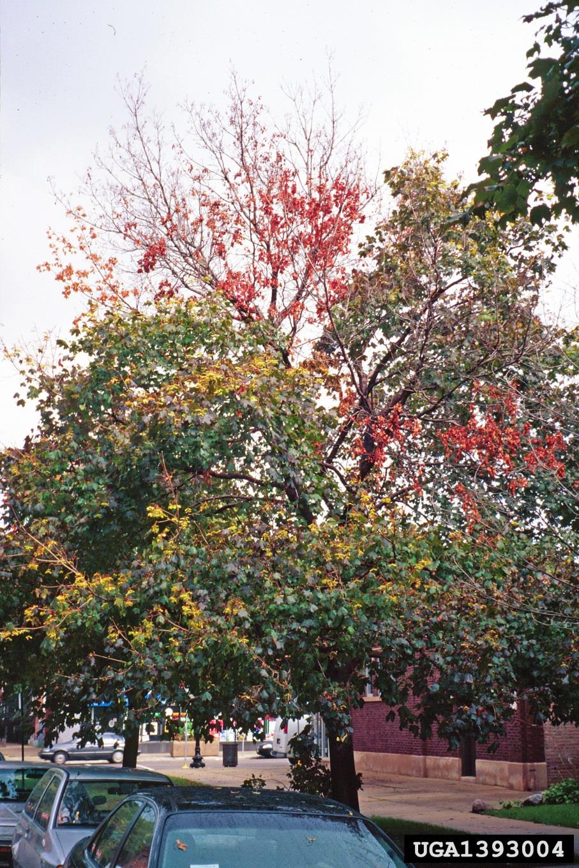
Asian Longhorned Beetle What to Look For
1
Crown of tree declines first
Feeding galleries under bark
Exit holes are perfectly round, and the diameter of a pencil
Infestation can cause patches of trunk to appear black and covered in sap
Sawdust (frass) can accumulate on branches and at the base of the tree

Slide 7
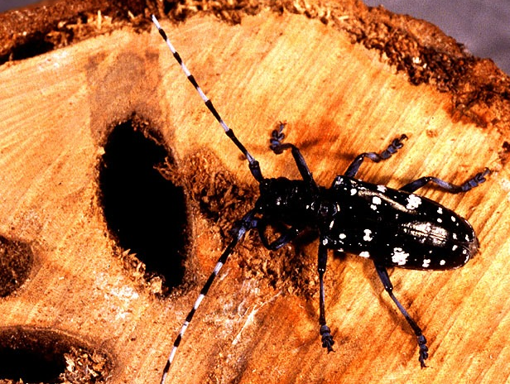
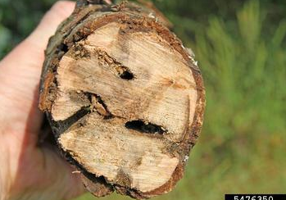
Asian Longhorned Beetle What to Look For
2
Crown of tree declines first
Feeding galleries under bark
Exit holes are perfectly round, and the diameter of a pencil
Infestation can cause patches of trunk to appear black and covered in sap
Sawdust (frass) can accumulate on branches and at the base of the tree
2

Slide 8
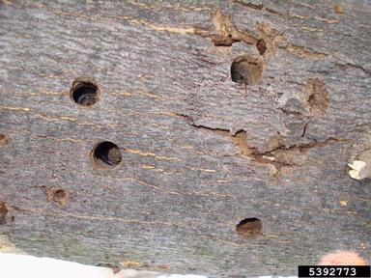
Asian Longhorned Beetle What to Look For
3
Crown of tree declines first
Feeding galleries under bark
Exit holes are perfectly round, and the diameter of a pencil
Infestation can cause patches of trunk to appear black and covered in sap
Sawdust (frass) can accumulate on branches and at the base of the tree
3

Slide 9
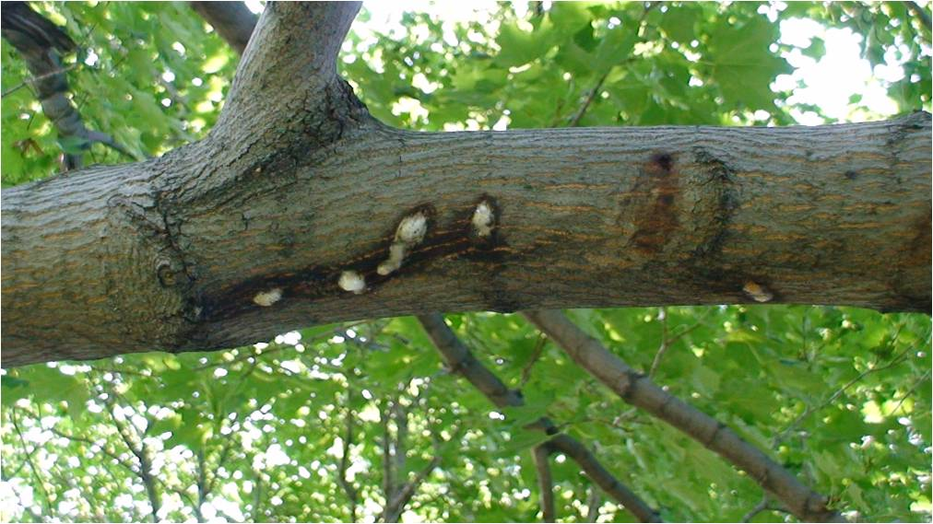
Asian Longhorned Beetle What to Look For
4
Crown of tree declines first
Feeding galleries under bark
Exit holes are perfectly round, and the diameter of a pencil
Infestation can cause patches of trunk to appear black and covered in sap
Sawdust (frass) can accumulate on branches and at the base of the tree

Slide 10
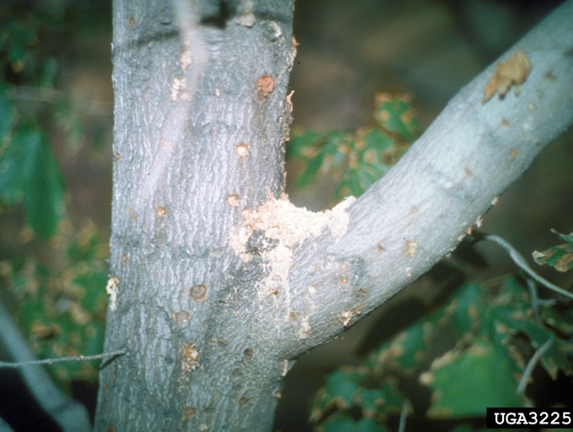
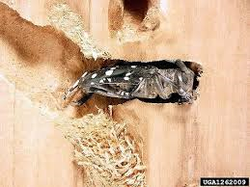
Asian Longhorned Beetle What to Look For
5
Crown of tree declines first
Feeding galleries under bark
Exit holes are perfectly round, and the diameter of a pencil
Infestation can cause patches of trunk to appear black and covered in sap
Sawdust (frass) can accumulate on branches and at the base of the tree
5

Slide 11
Asian Longhorned Beetle What to Look For (cont.)
LATE SUMMER: Beetles most likely to be seen on trees
WINTER/FALL:
Tree damage (e.g., exit holes) most obvious on defoliated trees
YEAR-ROUND: Frass; Exit Holes; Black ‘Sap’

Slide 12
Asian Longhorned Beetle Additional Resources
USDA
http://asianlonghornedbeetle.com/
Hungry Pests
http://www.hungrypests.com/the-threat/asian-longhorned-beetle.php
Don’t Move Firewood
http://www.dontmovefirewood.org/gallery-of-pests/asian-long-horned-beetle.html
Outsmart Invasives Video Clip
https://www.youtube.com/watch?v=nIN4lmfuQnk
EDDMaps: Reporting App for Smartphones
http://www.eddmaps.org/

