Slide 1
Early
Pest Detection
Summer 2018

Slide 2
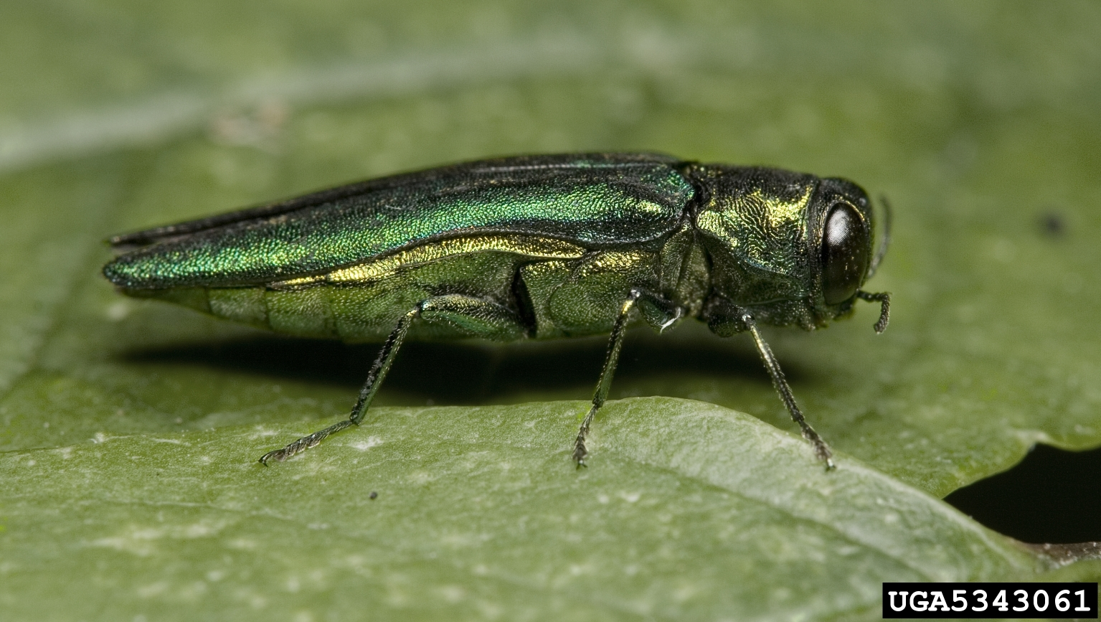
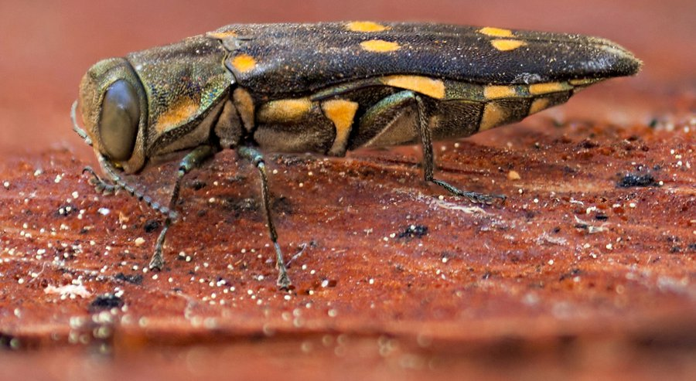
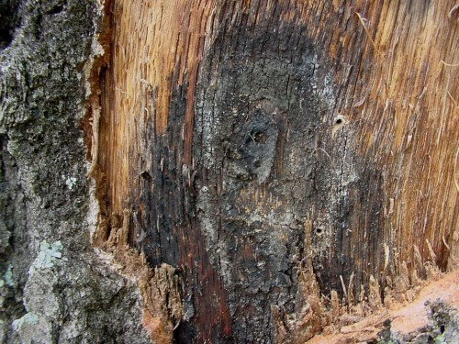
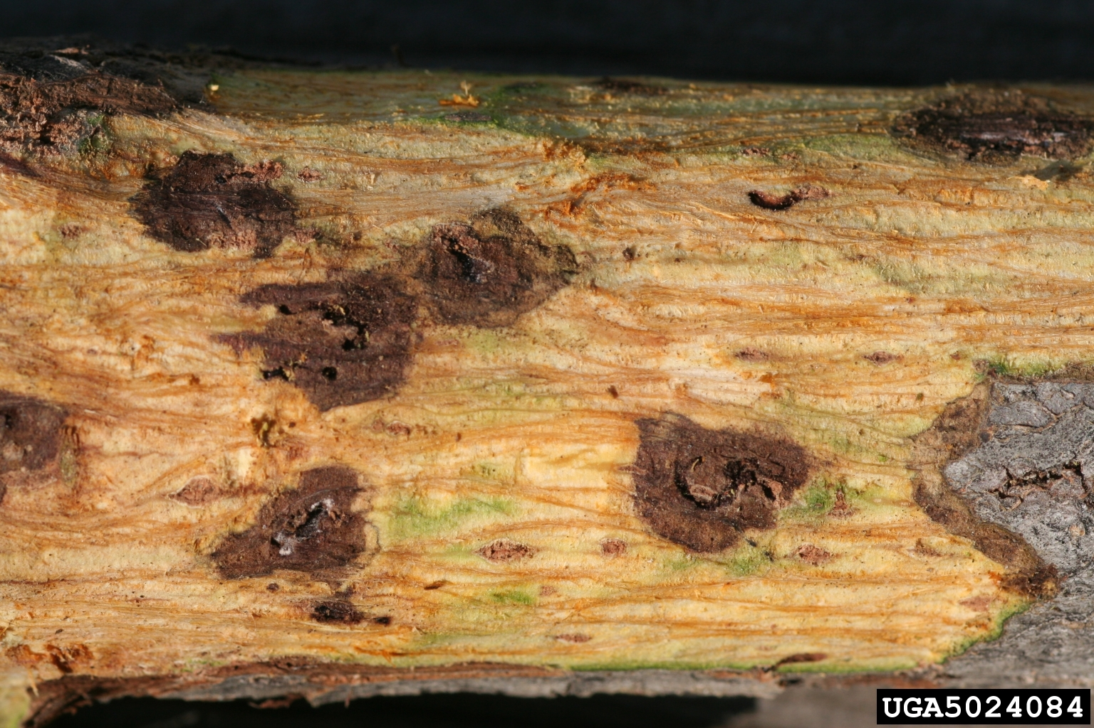
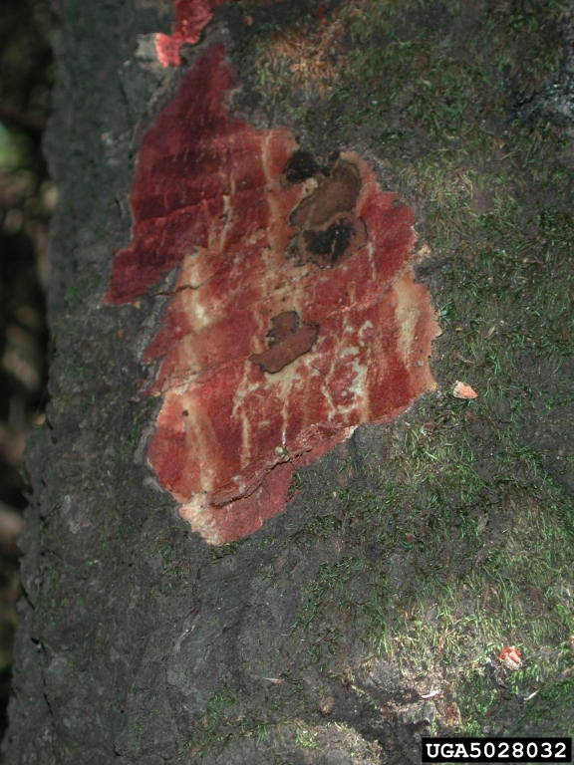
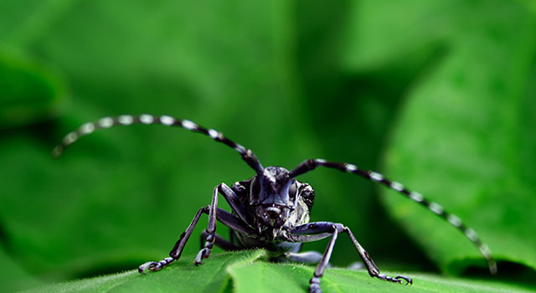
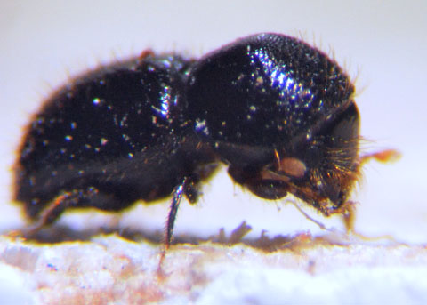
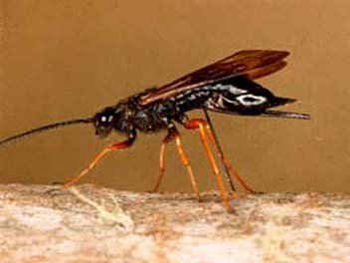
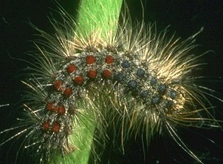
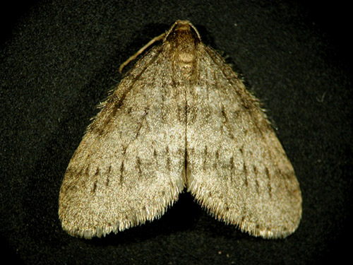
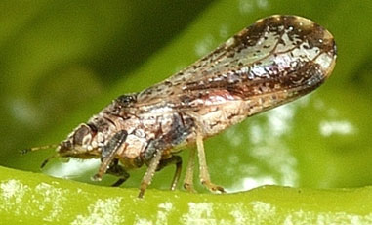
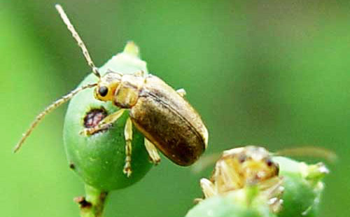
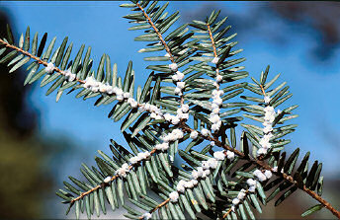
Pest Detection Protocol
Notes:
Emerald Ash Borer, Asian longhorned beetle, Balsam woolly adelgid, citrus greening (huanglongbing), gold-spotted oak borer, gypsy moth (European, Asian and Rosy), hemlock woolly adelgid, oak wilt, polyphagous shothole borer, sirex woodwasp, sudden oak death, thousand cankers disease, viburnum leaf beetle, winter moth

Slide 3
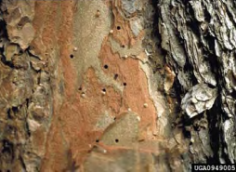
Exit Holes
Tunnels through bark caused by insects exiting the tree
Shape and size of the holes are indicative of the type of insect

Slide 4
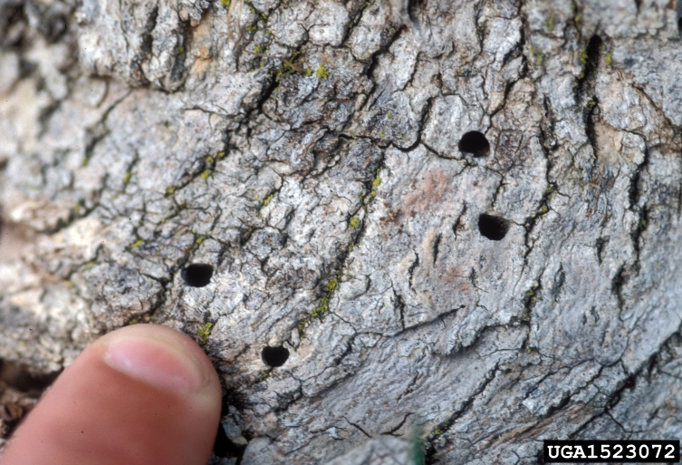
Exit Holes
Ex. of the appearances of exit holes:
  Small, D-shaped exit holes
  Multiple exit holes the size of a pen tip
  Tiny holes surrounded by cankers

Slide 5
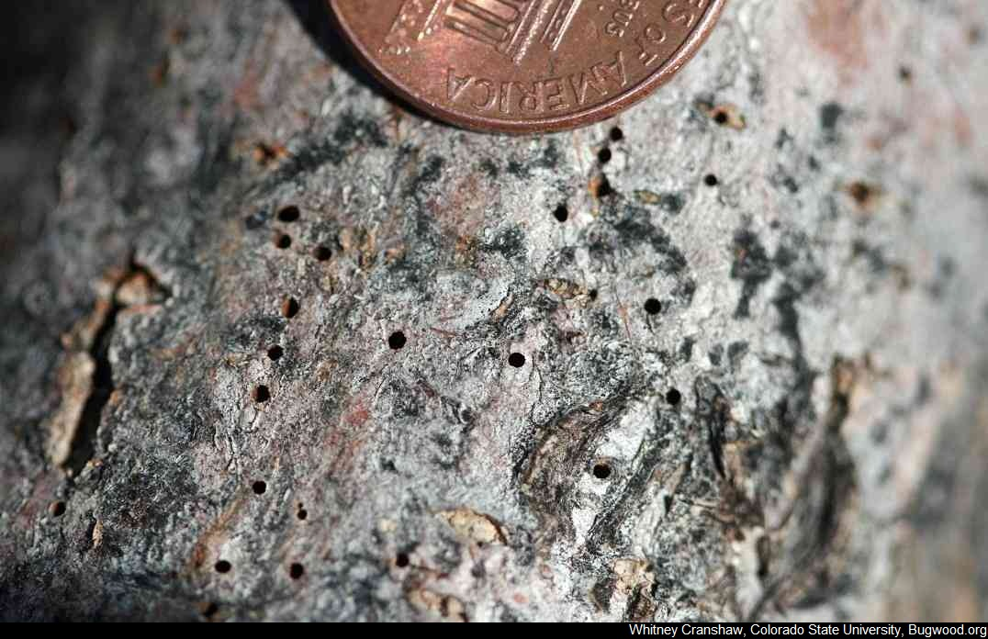
Exit Holes
Ex. of the appearances of exit holes:
  Small, D-shaped exit holes
  Multiple exit holes the size of a pen tip
  Tiny holes surrounded by cankers
Notes:
Thousand Cankers

Slide 6
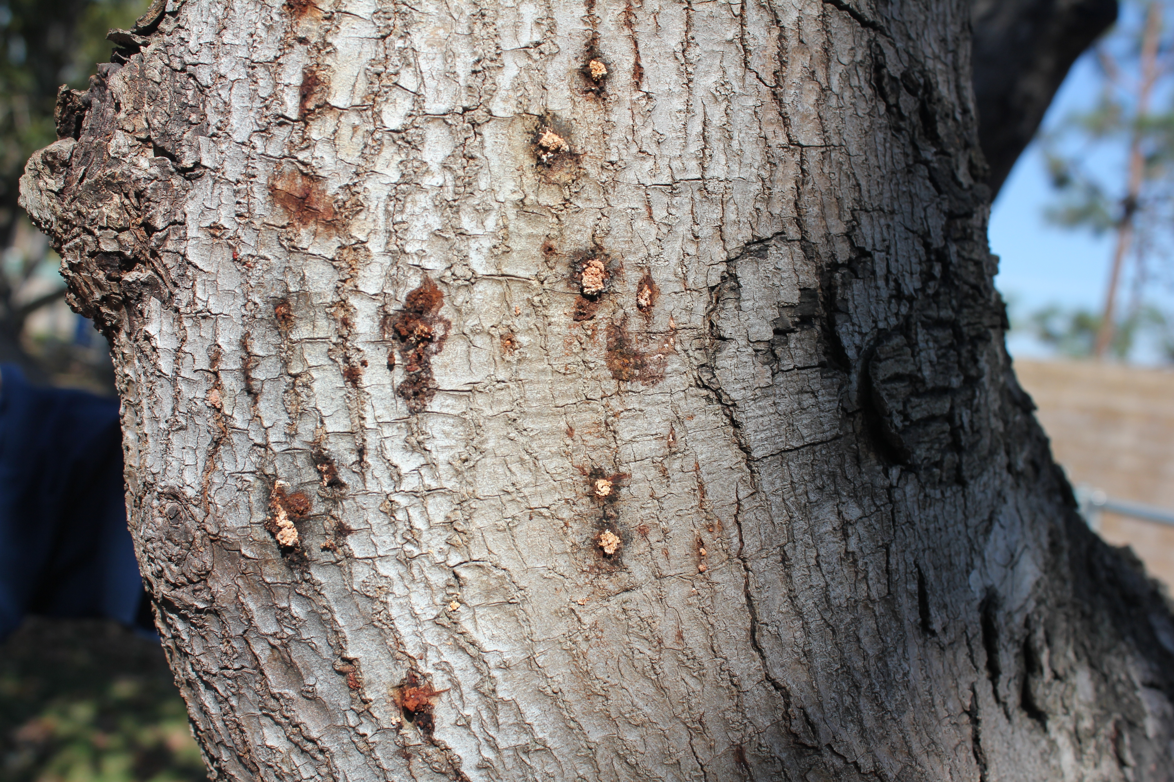
Exit Holes
Ex. of the appearances of exit holes:
  Small, D-shaped exit holes
  Multiple exit holes the size of a pen tip
  Tiny holes surrounded by cankers
Notes:
Polyphagous Shothole Borer

Slide 7
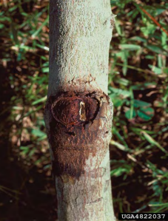
Exudation
Substance that oozes from a damaged area on the tree
Often sticky, powdery, or slick, and causes discoloration of the bark

Slide 8
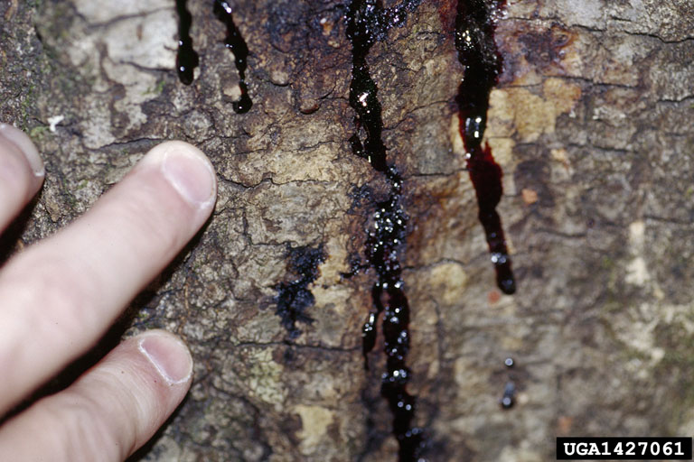
Exudation
Exudation takes many forms:
  Red or black staining “ooze”
  Black fungal mat present below cracked bark
  Brown fungal mat present in sapwood
  Wet or dry discoloration around exit holes
  White powdery substance around exit holes
  Black or reddish ooze around cankers
  White woolly egg masses, undersides of leaves

Slide 9
Exudation
Exudation takes many forms:
  Red or black staining “ooze”
  Black fungal mat present below cracked bark
  Brown fungal mat present in sapwood
  Wet or dry discoloration around exit holes
  White powdery substance around exit holes
  Black or reddish ooze around cankers
  White woolly egg masses, undersides of leaves

Slide 10
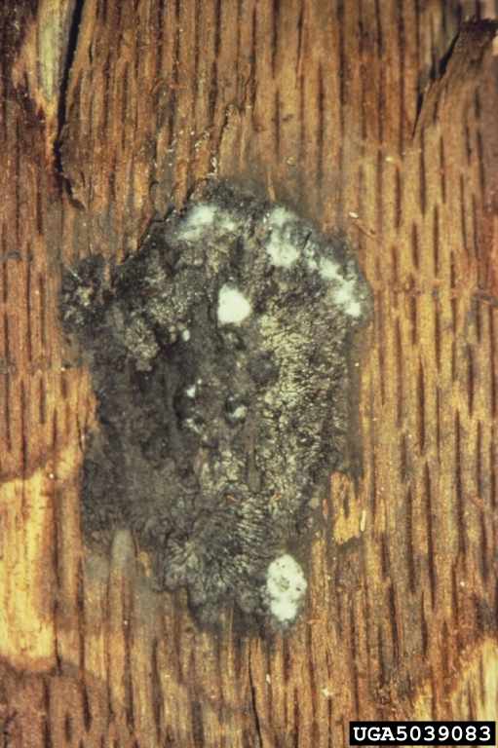
Exudation
Exudation takes many forms:
  Red or black staining “ooze”
  Black fungal mat present below cracked bark
  Brown fungal mat present in sapwood
  Wet or dry discoloration around exit holes
  White powdery substance around exit holes
  Black or reddish ooze around cankers
  White woolly egg masses, undersides of leaves
Notes:
In the red oak group, symptoms are characterized by a wilting and bronzing of the foliage, starting at the tree top and tips of branches, and spreading rapidly throughout the entire crown. Symptoms develop beginning in May and continue throughout the growing season. Individual leaves turn bronze progressively, from the tip to the base, sometimes leaving a small area of green tissue at the base around the midrib (French & Stienstra, 1980) (figure 3). Leaves in all stages of discolouration, including green leaves, are shed more or less continuously as the disease progresses. Some diffuse staining may be observed in the outermost sapwood, where the fungus has induced the tree to produce gums and tyloses which discolour the wood (French & Stienstra, 1980).
The fungus produces endoconidia in gray or tan mats beneath the bark of infected, dying or dead trees (figure 2). In some trees, more commonly red oaks, mycelial growths within these mats enlarge to form cushion-shaped structures called pressure pads which can exert sufficient pressure to raise and split the bark. A fruity odour which attracts insects is produced by the mats. Trees of all ages may be affected and usually die the same season that the symptoms appear.
Members of the white oak group are more resistant to oak wilt and may live several years before they die. Some may even recover from infection. Some white oaks may carry the fungus with no foliar symptoms of disease. Generally, however, bronzing is less pronounced and defoliation is reduced in the white oaks, frequently occurring only on a few branches of affected trees. Leaves turn brown from the leaf tip toward the leaf base and discolouration patterns resemble those due to normal fall colour changes (French & Stienstra, 1980). Distinct staining or streaking is often observed in the xylem of affected branches of white oaks (figure 4), less frequently in red oaks.
ILLINOIS AT RISK!

Slide 11
Exudation
Exudation takes many forms:
  Red or black staining “ooze”
  Black fungal mat present below cracked bark
  Brown fungal mat present in sapwood
  Wet or dry discoloration around exit holes
  White powdery substance around exit holes
  Black or reddish ooze around cankers
  White woolly egg masses, undersides of leaves

Slide 12
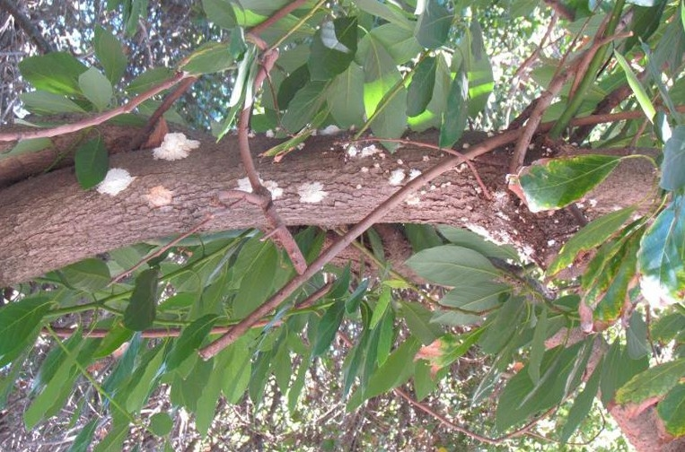
Exudation
Exudation takes many forms:
  Red or black staining “ooze”
  Black fungal mat present below cracked bark
  Brown fungal mat present in sapwood
  Wet or dry discoloration around exit holes
  White powdery substance around exit holes
  Black or reddish ooze around cankers
  White woolly egg masses, undersides of leaves
Notes:
Another strain of fungus carried by PSHB

Slide 13
Exudation
Exudation takes many forms:
  Red or black staining “ooze”
  Black fungal mat present below cracked bark
  Brown fungal mat present in sapwood
  Wet or dry discoloration around exit holes
  White powdery substance around exit holes
  Black or reddish ooze around cankers
  White woolly egg masses, undersides of leaves
Notes:
Sudden Oak Death

Slide 14
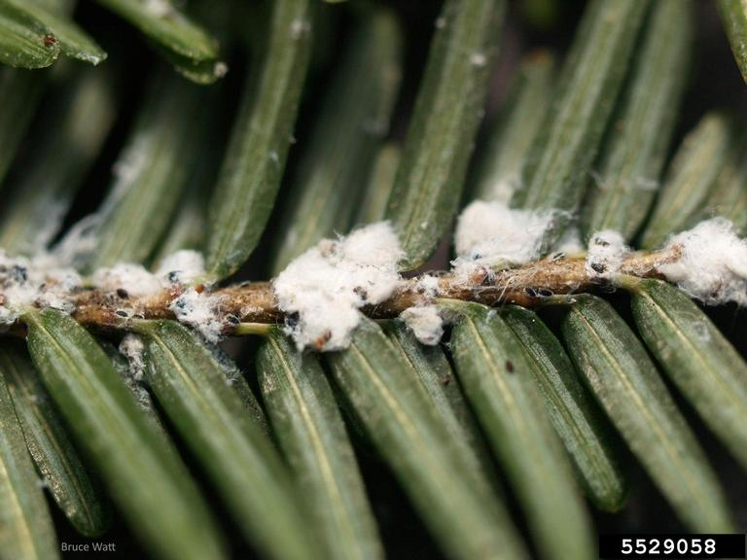
Exudation
Exudation takes many forms:
  Red or black staining “ooze”
  Black fungal mat present below cracked bark
  Brown fungal mat present in sapwood
  Wet or dry discoloration around exit holes
  White powdery substance around exit holes
  Black or reddish ooze around cankers
  White woolly egg masses, undersides of leaves*
*Note: These are egg masses, but may be confused with exudation
Notes:
NOTE – this is not exudation, but commonly mistaken

Slide 15
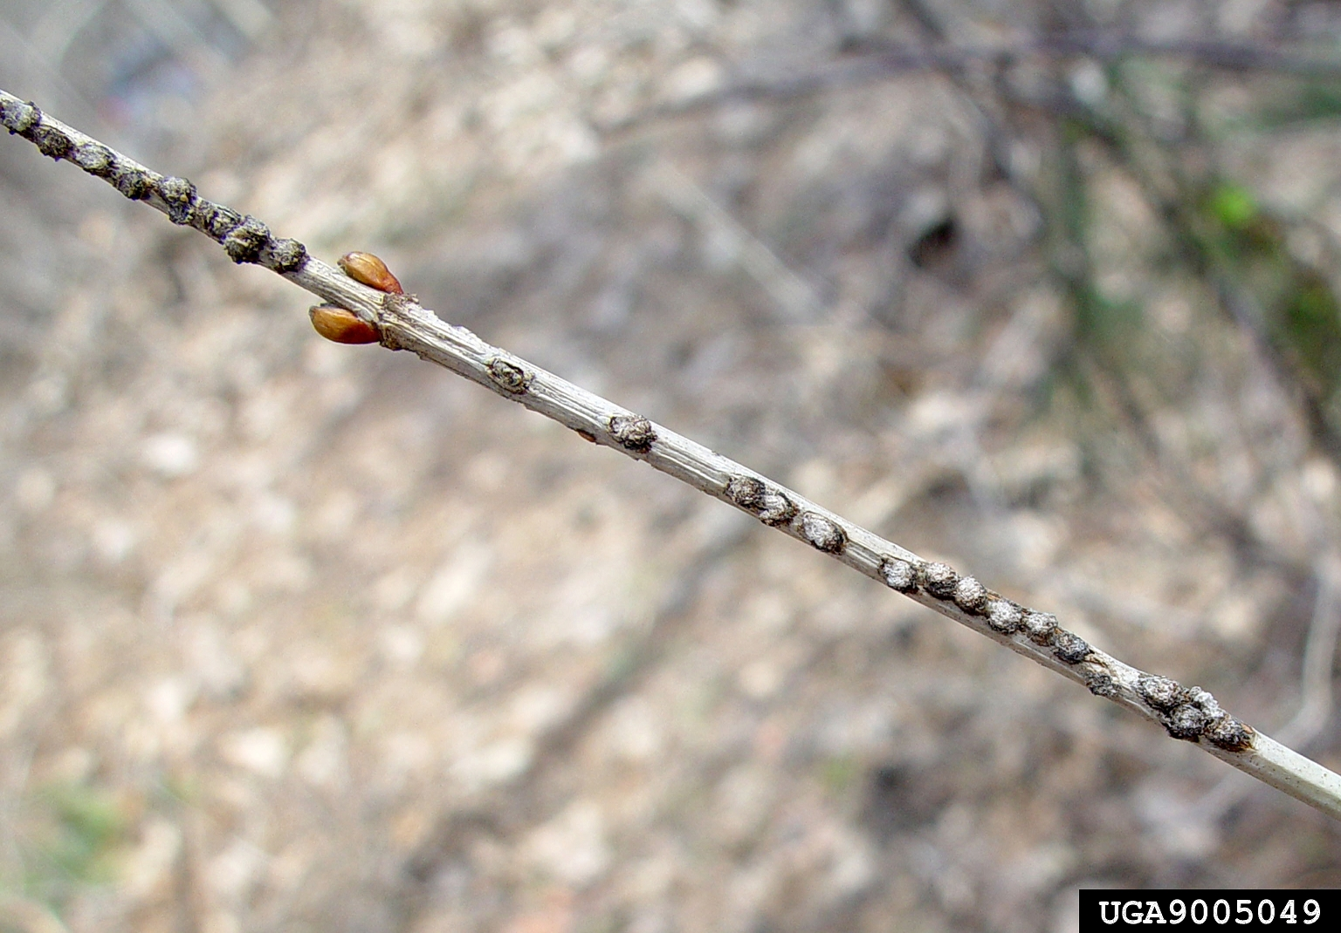
Egg Sites/Eggs
Insect or pest eggs are typically found on the bark of twigs and branches, around crevices, or around existing wounds

Slide 16
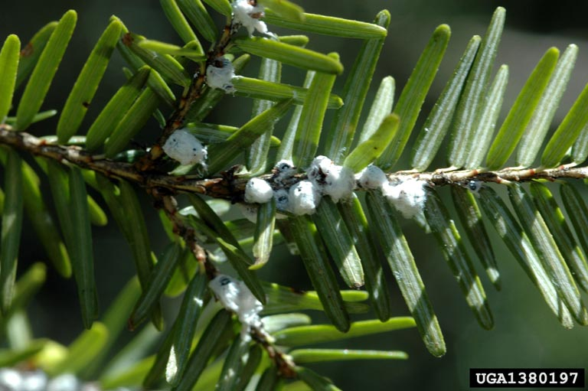
Egg Sites/Eggs
Insect eggs have a variety of appearances and can be found at various locations on the tree:
  Waxy, woolly white egg masses at needle base
  Fluffy brown egg masses on trunk
  Clusters of small oval eggs
  Shallow, round discolored ‘divots’

Slide 17
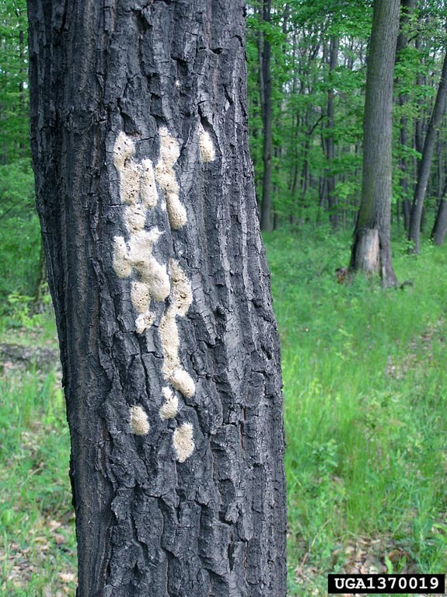
Egg Sites/Eggs
Insect eggs have a variety of appearances and can be found at various locations on the tree:
  Waxy, woolly white egg masses at needle base
  Fluffy brown egg masses on trunk
  Clusters of small oval eggs
  Shallow, round discolored ‘divots’
Notes:
Gypsy Moth

Slide 18
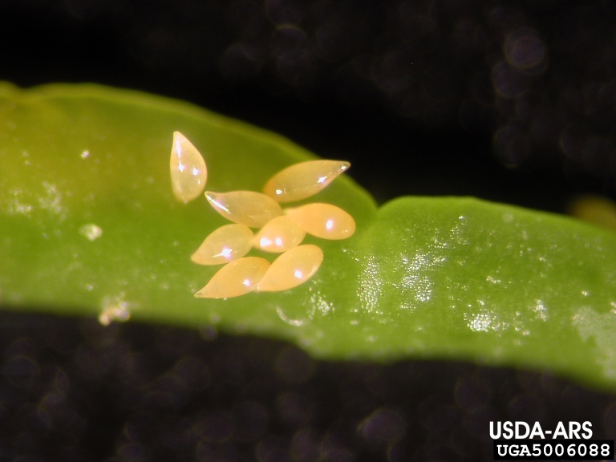
Egg Sites/Eggs
Insect eggs have a variety of appearances and can be found at various locations on the tree:
  Waxy, woolly white egg masses at needle base
  Fluffy brown egg masses on trunk
  Clusters of small oval eggs
  Shallow, round discolored ‘divots’
Notes:
Asian Citrus Psyllid or Emerald Ash Borer

Slide 19
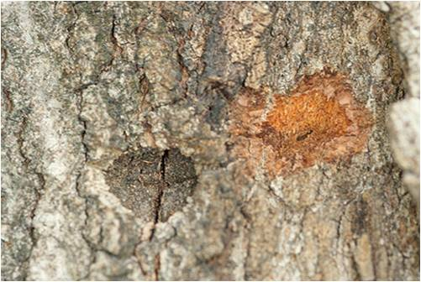
Egg Sites/Eggs
Insect eggs have a variety of appearances and can be found at various locations on the tree:
  Waxy, woolly white egg masses at needle base
  Fluffy brown egg masses on trunk
  Clusters of small oval eggs
  Shallow, round discolored ‘divots’
Notes:
ALB or EAB

Slide 20
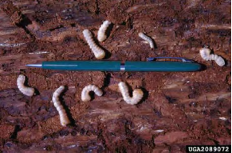
Adult Insects, Larvae, Pupa
Found on or just below the bark, or on foliage

Slide 21
Adult Insects, Larvae, Pupa
Assigned Numbers
  0: None
  1: Moth with white to light brown wings
  2: Black beetle with white spots and long antennae
  3: Small emerald green beetle
  4: small brown beetle with orange spots on its outer wings
  5: Caterpillar with three sets of blue spots, six sets of red spots
  6: Tiny brown beetle (PSHB)
  7: Bright green winged insect (Citrus psyllid)

Slide 22
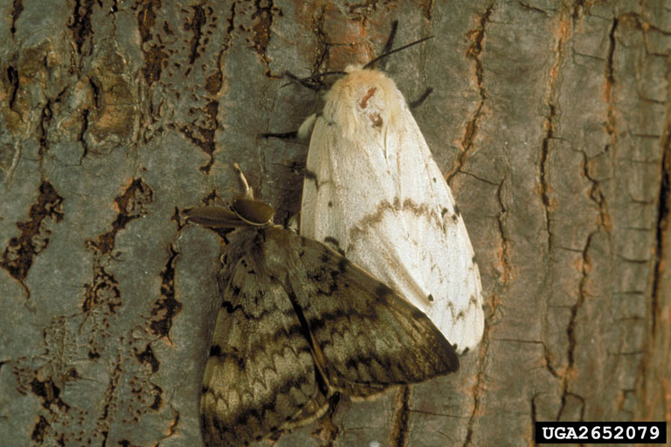
Adult Insects, Larvae, Pupa
Assigned Numbers
  0: None
  1: Moth with white to light brown wings
  2: Black beetle with white spots and long antennae
  3: Small emerald green beetle
  4: small brown beetle with orange spots on its outer wings
  5: Caterpillar with three sets of blue spots, six sets of red spots
  6: Tiny brown beetle (PSHB)
  7: Bright green winged insect (Citrus psyllid)

Slide 23
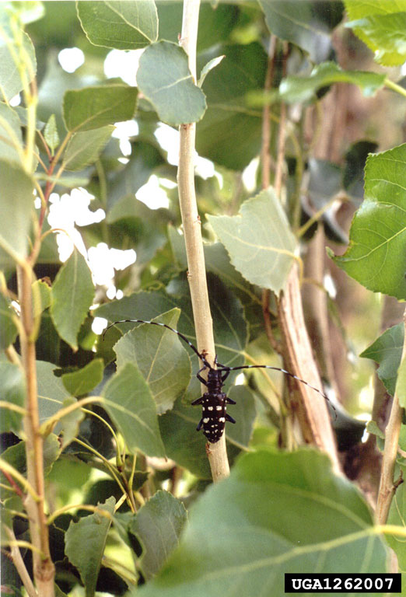
Adult Insects, Larvae, Pupa
Assigned Numbers
  0: None
  1: Moth with white to light brown wings
  2: Black beetle with white spots and long antennae
  3: Small emerald green beetle
  4: small brown beetle with orange spots on its outer wings
  5: Caterpillar with three sets of blue spots, six sets of red spots
  6: Tiny brown beetle (PSHB)
  7: Bright green winged insect (Citrus psyllid)

Slide 24
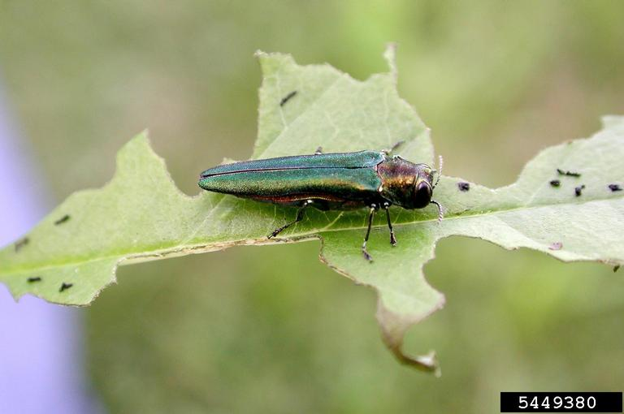
Adult Insects, Larvae, Pupa
Assigned Numbers
  0: None
  1: Moth with white to light brown wings
  2: Black beetle with white spots and long antennae
  3: Small emerald green beetle
  4: small brown beetle with orange spots on its outer wings
  5: Caterpillar with three sets of blue spots, six sets of red spots
  6: Tiny brown beetle (PSHB)
  7: Bright green winged insect (Citrus psyllid)

Slide 25
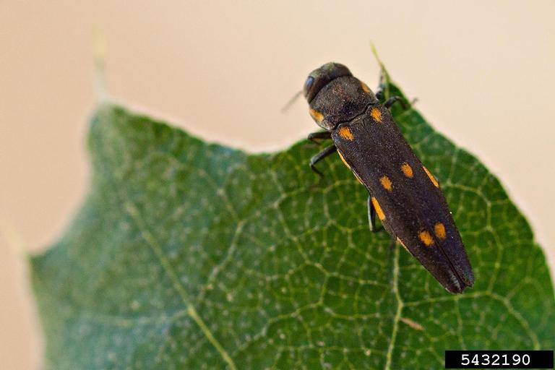
Adult Insects, Larvae, Pupa
Assigned Numbers
  0: None
  1: Moth with white to light brown wings
  2: Black beetle with white spots and long antennae
  3: Small emerald green beetle
  4: small brown beetle with orange spots on its outer wings
  5: Caterpillar with three sets of blue spots, six sets of red spots
  6: Tiny brown beetle (PSHB)
  7: Bright green winged insect (Citrus psyllid)

Slide 26
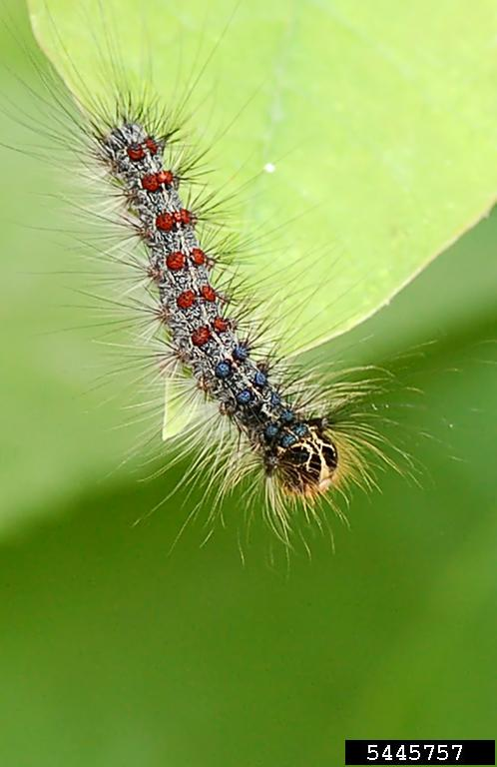
Adult Insects, Larvae, Pupa
Assigned Numbers
  0: None
  1: Moth with white to light brown wings
  2: Black beetle with white spots and long antennae
  3: Small emerald green beetle
  4: small brown beetle with orange spots on its outer wings
  5: Caterpillar with three sets of blue spots, six sets of red spots
  6: Tiny brown beetle (PSHB)
  7: Bright green winged insect (Citrus psyllid)

Slide 27
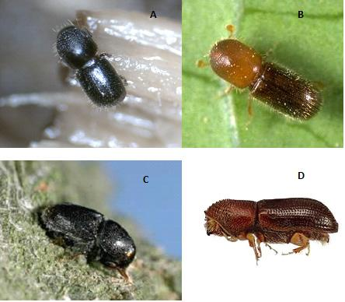
Adult Insects, Larvae, Pupa
Assigned Numbers
  0: None
  1: Moth with white to light brown wings
  2: Black beetle with white spots and long antennae
  3: Small emerald green beetle
  4: small brown beetle with orange spots on its outer wings
  5: Caterpillar with three sets of blue spots, six sets of red spots
  6: Tiny brown beetle (PSHB)
  7: Bright green winged insect (Citrus psyllid)

Slide 28
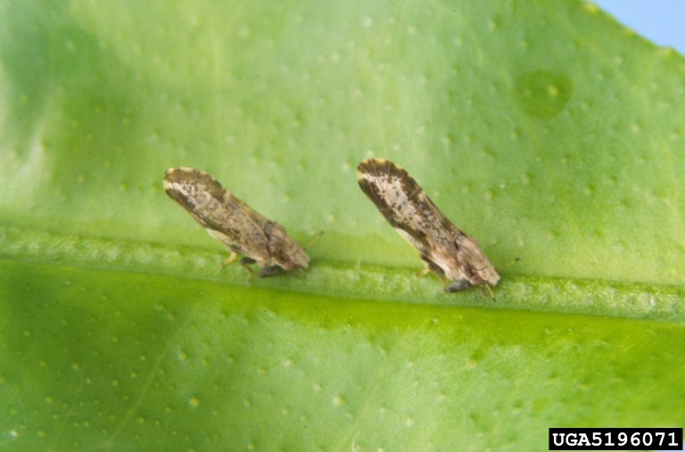
Adult Insects, Larvae, Pupa
Assigned Numbers
  0: None
  1: Moth with white to light brown wings
  2: Black beetle with white spots and long antennae
  3: Small emerald green beetle
  4: small brown beetle with orange spots on its outer wings
  5: Caterpillar with three sets of blue spots, six sets of red spots
  6: Tiny brown beetle (PSHB)
  7: Bright green winged insect (Citrus psyllid)

Slide 29
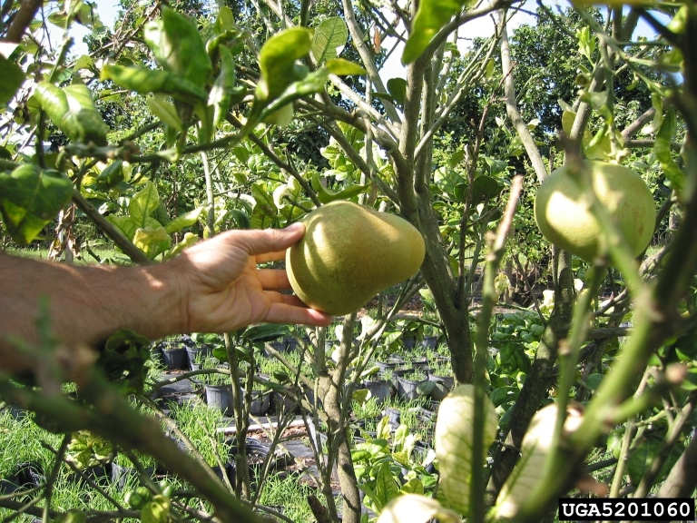
Damaged Fruits/Tree Buds
The shape deformation or blotchy discoloration of buds or fruits

Slide 30
Damaged Fruits/Tree Buds
Damage Classes
  0: None
  1: Misshapen fruits
  2: Discolored fruits
  3: Buds appear shriveled

Slide 31
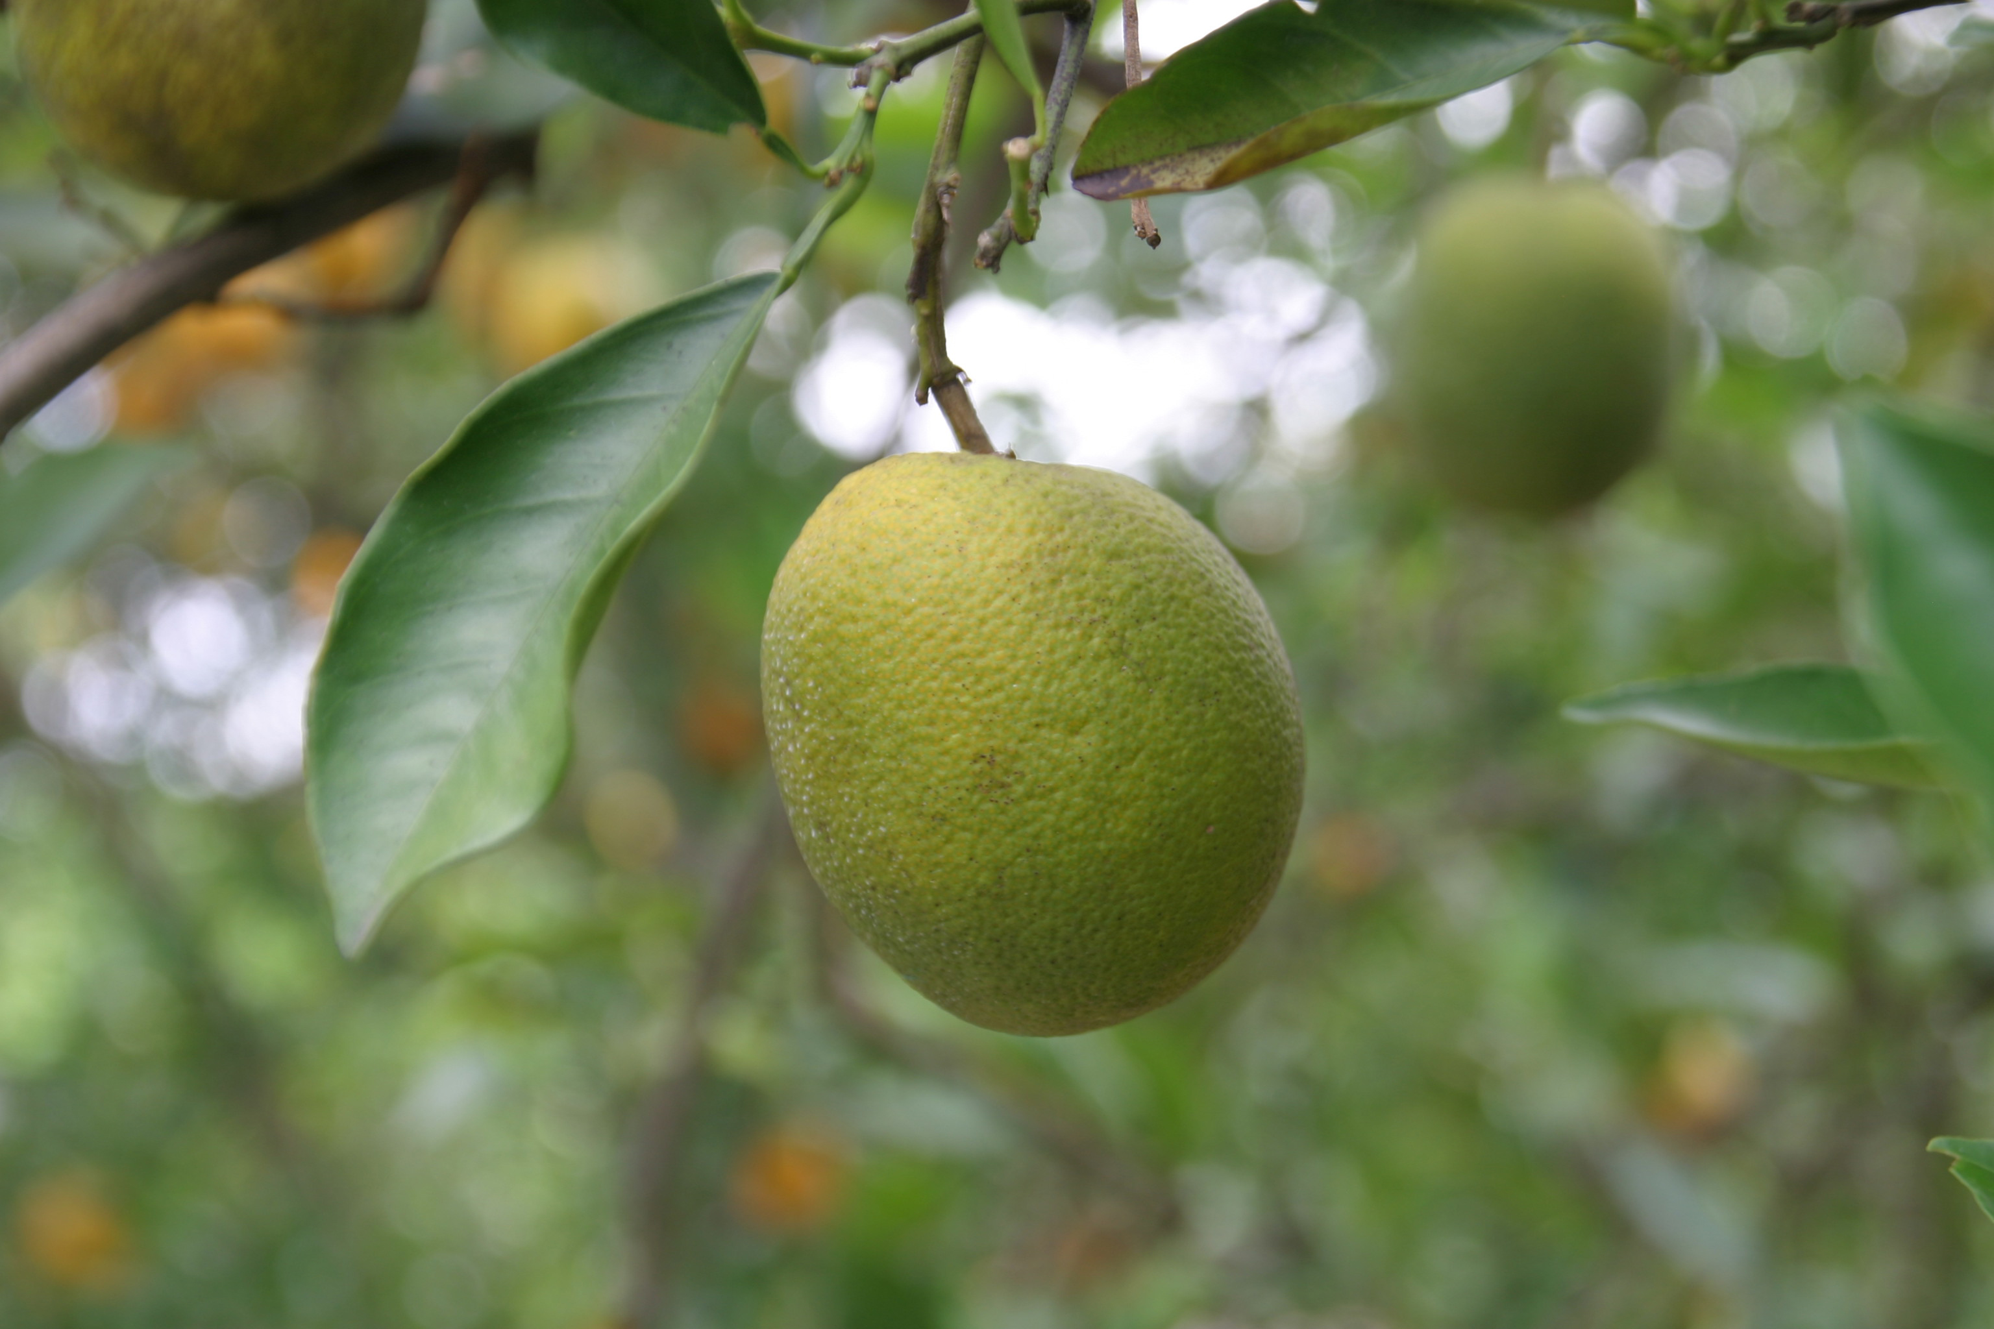
Damaged Fruits/Tree Buds
Damage Classes
  0: None
  1: Misshapen fruits
  2: Discolored fruits
  3: Buds appear shriveled

Slide 32
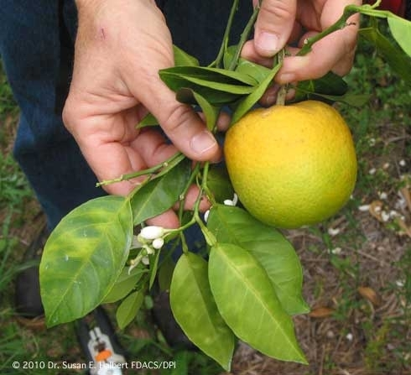
Damaged Fruits/Tree Buds
Damage Classes
  0: None
  1: Misshapen fruits
  2: Discolored fruits
  3: Buds appear shriveled

Slide 33
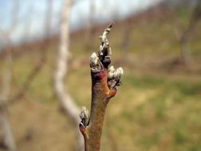
Damaged Fruits/Tree Buds
Damage Classes
  0: None
  1: Misshapen fruits
  2: Discolored fruits
  3: Buds appear shriveled
Photo from Forestry Commission UK

Slide 34
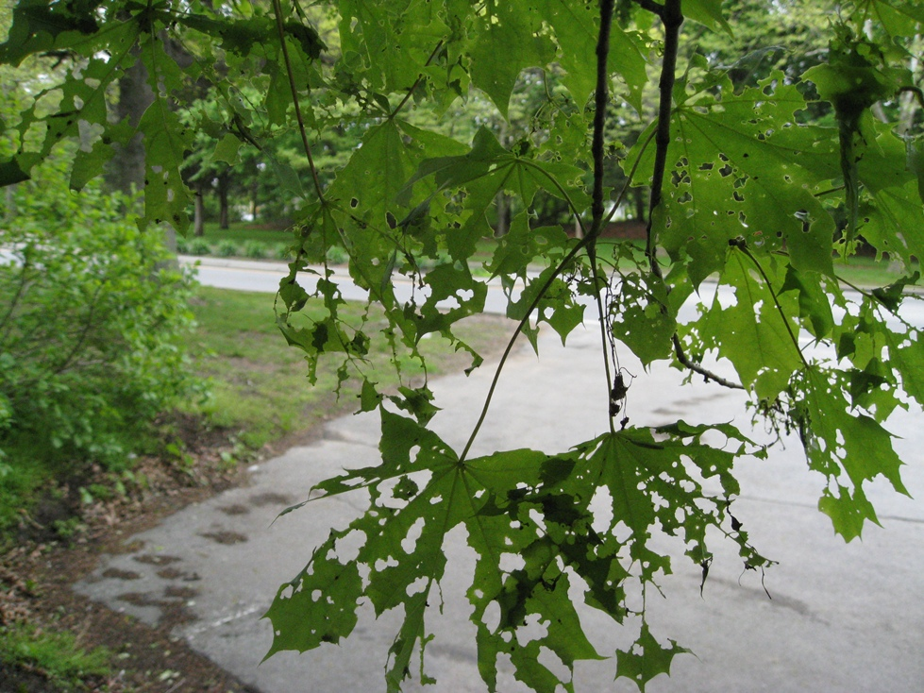
Holes in Leaves
Portions of the leaf missing due to insect feeding
Can occur on the outer edges or inner parts (usually near midrib or veins) of leaves

Slide 35
Holes in Leaves
Defoliation Classes
  0: None
  1: Holes on leaves are near outer edge of leaf
  2: Holes are closer to the central vein (midrib) of the leaf

Slide 36
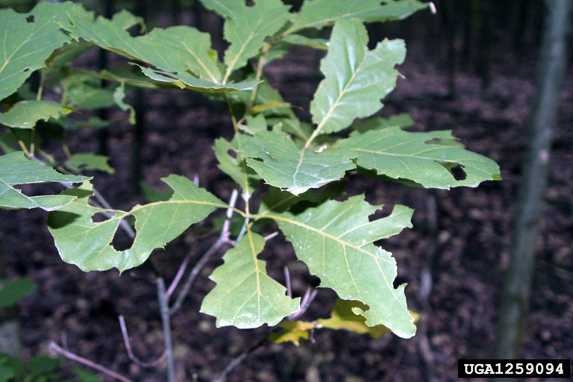
Holes in Leaves
Defoliation Classes
  0: None
  1: Holes on leaves are near outer edge of leaf
  2: Holes are closer to the central vein (midrib) of the leaf

Slide 37
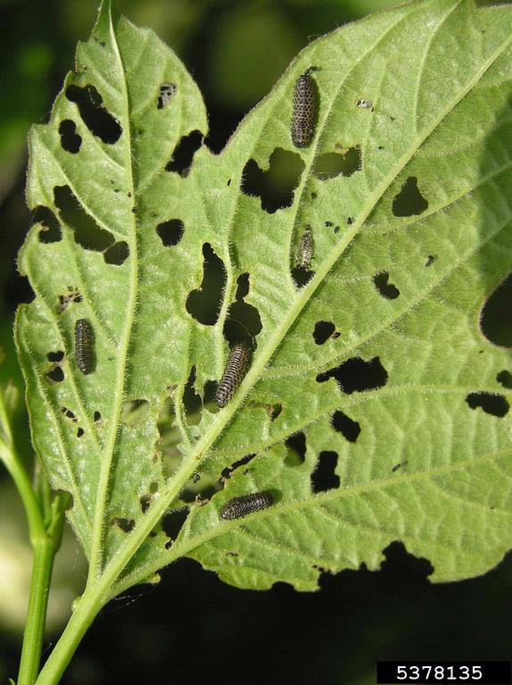
Holes in Leaves
Defoliation Classes
  0: None
  1: Holes on leaves are near outer edge of leaf
  2: Holes are closer to the central vein (midrib) of the leaf

Slide 38
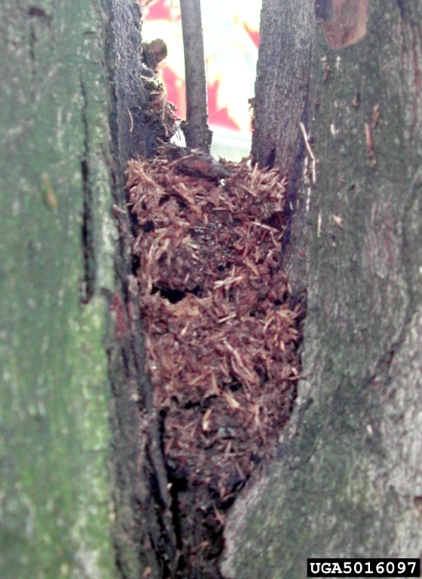
Frass
Powdery excrement formed by insects chewing on bark, stems, and leaves
Typically found in crevices or at the base of the trunk
Similar in appearance to sawdust

Slide 39
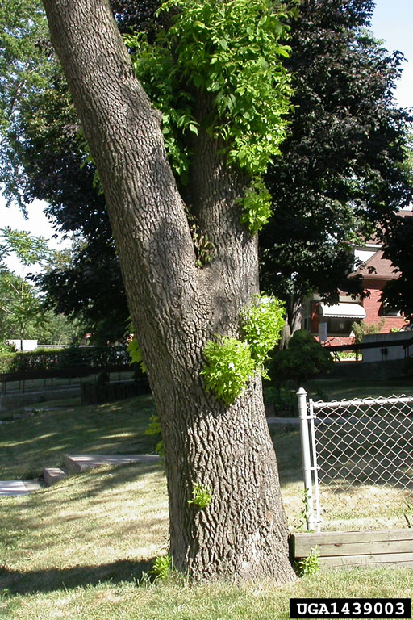
Epicormic Sprouts
Weak branch attachment growing at the base of the tree, along the trunk, or on branches
Can be caused by topping (over-pruning the top of a tree), insect infestation, or other disease

Slide 40
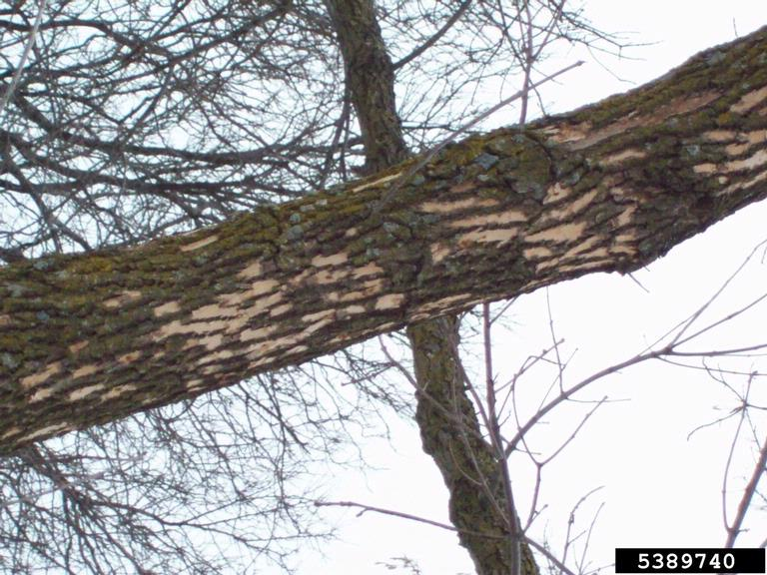
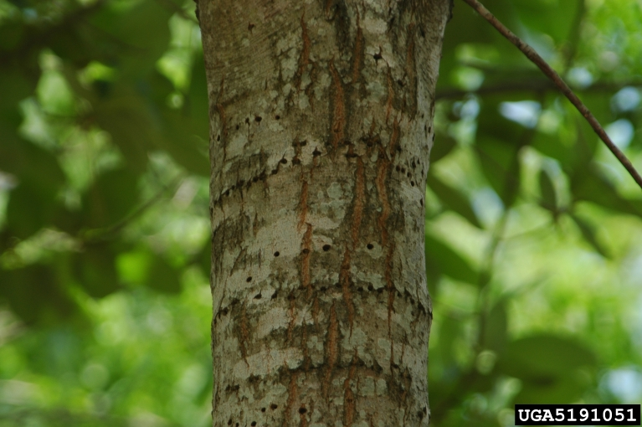
Woodpecker Damage
Holes drilled into the bark
Large sections of missing outer bark along the trunk (blonding)
Yellow-bellied Sapsuckers (a type of woodpecker) drill holes in close proximity, forming neat horizontal rows – not of concern
Above: Blonding on an ash tree
Left: Sapsucker marks left on a tree

Slide 41
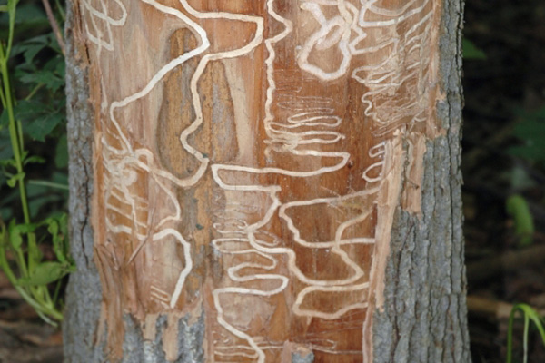
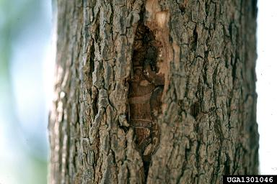
S-Shaped Galleries
Winding tunnels and pathways caused by feeding insects that are found beneath the bark

Slide 42
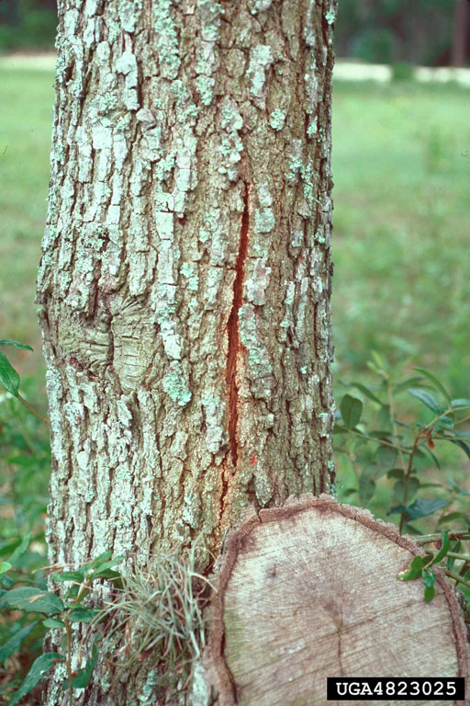
Bark Fissures/Cracks
Splits in the bark along the bole (trunk)
Often vertical
Tissue underneath has been damaged

Slide 43
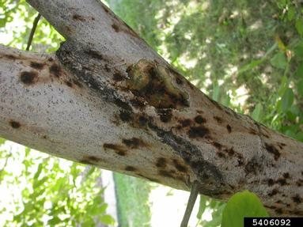

Cankers/Dead Bark
A local, often sunken, depression of dead plant tissue found on a twig, branch, or trunk
Notes:
Sometimes like a contained, bordered blemish, sometimes more irregular in shape.

Slide 44



Galls on Twigs/Branches/Leaves
A swelling or growth of plant tissue that has developed as the result of feeding activity of insect or mites

Slide 45

Fine Twig Dieback/Dead Twigs
Fine twigs are the support structures for the leaves, buds, flowers, and fruit of a tree
Dieback indicates the death of these structures
A symptom for some pests or disease is the dieback of fine twigs, often starting at the top of the tree and working down
USFS / HTHC Staff Photo

Slide 46

Leaf Discoloration (Deciduous)
Damaged, dying, or stressed leaves will change color outside of the normal autumn fall.
This can be caused by disease, nutrient imbalance, or drought
Discolored leaves cannot photosynthesize, depriving the tree of energy
John Hartman, University of Kentucky, Bugwood.org
Bacterial leaf scorch on a maple leaf

Slide 47

Needle Discoloration
Damaged, dying, or stressed needles will change color
This can be caused by disease, nutrient imbalance, or drought
Discolored needles cannot photosynthesize, depriving the tree of energy
Penn State Department of Plant Pathology and Environmental Microbiology Archives, PSU, Bugwood.org
Discolored hemlock needles

Slide 48

Wilted or Browning Leaves
A weakness of leaf rigidity or loss of color due to the reduction of internal water pressure
Typically results from insect damage, environmental or chemical stress, root damage, or poor soil conditions
Photo by Julia Pike

Slide 49

Premature Leaf Loss
The loss of leaves prior to expected seasonal declines

Slide 50
Notes/Extra Information
If at any point during a pest check, you need to record an ‘other’ category, type what you saw here
This is also where you can include any information that may be useful for your program – it is open-ended!

Slide 51
THANK YOU!

