Slide 1
Healthy Trees, Healthy Cities Web Dashboard

Slide 2
This Presentation
This presentation is meant to guide you through all the features and pages found in the Healthy Trees, Healthy Cities (HTHC) web-based dashboard
Pages in Green explain general pages in HTHC – how to find resources and navigate through the dashboard
Pages in Blue highlight pages involved in setting up and running projects

Slide 3
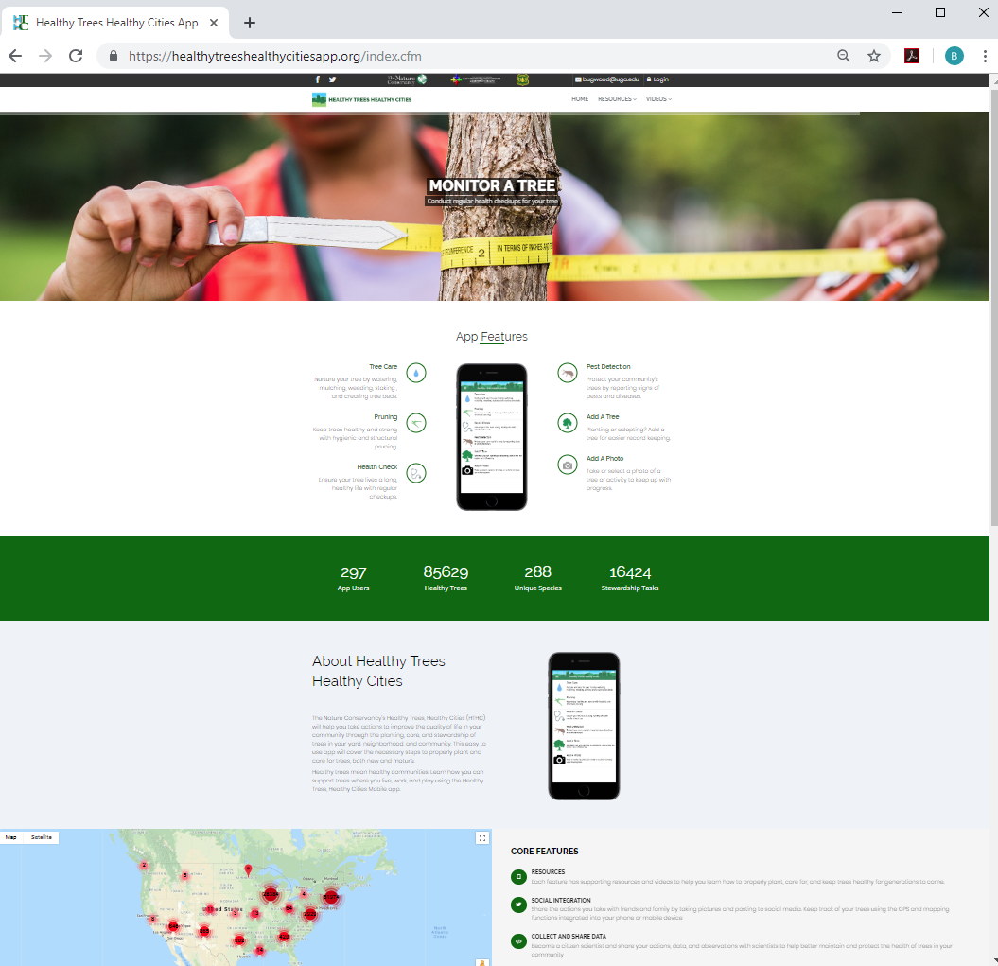
Home Page
The home page offers a lot of info about Healthy Trees, Healthy Cities (HTHC)
By scrolling down the page, you can see stats about HTHC – the number of species logged, number of trees, and users, and basics about the mobile app and dashboard’s core features.
On the top of the page is the navigation bar, which you’ll use to log in, access resources, and find your projects.

Slide 4
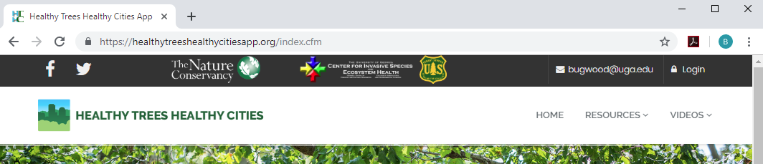
Navigation Bar
Lead to the HTHC Facebook and Twitter pages
Need to contact us with a question about the dashboard? Click here to open an email to Bugwood, the developer
Click here to login or to sign up for an account
The home page offers a lot of info about Healthy Trees, Healthy Cities (HTHC)
By scrolling down the page, you can see stats about HTHC – the number of species logged, number of trees, and users, and basics about the mobile app and dashboard’s core features.
On the top of the page is the navigation bar, which you’ll use to log in, access resources, and find your projects.
The Home button returns you to the HTHC home page
Click here to access HTHC resources – training materials, presentations, and videos designed to assist you in checking your tree’s health, understanding pests, or performing stewardship on your tree. Each of these offers a drop-down with more specific choices.

Slide 5
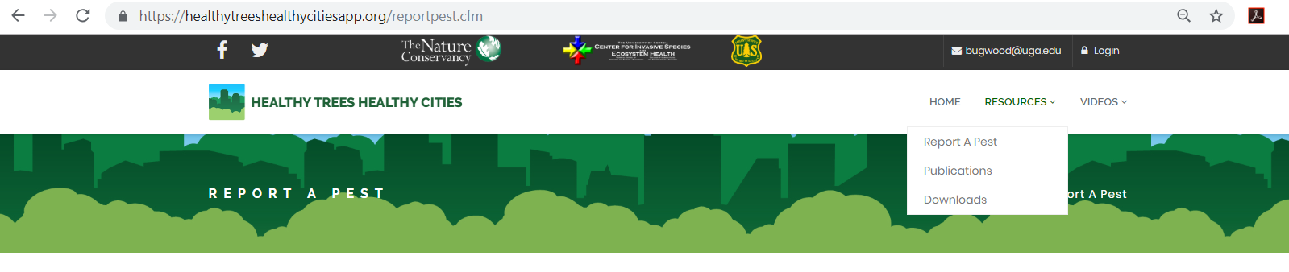
HTHC Resources
Clicking on ‘Resources’ will bring up a drop-down of link to resource pages on the HTHC Web Dashboard site
HTHC has many resources chosen to help you steward trees, train others, and learn about trees.
Use the ‘Resources’ tab on the navigation bar to access these resources.
Report A Pest: Brings a page with links to sites for reporting evidence of significant forest pests and diseases. If you think you found evidence of a pest, report it!
Publications: Links to page with several useful publications from HTHC and others, with info on Best Management Practices for trees, how to choose a tree for a planting site, and scheduling tree care.
Downloads: Links for PDFs or PowerPoint presentations for Best Management Practices, Tree Planting and Stewardship, Pest Wallet Cards, and the Pest Presentations HTHC uses for trainings.

Slide 6
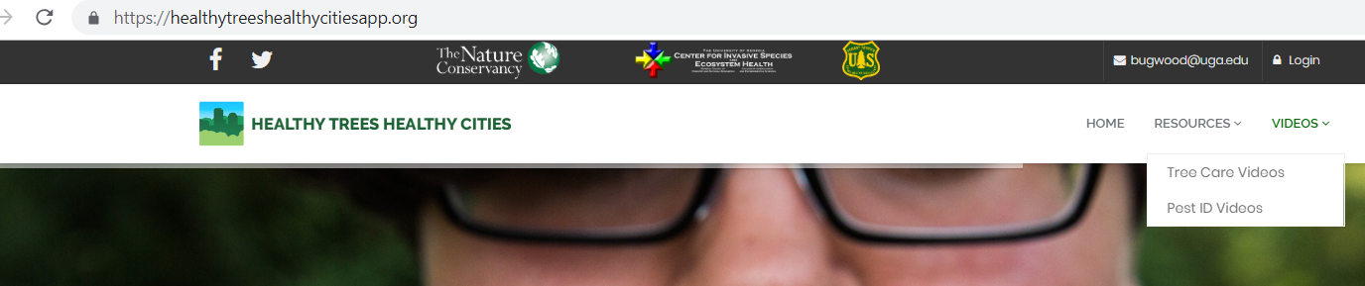
HTHC Videos
Clicking on ‘Videos’ will bring up a drop-down of link to resource pages on the HTHC Web Dashboard site
HTHC has many resources chosen to help you steward trees, train others, and learn about trees.
Use the ‘Resources’ tab on the navigation bar to access these resources.
Tree Care Videos: Links to a page with embedded vides on best practices for planting, pruning, and stewarding your trees.
Pest ID Videos: Links to page with videos explaining the threat posed by several significant forest pests, and how to look for them in your trees.

Slide 7
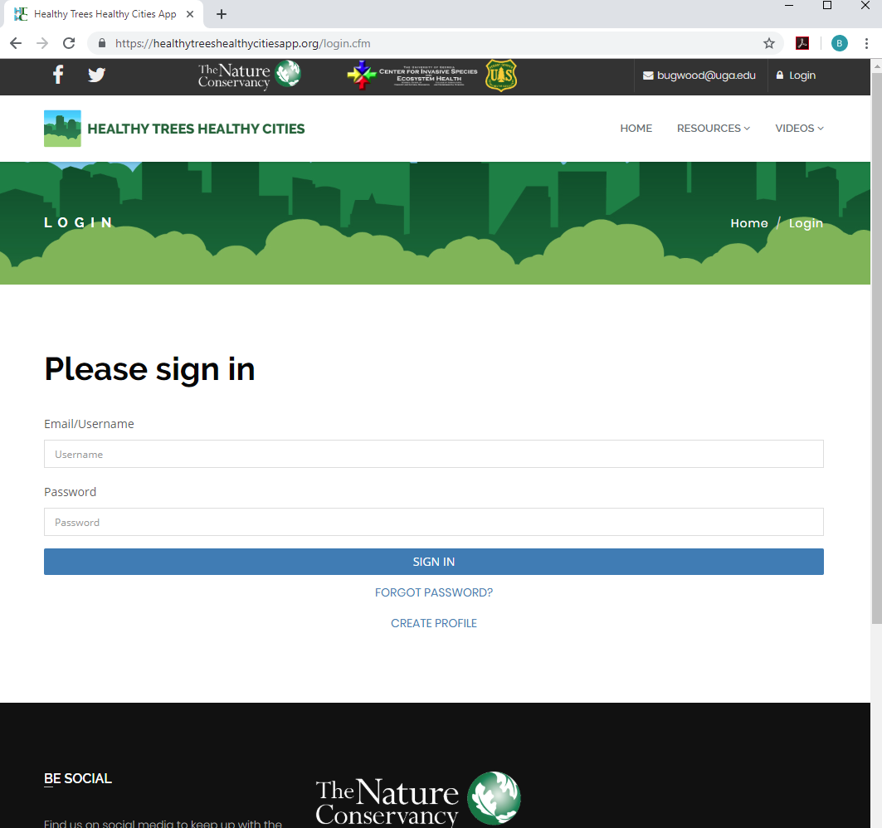
Login Page
Sign in by filling out your username and password. Most often, your username is the email you used when you initially signed up.
Here you can either login to your HTHC account or sign-up for one by creating a profile.
If you have an account with EDDMapS, or any of their apps, you don’t need to create a new profile for HTHC. You can just sign in!
Signing in will give you access to your projects
Forgot the password to your account? Click here to get it reset.
New to HTHC (and EDDMapS)? Create a profile here.

Slide 8
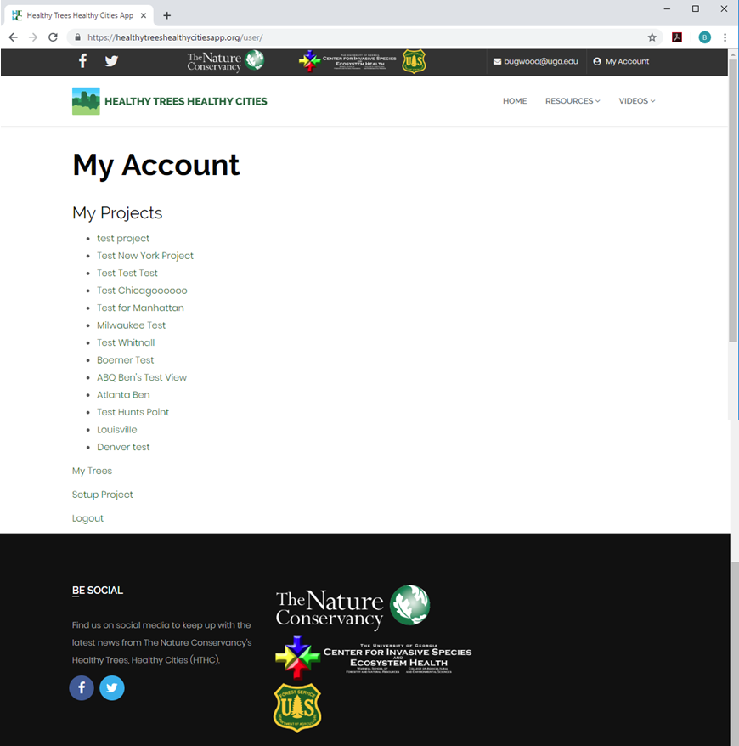
My Account Page
Your My Account page will show you any projects you have created or joined. You can be a part of or create as many projects as you like!
Once you are logged in, clicking here on any page will bring you back to your My Account landing page.
Once you’re logged in, you can navigate to your My Account Page (the button at the top right)
Here, you can find projects you have created or joined.
You can also find trees you have been assigned in these projects (My Trees).
If you are a project leader, you can create new projects by clicking on the Setup Project button.
If you have project leader status, you can create new projects by clicking here.
Click here to see any trees that have been assigned to you by your project leaders.

Slide 9
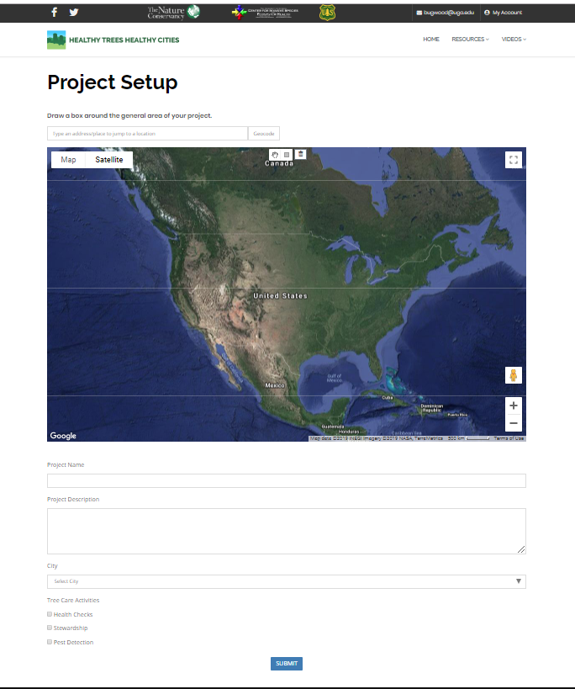
Project Setup Page
Choose a project’s general area using the map and search bar here. The general area is where you’ll grab trees from, so be sure it includes the entire geographic scope of your project.
Access this page via your ‘My Account’ page.
The first step for setting up an HTHC project is choosing your general area – you’ll add trees to your project later.
Project pages can be made public-facing, or kept private.
Choose a name for your project – visible to you and anyone you share it with.
Give your project a description – it’s purpose, scope, etc, to help project participants understand its significance.
Select your project’s city. If your city isn’t listed in the drop-down, contact us so we can add it! HTHC is always happy to start working in new locations!
Choose the focus of your project – Health Checks, Stewardship, or Pest Detection – or any combination.

Slide 10
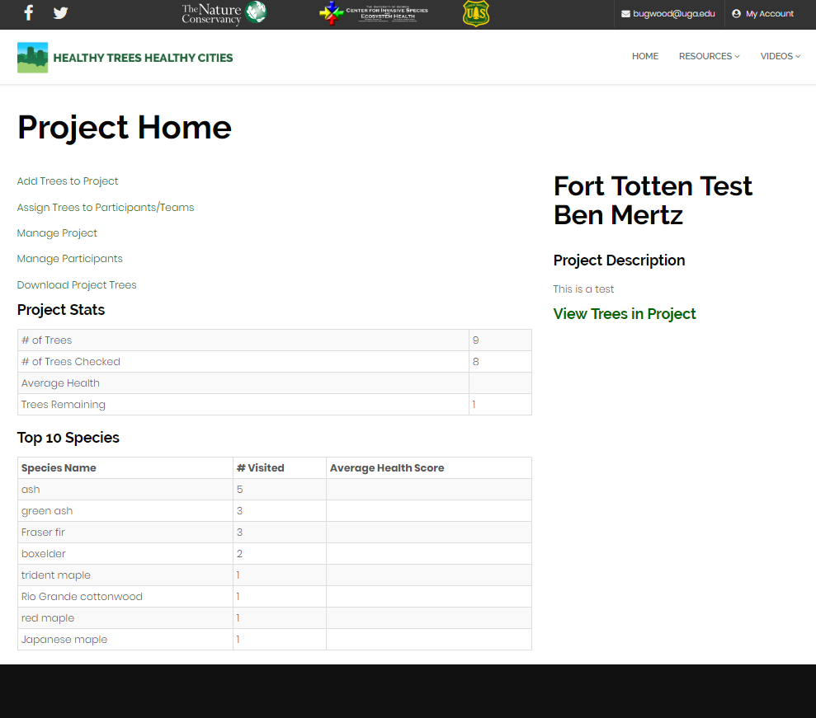
Project Home Page
Click here to generate a link to your project’s data. The server will grab all your project data, then send you an email with the data in a few minutes.
Use these links to manage trees and participants in your project. A separate slide in this presentation explains each one.
Your project’s name and description. Need to edit these? Click on ‘Manage Project’ which brings you back to the Project Setup page.
This is where you can access and edit your project.
The options you see are dependent on your status in the project – Project Leaders will see options to add trees, assign trees, and manage participants. Participants will just see information about the trees they’ve been assigned.
Basic project stats are displayed here. A “checked” tree has had a health check, pest check, or stewardship activity recorded on the app.
The most common species in your project are listed here – along with the average health score of the trees. This is meant to be a quick snapshot - more info about individual trees is in the other pages of your project.

Slide 11
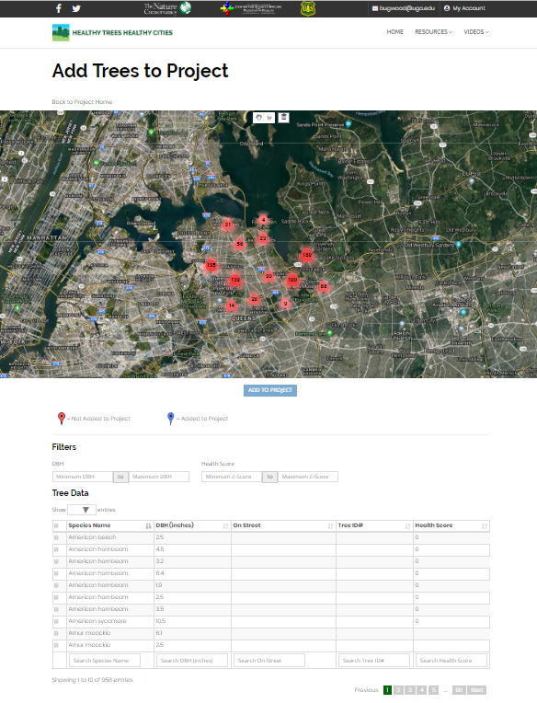

Add Trees to Project Page
(Project Leaders Only)
The map will display any trees in HTHC’s database in your project’s general area. As you add trees to your project, they will disappear from the map.
Use the hand button to pan on the map.
Click the polygon button to start drawing a polygon around the trees you want to add to your project.
Access this through a project’s home page.
This page is solely for adding trees to your project – managing trees is on another page.
Select trees by using the polygon tool in the map to draw a shape around those you’re interested in, or by selecting trees using the spreadsheet below the map.
Only trees that are in the HTHC database are available here –If you have inventory data you’d like to add to HTHC, contact us!
You can also use the mobile app to add trees – as soon as a tree is added via the app, it will appear in the dashboard.
When you’ve selected trees by either the map or the spreadsheet, click ‘Add to Project’ to include them in your project.
Use filters to limit what trees are visible in the spreadsheet, or search for specific species or tree names using the search bars.
Select trees using the checkboxes. The box in the top row will select all trees in the spreadsheet.

Slide 12
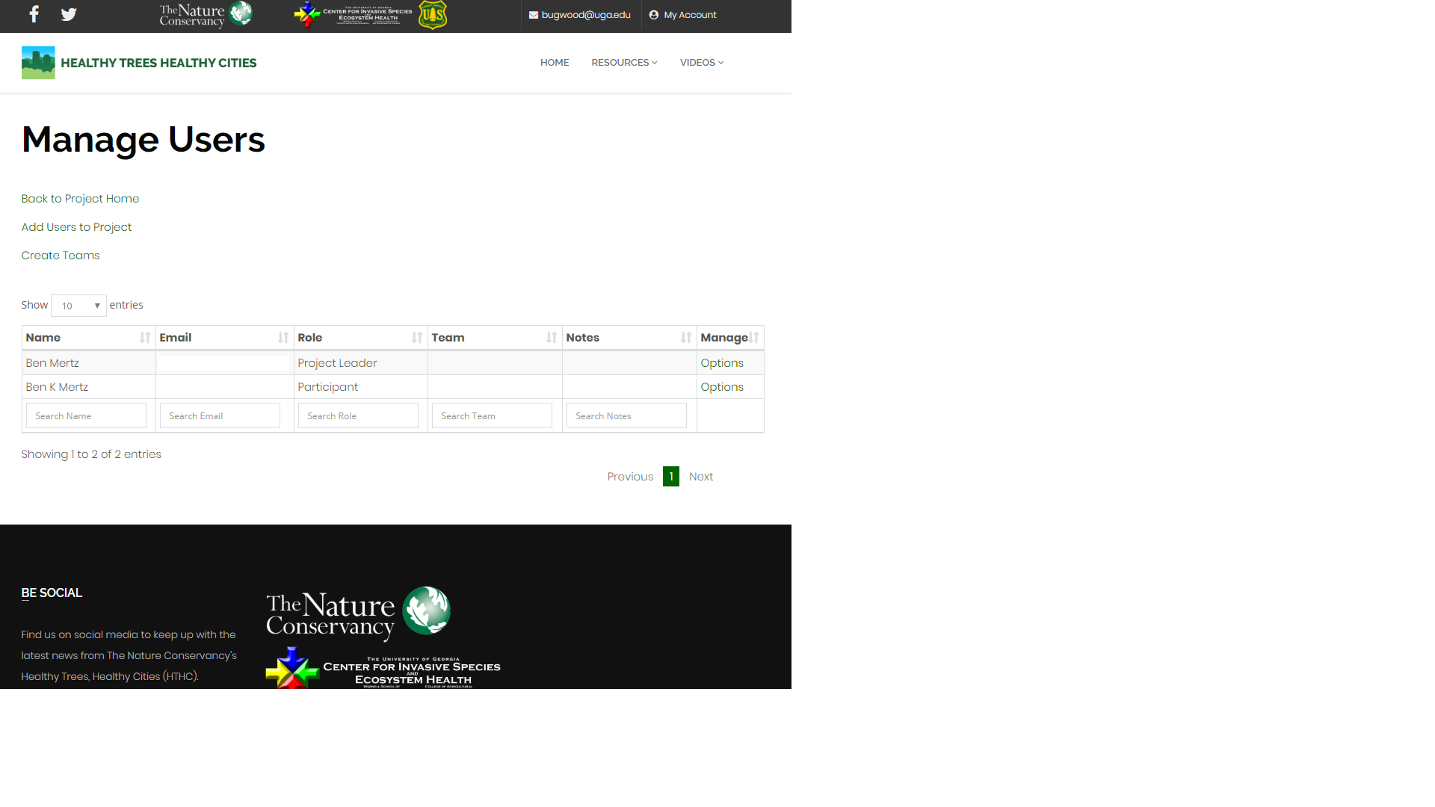
Manage Participants Page (Project Leaders Only)
Add users to your project. A drop-down will open – search for users by name (first or last). The user must have an HTHC account before they can be added to a project.
Once you have added users, you can sort them into team. Trees can be assigned to teams or individual users – but checking trees works best in teams!
Click on ‘Options’ in the Manage column to Add Notes about a participant, edit their Team, give them Project Leader status, or to remove them from your project.
Use the ‘Add Users to Project’ button to find and add people to your project.
Only people with HTHC accounts can be added to a project – so be sure volunteers or field staff sign up.
You can also sort users in your project into Teams – and then assign trees based on teams that contain multiple users.
You can also add notes about users – for example, if a user has good tree ID skills!

Slide 13
Download Project Trees
The HTHC Web Dashboard only displays a small part of the data the Mobile app can collect about your trees.
You can download the data associated with your project’s trees at any time.
Data downloads include a full history of past visits to your tree – whether done by a project member or not.
The data can be imported into iTree Eco (v6) to run their analyses.
Click here to download your tree data. A link will be emailed to the email associated with your account a few minutes after you click.

Slide 14
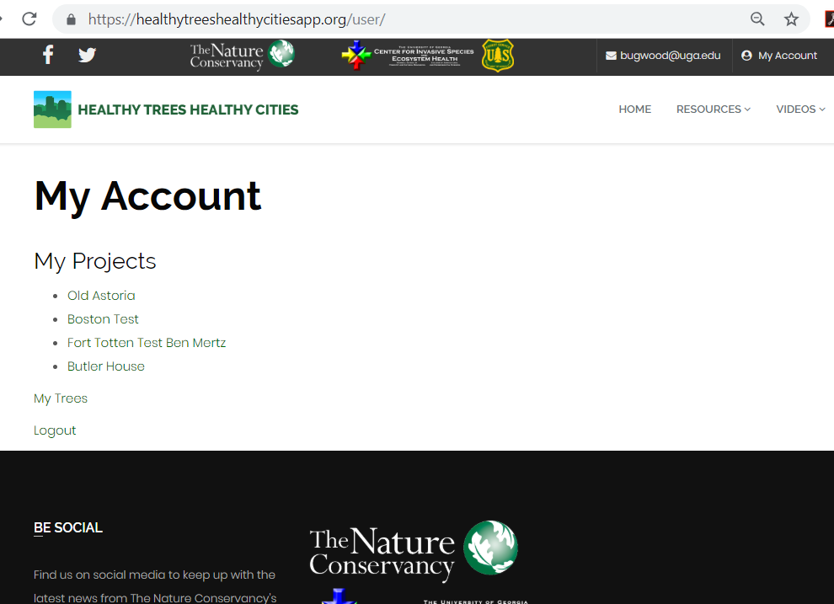
Participants – My Account Page
If you’ve been added to projects, you can access them here to see project info, and your stats for the project – how many trees you’ve checked, etc.
Participants can be added to projects by project leaders – if you want to join an HTHC project, contact the project leader.
You can see projects you’ve been added to on your My Account page.
You can access trees you’ve been assigned by clicking on ‘My Trees’.
You can see trees assigned to you in any project by clicking here.

Slide 15
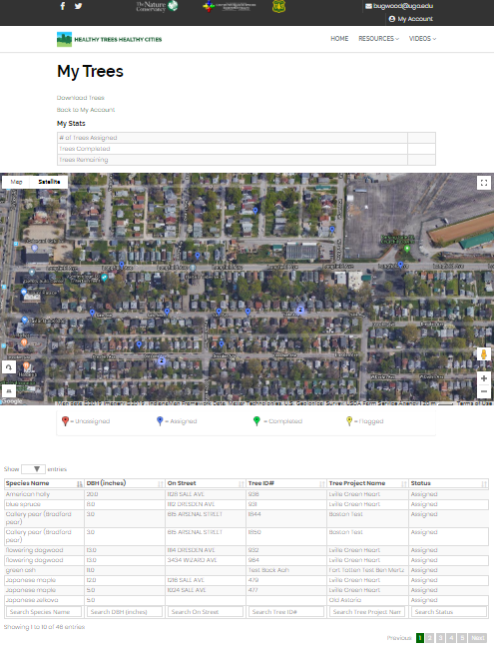
Participants – My Trees Page
Download trees by clicking here.
View the trees assigned to you in a map. Tap on a tree’s point to see some basic info about it.
View stats like the # of trees assigned to you, the # you’ve checked, and the # remaining.
Participants can view trees they’ve been assigned in Projects, or trees they have inventoried while signed in on the HTHC Mobile App.
Participants can also download the data associated with these trees.
View tree data in a spreadsheet here. You can also sort by the fields displayed or search for specific trees.

