Slide 1
Using the Healthy Trees, Healthy Cities Dashboard
What the dashboard does
The HTHC dashboard is designed to make it simple for people using the Healthy Trees, Healthy Cities (HTHC) app to manage projects. Its easy-to-use format allows you to create a project, add trees to it, assign trees to staff or volunteers individually or as teams, track completion, and to download the data you’ve collected.
This document guides you through making a demo project, and in the process, shows off how to use each of the features found in the dashboard. Once you’ve used this document, you’ll be ready to use the dashboard to create and manage your own projects! For any questions or comments, reach out to hthc@tnc.org.
Creating projects in the HTHC dashboard is only available to those with ‘Project Leader’ status in the dashboard. Please contact Rachel Holmes, rholmes@tnc.org, to gain this status.
If you experience an error, or another issue, email rholmes@tnc.org . Describe what you were doing when the error occurred and if possible, include a screenshot of the error. This will help us greatly in our continued development of the dashboard!

Slide 2
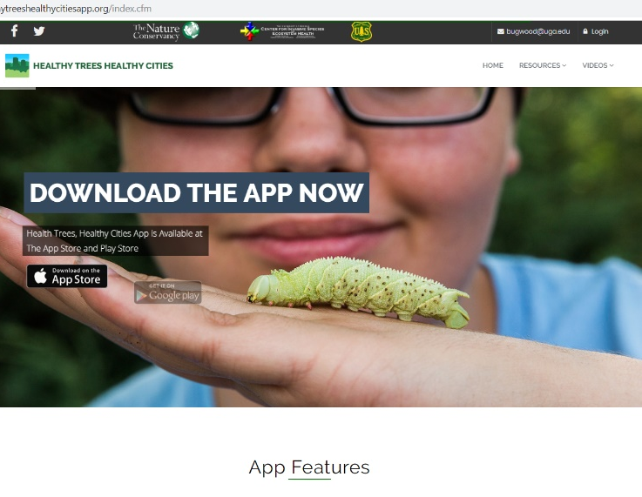

Setting up an Account
Navigate to HTHCApp.com. The homepage has a link to the app, along with some tree photos and stats on overall usage.
On the top right of the screen, there are several useful links. The Resources and Videos links lead to training materials, pest powerpoints, and tutorials on subjects related to tree stewardship, tree health, and pest detection.
On the top right is the Login link. Click here to login or to set up a new account.

Slide 3
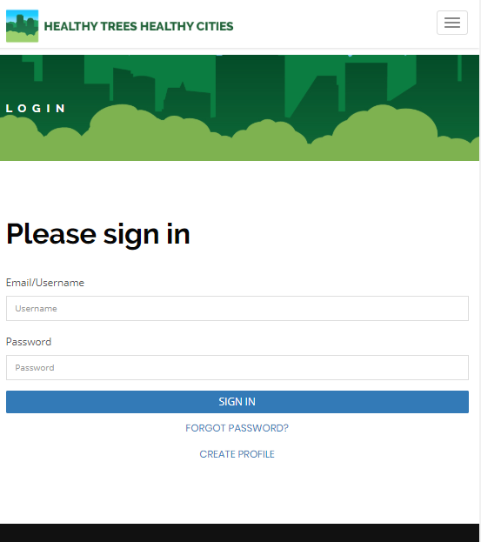
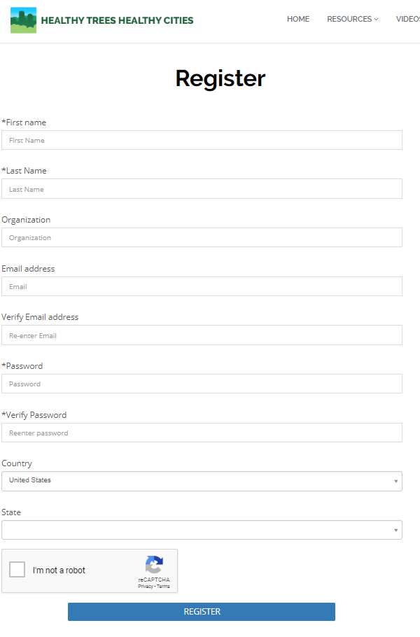
Setting up an Account
At the login page, if you’ve already made an account, simply sign in
Otherwise, click ‘Create Profile’ to add your account to HTHC. You’ll need to fill out the information that appears under the Register form (bottom right screenshot).
Some features of the dashboard are only available to users with ‘Project Leader’ status – including all of what this tutorial discusses. If you haven’t already, reach out to rholmes@tnc.org to ask for this status.
As a Project Leader, you’ll be able to create new projects and manage the trees and users within a project.
Those with ‘Participant’ status can view less – they can join projects, have trees assigned to them, and see their own statistics, but can’t create their own projects or change the trees or users in a project.

Slide 4
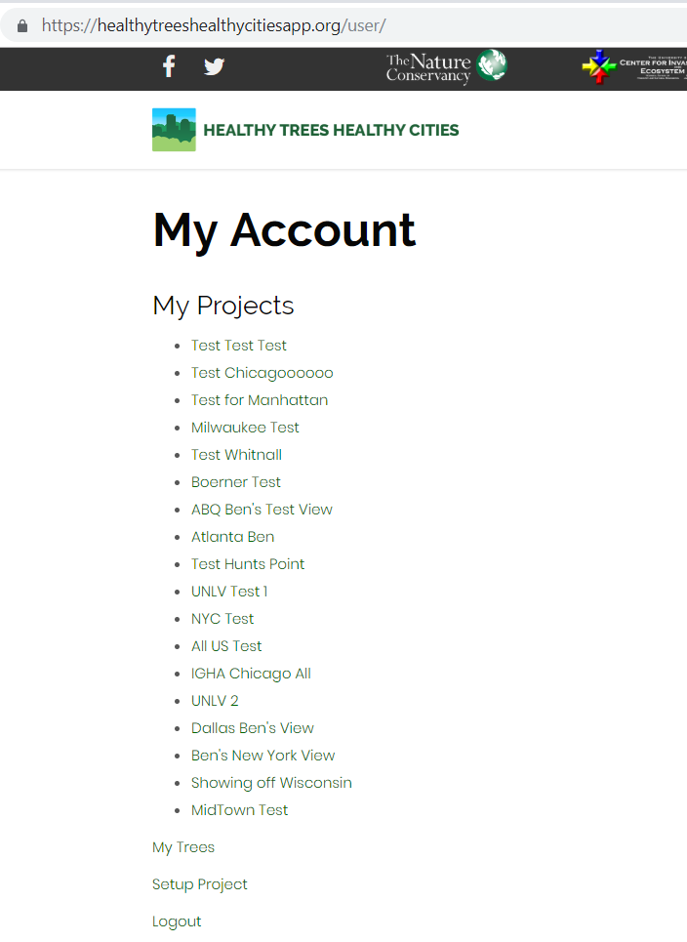
Account Page
Once you’ve signed in, your ‘My Account’ page will open. This page is your personal hub in HTHC.
Any projects you’ve created will appear here.
You can create however many you like – if you end up making a bunch, consider some creative names!
Trees can be in more than one project, so you could set up one project for field staff doing health checks, and a separate project to manage volunteers performing tree care.
Since trees can be in multiple projects, you don’t need to worry about ‘stealing’ a tree from another group.
The data added to trees stay with the tree – not the project – so any visits to a tree will be visible to any project.
Below your projects is your link to ‘My Trees’, which will display all trees that have been assigned to you by any project you are a part of.
Click on the Setup Project link (circled in red) to start creating your project!

Slide 5
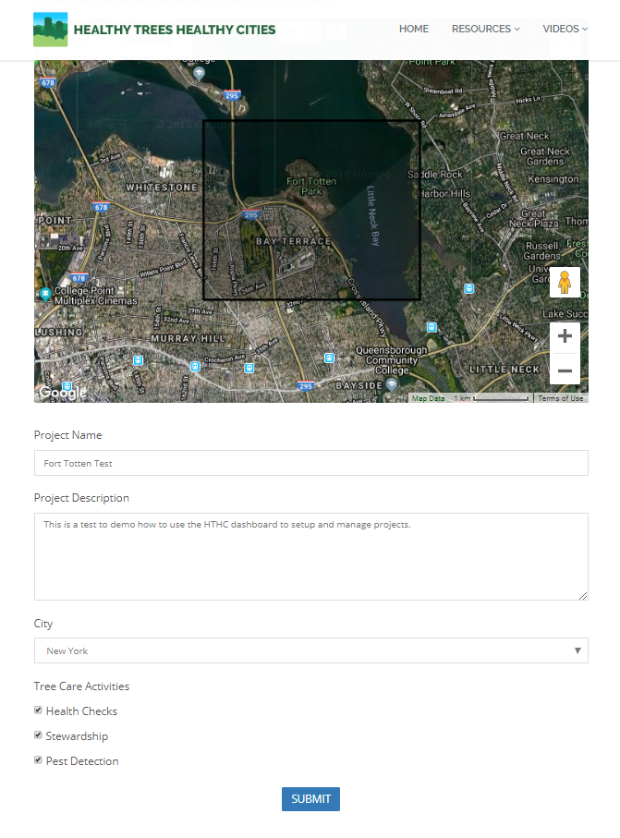
Creating a Project
The first step to creating a project is the setup page.
Here, you’ll describe your project, define its general area, and specify its focus (tree stewardship, tree health, pest detection, or any combination of the three).
You can revisit this setup page whenever you like, and edit any of the details in it, including the location.
Projects can be involved or stay simple depending on your needs.
They can be used just to download data for analysis, or used for managing many volunteers or field staff.
The next few pages go over how to set up your project.
For our demo project, we’re going to focus on a place in New York City, the New York City Urban Field Station, where USFS researchers are, right now, diligently analyzing the data brought in by Healthy Trees, Healthy Cities.
If you’d rather, you can follow the steps laid out here using trees in your area.

Slide 6
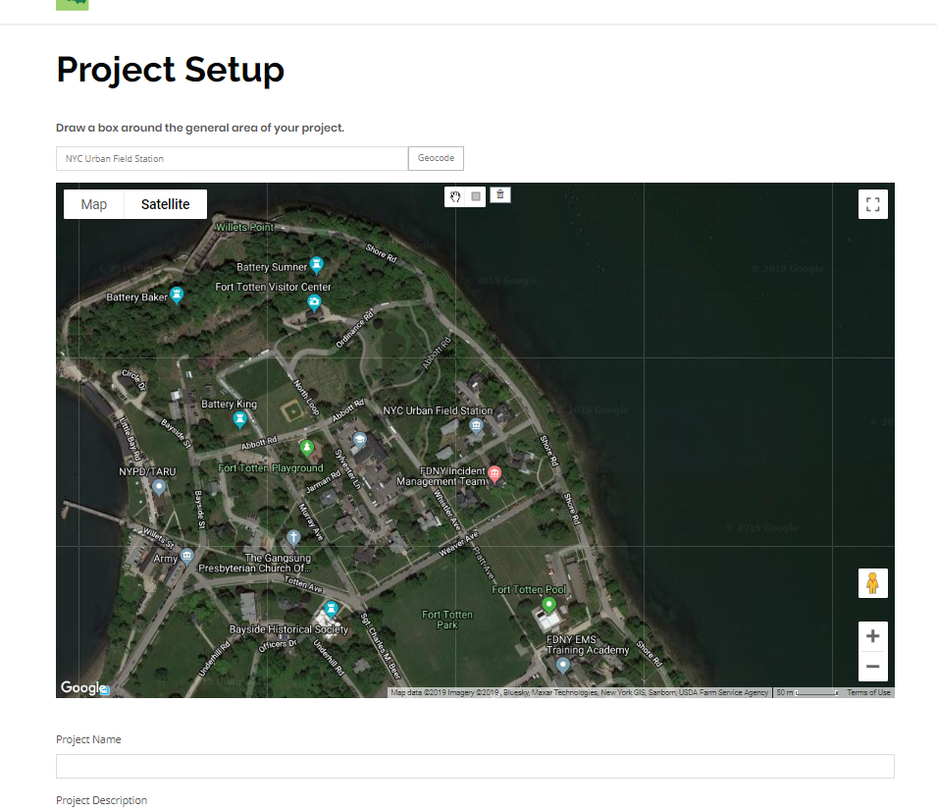
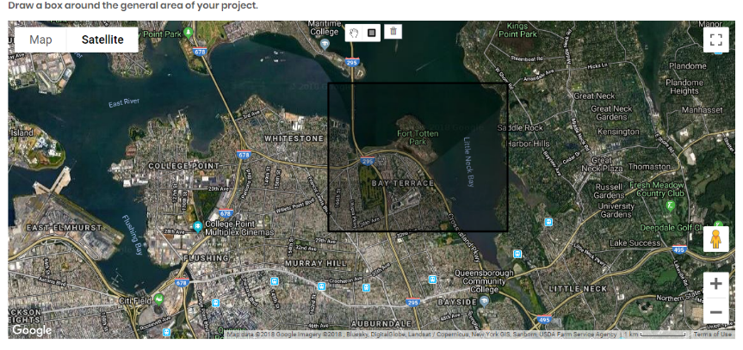
Creating a Project
First, let’s define the general area of your project, by using the map at the top of the page. The goal here is to set the area that the dashboard will look for trees – you’ll actually add trees to your project later. For example, if you wanted to grab trees from parks across an entire city, you’ll want to drag a box around the entire city here.
For projects, it’s useful to keep this general area as small as possible, so the dashboard only looks for trees in the areas you’re interested in. (It will run a bit slower if you’re looking for trees from large areas with many trees).
Above the map is a search bar. Type in “NYC Urban Field Station” and then click on the Geocode button. This should take you straight to the home office of HTHC, along with great researchers from USFS, NYC Parks, and the Natural Areas Conservancy!
Once you have centered the map around the Urban Field Station, draw a box around the general area. You may need to zoom out a bit to make sure you include all of the area around the Field Station.

Slide 7
Creating a Project
After you’ve set the broad area of your project, you’ll fill in some details. All of these are editable later – if your project’s scope changes, or you just want to fix a typo – you can do it whenever you want!
Project Name - This can be anything you want – and can be edited later if you need to change it. For this project, call it “Fort Totten Test <Your Name>”.
Project Description - This will display on the project home page and be visible to participants in the project. It’s a good place to include information on the scope of the project, your organization, or contact info for interested participants. Add whatever details you like for this tutorial.
City – Choose what city your project is located in. If your city isn’t represented here, let us know and we can add it! Choose New York for this tutorial. If your city isn’t listed, you can still create Projects with full functionality – the City field won’t affect the data collected.
Tree Care Activities - HTHC focuses on three areas: Tree Health, Tree Care, and Pest Detection. Future app functionality will allow projects to focus on just the activities they are interested in. Currently, there’s no difference between selecting all three or selecting none – but later, these will simplify data downloads to just include the requested information. For this tutorial, choose all three.
Once you’ve filled out everything, hit Submit! Now you have your first project with Healthy Trees, Healthy Cities.

Slide 8
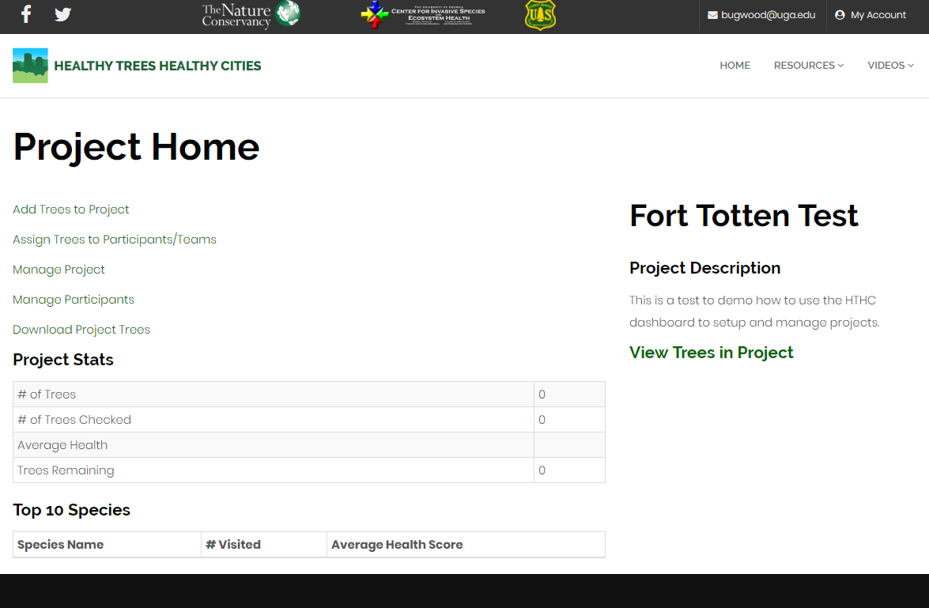
Project Homepage
The project page has links to all the tools for managing your project, and will display some basic statistics about it as well. For your project, it will show that you have 0 trees, and the top 10 species list will be blank – this will change as we add trees! If any tree in your project gets a health check, it will display as ‘checked’ here.
Add Trees to Project – bring in trees from your project’s area into your project so you can download their data and assign them to participants
Assign Trees to Participants/Team – Choose trees for individual members or teams in your project
Manage Project – Edit any of the info you inputted during the Create a Project steps
Manage Participants – Add users to your project, create teams of multiple users, and add notes about users
Download Project Trees – Download an Excel spreadsheet containing all the data associated with your project’s trees
Project Stats – Some basic statistics about the trees in your project. Currently focused on tree health, but future upgrades to the dashboard could allow customization of what is visible.
Top 10 Species – More basic statistics about the trees in your project.

Slide 9
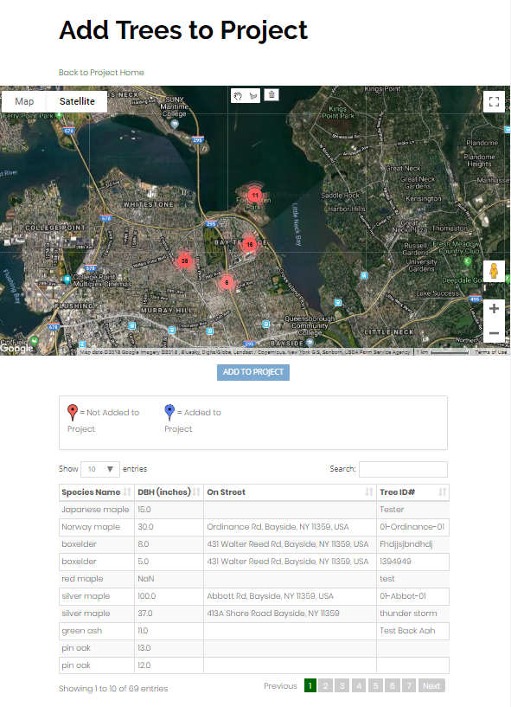
Adding Trees to a Project
The Add Trees to Project page has two components – a map and a spreadsheet. Eventually, the spreadsheet will allow you to search for trees based on several different fields, like species, specific tree ID numbers, and others, but for now, the map is how you will add trees to your project.
In the map, all the trees in the database within the bounding box you made during project setup are visible.
Points of individual trees will be visible when you zoom in.
You can click on any of the red circles representing many trees to zoom in on them, or use the map’s tools to pan and zoom.
The spreadsheet will display all trees in the project
Clicking on a tree in the spreadsheet will zoom the map to that tree
Click on the circle representing Fort Totten’s trees, circled on the right, to view the trees we want to add to this project

Slide 10
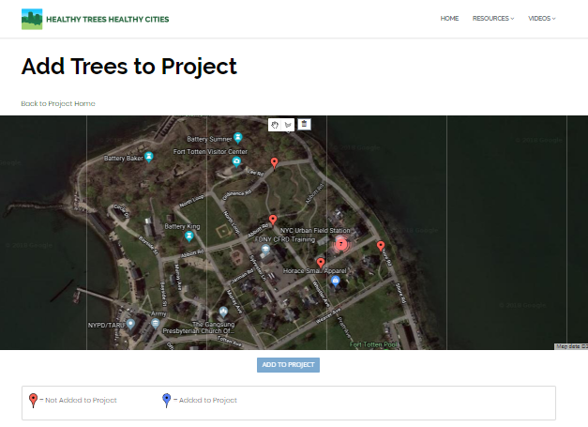
Adding Trees to a Project
Now that you’ve zoomed in on Fort Totten, you can see some individual trees, and a circle with 7 trees hidden underneath it –where the NYC Urban Field Station is.
Red markers indicate trees that haven’t been added to your project yet.
Blue markers are trees that you have added (you’ll see some blue soon!).
You can also click on any tree marker to get a pop-up with info about that tree
Click on the circle representing 7 (or more) trees to zoom in and see all the trees there.

Slide 11
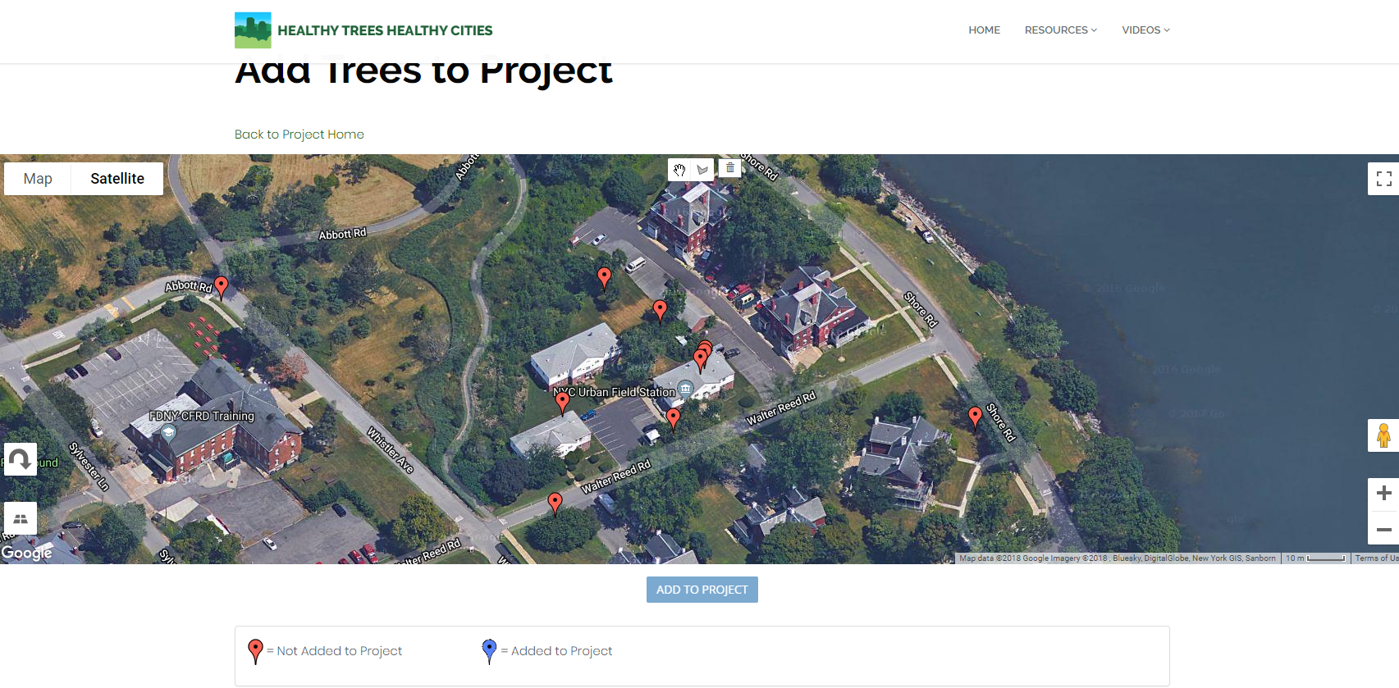
Adding Trees to a Project
Toggle between Map and Satellite view
Draw a polygon around trees
Pan map
Undo current polygon
View map in full screen
Rotate the map 90 degrees
Switch out of tilted view
Zoom In/Out
Add trees in polygon to the map
You should be able to see all trees in Fort Totten now. We’ll use the map’s tools for the next step, so take a minute to familiarize yourself with them
Panning/changing the map views
The Google map may automatically switch to a tilted or angled view when zoomed in – you can use the button at bottom left to switch it back.
You can rotate the view of the map 90 degrees using the curved arrow button at bottom left, but only while in tilted view.
Switch between map view and satellite view at the upper left.
The button at the upper right will toggle the map into full screen mode
Zoom in and out with your mousewheel or the buttons at bottom right
Using the add trees tool
Add trees by drawing a polygon around any number of trees
From one at a time to block by block, to grabbing all of a city’s trees at once!
The polygon tool is located at the top center of the map
If you don’t like the polygon you’re making, use the trashcan button just right of the polygon button to delete it (this WILL NOT delete any trees from the database!)
Once you’ve completed a polygon, click the ‘Add to Project button just below the map to add the trees to your project

Slide 12
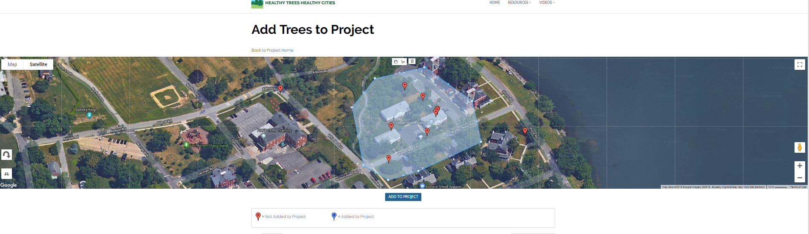
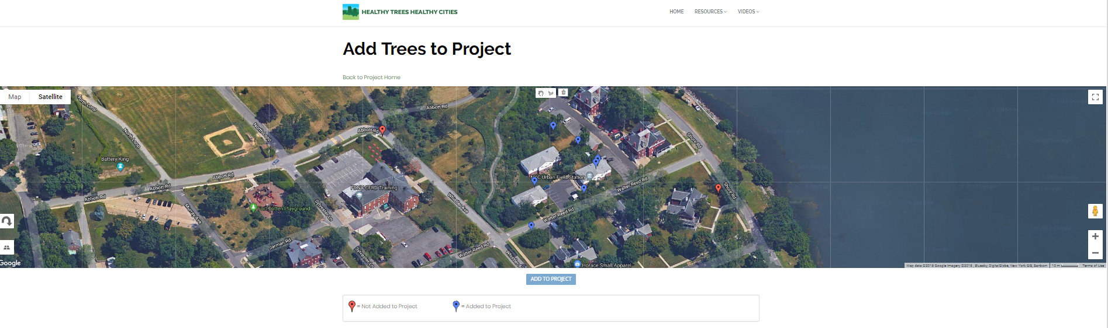
Adding Trees to a Project
Time to add some trees to your project! Draw a polygon around the main cluster of trees, then hit Add to Project!
Use the polygon tool to draw around the trees
Then hit ‘Add to Project’
Red points are trees still not included in the project
Blue points indicate trees that have been added to the project
Once you’ve added trees, click on Back to Project Home, located just above the map.

Slide 13
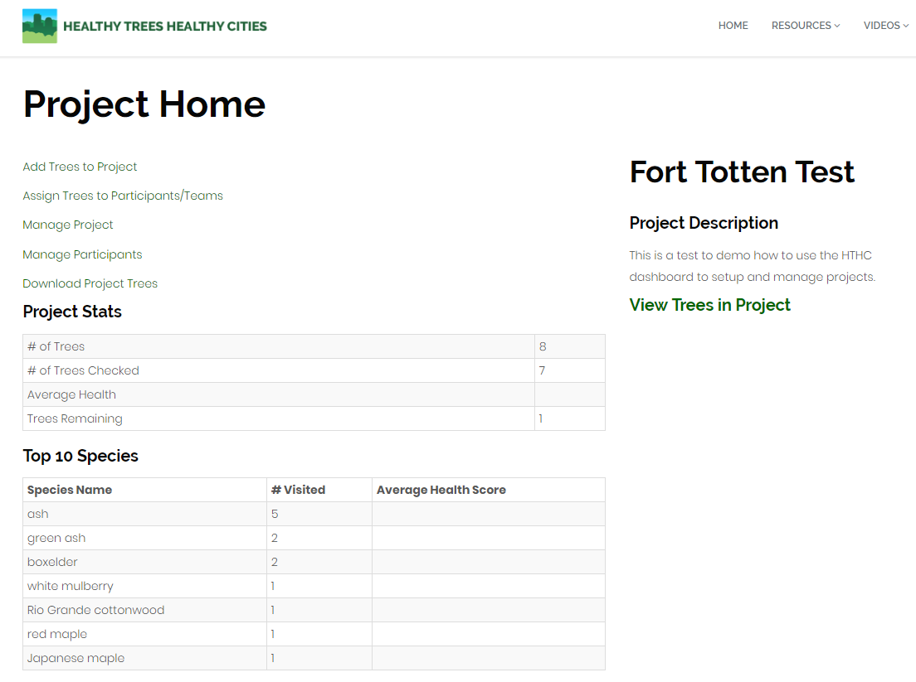
Adding Participants
Now the trees you have added to your project will appear on your project home page.
If a tree has already been given a health check, it will be counted here as ‘checked.’
You can always go back to the Add Trees to Project page to add more trees.
Now you can learn to manage people in your project.
Once you’ve added users to a project, you can assign them trees using a map similar to how you added trees.
But first, you need to add them to your project.
Individuals can’t join your project on their own – you have to add them.
Click on ‘Manage Participants’ to find users to add to your project.

Slide 14
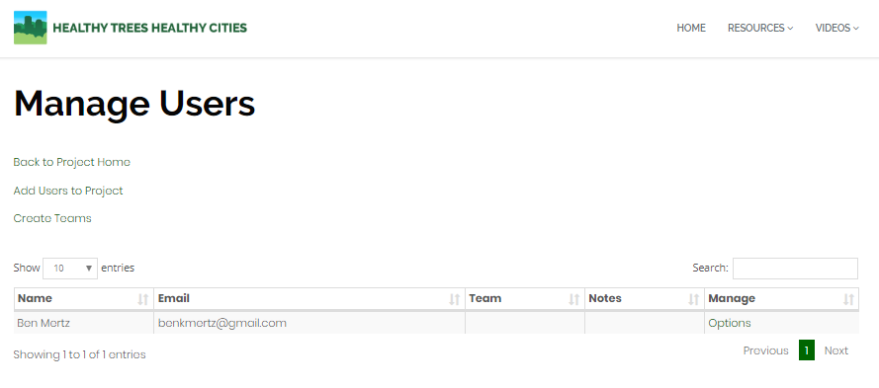
Adding Participants
The Manage Users page is where you will add (or remove) participants to your project, sort them into teams, and add notes for a user.
The Add Users to Project link will bring up a search bar to find users in Healthy Trees, Healthy Cities and add them into your project.
The Create Teams link will open a window to create teams from participants already in your project.
Users of HTHC can be in any number of projects they want.
When you’re ready, click on the ‘Add Users to Project’ link, which will open a mini-window to add people to your project!
The spreadsheet (which currently has just one participant – you) will populate with participants as you add them.
Beyond their name and email, a few important columns are visible.
Team will display once you have created and added participants to teams (which are optional).
Notes will be checked if a participant has a note. These are meant to be internal – to help project leaders manage users by keeping track of their preferences or other issues.
Manage – click on Options to add a note about participants, edit their team, or remove them from the project.

Slide 15
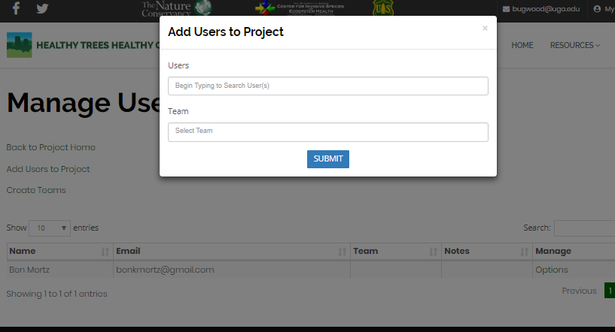
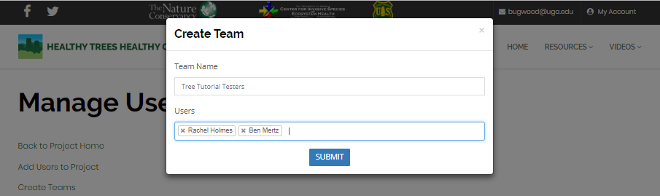
Adding Participants and Creating Teams
The Add Users to Project window has two text bars to use.
Users – find users by searching for their names or emails.
Teams – Select from teams you have made.
Search for ‘Ben Mertz’ and add him to your project.
Hit Submit to add them to your project.
Your project should now have two users – yourself and Ben Mertz.
Now you can create a team for these users.
With a team, you can assign trees to two people who will work together to check or visit trees. (For example, a field crew of 4 checking trees block by block).
Once you have participants in your project, click on Create Teams and make a team for two of your participants. It can have any name you like!

Slide 16
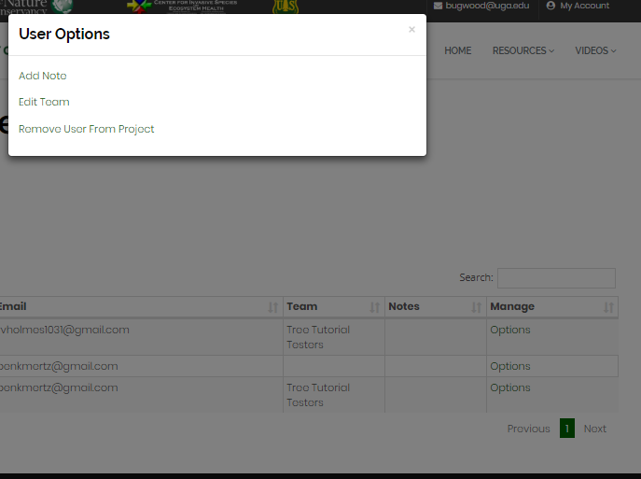
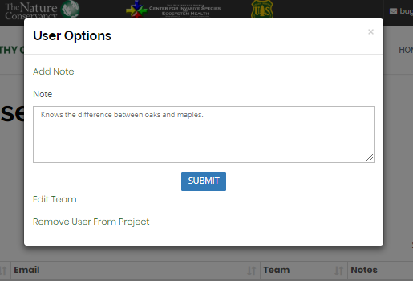
Managing Participants
The Manage column of the participants spreadsheet contains options for adding notes, editing the team of a user, and removing the user from a project.
Click on Options in the Manage column for Ben Mertz, which will bring up the window seen at right.
Add a Note for Ben. You can add any text you like here, (see bottom right screenshot). Notes aren’t directly searchable, but if a participant has a note it will be viewable in the spreadsheet.
In a project with many users and teams, the Options button is also where you can switch a user to a different team or remove them from the project.
Now that we have participants in our project, have a team for them, and know how to manage them, let’s assign them some trees!
Click on Back to Project Home to go back to the homepage.

Slide 17
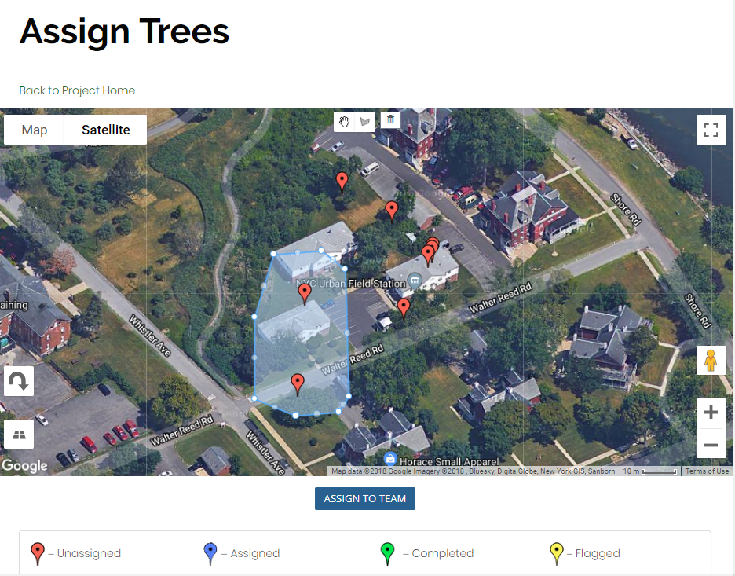
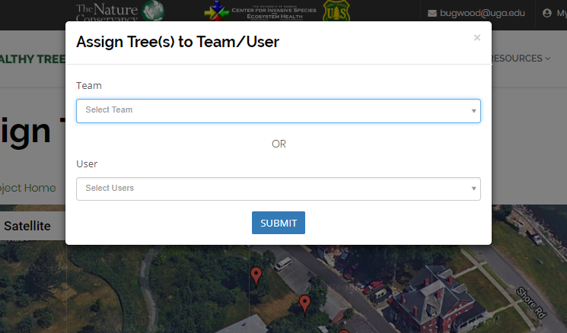
Managing Participants
At the project home page, click on the link to Assign Trees to Participants/Teams.
This will open a page that looks similar to how you added trees to your project, and works in the same way. Only trees you have added to your project will be visible here.
Use the polygon tool in the map to draw a polygon around any two of the trees on the map. Then click on the Assign to Team button just below the map.
The window that appears lets you assign trees to either a team or to individual users.
We here at Healthy Trees, Healthy Cities love working together on trees, so let’s assign these to the team we created earlier by clicking on the Select Team drop-down bar. Any teams you have created will appear here. Select the team you created and hit Submit.
You can also try assigning trees to yourself – when you do this, they will appear in your account’s My Trees page on the dashboard and in the app. (Going live in Spring 2019).

Slide 18
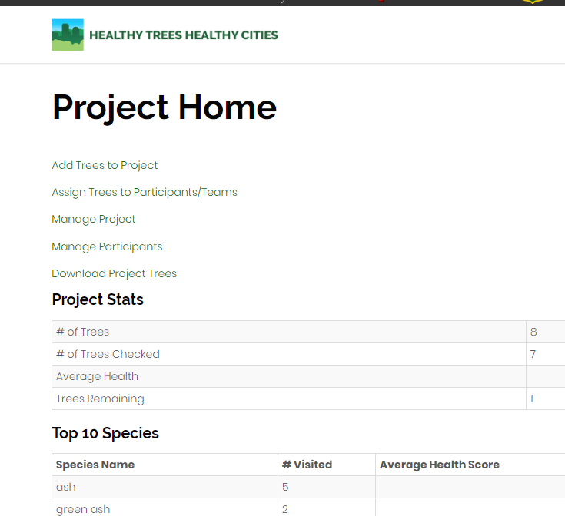
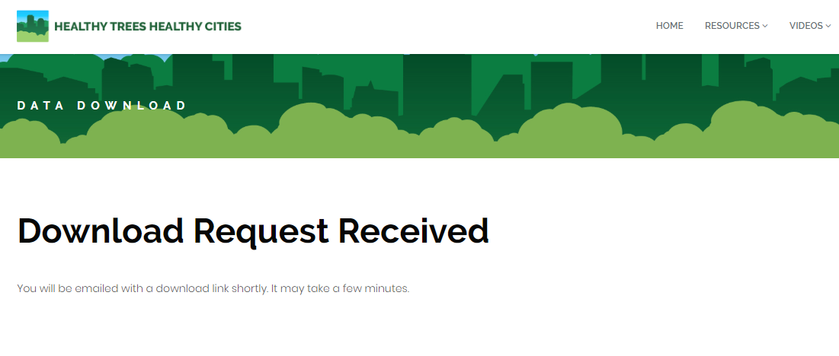
Downloading Data
The Healthy Trees, Healthy Cities dashboard is primarily focused on helping you view and manage trees in your project. For lots of reasons, you may want to do more with your data. For this, we make it simple to download the data associated with your project’s trees.
In a data download, you get all data associated with your project’s trees – species, location, dbh, and if it’s been visited for anything by an app user, a record of each visit.
Data downloads separate tree visits into separate records (rows in the Excel spreadsheet), so trees get a new record every time a tree care, health check, or pest detection visit occurs.
To download data, navigate to your project’s homepage.
Click on the Download Project Trees link. This opens a new page.
A page will load stating that your request was received. The email associated with your account will get a link to a .CSV file with your data.
A data dictionary exists to explain each field found in the downloads.
We’re also available to discuss how you can use the data collected for your needs – contact hthc@tnc.org for more info

