Slide 1
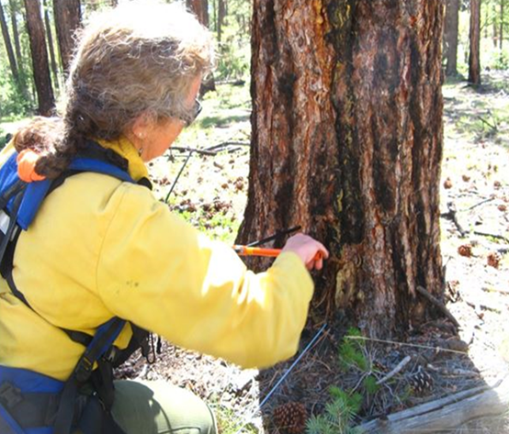
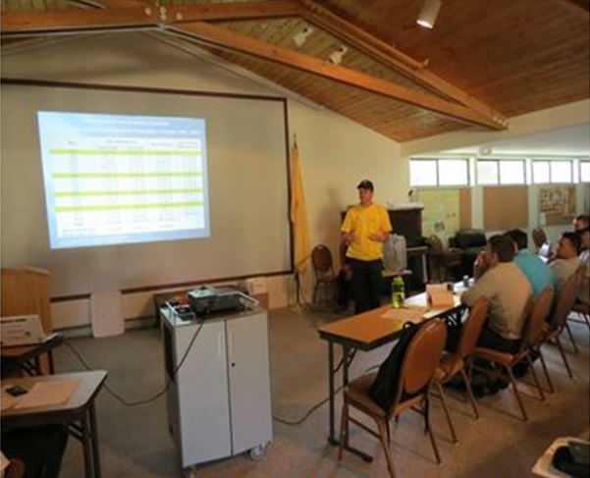
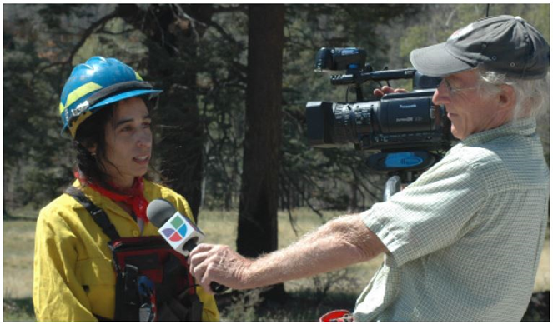
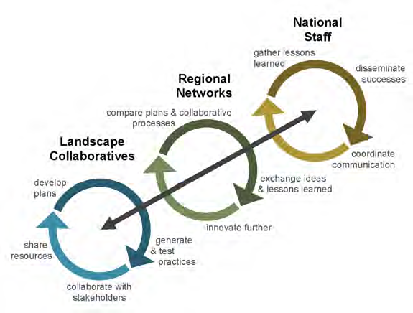
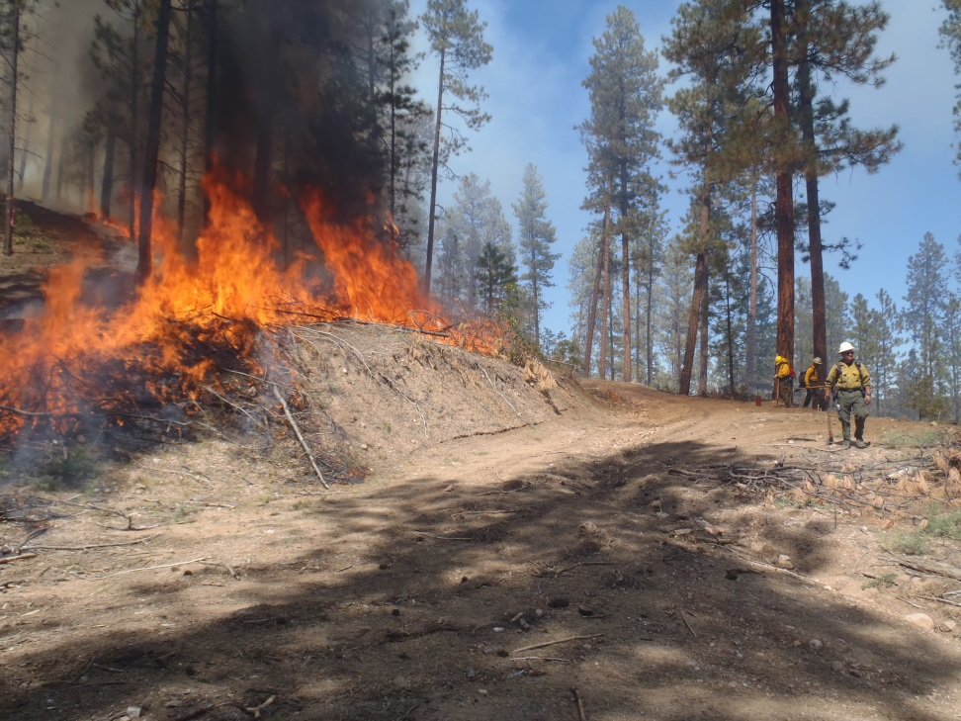
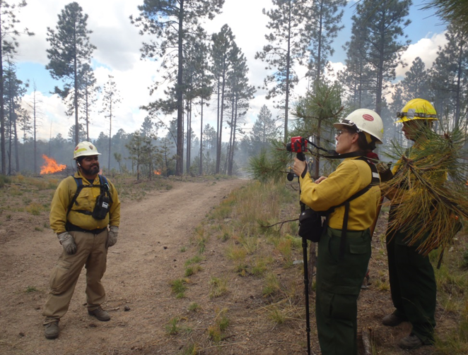
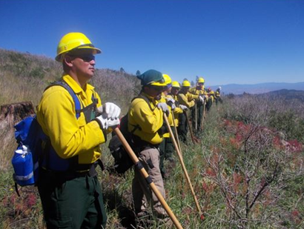
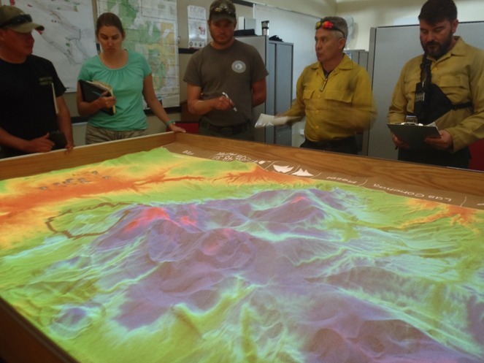
Improving Forest Resilience Locally and Abroad:
Spanish Language Controlled Fire Training Exchange (TREX)
Rodolfo Zúñiga Villegas - The Nature Conservancy in Michigan
Overview
Takeaways
Spanish Language TREX Objectives
Worldwide as well as in the United States, fire is challenging its usual expected intensity and behavior by becoming more unpredictable and devastating. More than two-thirds of U.S. forests have altered fire dynamics. There is growing awareness of wildfire’s devastating consequences on native forests due to weather pattern changes and limited or deficient forest management. Land owners, local and federal governments, indigenous groups, conservation NGOs, as well as land management agencies are taking notice.
As a result, unique fire training solutions are being implemented such as Spanish Language Training Exercise (TREX). TREX brings both international and local Spanish bilingual forest experts together to share and learn about controlled burns, fire management and other conservation practices on grasslands and forests. This program strengthens local partnerships and forest health in the USA, in particularly in New Mexico, while also improving forest resilience overseas. These events are hosted by the Fire Learning Network (FLN), The Nature Conservancy (TNC), and Santa Fe National Forest (USFS).
TREX began in 2008 with the objective of helping supplement the decline in qualified wild land firefighters in the US
There have been 5 TREX exclusively for Spanish speaking participants
TREX brings Spanish bilingual forest experts together to share and learn about controlled burns, fire management and conservation practices.
Burns performed by TREX result in forests with improved ability to withstand fires and absorb more water.
Trainings are aimed to combine the experience of international wild land firefighters with a group of local wild land firefighters.
Work together in the field, share knowledge of prescribed burning, and analyze and classify fuels and fire effects.
Allows analysis of other environmental issues related to conservation of forests and grasslands in the United States.
Compare and contrast both methodologies and techniques used in their home countries, its effects and ways to improve current socioeconomic and political trends.
TREX began in 2008 with the objective of helping supplement the decline in qualified wild land firefighters in the United States.
The Fire Learning Network (FLN) has organized more than 40 exchanges in English, in which over 60 thousand acres have been treated with prescribed fire.
This is the fifth occasion in which FLN, in collaboration with the Santa Fe National Forest has offered a TREX exclusively for Spanish speaking participants, in northern New Mexico.
Training: Everything from Forest Management to Media
Common Goals & Challenges
On site experts share information about local forest ecology, forest thinning, and prescribed and wildfire fire management (particularly fuel types and fire effects).
Each TREX participant and special guests prepare a presentation of about 20 minutes, in order to share information of their work on fire management in their home countries to both identify challenges and to offer possible alternatives or solutions.
Who manages it ?
Why Spanish TREX in New Mexico?
Northern New Mexico has a lot of land managed by the USFS using efforts at a large scale to prevent large catastrophic wildfires (through selective thinning of forests and controlled fire).
Spanish is the native language widely used in the region among wild land firefighters in the area, making the exchange between international participants and local hosts effective and dynamic.
It has improved the ability of treated forests to withstand fires, absorb more water and also has trained and coached hundreds of fire fighters in the use of appropriate techniques to be implemented in their countries of origin.
All TREX participants are trained to interact both effectively and objectively with media personnel.
Fuel reduction = forest resilience
Participants from Portugal, Spain, Andorra, Puerto Rico, Mexico, Guatemala, Honduras, Costa Rica, Chile, Argentina & the U.S. have contributed to burning several thousand acres in New Mexico.
Strengthening local partnerships and forest health in New Mexico while improving forest resilience abroad.

