Slide 1
Getting to Possible
Stale Myths and Fresh Realities of Collaborative Conservation on Public Lands
Gina Knudson
Salmon Valley Stewardship
Feb 29, 2012

Slide 2
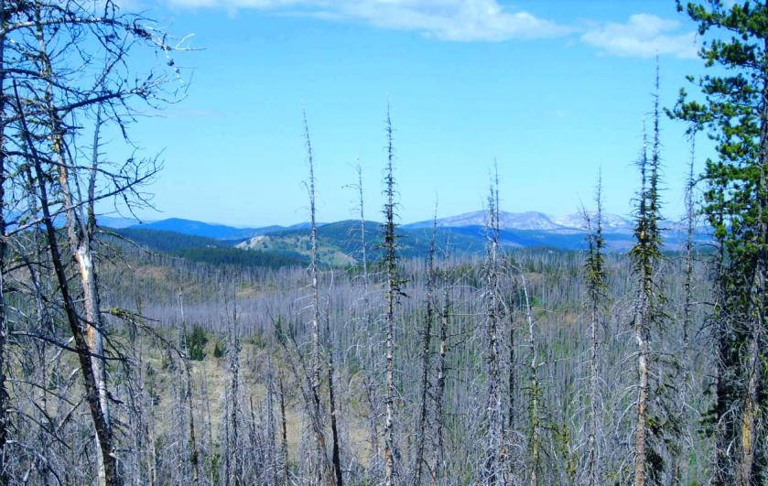
Where I Work
Lemhi County, Idaho is 92% public land
Most of that is land managed by the Salmon-Challis National Forest
Forest Management Plan was released in 1988 – one of the oldest in the USFS system
The agency has been a sitting duck for litigation.
2000 Clear Creek Fire burned almost 217,000 acres
2006 Lemhi County Forest Restoration Group formed

Slide 3
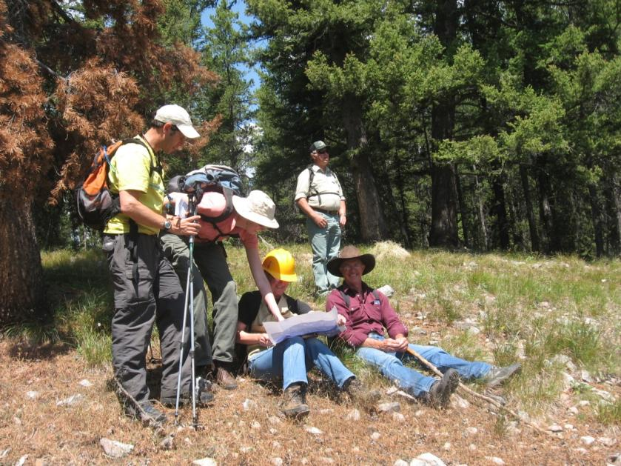
Participating Groups
Lemhi County Commissioners
Idaho Conservation League
Lemhi County Weed Superintendent
Lemhi County WUI Coordinator
Lemhi County Econ Development
Salmon Valley Stewardship
Wild West Institute
The Nature Conservancy
North Fork Fire Department
Idaho Department of Fish and Game
Lost Trail Powder Mountain
Pyramid Mtn. Lumber
Interested Citizens

Slide 4

Stale Myth #1 -
There’s a Recipe for Success
Notes:
The interests, talents and the resources that my participants bring to the table will be vastly different in your community. Spice and diversity almost always beats bland.

Slide 5
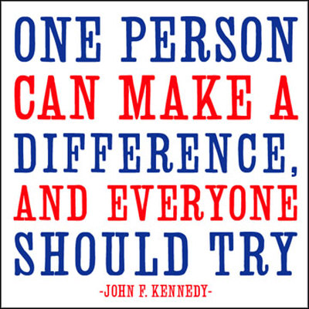
Fresh Reality #1
Notes:
People matter in the business of collaboration. In some places The Nature Conservancy and The Wilderness Society take a lead role in a collaborative. In Central Idaho, TNC has prioritized the protection of private lands that have endangered salmon and steelhead so we get token participation. In 2006, a Wilderness Society rep showed up in our formative meeting, explained that TWS was most concerned about noxious weeds and then said she probably wouldn’t have time to make another meeting. In other places, industry will play a lead role. Our nearest fully functioning mill is about 200 miles away in Seeley Lake, MT and they do participate when they can, but Lemhi County is somewhat out of their priority area.
My organization is a very small, place-based organization and we fill the role as coordinator. Our approach and our resources have an obviously different flavor than when larger organizations take a lead role.
So there’s the cultural differences of varying organizations, but then there’s the more fascinating psychology of human dynamics. Even if all of us in this room had the exact same organizations participating in our collaboratives, chances are good that the people representing those organizations would be different. And that’s where the fun begins… the ingredients. In cooking, it’s hard to go wrong when you are dealing with beautiful fresh ingredients, and likewise it’s hard to go right with the cheapest cuts of tough meat or old produce.
If you participate in a collaborative and you find yourself putting up more hurdles than you are taking down, you might not be a fresh ingredient.
Which brings me to my next Stale Myth…

Slide 6

Stale Myth #2 –
FACA Won’t Let Me Do It
Notes:
Explanation: Steve Hartmann of the BLM pronunciation of FACA.
Does this meet FACA?
The Federal Advisory Committee Act either applies and you comply with it, or it doesn’t and you don’t have to. Fortunately, the Forest Service has shown some outstanding leadership and made the question of whether your group falls under FACA extraordinarily clear.

Slide 7
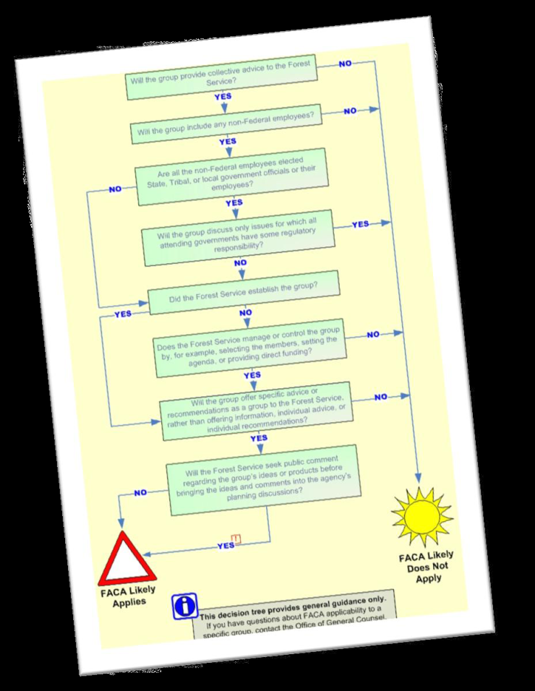
Fresh Reality #2 --
The FACA
Easy Button
Brought to you by the good humans at the Forest Service’s National Partnership Office

Slide 8
FACA Made Easy Part 2
When Does FACA Apply?
A federal agency must comply with FACA when it (1) establishes, utilizes, controls, or manages (2) a group with non-federal members that (3) provides the agency with consensus advice or recommendations.
  KEY POINT: Only groups that meet all three of these legal elements are subject to FACA.
Notes:
Just to be on the safe side, I make some kind of statement of total domination at every meeting to prove that the Forest Service has absolutely no control of the group.
On a serious note, there is almost no excuse for a group being established by the Forest Service since the agency very rarely offers any financial resources to support said efforts.

Slide 9
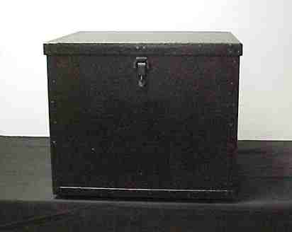
Stale Myth #3 –
Collaboration Ends When NEPA Begins

Slide 10

Fresh Reality #3 –
The Gospel of CEQ Shall Set You Free

Slide 11
Collaborating Throughout NEPA
Agencies can work directly w/ collaboratives at all phases of NEPA, seeking input and agreement on:
  purpose and needs statement,
  alternatives,
  collection and use of data,
  impact analysis,
  development of a preferred alternative, and/or
  recommendations regarding mitigation of environmental impacts

Slide 12
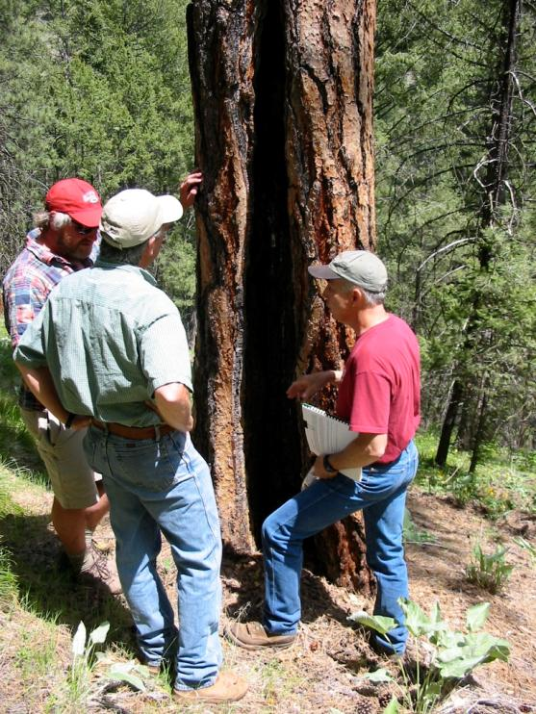
Final Thoughts
Be the fresh ingredient in your collaborative
Meet the FACAs
Open the Black Box
Read from the Gospel
Thanks!

