Slide 1
Creating Nimble and Effective Collaborations for Sustainable Results
Lynn Decker & Anne Bradley
Fire Learning Network
The Nature Conservancy

Slide 2
Fire Learning Network (FLN)
The FLN is a cooperative program of the Forest Service, Department of the Interior agencies—Bureau of Indian Affairs, Bureau of Land Management, Fish and Wildlife Service and National Park Service—and The Nature Conservancy. The partnership has a ten-year proven track record of helping to restore our nation’s forests and grasslands and to make communities safer from fire.
An equal opportunity provider

Slide 4
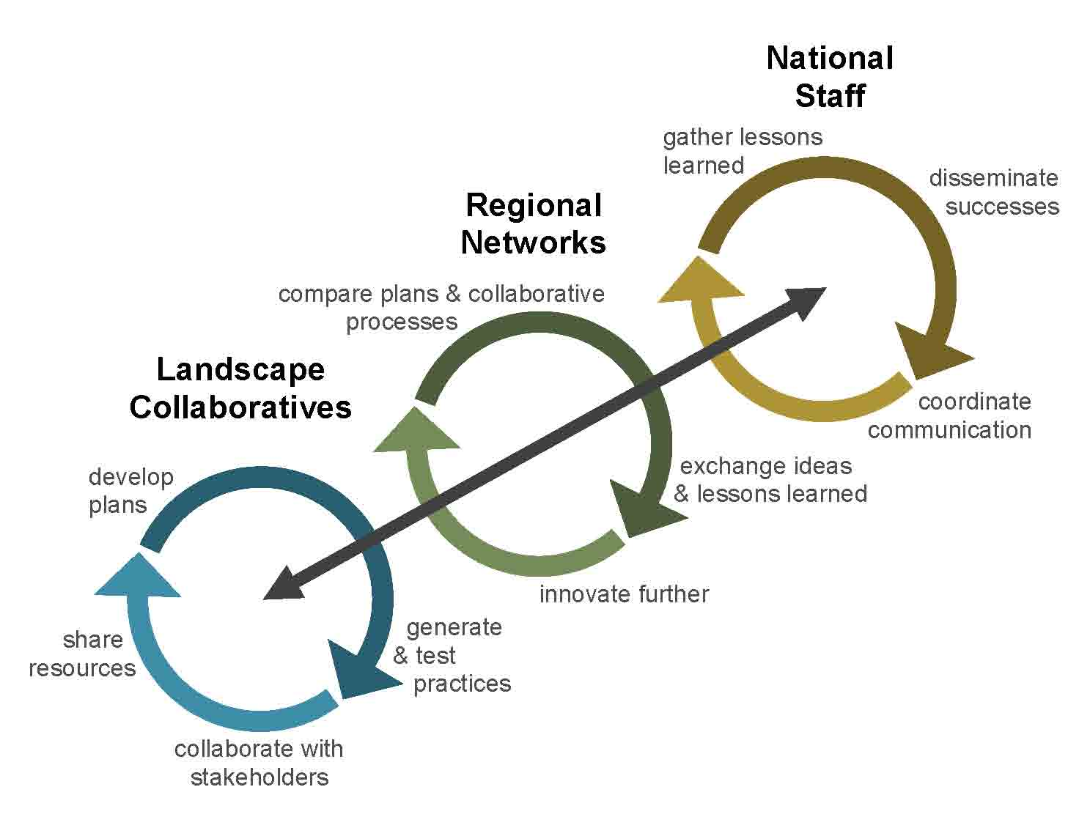

Slide 5
Cooperation, Coordination, and Collaboration: What’s the Difference?

Slide 6
Collaboration: What Makes It Work,
2nd Ed.
Co-Authors: Paul Mattessich, Marta Murray-Close, Barbara Monsey
ISBN: 0-940069-32-6
Fieldstone Alliance

Slide 7
Collaboration isn’t
a project you undertake.
It is a commitment
that you make.

Slide 8
Gears of Collaboration
aligning interests
mobilizing resources
engaging members and the community
establishing accountability
taking action
learning together
FLN Outcomes:
Building capacity for action
Impact at scale
Sustainable
trust
Gears of Collaboration
power
Demonic Variables of Collaboration = Power and Trust
Notes:
Trust (can be within or between entities or organizations)
Power (can be differences in perceived or real power)
Fire Learning Network:
Building capacity for action
Conservation of the landscape at “impact” scale
Sustainable relationships that can handle the next big challenge

Slide 9
Aligning interests
What is important?
Developing a shared mission and vision; be open to starting to work on what you can agree upon
Develop a shared understanding of the ecological and social context (conceptual model)
Collaboratively develop spatially explicit desired conditions (the context for action)
Collaboratively develop implementation plans
Take a learning by doing approach
Develop other opportunities to learn together – it also contributes to building trust
Include opportunities for building relationships – field trips, working over meals together
Bring in folks from successful collaborations to coach/talk to your group
Invest by giving up some control

Slide 10
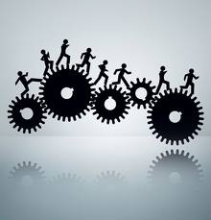
Mobilizing resources
What is important:
Developing networks: connections to people, organizations, groups, decision makers, etc. (connections/endorsements that enhance effectiveness and legitimacy of the collaboration)
Develop resource sharing plans and MOU’s
See the larger landscape as a shared landscape
Innovate solutions together
Facilitate access to resources (right capabilities, funds for planning and implementation, equipment, etc.)
Recognizing and making transparent the contributions of all as equally important to the outcome

Slide 11
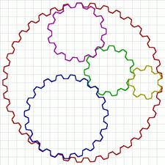
Engaging members and the community
What is important:
Inclusion of all members that are willing to engage in the work
Ability to bring in “expertise” to inform the group process and acquire diverse knowledge and skill capacity
Collaboration offers something worth spending time on and participating with
Process for engaging others as the process evolves
Operate as though everyone has something to offer and something to learn
Information, processes and products freely shared (no secrets – e.g. develop website or some way to put what you are doing out there in the open)

Slide 12
Establishing Accountability
What is important:
Process and tools to set priorities and stay focused and at the same time nimble
Clarify members’ “domains” for products, responsibilities, relationships
Process and tools to hold each other accountable within the collaborative
Process and tools to demonstrate accountability externally to key influencers and audiences
Gauging satisfaction, achievement of objectives achievement of collaboration milestones
Leading by example

Slide 13
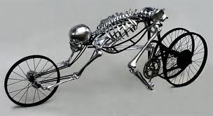
Taking Action
What is important:
Establishing joint projects – learning by doing
Getting to implementation; implementing your collaborative projects and learning together from them
Documenting accomplishments and lessons learned
Implementing 2nd, 3rd and 5th projects of the collaboration – this is where you will see your hard work payoff and your relationships make the improbable possible

Slide 14
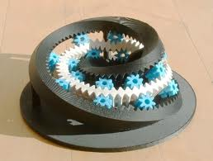
Learning together
What is important:
Implement a practice of learning before, learning during and learning after
Use simple tools but use something
- Learning workshops in lieu of meetings
- Peer assists and peer reviews
- Developing products together
- After Action Reviews
- Emergent Learning Maps
- Photo monitoring
Whatever you do, do it together, engage to learn and implement/adjust based on that learning – commitment to follow through

Slide 15
What are some indicators of good and bad collaborations?
Good Collaborations
Bad Collaborations
1
2
3
-
-
-
1
2
3
-
-
-

Slide 16
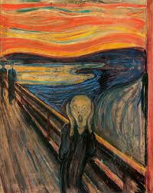
Indicators of Bad Collaboration:
Endless unproductive meetings
Nobody stays committed
Same decisions made over and over
Partners not accountable to each other
Conflict/mistrust lurks below the surface
Collaboration dies when money dries
Best practices/learning lost or wasted
Agreed upon projects not implemented

Slide 17
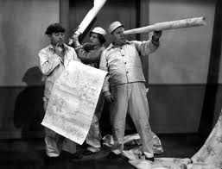
Indicators of Good Collaboration:
The best “team” you’ve ever been on
Work is fun
You are able to scale up your impact
Near boundary-less conservation
Lower probability of appeals, litigation
Spirit of public service renewed
Tangible conservation outcomes that can be measured
Alignment of ecological & social goals

Slide 18
Fire Learning Network Collaboration Lessons Learned Quick list of 10
Send the right people to the collaboration.
Commit to the process.
Start with a shared mission and vision that the collaboration can agree on (even if it is simple to start with).
Ensure that the process is open, inclusive, transparent, accessible, and tailored to local needs.
Everyone has something to share and something to learn. Co-learning changes relationships.

Slide 19
Fire Learning Network Collaboration Lessons Learned Quick list of 10 (continued):
Playing nice with others and sharing your toys matters.
Keep the commitments that you make. Ultimately success is about relationships.
Incorporate food, fun, and field co-learning opportunities.
Implement the projects; nothing undermines a collaboration more than not getting to implementation.
It's a team effort. You succeed, fail, and evolve as a team. Share leadership and credit.

Slide 20
Fire Learning Network (FLN)
The FLN helps federal land managers: convene highly successful, integrated collaborative planning efforts, build stakeholder trust and understanding, improve local community capacity to live with fire, overcome planning gridlock, tap new funding sources for restoration and address climate change. At a national level, the FLN is also providing training that helps fire professionals work with local communities, introducing tools for collaboration in fire planning, building public support for forest and fire restoration, and helping the agencies adopt an “all lands” and science based approach.
Lynn M. Decker
ldecker@tnc.org (801) 320-0524
http://www.conservationgateway.org/topic/fire-learning-network
An equal opportunity provider

Slide 21
Collaboration Myth & Path Group Exercise
World Café style facilitated small group discussion
4-5 per table; mix it up
2 rotations: 1 - 20 minutes; 2 – 15 minutes
Listen, share, don’t dominate; ask how
Close - share an insight per table
Follow up

