Slide 1
Flood Risk and Climate Adaptation:
Federal Policies & Nonfederal Actions
Climate, Risk, and Resilience 2013 | New Orleans, LA | 29 May 2013

Slide 2
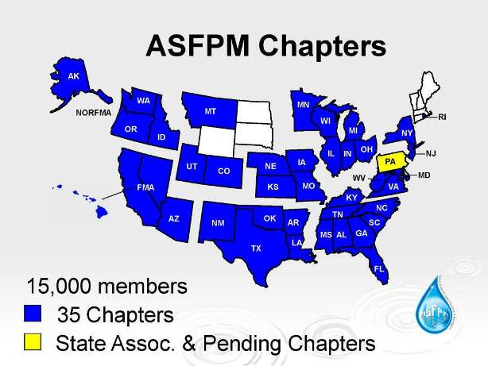
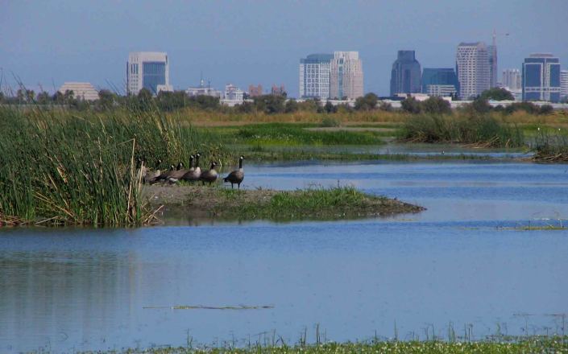
Association of State Floodplain Managers
Mission: Mitigate the losses, costs, and human suffering caused by flooding.
and
Protect the natural and beneficial functions of floodplains.

Slide 3
Briefing Overview
Background: Federal Flood Policy
Federal Policy Changes
Early Lessons from Hurricane Sandy

Slide 4
Briefing Overview
Background: Federal Flood Policy
Federal Policy Changes
Early Lessons from Hurricane Sandy

Slide 5
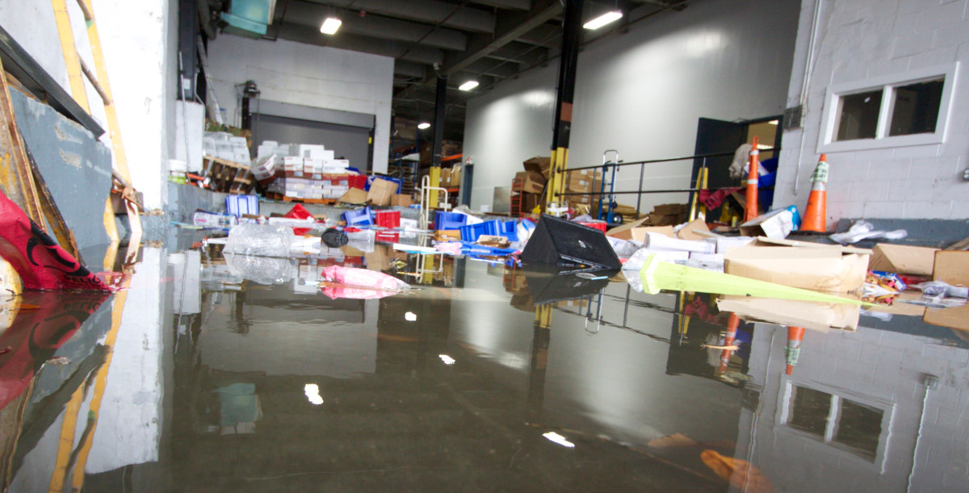
Floodplain Management: Roles
So, who manages flood risk, anyway?
Federal Role
State Role
Local Role
Private Sector
Personal Role

Slide 6

Policies Contribute to Risk
Federal Policies
States & Communities
Emphasis on structural approaches
Disaster relief environment
Control land use for short-term benefits
Perceive flooding to be a federal problem
Externalize the costs & consequences
Public
Unaware of – or unwilling to accept - residual risk
Misplaced concern about having to obtain flood insurance
NFIP & the 100-Year Standard

Slide 7

Sidebar: Executive Order 11988 on Floodplain Management
President’s Statement Accompanying Executive Order 11988
Despite substantial efforts by the Federal Government to reduce flood hazards and protect floodplains, annual losses from floods and adverse alteration of floodplains continue to increase. The problem arises mainly from unwise land use practices.
Because unwise floodplain development can lead to the loss of human and other natural resources, it is simply a bad Federal investment and should be avoided.
- May 24, 1977
Notes:
Despite substantial efforts by the Federal Government to reduce flood hazards and protect floodplains, annual losses from floods and adverse alteration of floodplains continue to increase. The problem arises mainly from unwise land use practices.
The Federal Government can be responsible for or can influence these practices in the construction of projects, in the management of its own properties, in the provision of financial or technical assistance including support of financial institutions, and in the uses for which its agencies issue licenses or permits. In addition to minimizing the danger to human and nonhuman communities living in floodplains, active floodplain management represents sound business practice by reducing the risk of flood damage to properties benefiting from Federal assistance.
Because unwise floodplain development can lead to the loss of human and other natural resources, it is simply a bad Federal investment and should be avoided.

Slide 8
Sidebar: Executive Order 11988 on Floodplain Management
Executive Order 11988
Each agency shall provide leadership and shall take action
to reduce the risk of flood loss,
to minimize the impact of floods on human safety, health and welfare, and
to restore and preserve the natural and beneficial values served by floodplains…
Agencies, such as DOT, HUD, etc., implemented the EO through revised regulations with guidance from CEQ, WRC, GSA
43 FR 22308 (Feb. 10, 1978)
GSA Administrative Order 1095.2 (July 23, 1979)

Slide 9

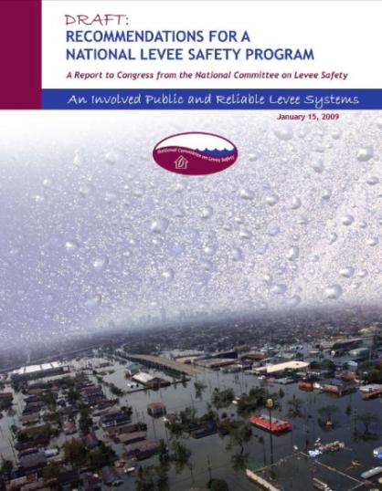
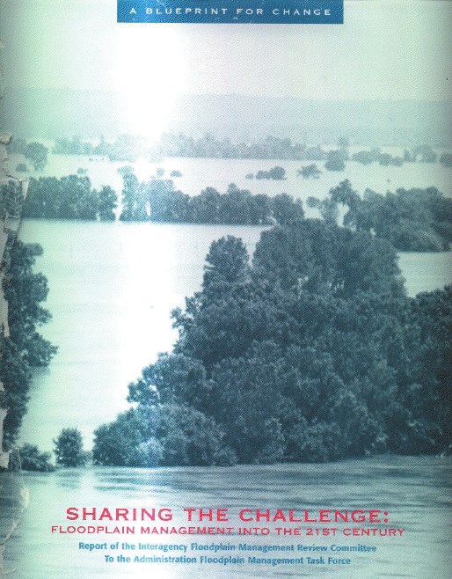
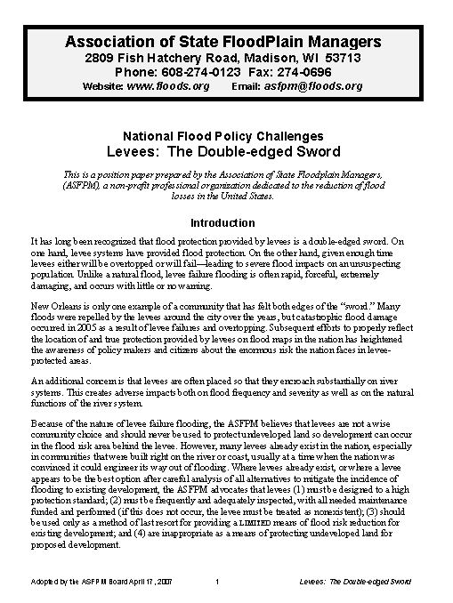
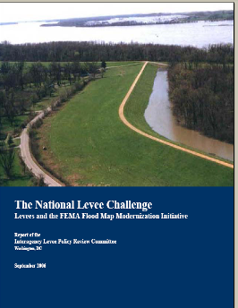

Slide 10
Key Recommendations of Reports: 1970s - present
“100-year” standard inadequate for flood damage reduction structures, especially for urbanized areas.
Structures, such as levees, floodwalls, and dikes alone will not reduce risk – nonstructural measures must be integrated.
Federal policies may present barriers to nonstructural approaches and local initiative for management of flood-prone lands.
Climate impacts threaten coastal communities and economies. Some states and local governments are working to prepare for these impacts by adopting modern standards and long-term strategies to allow more room for rivers, beaches, and coastal ecosystems.
Although floodplain and land use management is a state and local responsibility, the federal government plays a critical role in providing standards, funding, and technical assistance.

Slide 11
Damage Drivers
Current Federal Policies:
Allow intensification in hazardous areas
Ignore changing conditions
Ignore adverse impacts to existing properties
Undervalue natural floodplain services
But, changes are already underway…
Notes:
Under current policy we do the following:
allow development in high risk areas---IN FACT, the national approach is:
Map the high-risk floodplain, then show people how to build in it
use existing conditions and ignore impact of new development on flood levels
development often results in increased flood stage, flow, velocity: altered sediment and erosion---with no mitigation considered
fail to consider value of storage or benefits of natural floodplain functions
NFIP Evaluation underway---- Cost $5 million, done in the fall of 2005 Larson on Steering Committee to guide what is looked at in the 8-10 research studies underway---may look at 1% chance flood as a standard---

Slide 12
Briefing Overview
Background: Federal Flood Policy
Federal Policy Changes
Early Lessons from Hurricane Sandy

Slide 13
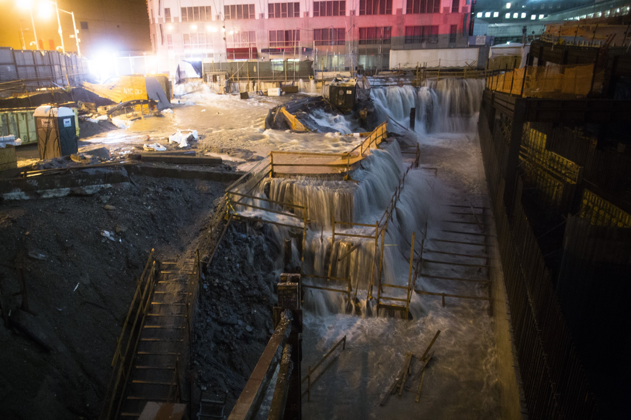
Early Lessons of Sandy
Resilience in a Changing Climate
“Structural” v. “Nonstructural”
Money Matters:
  Public Investments
  Private Capital
  Tradeoffs
  True-cost pricing

Slide 14
Briefing Overview
Background: Federal Flood Policy
Federal Policy Changes
Early Lessons from Hurricane Sandy

Slide 15
Federal Policy Responses
NFIP Reform
Supplemental Appropriations for Sandy
Water Resources Development Act of 2013
Principles and Guidelines
Executive Orders 11988, 13514
Federal Sandy Rebuilding Task Force

Slide 16

BW-12 and Insurance Affordability
Philosophy behind Biggert-Waters
  Majority of reforms focused on financial solvency of the program
    Federal insurance subsidies mask actual risk
    Actions to reduce risk => Lower Premiums
    Higher Risk => Higher Premiums
    Reduce program debt
  National Flood Mapping Program
Notes:
The law made a number of reforms to strengthen the future financial solvency and administrative efficiency of the program by raising
historically low premiums and reducing homeowners’ incentives for rebuilding in flood risk
zones.
Of course flood map accuracy also is important in not only properly rating flood risk but also for long term resiliency of communities. The Flood Insurance Reform Act of 2012 authorized several regulatory changes to improve the accuracy of flood maps and established a process to allow communities to request a remapping based on the standards recommended by a newly established Technical Mapping Advisory Council and adopted by FEMA. The new law also authorized the creation of an independent Scientific Resolution Panel consisting of experts on flood hazard maps and flood insurance to address mapping-related concerns from communities that are dissatisfied with the outcome of
their appeal to FEMA.
What was amazing is how different 2012 was from 2004. Mood of Congress 180 degrees different than in 2004 when there was last major reform of NFIP passed. At that time, ASFPM was helping promote the “2 strikes and you are out of the taxpayer pocket” approach to either move to actuarial rating or not being allowed to have insurance. We were laughed out of most offices and the one acknowledgement we received to that notion was the beleagured SRL program which was largely made unworkable by Congress. What a difference $17 billion in debt makes!

Slide 17
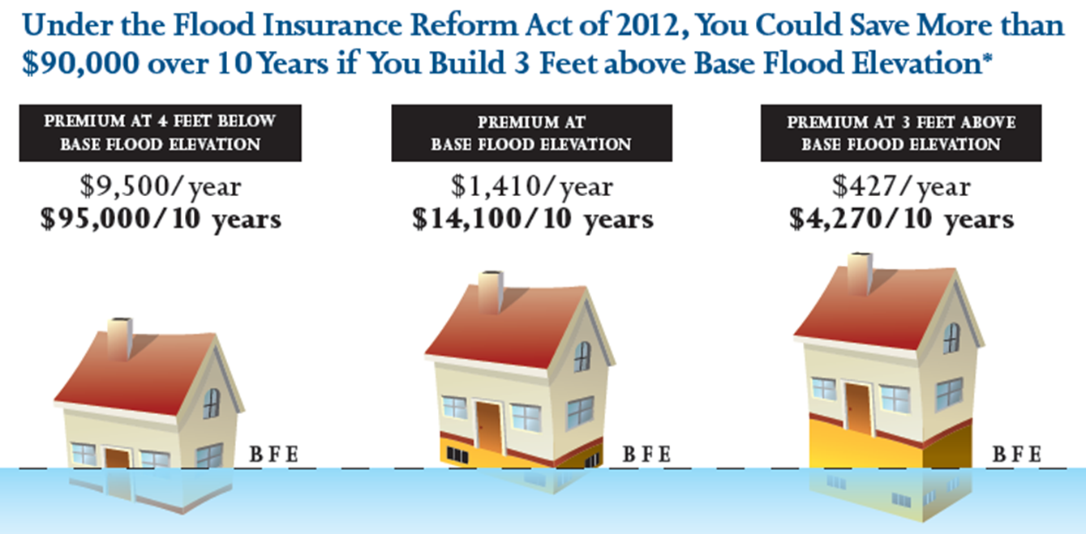
Need to Build Higher!

Slide 18
The Sandy Connection
Then there was Sandy
  200,000+ structures affected
  Projected flood claims to be $7-10 billion
  By January 2013, NFIP in process on over 130,000 flood claims
  Projected to be second biggest claims event in history of NFIP behind Katrina
  Could push NFIP debt to nearly $29 billion total
  Congress approved $60.4 billion in supplemental funding ($33 billion for long term recovery and rebuilding)
Notes:
Any way you look at it, Sandy is going to be a big event where it concerns the NFIP. As a point of comparison, after Katrina, there were over 167,000 claims paid for more than $16 billion.
For the taxpayer (all of us), Congress approved a $60.4 billion emergency supplemental package. The big question is how much of that funding will go to more resilient rebuilding and reconstruction.

Slide 19

Notes:
This is a photo of one of the first house elevations in the Sandy affected area. Photo courtesy of Roderick Scott, elevation contractor.

Slide 20
Recent Federal Policies
RESTORE Act
NFIP Reform
Supplemental Appropriations for Sandy
Water Resources Development Act of 2013
Principles and Guidelines
Executive Orders 11988, 13514
Federal Sandy Rebuilding Task Force
Uniform Flood Risk Reduction Standard:
Best-available-data for elevation plus 1’ freeboard
http://portal.hud.gov/hudportal/HUD?src=/sandyrebuilding/FRRS

Slide 21

Summary & Conclusion
Federal policies increase emphasis on state and local leadership in managing flood risk and adapting to climate change.
Project and program finance changes will require new approaches.
States and communities are leading the way.

Slide 22
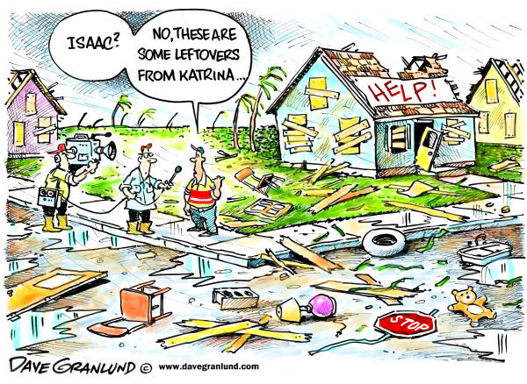
Thank you!
Sandy?
Irene

