Slide 1
Reducing Disaster Risk: A Conservative Perspective
Eli Lehrer
President, R Street

Slide 2


Slide 3

Our New Offices

Slide 4
Our Views on Disaster Risk

Slide 5

All Choices Involve Costs

Slide 6
Government Encourages Bad Choices
Much development in harm’s way comes as a result of government subsidies.
Risk-based insurance rates are the single best protection.
We don’t have them anywhere.

Slide 7
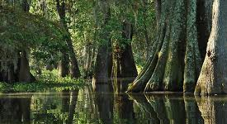
Pure Conservation Has a Place

Slide 8

Mostly, Government Should

Slide 9
Our Goals

Slide 10
What We Want
Less government regulation and fewer subsidies.
Risk-based insurance rates.
Conservation of wetlands for their natural and beneficial uses.

Slide 11
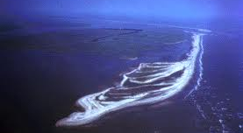
CBRA: My Favorite Environmental Law

Slide 12
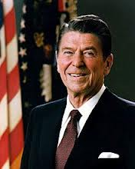
We Need More of the Same

Slide 13
Progress

Slide 14
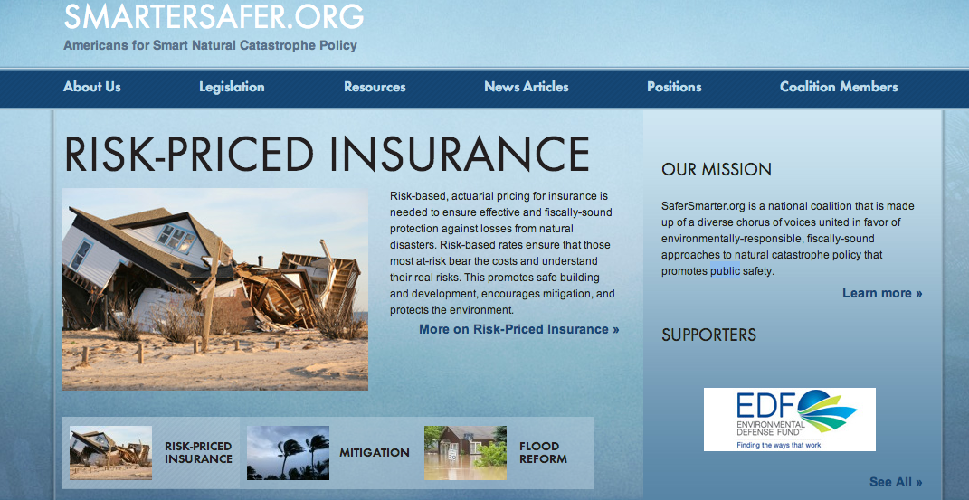
Where We’ve Succeeded
Smartersafer.org…everyone together.

Slide 15






A Broad Coalition for Flood Reform

Slide 16
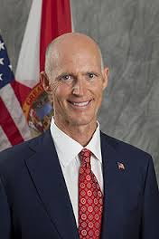
More Progress in the States
Florida HB1770: Coastal Preservation

Slide 17
Obstacles We Face

Slide 18

1: “I Fly Commercial…Whenever Possible.”

Slide 19
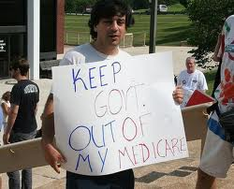
2: “Keep the Government’s Hands off of my Medicare!”

Slide 20
Thank You!

