Slide 1
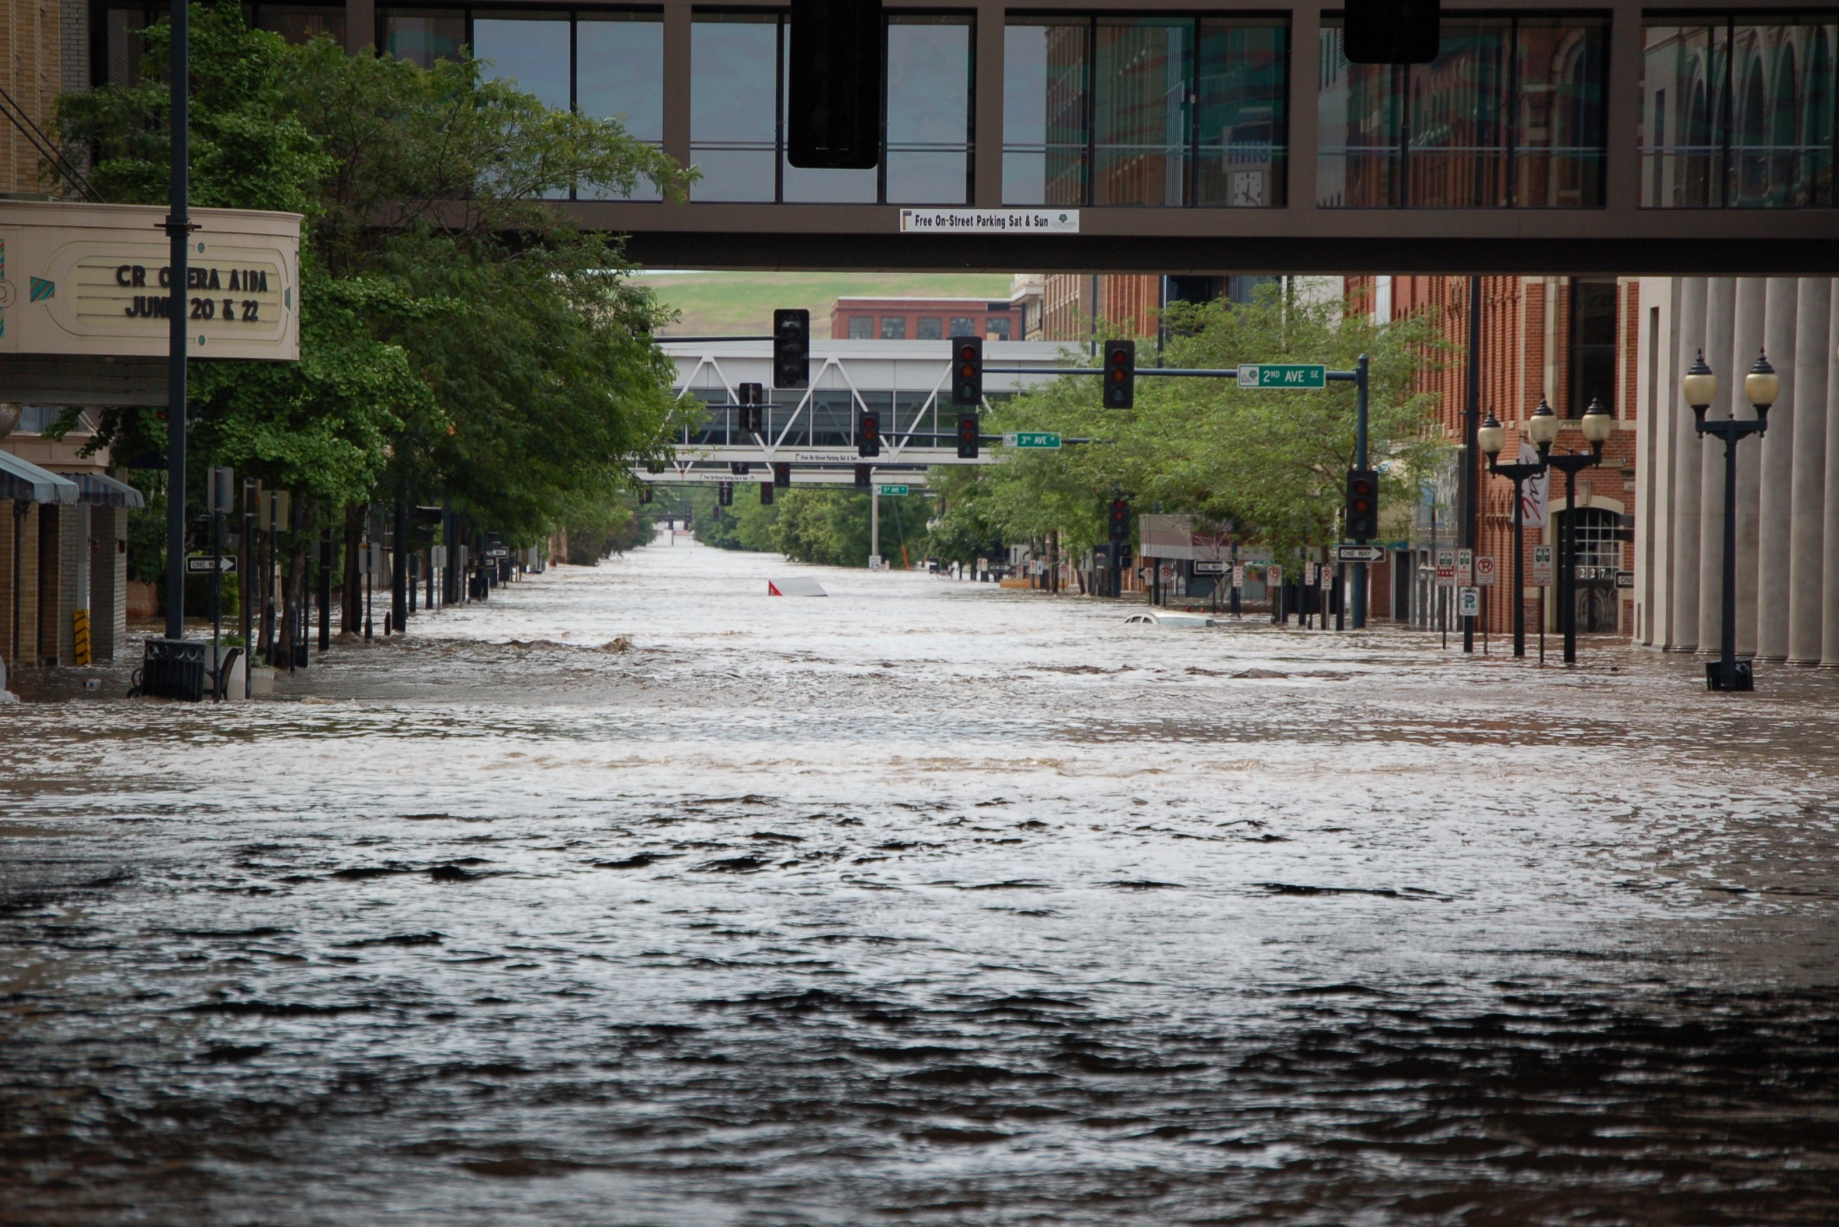
Flooding in the Cedar/Iowa Rivers:
A New Approach to Flood Risk Reduction

Slide 2
Notes:
Similar to all Iowa Streams

Slide 3
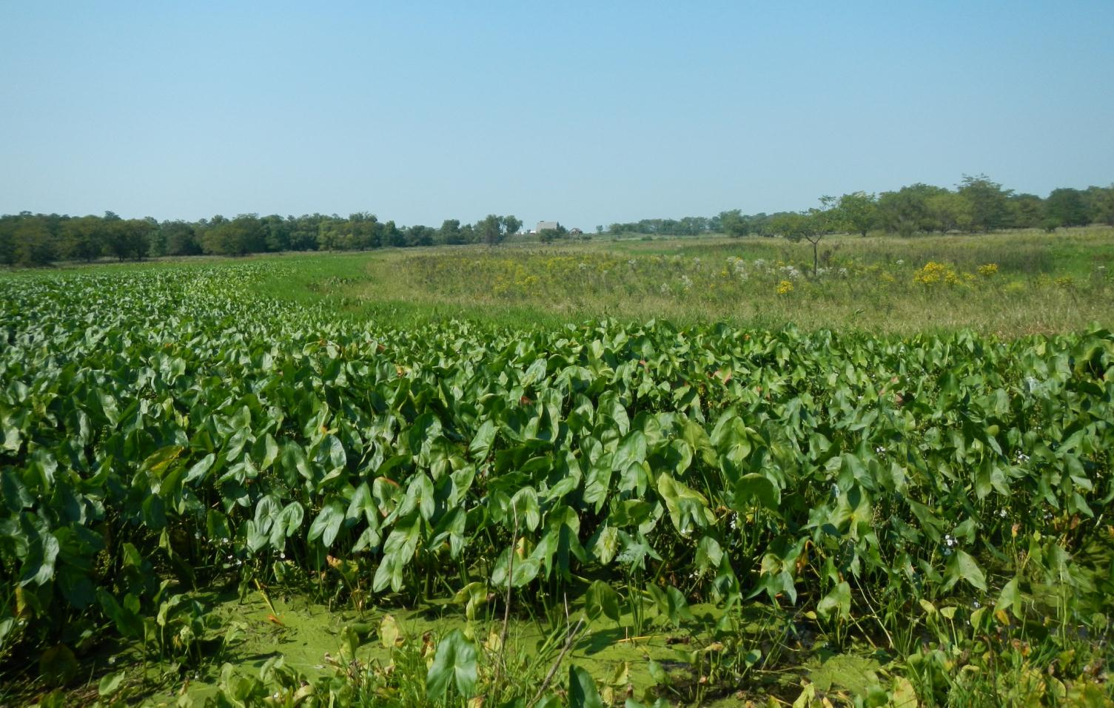
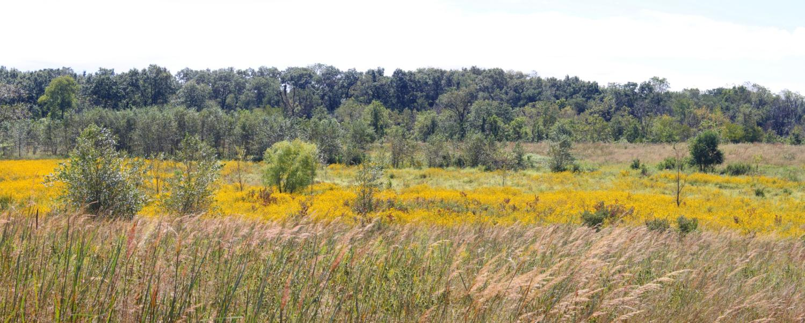
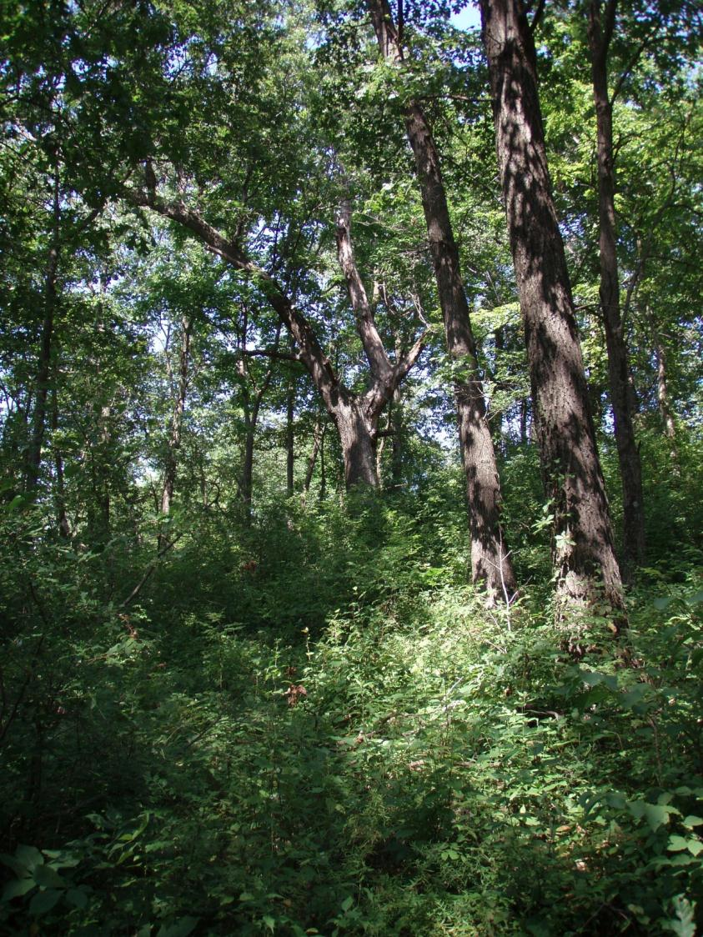
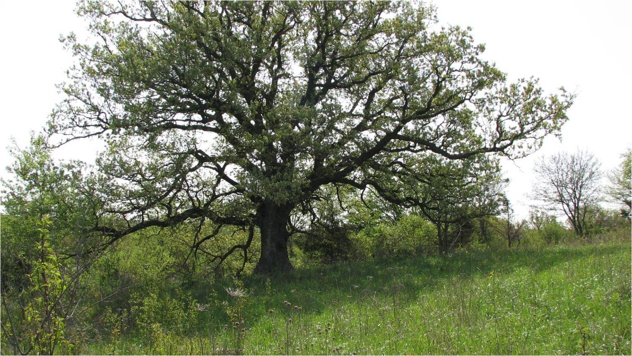
Notes:
Even most Iowans would be surprised to know that South East Iowa is a hotspot for biodiversity.
The Mississippi and the lower reaches of its large tributaries (Iowa/Cedar, Skunk, Des Moines)-has a tremendous wealth and variety of habitats and species. Sand prairies, alluvial wetlands upland oak savannas, floodplain savannas, fens, wet meadows, oxbows, floodplain forests, old fields, bottomland timber….

Slide 4
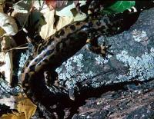
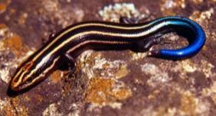
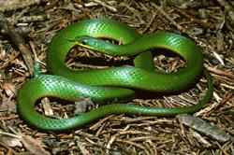
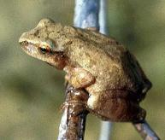
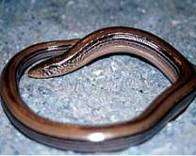
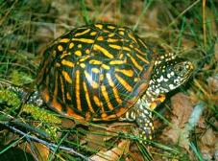
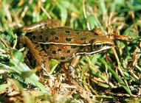
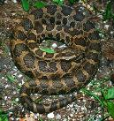
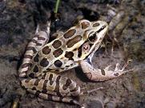
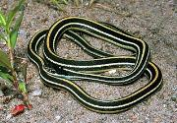
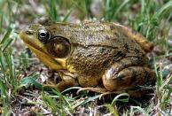
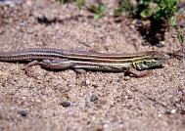
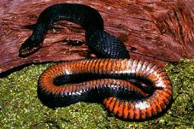
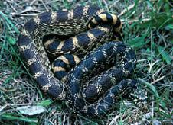
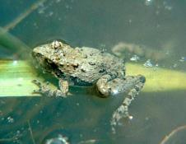
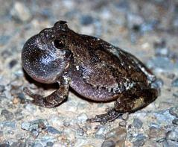
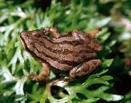
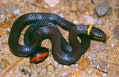
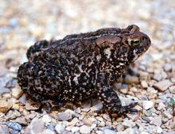
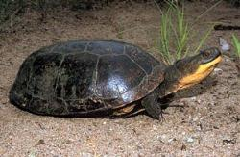
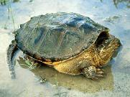
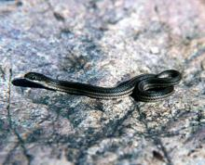
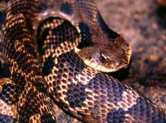
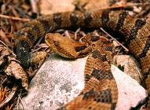
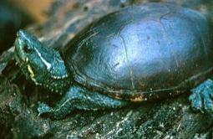
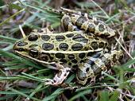
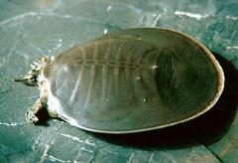
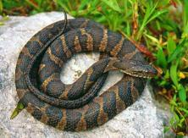
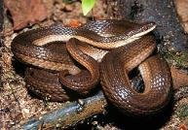
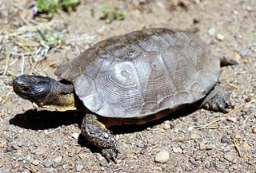
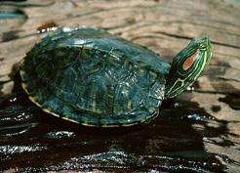
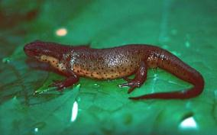
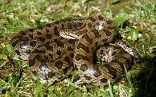
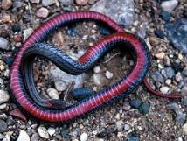
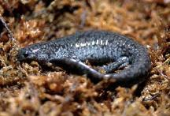
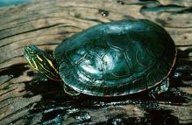
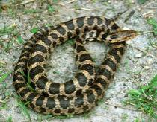
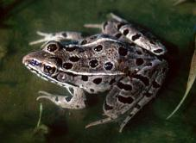
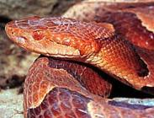
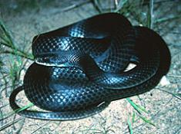
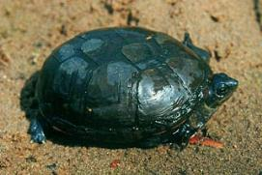
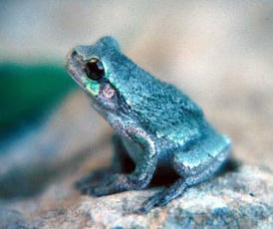
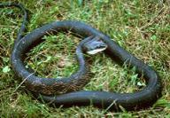
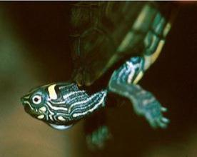
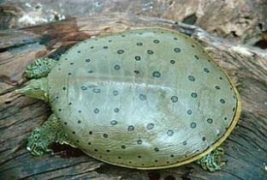
Collage of 50 Species
Photos Courtesy of Jeff LeClaire www.herpnet.net
Notes:
Each picture here represents a species that is found, or for some of the rarer species, is most likely found, in the ARCA.
Widespread global declines in in amphibian and reptile populations necessitate conservation action. Unfortunately Iowa has lost much of it’s habitat and restoration is expensive. Southeast Iowa represents a great investment opportunity for conservation of Herps. They aren’t the only ones that benefit!

Slide 6
93% Row Crop

Slide 7
Historical Hydrology Changes
Iowa Stream Miles:
Pre-European:
22,000 miles
Current:
71,600 miles
Adapted from Andersen, Iowa Geology 2000, Iowa DNR
Notes:
From Andersen 2000.
We also know that the hydrology of Iowa has been drastically altered with European settlement – especially in the prairie pothole region, or the Des Moines lobe, where shallow wetlands, marshes and wet prairies were drained via subsurface tiling and alterations to streams. This is an example in the southeastern portion of the Des Moines lobe – Bear Creek watershed.
Yet many ongoing efforts to improve water quality and stream habitat conditions do not address the legacy of altered hydrology.

Slide 11
Notes:
One Structure on Iowa River. Will have a levee in CR

Slide 12
Iowa River,
2008
Cedar River,
2008
Notes:
Enter 2008 – 3.5-10 dollars of damage, we now have political and public will providing opportunity for TNC to work at the scale of the threat….

Slide 13
Notes:
5000 homes, 7000 jobs

Slide 14
Develop Systemic Flood Risk Management Strategies and Plans for Tributary Watersheds of the Upper Mississippi River.
…To truly address flood risks systemically requires actions throughout the watershed. Addressing flood risks through an integrated water resources management approach will result in a more resilient and sustainable UMR Watershed….

Slide 15
2009 Iowa-Cedar Watershed Interagency Coordination Team
…create a basin-wide management plan based on public input and collaboration. We aim to reduce flood risk while increasing the social, economic, and environmental value of the basin’s water and land resources
© Carl Kurtz

Slide 17
Basic Elements:
Modeling: Capitalize on Science and Expertise/Focus on Multiple Benefits (Social, Environmental, Economic)
Kris Johnson/InVEST
Public Engagement: Share Scenarios (with Watershed Management Authorities)
“on-the-ground” work has been occurring

Slide 18
Parting Thoughts:
Hot Topics: Flooding, Drought, Nutrients, Flooding…#iaflood
- Need to capitalize on, but not get caught up in “trends”
Is long term continuity realistic?
“Conversations with Communities” using good science is essential but challenging
Challenging to communicate (internally).

