Slide 1
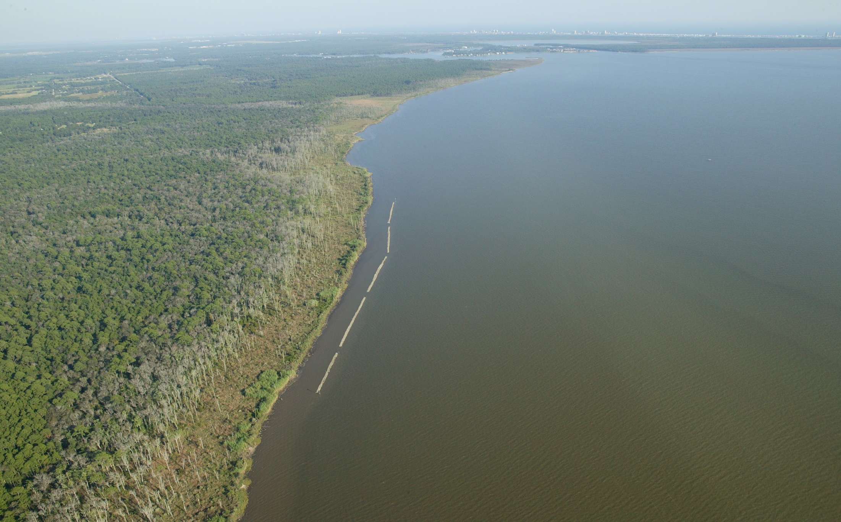
ENVIRONMENT, ECONOMY AND COMMUNITY: MAKING THE CASE FOR GULF OF MEXICO RESTORATION
© JoeBay Aerials
Judy Haner, Marine and Freshwater Programs Director
The Nature Conservancy in Alabama

Slide 2
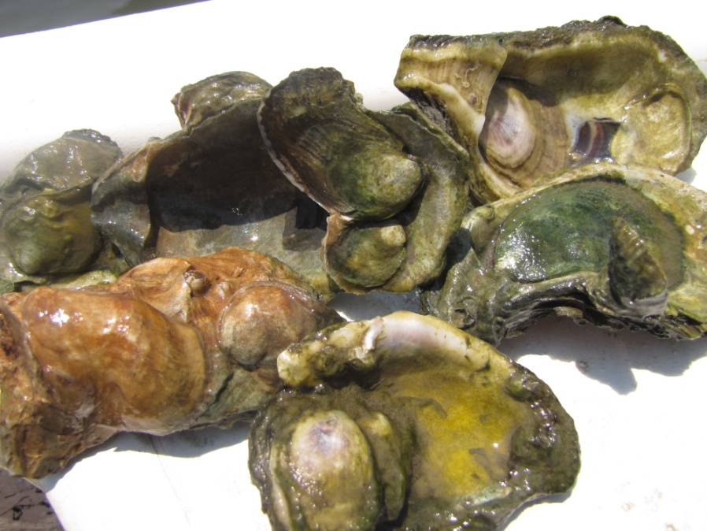
Foundation for the Environment
Notes:
Historically reefs in the northern Gulf were 3-dimensional structures 3’, 7’ and more than 12’ in vertical relief, like the Sabine Reef on the border of LA and TX. These reefs protected soft marsh shorelines from waves, provided calm clear waters for seagrasses. These three habitat served as the foundation for the environment in coastal Alabama and the northern Gulf.
How many folks recall being able to see the bay bottom or seagrasses along the shore? Are they there now?

Slide 3
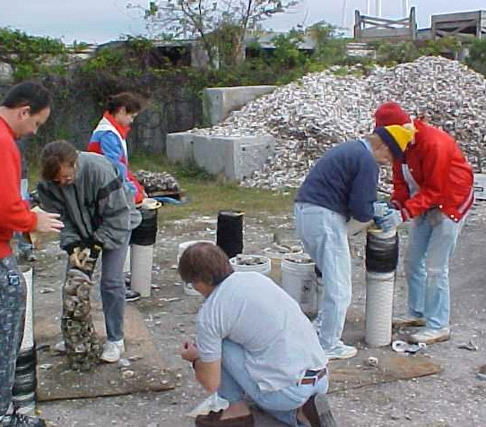
Small Restoration Projects

Slide 4
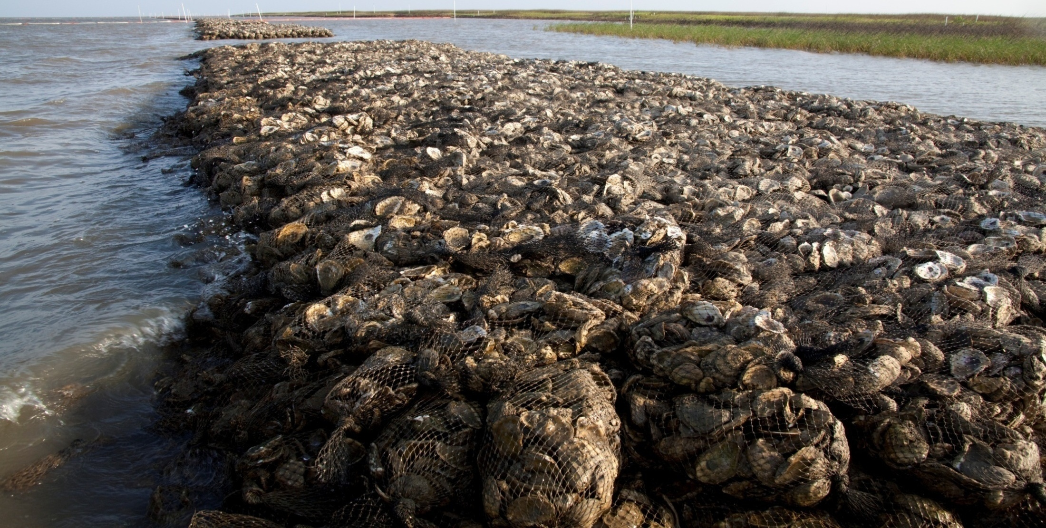
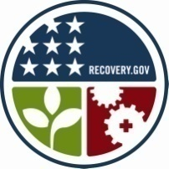
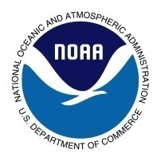
Larger Restoration Projects
The American Recovery and Reinvestment Act of 2009 and NOAA helped TNC build more than 1.5 miles of oyster reef in Alabama

Slide 5
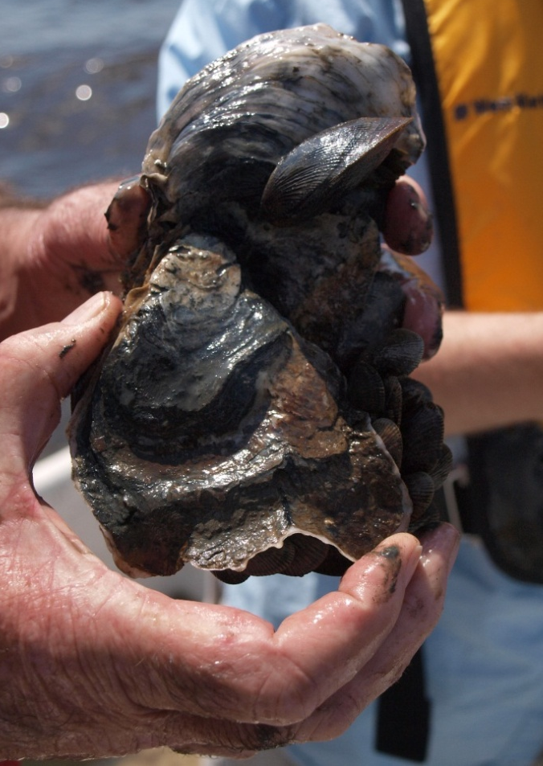
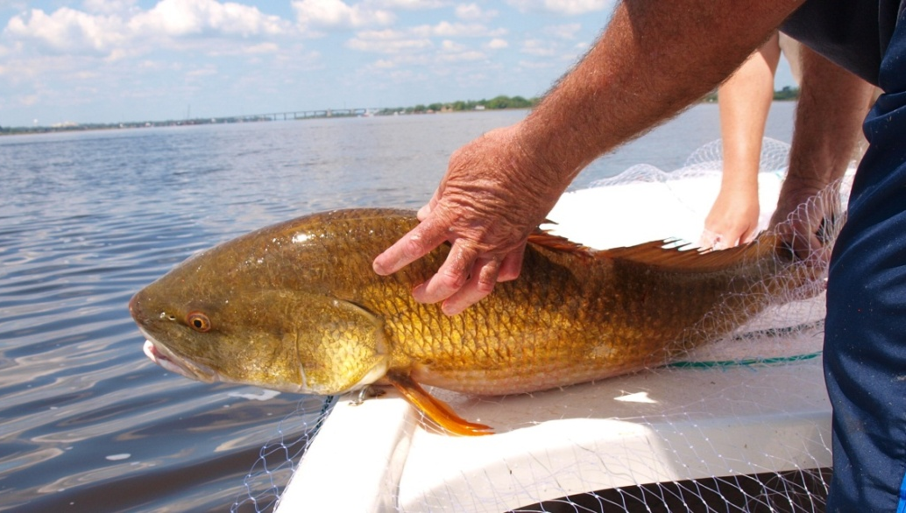
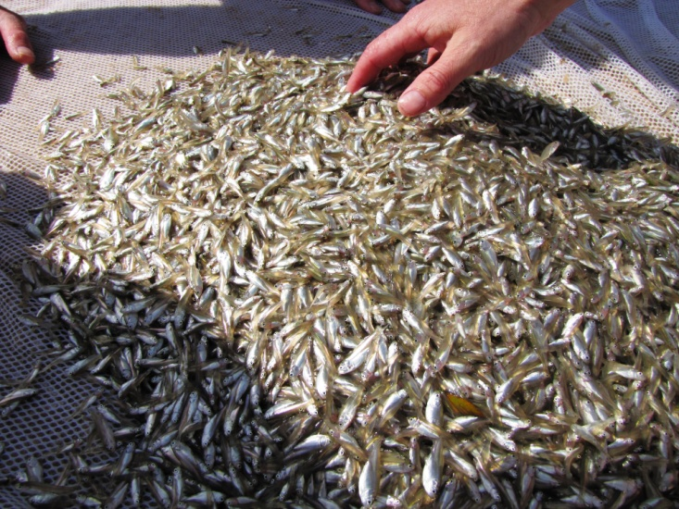
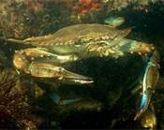
Building Environmental Resilience
© Allen Tate, TNC
© Thomas Mohrman, TNC
© Allen Tate, TNC
http://animals.nationalgeographic.com/animals/invertebrates/blue-crab/
Notes:
These photos capture the results of restoration, including the growth of new oysters and the fisheries benefits that can be derived from oyster reefs. It is estimated that one acre of oyster reef increases fisheries catch values by $4,200 annually. Oyster also provide valuable water filtration benefits, each acre of oyster reef provides $6,500 in denitrification services annually.

Slide 6
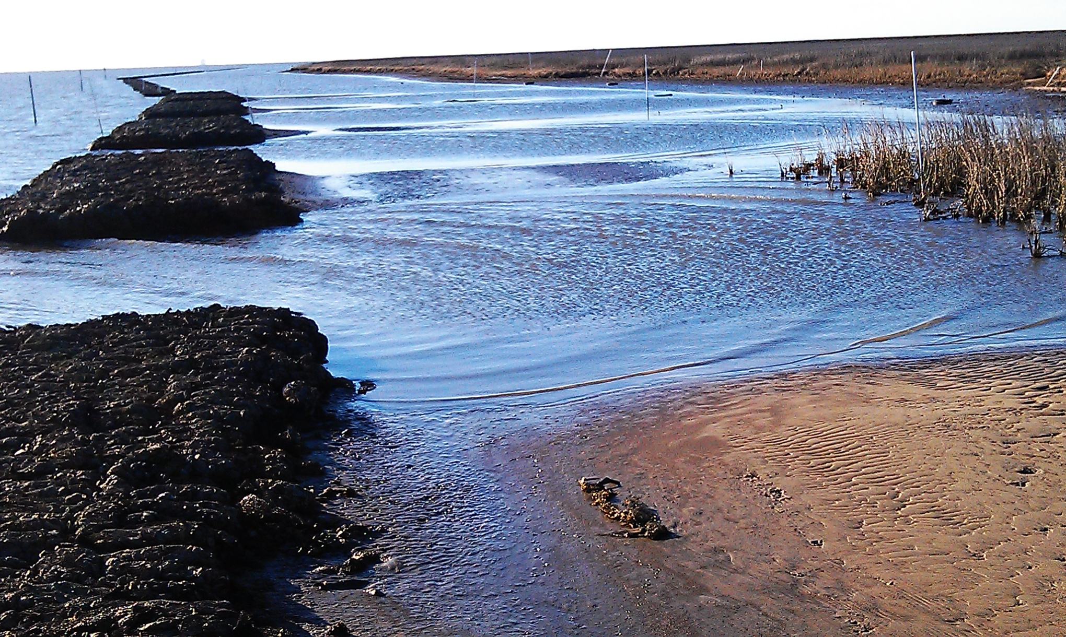
Building Environmental Resilience
Jeff DeQuattro/TNC
Notes:
This shows sediment accumulation behind some of the reefs. We’ve seen between 10-18” at the various sites. While these responses haven’t happened this fast at all of the sites, our long-term monitoring will help track how these systems do respond after more than 2 years.

Slide 7
2007
2010
2012
Notes:
This time lapse at coffee island shows another expansion of the marsh footprint. 2007

Slide 8
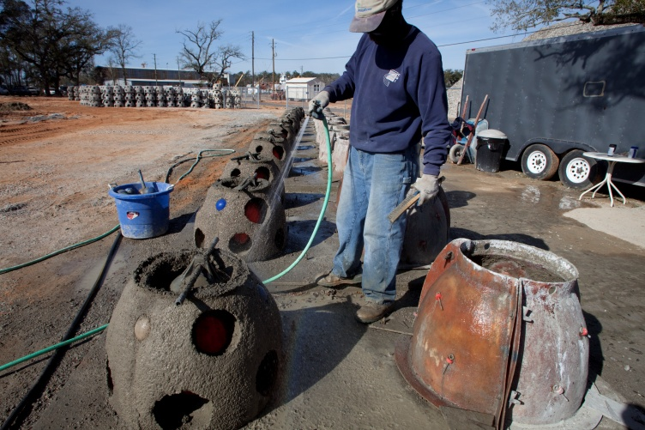
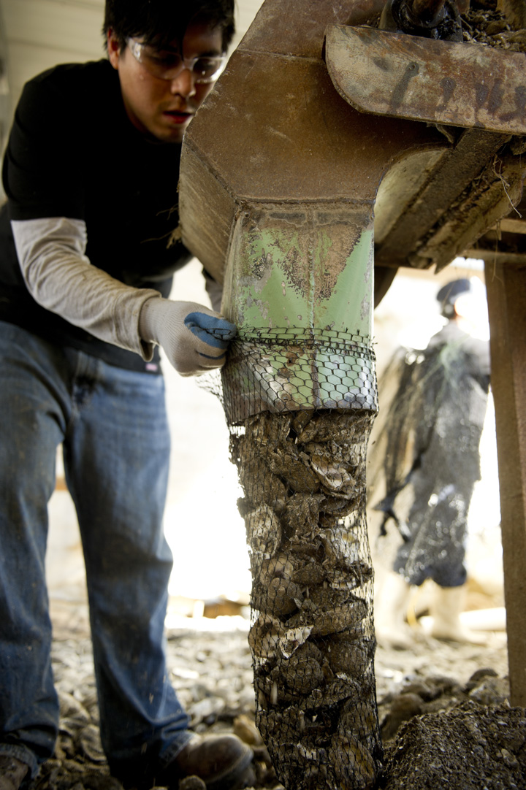
Foundation for the Economy
Reef Construction
© Beth Maynor Young
10 miles/year:
= 380 jobs, created or sustained
= $29M in revenue/sales
= ~$10M in household incomes
© Andrew Kornylak
Notes:
Over the last year, we started more proactively engaging private waterfront owners, businesses, industry and community leaders. We began an economic study of the restored reefs shortly after the oil spill and it wrapped up this spring, highlighting:

Slide 9
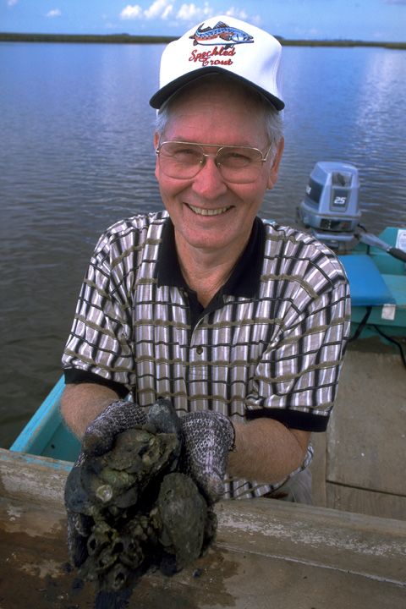
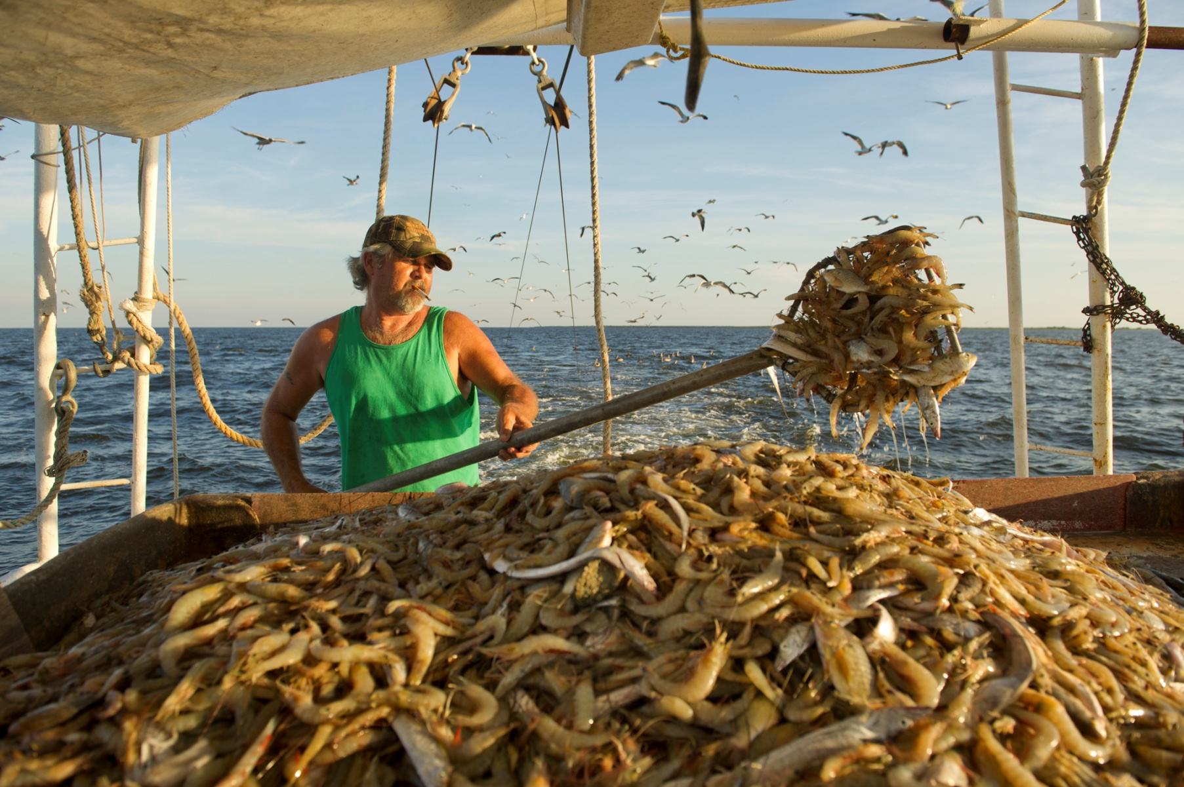
Foundation for the Economy
Commercial Fisheries
© Lynda Richardson
Fish/Crabs/Oysters:
= ~$8M in revenue/sales
= over $2M in household incomes
© Amy Vitale

Slide 10
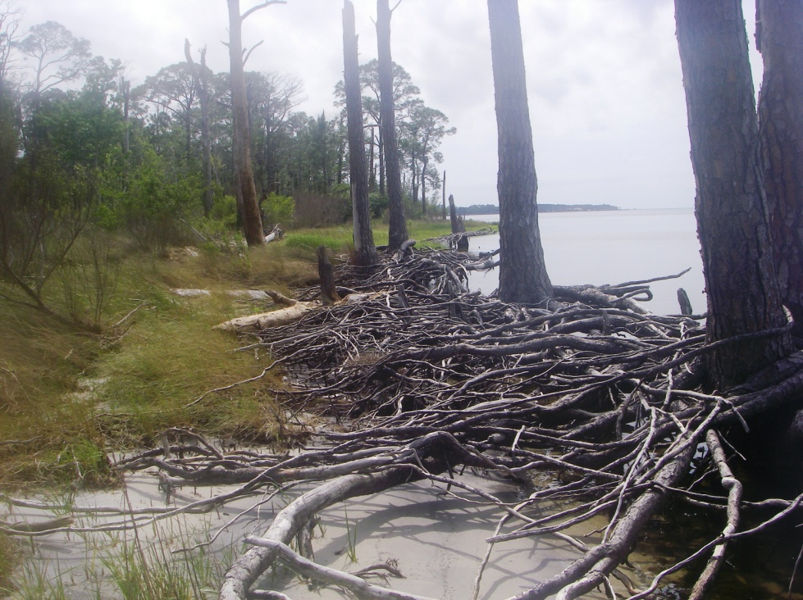
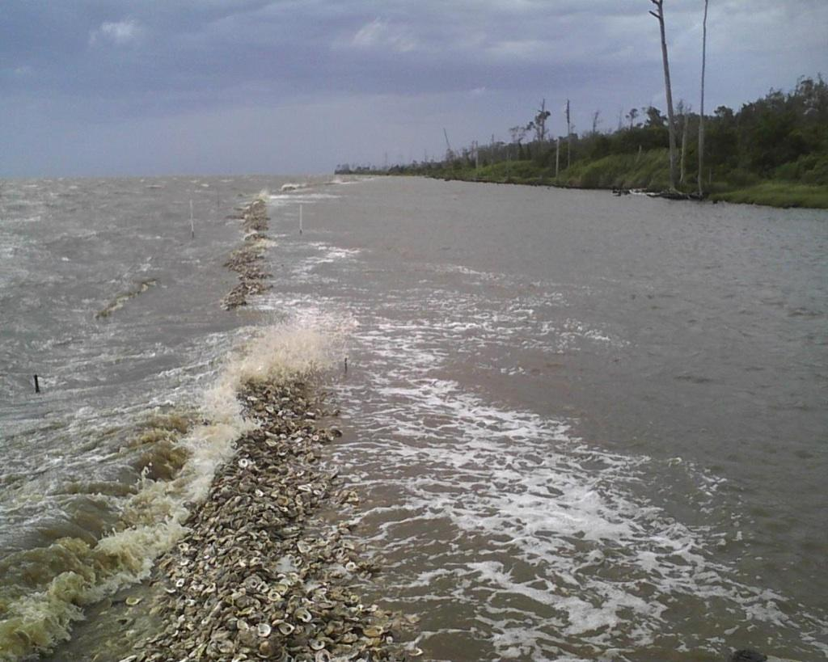
Building Resilience
Shoreline Protection

Slide 11
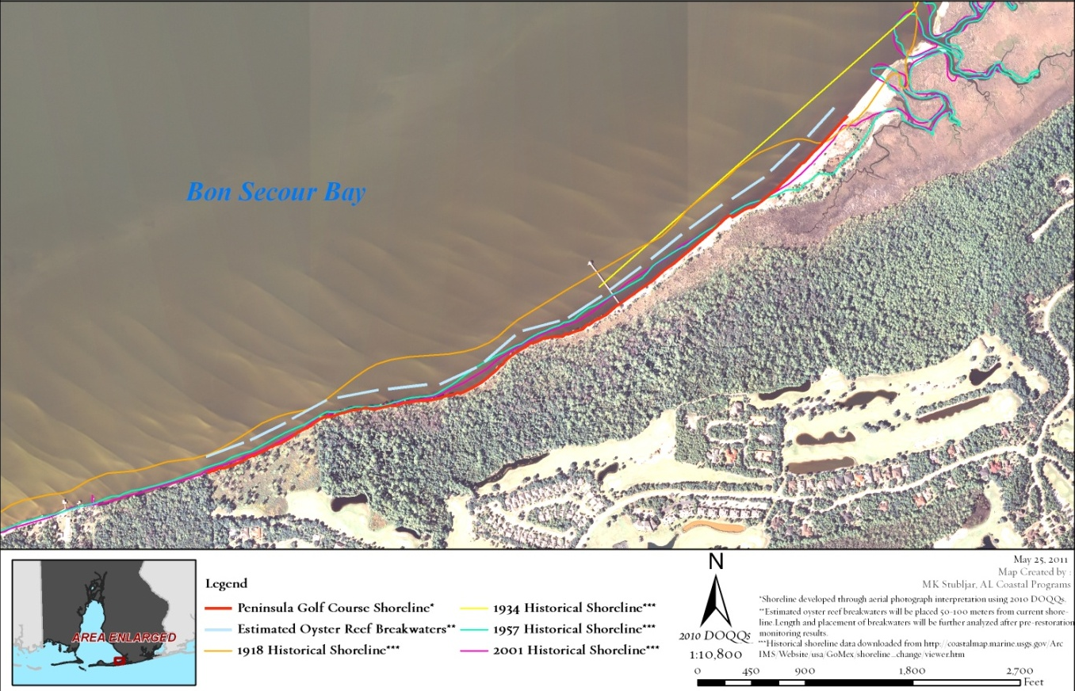
Building Resilience
Shoreline Protection
Notes:
Community resilience
Example…1 mile of shoreline
50 year time frame
erosion = 5 ft/yr
Property Loss = 30 acres = Value ~$3M
30 acres = ~23 football fields; X 600 miles for coastal AL = 18,000 acres or almost 14,000 football fields

Slide 12
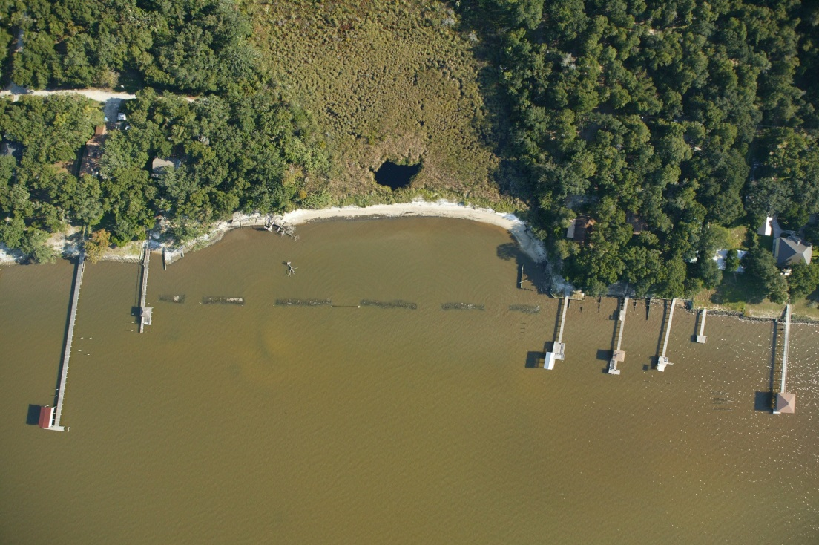
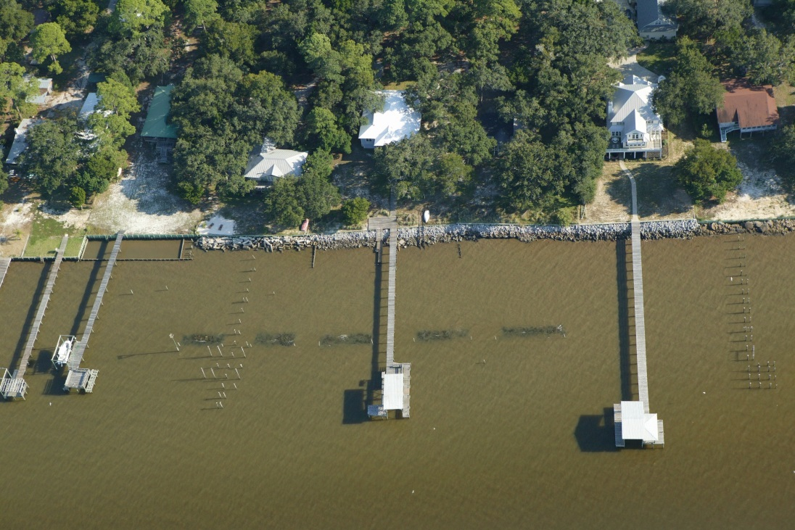
Building Resilience
Private Landowners
© JoeBay Aerials

Slide 13
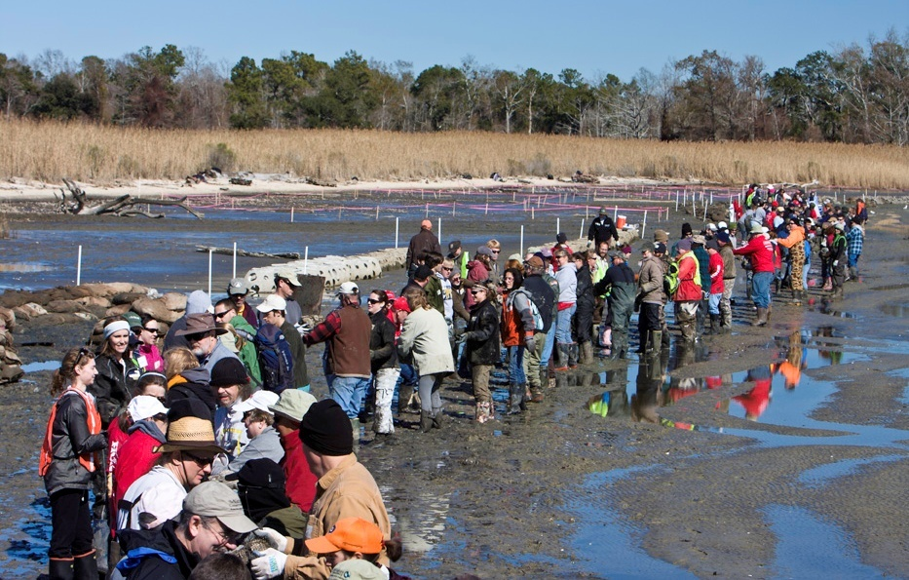
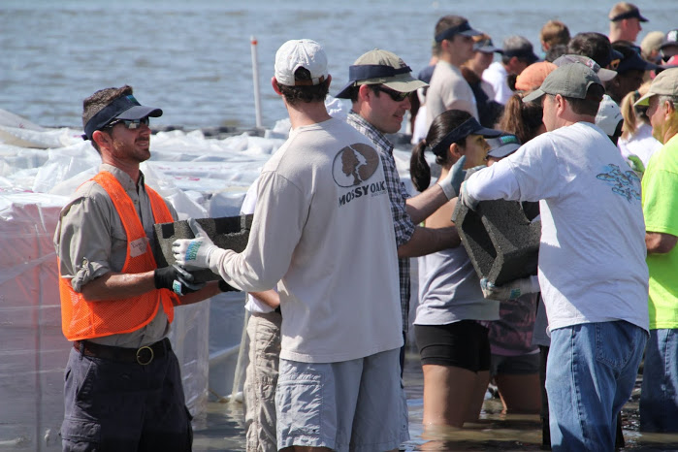
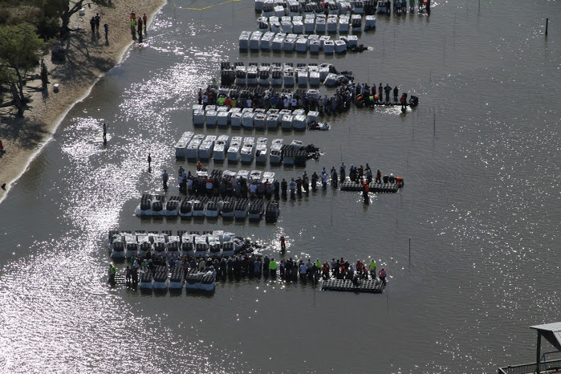
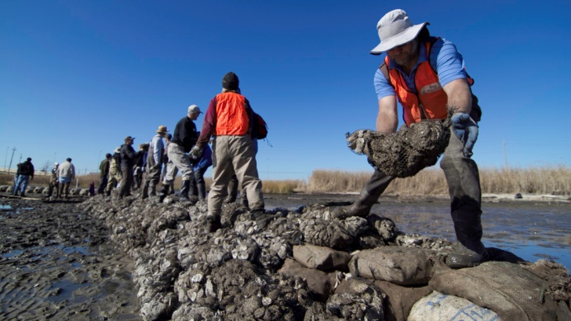
Community Engagement
© Erika Nortemann and JoeBay Aerials
January and March 2010
550 volunteers
April and May 2013
920 volunteers

Slide 14
Take Home Points
Explore All Partnerships
Federal – USFWS, NOAA, ACOE (GP)
State/Local – ADCNR, Town of Perdido Beach
Academic – Dauphin Island Sea Lab, Univ. of South Alabama
Non-traditional – Boat People SOS, Smart Home America
Private – individual landowners
Process of learning, research, implementation and adaptive management
Think outside of the box - don’t disregard less pristine areas for restoration

