Slide 1
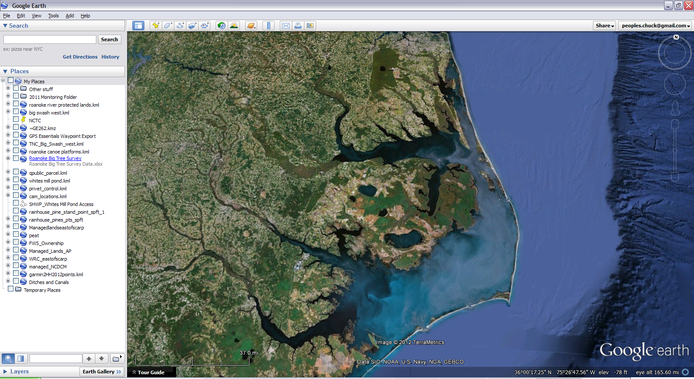
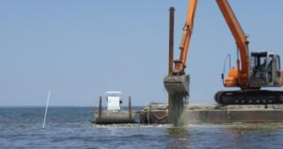
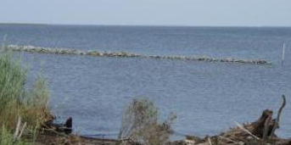
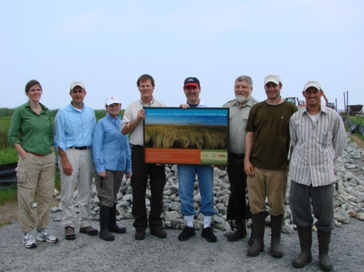

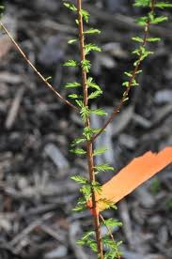
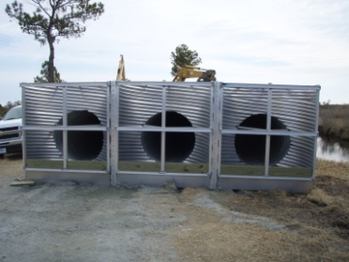
Using ecosystem restoration to build resilience into regional coastal landscapes
Notes:
Here as a spokesperson for a team and my talk is derived from the efforts of
a number of people

Slide 2
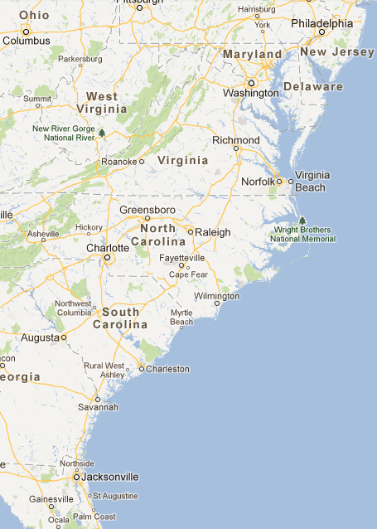
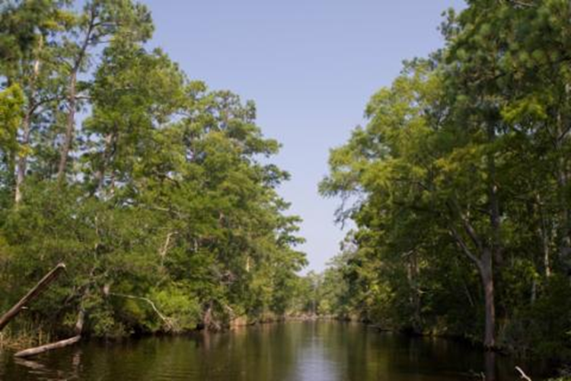
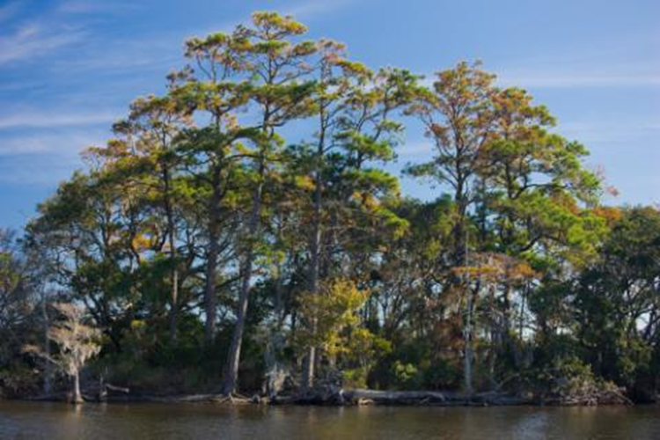
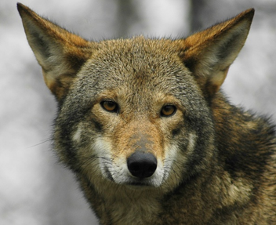
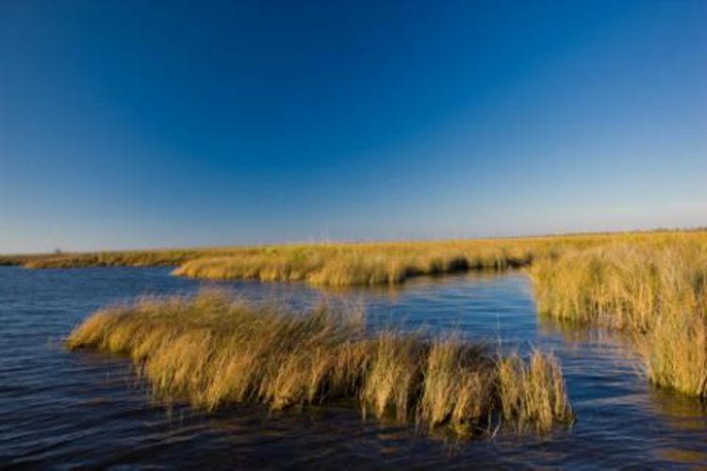
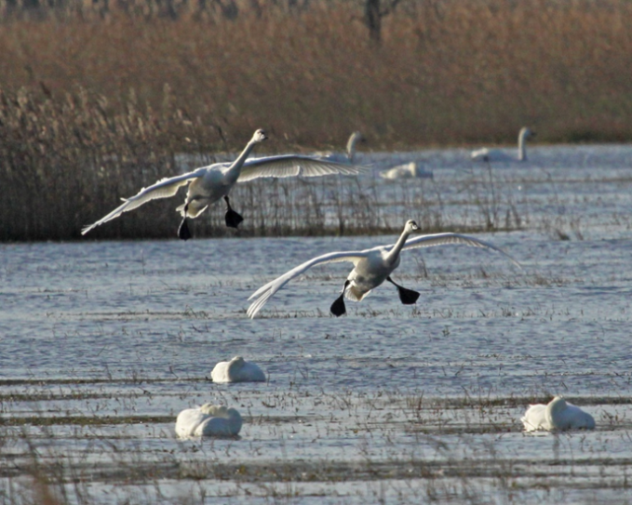
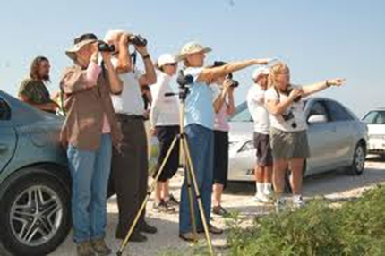
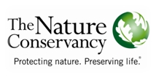
Albemarle Sound
Pamlico Sound
Notes:
We are working along the northeastern coastal plain of North Carolina, behind the Outer Banks barrier island complex. Due to very few inlets along the Outer Banks, the tidal range for the Albemarle and Pamlico Sounds is predominantly driven by winds. This area is the only place where red wolves roam in the wild, and we also have populations of the red-cockaded woodpecker and stands of rare Atlantic White Cedar, and this area supports wintering water birds such as tundra swans.
Located in northeastern corner of the state, the Albemarle-Pamlico Sound region of North Carolina is a prime example of both the importance and fragility of the land-water interface. 2nd largest estuarine complex in US, 7 sounds, largest lagoonal system on east coast, pocosin forest include globally rare Atlantic white cedar and pond-pine canebreak
Complex network of ecosystems allows the area to support amazing biological diversity, including several endangered and threatened species.
Focal point for conservation
Large floodplain forests; barrier islands, estuaries, tidal and non-tidal rivers, and extensive peat- based wetlands, primarily pocosin forests
Over 3 million people visit the area annually
15 federally listed threatened or endangered species
Over 200 species of birds, half a million ducks, swans and geese, and 80% of the Atlantic Flyway population of Tundra swans winter here
Black bear densities in this region are the highest in the east
All of the work we’re doing is part of an overall effort to try to figure out ways that we can facilitate adaption to changing climate conditions – particularly sea level rise. This region is a great place to focus our attention because there already is a large investment, on the ground, in the conservation estate, and there is wide recognition – statewide- that there is a tremendous economic multiplier related restoring and enhancing natural ecosystems. And lastly – the ecosystem co-benefits – natural. social, and economic – are significant.
Resilience - "the capacity of a system to absorb disturbance and change while essentially retaining the same basic functions, structure, and feedbacks
provisioning services like the delivery of food, fresh water, wood and fiber, and medicine - and services that are less tangible and harder to measure but equally critical: regulating services like carbon sequestration, erosion control, and pollination; cultural services like recreation, ecotourism, and educational and spiritual values; and supporting services like nutrient cycling, soil formation, and primary productivity
Impacts are Amplified by land use/management practices
Investment in conservation assets
Vulnerability of area
Economy centered on natural systems and services
Tourism, commercial & recreational fishing, storm surge protection, carbon storage

Slide 3
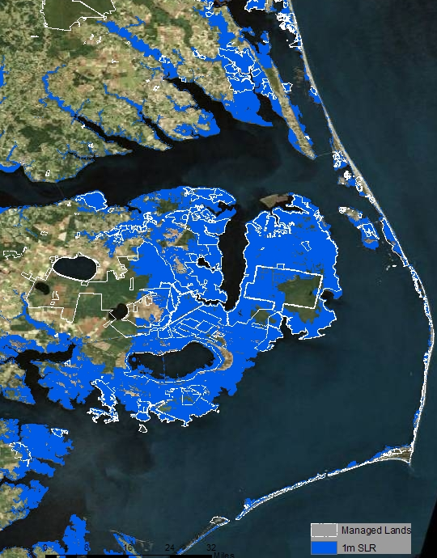
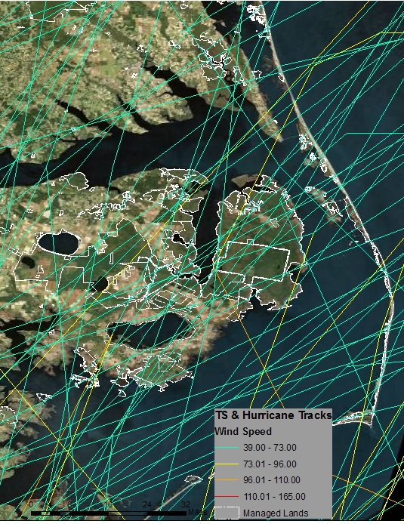
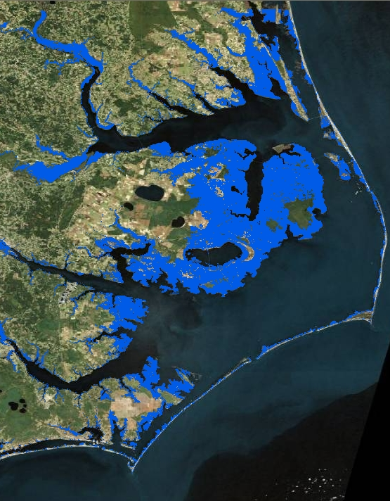
Vulnerability of the Albemarle-Pamlico Region
Extremely flat with low elevation
  Area is one of the most vulnerable regions in N. America to impacts of sea-level rise
  Over 415,000 acres of public lands lie within 1m of sea-level
Susceptible to tropical storms hurricanes and nor’easters
1M SLR, Bathtub Model
with Hydrologic Connectivity
Notes:
Much to some folks chagrin we are now informed that not only are we in an area at the higher end of the SLR rate but it is amplified due to slowing currents and eddying effects

Slide 4
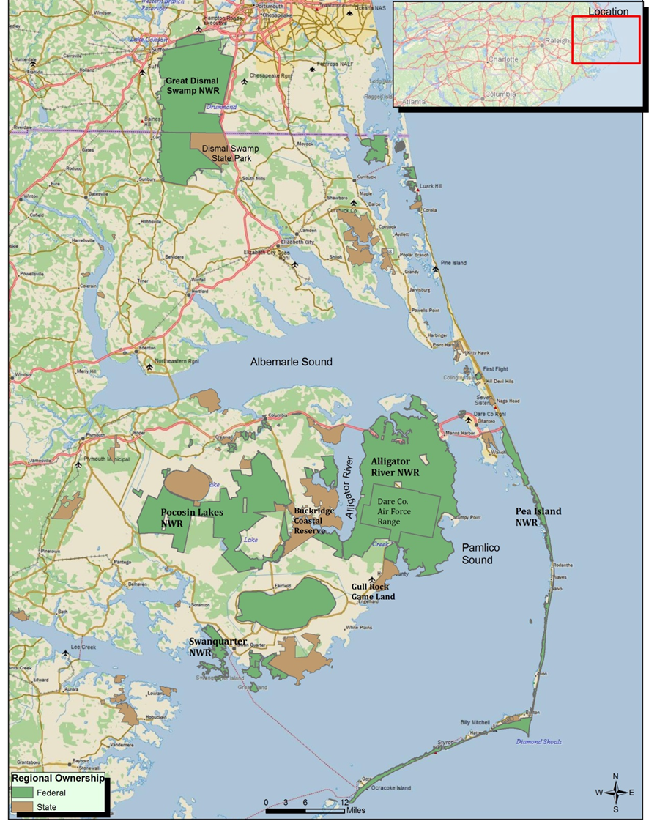
Over 665,000 acres of public managed lands
  Long-term TNC investment in regional land acquisition
Strategic partner-
  US Fish & Wildlife Service
  9 refuges, 490,000 acres
  40% of FWS ownership on eastern seaboard within this one region
Notes:
Great Dismal Swamp - 1973
Alligator River – 1984
WRC, DCM lands shown in brown
Our restoration Work initially focused on alligator river here, and we funded research with FWS and duke wetlands center here at pocosin lakes

Slide 5
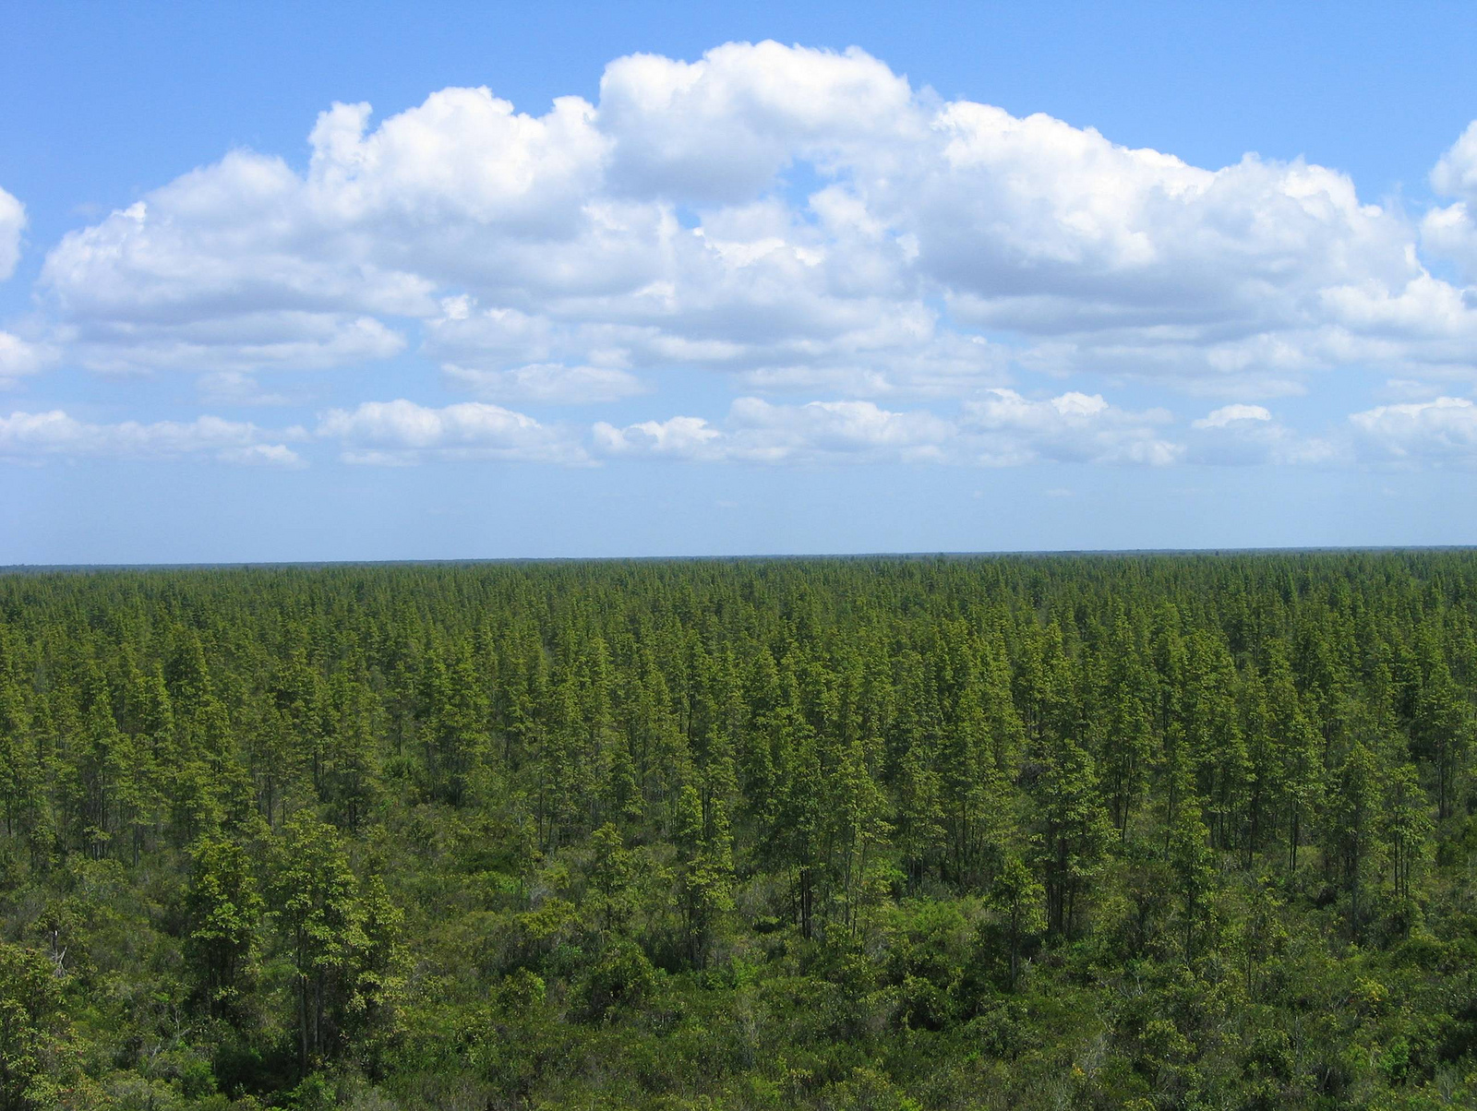
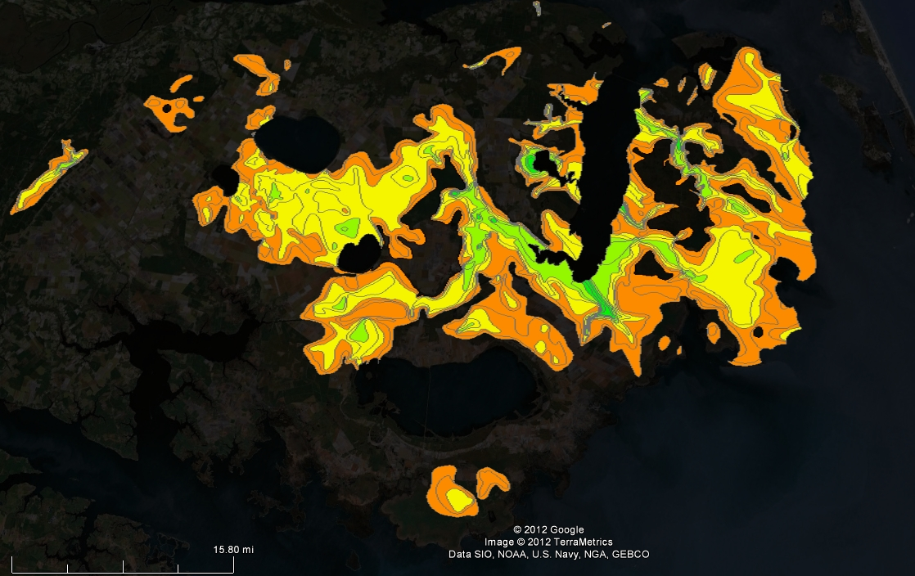
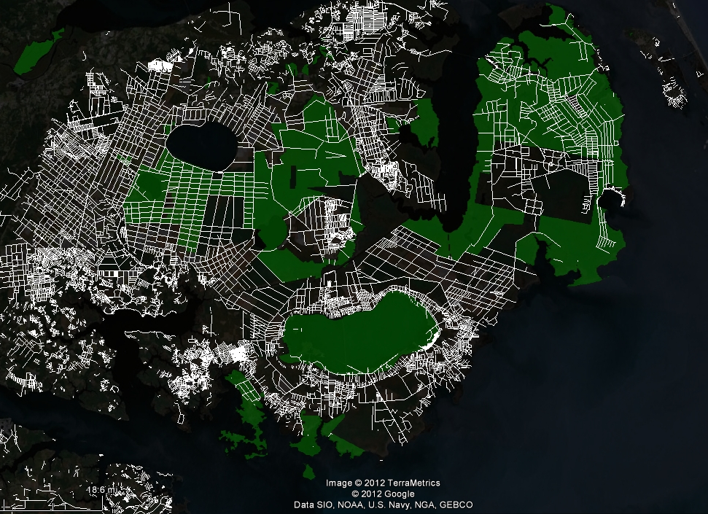
Notes:
Area dominated by pocosins, known as southeastern shrub bogs with forests of pond pines, white cedars
the chocolate-colored soils are layered with thousands of years of slowly decaying organic material.
The most precious ingredient in these pocosins, or peatlands, is the carbon-rich peat soil.
Largest deposits within this Albemarle-Pamlico region
Chemical sponges
Importantly, these wetlands have been producing peat for thousands of years and a deep peat layer has developed in this region that ranges from about 2 to 14 feet deep. The peat deposit is an important carbon sink that we are striving to protect.
200 years of ditching –man trying to carve a living out of a difficult environment. Plumbing system
Indicative why we must work at scale
Release of N and Hg
Release of CO₂ and CH₄
Incremental soil loss
Ignition
Catastrophic loss
Saltwater intrusion
Vegetation die-off/change
Soil decomposition
Subsidence & increased inundation

Slide 6
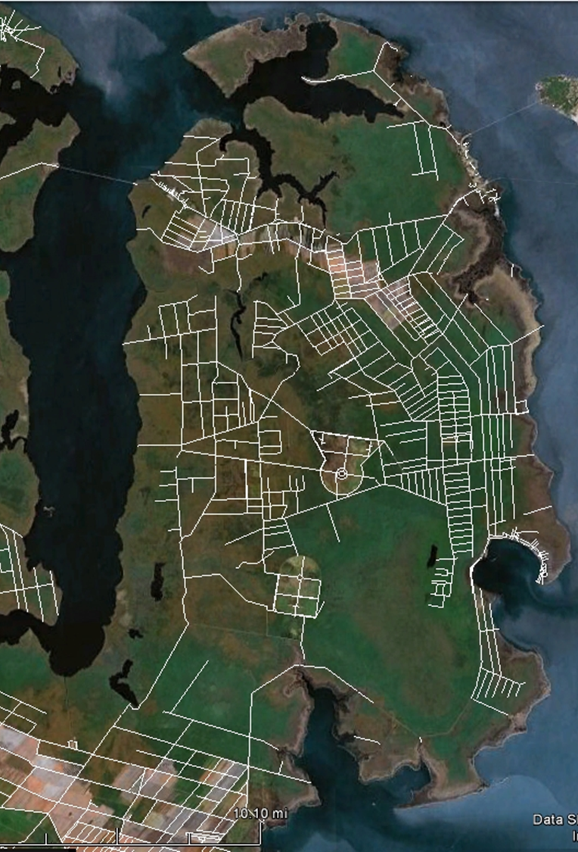
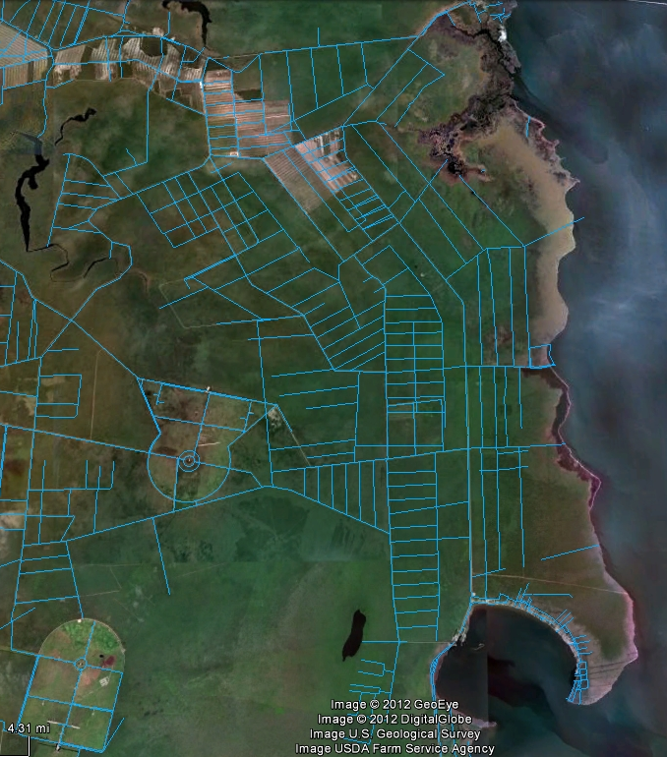
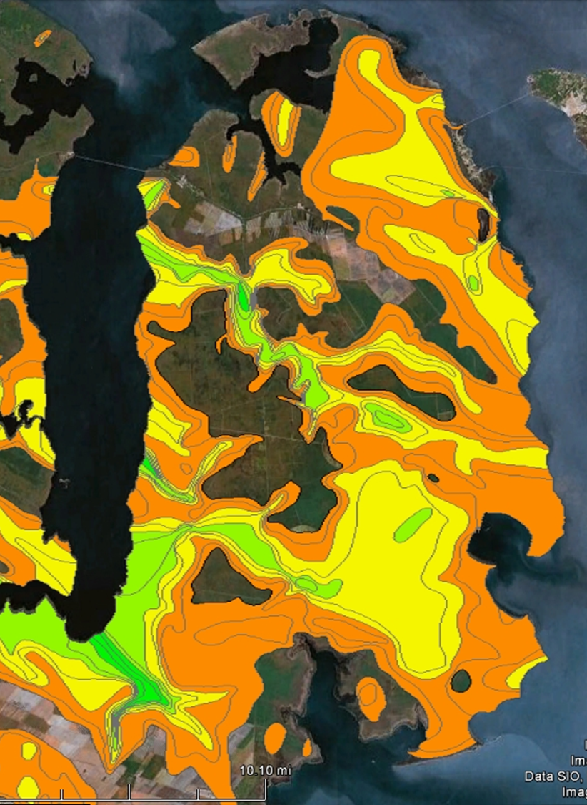
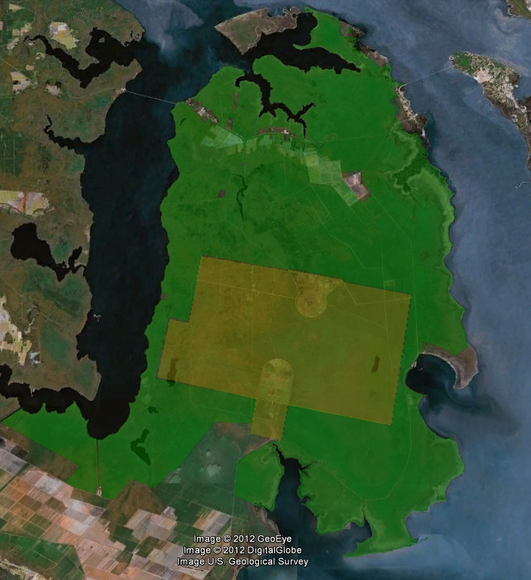
Working on the front lines:
Alligator River National Wildlife Refuge
Significant opportunities
Contiguous public lands (200k ac.) and shoreline
Hydrologic alteration via ditching
Pocosin wetlands and peat deposits
Significant impacts evident
Shoreline erosion
Saltwater intrusion
Vegetation transition
Demonstration/Pilot Project Site
Notes:
Using public lands to do this work is so important about how we have this tremendous opportunity to do an experiment that will have impacts well beyond that site – that is a unique opportunity we don’t’ have in many places:
private landowners usually not willing to let their places be used as an experiment
Rarely have areas this large
Rarely have opportunity to work at very large scales across the region – i.e. multiple refuges

Slide 7
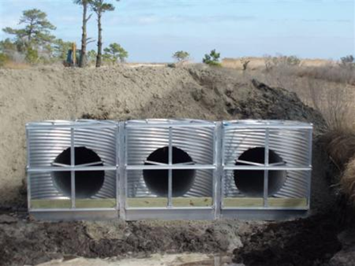
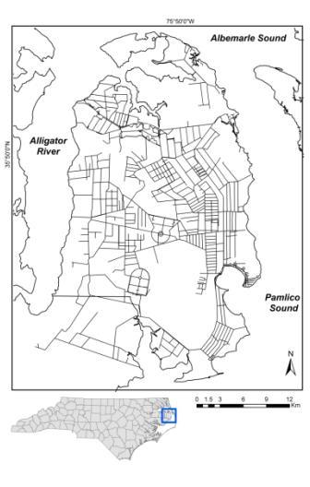
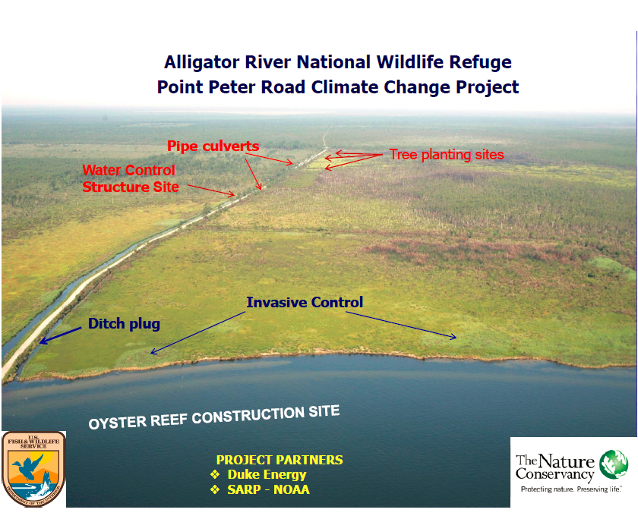
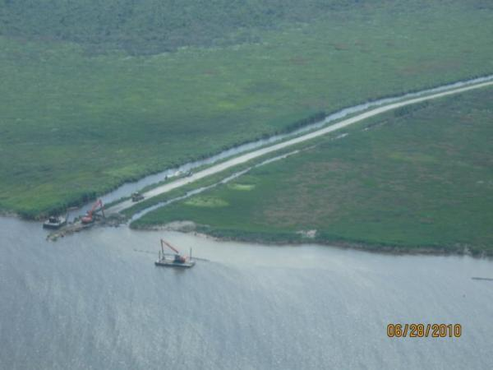
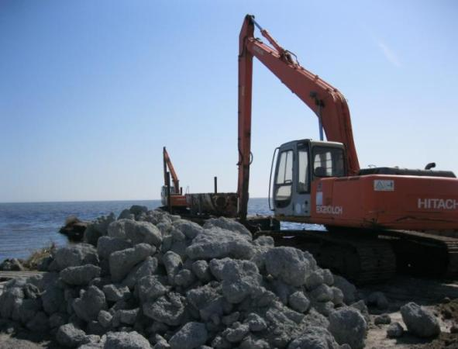
Point Peter Road
Demonstration Site
Notes:
Our natural solutions are based on coastal adaptation approaches that have measureable, expected outcomes. Our first solution was to restore natural hydrology. To accomplish this, we constructed a water control structure that was expected to prevent salt water intrusion. We have also installed ditch plugs to reduce drainage and prevent low dissolved oxygen plumes. Our second solution is to construct oyster reefs with marl (chunks of limestone) and bagged oyster shells. These reefs are expected to reduce erosion and provide habitat for a diverse array of organisms. Finally, our third solution is to facilitate ecosystem transition by establishing vegetative plantings that are either flood and/or salt tolerant. We expected to establish native tree species, which in the long term would accrete biomass and provide desired habitat.
Our natural solutions are based on coastal adaptation approaches that have measureable, expected outcomes. Our first solution was to restore natural hydrology. To accomplish this, we constructed a water control structure that was expected to prevent salt water intrusion. We have also installed ditch plugs to reduce drainage and prevent low dissolved oxygen plumes. Our second solution is to construct oyster reefs with marl (chunks of limestone) and bagged oyster shells. These reefs are expected to reduce erosion and provide habitat for a diverse array of organisms. Finally, our third solution is to facilitate ecosystem transition by establishing vegetative plantings that are either flood and/or salt tolerant. We expected to establish native tree species, which in the long term would accrete biomass and provide desired habitat.
Some of the strategies include building oyster reefs to break down wave fetch and reduce shoreline erosion – in some areas we were losing five meters a year to wave energy and storms. We are also proposing to restore natural hydrology to reduce the oxidation of organic soils (peat) and also the threat of catastrophic wildfire. We are accomplishing this through our work with partners on the ground to restore important habitat and make key landscape connections through strategic land acquisition.
Construction of nearshore oyster reefs
Establishment of submerged aquatic vegetation
Maintenance and enhancement of marsh buffers
Planting salt- and flood-tolerant vegetation (e.g. bald cypress)
Installation of water control structures or plugging ditches
Identify climate resilient tracts for connectivity between conservation lands and corridors for wetland migration
Water control structure
Flashboard risers
Tideflex check valves
Three culverts under the road to connect wetland areas
Completed March 2011
Sheet pile ditch plug
Secondary drainage ditch
Completed December 2010
Marl (limestone)
400 linear feet
Reefs installed June 2010
Oyster shell bags
400 linear feet
Reefs installed December 2010/February 2012
First and foremost, great colonization and oyster survival
During past year of measurements
No oyster reefs:
13.8 feet per year
Marl or shell bag oyster reefs:
5.6 feet per year
Estimate of C loss from shoreline, 400’ wide
No oyster reef: 72 C t/yr
Marl or shell bag: 29 C t/yr

Slide 8
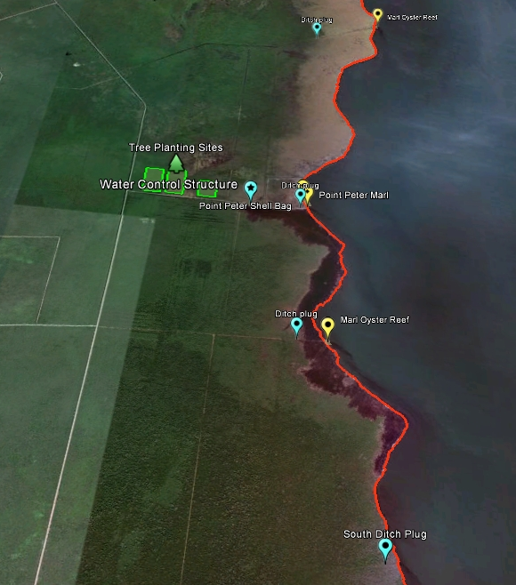
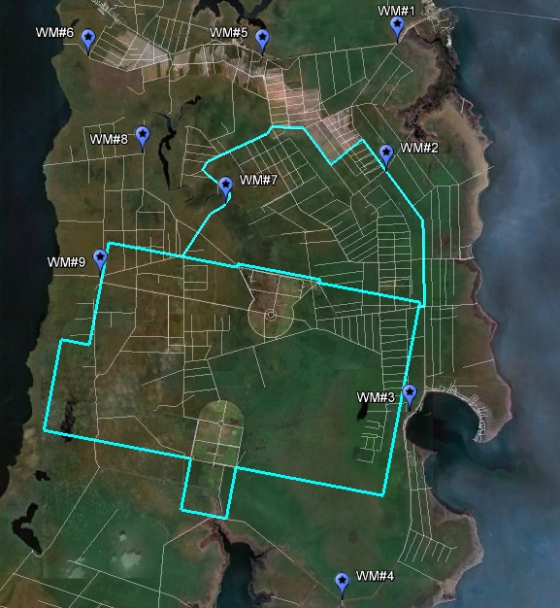
Expansion of efforts
Restoration of secondary ditches
Expansion of marl oyster reefs
11 miles of shoreline hotspots addressed
Large scale water monitoring network
Partnership for resilient coastal ecosystems: U.S. Fish and Wildlife Service
  MOU for Nine coastal refuges
Notes:
11 miles of shoreline
800’ of reefs at point peter
2 additional 200’ reefs

Slide 9
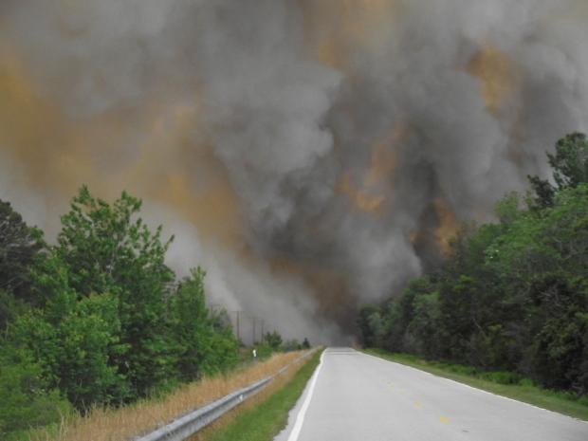
Nothing like a Catastrophic Wildfire to generate interest….
Pains Bay Fire (2011)
  45,294 acres
  Lasted 120 days
  Cost $14,000,000
  5,529,088 tons of carbon lost to the atmosphere
Notes:
In addition, catastrophic wildfires are a major threat to the very flammable peat layer. Often started by lightning strikes, these fires disrupt traffic, military operations, and pose a threat to human health and safety. In 2011, the Pains Bay Fire occurred on the southeast peat dome of ARNWR and lasted for four months, burning over 45,000 acres. This fire cost $14 million to fight and we lost 5.5 million tons of carbon to the atmosphere. And while wildfires are important part of these ecosystems, the size and severity is not typical and unfortunately, we’ve had similar sized fires at Pocosin Lakes and Great Dismal Swamp NWR.

Slide 10
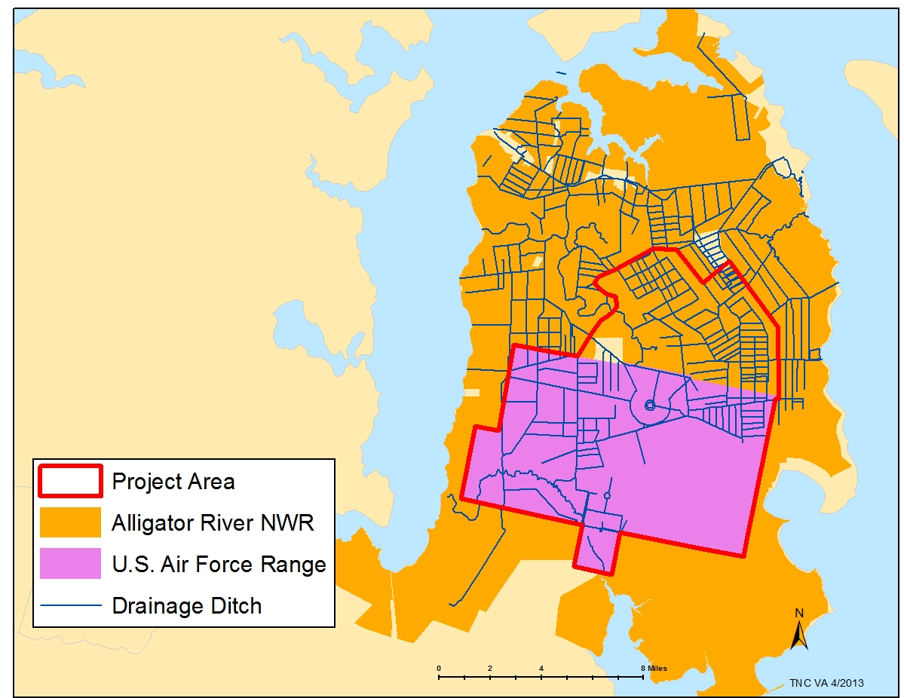
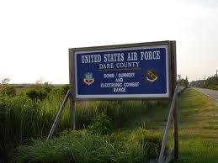
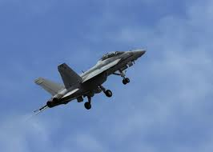
Integrated Hydrological Management Planning
TNC / FWS / DoD
65,000 Acres
$520K

Slide 11
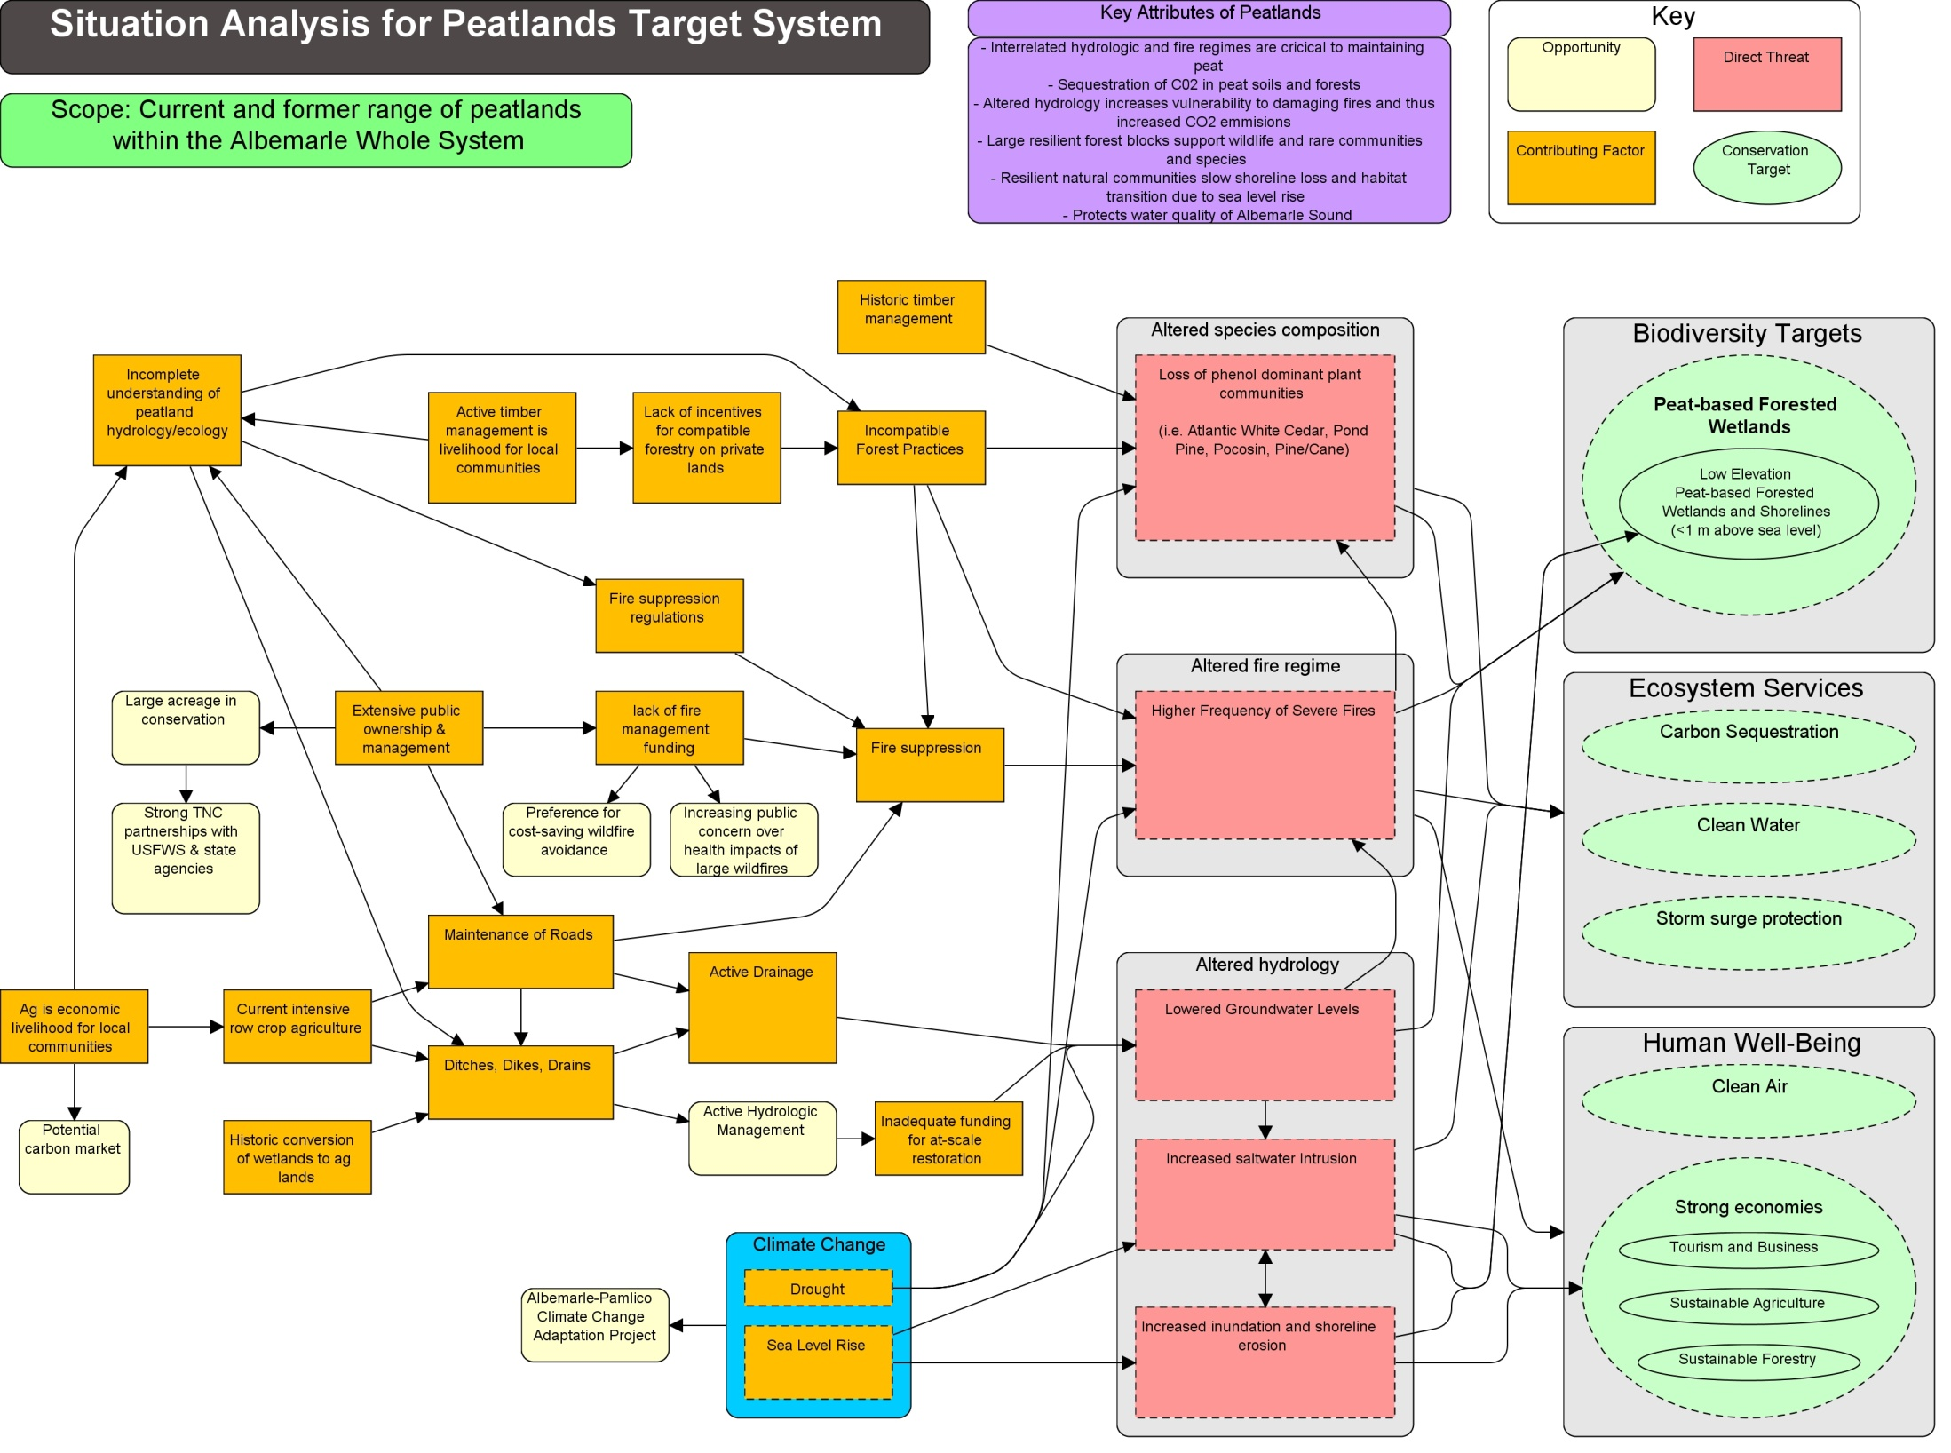
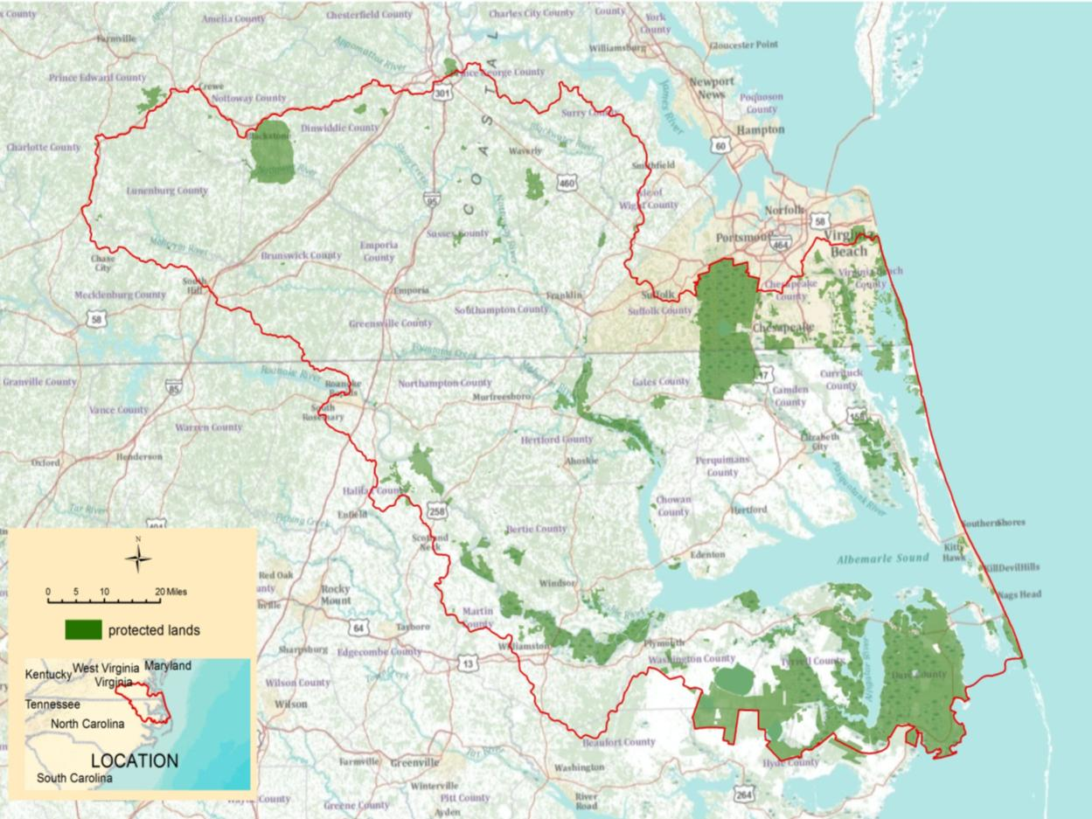
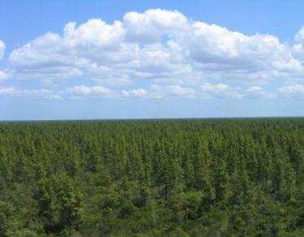
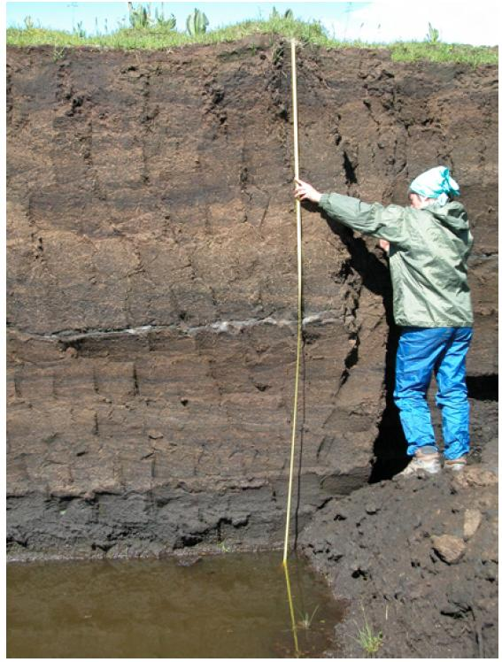
Albemarle Sound Whole System - Peatlands
Dismal Swamp NWR/SP:
126,000 ac.
Alligator River NWR:
154,000 ac
Peat soil profile
Pocosin Lakes NWR:
110,000 ac
Notes:
ASWS planning
Peatland pocosin meeting
2 regions, etc

Slide 12
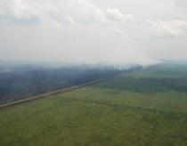
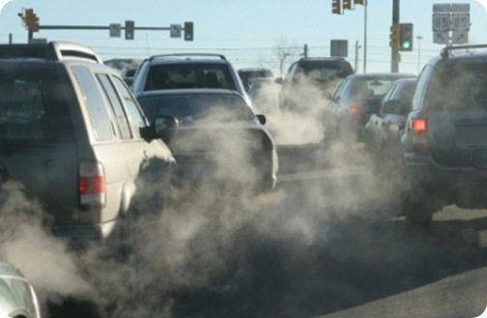
Regional costs of drainage and catastrophic fires
4 Pocosin Forest Wildfires from 2008 - 2011
  97,000 acres
  20 million metric tons of carbon released
  $57 million in suppression costs
  567 days from ignition to out
Estimated that the 20 million metric tons of carbon released in four fires would equate to annual greenhouse gas emissions from over 14,000,000 passenger vehicles
Notes:
During previous four year period (2008 and 2011) four expensive, long duration fires on the three large peatland refuges in this landscape
Over 97,000 acres, put approx., 20 million metric tons (or some other metric) of carbon into the atmosphere,
cost $58 million,
and took 562 days to manage.
Had the proposed peatland restoration already been delivered on the landscape thousands of acres of habitat could have been protected, tons of carbon would have remained sequestered, millions of dollars would have been saved, and thousands of hours of staff time could have been proactively directed.
We estimate that the 20 million metric tons of carbon released in four fires would equate to annual greenhouse gas emissions from over 14,000,000 passenger vehicles or annual CO2 emissions of 17 coal fired power plants.
– this chart indicates 1450 tons per hectare – significantly more that temperate forests at 320 tons per hectare – recent studies indicate that conservation of soil carbon has great potential to mitigate CO2 emissions. That’s why carbon registries such as the Climate Action Reserve and the Voluntary Carbon Standard are emphasizing protocol development for peatlands in particular and wetlands in general- and we need to participate in that process.

Slide 13
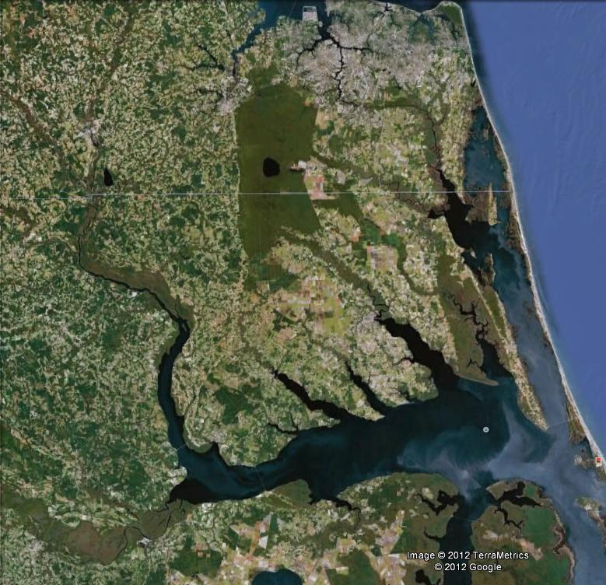
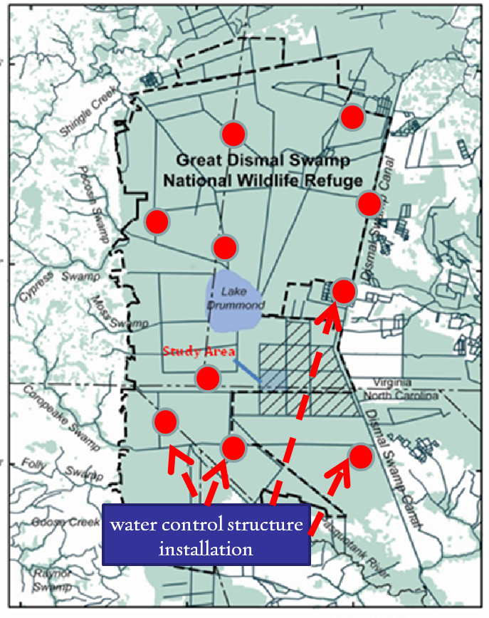
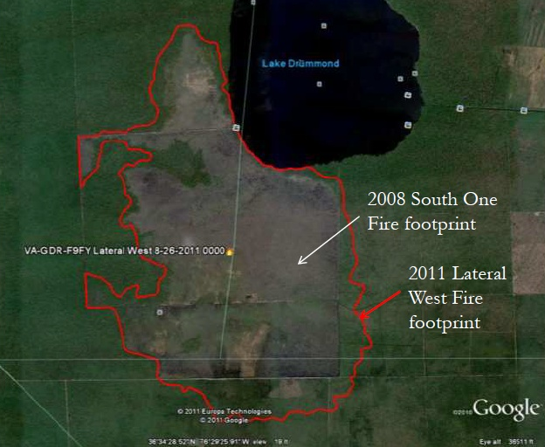
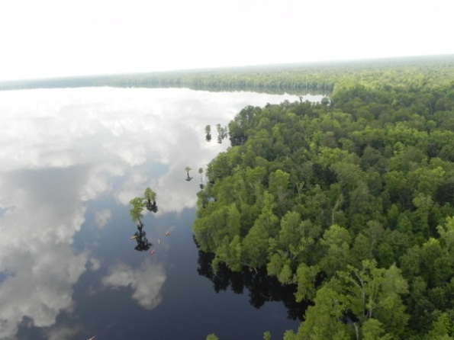
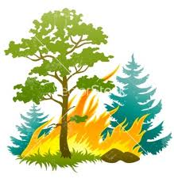
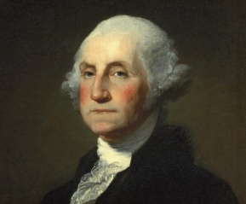
Regional Scaling up – Great Dismal Swamp
Hampton Roads Metro Area
~ 1.6 million residents within 30 miles of Dismal Swamp
Great Dismal
Swamp NWR
Predicted fire return interval: 50 yrs; Actual: 3 years
Albemarle Sound
Notes:
GDSNWR 112,000 acres, important freshwater supply into Albemarle Sound
Large peatland impacted by drainage. Large-scale drainage efforts began under George Washington in late 1700’s with goal of conversion to rice plantation. Now 150 miles of ditches and drains. GDS on the edge of Hampton Roads metro area – 1.6 million residents within 30 miles. 2 fires within past 4 years in areas fire ecologists expect to burn every 50 years. Most recent fire was 6,000-acre Lateral West fire in 2011. Severe fire – consumption of up to 3 feet of peat. Would likely not have been extinguished without 12 inches from Hurricane Irene. Concern that such fires will repeat and possibly larger with even greater smoke/air quality impacts. Can’t count on hurricanes to put them out.
TNC working with FWS to develop and implement hydrologic management plans. Installation of WCS in strategic sites. Nearly complete in 6,000-acre area southeast of Lake Drummond;

Slide 14
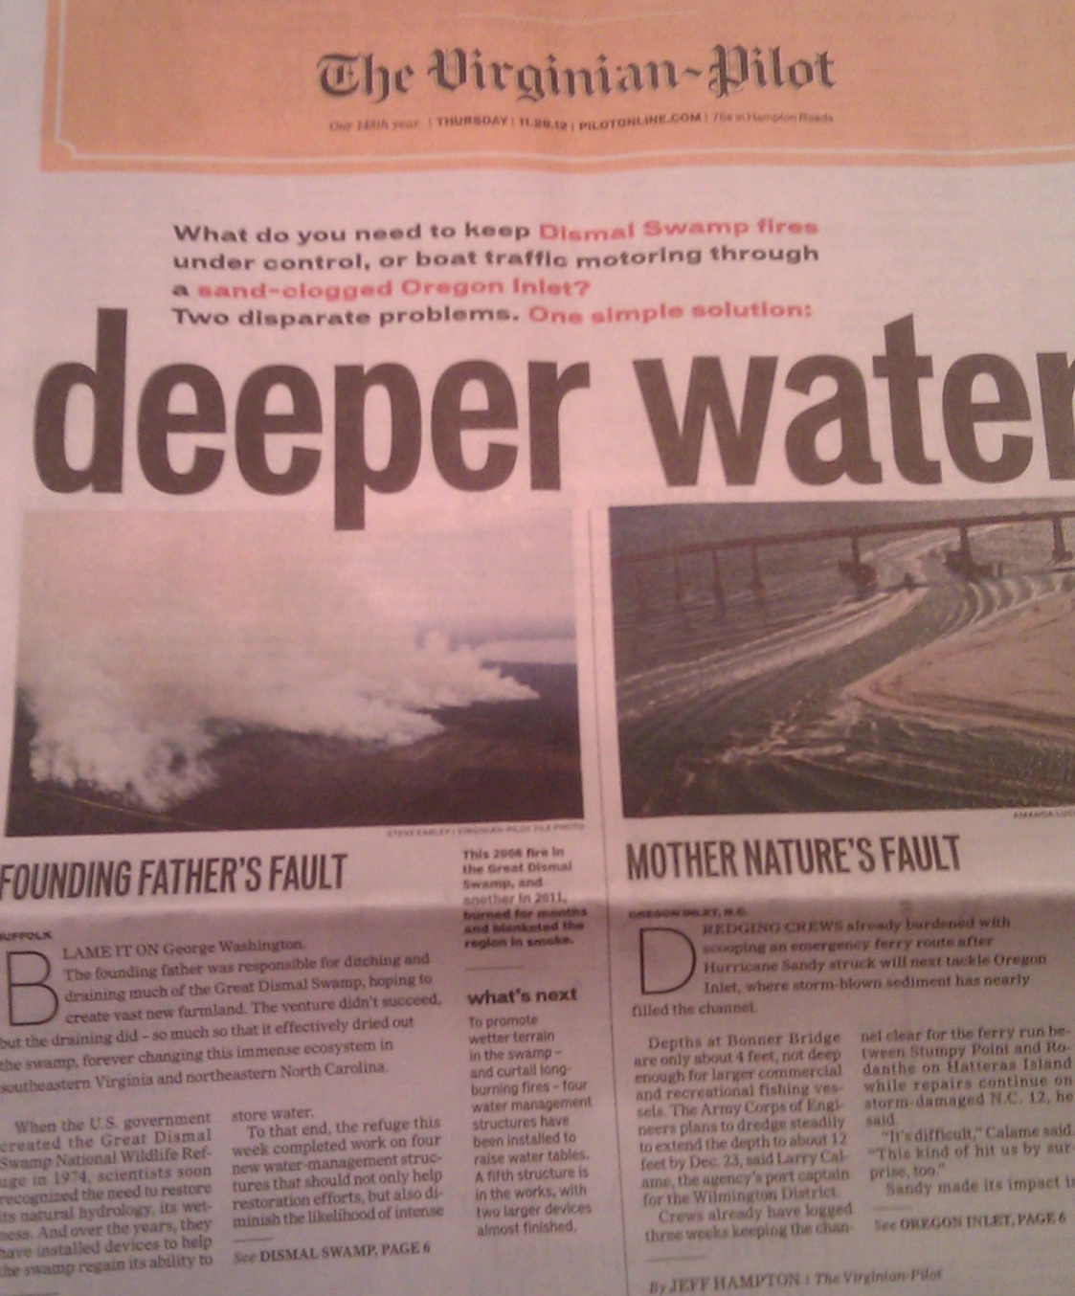
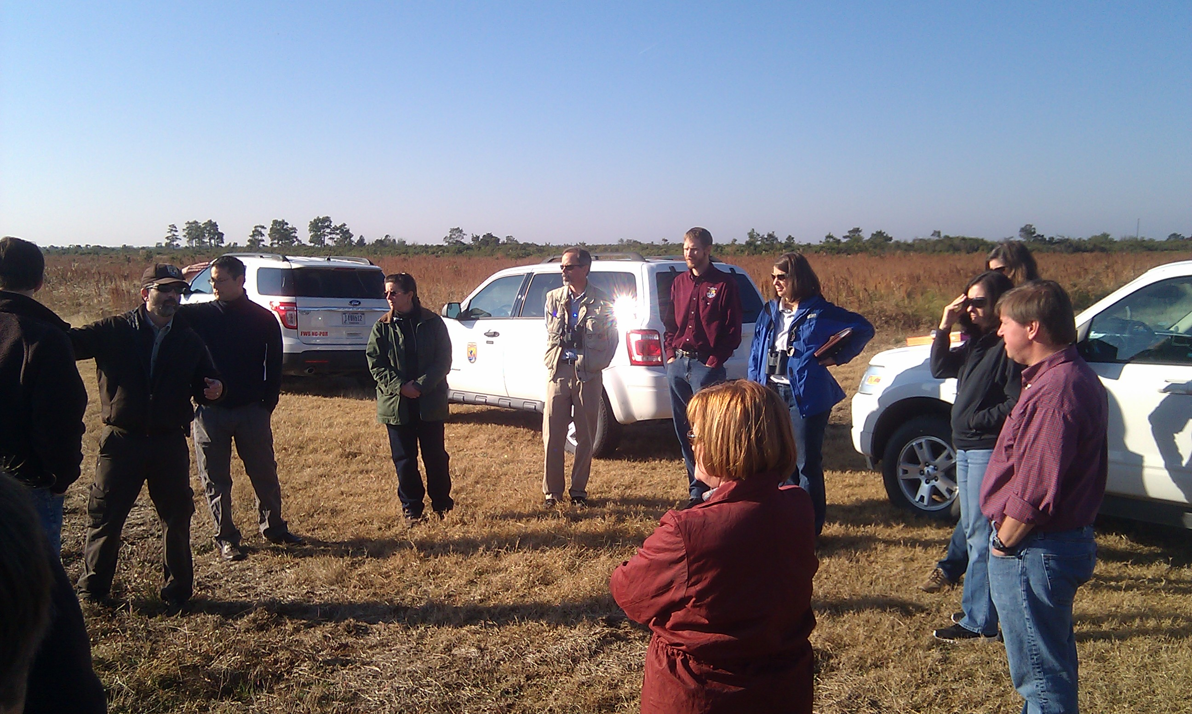
Peatlands Convening

Slide 15

Moving the needle
Creating Opportunity - Peatland carbon restoration
    Collaboration with refuges and ecological services staff
  Regional feasibility analysis
  VCS Peatland re-wetting methodology
  Proof of concept project

Slide 16




Where to from here…
Even with responsible conservation partners, we are in essence managing their land (our land legacy).
    Science to drive project development;
    Demonstration and monitoring driving broader awareness and management application;
    Shift to where future plans, budgets and policy instill and incentivize restoration actions
Notes:
Move from our actual implementation to a policy and agency priority

Slide 17

Acknowledgements
Funding
Duke Energy
Albemarle-Pamlico National Estuary Program
FWS Cooperative Agreement
DOD - USAF
TNC-NOAA Community-based Restoration Program
SARP-NOAA Community-based Restoration Program
FAF-NOAA Community-based Restoration Program
Wildlife Conservation Society Wildlife Action Opportunities Fund
Grady-White Boats
Private donations
The Nature Conservancy:
Christine Pickens, Aaron McCall, Kate Murray, Brian Boutin, Brian van Eerden
USFWS:
Mike Bryant, Dennis Stewart, Scott Lanier, Chris Lowie, Bruce Creef, Howard Phillips, Sara Ward
Notes:
APNEP grant of significance – 2 refuges, 1 state park

Slide 18

For more information: cpeoples@tnc.org

