Slide 1
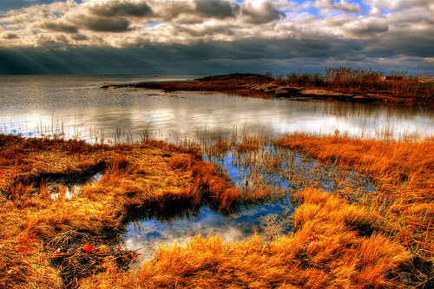
Building Coastal Resilience for
Climate Adaptation & Disaster Risk Reduction
Dr. Michael Beck
The Nature Conservancy &
Univ. of California Santa Cruz
www.nature.org &
www.coastalresilience.org

Slide 2
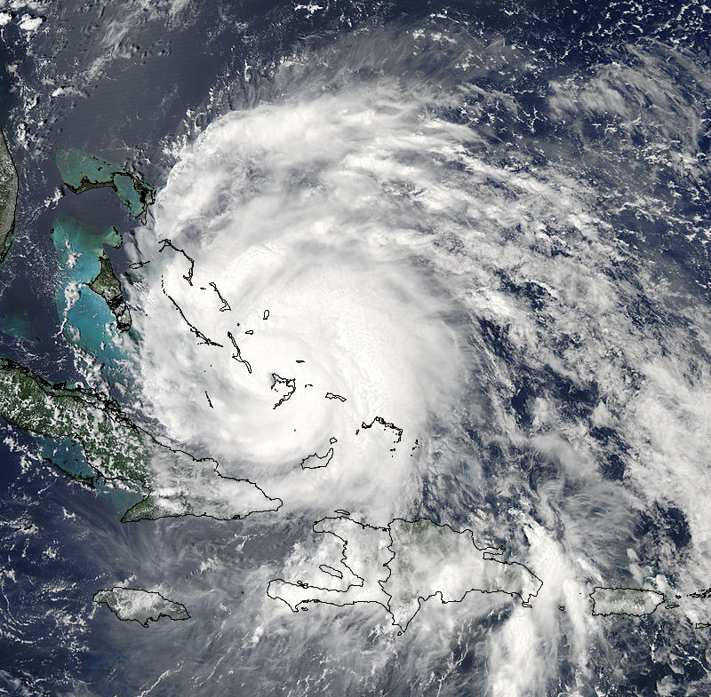
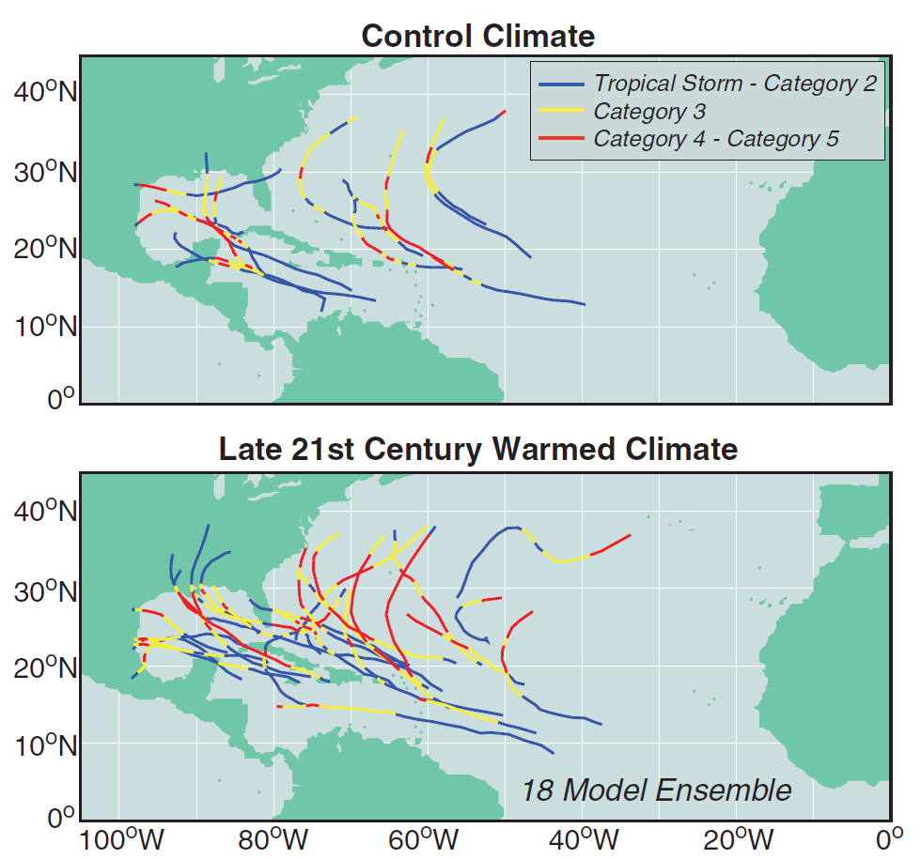
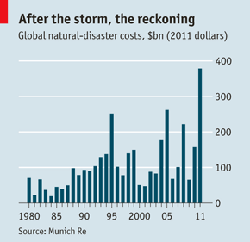
Storm Hazards Are Real Now & Rising
Bender et al 2010, Science
Notes:
There is limited agreement on the basic definitions of risk and vulnerability both within and between the disaster risk reduction and climate change adaptation communities (Renaud and Perez 2010). Following Shepard et al. (2011) : ‘‘vulnerability’’ is the susceptibility of both biophysical and social systems to a ‘‘hazard,’’ which is an event or occurrence that has the potential to cause harm to people and/or property. ‘‘Risk’’ is the likelihood or probability of such harm.

Slide 3
Meeting Multiple Management Objectives
Risk Reduction
Objectives
Conservation Objectives
Susceptibility, Sensitivity
Exposure, Adaptive Capacity
Representation, Redundancy,
Resilience
New Priorities & Actions
Notes:
Total vulnerability is a result of these things
Understanding and reducing vulnerability will help build resilience
Vulnerability determined by physical, social, econ, and environ factors, which increase the
susceptibility of a community to the impact of hazards. (Renaud DRR)
Vulnerability is the degree to which a system is susceptible to, and unable to cope with CC. Vulnerability is a function of the
character, magnitude, and rate of climate change and variation to which a system is exposed, its sensitivity, and its adaptive capacity.
By resilience, we mean both the ability to resist changes (maintain similar states) and to bounce back or return to similar states after perturbations.

Slide 4
Coastal Resilience aims to reduce socio-economic & ecological risks of coastal hazards
Thru Restoration & ReDevelopment
The Coastal Resilience approach:
1. Assess Risk
2. Identify Solutions
3. Take Action
4. Measure Effectiveness
9:00 on Thurs
Notes:
There is limited agreement on the basic definitions of risk and vulnerability both within and between the disaster risk reduction and climate change adaptation communities (Renaud and Perez 2010). Following Shepard et al. (2011) : ‘‘vulnerability’’ is the susceptibility of both biophysical and social systems to a ‘‘hazard,’’ which is an event or occurrence that has the potential to cause harm to people and/or property. ‘‘Risk’’ is the likelihood or probability of such harm.

Slide 5
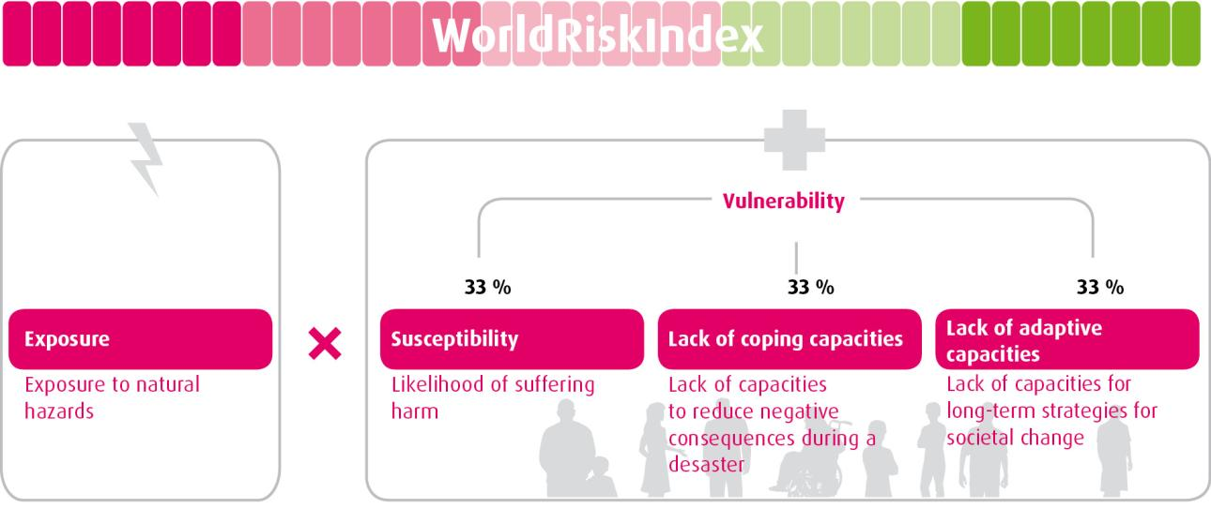
Components of the WorldRiskIndex

Slide 6
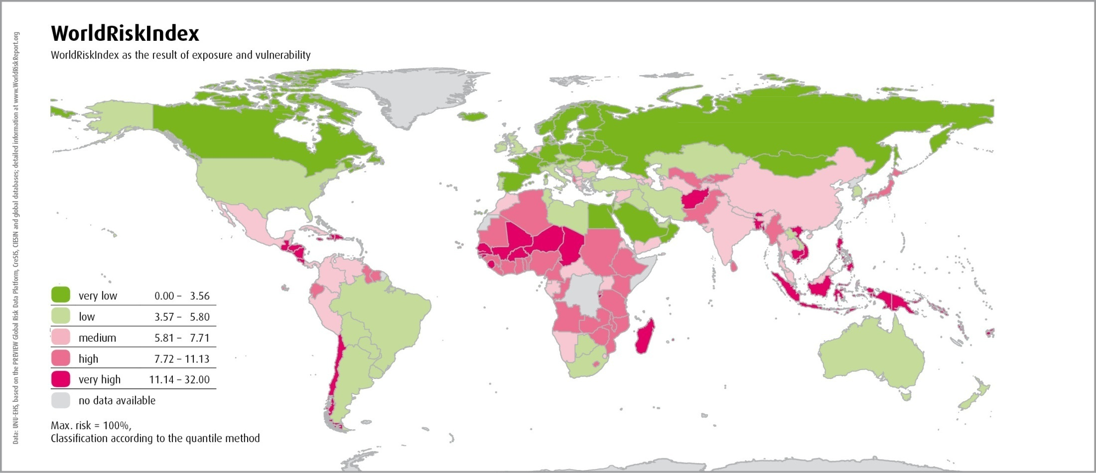
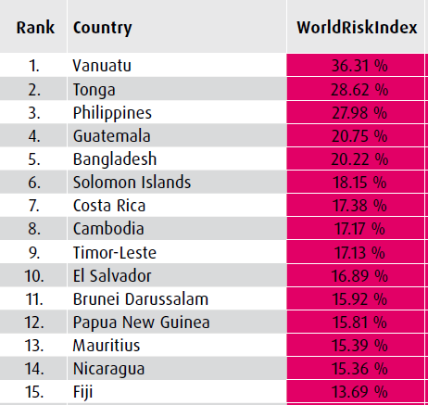
Results for the WorldRiskIndex

Slide 7
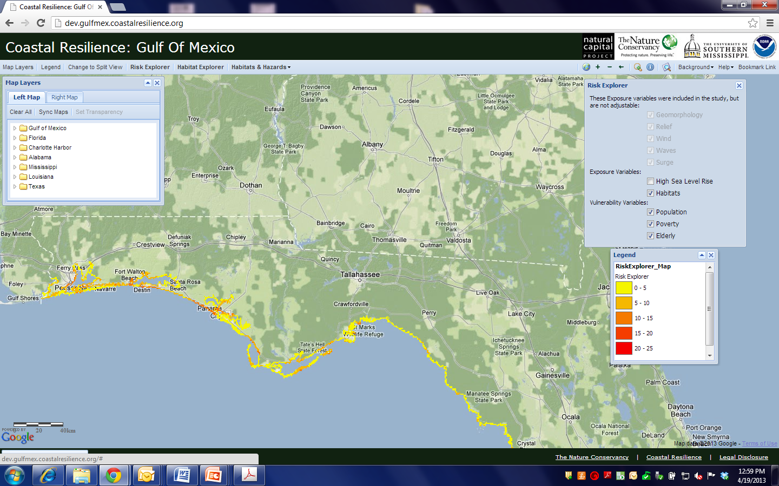
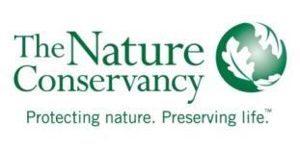

Gulf Coast Risk Assessment
www.gulfmex.coastalresilience.org

Slide 8
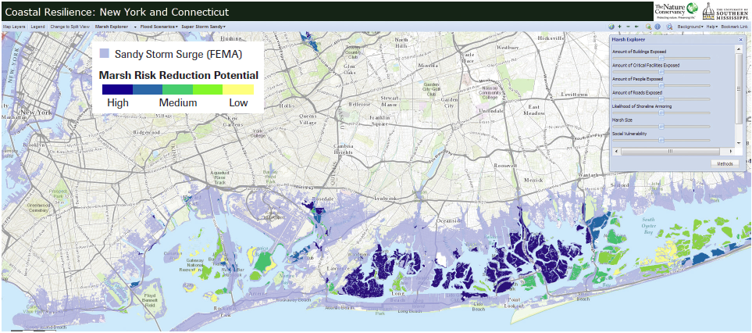
Assessing Solutions: Which marshes might provide the most risk reduction benefits in NY and CT
Socio-Economics Behind Marshes
$19 billion in building replacement costs
321,000 people
1,700 miles of roads
138 critical facilities
www.LIS.coastalresilience.org

Slide 9
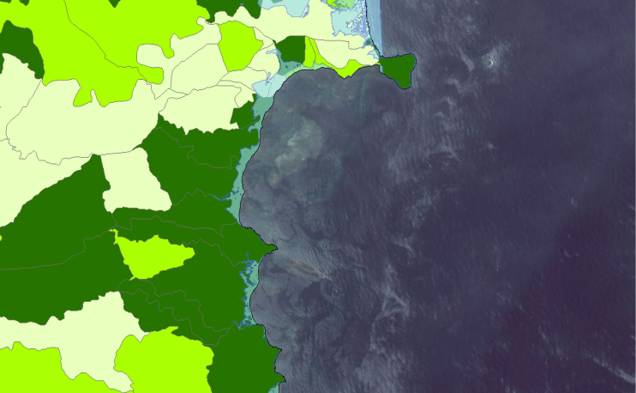
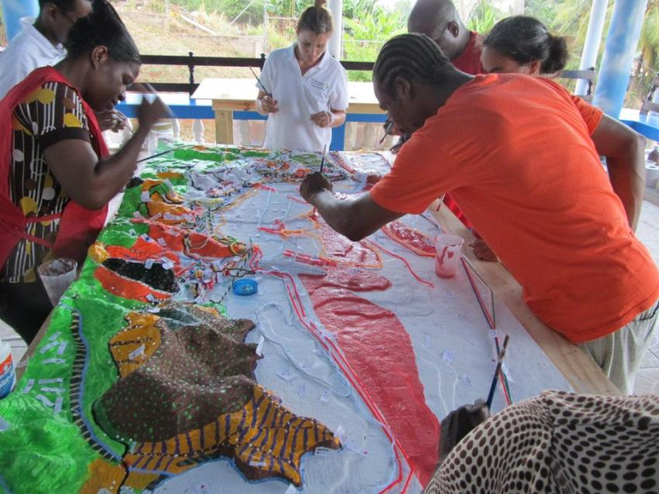

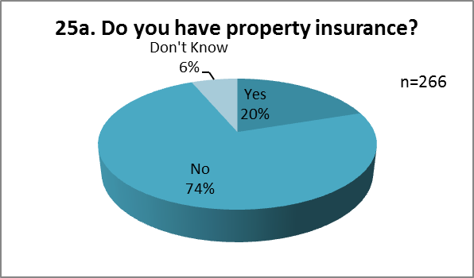
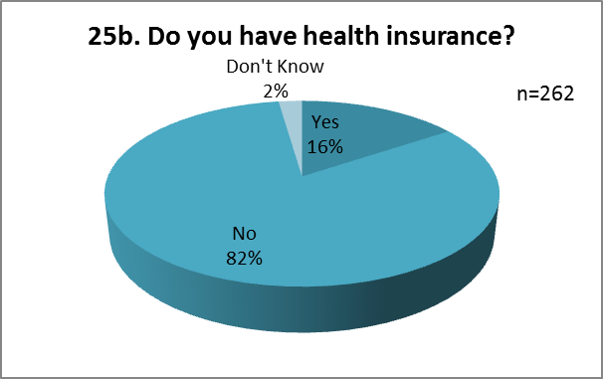
+
Science
Participatory mapping
Community surveys
=
Effective EBA solutions
Notes:
Merging science, participatory mapping and community surveys to design and implement effective nature based strategies (solutions that will “stick”)

Slide 10

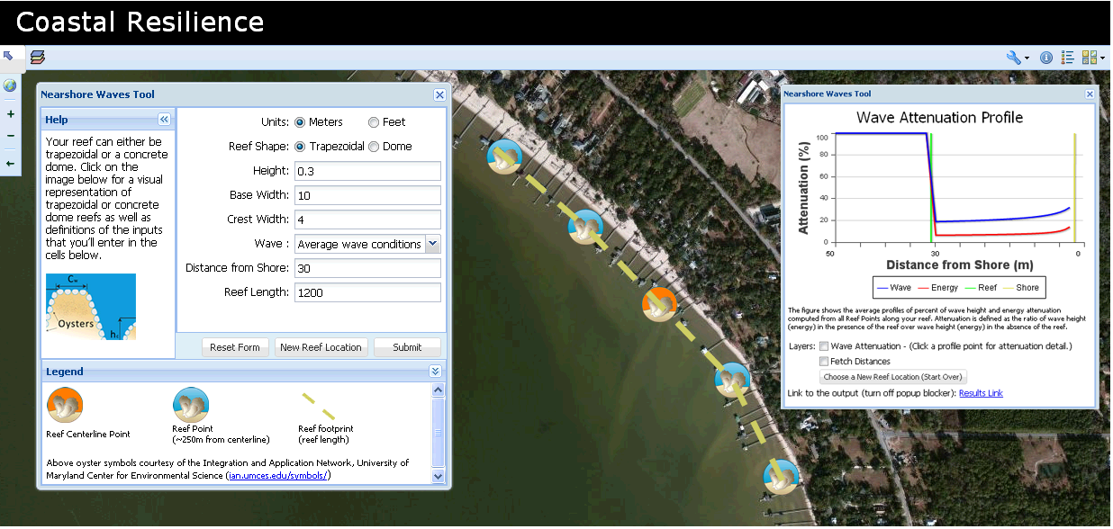
Designing Oyster Reefs as Breakwaters
www.gulfmex.coastalresilience.org

Slide 11
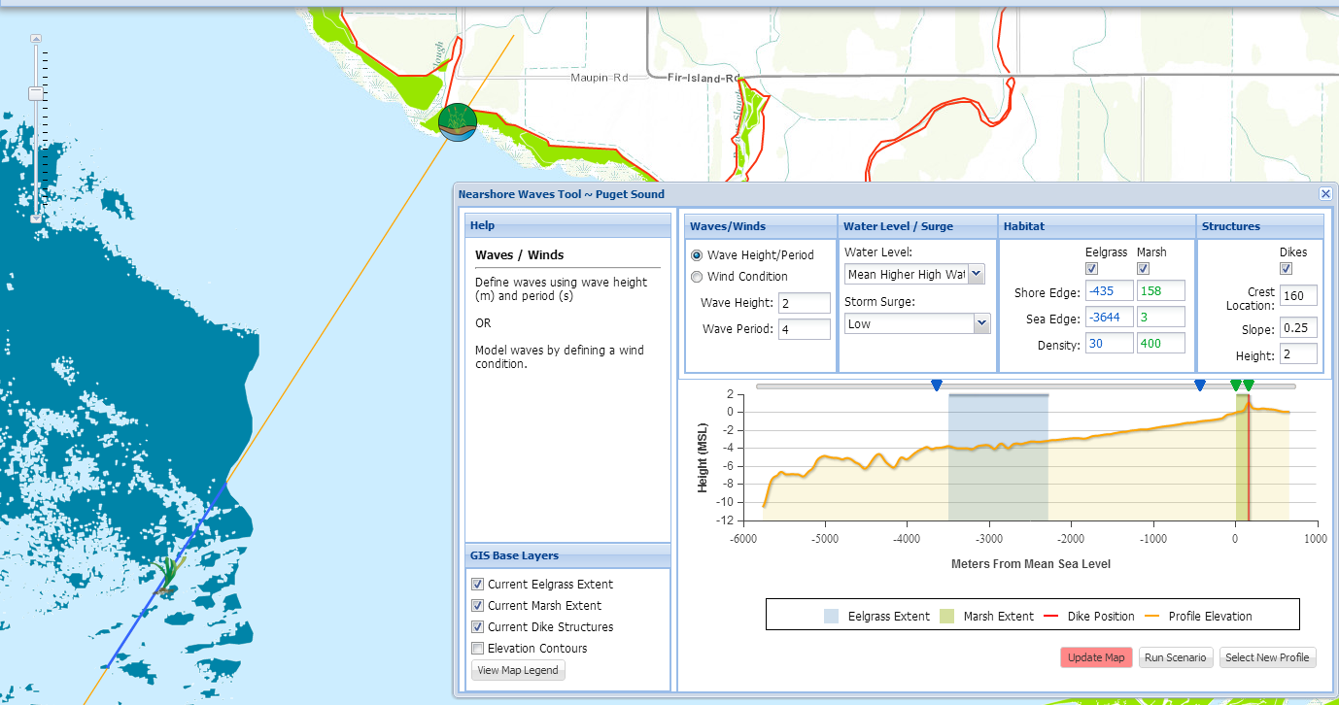
Puget Sound Coastal Resilience
Estimating wave reduction & restoration of eelgrass, marsh and dikes -- TNC, NatCap, USGS

Slide 12
“Solutions Assessment”-- Draft
Solution index _{i}
Δ Risk _{i}
Cost/benefit _{i}
Feasibility _{i}
=
+
+
i
Resettlement
Zoning
Green infrastructure
Grey infrastructure
….
Exposure
Susceptibility
Coping capacity
Adaptive capacity
Costs
Initial
Maintenance
Sustainability
Benefits
Direct
Co-benefits
Livelihoods
Funding
Permitting
Agency mission
Policy
Incentives
Dis-incentives
Time to implement
Duration
Maintenance
Spatial elements
Enabling cond.
Ecological cond.
Willingness

Slide 13
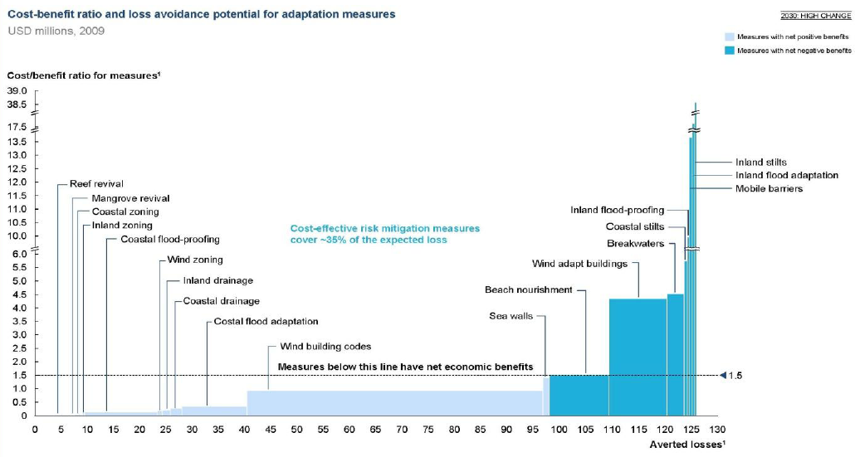
Barbados
Examining Costs:Benefits of Coastal Adaptation Approaches
Cost:Benefit ($M)
Reef Rest.
Mangrove Restoration
Measures w/ net Pos benefits
Measures w/ net Neg benefits
Breakwaters
Beach nourish
Wind Building Codes
Amount of Averted Loss ($M)
Based on work by Economics of Climate Adaptation working group- Swiss Re climada model

Slide 14
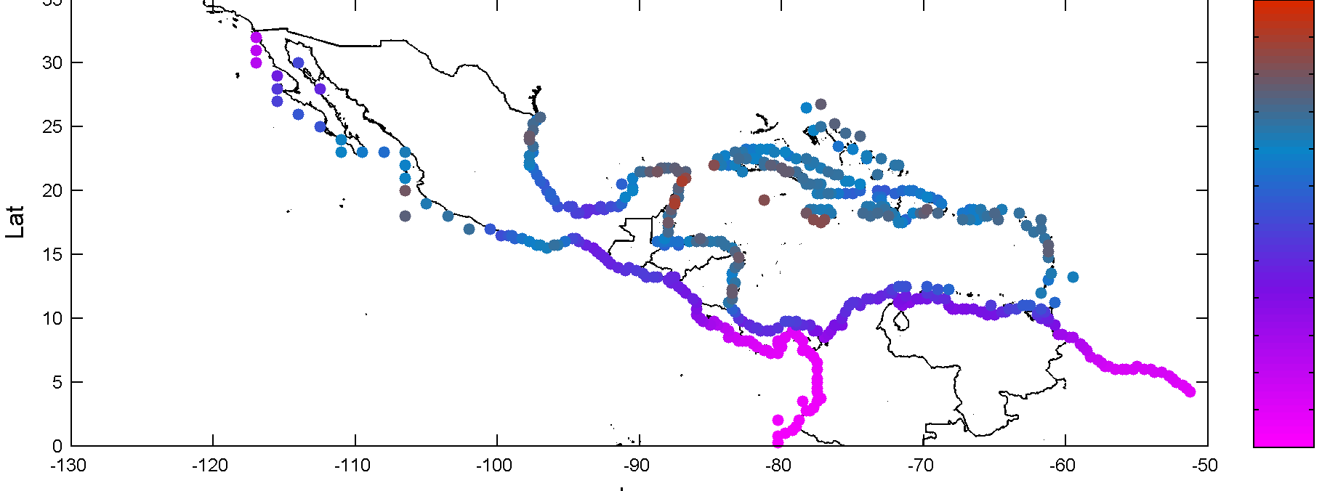
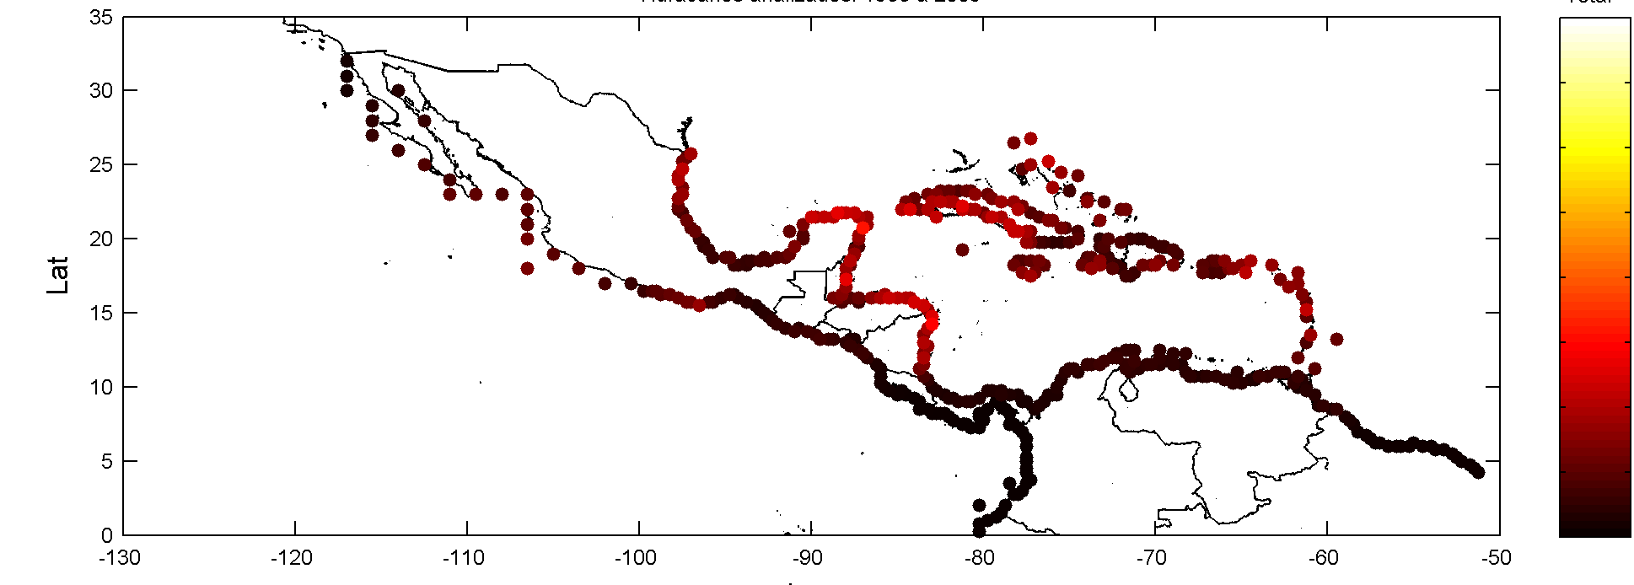
Estimating Risk Across Caribbean & Latin America
Hurricane Wind Speed
Km/h
240
0
Hurricane Storm Surge
m
4
0

Slide 15
Making the Case in Science
Papers & Reports 2010-2012
Beck, M. W., C. Shepard. 2012. Coastal habitats and risk reduction In World Risk Report 2012.
Beck et al. 2013. Using interactive decision support to integrate coast hazard mitigation and ecosystem services in Long Island Sound, New York and Connecticut USA. In Linkages between Ecosystems, Livelihoods and DRR.
Ferdaña, Z. et al. 2010. Building Interactive Decision Support to Meet Management Objectives for Coastal Conservation and Hazard Mitigation on Long Island, New York, USA, in Building Resilience to Climate Change: Ecosystem-based adaptation and lessons from the field.
Gilmer, B. and Z. Ferdaña. 2012. Developing a Framework for Assessing Coastal Vulnerability to Sea Level Rise in Southern New England, USA, in Resilient Cities 2: Cities and Adaptation to Climate Change.
Gilmer, B. et al. 2012. Informing Conservation Planning Using SLR and Storm Surge Vulnerability Assessments in
  Galveston Bay and Jefferson County, Texas.
  Grand Bay, Mississippi and Alabama
  Saint Andrews Bay and Choctawhatchee Bay, Florida. The Nature Conservancy.
Grantham, H.S., E. McLeod, A. Brooks, J. Hardcastle, A.J. Richardson, E. Poloczanska, T. Hills, T., S.D. Jupiter, N. Mieszkowska, C.J. Klein, and J.E.M. Watson. 2011. Ecosystem-based adaptation in marine ecosystems of tropical Oceania in response to climate change. Pacific Conservation Biology 17: 241-258.
Hale et al. 2011. Helping coastal communities adapt to climate change. Solutions 1:84-85.
McIvor, A. L., Möller, I., Spencer, T., and Spalding, M., 2012. Natural Coastal Protection Series: TNC & WI
  Reduction of wind and swell waves by mangroves
  Storm surge reduction by mangroves
Mcleod et al. In press. Integrating climate & ocean change vulnerability into conservation planning. Coastal Mgmt.
Mcleod et al.. In press. Preparing to manage coral reefs for ocean acidification: Lessons from coral bleaching. Frontiers in Ecology and the Environment.
Spalding et al. In press. Coastal ecosystems: a critical element of risk reduction. Conservation Letters.
Spalding et al. In press. The role of ecosystems in coastal protection: adapting to climate change and coastal hazards. Ocean & Coastal Management.
See www.coastalresilience.org/resources

Slide 16
SNAP Group on Coastal Defenses
Co-Led by TNC & WCS with NCEAS
Bringing together leading ecologists, economists, engineers and policy wonks to
Provide evidence & databases on when, where and how investments in natural defenses are cost-effective;
Develop practical guidance for decision-makers & practitioners to implement solutions;
Identify policy and financial incentives that lead to reduced risks for people and nature.
Working Group
Resource User Group
Rapid Response Team
Notes:
There is limited agreement on the basic definitions of risk and vulnerability both within and between the disaster risk reduction and climate change adaptation communities (Renaud and Perez 2010). Following Shepard et al. (2011) : ‘‘vulnerability’’ is the susceptibility of both biophysical and social systems to a ‘‘hazard,’’ which is an event or occurrence that has the potential to cause harm to people and/or property. ‘‘Risk’’ is the likelihood or probability of such harm.

Slide 17
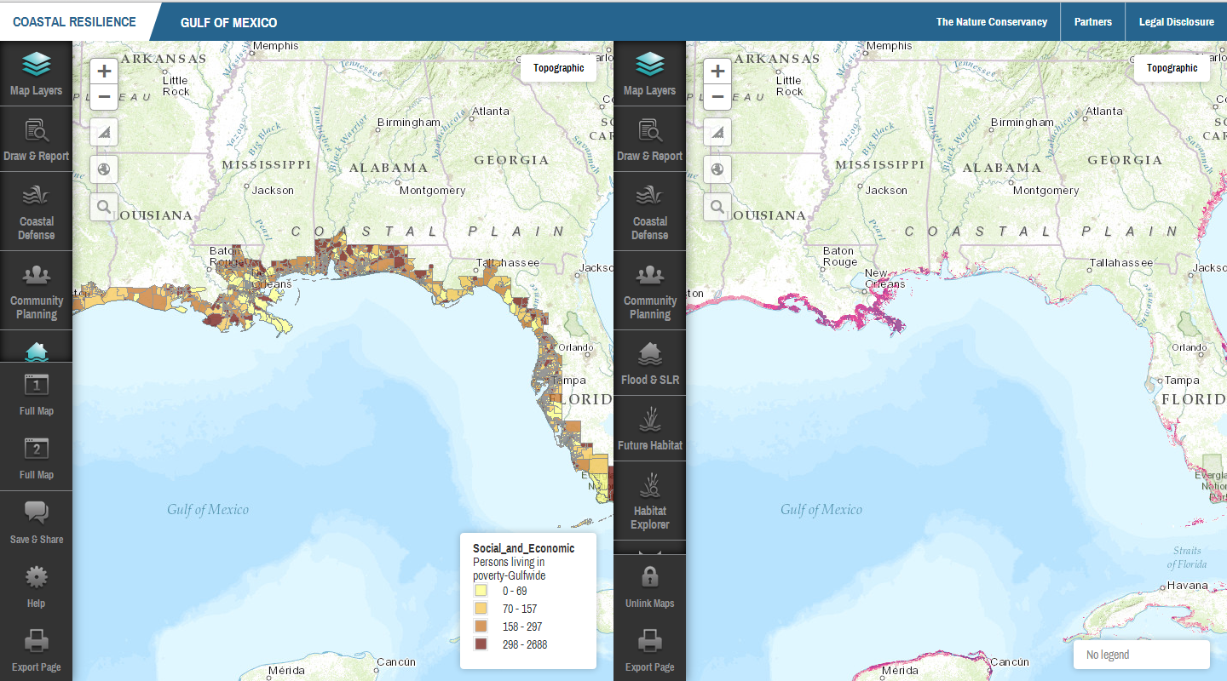
New Coastal Resilience platform will launch July 2013
Social Vuln.
% Below Poverty
Exposure
Storm Surge Freq
Ten local applications and one global tool

Slide 18
Summary
  Connecting Science, Tools, Policy & Action to build Coastal Resilience (Globally + 10 States + 7 nations)
  Building a Robust Framework to Assess Risk, Identify Solutions, Take Action & Measure effectiveness
  Coastal habitats can play major role in reducing risks
  Opportunity to re-focus Billions in Hazard Mitigation & Adaptation $ to Greener Infrastructure
  And in reducing development risks
  With partnerships in Engineering, Re-Insurance &
  Aid/Development groups
  Many new innovations this year; more coming

Slide 19
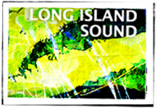
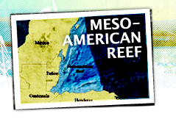
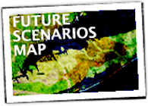
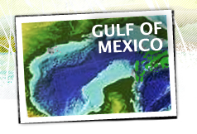
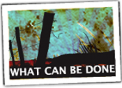
Visualizing coastal impacts,
planning wisely for the future, and making smart choices today
coastalresilience.org
Mike Beck
mbeck@tnc.org
Decision Support
Grenada & Grenadines
Papua New Guinea &
Solomon Islands
Geographies
Solutions

Slide 21
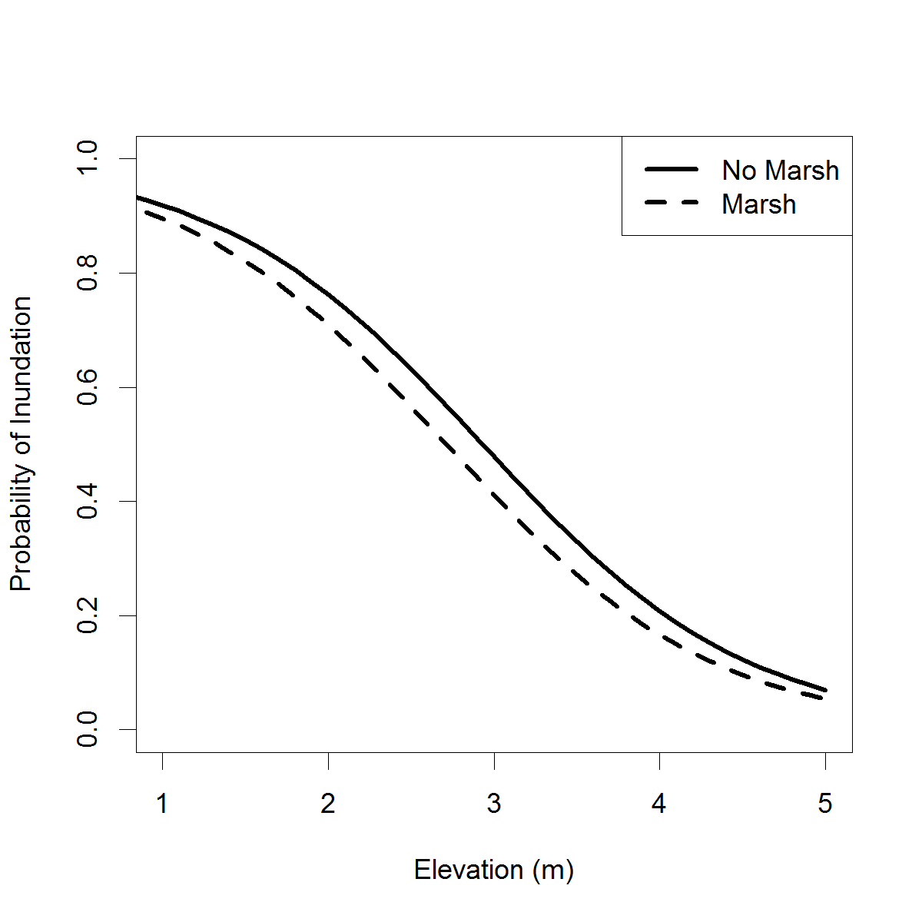
Were Buildings Behind Marshes Less Likely to be Flooded in NYC
Structures at similar distance from shore & elevation
Logistic regression
Within 5 boroughs
Structures behind marshes
12% less likely to be flooded
Examining rest of NY marshes
& beaches/dunes in NY/NJ
w/ Dr. Rob Young (WCU)

Slide 22
The Coastal Resilience framework:
1. Assess Risk
Risk = Exposure * Social Vulnerability
  (Vulnerability = Sensitivity * Coping Capacity * Adaptive Capacity)
2. Identify Solutions
Each potential solution (i) is
Solution_{i} = Δ Risk_{i} * (Benefit/Cost) _{i} * Feasibility_{i}
3. Take Action
4. Measure Effectiveness
Notes:
There is limited agreement on the basic definitions of risk and vulnerability both within and between the disaster risk reduction and climate change adaptation communities (Renaud and Perez 2010). Following Shepard et al. (2011) : ‘‘vulnerability’’ is the susceptibility of both biophysical and social systems to a ‘‘hazard,’’ which is an event or occurrence that has the potential to cause harm to people and/or property. ‘‘Risk’’ is the likelihood or probability of such harm.

Slide 23
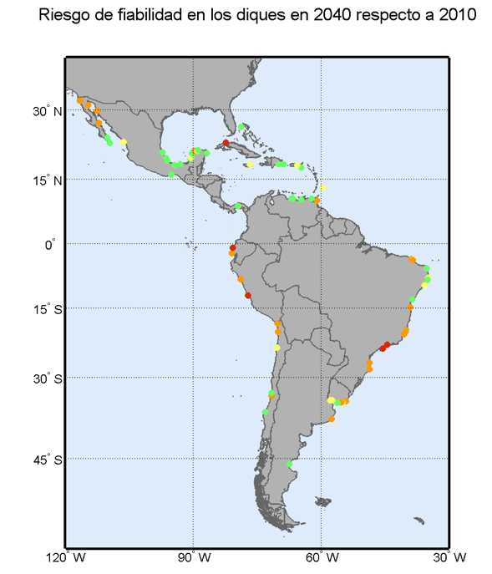
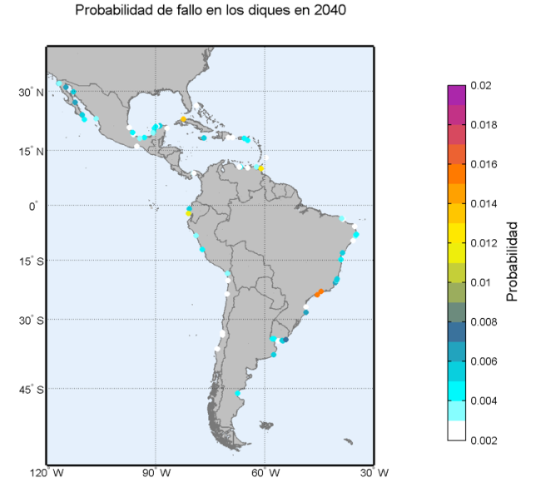
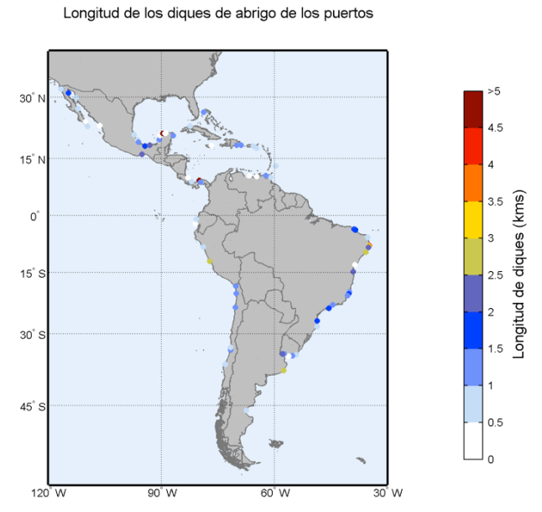
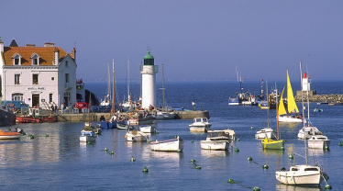
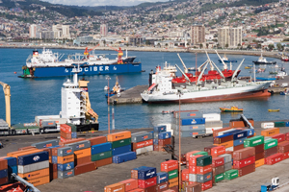
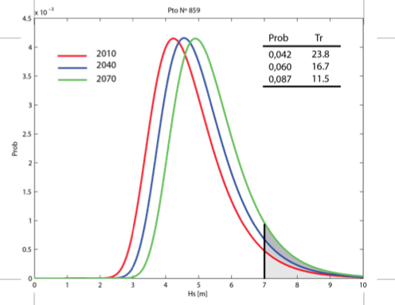
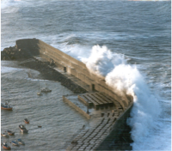
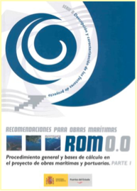
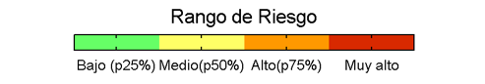
Example of Risk integration 2:
Reliability of Defensive Breakwaters
Type of sea-port as a function of its socio-economic relevance
Hazard
Exposure
Vulnerability
Length to repair
Change in design probability level

Slide 24
What I aim to focus on this talk is some of the newest stuff that we have been working on & to be able to point you to the sessions and people who you can find out more from.
Tools are for engagement – helped to get CT policy in place & tercek on Coumo commission

Slide 25
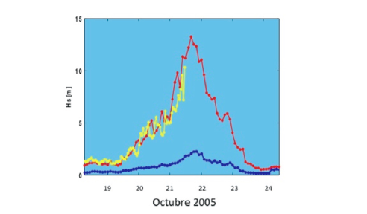
Hurricane Wilma (2005) and MesoAmerican Reef Protection
Puerto Morelos, Mexico
Wave Height (m)
outer reef
Records of significant wave heights off Puerto Morelos, MX
outer reef - red and yellow lines
within the reef lagoon- blue line
in reef lagoon
Blanchon, et al. 2010. Arrecifes de coral y cambio climático: vulnerabilidad de la zona costera del estado de Quintana Roo. p. 229-248. En: Botello et al. (ed.). Vulnerabilidad de las zonas costeras mexicanas ante el cambio climático. Semarnat-ine, unam-icmyl, Universidad Autónoma de Campeche. 514 p.
‘… coral reef was able to attenuate the energy of storm waves by 99% during Hurricane Wilma’
Blanchon, et al. 2010. Arrecifes de coral y cambio climático: vulnerabilidad de la zona costera del estado de Quintana Roo.

Slide 26
Key new features
Specific tools for specific geographies
Designed for partner engagement
Centralized database management
New geographies added easily
Other features
Works well on tablet devices
Better web performance
Draw & Report tool
Export map
Save & Share map

Slide 27
