Slide 1
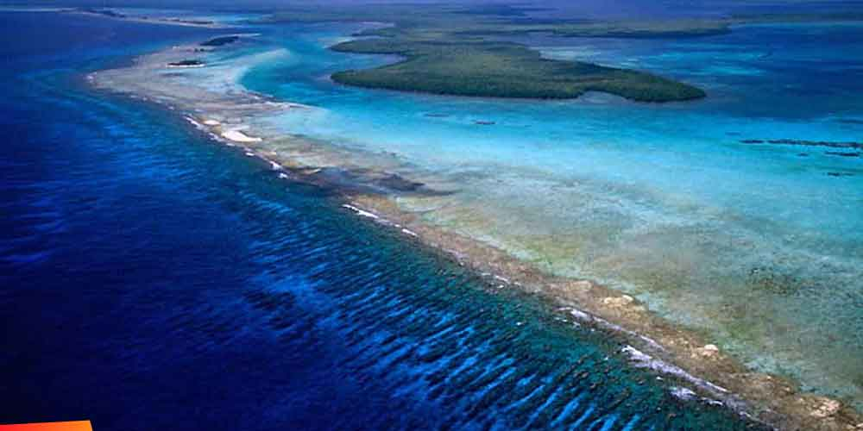
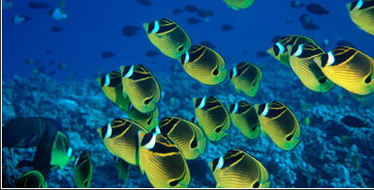
Incorporating natural defenses in hazard risk and reduction decisions

Slide 2
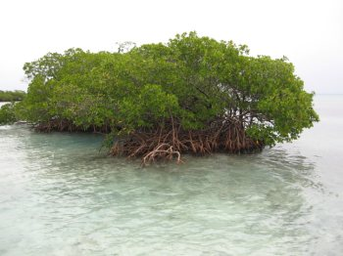
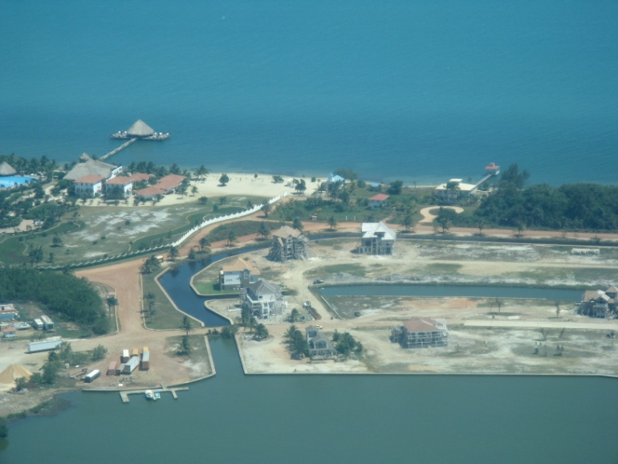
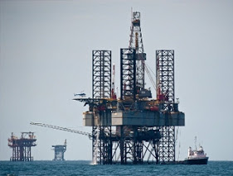
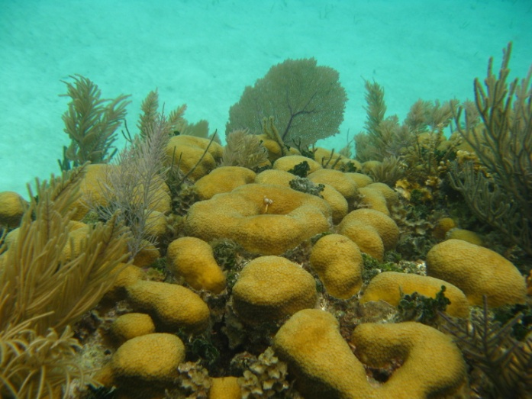
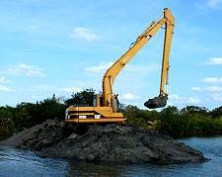
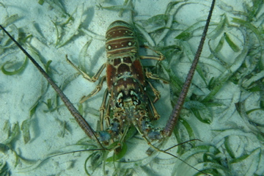
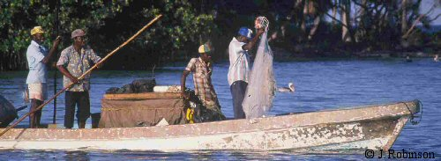
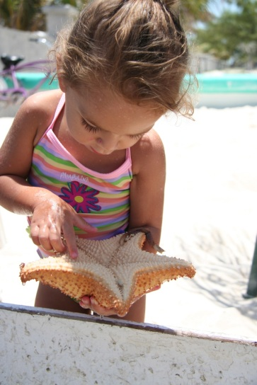
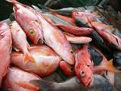
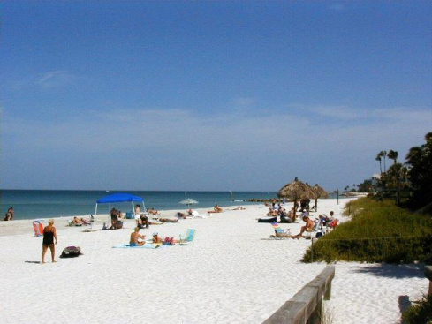
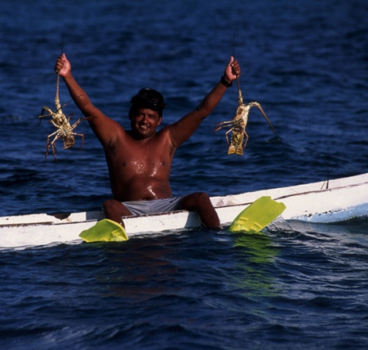
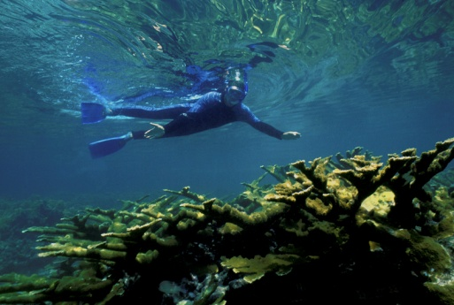
Notes:
2
Coastal and marine ecosystems provide important benefits to the Belizean people…. Note mixture of things traditionally considered IMPACTS TO and BENEFITS PROVIDED BY natural systems. Belize has the largest unbroken barrier reef in W. hemisphere (220 km)…home to rich biological diversity and ~320,000 people

Slide 3
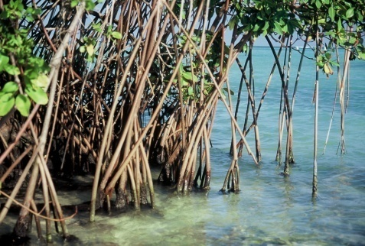
Coastal Capital of Belize
Economic Contribution of Belize’s Coral Reefs and Mangroves
Tourism: US$150-$196 M/yr
(snorkeling, diving, sport fishing, etc)
Fisheries: US$14-$16 M/yr
(lobster, conch, finfish, aquaculture)
Shoreline Protection: US$231-347 M/yr
(avoided damages via mangroves, coral reefs)
Cooper, E., L. Burke and N. Bood. 2009. WRI.

Slide 4
But what about the future?
Notes:
To what degree will these benefits continue to be provided if habitats degrade?
What management schemes best balance multiple objectives?

Slide 5
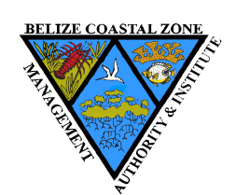
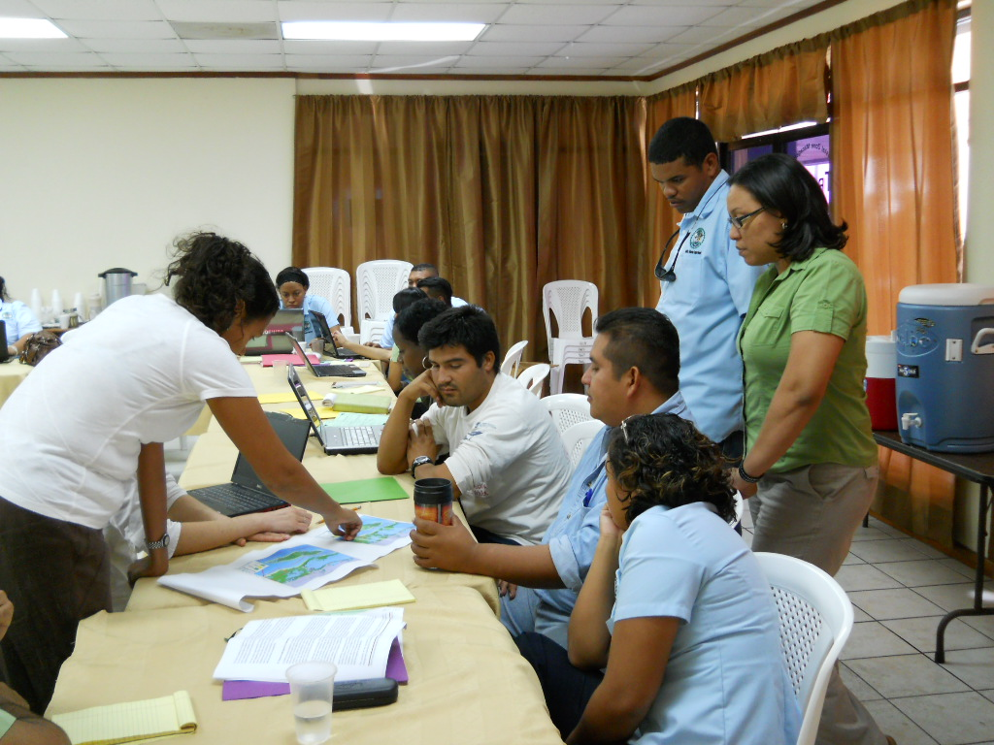
Integrated Coastal Zone
Management for Belize
Stakeholder engagement
Models

Slide 6
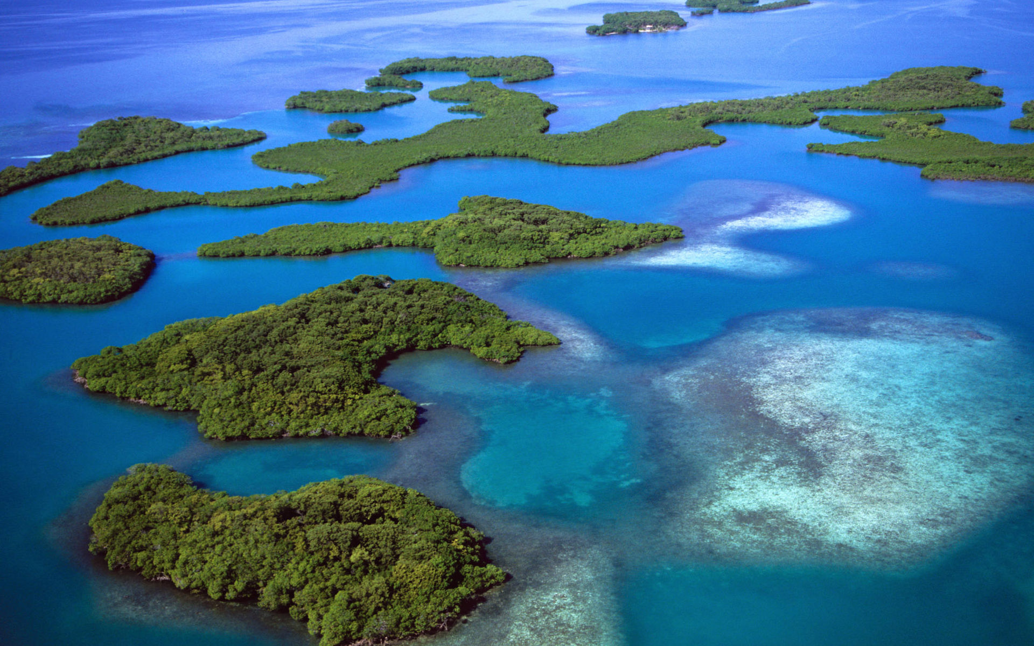
Marine Transportation
Tourism/Recreation
Conservation
Fishing
Coastal Development
Aquaculture
Agriculture
Dredging
Oil exploration
Special Development Areas
Cultural & Historical Areas
Notes:
One important role for stakeholder engagement was to define important activities.

Slide 7
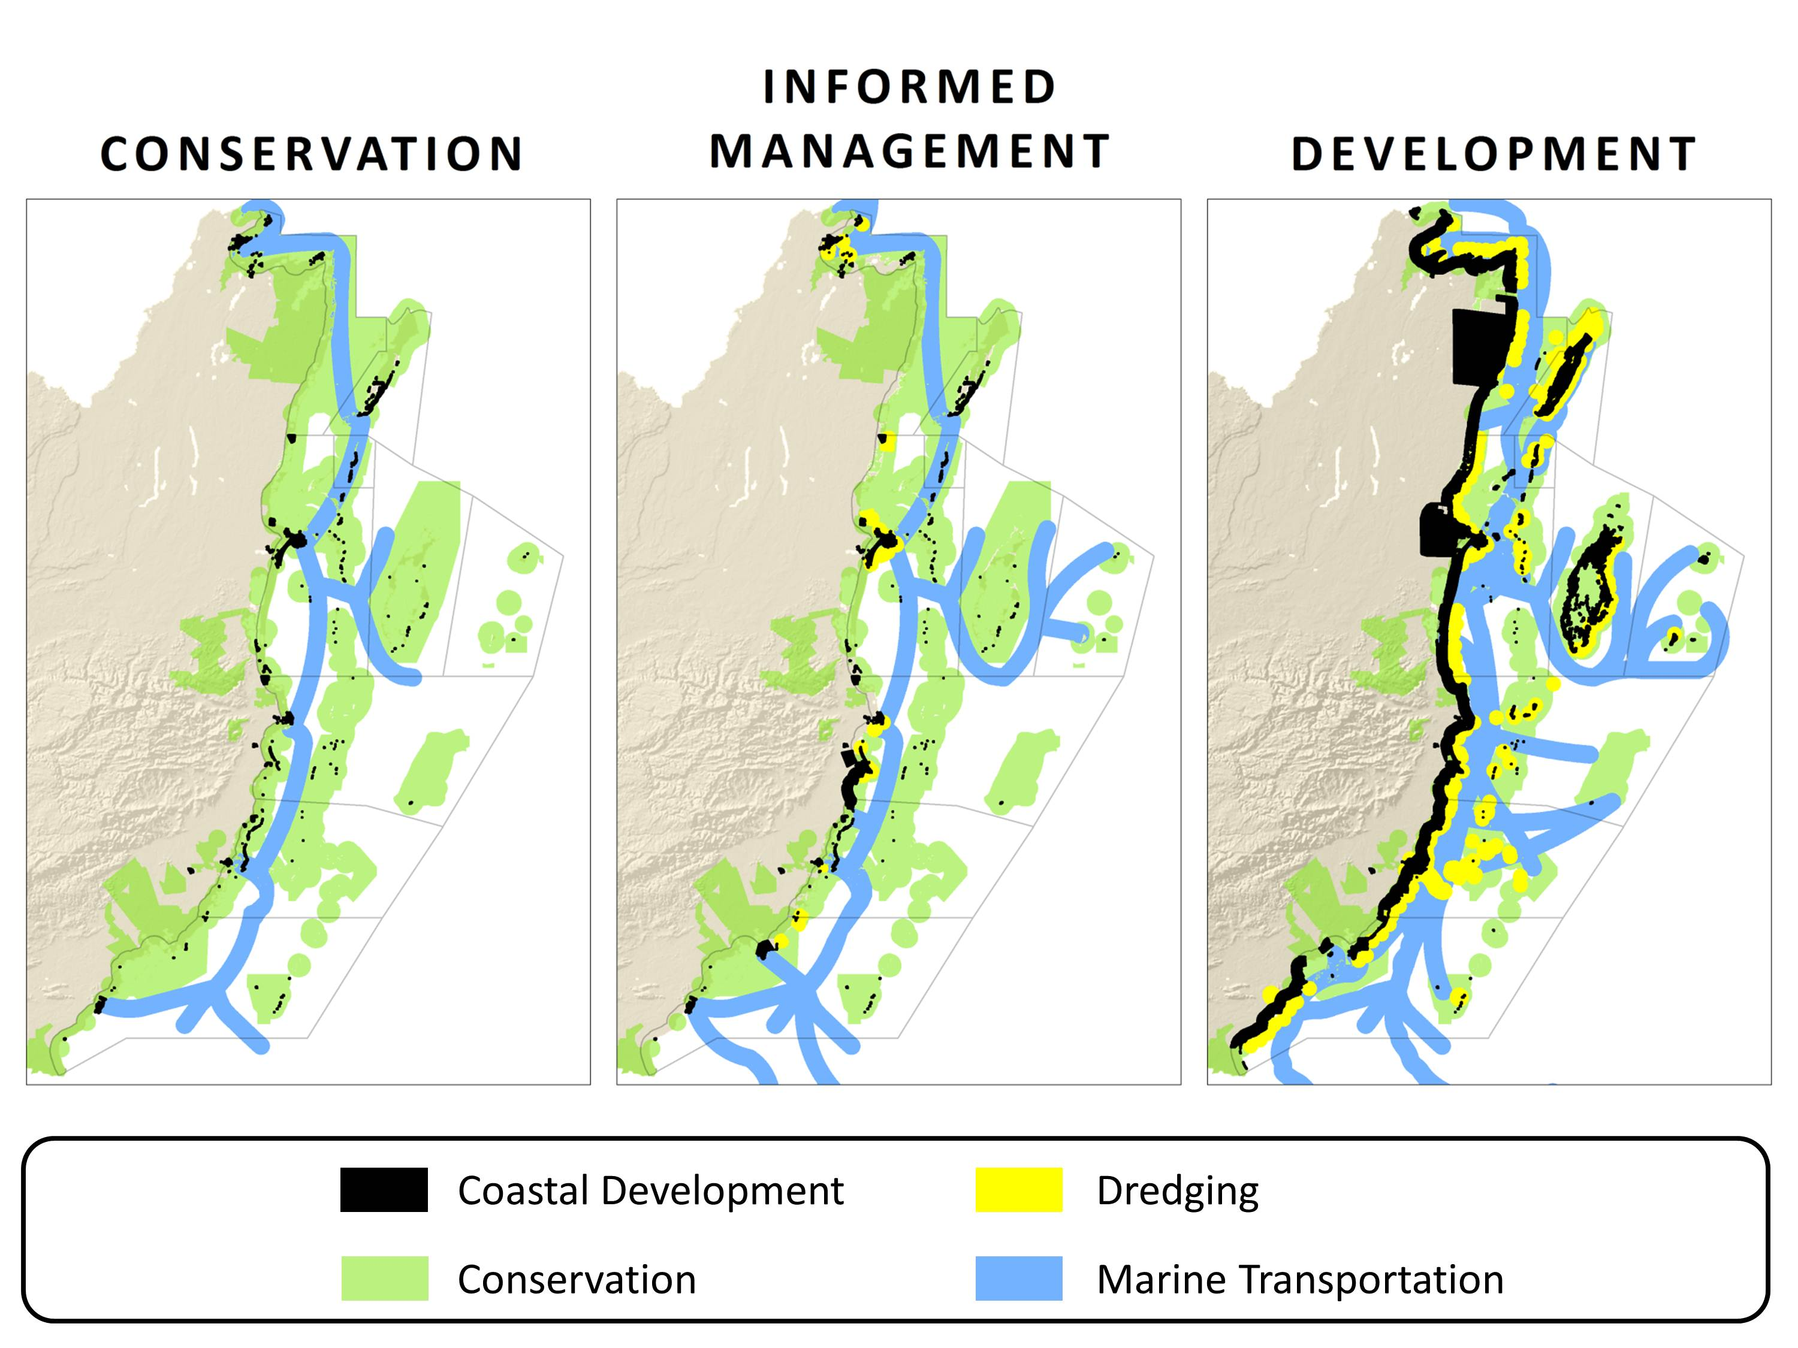
Possible future zoning schemes
Notes:
current distribution of uses, other planning efforts, stakeholder visions

Slide 8
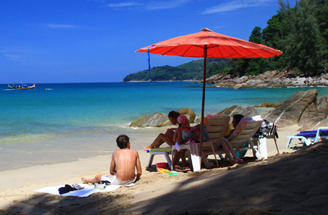
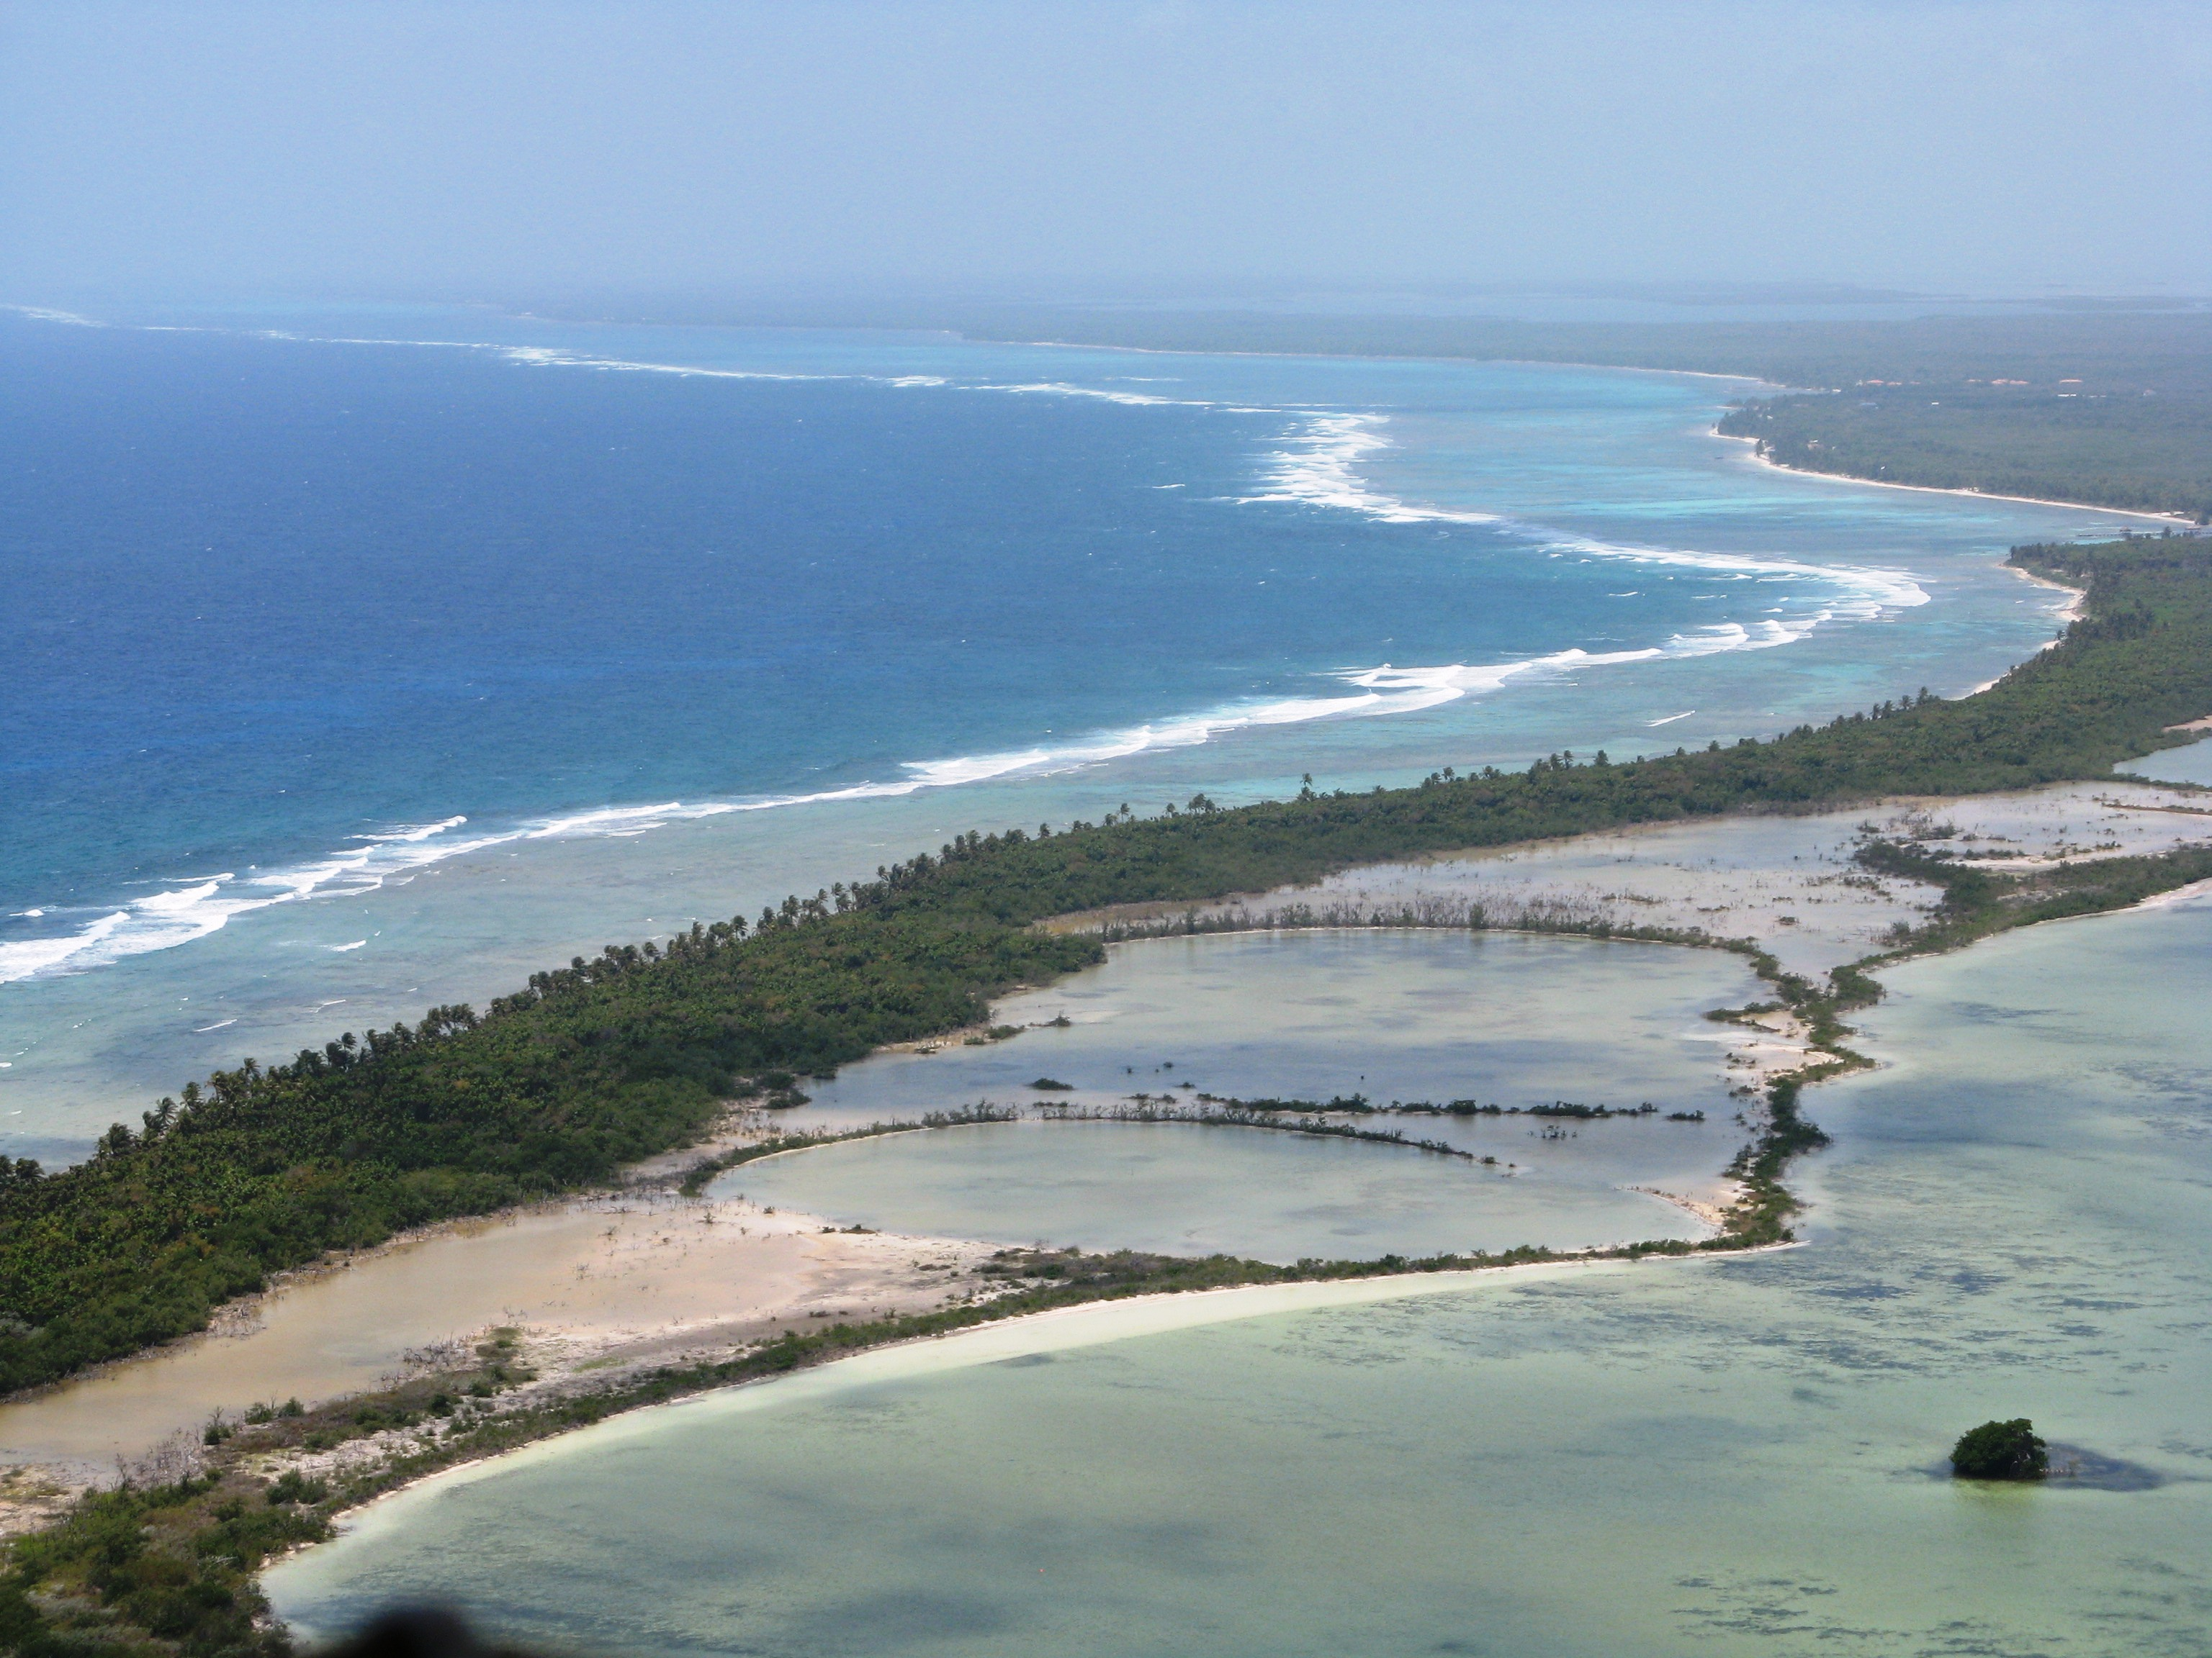
Area of functional habitat (km²)
Landings of spiny lobster (lbs)
Distribution of tourists (visitors/day)
Shoreline protected from erosion (m²)
Notes:
We also agreed on metrics with which to measure those desired outcomes…both in biophysical and dollar terms.

Slide 9
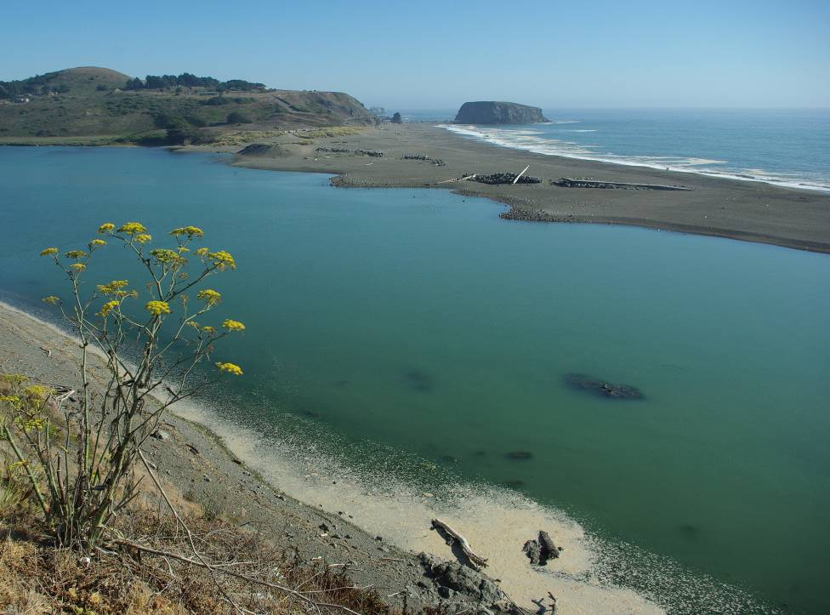
InVEST
Accounting for nature’s benefits
Changes in ecosystem → Changes in ecosystem services and their values
Free. Open source.
www.naturalcapitalproject.org
Notes:
For this we use InVEST

Slide 10
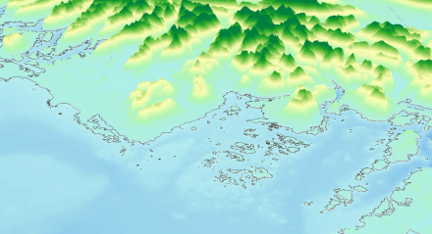
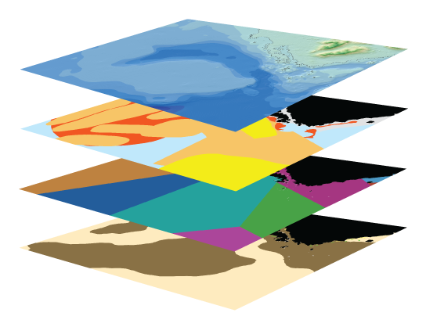
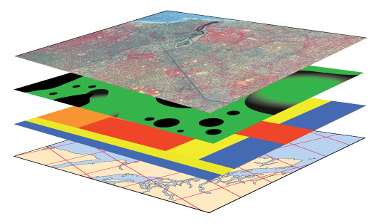
Input Data (reflect scenarios)
Marine InVEST Models
Model Outputs
(ecosystem services & values)
ECOSYSTEM SERVICES
VALUATION
e.g.
Blue Carbon
Carbon Sequestered
Value of carbon sequestered
TERRESTRIAL SYSTEMS
Wave Energy
Energy Captured
Value of captured wave energy
BIO-PHYSICAL
3
9
Coastal Protection
Avoided
Area Flooded/Eroded
Value of avoided damages
Bathymetry & Topography
Habitat Risk
Species distribution
SCENARIOS
Recreation
Visitation Rates
Expenditures due to recreation
activity
Oceanography
5
4
Habitat type
7
Water Quality
Fishery
Landed
Biomass
1
8
Net present value of finfish and shellfish
SOCIO-ECONOMIC
6
Aquaculture
Harvested
Biomass
Population density
2
Demographics
Aquaculture operation costs
Aesthetic Quality
Property values
Guerry et al 2012
Notes:
This represents the marine models in InVEST, with models outlined in black being the ones we used in Belize. Take home from this slide is that input data reflect current conditions or future scenarios and are made up of biophysical and other kinds of information. Marine models can be used singly or in conjunction with one another. And ouputs can be in biophysical or monetary metrics.
Flow rate, sediment, nutrients, toxic waste and bacteria
Wastes, filtration
De facto MPA
Light attenuation, sedimentation
Water purification
Food supply (shellfish)
Beachgoing
Spawning, rearing
Wave attentuation

Slide 11
Development Risk to mangroves Lobster catch & revenue
Risk in 2025
Annual lobster catch 2025
(thousand lbs)
Low
Medium
High
100 150 200 250 500

Slide 12
Coastal protection model
Storm size = Category hurricane
Return period = 12 yrs
Surge = (0.4-2.2 m)
Wave height (H₀ = 0.9 – 8 m )
Wave period (T =3-11 s)

Slide 13
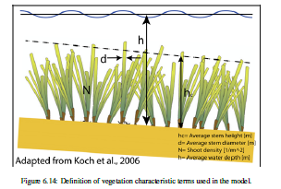
Kriebel and Dean (1993)
Mendez and Losada (2004)
h
Erosion of
property
$$EPV=\sum_{t=1}^{τ}{\frac{pD_{A}}{{(1+i)}^{t}}}$$
N
Notes:
Just a few examples of the model formulations and parameters

Slide 14
Coastal protection
15 hrs Storm
H_{max}=1.5m
T=4s
Beach
Offshore
Erosion Difference: 1.5m

Slide 15
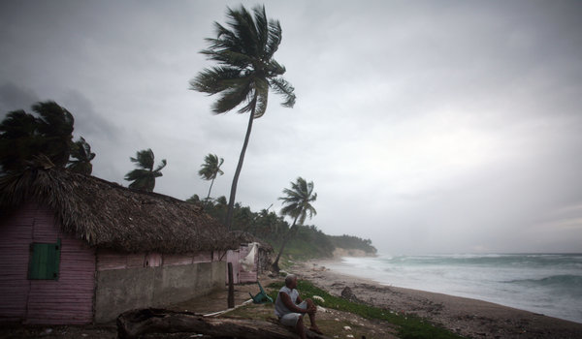
How might coastal development affect
Erosion/flooding from storm events?

Slide 16
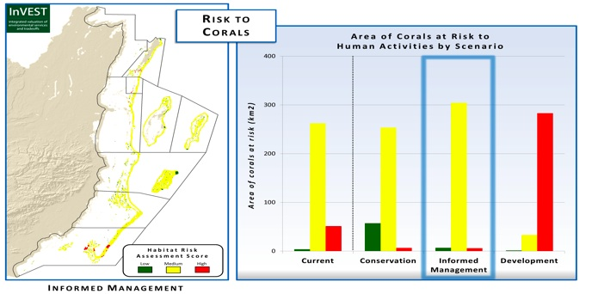
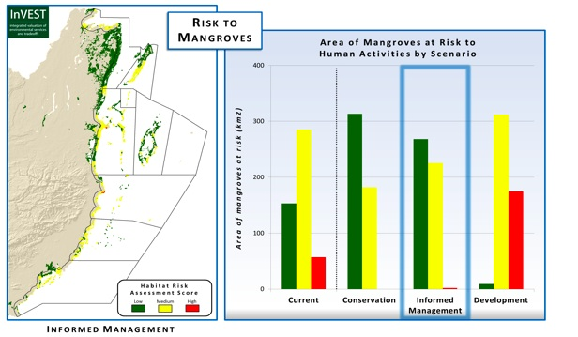

Slide 17
Regional differences in land protection and avoided damages
Notes:
IM generally highest because of combination of conservation and development

Slide 18
How might coastal development affect
Erosion/flooding from storm events?
Coastal and marine recreation?
Nursery habitat for key species?
Fisheries?

Slide 20
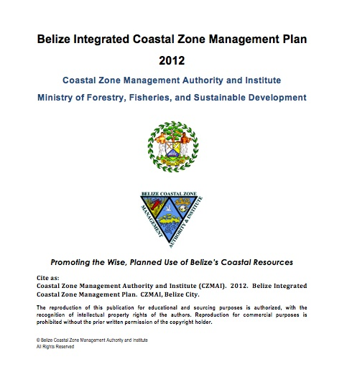
Use zoning scheme and ICZM plan to inform permitting, climate adaptation activities
EIA review committee chaired by Director CZMAI
Notes:
Ministries for Slide 11 include:
Ministry of Energy, Science & Technology, and Public Utilities (oil/gas)
Ministry of Natural Resources and Agriculture (aquaculture)
Ministry of Works and Transport (dredging, transport infrastructure)
Ministry of Forestry Fisheries Sustainable development, Department of Environment
Ministry of Housing and Urban Development (coastal development; CZMAI provides “advising”)
Also for climate-related stuff, we may want to mention:
Ministry of Labour, Local Government, Rural Development and National Emergency Management

Slide 21
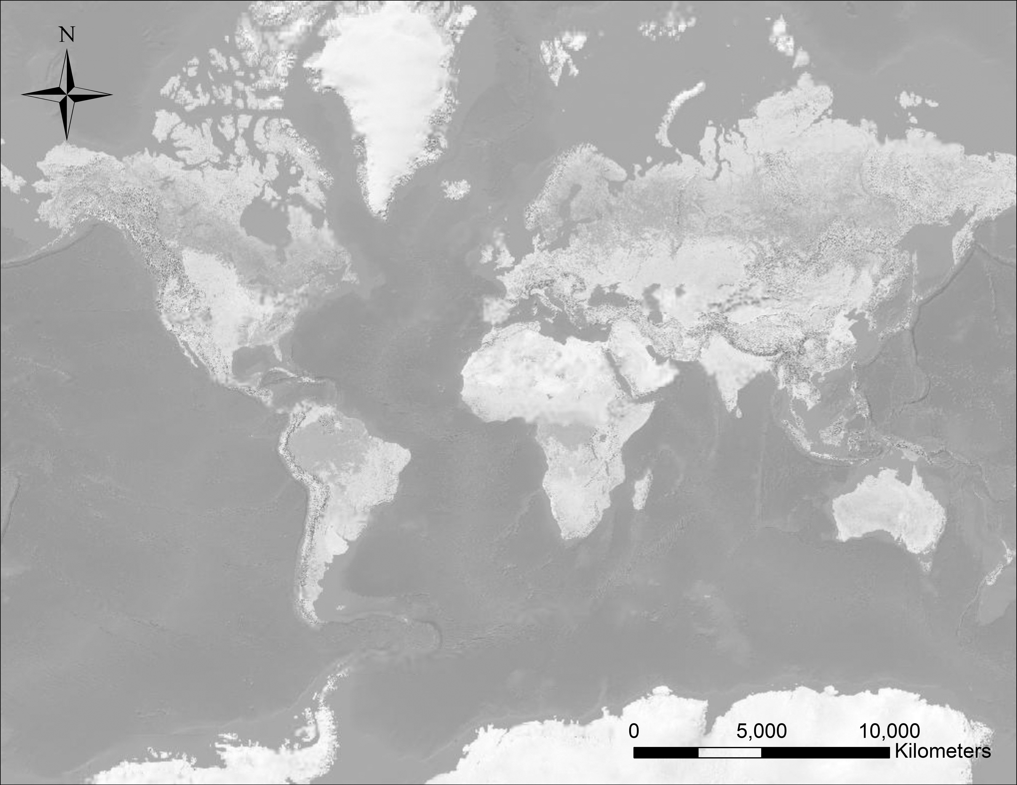
Diverse decision contexts for hazard risk and reduction
S
S
S
C
P
C
S
R
S
M
S
S
S
D
P
S
P
P
D
P
S
Spatial Planning
Payment for Ecosystem Services (PES)
Climate Adaptation Planning
Development Impacts and Permitting
Restoration Planning
Ruckelshaus et al. accepted
Corporate Risk Management
Notes:
Briefly describe the 6 decision contexts here…mention that we’ll focus on a few that highlight new frontiers beyond concepts illustrated by the BZ case study

Slide 22
Hazard risk and reduction: Different decisions, different metrics
Decision context | Analyses, metrics | Geography
Corporate risk management | Cost: Benefit of grey, green approaches; co-benefits | Texas (Dow), global (Unilever)
Payment schemes for hazard reduction, secure water supply | Optimal ROI for protection, restoration activities | Latin America, India, China
Vulnerability of people, property, infrastructure | Relative risk with and without habitats | US, Belize, Canada, Mozambique
Restoration siting, design | Area flooded, eroded; people affected; property value, avoided damage $ | US

Slide 23
Mary Ruckelshaus, Steve Polasky, Gretchen Daily, Peter Kareiva, Taylor Ricketts, Jon Foley, Jon Hoekstra, Heather Tallis, Anne Guerry, Becky Chaplin-Kramer, Rich Sharp, Emily McKenzie, Liz Rauer, Brian Robinson, Gail Kaiser, Guy Ziv, Stacie Wolny, Jodie Toft, Katie Arkema, Greg Guannel, Gregg Verutes, Spencer Wood, CK Kim, Joey Bernhardt, James Douglass, Martin Lacayo-Emery, Kathryn Glowinski, Nicolas Chaumont, Derric Pennington, Amy Rosenthal, Yonas Ghile, Rob Griffin, Suzanne Langridge, Lula G-Michael, Nasser Olwero, Doug Denu, Nirmal Bhagabati, Bonnie Keeler, Lisa Mandle, Joanna Nelson, Leah Bremer, Mike Anderson, Kris Johnson, Peter Hawthorne, Shan Ma, Jess Silver, Adrian Vogl, Joe Faries, Brad Eichelberger.
Support from:
Gordon and Betty Moore Foundation, David and Lucile Packard Foundation, Rockefeller Foundation, Summit Foundation, MacArthur Foundation, Google/Tides Foundation
NOAA, NSF, DoD, EPA
Private Individuals
TNC, WWF, Stanford, UMN
www.naturalcapitalproject.org

Slide 25
Average user days per year (836 sites)
Model validation: real vs
crowd-sourced data
Wood et al. in review
Notes:
Since its launch in 2004, approximately 70 M Flickr users have uploaded over six billion photographs to the image-sharing website. The relationship between user-days (% total) measured empirically (eg park entrace data) vs estimated using photos in flickr. Datasets included: National Parks (US, Uganda, Australia, Nepal), UK Visitor Attractions [museums, churches, gardens, etc; www.alva.org.uk]; state parks and beaches (US); amusement parks (global).

Slide 26
Coastal protection
NOT TO SCALE
Avoided re-nourishment cost
Avoided property damages
Avoided people displaced

Slide 27
Coastal protection
Forcing
Conditions
Attenuation
Hydrodynamic
Output
Wave height
Mean water level
Runup
Storm surge
Erosion
Flooding
Near property
and people
Waves
Baseline tide
Long-term sea-level rise
Currents
Wind
Biogenic habitat
Abiotic morphology
‘Hard’ structures

Slide 28
Regional differences in catch and revenue under alternative futures
Notes:
Tail portion only

Slide 29
Regional differences in visitation and expenditures under alternative futures
Notes:
Bar graphs of 3 services – recreation, fishing, coastal protection – illustrate that regions vary and can use models to identify which regions provide the country with greatest amounts of service and how that will vary under alternative future zoning schemes.

Slide 30
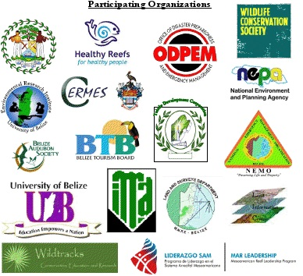
Building Capacity
2 in-country trainings
CZMAI running InVEST
Notes:
Absolutely critical to this whole process is training and capacity building. We’ve held 2 in-country trainings. 1st for 30 people (mixture of government, NGO and academic scientists and analysts). More than 50 people from throughout the Caribbean islands and Central American countries attended the second workshop. Participants included officials from various national government departments and ministries (Nat Resources, Ag, Fisheries, Environment, Disaster Management etc), academic leaders in climate change, coastal engineering, and ecology, and representatives of local and international environmental NGOs. At least three scientists in the Belizean government now use InVEST; they provided many of the iterative analyses that have been critical for the community engagement and development of the spatial zoning scheme throughout the later stages of the planning process.

Slide 31
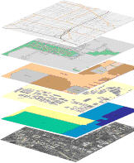
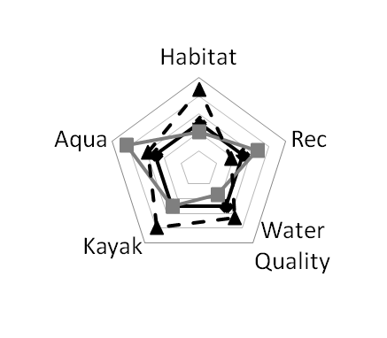
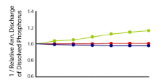
1
2
3
Define Partnerships, Roles & Objectives
Compile Data
Generate Baseline & Scenarios
4
Iterate & Build Capacity
Assess Outcomes
6
7
Inform Decisions
5
Synthesize Results
Notes:
The final step in this approach is to inform decisions.

Slide 32
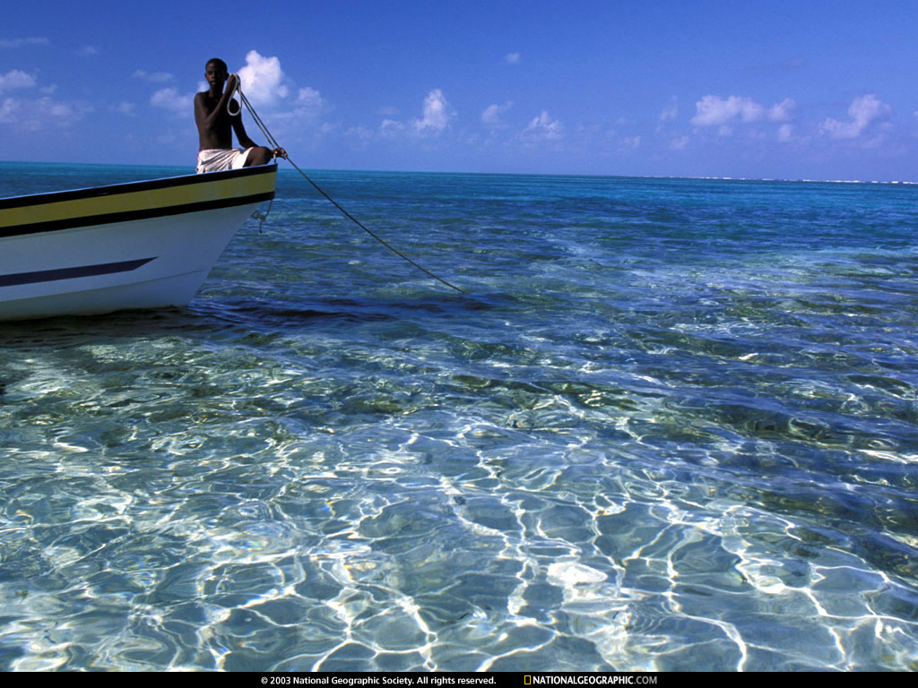
Ecosystem service approach and tools useful in planning for disaster risk reduction and other objectives
Iterative science-policy process matters
Accessible tools, trained partners, & capacity building are critical
A wide variety of metrics resonate

