Slide 1
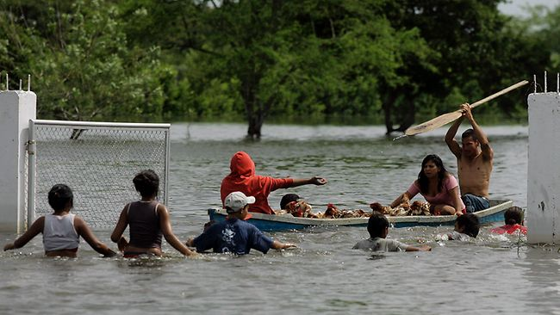
Evan Girvetz, PhD
The Nature Conservancy
Central Science and
Climate and Disaster Risk Reduction
May 28, 2013

Slide 2
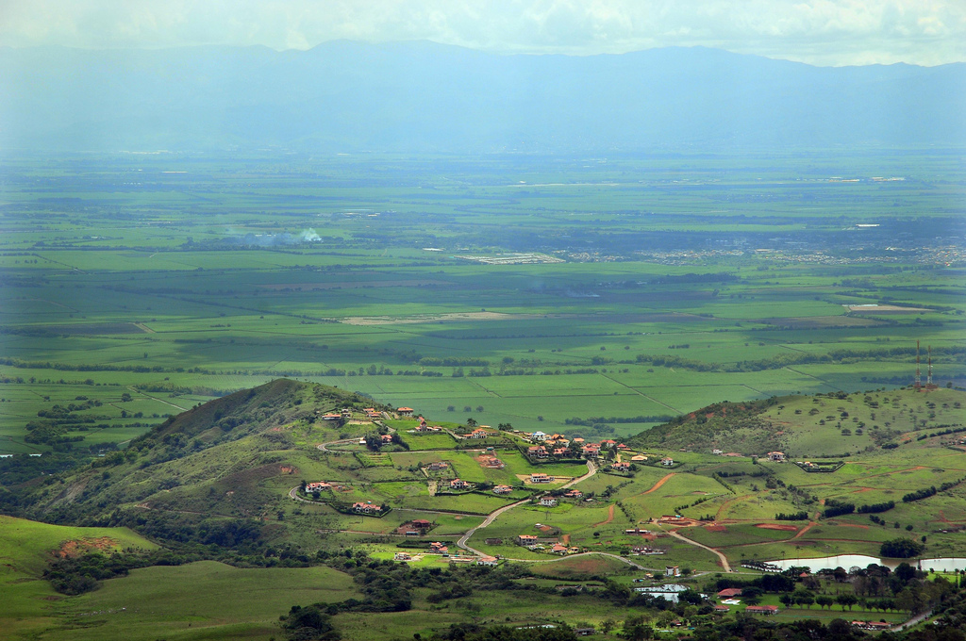
Neil Palmer, CIAT

Slide 3
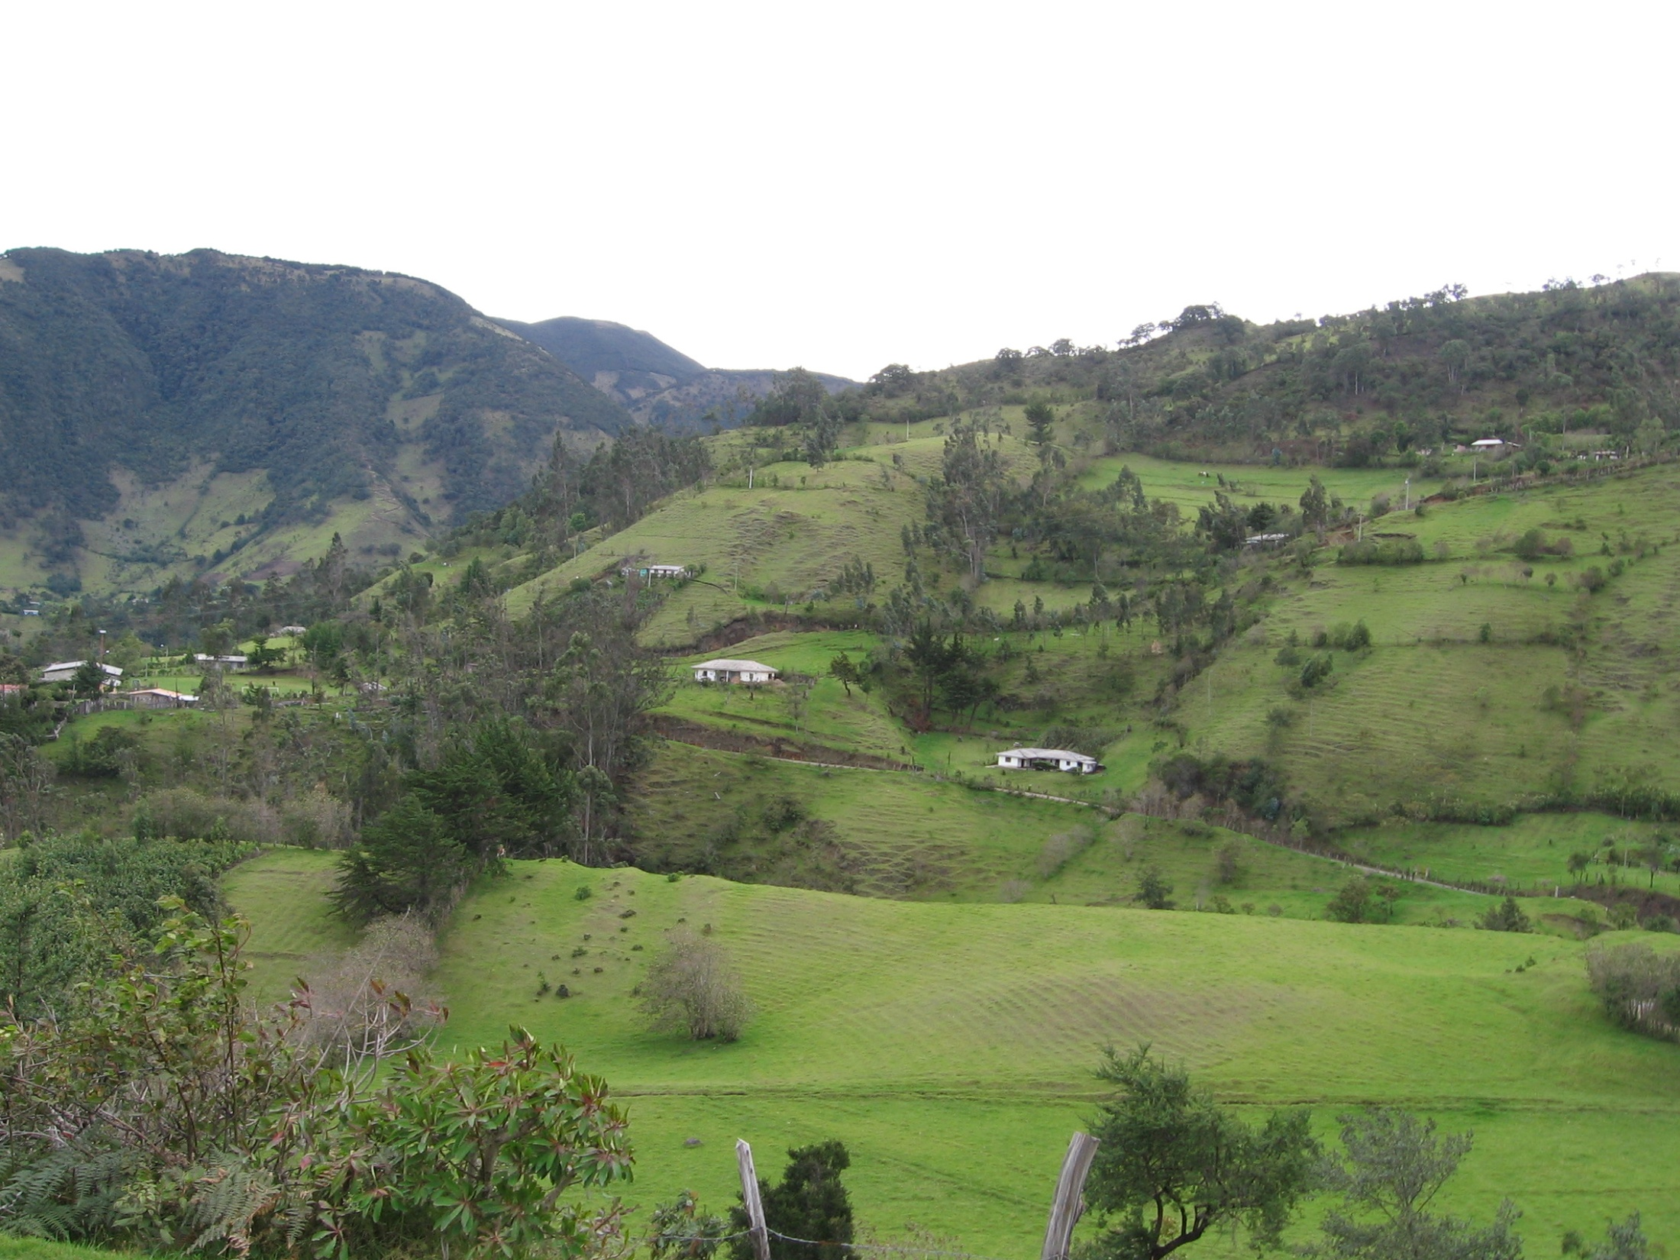

Slide 4
Assess Risk
Resilient
by
Design

Slide 5
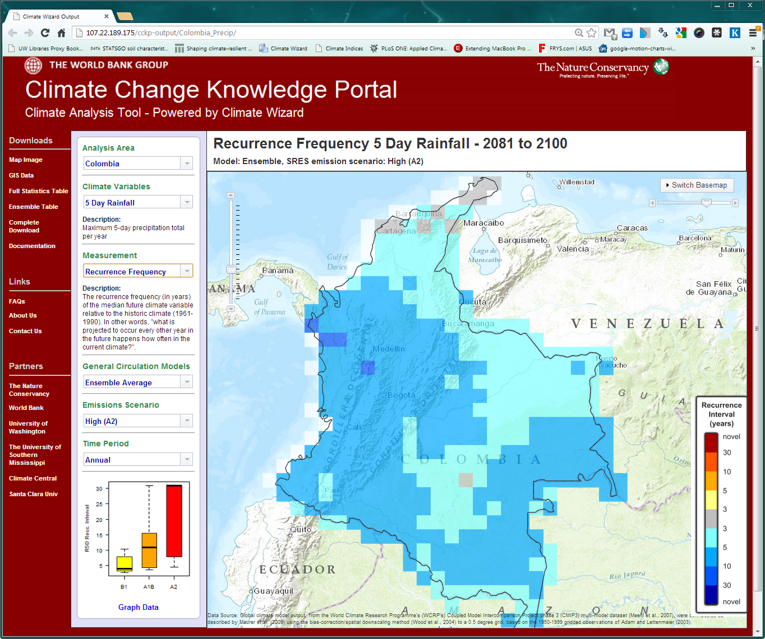
http://ClimateKnowledgePortal.ClimateWizard.org

Slide 6
Climate Impact Models
Assess Impacts (Modeling by partners Natural Capital Project and CGIAR-CIAT)
General Circulation Climate Models
Hydrologic modeling
SWAT
InVEST

Slide 8
http://news.com.au
Notes:
Palmira, Colombia

Slide 9
Assess Risk
Resilient
by
Design
Evaluate Solutions

Slide 10
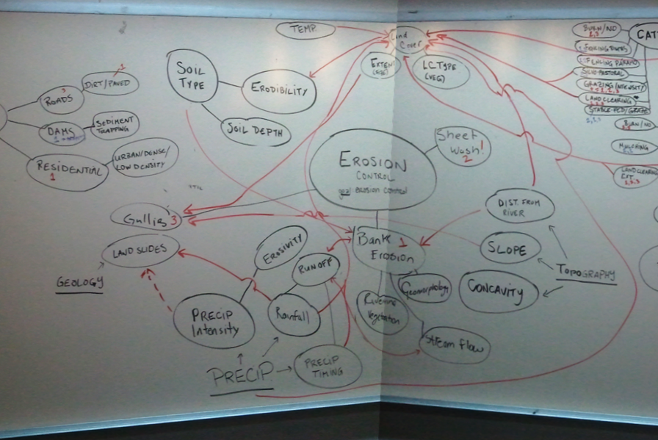

Slide 11
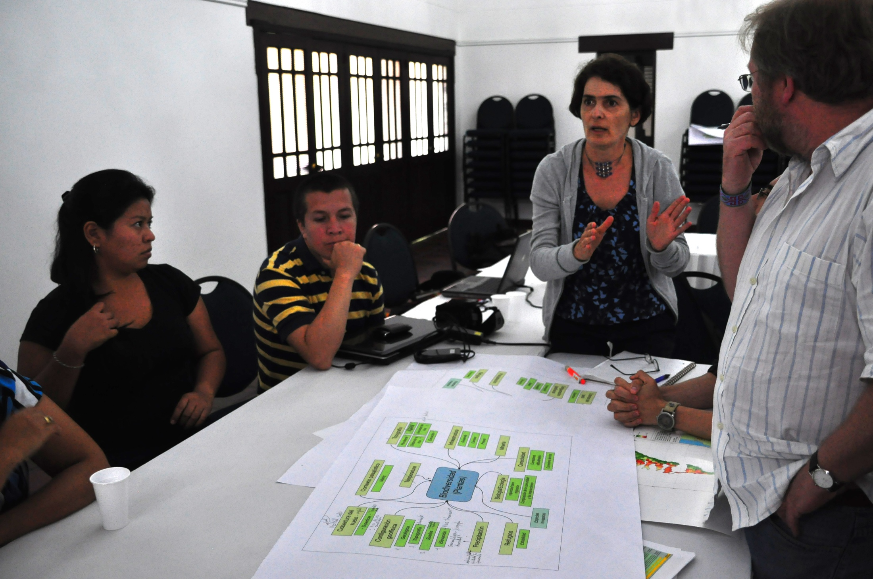

Slide 12
Analyze Solutions

Slide 13
Assess Risk
Resilient
by
Design
Evaluate Solutions
Design Investments

Slide 14
RIOS: Optimized Portfolio of Investments
Biophysical weights
Slope
Erosivity
Erodibility
Management Factor
Vegetation Condition
Retention Efficiency
Feasibility of Activities – Stakeholder Preferences
Changes in Landuse
Estimated Costs of Activities
Portfolio of Investments

Slide 15
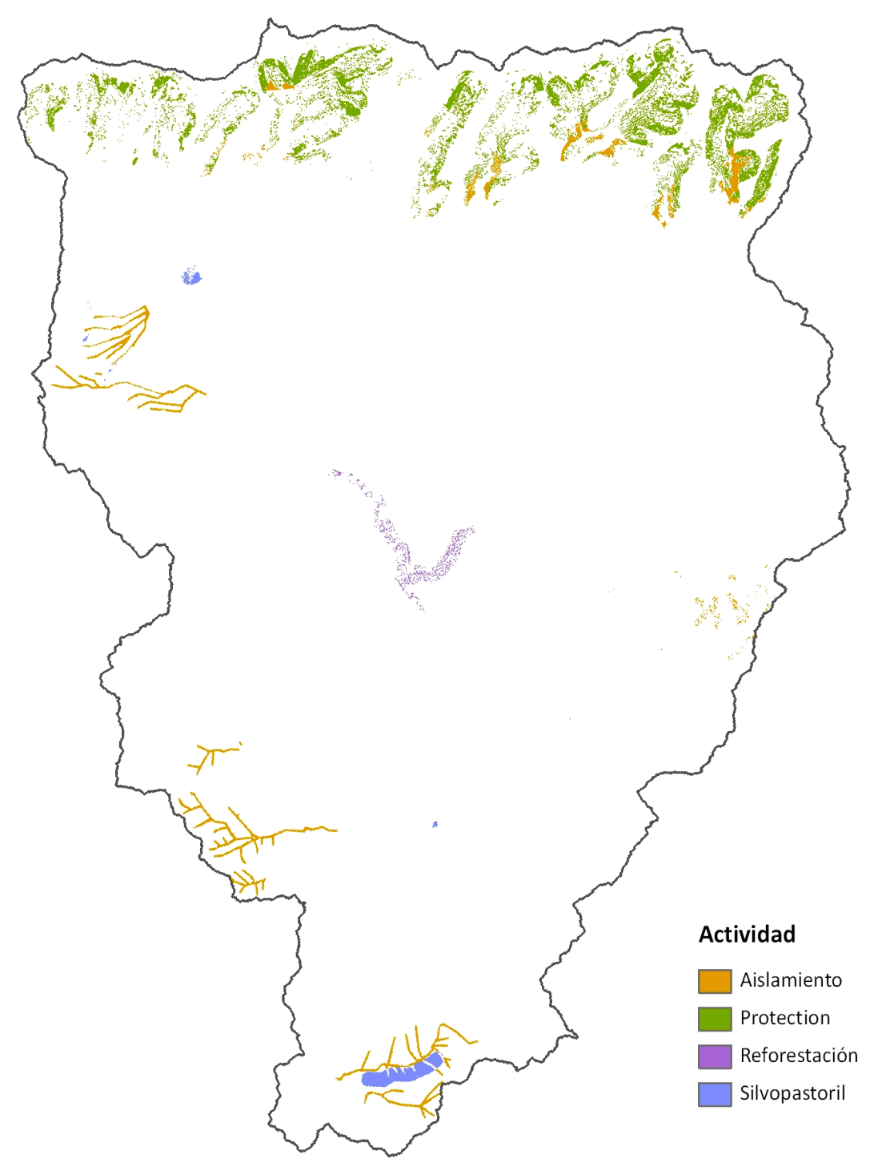
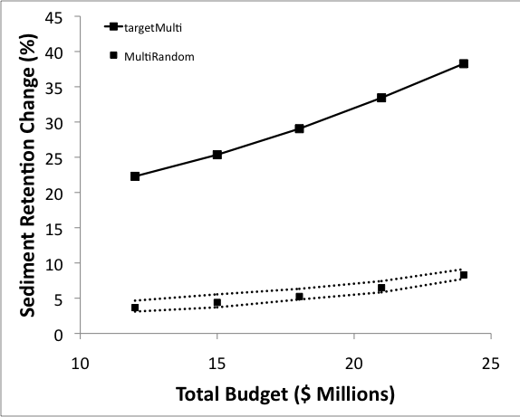
Optimized Investments
Change in Sediment Retention (%)
Fences
Protection
Restoration
Silvopasture
Total Budget (US$ Millions)

Slide 16
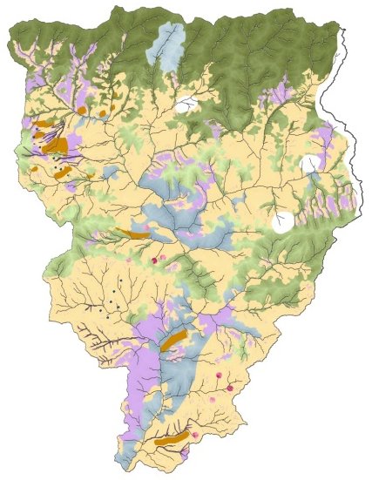
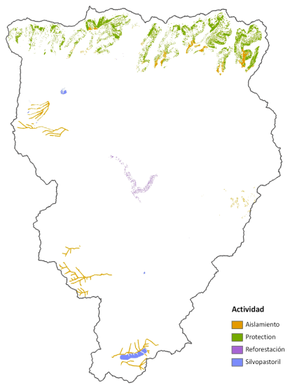
RIOS: Planning for the Future
Year
2013
2030
2050
Optimal Portfolio of Investments Over Time
Activity
Weights
Investment
Portfolio

Slide 17
Assess Risk
Resilient
by
Design
Implement & Monitor
Evaluate Solutions
Design Investments

Slide 18
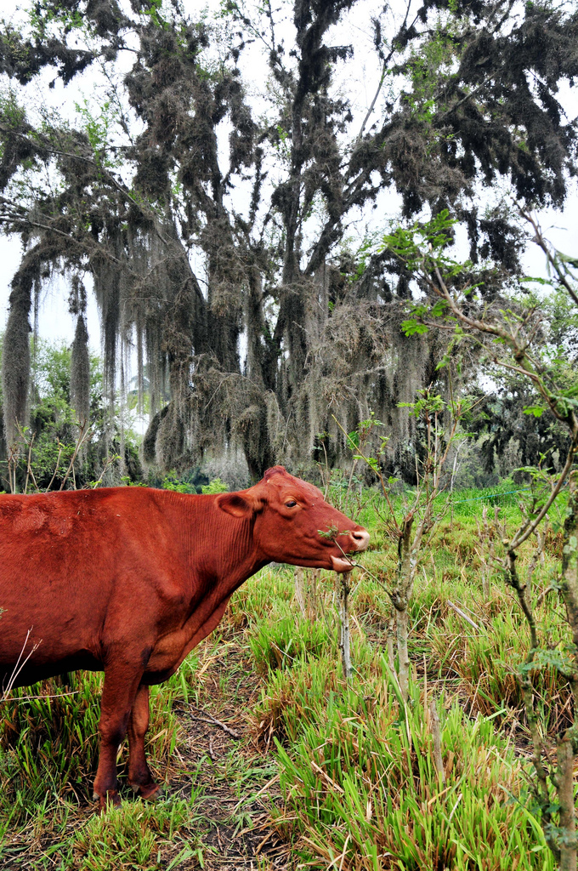
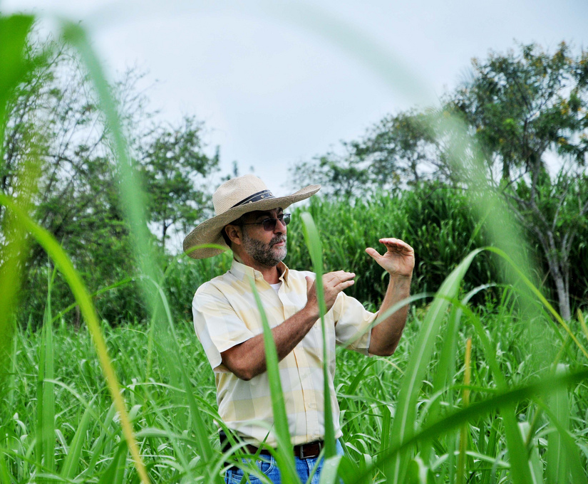
Solution: Silvopastoral System (Livestock and Trees)
Neil Palmer, CIAT
Notes:
Pic by Neil Palmer (CIAT). A perfect example of eco-efficient agriculture, provided by a CIPAV silvo-pastoral system at Reserva Natural El Hatico, familia Molina Durán, near Palmira, Colombia. Pictured is Carlos Hernando Molina. Please credit accordingly. Contact n.palmer@cgiar.org

Slide 19
Assess Risk
Capacity Building
Science & Tools
Resilient
by
Design
Implement & Monitor
Evaluate Solutions
Design Investments
Partner Collaboration
Stakeholder Engagement

