Slide 1
Challenges and Opportunities in Addressing Climate Change
The Nature Conservancy’s Climate, Risk & Resilience 2013 Learning Exchange
Col. Richard Hansen
U.S. Army Corps of Engineers
Commander, New Orleans District

Slide 2
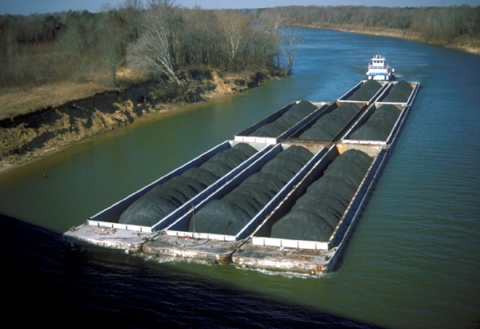
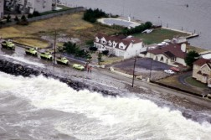
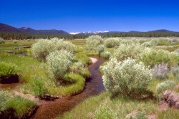
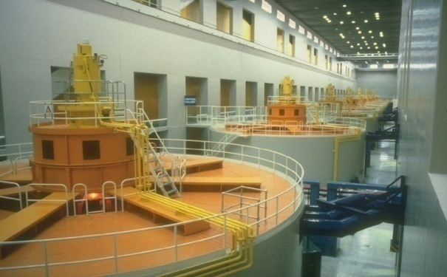
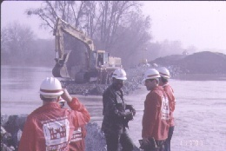
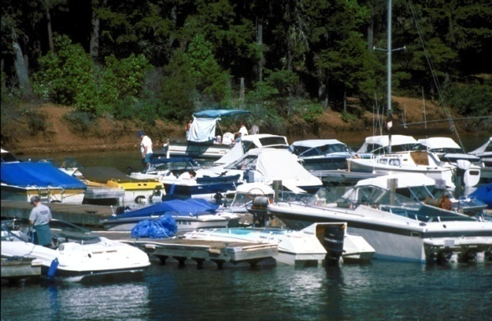
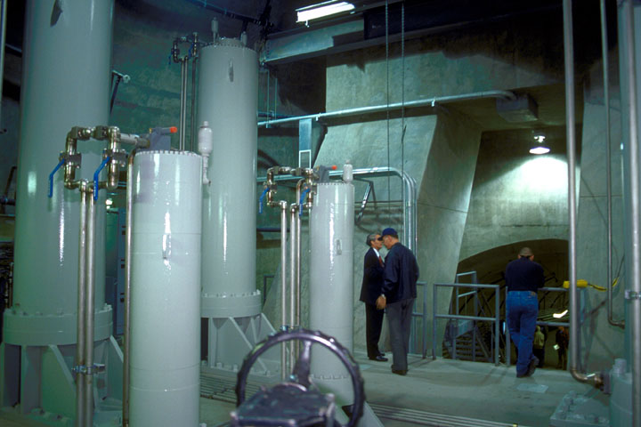
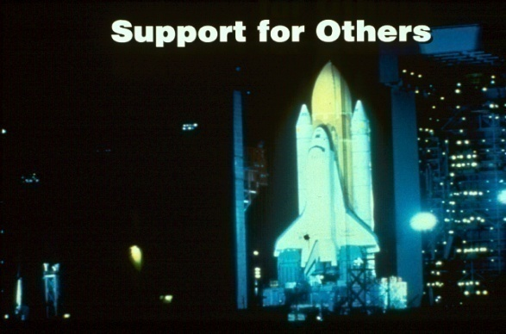
USACE: How We Serve the Nation
Navigation
Flood & Coastal
Storm Damage
Reduction
Environmental Protection
& Restoration
Hydropower
Emergency
Management
Recreation
Regulatory
Water Supply
Support for Others

Slide 3
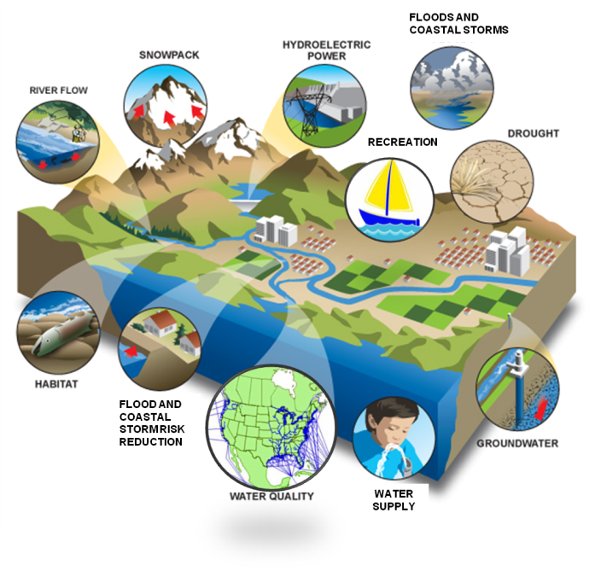
Climate Change Affects All USACE Civil Works Missions
Emergency Management
Environmental Restoration
Recreation
Flood and Coastal Storm Risk Reduction
Water Supply
Navigation
NAVIGATION

Slide 4
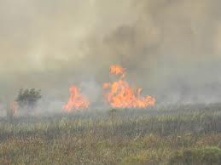
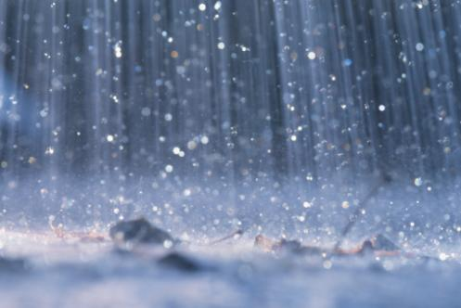
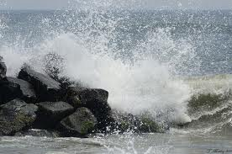
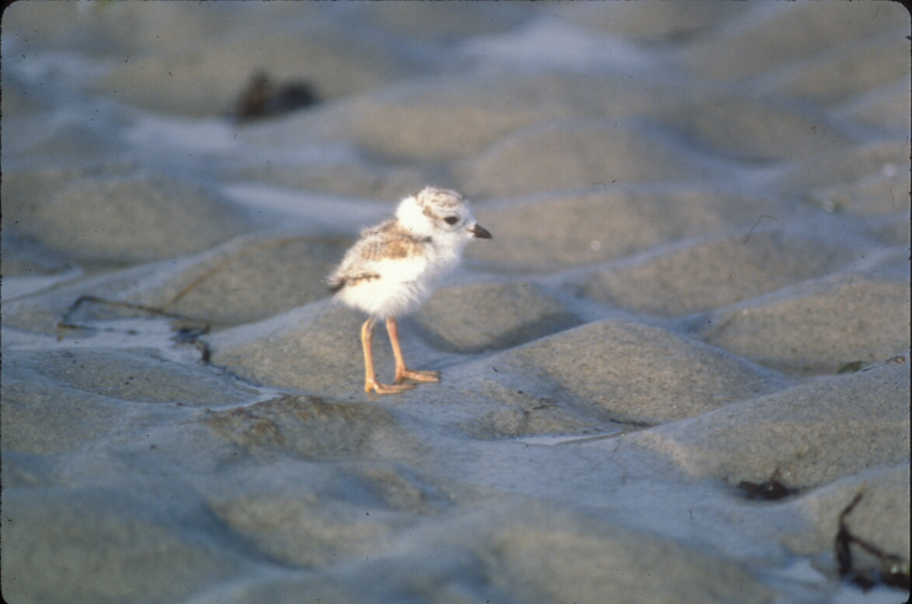
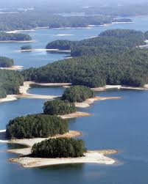
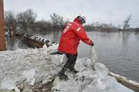
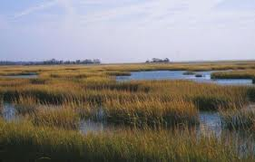
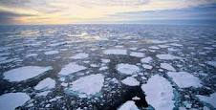
USACE Climate
Adaptation Mission:
To improve resilience and decrease vulnerability to the effects of climate change
and variability
Bill Byrne, MA F&W

Slide 5
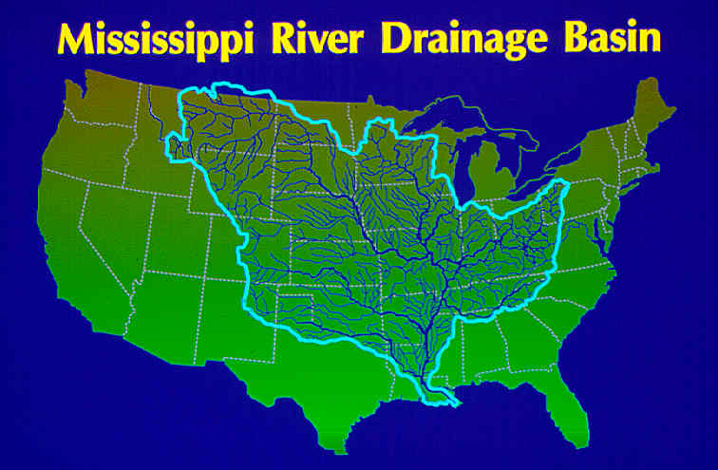

Slide 6
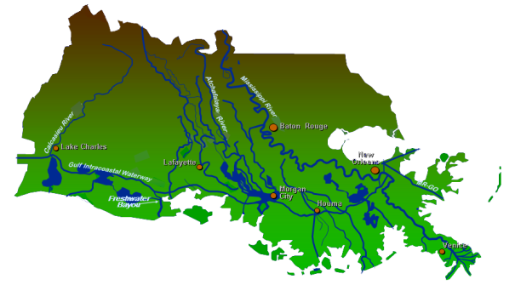
New Orleans District
MN
ND
MI
WI
MINNEAPOLIS
ST. PAUL
DUBUQUE
IA
ROCK ISLAND
IL
IN
KS
ST. LOUIS
MO
CAIRO
KY
OK
AR
TN
MEMPHIS
LITTLE ROCK
AL
2,800 miles of navigable channel
973 miles of MR&T levees
325 miles of hurricane levees
18 locks and control structures
SHREVEPORT
VICKSBURG
LA
JACKSON
TX
MS
BATON ROUGE
NEW ORLEANS

Slide 7
The Four Major Flood Risks in Coastal LA
Sea Level Rise
River
Flooding
Coastal Erosion
& Environmental
Degradation
Rainfall
Hurricane Storm
Surge
and Subsidence

Slide 8
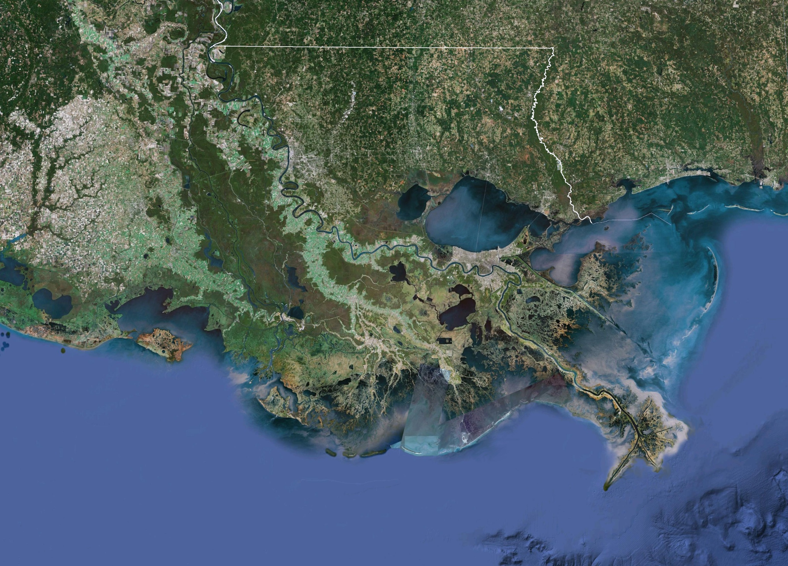
Southeast Louisiana
Mississippi River
Mississippi
Louisiana
Lake
Pontchartrain
Lake
Borgne
New Orleans
Mississippi River
River Vulnerability
From high river stages
Hurricane Vulnerability
From the Gulf
From the Lake
From the River
Gulf of Mexico

Slide 9
Hurricane and Storm Damage Risk Reduction System

Slide 10
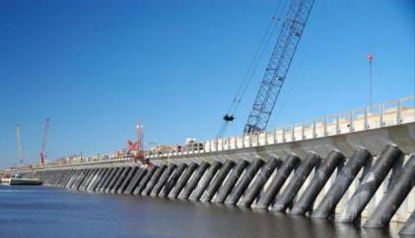
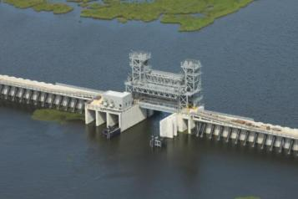
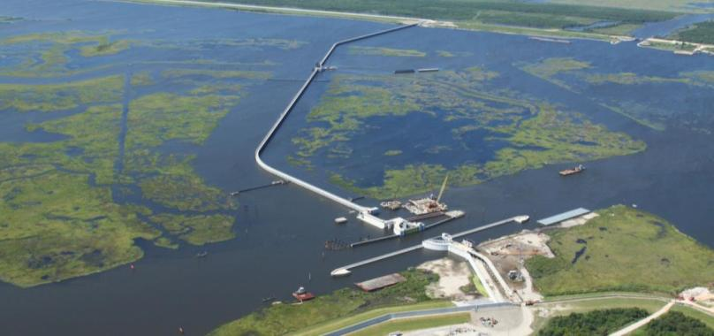
IHNC-Lake Borgne Surge Barrier

Slide 11
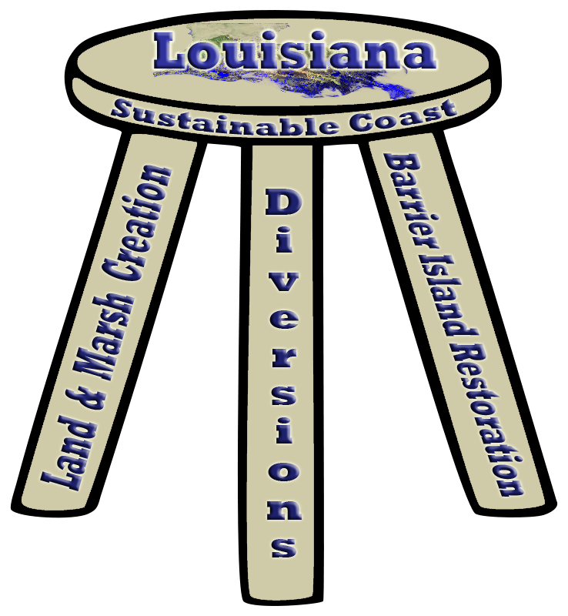
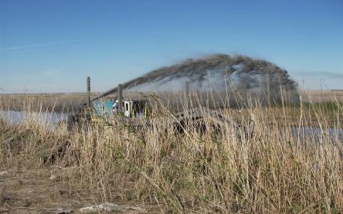
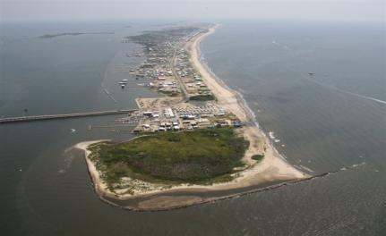
Cameron Parish Coastal
Marsh Restoration
Grand Isle
Davis Pond Freshwater Diversion

Slide 12
Challenges and Opportunities
Continued support of flood risk management, navigation and coastal restoration
Balance missions to work together for sustainable coast
Adaptive Management
Consider climate change to develop sustainable solutions

Slide 13
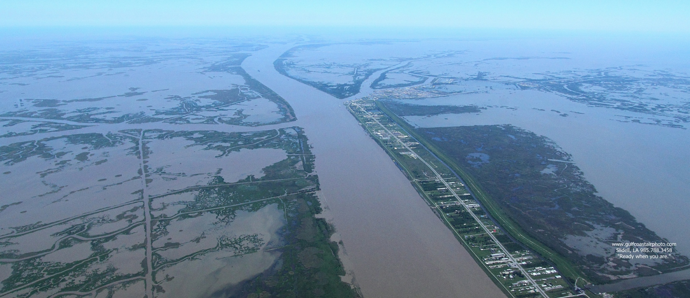
Thank You

