Slide 1
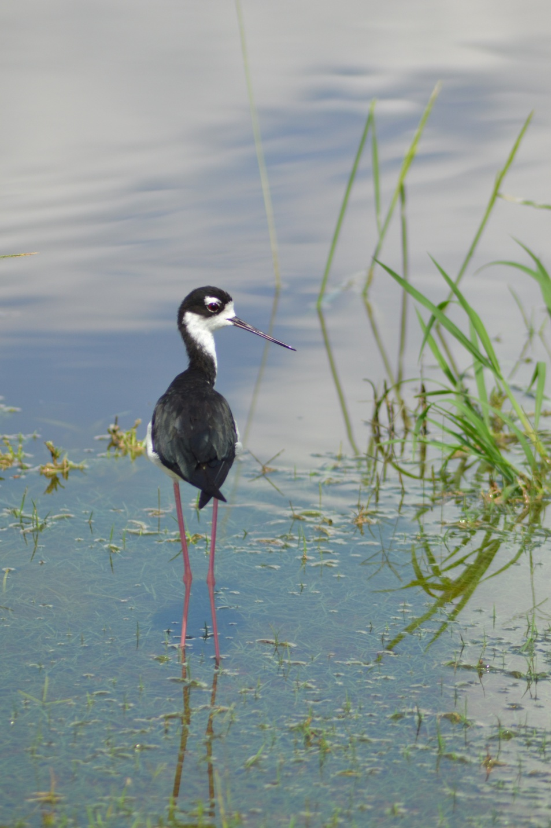

Coastal Conservation
In
Louisiana
LOUISIANA

Slide 2
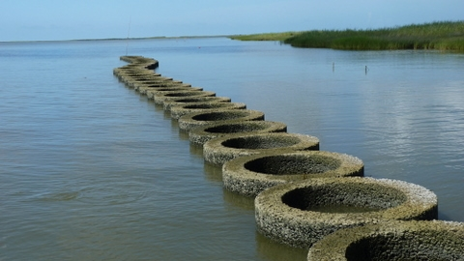
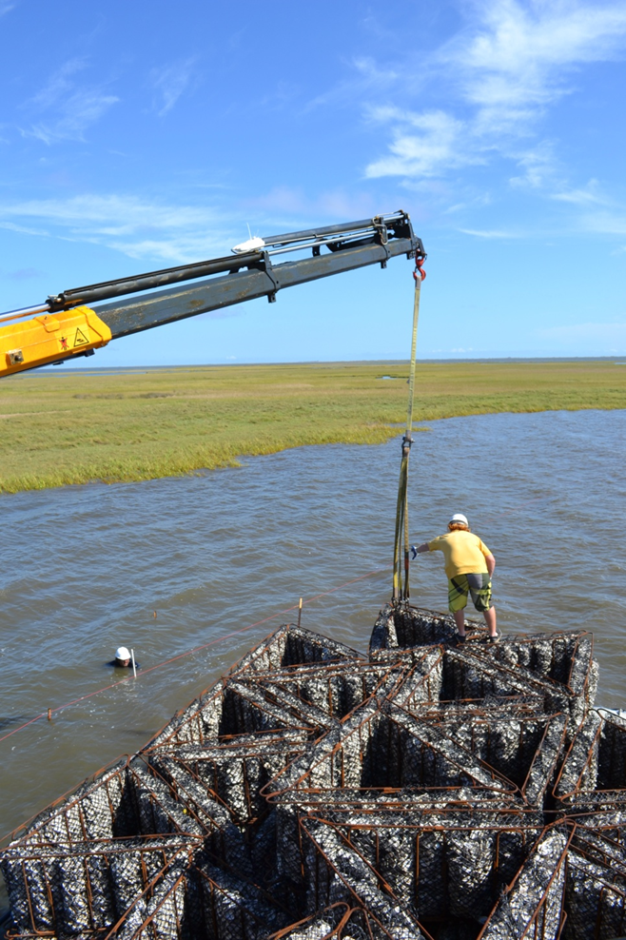
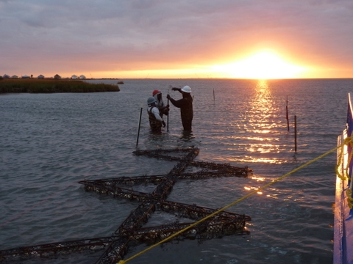
OysterHabitat Restoration & Shoreline Stabilization
LOUISIANA

Slide 3
