Slide 1
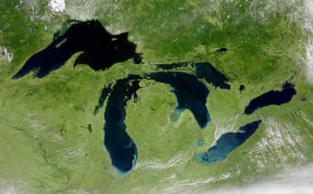
The Great Lakes Project
Patrick Doran, PhD pdoran@tnc.org
Katie Kahl, PhD kkahl@tnc.org
Kim Hall, PhD kimberly_hall@tnc.org
www.nature.org/greatlakes
Notes:
8 states

Slide 2
Stakeholders 5 Ways
Current state of knowledge: Survey results
Creating a space for collaboration
Case studies
Workflows
Place-based workshops

Slide 3
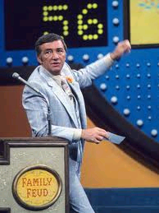
Survey Says…
Climate change and adaptation are on our minds (80%)…
…but we’re confused about the science (50%)…
…and hardly anyone knows what to do!!! (26%)

Slide 4
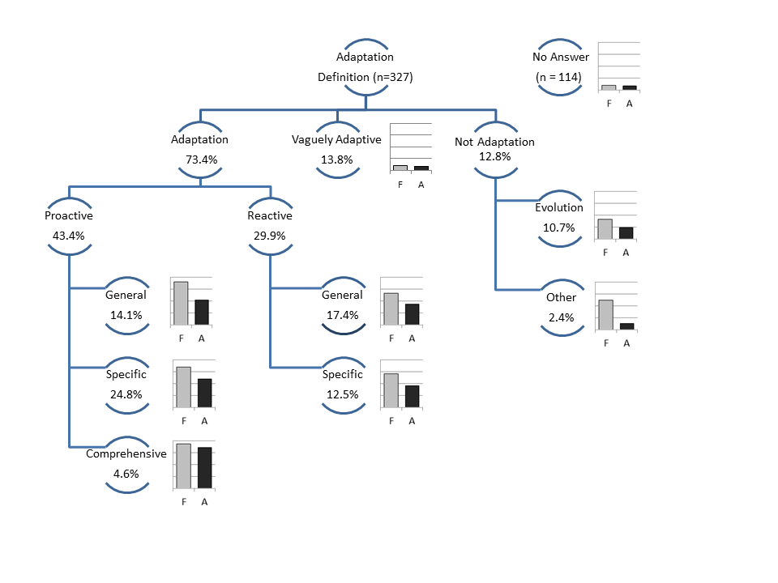
Adaptation Confusion?
74% provided a def
43% proactive
30% reactive
27% missed

Slide 5
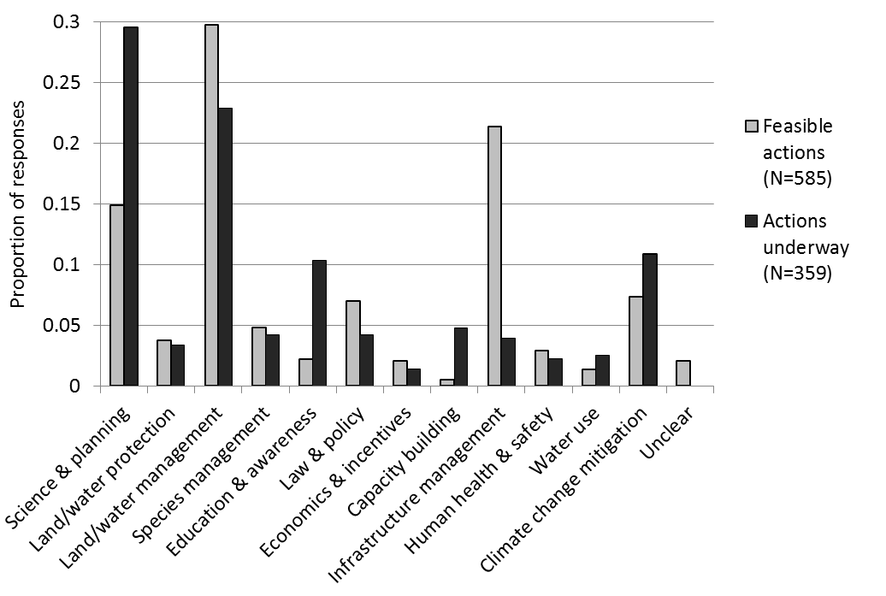

Slide 6
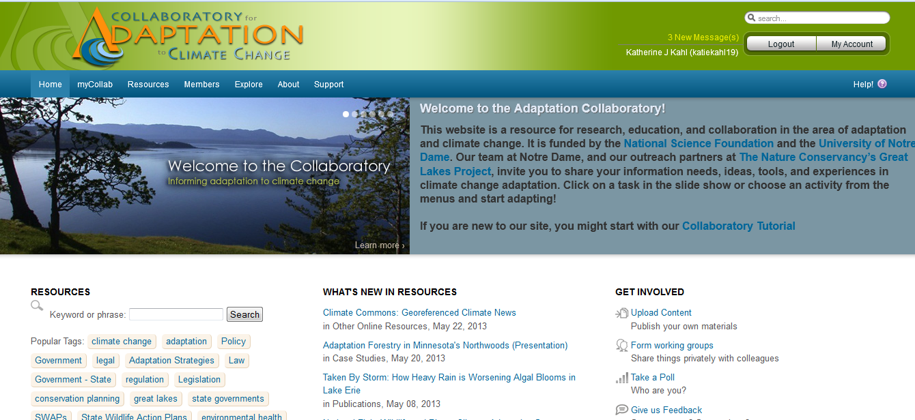
Goal: Engage & connect multi-sector practitioners, planners, decision makers, educators on climate change adaptation

Slide 7
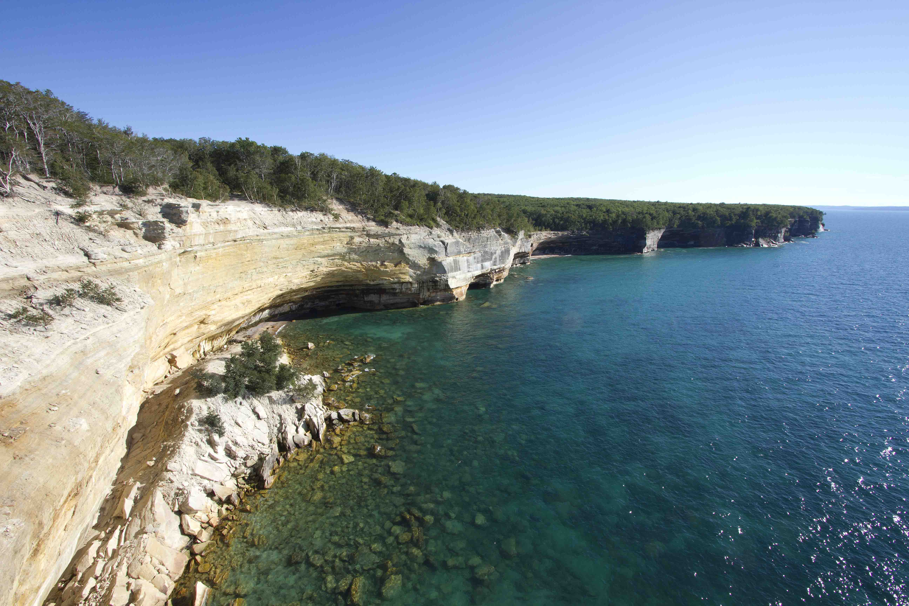
Target Audience:
Great Lakes state DNRs: from vulnerability assessments to action; using NatureServe CCVI, niche models, interactive versions of frameworks for adaptation
City of Chicago: “Climate Checklist” for resource managers
Northern forest managers in the upper Midwest (Federal, State, Tribal, NGOs, Industry, private non-industrial)
Multi-sector interests working on Great Lakes coastal community adaptation – workshop support.

Slide 8
Evolving effort
NSF: computer science
Bridge gap: research & practitioner needs
Create a testing ground; Experiments
Notre Dame’s role
TNC’s role

Slide 9
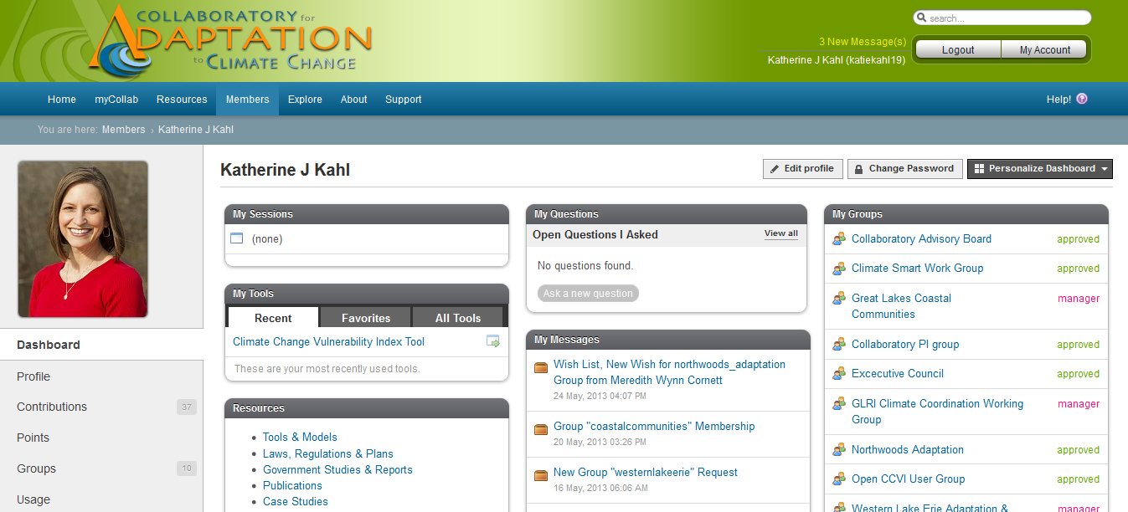
Resources, Tools, Data, Groups, Discussions
Case Studies

Slide 10
Case Studies nature.org/greatlakesclimate

Slide 11
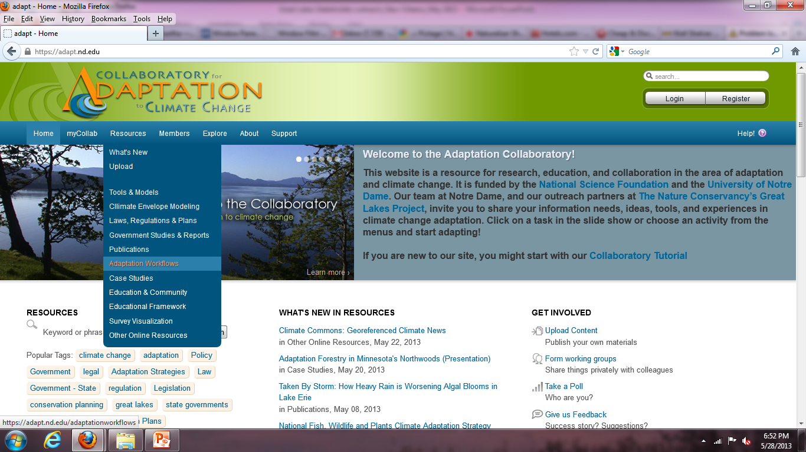
Adaptation “Workflows”
Step people through the process via an issue
Link them to people, resources, tools at each step- in a real example
Leave their examples, ask questions, discuss a step/tool/analysis
Gather demographics to inform development & marketing

Slide 12
Exploring Coastal Resilience in the Great Lakes

Slide 13
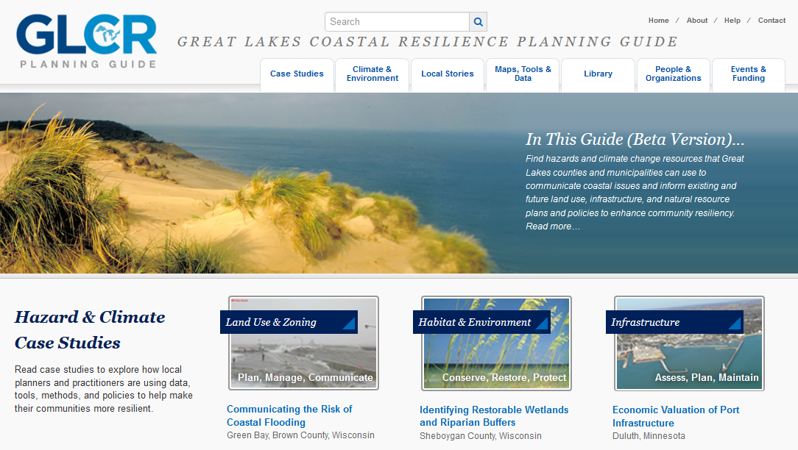
Goals:
Demonstrate the workflow concept
Demonstrate the GLCRPG
Support city of Toledo
Intersect efforts

Slide 14
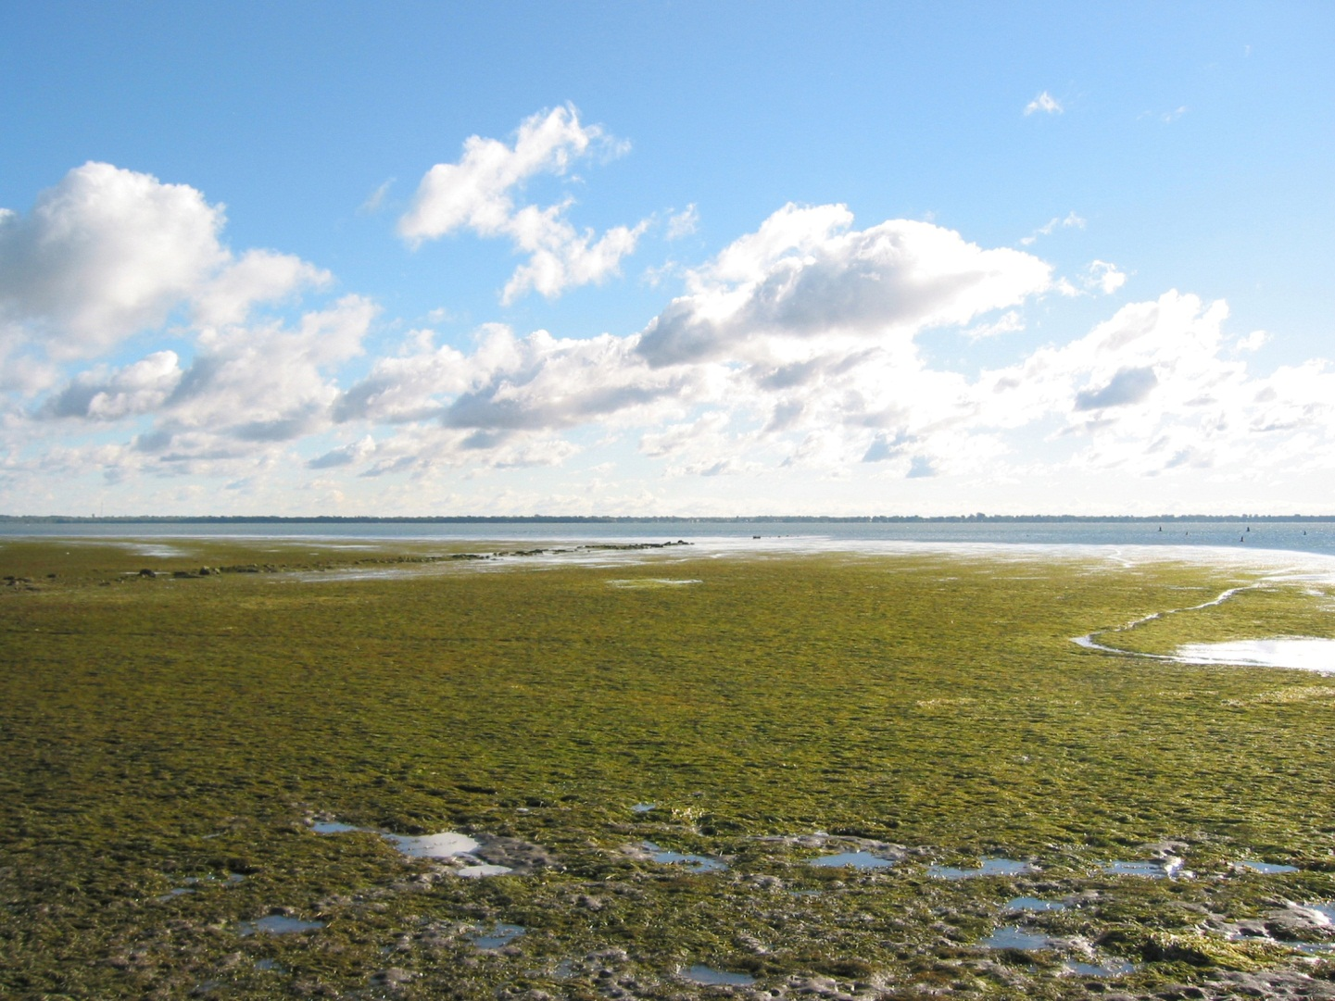
Lessons Learned
Katie Kahl
The Nature Conservancy, Great Lakes Project January 25, 2013
Language matters
People aren’t clear on concepts
Lack of communication between sectors
Pay attention to the decision-making context – metrics
We’re early in the process (learning →planning→ action)
We’re good at ecological priorities – need new ways of incorporating and translating sociocultural and economic priorities

Slide 15
Questions?
Patrick Doran pdoran@tnc.org
Katie Kahl kkahl@tnc.org
Kim Hall kimberly_hall@tnc.org

