Slide 1
SCIENCE AND TOOLS:
Effectiveness, multiple benefits, and economics of natural defenses/infrastructure:
How does it stack up against and integrate with built infrastructure?

Slide 2
Session outline:
Introduction – Setting the scene: The Natural Coastal Protection project/mangroves (10 minutes)
Short presentations from our panellists (10 minutes each)
Panel discussion, including questions from the audience (40 minutes)

Slide 3
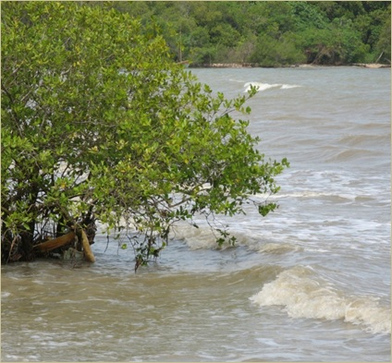
Setting the scene:
Coastal defense services from mangroves
The Natural Coastal Protection project,
working from Cambridge, UK
part of the Global Marine Team
Anna McIvor^{1,2}, Mark Spalding¹, Tom Spencer² and Iris Möller²
¹Global Marine Team, The Nature Conservancy
² Cambridge Coastal Research Unit, Dep’t of Geography, University of Cambridge UK

Slide 4
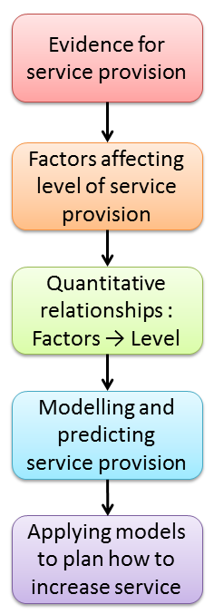
Natural Coastal Protection project research methodology
Literature review focusing on the following topics:
Scientific evidence that ecosystem provides coastal defense service
Which factors affect service provision? How they do so?
What the relationship is between the two? (i.e. ecosystem characteristics and service provision)
Has the service been modelled numerically? Can the models predict service provision based on measurable factors?
How can these models be applied to planning the appropriate use of ecosystems in coastal defense?
Examples of where ecosystems have provided coastal defense benefits.
Examples demonstrating use of ecosystem
Wind and swell waves & storm surges here – very brief overview!

Slide 5
Mangrove wind wave reduction
Small number of studies (7).
Small waves only (max wave height 70cm).
1 study during small storm surge (40 cm high waves).
Mangroves can reduce the height of wind and swell waves by between 13 and 66% over 100 m of mangroves, and between 50 and 100% over 500 m of mangroves.
High
Wave reduction depends on the width of the mangrove forest and the density of vegetation (aerial roots and branches) combined with the water depth.
Wave height and period, and slope of the substrate, also affect wave reduction.
Low
High

Slide 6
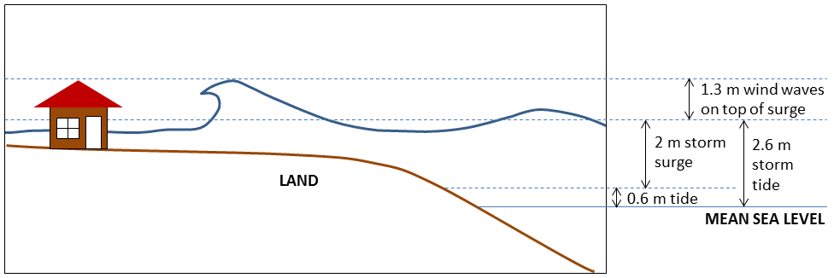
Storm surge reduction by mangroves
Limited data available on water levels and inundation, all from Florida (Krauss et al., 2009¹; Zhang et al., 2012²).
Validated numerical models are needed because impossible to control for mangrove presence/absence in the field (Zhang et al., 2012).
Mangroves are only able to attenuate storm surges by a small amount per km.
Therefore very wide bands of mangroves are needed to significantly reduce storm surge water levels.

Slide 7
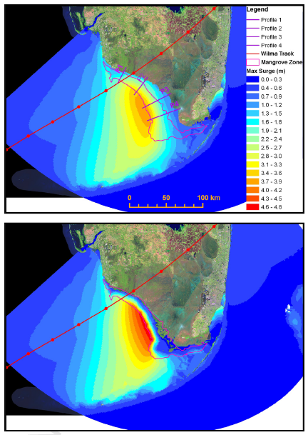
Storm surge reduction by mangroves
Depends on:
storm surge forward speed (slow moving surges are reduced less);
vegetation density;
presence of open water areas/channels (surge passes through more easily);
hurricane intensity, which may damage trees reducing their potential to reduce surges.
(based on numerical model by Zhang et al., 2012)
While storm surge height reduction is small per km mangrove width, a small change in storm surge height can result in a large change in flooded area, depending on local topography, and hence a large reduction in damage to property.
Storm surge reduction in Florida during Hurricane Wilma
From Zhang et al., 2012

Slide 8
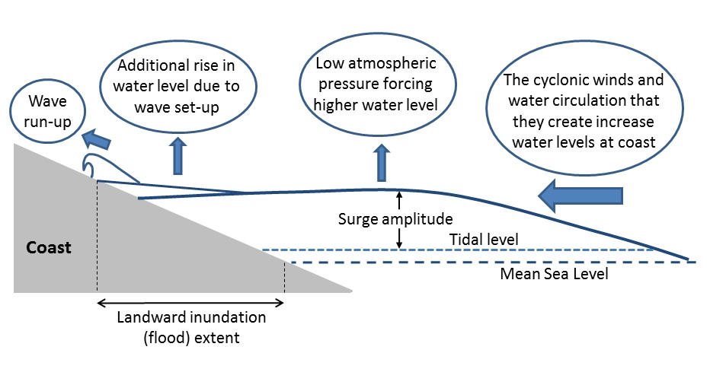
Wind wave and storm surge reduction by mangroves
The reduction in wind and swell waves riding on top of the surge can result in a large reduction in storm damage
Tanaka (2008) numerically modelled the storm surge from Cyclone Sidr (2007, Bangladesh) through a 150m belt of Casuarina (non-mangrove)
Trees had no effect on storm surge level, but reduced waves on surge, resulting in 12 to 28 cm reduction in the height the water reached over this short distance
Suggests best use of mangroves in combined approach:
e.g. mangroves reduce waves in front of dike/wall, reducing damage and therefore maintenance costs.
Also may reduce required height of wall/dike.
Storm surge forcings

Slide 9
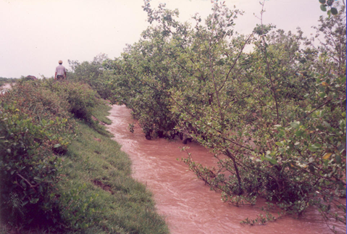
Mangroves in coastal risk reduction – Vietnam case study
Coastal afforestation for disaster risk reduction
in Vietnam, undertaken by Vietnamese, Danish
and Japanese Red Cross between 1994 – 2010
hybrid structures – dyke + mangrove
8,961 hectares of mangroves created,
protecting 100 km of dyke
Themes:
- hybrid structures
- multiple risk reduction measures
- multiple benefits
(IFRC, 2011)
2 million people estimated to be better protected by mangroves and other trees
Comparing damage caused by similar typhoons before and after intervention, damage to dykes reduced by between US$ 80,000 to US$ 295,000 in studied communes, and savings of up to US$ 38 million in total avoided losses
Mangroves protecting dike in Vietnam
Sonneratia caseolaris plantation protects
sea dikes in Thai Binh Province, Vietnam (photo from presentation by Mai Sỹ Tuấn)
(Jegillos et al., 2005; IFRC, 2011)

Slide 10
Mangrove storm surge reduction in Vietnam – cost benefit ratios
Commune | Dai Hop | Thai Do | Giao An
Population | 10,955 | 6,087 | 10,496
Dyke line (km) | 4 | 7.5 | 3.2
Planting-related costs (USD) | 425,866 | 858,373 | 646,641
Protective benefits (USD) | 676,868 | 15,330,243 | 37,818,545
Benefit/cost ratio | 1.59 | 17.9 | 58.5
Direct economic benefits | 628,094 | 672,436 | 6,748,533
Benefit/cost ratio | 3.06 | 18.64 | 68.92
Including reduced dike maintenance costs and avoided losses to shrimp farms, farmland and other property and infrastructure
Including multiple benefits: fisheries, wood, honey, water filtration, carbon sequestration
(IFRC, 2011)

Slide 11
Mangrove storm surge reduction in Vietnam – multiple benefits
Themes:
- hybrid structures
- multiple risk reduction measures
- multiple benefits
Significant co-benefits (e.g. shellfish, bees)
(IFRC, 2011)
Multiple benefits of mangroves – many other ecosystem services
Ecosystem | Ecosystem services
Mangrove | Primary productivity supporting fisheries (fish, shellfish, crabs), wood (firewood/timber), non-timber forest products (e.g. honey, plants for foods and medicines), uptake of nutrients and water filtration, sediment retention, shelter for fish nurseries, carbon sequestration (mangrove peats)
(Ewel et al., 2008; Barbier et al., 2011; IRRC, 2011; and others)
other ecosystem services contribute to on-going livelihoods
particularly important post-disaster when normal services may be interrupted
therefore contribute to local resilience.

Slide 12
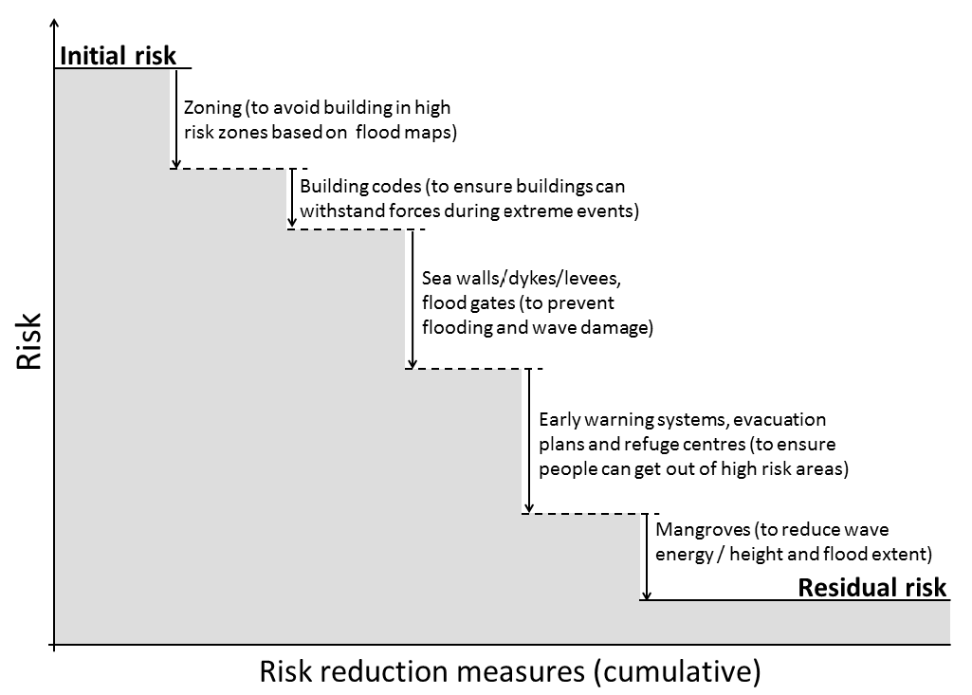
Mangroves in coastal risk reduction – Vietnam case study
300,000 students, teachers, volunteers and commune wards also trained in disaster preparedness
Themes:
- hybrid structures
- multiple risk reduction measures
- multiple benefits
(IFRC, 2011)
Multiple risk reduction measures
There will always be some
residual risk.
Zoning
Building codes
Built infrastructure
(sea walls, dikes)
Early warning systems, evacuation plans, refuge centres
(Adapted from diagram presented by Ty Wamsley, US Army Corps of Engineers.)
Mangroves

Slide 13
TOOLS & SCIENCE:
Effectiveness, multiple benefits, and economics of natural defenses/infrastructure: How does it stack up against and integrate with built infrastructure?
In summary – Mangroves as a natural risk reduction measure
Session themes | Evidence (observations, case studies, models etc) | Comparing natural defenses with built infrastructure | Potential for integration with built infrastructure
Effectiveness | Reduce wind and swell waves over short distances, storm surges over longer distances | Waves – mangroves can achieve same level of reduction (larger spatial footprint) | High: best solution may be combined use, with mangroves reducing waves in front of built infrastructure
Multiple benefits | Fisheries, wood, honey, water filtration, carbon sequestration | Hard defences built for single purpose of coastal defence – few other benefits | Combined approaches likely to result in provision of multiple benefits
Economics | Few cases where mangroves used alone in coastal defence |  | Vietnam case study: cost/benefit ratios favorable, mangroves reduced maintenance costs to dikes and reduced other losses

Slide 14
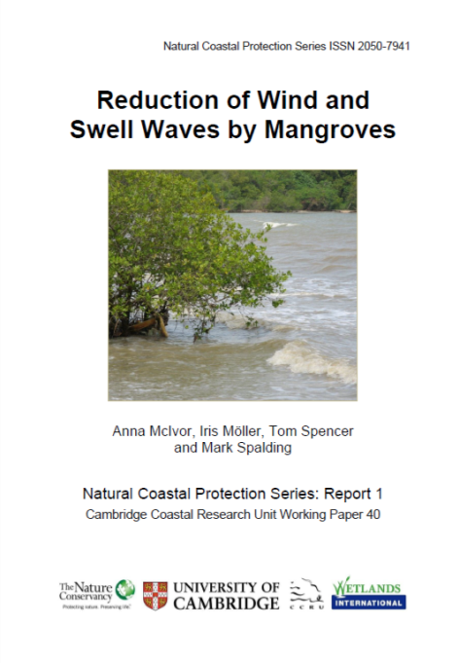
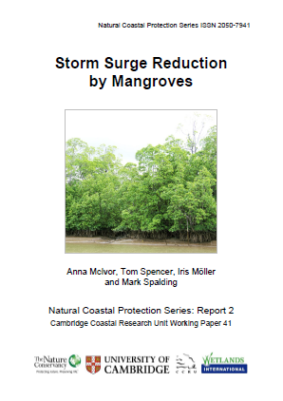
Reports on-line:
http://www.naturalcoastalprotection.org
& http://coastalresilience.org/science
For more information:
contact Anna McIvor anna.mcivor@tnc.org
or Mark Spalding mspalding@tnc.org
Acknowledgements
Femke Tonneijck, Mike Beck, Jan van Dalfsen, Pieter van Eijk, Joanna Ellison, Filippo Ferrario, Dolf de Groot, Evamaria Koch, Catherine Lovelock, Karen McKee, David McKinnie, Denise Reed, Pam Rubinoff, I. Nyoman Suryadiputra, Norio Tanaka, Trevor Tolhurst, Mai Sỹ Tuấn, Ty Wamsley, Bregje van Wesenbeeck, Jo Wilson, Han Winterwerp, Eric Wolanski and Colin Woodroffe.
We thank all these people for their comments on this research and these reports, either through correspondence, or at the “Mangroves as Coastal Protection” workshop held in Bogor, Indonesia, 19-22 January 2012, or at the Natural Coastal Protection workshop help in Cambridge, UK, 27-29 March 2012.
This work has been funded by The Nature Conservancy
and The Mangrove Capital Project coordinated by
Wetlands International.

Slide 15
TOOLS & SCIENCE:
Effectiveness, multiple benefits, and economics of natural defenses /infrastructure: How does it stack up against and integrate with built infrastructure?
Panellists:
Coastal: Christine Pickens – TNC North Carolina – Albemarle Sound Project
Coastal: Jaap Kwadijk – Deltares, The Netherlands – Deltares approach to and experience of using natural infrastructure
Coastal: Jennifer Molnar – TNC Central Science – TNC Dow Texas project
Freshwater: Kris Johnson – TNC North America Freshwater Program – Floodplains for flood risk reduction
Please write down your questions – take questions after all panelists have spoken.

