Slide 1
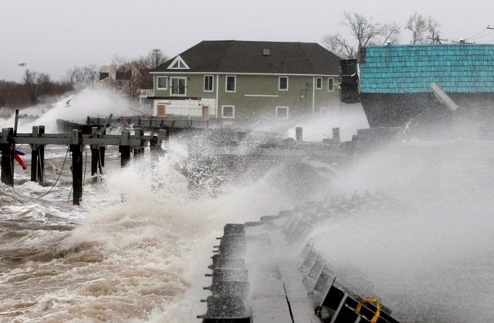
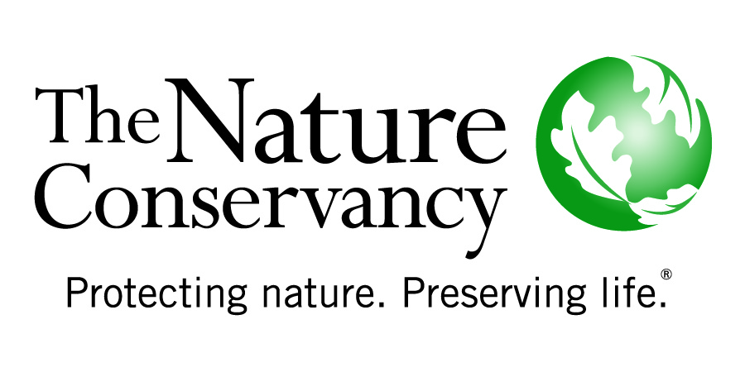
Risk Assessment 101
Chris Shepard
Marine Scientist
Global Marine Team

Slide 2
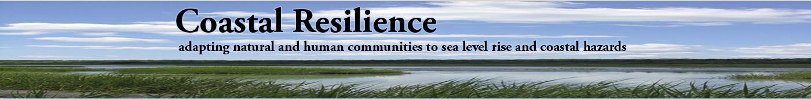
Assess Risk
Identify Solutions
Take Action
Measure Effectiveness

Slide 3
UNISDR Definitions
Risk = The combination of the probability of an event and its negative consequences.
Vulnerability = The characteristics and circumstances of a community, system or asset that make it susceptible to the damaging effects of a hazard.”
Natural hazard- Natural process or phenomenon that may cause loss of life, injury or other health impacts, property damage, loss of livelihoods and services, social and economic disruption, or environmental damage.
Adaptation- The adjustment in natural or human systems in response to actual or expected climatic stimuli or their effects, which moderates harm or exploits beneficial opportunities.
Disaster risk reduction- The concept and practice of reducing disaster risks through systematic efforts to analyse and manage the causal factors of disasters, including through reduced exposure to hazards, lessened vulnerability of people and property, wise management of land and the environment, and improved preparedness for adverse events.

Slide 4
RISK= Exposure X Vulnerability
Exposure- who or what is exposed to the hazard
Vulnerability- characteristics and circumstances of a community, system or asset that make it susceptible to the damaging effects of a hazard

Slide 5
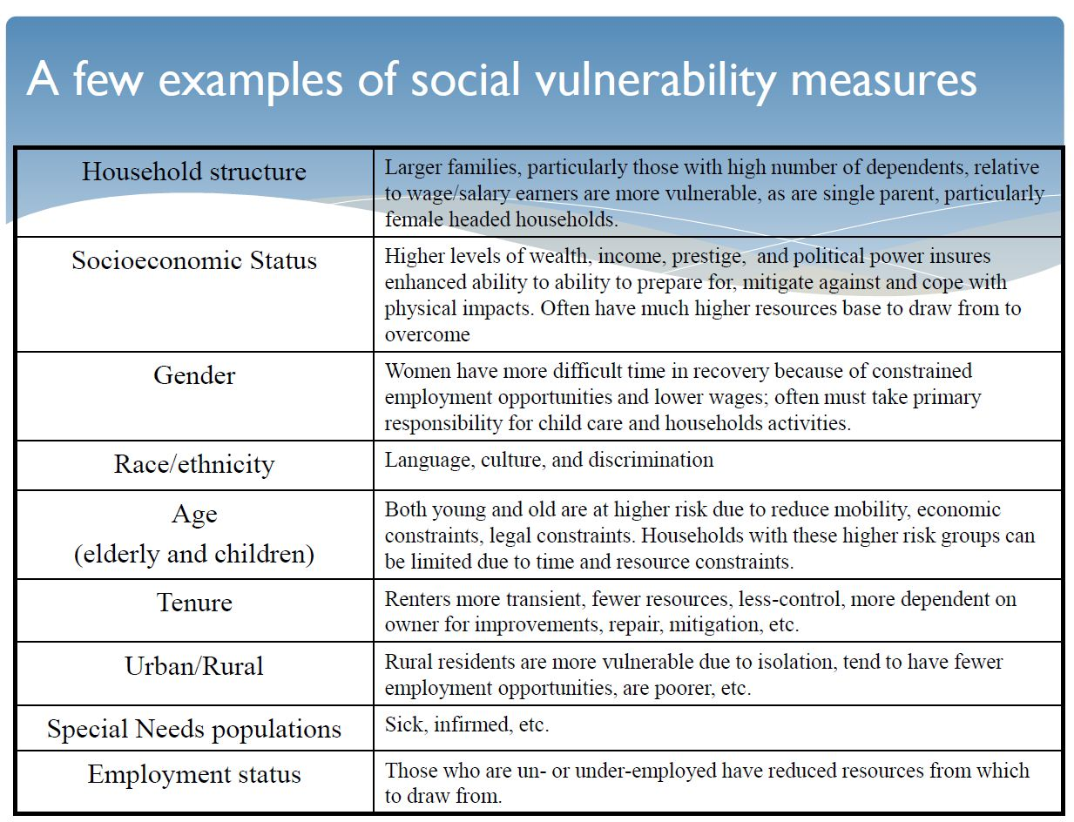

Slide 6
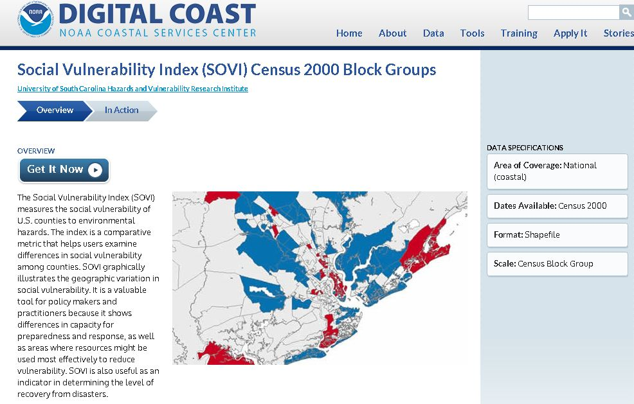

Slide 7
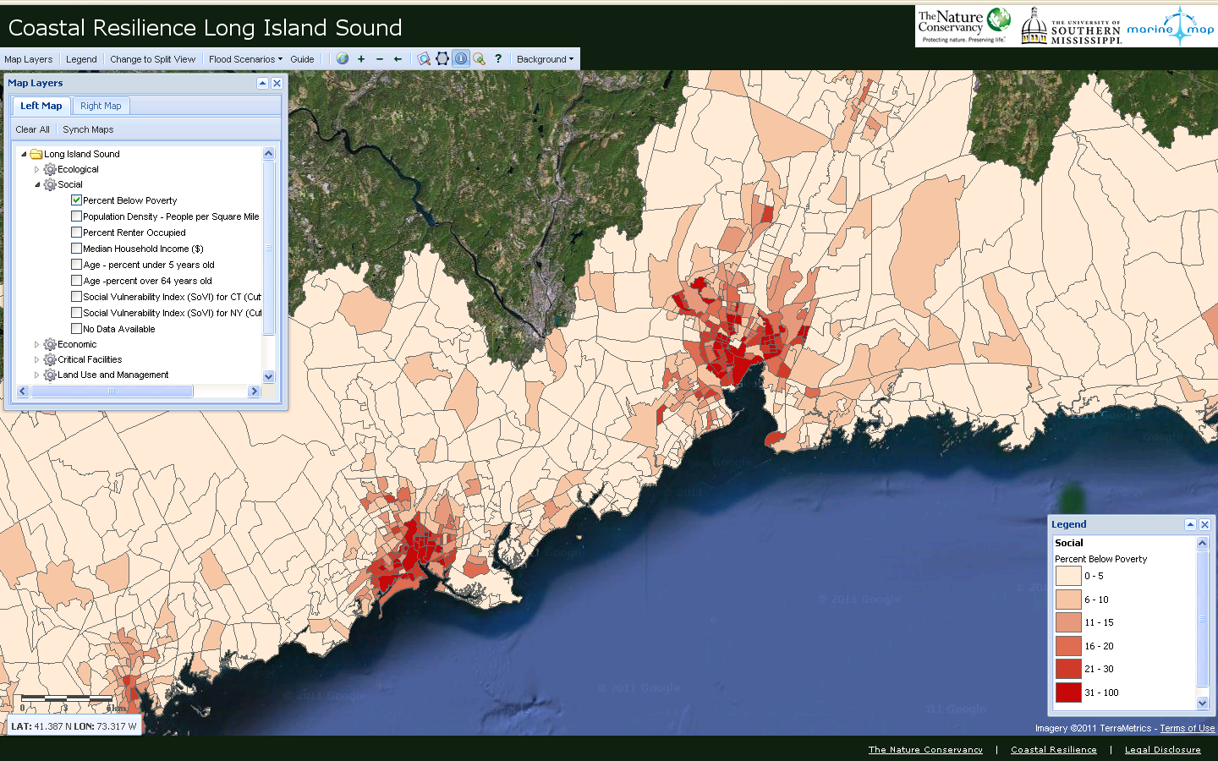

Slide 8
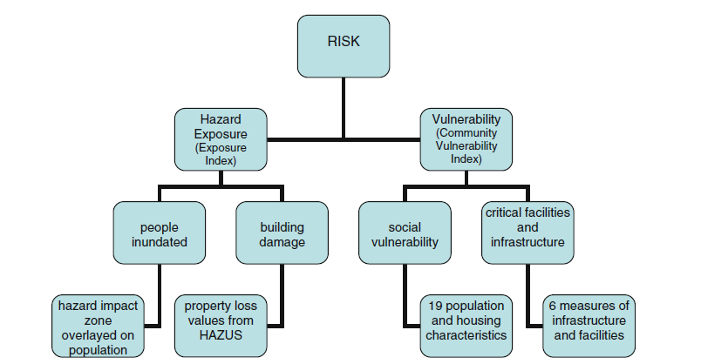
RISK= Exposure X Vulnerability
Shepard et al. 2011

Slide 9
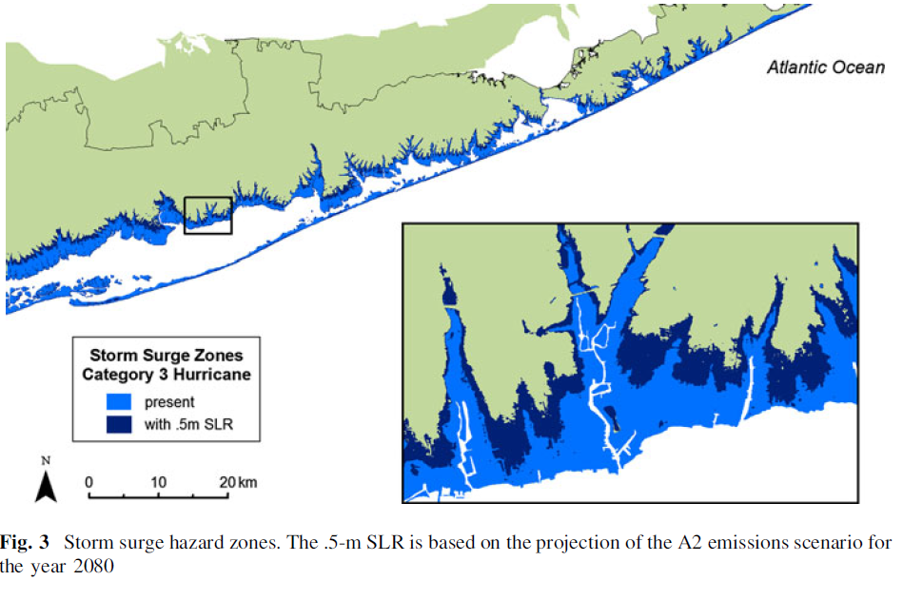
Shepard et al. 2011

Slide 10
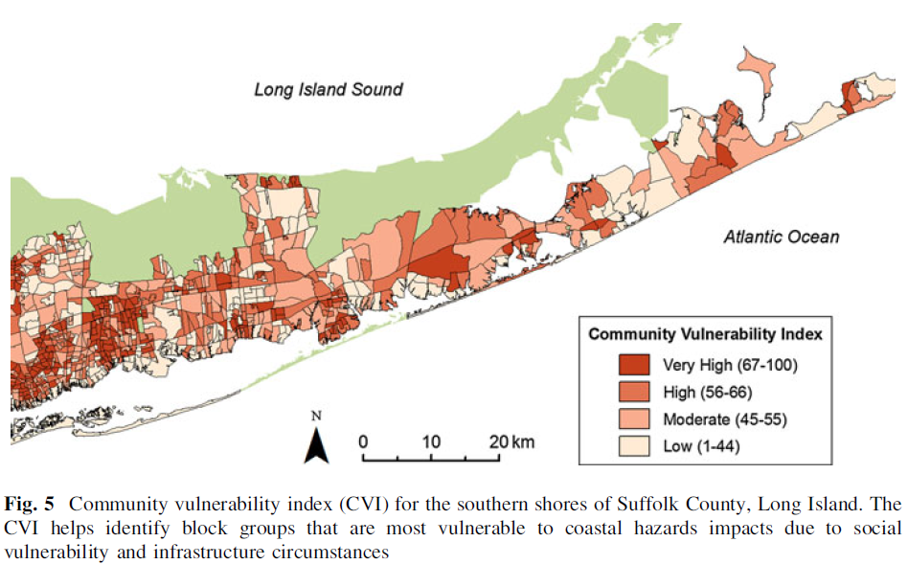
Shepard et al. 2011

Slide 11
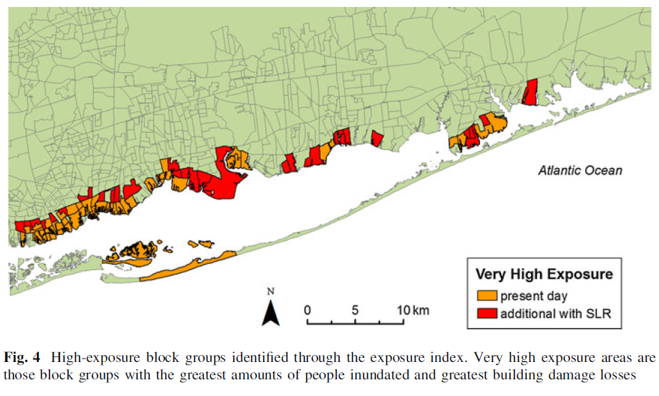
SLR increases exposure
Shepard et al. 2011

Slide 12
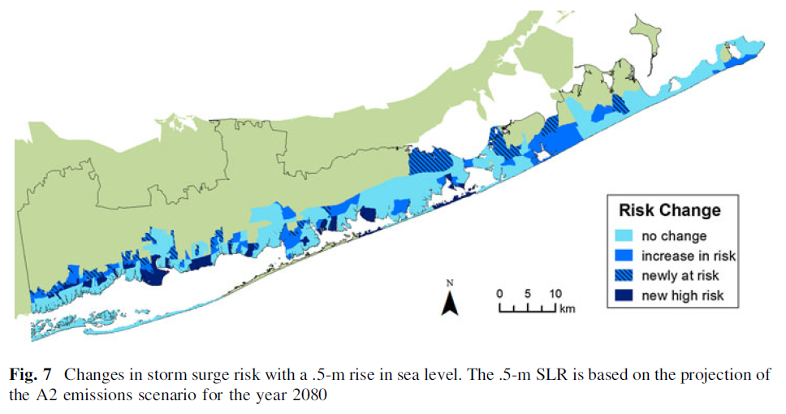
Visualizing Risk
Shepard et al. 2011

Slide 13
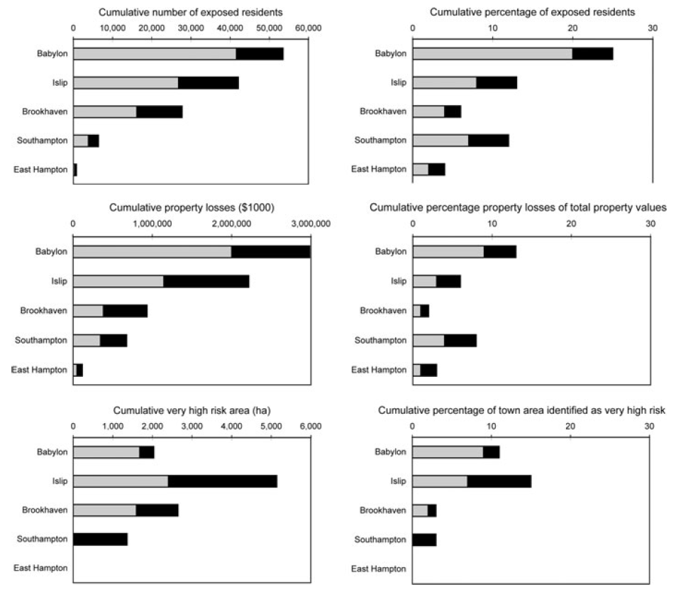
Shepard et al. 2011

Slide 14
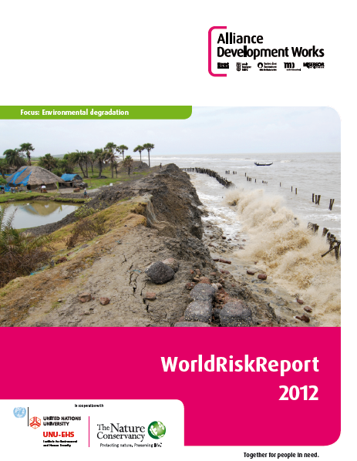
World Risk Report: Coastal Habitats and Hazards
Mike Beck and Christine Shepard
The Nature Conservancy &
UC-Santa Cruz
Global Scale

Slide 15

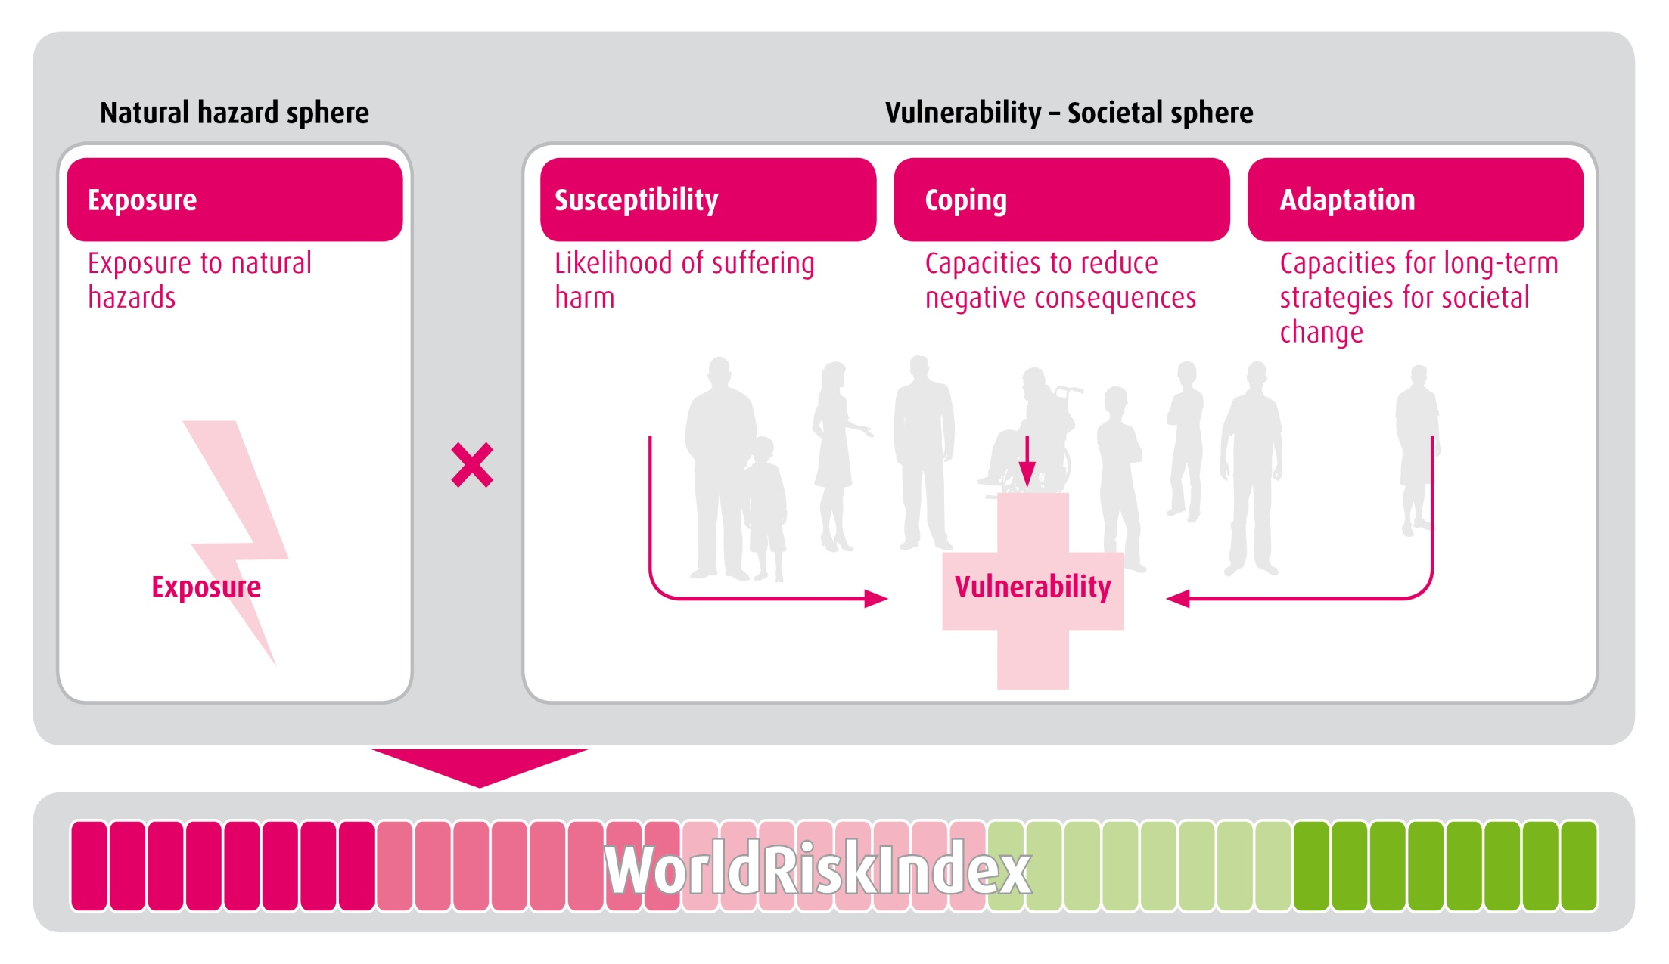
World Risk Index

Slide 16
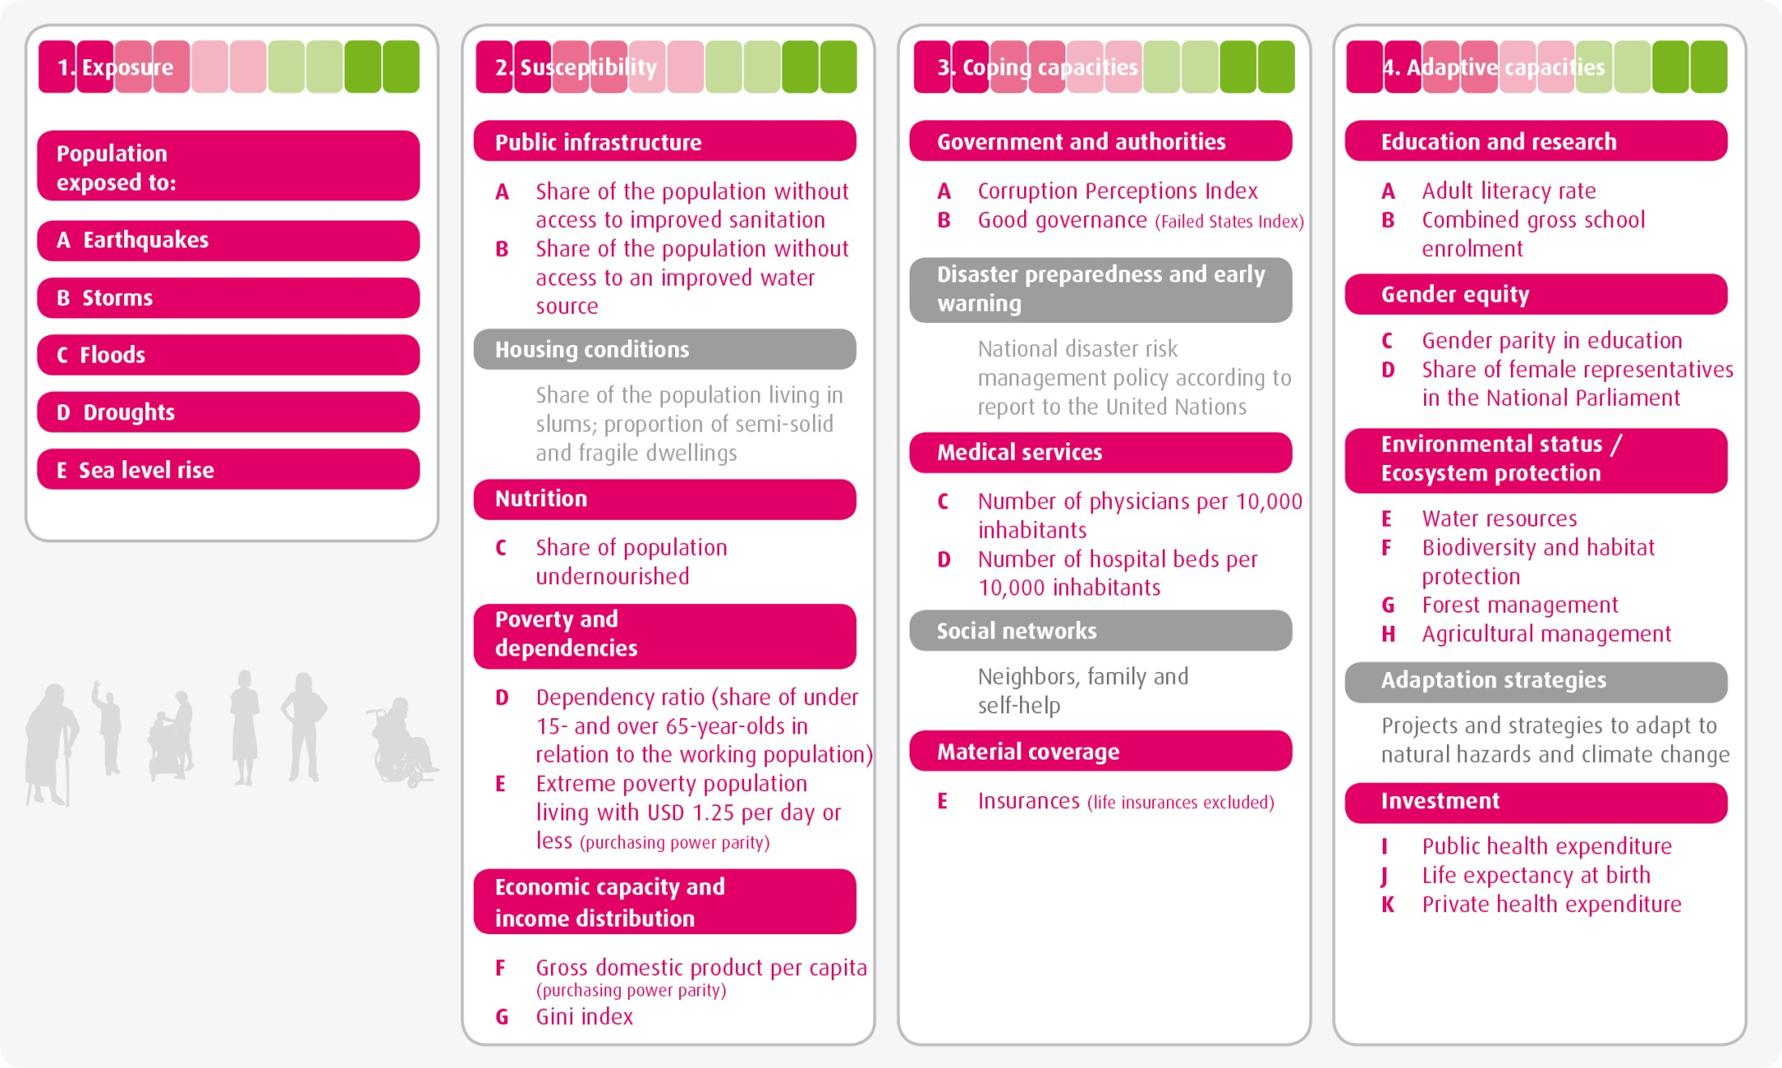
Components and Indicators of the World Risk Index

Slide 17
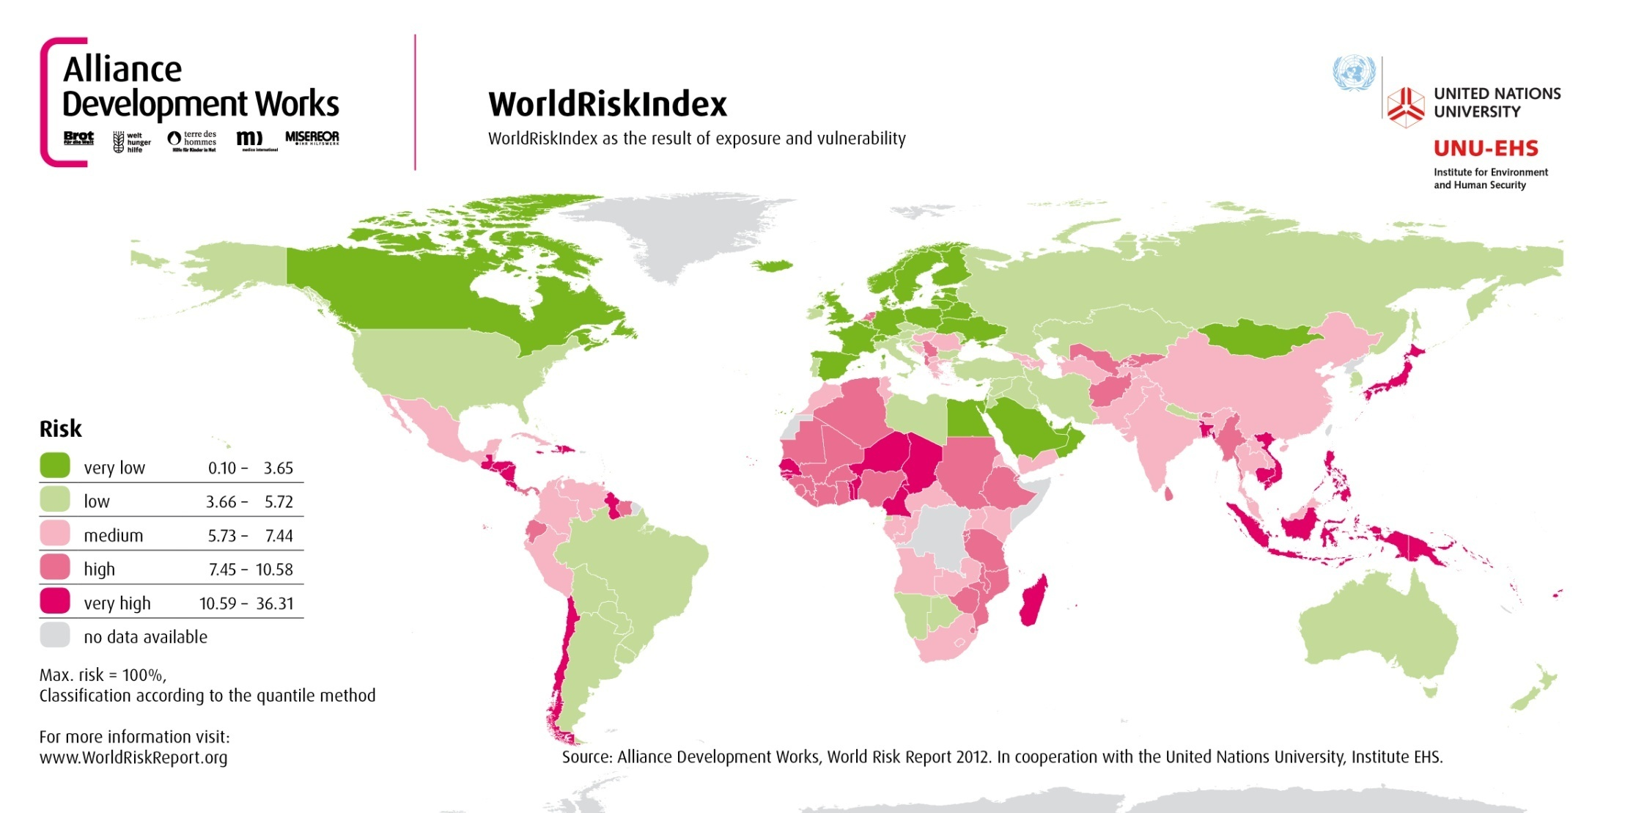
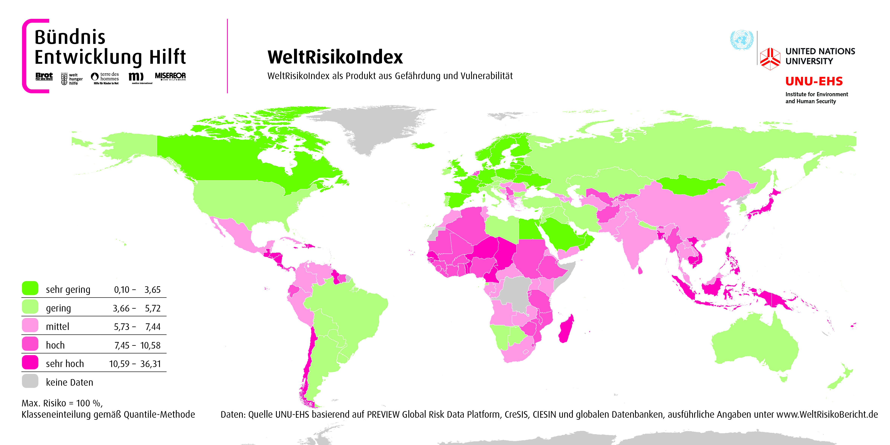
WorldRiskIndex 2012

Slide 18
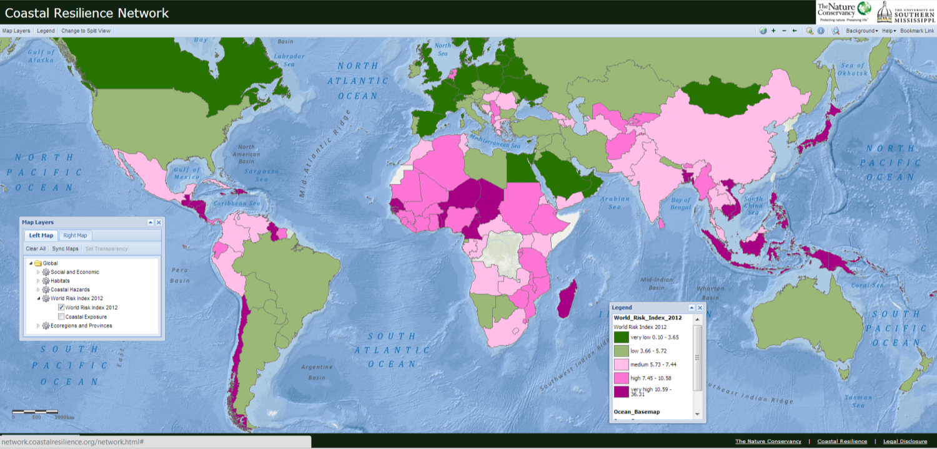

Slide 19
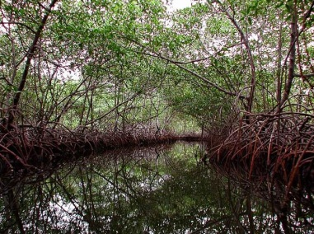
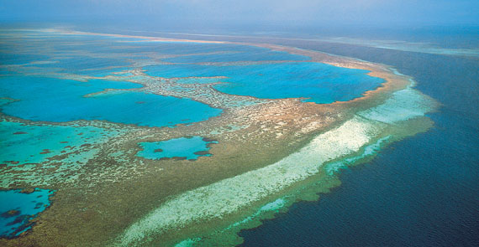
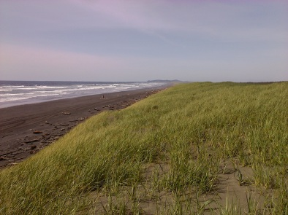
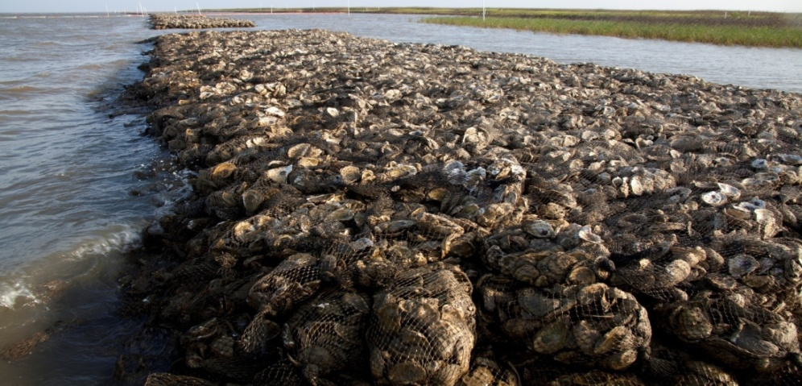
Where do habitats fit into Risk assessment?

Slide 20

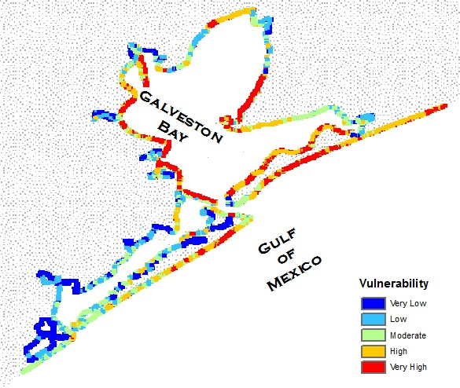
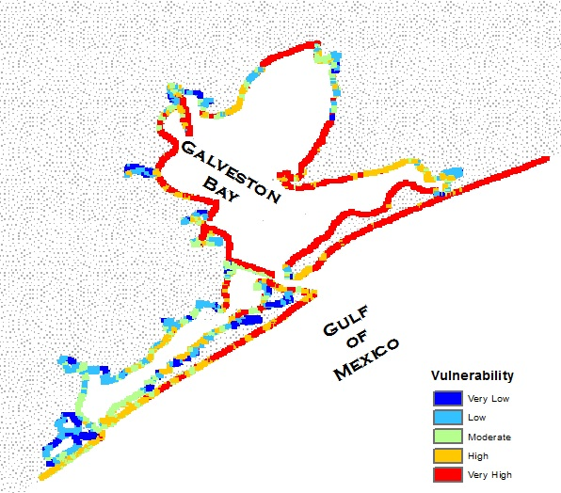

Where do specific habitats play a role in risk reduction across the Gulf?
With oyster reefs and marshes
Without oyster reefs and marshes
Notes:
Give ideas of places with erosion and in considering several management optins this helps to see how natural habitats can be part of the solution

Slide 21
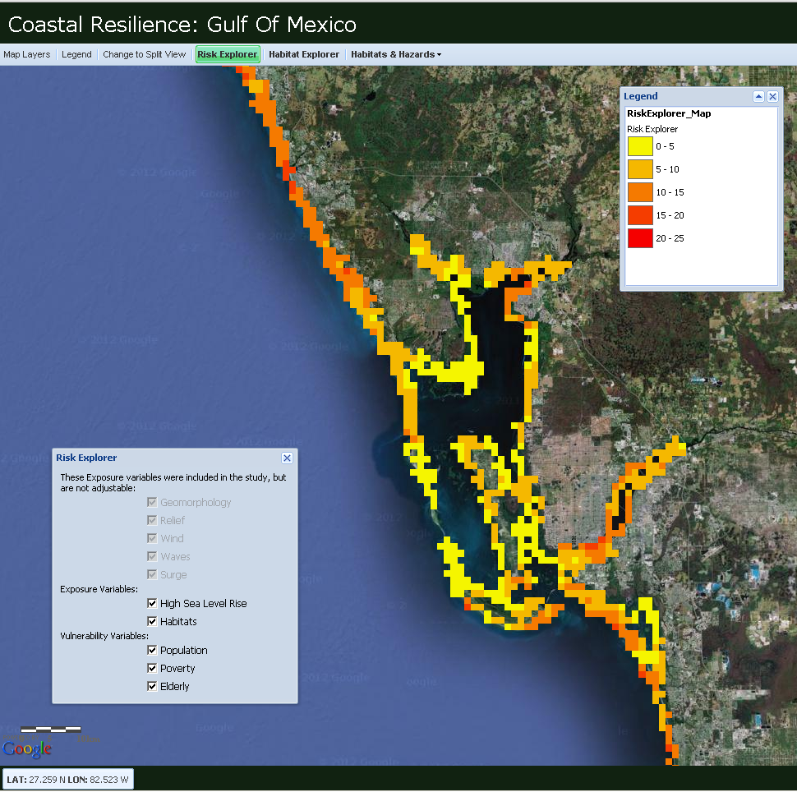
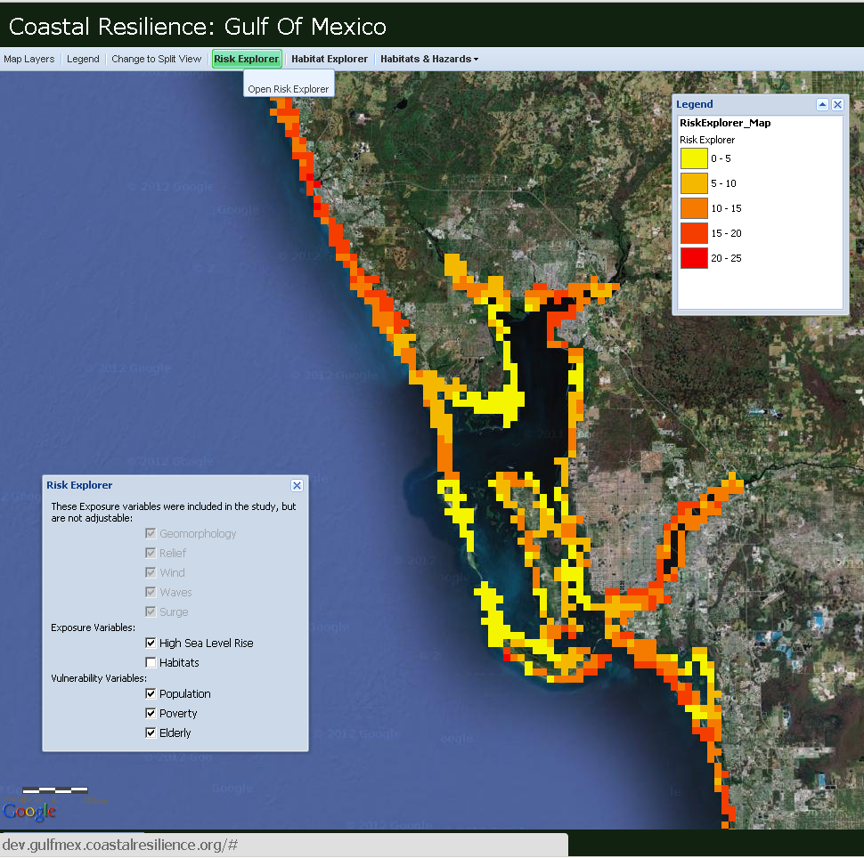
Risk Explorer
Risk Explorer- interactive web based risk assessment

Slide 22
www.coastalresilience.org
Chris Shepard
cshepard@tnc.org

