Slide 1
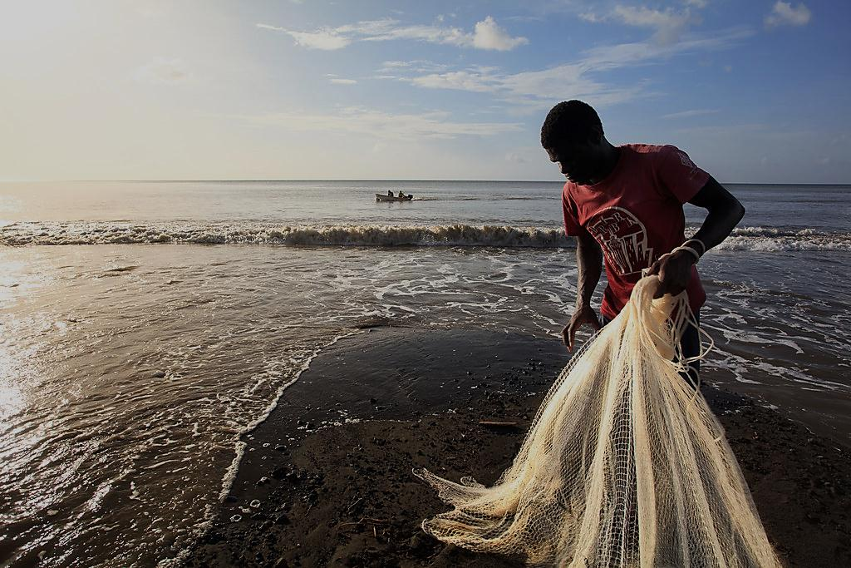


Evaluating the effectiveness of nature based strategies: engaging and building baseline information on communities
Terry Charles, Juliana Castano and Vera Agostini
Photo: Marjo Ahijo
Notes:
[add photo]

Slide 2
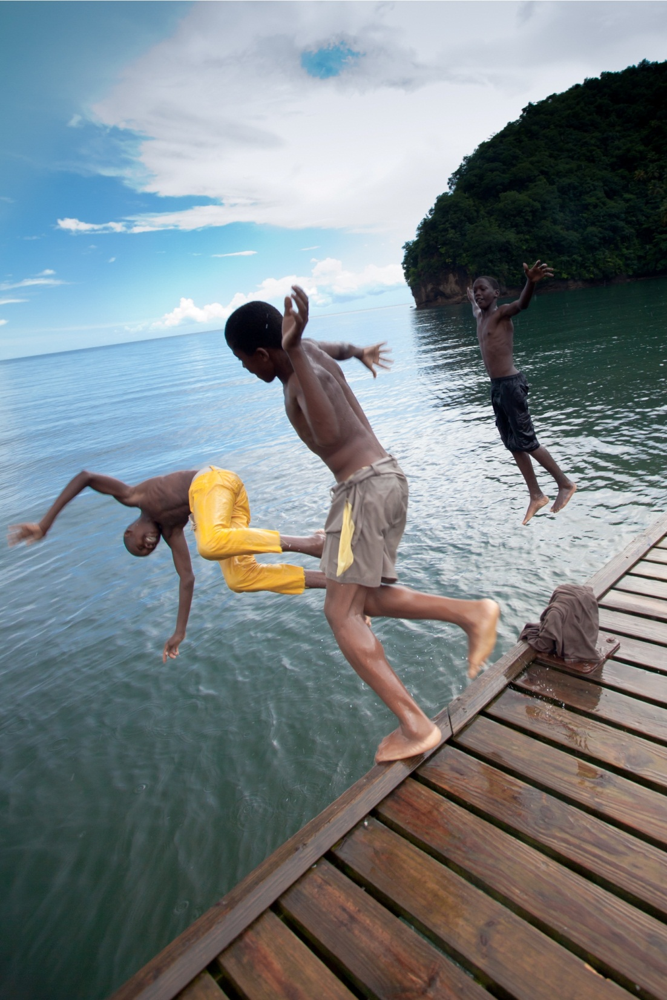
Why a baseline on people?
TNC – Red Cross partnership in Grenada
Tools we used
Preliminary results from Grenada survey
Photo: Marjo Ahijo
Notes:
In this presentation I am going to cover the following areas:
Why collect information on communities to include in monitoring and evaluation
The partnership between TNC and the Red Cross in Grenada to do this
The tools we used to collect this information (an assessment tool but not only…)
Some flavor of results coming out of this survey
[add photo]

Slide 3


Building a baseline on communities
E
B
A
+
=
Notes:
The premise of nature based adaptation solutions (or EBA) is that nature and people can work together to put in place solutions that work and help increase resilience to climate change. In order to evaluate how effective these solutions are we have to make sure we have a baseline and are measuring our progress against that baseline in time for both nature AND people characteristics.
[Juliana I remember you had this same concept but illustrated with photos, can you send? I can’t find it!]

Slide 4
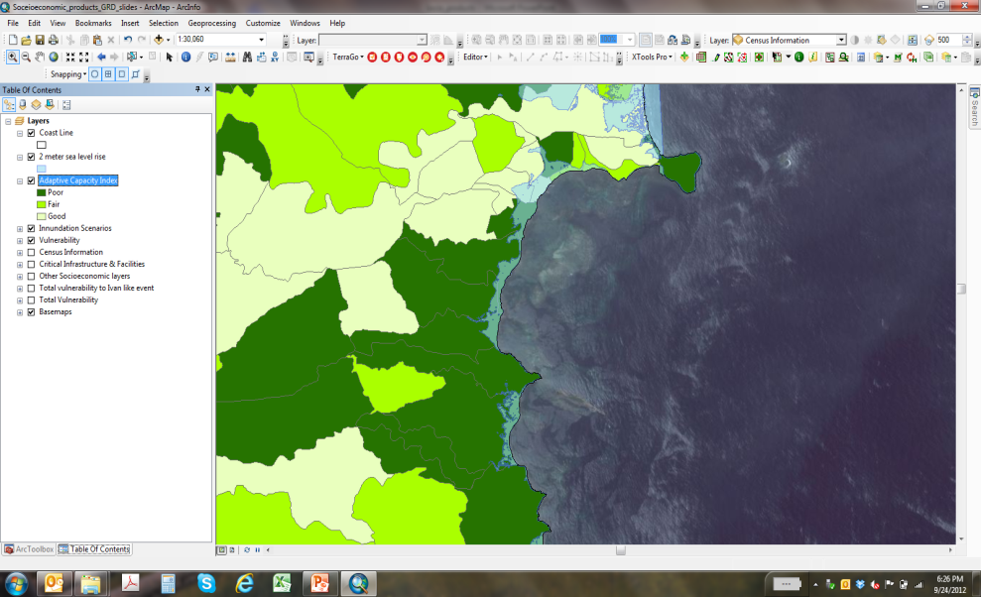
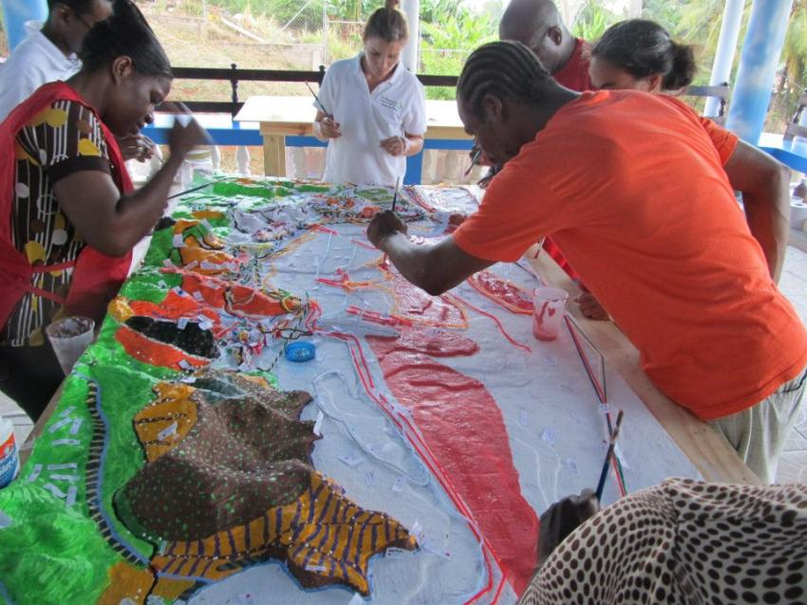
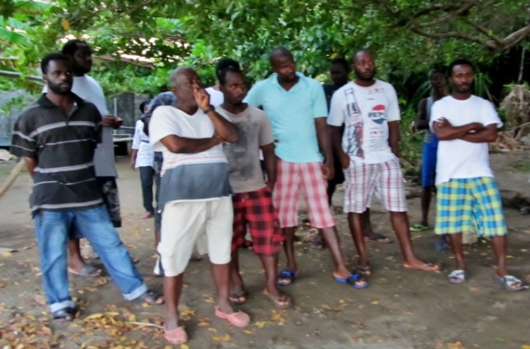
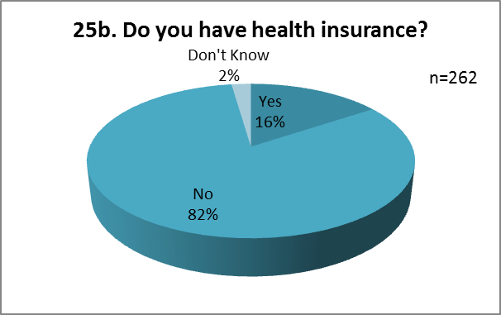
TNC – Red Cross partnership
Science
Participatory mapping
Community surveys and engagement
Notes:
The partnership in Grenada between TNC and Red Cross: Merging science, participatory mapping and community surveys and engagement, to design and implement effective disaster risk reduction and adaptation strategies (solutions that will “stick”). The Red Cross toolbox and experience with communities from the island to help connect with and mobilize communities, coupled with TNC’s science tools and work around designing possibilities for nature based solutions. A powerful mix.

Slide 5
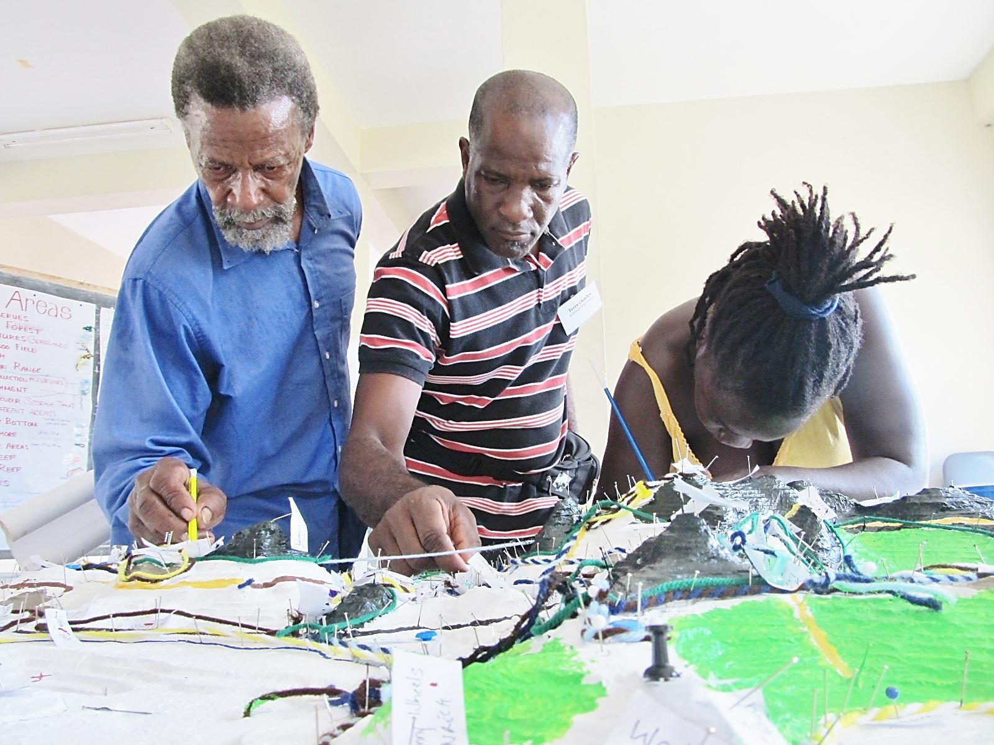
Tools we use
Photo: Juliana Castano

Slide 6
Vulnerability and Capacity assessment (VCA) – what it is
.
VCA is a participatory investigative process designed to assess the risks that people face in their locality, their vulnerability to those risks, and the capacities they possess to cope with a hazard and recover from it when it strikes. Through VCA, donor organisations can work with vulnerable communities to identify the risks and take steps to reduce them by drawing on their own skills, knowledge and initiative. In sum, VCA helps people to prepare for hazards, to prevent them from turning into disasters and to mitigate their effects.

Slide 7
VCA – Tools used in area
Review of secondary sources
Direct observation
Historical profile and Pictogram
Seasonal Calender
Focus group discussions: livelihood , coping strategies
Institutional analysis
Mapping of hazards, vulnerabilities, capacities and resources
Change , Influence, Accept (CIA)
Risk analysis

Slide 8
VCA – added value
Engagement/mobilization of the community via:
  Data collection
  Community participation in surveys
  Process of sharing information
Notes:
I substituted involvement of the community with engagement/mobilization….is this correct? Also modified this slide I hope I understood you correctly????

Slide 9
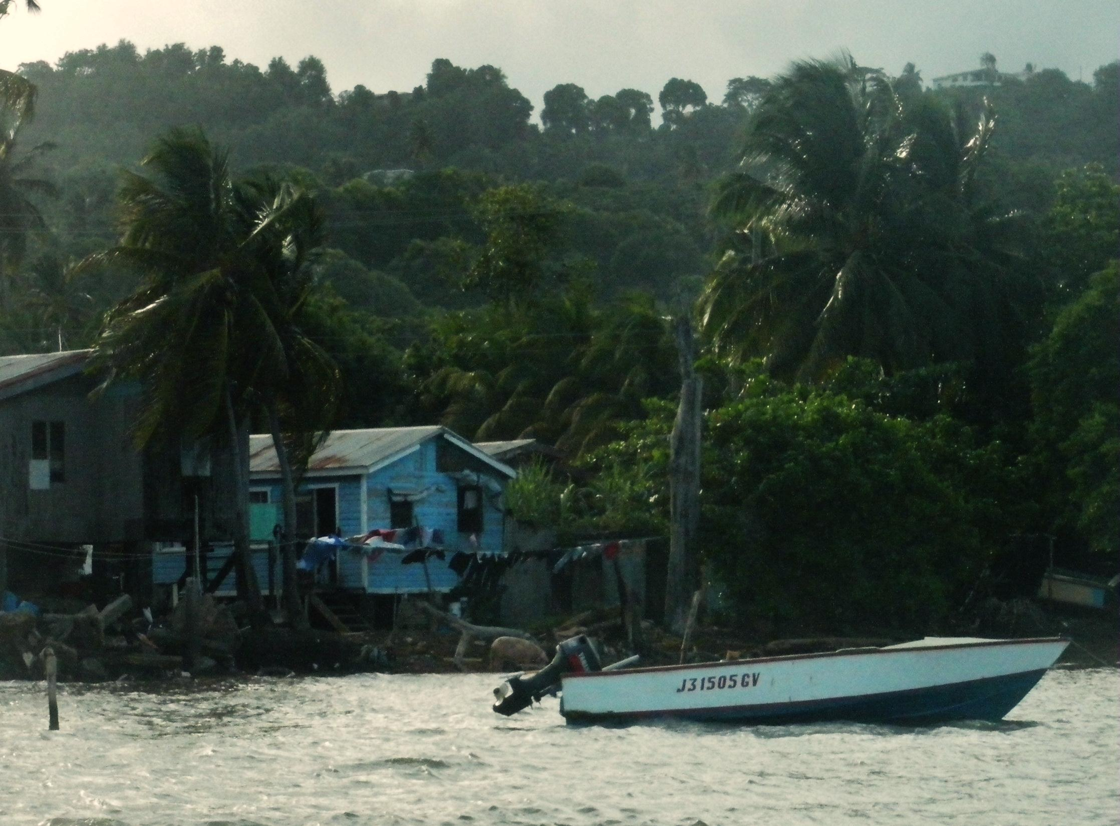
A baseline survey – some results
Photo: Juliana Castano
Notes:
Now I wanted to give you some flavor of the type of information we have collected via community surveys
[Terry you may have to cut these slides from 4 to 2…..see what you think. I am afraid you are going to run out of time!]
[Vera to add map of study area with project boundaries]

Slide 10
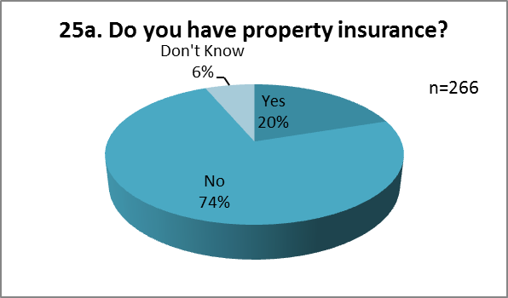
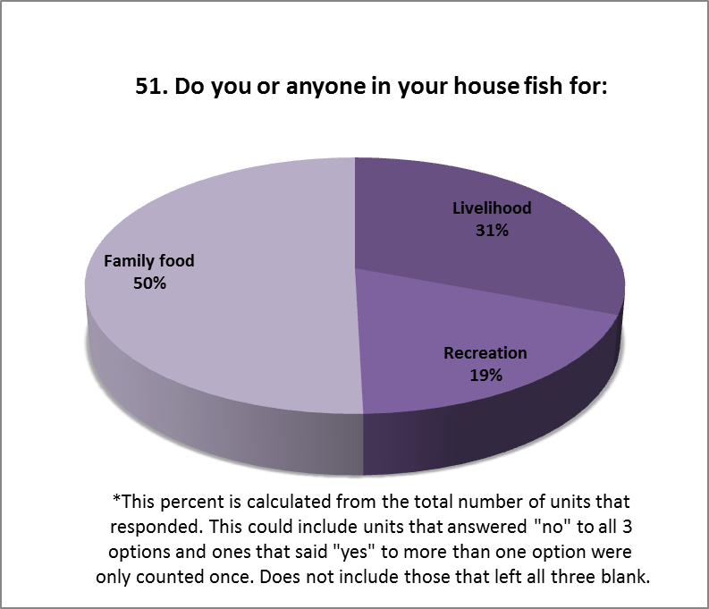
Background information
Notes:
Some of the information coming from the survey helps us define the context we are working in, the characteristics of the communities for which we are trying to design adaptation strategies.

Slide 11
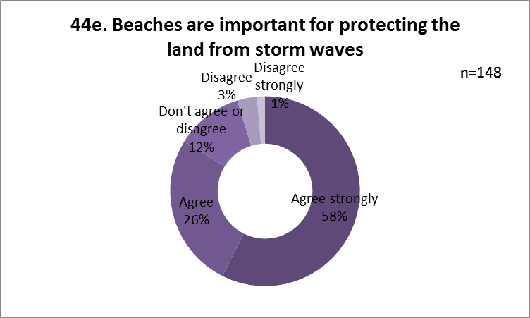
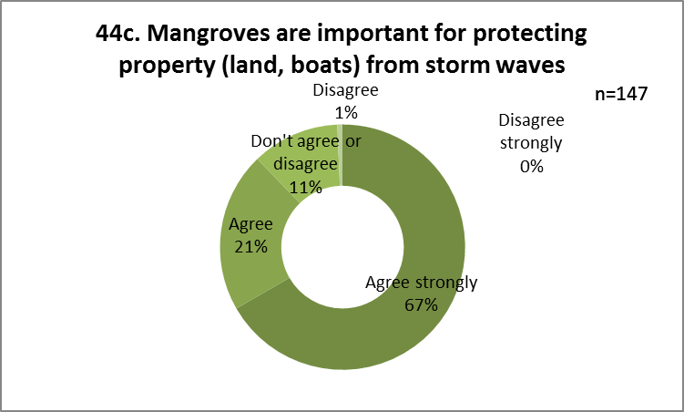
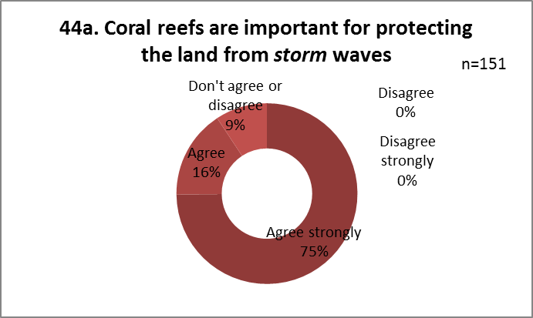
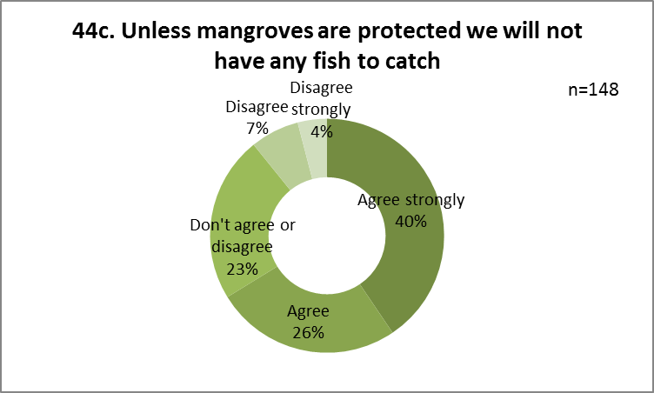
Background information
Notes:
Also important information is the community’s perception of Nature’s services, what beaches, mangroves and reefs can do for them.

Slide 12
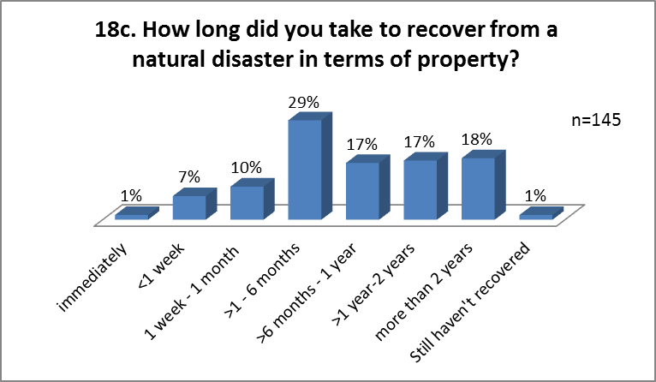
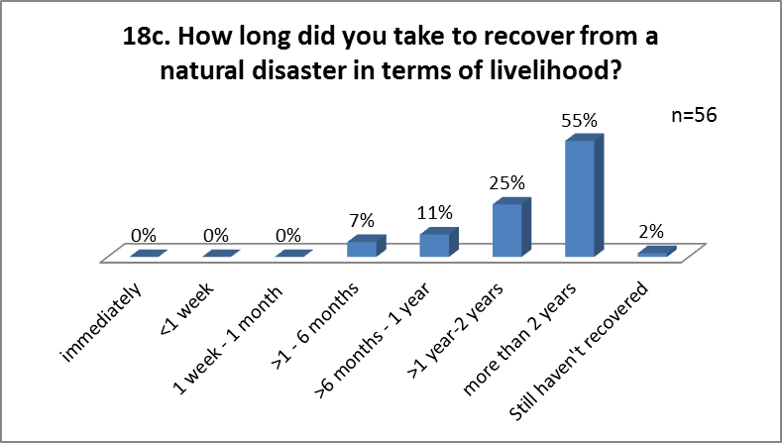
Baseline -- current vulnerability
Notes:
Here we are giving you an example of some of the information we collected to measure a community’s adaptive capacity, ability to cope after a disaster. Our hope is that as we implement proposed adaptation solutions and measure this same parameter over the years we will find that their coping capacity increases

Slide 13
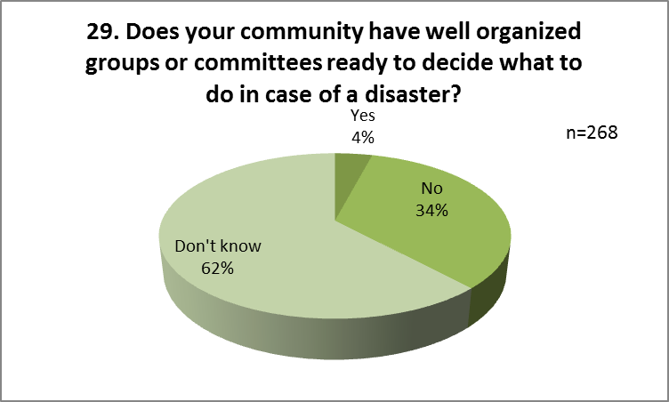
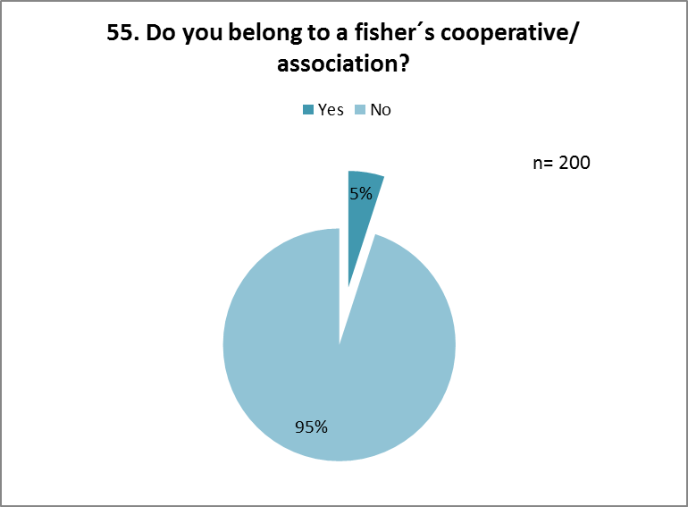
Baseline -- current vulnerability
Notes:
Another example of an important element to measure to assess a community’s adaptive capacity – networks in place to help respond to a disaster. The more there are, the better able a community is to cope and adapt.

Slide 14
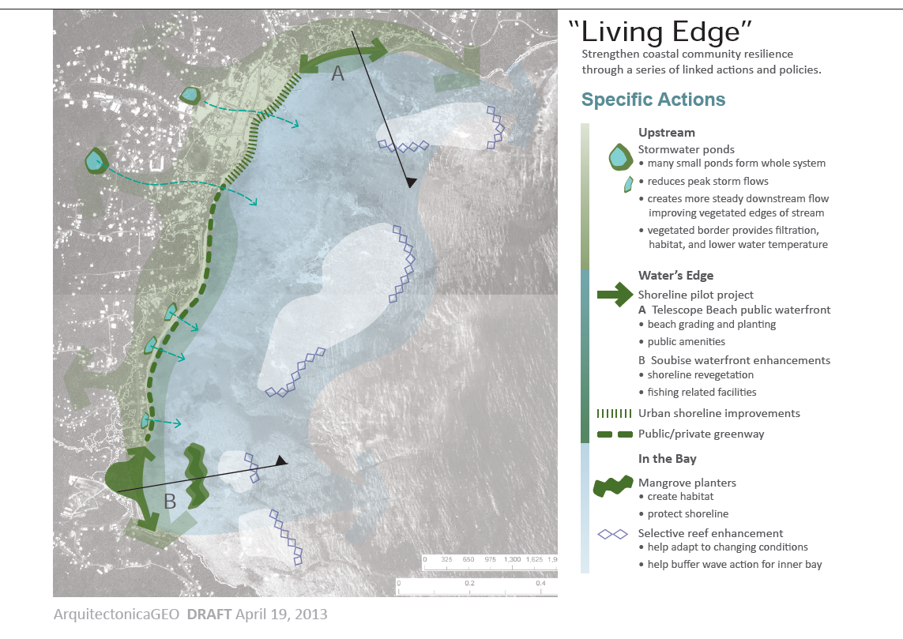
Next steps
Continue data analysis to build baseline – include spatial representation
Link indicators with specific actions
Design a monitoring protocol and a reporting mechanism
Continue to engage and mobilize communities
Notes:
To conclude I wanted to leave you with a quick sense of our next steps as they relate to Monitoring and Evaluation (plenty of other additional things we will be doing together in Grenada…).
We collected large volumes of information via the VCA process…..we will continue this analysis with TNC which will include developing approaches to display it spatially and train some of the staff on my team to do this
We will continue to design monitoring and evaluation indicators linked to the specific set of actions we have identified together with communities and government on the ground (this graphic represents some of those actions)
And of course we will continue to do the important work of community engagement and mobilization……as there are is no sophisticated monitoring and evaluation scheme or for that matter, nature based adaptation strategy that will work without community buy in and participation all along the way………

Slide 15
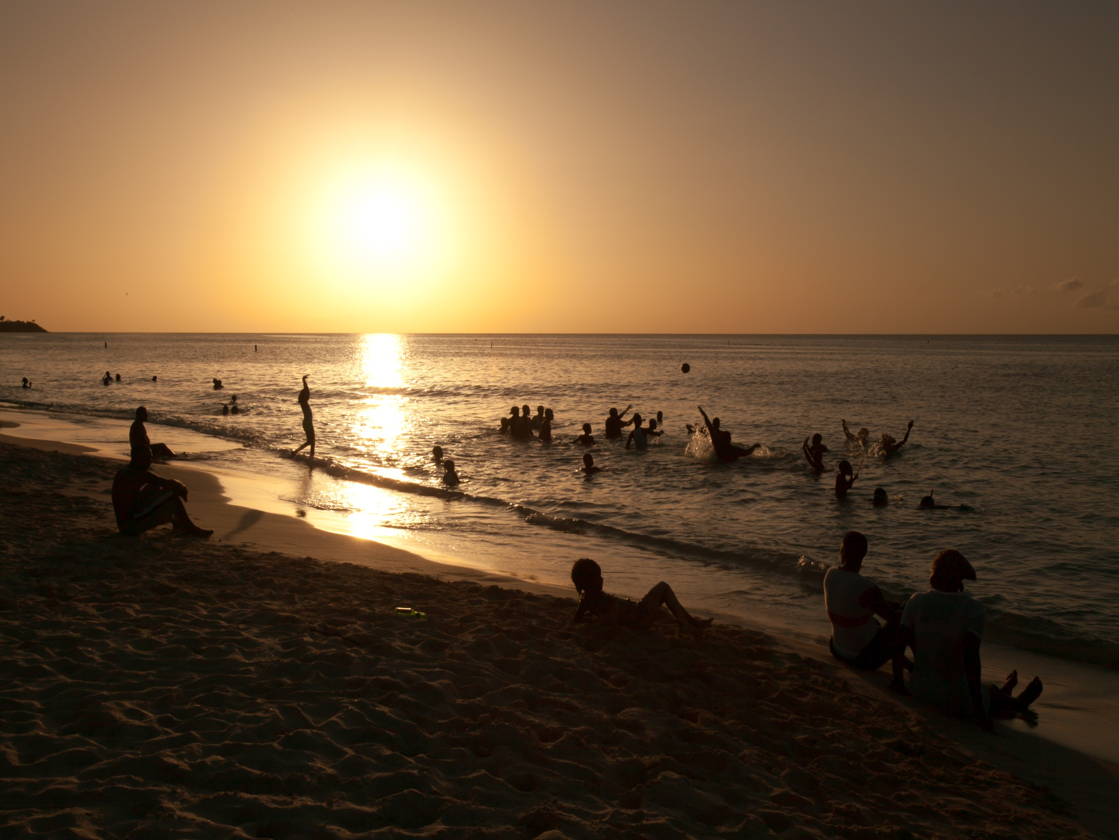
Thank you
Terry Charles, Director General
Grenada Red Cross Society
Terrycharles_grenada@yahoo.com
Photo: Marjo Ahijo
Notes:
[add photo]

Slide 16

