Slide 1
Measuring what matters
Anne Guerry, NatCap Lead Scientist
TNC Climate Risk & Resilience 2013
New Orleans

Slide 2
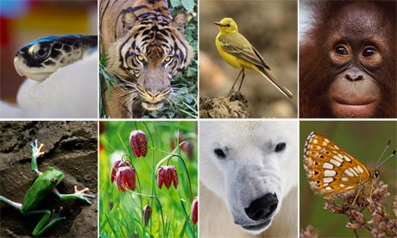
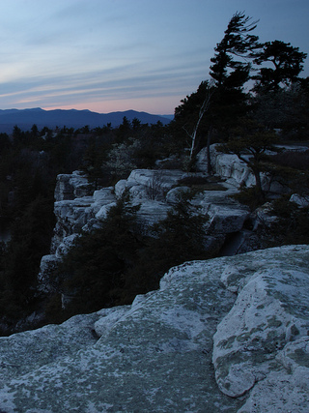
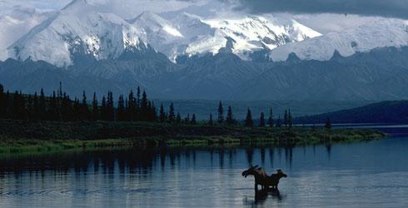
Notes:
Biodiversity, special places

Slide 3
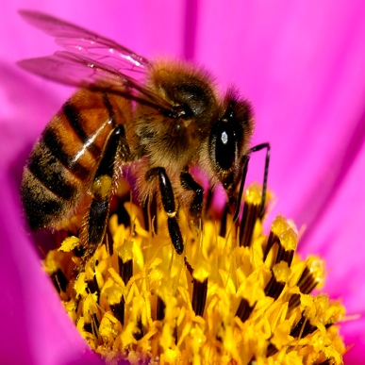
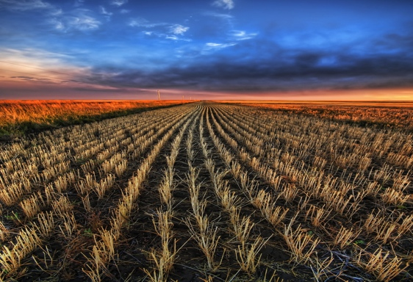
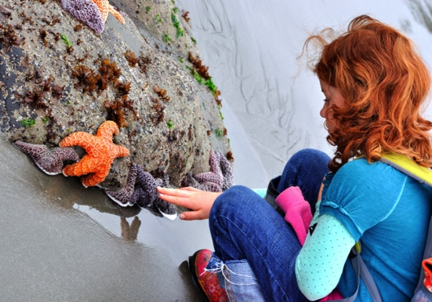
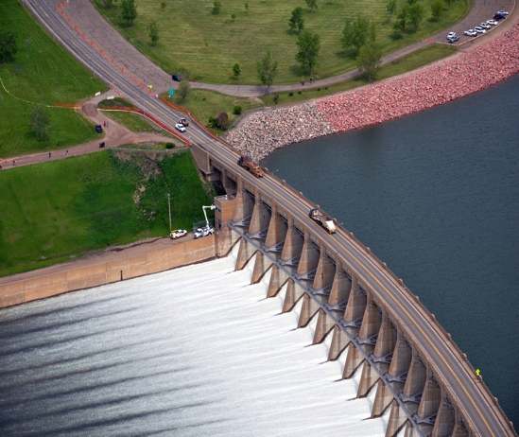

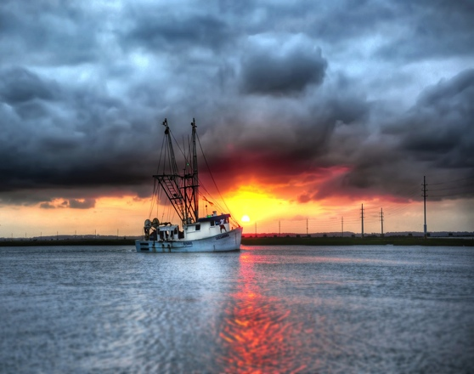
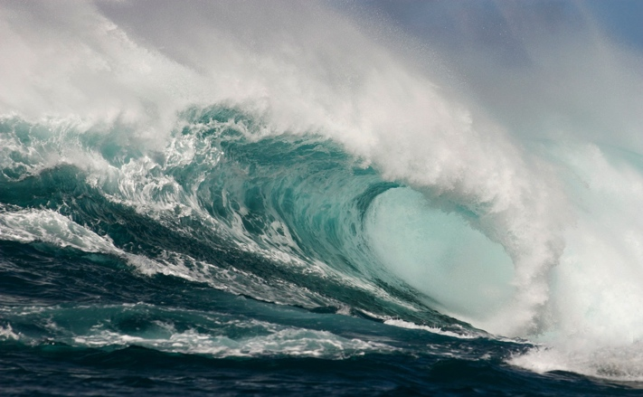
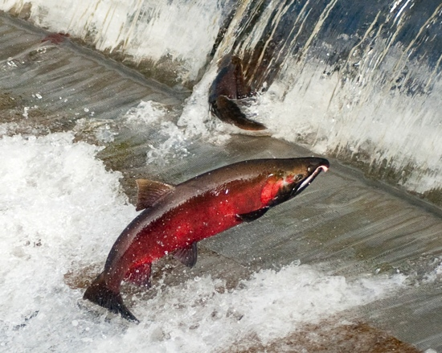
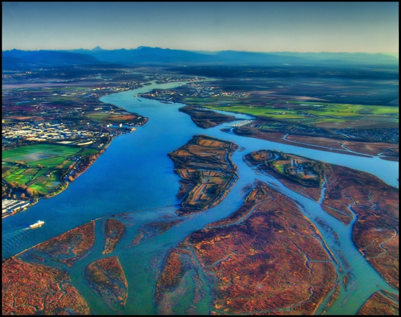
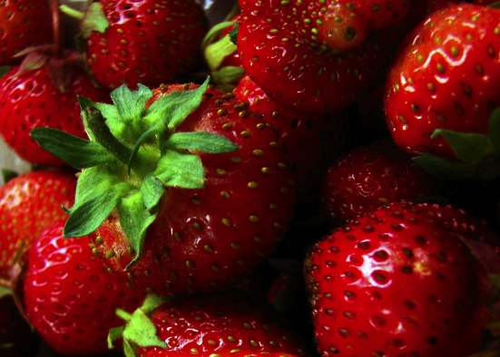
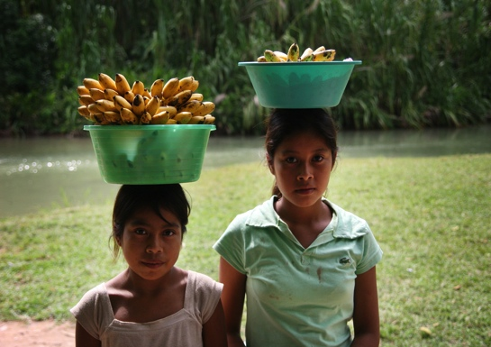
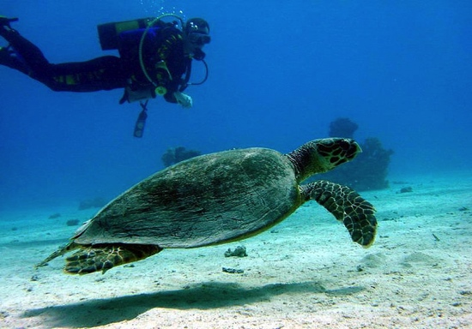
Food, fuel, fiber
Pollination
Coastal protection
Clean
water
Recreation
Notes:
But if we instead focus on all of the rich and diverse ways that ecosystems sustain and fulfill human life,
Bee: http://www.flickr.com/photos/da100fotos/1512796328/lightbox/
Farm: http://www.flickr.com/photos/stuckincustoms/3664680772/lightbox/
Tidepool: http://www.flickr.com/photos/merydith/7482803604/lightbox/
Dam: http://www.flickr.com/photos/usacehq/5818613354/lightbox/
Logs: http://www.flickr.com/photos/wulf/2330451253/lightbox/
Boat: http://www.flickr.com/photos/zrfraileyphotography/6031045906/lightbox/
Wave: http://www.flickr.com/photos/nathangibbs/4409365585/lightbox/
Salmon: http://www.flickr.com/photos/soggydan/4041045863/lightbox/
Delta: http://www.flickr.com/photos/ecstaticist/3055718118/lightbox/
Berries: http://www.flickr.com/photos/vegas/695595547/lightbox/
Girls: http://www.flickr.com/photos/nathangibbs/1487546623/lightbox/
Diver: http://www.flickr.com/photos/tom_weilenmann/54018832/lightbox/

Slide 4
people
nature
Notes:
In this narrative, people put pressure on the environment.

Slide 5
people
nature
Notes:
we can change the narrative and direct investments in ways that promote conservation and foster human wellbeing at the same time.

Slide 6
Notes:
Highlight where engineering, etc done well

Slide 7
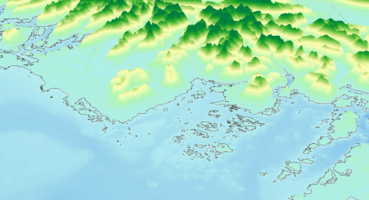
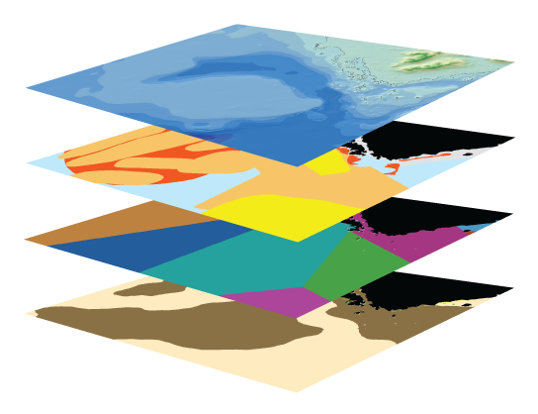
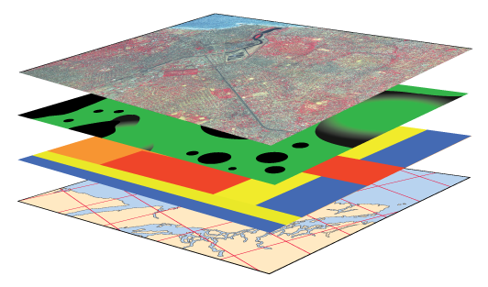
Input Data (reflect scenarios)
Marine InVEST Models
Model Outputs
(ecosystem services & values)
ECOSYSTEM SERVICES
VALUATION
e.g.
Blue Carbon
Carbon Sequestered
Value of
carbon sequestered
TERRESTRIAL SYSTEMS
Renewable Energy
Energy Captured
Value of captured
energy
BIO-PHYSICAL
3
9
Coastal Protection
Avoided
Area Flooded/Eroded
Value of avoided damages
Bathymetry & Topography
Habitat
Risk
Species
distribution
SCENARIOS
Recreation
Visitation Rates
Expenditures due to recreation
activity
Oceanography
5
4
Habitat type
7
Water
Quality
Fishery
Landed
Biomass
1
8
Net present value of
finfish and shellfish
SOCIO-ECONOMIC
6
Aquaculture
Harvested
Biomass
Population density
2
Demographics
Aquaculture operation costs
Aesthetic Quality
Property values
Guerry et al 2012
Notes:
This represents the marine models in InVEST, with models outlined in black being the ones we used in Belize. Take home from this slide is that input data reflect current conditions or future scenarios and are made up of biophysical and other kinds of information. Marine models can be used singly or in conjunction with one another. And ouputs can be in biophysical or monetary metrics.
Flow rate, sediment, nutrients, toxic waste and bacteria
Wastes, filtration
De facto MPA
Light attenuation, sedimentation
Water purification
Food supply (shellfish)
Beachgoing
Spawning, rearing
Wave attentuation

Slide 8


Slide 9
Human health
Livelihoods
Jobs
Quality of life
Notes:
Highlight where engineering, etc done well

Slide 10

#4 slide (e.g.’s)
Connecting to wellbeing
Including people
Matching metrics to the decision-context
Measuring impact
Notes:
Connecting to wellbeing
Including people
Matching metrics to the decision-context
Measuring impact

Slide 11
Connecting to wellbeing

Slide 12
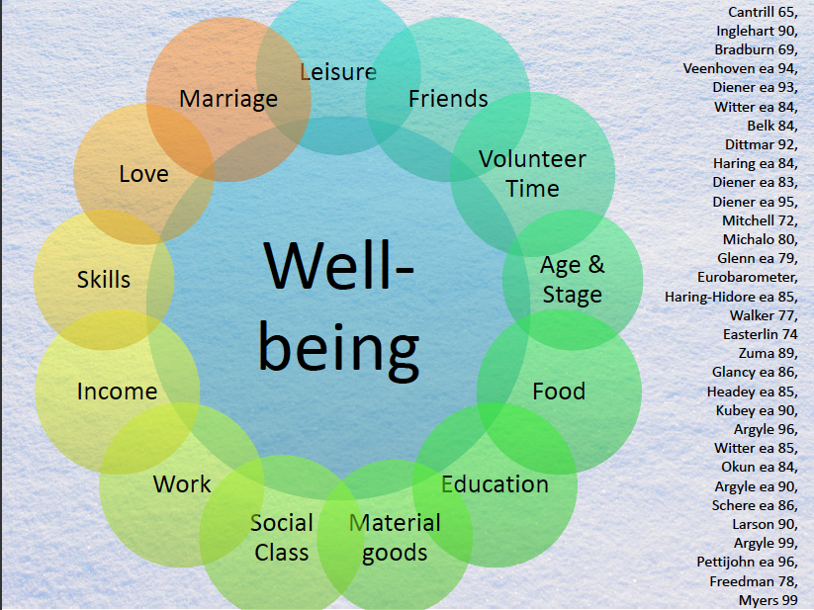
Linking to human well-being
Of 14,158 studies of happiness, 31 explored the role of nature.
(Veenhoven 2011)

Slide 13
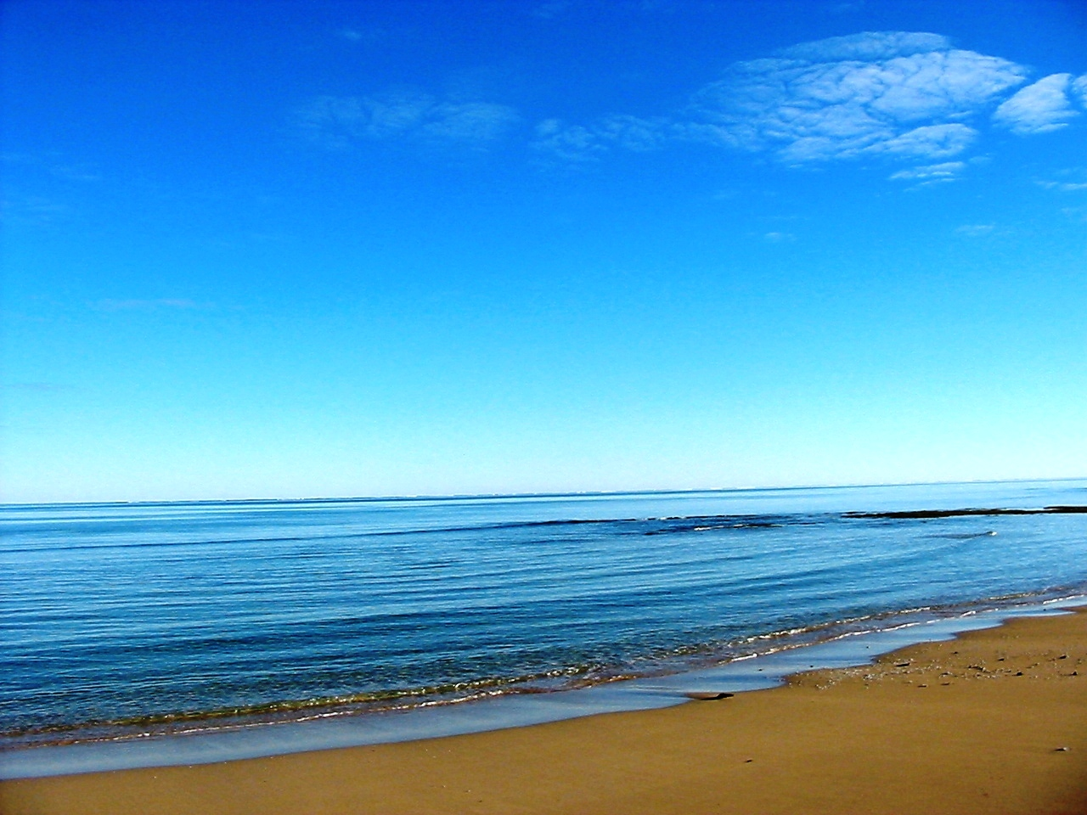
91 countries
Happiness data
How do we best predict happiness? Does natural capital play a role?
Russell, Guerry et al in prep
Notes:
We explored the role of different forms of capital (financial, built, social, human, and natural) as determinants of well-being and found that social & human capital (combined) or natural capital explain national well-being across the globe equally as well or better than financial & built capital (Fig 1).
Financial and built capital together explained 62%, natural capital explained 67%, and human and social capital together explained 84% of the variation in human well-being across the 91 countries.

Slide 14

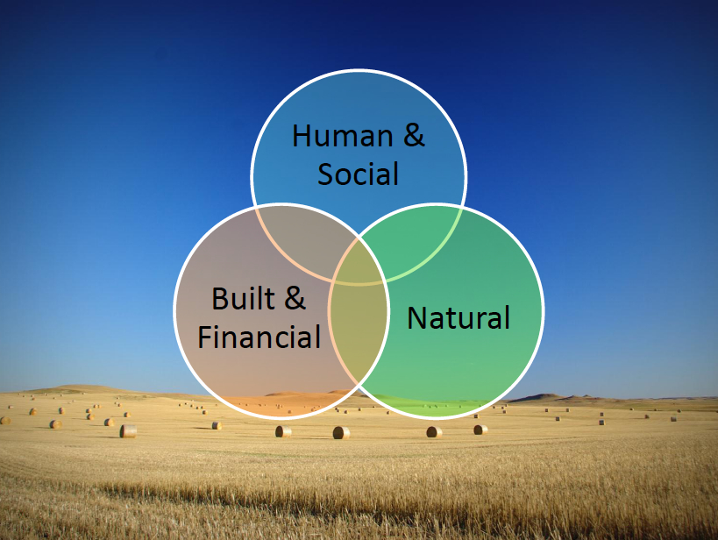
Linking to human well-being
84%
62%
67%
Russell, Guerry et al. in prep
Russell, Guerry et al in prep

Slide 15


Synthesizing literature that connects nature experience and wellbeing
Notes:
Ulrich (1984) showed that “patients recovering from gallbladder surgery who had a view from their hospital window had shorter postoperative stays, and less potent pain medication requirements, than those who looked out onto a brick wall.”

Slide 16
knowing | seeing | interacting | living within | socializing within
physical health
mental health
spiritual health
security
learning
inspiration
sense of place
identity
competency
connectedness
happiness
Russell, Guerry, et al. in press Annual Review of Environment and Resources

Slide 17
Including people

Slide 18
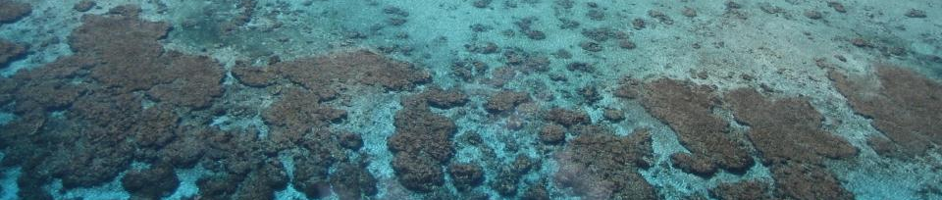
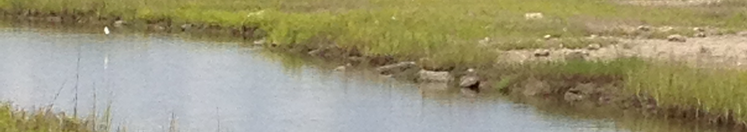
Where and to what extent do coastal ecosystems protect the most vulnerable human populations and highest value properties from sea level rise and storms?

Slide 19
Arkema et al in press
Nature Climate Change
Notes:
In general east and gulf coasts are most exposed to coastal hazards. Habitats provide protection for the greatest number of people, socially vulnerable populations, and property in FL and NY.

Slide 20
Notes:
Habitats protect a disproportionate number of poor families in the Gulf coast, rural west coast and urban east coast and a disproportionate number of elderly people in Florida.

Slide 22
Santa
Okaloosa
Walton
Escambia
Rosa
Jefferson
Bay
Wakulla
Taylor
Gulf
Franklin
Dixie
Levy
Citrus
Hernando
Pasco
Pinellas
Hillsborough
Coastal Hazard
Manatee
Lowest
Intermediate
Highest
Sarasota
Charlotte
Lee
Collier
Monroe
Notes:
Map = scenario A2 w/habitats; bar is scenario A2 w/ and w/o habitats – total population in highest hazard (red areas); counties on x axis go from NW to SE
Results show variation among counties in total population at highest risk of hazards and protected by habitats.
In this scenario
habitats matter the most
in those counties
with the largest difference between white and black bars.

Slide 23
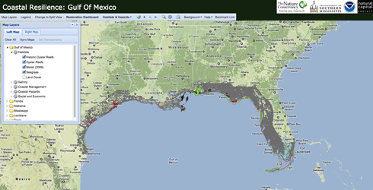

Slide 24
Matching metrics to the decision context

Slide 25
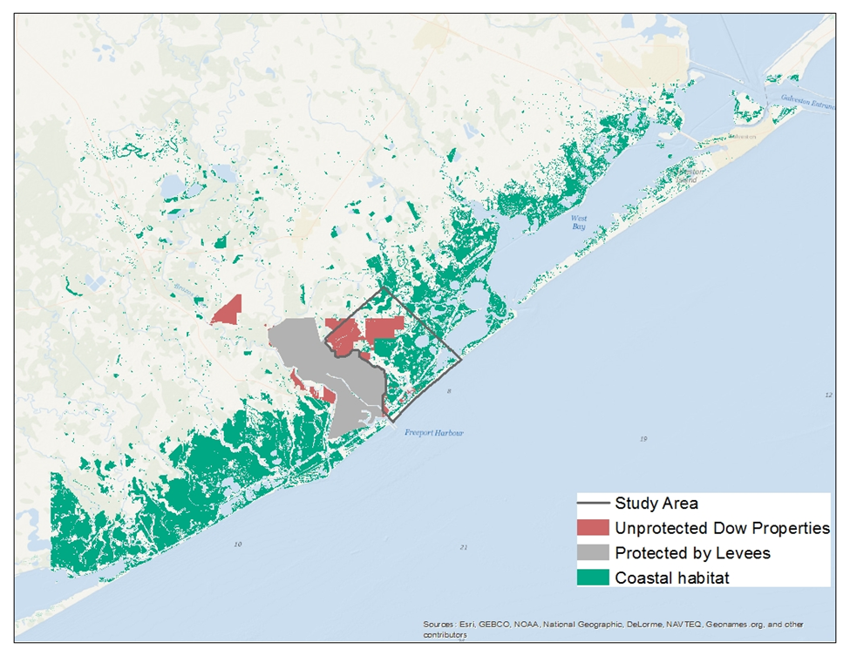

Slide 26

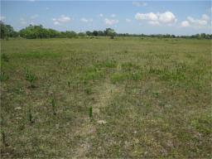
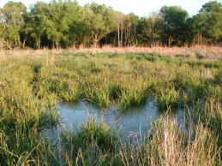
Hypotheses/Questions
To what extent is marsh restoration a substitute for levees? What are avoided damages or benefits for Dow of alternatives?
Marsh restoration has spillover effects to public (direct and indirect). What are avoided damages or benefits to public of alternatives?
- Direct: Protect “public” properties
- Indirect: Recreation, carbon sequestration, fisheries
Notes:
AA – Quantify these to make a case for restoration beyond flood protection

Slide 27
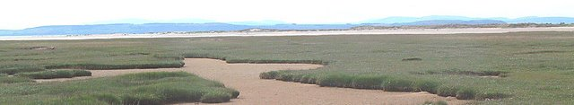
Results
  Salt marsh restoration is not significantly more cost effective in reducing damages in this area to Dow
  NPV of carbon sequestration is $1.2 million
  Recreation expenditures increase $150 million
  12 fisheries benefit from marsh restoration
  Habitat improves for >200 spp.

Slide 28
Assessing impact

Slide 29

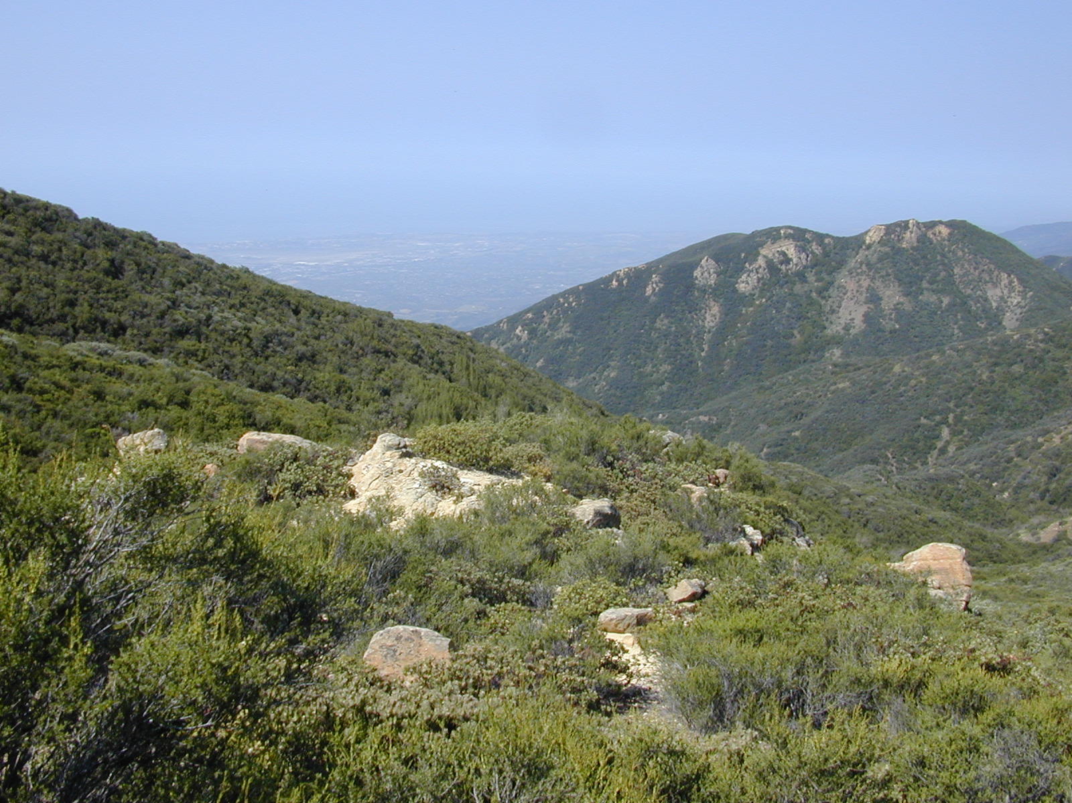




The Natural Capital Project

Slide 30

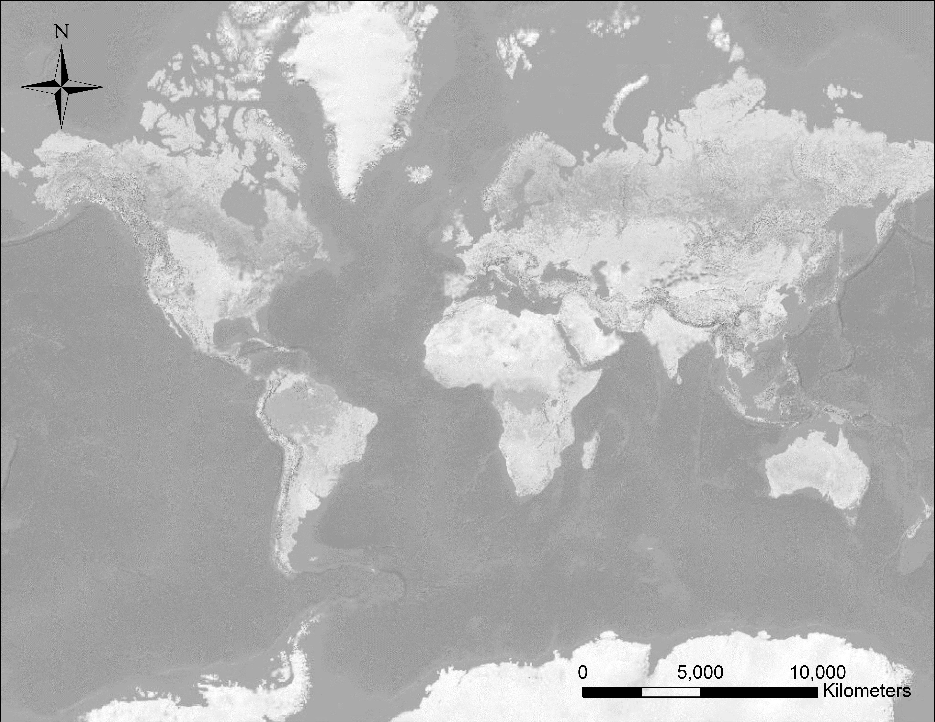



The Natural Capital Project
Incorporating ecosystem services in decisions
S
S
S
C
P
C
S
R
S
M
S
S
S
D
P
S
P
P
D
P
S
Spatial Planning
Payment for Ecosystem Services (PES)
Climate Adaptation Planning
Development Impacts and Permitting
Restoration Planning
Ruckelshaus et al. in review
Corporate Risk Management

Slide 31
Pathways for informing decisions
CONDUCT
RESEARCH
CHANGE PERSPECTIVES
GENERATE
ACTION
IMPROVE
OUTCOMES
People
aware of &
understand BES
Alternative choices
based on ES
framework
Results
Produced
Enhanced &
balanced BES
provision
Published
Stakeholders
focused on BES
Plans & policies
consider
BES impacts
Improved outcomes for
biodiversity
& human wellbeing
Disseminated
Stakeholder
differences
mediated
New policy & finance mechanisms established
1
2
3
4
Increasing impact

Slide 32
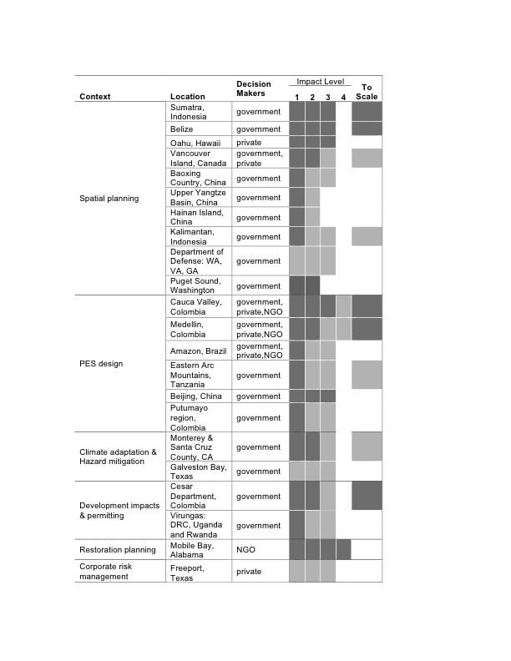
Spatial
Planning
Spatial
Planning
PES
Design
Climate Adaptation
Legend
Colors: evidence of impact on the ground (darker shades, more impact)
Grey: currently working toward that level of impact
Permitting/
Mitigation
Restoration
Corporate
Risk Mgmt
Notes:
A little more information in this format….colored squares are where there’s evidence of impact at that level, grey squares are where we are currently working toward that level of impact. Two things to note: 1st 2 are most mature…more examples, more impact (been at it longer). 2. Not much yet that goes all the way to impact 4—changing outcomes. For big planning processes, etc. generally need time to see evidence changed outcomes. One exception is:

Slide 33
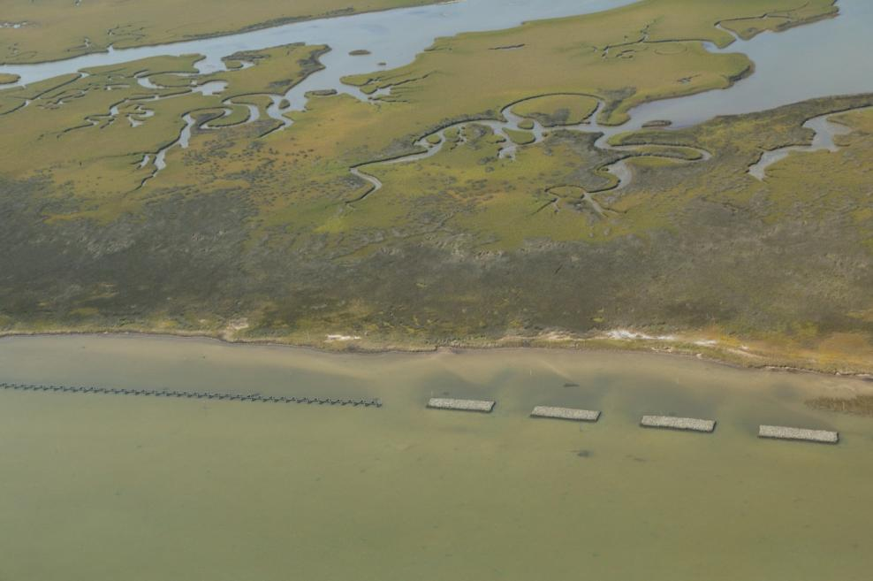



Restoring Oyster Reefs in Mobile Bay
Notes:
The American Recovery and Reinvestment Act and NOAA helped TNC build oyster reefs and create marshes in Mobile Bay

Slide 34

Coastal protection
Forcing
Conditions
Attenuation
Hydrodynamic
Output
Wave height
Mean water level
Runup
Storm surge
Erosion
Flooding
Near property
and people
Waves
Baseline tide
Long-term sea-level rise
Currents
Wind
Biogenic habitat
Abiotic morphology
‘Hard’ structures

Slide 35

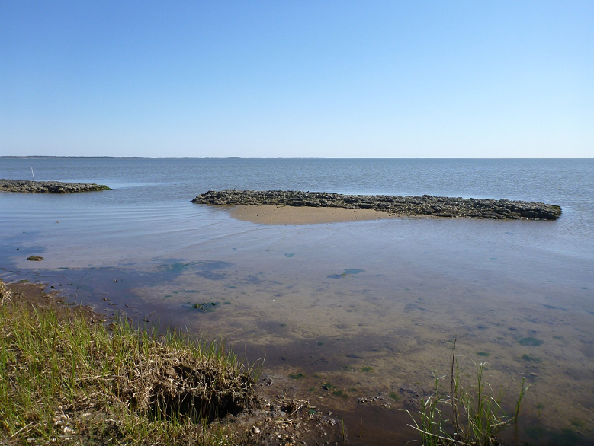
Observed Response
23-670% increase in fish abundance
Emergent marsh growing
Erosion slowing
Sediment accumulating

Slide 36
Notes:
Biodiversity, special places

Slide 37
Food, fuel, fiber
Pollination
Coastal protection
Clean
water
Recreation
Notes:
But if we instead focus on all of the rich and diverse ways that ecosystems sustain and fulfill human life,
Bee: http://www.flickr.com/photos/da100fotos/1512796328/lightbox/
Farm: http://www.flickr.com/photos/stuckincustoms/3664680772/lightbox/
Tidepool: http://www.flickr.com/photos/merydith/7482803604/lightbox/
Dam: http://www.flickr.com/photos/usacehq/5818613354/lightbox/
Logs: http://www.flickr.com/photos/wulf/2330451253/lightbox/
Boat: http://www.flickr.com/photos/zrfraileyphotography/6031045906/lightbox/
Wave: http://www.flickr.com/photos/nathangibbs/4409365585/lightbox/
Salmon: http://www.flickr.com/photos/soggydan/4041045863/lightbox/
Delta: http://www.flickr.com/photos/ecstaticist/3055718118/lightbox/
Berries: http://www.flickr.com/photos/vegas/695595547/lightbox/
Girls: http://www.flickr.com/photos/nathangibbs/1487546623/lightbox/
Diver: http://www.flickr.com/photos/tom_weilenmann/54018832/lightbox/

Slide 38
Improve outcomes for people and nature.

Slide 39
#4 slide (e.g.’s)
Connecting to wellbeing
Including people
Matching metrics to the decision-context
Measuring impact
Notes:
Connecting to wellbeing
Including people
Matching metrics to the decision-context
Measuring impact

