Slide 1
Coastal Resilience in Grenada and St. Vincent & the Grenadines
At the Water’s Edge (AWE)
Monitoring and Evaluation (M&E)
Notes:
Greetings, I’ll describe 18 months of AWE experience in the development of an M&E framework. I’ll briefly outline what we’ve done so far and what we plan to do and then examine what has and hasn’t worked. And since this is an exchange…I hope we can then swap ideas about how to really effectively monitor and evaluate adaptation projects

Slide 2
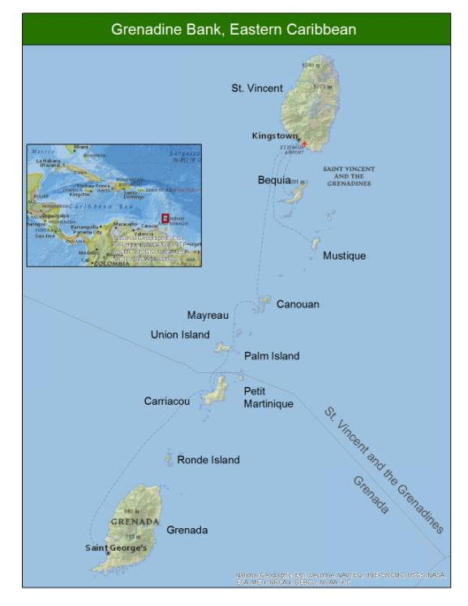
Grenadine Bank pilot EBA and resilience solutions in SIDS
simple evaluation methodology for pilot sites incorporating: ecological and socioeconomic indicators
Monitoring plan and reporting mechanism
Notes:
Develop a simple evaluation methodology for pilot sites incorporating: ecological and socioeconomic indicators
Outputs:
Monitoring plan for pilot sites
Integrating ecological and socio-economic indicators of EBA
M&E reporting mechanism. Eg. Report card, dashboard/online tracking

Slide 3
6-Step Methodology
Describe the adaptation context
Define the desired contribution to adaptation
Develop adaptation strategies
Create an adaptation theory of change
Choose indicators and set baselines
Develop and implement a plan for M&E
Proj mgmt
Adaptive mgmt
M&E
Notes:
Consider saying you will focus on a set of these….

Slide 4
6-Steps to AWE M&E framework
Describe the adaptation context
Define the desired contribution to adaptation
Develop adaptation strategies
Create an adaptation theory of change
Choose indicators and set baselines
Develop and implement a plan for M&E
Project planning and development
Monitoring & Evaluation
Notes:
Consider saying you will focus on a set of these….

Slide 5
6-Steps to AWE M&E framework
Describe the adaptation context
Define the desired contribution to adaptation
Develop adaptation strategies
Create an adaptation theory of change
Choose indicators and set baselines
Develop and implement a plan for M&E
Notes:
Consider saying you will focus on a set of these….

Slide 6
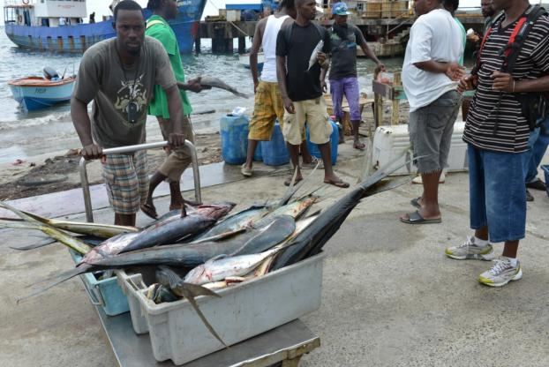
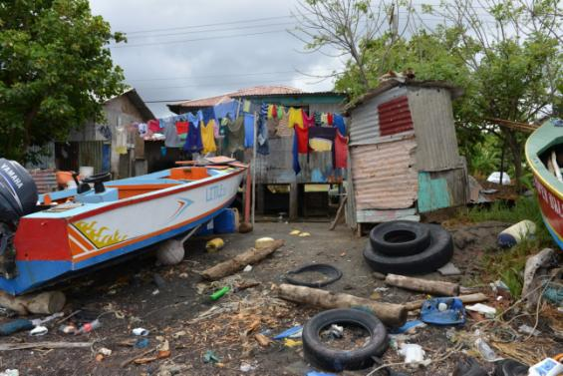
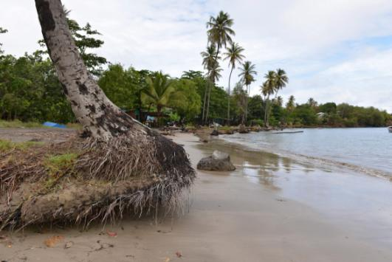
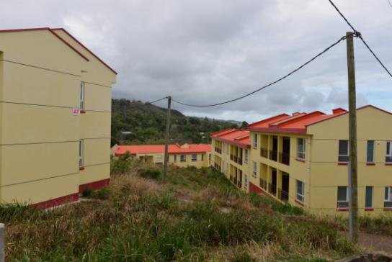
M&E plan
Indicators & Baselines
Theory of Change
Adaptation strategy
Contribution to Adaptation
Adaptation context
Notes:
Grenville pilot context
Exposure: Eastern coastal town directly exposed to Atlantic storms and SLR
Sensitivity: Significant beach erosion, coastal flooding, mangrove clearing, reef decline, fisheries dependent
Adaptive capacity: Low awareness, poverty, and social capital

Slide 7
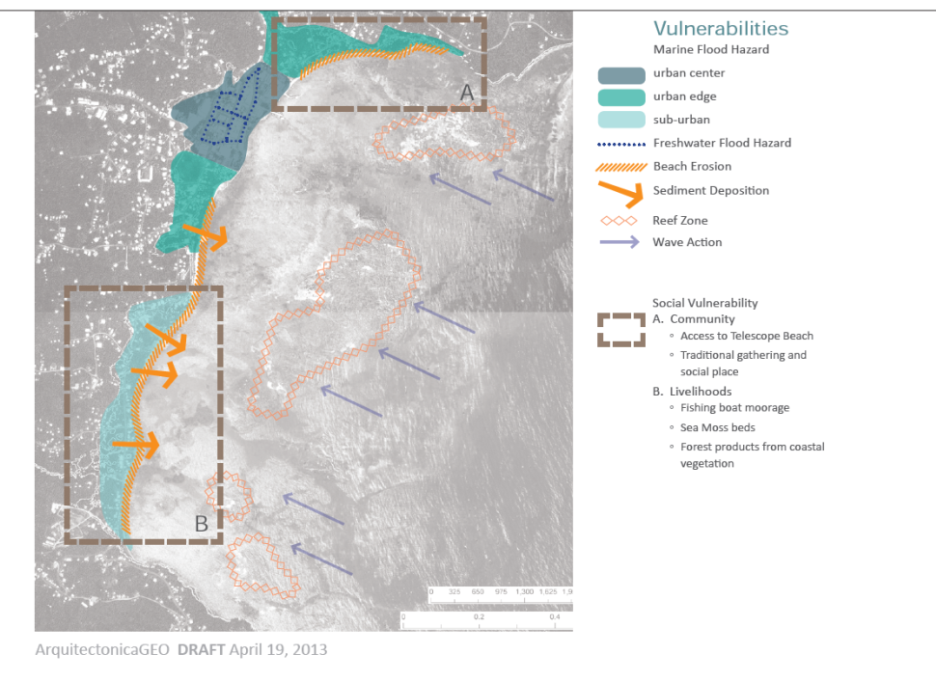
M&E plan
Indicators & Baselines
Theory of Change
Adaptation strategy
Contribution to Adaptation
Adaptation context
Notes:
Mapped vulnerabilities: Coastal flooding, coastal erosion etc

Slide 8
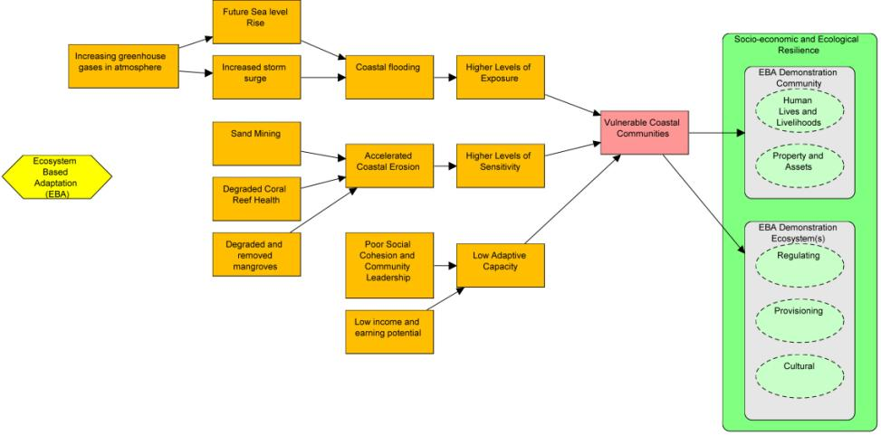
Grenville Conceptual model

Slide 9
2. Contribution to Adaptation
M&E plan
Indicators & Baselines
3 Dimensions of Adaptation | AWE focus
Adaptive Capacity (readiness to deal with impacts) | Reinforcing community structure and raising awareness
Adaptation Action (direct interventions) | Concrete biophysical activities to reduce climate risks
Sustained development –(human-wellbeing and economic welfare) | Facilitating or establishing successful and sustainable development in vulnerable populations (Livelihood enhancement)
Theory of Change
Adaptation strategy
Contribution to Adaptation
Adaptation context
Notes:
Increasing Adaptive Capacity –These activities are aimed at improving the quality of a population’s readiness to deal with known and unknown impacts of climate change.
Implementing adaptation actions – These are concrete socio-economic and biophysical focused activities to manage or reduce climate risks to vulnerable populations.
Sustained development –Achieving human-wellbeing and economic welfare in the face of climate change is the ultimate goal of adaptation. Hence these activities focus on facilitating or establishing successful and sustainable development in vulnerable populations.

Slide 10
Area of emphasis
M&E plan
AWE pilot project
Hypothetical UNDP project
Indicators & Baselines
Theory of Change
Adaptation strategy
Contribution to Adaptation
Adaptation context

Slide 11
Participatory AWE adaptation strategies
M&E plan
Indicators & Baselines
Planning, ecological and engineering experts meeting
  Proposed solutions compiled in attractive booklet
  Miami
Community Meeting
  Solutions refined into strategies
  Grenville
Theory of Change
Adaptation strategy
Contribution to Adaptation
Adaptation context

Slide 12
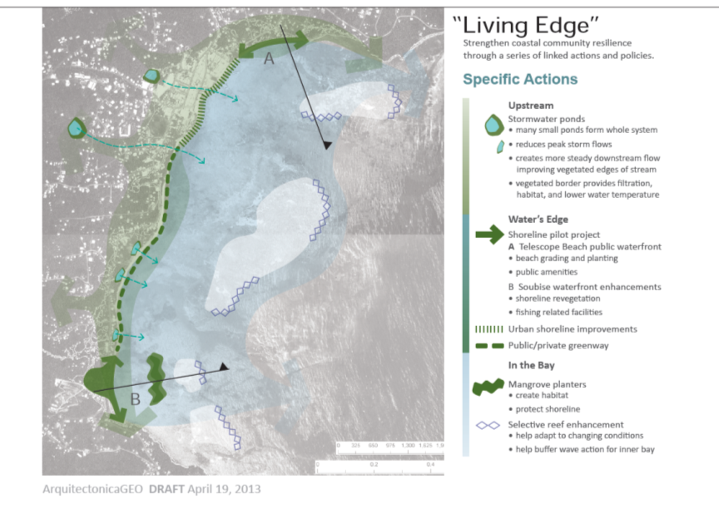
M&E plan
Indicators & Baselines
Theory of Change
Adaptation strategy
Contribution to Adaptation
Adaptation context

Slide 14
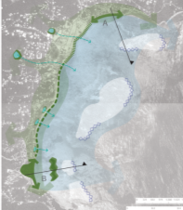
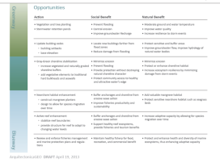
4. Theory of Change (Results Chain)
M&E plan
Indicators & Baselines
How do we get from strategies and actions to desired long term impacts
Theory of Change
Less Vulnerable Grenville
↑ adaptive capacity
↓ sensitivity
↓ exposure
Adaptation strategy
Contribution to Adaptation
Adaptation context
Notes:
Conditions and action steps that will get us to goal, what are our assumptions?
Helps to clarify what adaptation is –not just conservation as usual-

Slide 15
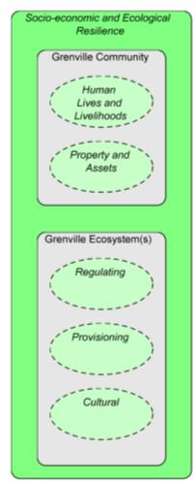
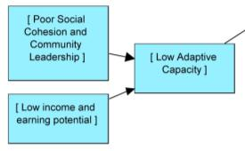


Slide 16
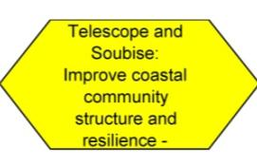
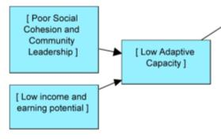

Grenville results chain (prelim)

Slide 17


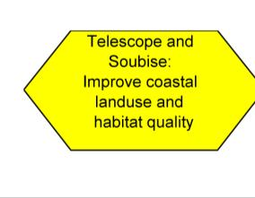
Grenville results chain (prelim)

Slide 18


Slide 19
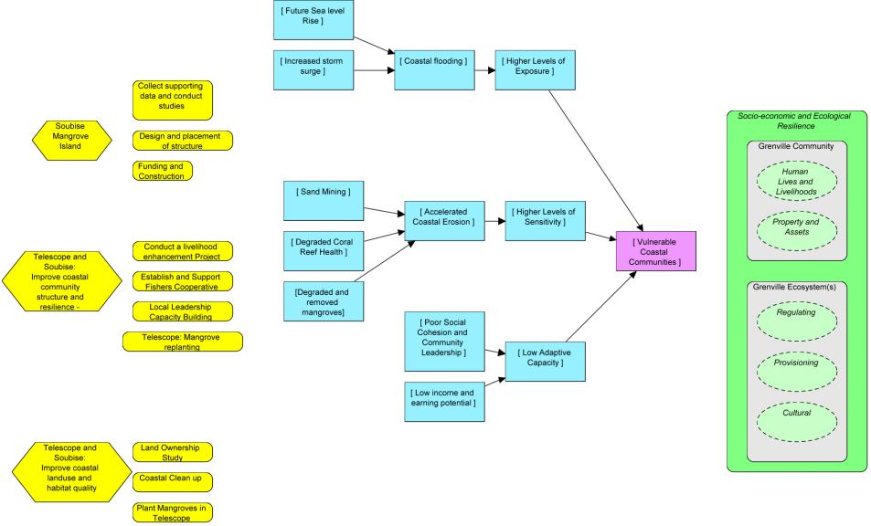
Grenville results chain (prelim)
Results
Main activities
3 main strategies

Slide 20


Slide 21
5. Indicators and Baselines
M&E plan
Indicators & Baselines
General Points
AWE Focus
Theory of Change
Indicators
  Simple, cost effective, scientifically sound, management relevant, affordable, etc.
Baselines
  Temporal or Spatial comparisons
Socio-Economic :
Biophysical
Adaptation strategy
Contribution to Adaptation
Adaptation context
Notes:
LET’S EXPAND THIS SLIDE TO BETTER REPRESENT SUITE OF INDICATORS AND TIME THEM TO RESULT CHAIN/ACTION PLAN

Slide 23
6. M&E Plan Development/Implementation
M&E plan
Indicators & Baselines
Scheduling
Data management
Roles and responsibilities
Budget
Report Cards (audience and communication)
Theory of Change
Adaptation strategy
Contribution to Adaptation
Adaptation context
Notes:
Monitoring Plan outline
Project context, goals and objectives.
Project information needs, location and sources of information
Suite of Indicators
M&E experimental design: Baselines and/or controls, evaluation methods
Scheduling: Frequency of data collection, analysis and reporting: When will baselines set & monitoring started.
Data management: Data analyses, storage, interpretation
M&E roles and responsibilities: Who coordinates, measures and collects data:
M&E information & communications plan (audiences, messages, dissemination methods and media)
Decision making triggers:
M&E budget (annual and long-term)

Slide 24
AWE specific lessons learned
Present and Future Challenges
  Data collection for project context, baseline and future monitoring
  Ownership and coordination of M&E process
  Keeping up with CoP
What worked
  6-step process for M&E framework
  Joining Co- SeaChange and Climate-eval
What didn’t
  Premature M&E activities

Slide 25
Broad challenges in measuring adaptation success
No universal indicators, unlike Climate Mitigation where tonnes of CO2 saved is globally accepted
Setting baselines when normal is changing?
Integrating
  Bottom-up and top-down approaches
  Short and Long-term scales of measurement
  Audiences: Community, national, global

Slide 26
Issues for discussion
6-step process is not prescriptive or linear but very useful so far:
Indicators:
  Scalability of indicators- pilot sites to national / regional
  Necessity/possibility of developing integrated bio-physical and socioeconomic indicators
How is this different from conservation M&E as usual?
Notes:
6-step process is not a prescription but useful so far:
Steps 1-4 good project development facilitates sound M&E
Steps 5-6 more focused on M&E but requires context and thinking from steps 1-4
Indicators of EBA success- needed mature strategies
6-steps might help with communication and comparison across adaptation projects worldwide
6-step process is not necessarily linear
Developing project context is continuous
Continuous development and refinement of strategies and feedback with Theory of Change

Slide 27
Adaptation M&E resources:
UNDP:
  Vulnerability Reduction Assessment (VRA),
  SGP Impact Assessment System,
  UNDP Climate Change Adaptation Indicator Framework
UKCIP- AdaptME a question-based approach
WRI-
GEF – Adaptation Funds
SEAChange: South East Asia Community of Practice for Monitoring and Evaluation of Climate Change intervention
World Bank
WWF
GIZ- training
Notes:
Monitoring and evaluation for climate-change adaptation is a new field…UNDP. Our approach needs to be:
Responsive: We will seek to meet our and our audiences’ M&E needs first.
Innovative: we will create EBA measures where very little exists, learn by doing, adapt and document lessons
Collaborative: we will team up with and build on existing efforts where reasonable
UNDP
WB methodology aims to quantify vulnerability in terms of existing conditions and assets (physical, biological, social, economic, and cultural), and the impacts of changes and hazards on those conditions/assets (Panray, Noyensing, & Reddi, 2009). Two sets of indicators:
1st set of measurement indicators address the individual/household scale,
2nd set explores the bio-geophysical and socio-economic impacts on the community as a whole.
The methodology described in the chapter “Vulnerability Assessment as a Tool to Build Resilience among the Coastal Community of Mauritius” focuses on a coastal fishing community, the methods can be applied elsewhere.
WWF India developed assessment method based on Livelihood Vulnerability Index with quantitative treatment of IPCC definition to assess vulnerability by setting out indicators that qualifies exposure, sensitivity and adaptive capacity and normalized values for each indicators to come up with five output profiles (climate, demographic, agriculture, ecosystem and socio-economic). However this is macro-level analysis based on secondary data, use of GIS application and involves several steps moving from indicators to profiles and ultimately to the final vulnerability index (Mohan & Sinha, 2010).

Slide 28
Next steps
Refine results chains and add indicators
Assemble biophysical and socio-economic baseline data
Draft monitoring plan

Slide 29
M&E plan
M&E plan
M&E plan
M&E plan
M&E plan
M&E plan
Indicators & Baselines
Indicators & Baselines
Indicators & Baselines
Indicators & Baselines
Indicators & Baselines
Indicators & Baselines
Theory of Change
Theory of Change
Theory of Change
Theory of Change
Theory of Change
Theory of Change
Adaptation strategy
Adaptation strategy
Adaptation strategy
Adaptation strategy
Adaptation strategy
Adaptation strategy
Contribution to Adaptation
Contribution to Adaptation
Contribution to Adaptation
Contribution to Adaptation
Contribution to Adaptation
Contribution to Adaptation
Adaptation context
Adaptation context
Adaptation context
Adaptation context
Adaptation context
Adaptation context
Notes:
Consider saying you will focus on a set of these….

