Slide 1
MARINE EXCHANGE Consider Your Audience: Communicating Effectively About Coastal Resilience
Zach Ferdaña, Senior Marine Conservation Planner Cara Byington, Associate Director, Marketing & Communications Tom McCann, Director of Communications, Global Marine Team

Slide 2
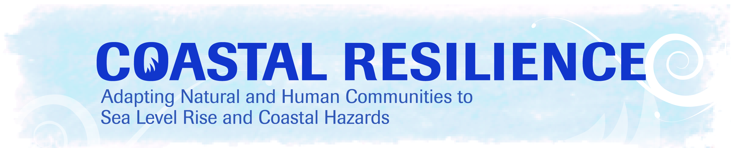
Approach
Planning frameworks/assessments/methods
Tools
…disaster risk reduction using nature-based solutions to coastal hazards & climate change
Notes:
Advance actions that prepare and protect ecosystems and reduce the severity of climate change impacts to coastal communities.
“Ecosystem-based Adaptation”
Benefits of Nature that help people adapt
Salt Marsh, Shellfish, Seagrass, Coastal Systems
Global Coastal Resilience (http://coastalresilience.org) is an innovative multi-hazard decision support tool that is being used to integrate coastal risks and ecosystem services in planning frameworks and allow for the examination of adaptation solutions at various scales. The Nature Conservancy will present an example of this on Long Island, New York, illustrating how sea level rise (SLR) was mapped to determine social, economic and ecological vulnerabilities. This study highlights both the limitations and opportunities of mapping SLR at regional scales in an attempt to determine how and to what extent this information can influence the development of ecosystem-based adaptation strategies.

Slide 3
Overview
Coastal Defense
Notes:
Advance actions that prepare and protect ecosystems and reduce the severity of climate change impacts to coastal communities.
“Ecosystem-based Adaptation”
Benefits of Nature that help people adapt
Salt Marsh, Shellfish, Seagrass, Coastal Systems
Global Coastal Resilience (http://coastalresilience.org) is an innovative multi-hazard decision support tool that is being used to integrate coastal risks and ecosystem services in planning frameworks and allow for the examination of adaptation solutions at various scales. The Nature Conservancy will present an example of this on Long Island, New York, illustrating how sea level rise (SLR) was mapped to determine social, economic and ecological vulnerabilities. This study highlights both the limitations and opportunities of mapping SLR at regional scales in an attempt to determine how and to what extent this information can influence the development of ecosystem-based adaptation strategies.

Slide 4
Strategic Communications Checklist
Goal – have you set a realistic goal given timeframe, resources, competition?
Audience – who specifically pulls the lever that leads to success? An agency, industry, county planner, funder.
Influence – who or what influences your primary audience? Focus on your audience and develop strategies and tactics that will influence them and the people around them.
Measure – how will you measure success, vote, rule, funds, a new partnership or permits?

Slide 5
The concept of “natural defenses” is more appealing than “infrastructure.”
(Terms Ranked on Seven-Point “Appeal” Scale)
Mean Score
5.9
5.5
5.2
5.0
4.4
11. Here are some phrases people might use in talking about efforts to conserve and restore the Gulf Coast. Please rate how appealing it sounds to you on a scale of one to seven, where one means NOT AT ALL APPEALING and seven means VERY APPEALING. A rating of 4 is NEUTRAL. Split Sample.

Slide 6
Firefighters are the most credible messengers.
Here is a list of people and organizations that take positions on issues affecting
land and waters along the Gulf Coast. Please tell me if you would generally
trust each person or organization’s opinion, or if you would be suspicious of it.
Difference
+67%
+65%
+65%
+63%
+59%
+57%
+57%
+51%
+48%
+47%
+44%
Local firefighters
Scientists at a [STATE] university
Local doctors and nurses
The U.S. Fish and Wildlife Service
Commercial fishermen
Volunteers who work on cleaning up the shoreline
The National Oceanic and Atmospheric Administration, or NOAA
Local shellfish growers
A public health expert
Scientists
Sport fishermen
Q15. Split Sample.

Slide 7
Strategic Communications Checklist
Goal – have you set a realistic goal given timeframe, resources, competition?
Audience – who specifically pulls the lever that leads to success? An agency, industry, county planner, funder.
Influence – who or what influences your primary audience? Focus on your audience and develop strategies and tactics that will influence them and the people around them.
Measure – how will you measure success, vote, rule, funds, a new partnership or permits?

Slide 8
Coastal Resilience Tool
http://www.youtube.com/watch?v=B8lJmz_RrS0

