Slide 1
bridging adaptation and DRR
PIET DE WILDT
Ministry for Infrastructure and the Environment
The Netherlands

Slide 2
WHAT ARE WE TALKING ABOUT
RISK : PROBABILITY & IMPACT
IMPACT : EXPOSURE & VULNERABILITY & RESILIENCE
LOT OF ENTRIES FOR DISASTER RISK REDUCTION

Slide 3
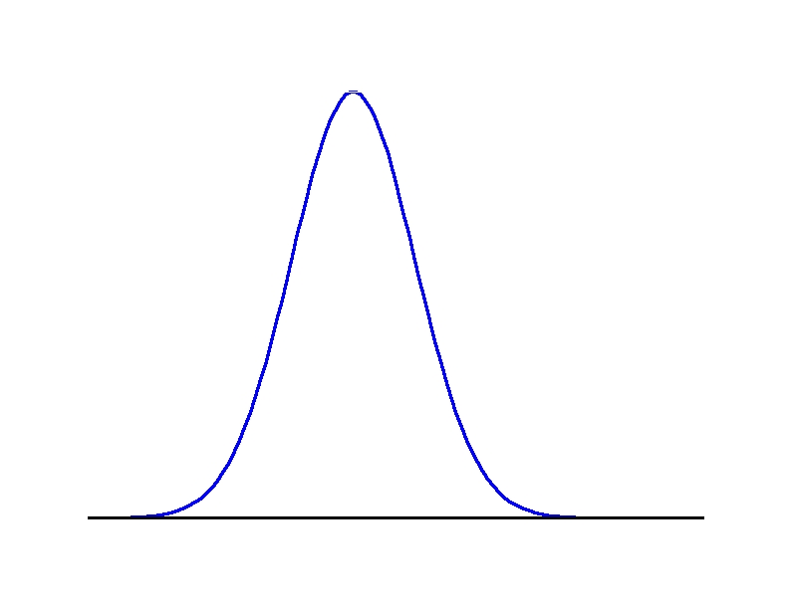
PROBABILITY

Slide 4
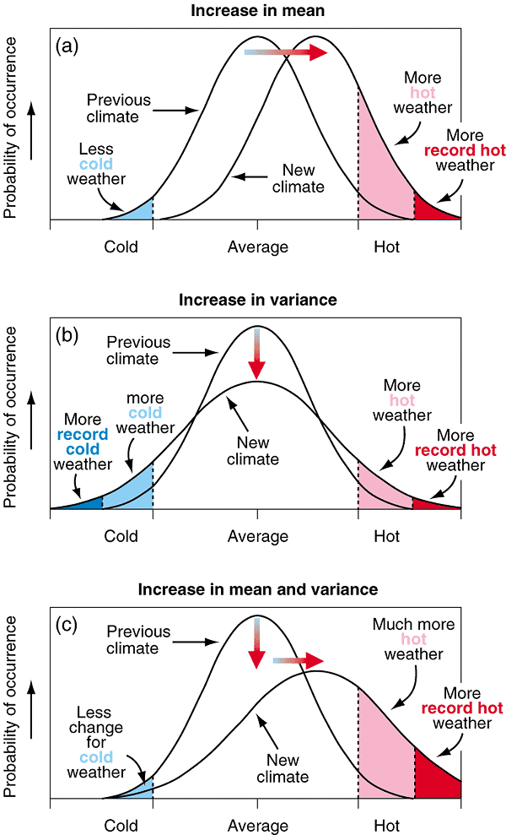
PROBABLITY & CLIMATE CHANGE

Slide 5
IMPACT
REDUCE EXPOSURE
people, property, systems, or other elements present in hazard zones that are thereby subject to potential losses
REDUCE VULNERABILITY
characteristics and circumstances of a community, system or asset that make it susceptible to the damaging effects of a hazard
INCREASE RESILIENCE
ability of a system, community or society exposed to hazards to resist, absorb, accommodate to and recover from the effects of a hazard in a timely and efficient manner

Slide 6
DRR in the UNFCCC
In 2010 the Conference of the Parties established the
Cancun Adaptation Framework
* adaptation must be addressed with the same level of priority as mitigation
* calls for ‘enhanc[ed] climate change related disaster risk reduction strategies’ and refers to the work already done by IPCC and ISDR
* basis for strategic and focused suggestions regarding the form and function of the Adaptation Committee
significant progress in strengthening the implementation of adaptation and the reduction of climate-related disaster risks in context of UNFCCC

Slide 7
DRR in the UNFCCC
In 2011 the CoP decided in Durban on
National Adaptation Plans
modalities and guidelines for the national adaptation plan process
Work programme to consider approaches to address loss and damage
platform for discussion and exchange of information on risks and loss and damage due the adverse effects of climate change, including on slow onset events en risk reduction (report 2013/14)
Adaptation Committee
the composition of, and modalities and procedures for, the Adaptation Committee

Slide 8
DRR in the UNFCCC
Adaptation Committee started in September 2012 and will report its first findings to CoP in November 2013.
Main objective:
Increase public awareness about risk reduction (vulnerabilities and hazards) and achieve commitment from public authorities
There are well aware that linking DRR with climate change adaptation offers a win-win opportunity:
  DRR offers opportunities for “bottom-up” strategies for adaptation to current climate variability including climate extremes
  DRR can promote early adaptation to Climate Change

Slide 9
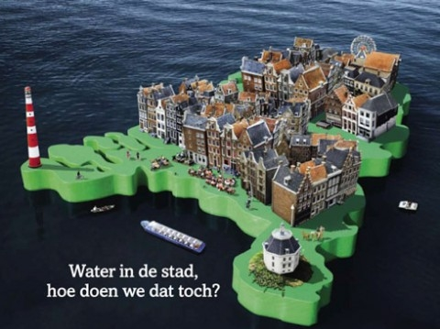
DRR in THE NETHERLANDS

Slide 10
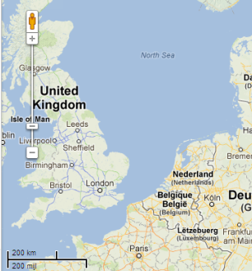
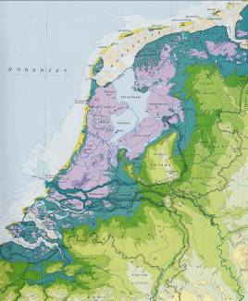
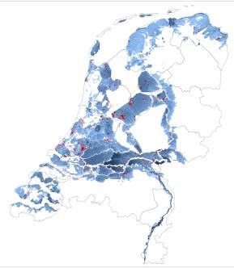
The Netherlands’ exposure profile
About 400 km of Rhine river
International catchment
60% flood prone
About 9 million inhabitants below flood level
GDP 600 bln euro
High protection level
3500 km of flood defences, hundreds of locks, sluices, pumping stations
A
H
R
100 km

Slide 11
RESPONSE POLICY
DECREASE EXPOSURE AND VULNARABILITY
physical system more robust to cope with climate change
(technology, spatial planning)
infrastructure, early warning
INCREASE RESILIENCE
society, economy, ecosystem more robust to cope with climate change
(humanities)
governance, ability to cope

Slide 12
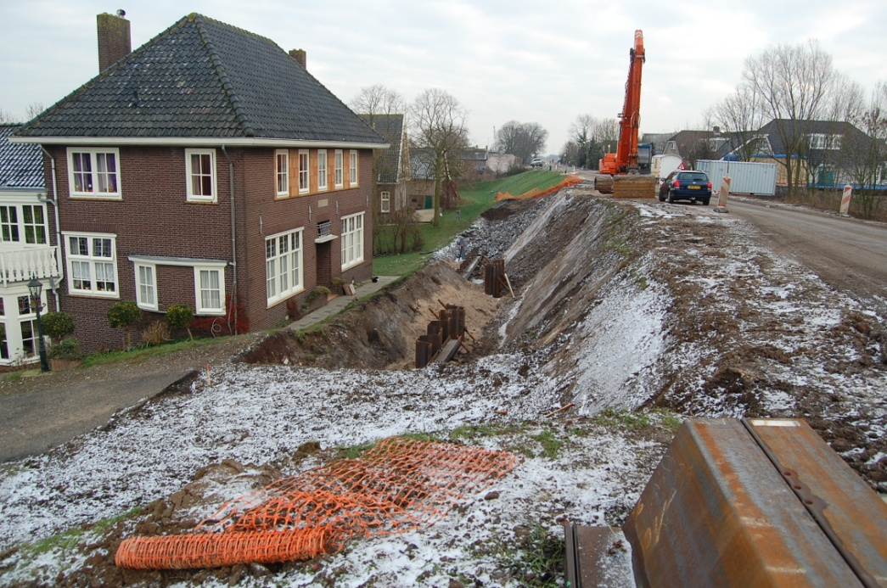
Well protected delta, requiring continuous effort
Legal standards
Legal periodic assessment (6yr)
Flood protection improvement
program
Waterboards / Rijkswaterstaat
(50-50%)
Delta Programme Commissioner

Slide 13
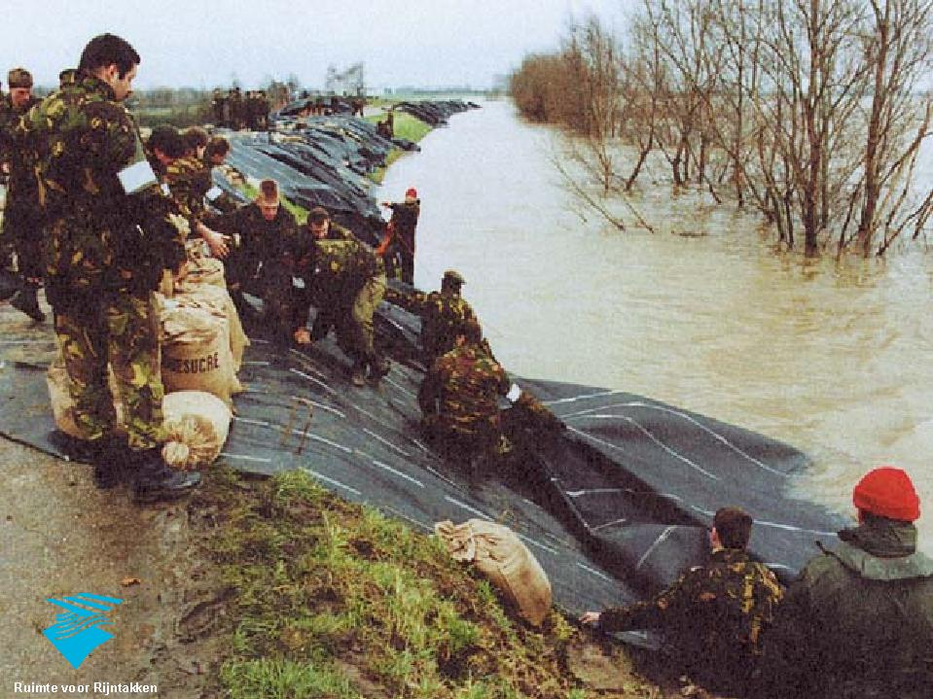
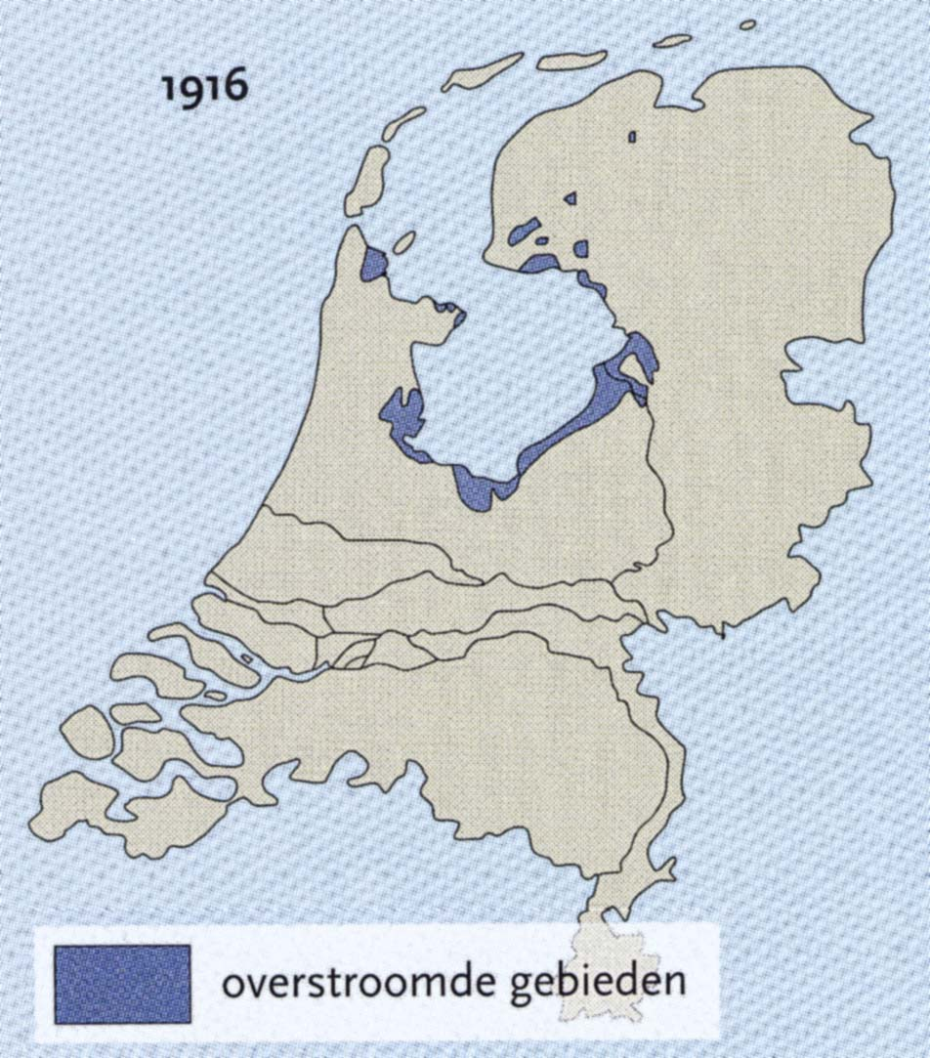
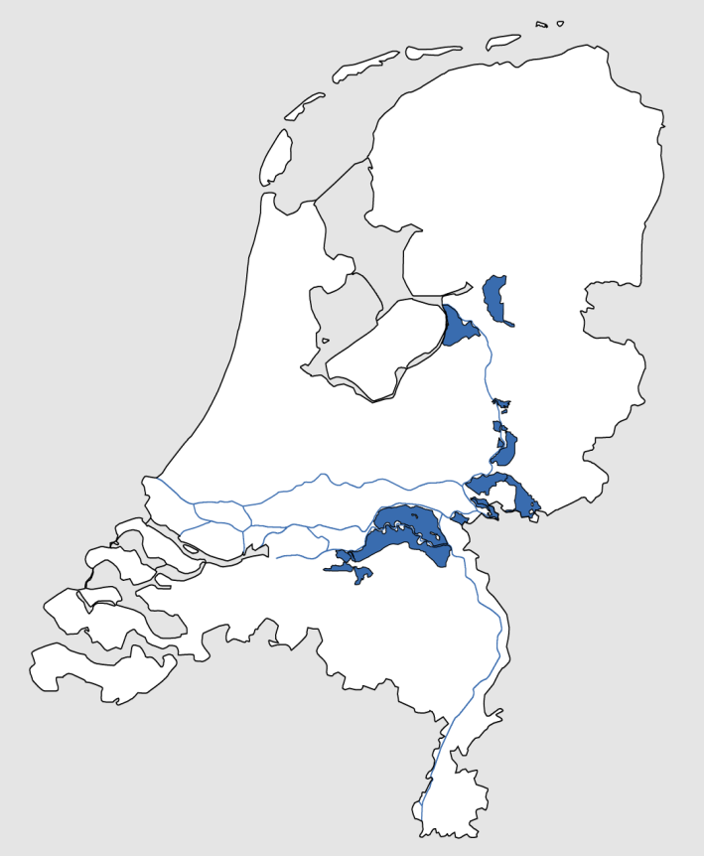
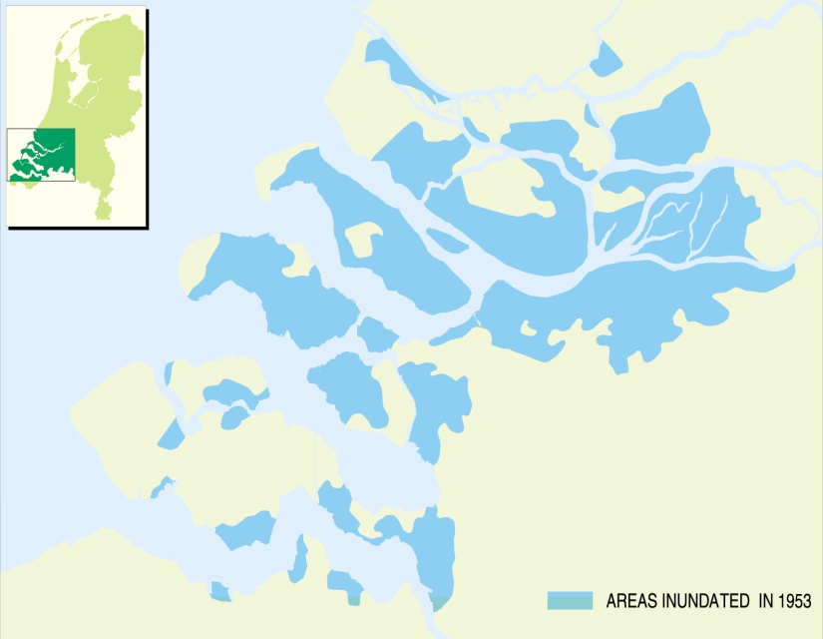
RECENT FLOOD HISTORY
1916
1995
1926
1953

Slide 14
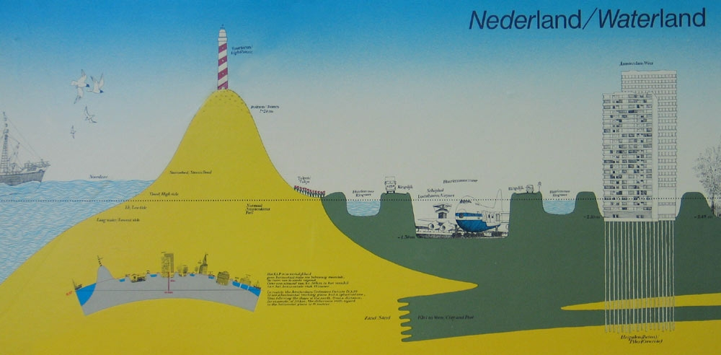
Delta under pressure‏
More summer
drought
More /extreme
storms
More/intense
rainfall
Increased
river
discharge
Spatial
developments
Sealevel rise
Increased
erosion
Decreased
river
discharge
Salt
intrusion
Subsidence

Slide 15
Delta Commission, 2008:
The threat is not acute,
but measures to improve
flood risk management and
fresh water supply
should be prepared urgently!

Slide 16
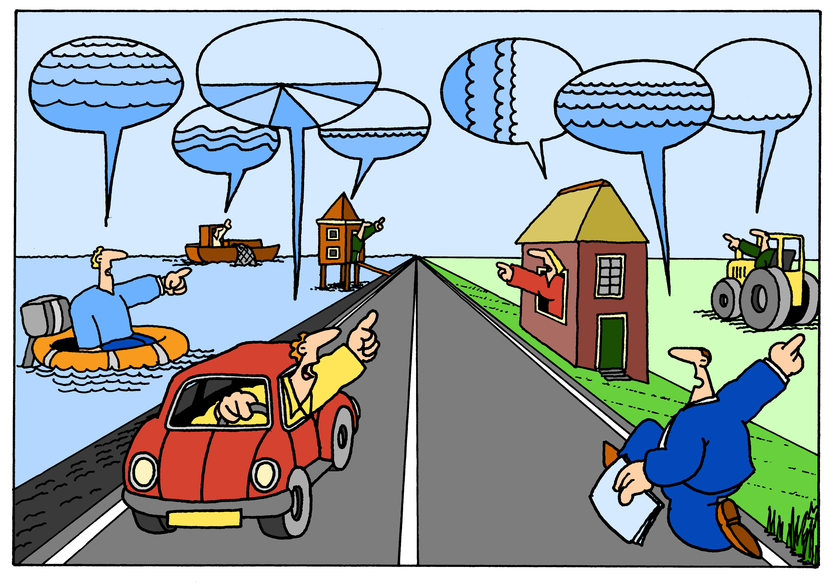
Multi-level governance
In order to:
  Collect creative and innovative ideas
  Combine with local developments (→“synergy”)
  Involve local stakeholders and built acceptance
Supervised by Delta Program Commissioner
  progress, uniformity, coherence
Joint fact-finding: Common knowledge base→ improve quality of information and acceptance
Delta Programme Commissioner

Slide 17
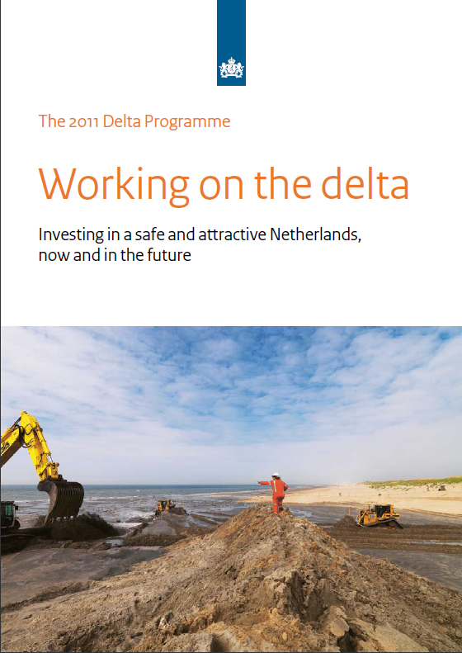
An innovative approach: Delta Programme
One Aim:
keeping NL a good, safe and attractive place to live and work for present and future generations (→ long term perspective)
Two Goals
Safe, now and in the future (2050-2100)
Fresh water supply guaranteed, also in dry periods
Three Basic values:
Solidarity, Flexibility and Sustainability
Not in answer to a disaster, but in advance, to be prepared or avoid it

Slide 18
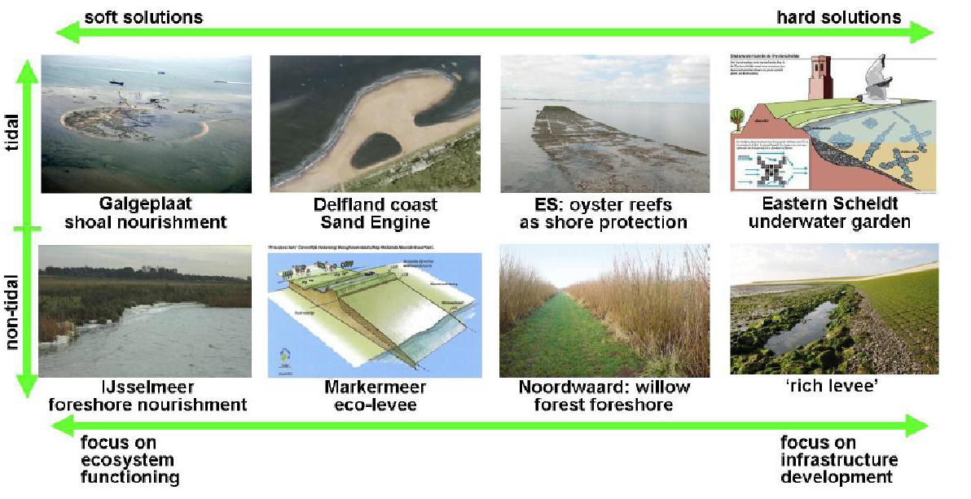
Flexible measures? Building with Nature!
Notes:
Use natural processes, to improve flood protection performance of the defenses, mainly by reducing wave action:
Sand nourishments, to create a shallow foreshore
Stimulate the development of natural reefs or vegetation

Slide 19
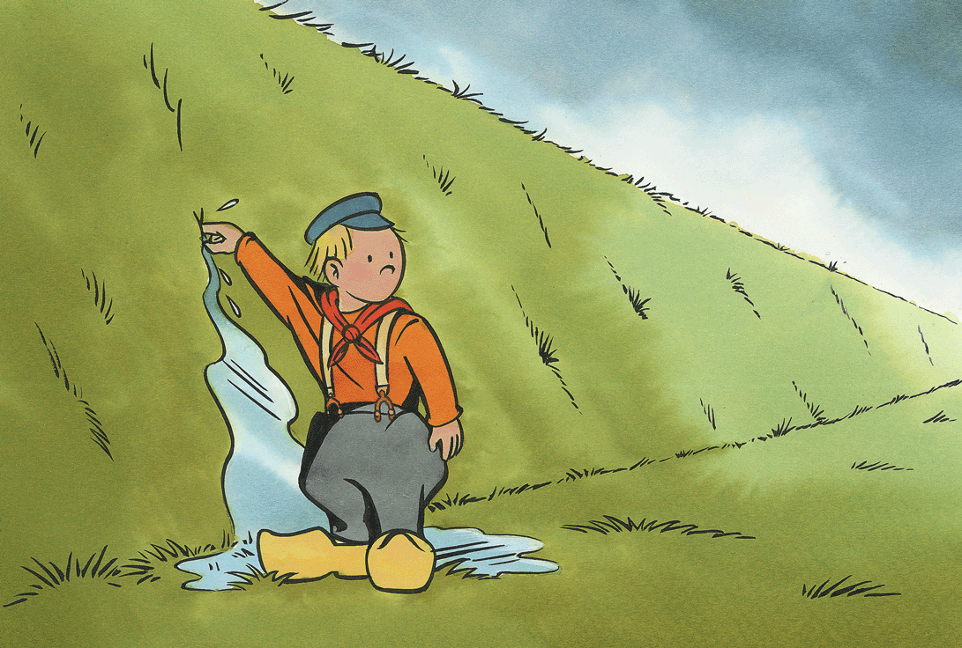
“Working together with water”
www.deltacommissie.com
“Working on the Delta”
www.deltacommissaris.nl

Slide 21
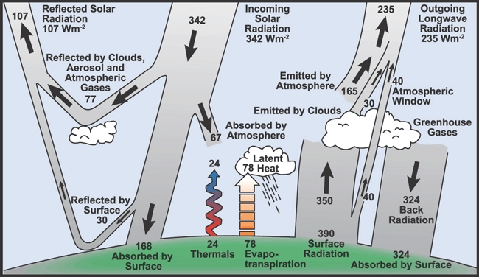
CLIMATE SYSTEM

Slide 22
REGIONAL CLIMATE SCENARIOS
CONSISTENT PROJECTIONS OF A POSSIBLE FUTURE CLIMATE
indication of changes in temperature, precipitation, evaporation, wind, etc.
Conditional for adaptation in watermanagement, coastal defecnce, agriculture, energy, nature, tourism,

Slide 23
REGIONAL CLIMATE SCENARIOS
Climate change in the Netherlands depends on global temperature rise and change in local wind regime
Scenarios are mainly used for impact assessment, adaptation options and policy

Slide 24
REGIONAL CLIMATE SCENARIOS

Slide 25
REGIONAL CLIMATE SCENARIOS
STILL TOO GENERAL FOR IMPACT ASSESSMENT,
GENERATING NEED FOR TAILORED ADVICE
Rural water management:
  What can be considered as a ‘standard meteorological year’ assuming a given scenario in 2050?
Main river management:
  How does the 1/1250yr 10-day precipitation change?
Wind energy sector:
  How does the distribution of wind events over the North Sea change?
Sewage design in cities:
  Does extreme precipitation change differently in the coastal areas than inland?

Slide 26
