Slide 1
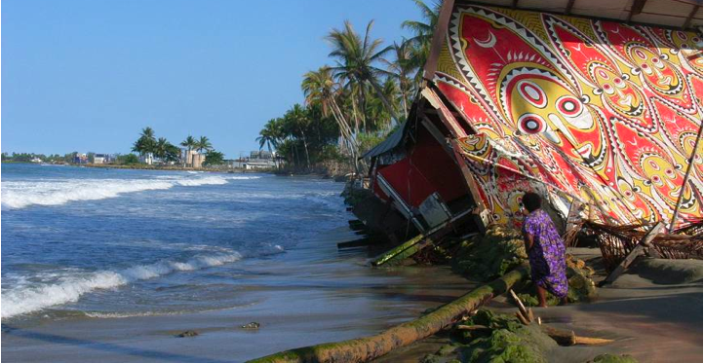
Bridging Adaptation and Disaster Risk Reduction TNC’s engagement in International policy
IUCN – Marco Calvo

Slide 2
UNISDR Hyogo Framework of Action (HFA)
HFA shifted interest from recovery and relief to prevention
Still planning and building codes
Post Hyogo - strengthen prevention and risk reduction, improve linkages with CC adaptation; carve specific place for EbA-Environment as a new cross cutting theme.

Slide 3
Vulnerability focus
Impact focus
Addressing the
drivers of
Vulnerability
Activities seek to
reduce poverty
and other non climatic or hazard related stressors that make people vulnerable
Building
response
Capacity
Activities seek to
build robust
systems for
problem-solving
Managing
climate and disaster risks
Activities seek to
incorporate climate
and specific disaster risk related information into
decision-making
Confronting
climate change and disasters
Activities seek to
address impacts
associated
exclusively with
climate change and specific disasters
Traditional Development Aid
New adaptation and DRR specific funding

Slide 4
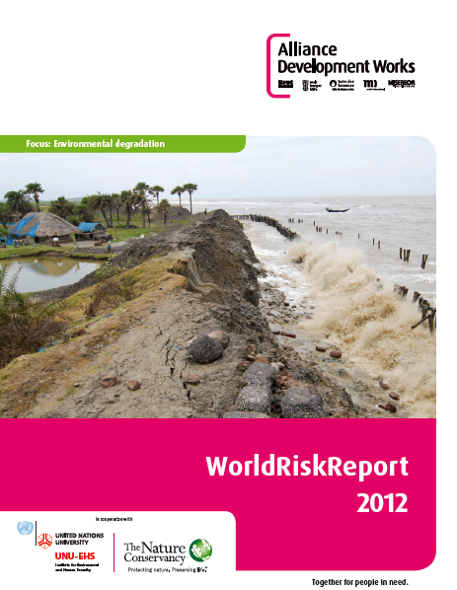
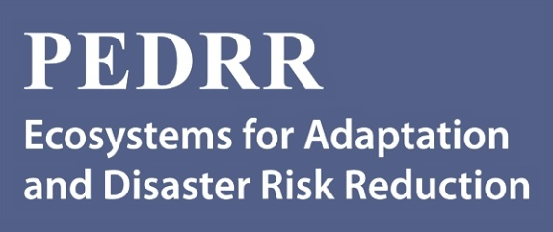
Importance of Partnerships

