Slide 1
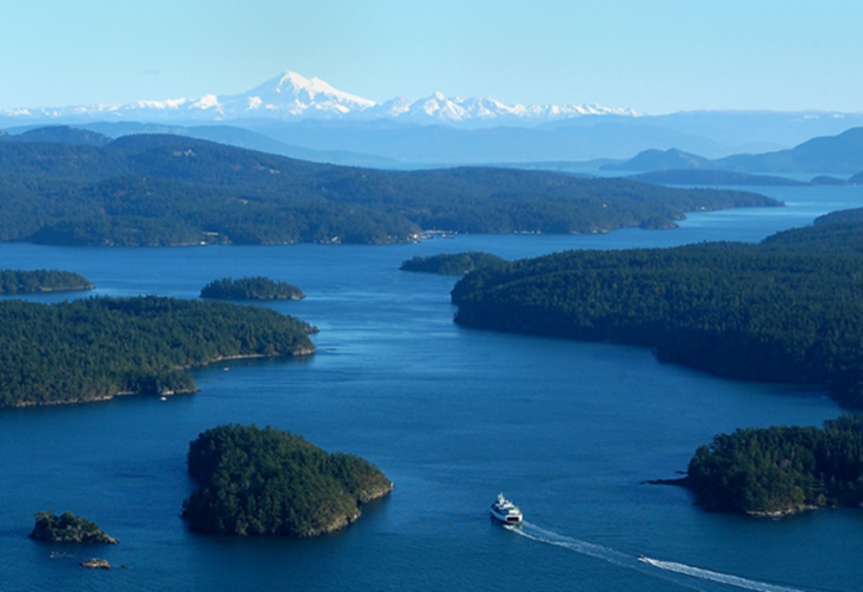
Puget Sound Floodplains by Design
A multi-agency, multi-benefits approach to floodplain management
Initiating Partners: TNC, PSP, USGS, FEMA, NOAA, EPA, Ecology
Notes:
3-4 slides to show people the site – and the program - and explain why it’s important.
Skagit
The Skagit is where we got our feet wet; but at this point we are working at the whole system scale – working across the entire Puget Sound basin
FbD – we have a whole program in Puget Sound – I will be just talking about one aspect of that program – that which is direclty focused on climate and disaster resilience
Puget Sound is iconic Pacific Northwest
Mountains, forests, water, salmon
Glacier covered mountains cascading down a 10,000 rivers and streams through dense forests into the contiguous United States’ only fjord
Historically supporting a huge abundance of fish and wildlife – notably salmon and shellfish – both freshwater and marine –
and other natural resources – forests, recreation/tourism

Slide 2
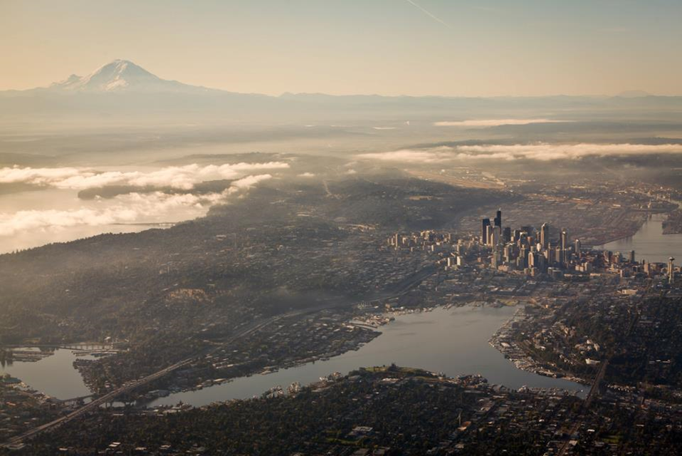
Notes:
But because this corner of WA is so idyllic and so resource abundant…
It is also the hub of the NW population and economy
PNW economic hub,
a global economic driver.
4 of the globe's 20 most recognizable brands;
among the US' fastest growing economies and populations
The vast majority of the uplands are fairly well protected forestlands/mountains
Dominated by national parks, national forests and state and private timberlands
So the vast majority of that population and economic activity is crowded into the lowlands and coastal areas – including the floodplains and deltas that also serve as the aquatic ecosystems connection between the mountains and the sea.

Slide 3
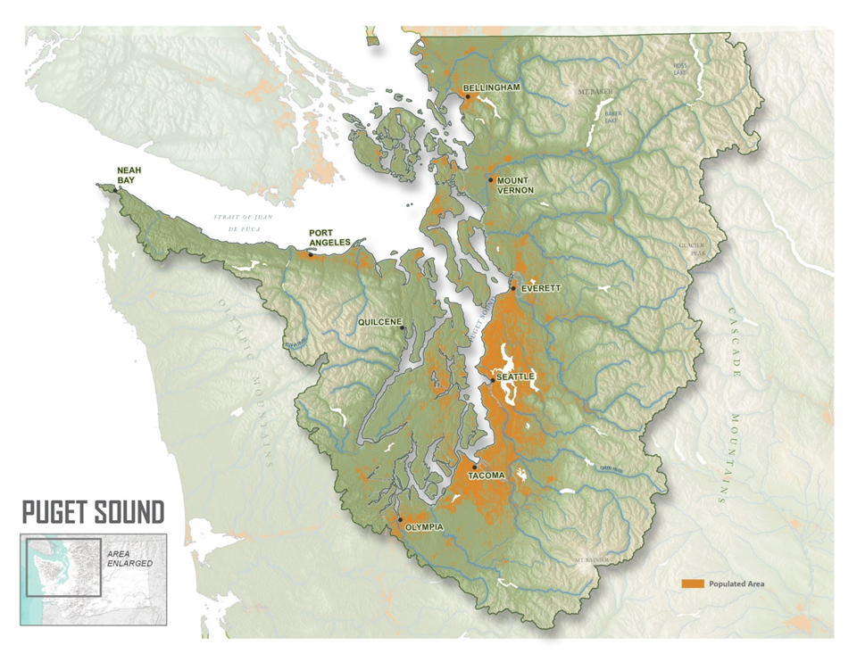
Notes:
3-4 slides to show people the site – and the program - and explain why it’s important.
This project is focused on the 17 major rivers and river deltas the flow into Puget Sound
And you can see (in orange) how the human activity is focused along the coasts and river corridors
In addition to population density shown in this map, the portions of the floodplains and deltas that aren’t used for commercial and residential uses are generally used for farming – between the maritime climate and the alluvial floodplain soils, it’s some of the most productive agricultural land in the country

Slide 4
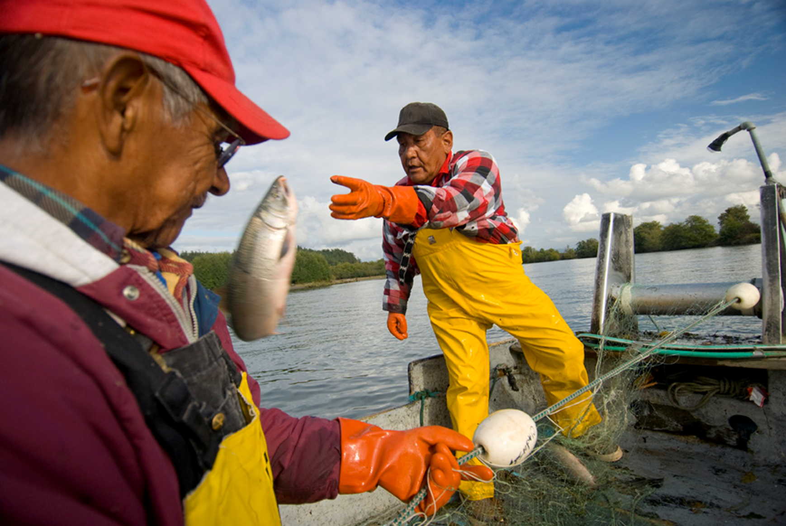
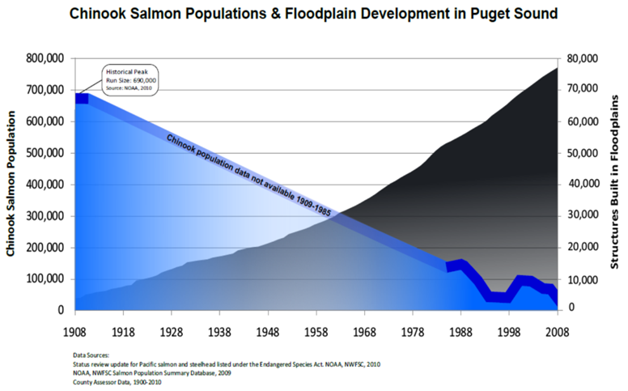
Notes:
As a result – the region’s once abundant fisheries – that been the primary sustaining force for a multitude native american tribes – have been significantly impacted
Levees and other bank hardening activitiies have resulted in the loss of over 70% of Puget Sound’s riverine and estuarine wetlands
In other words, the portion of the entire Puget Sound basin that produces the greatest ecosystem services – the floodplains and esutatrures – are also the portion of the entire region that has been most altered by human development
This not only has ecological impacts….

Slide 5
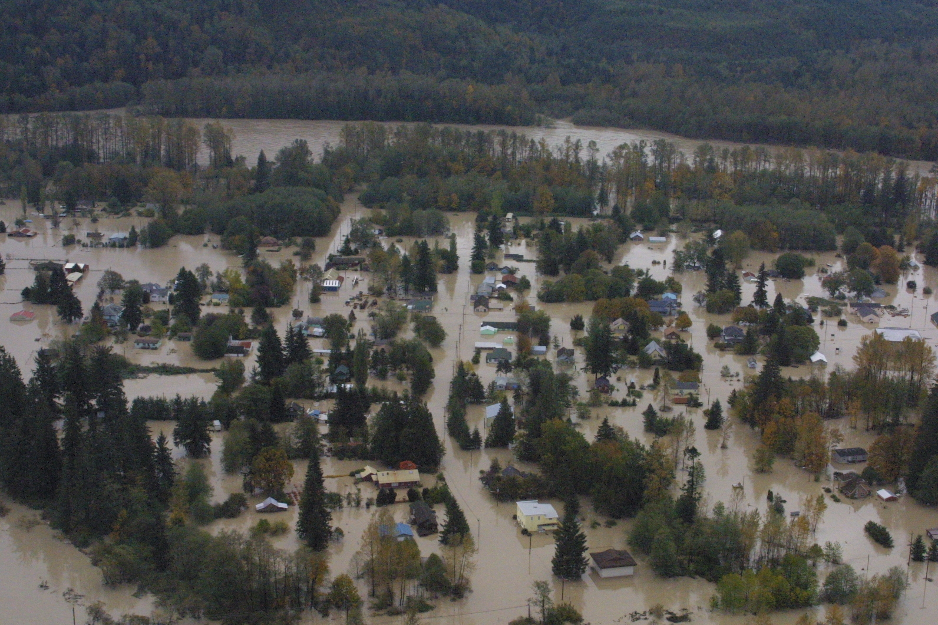
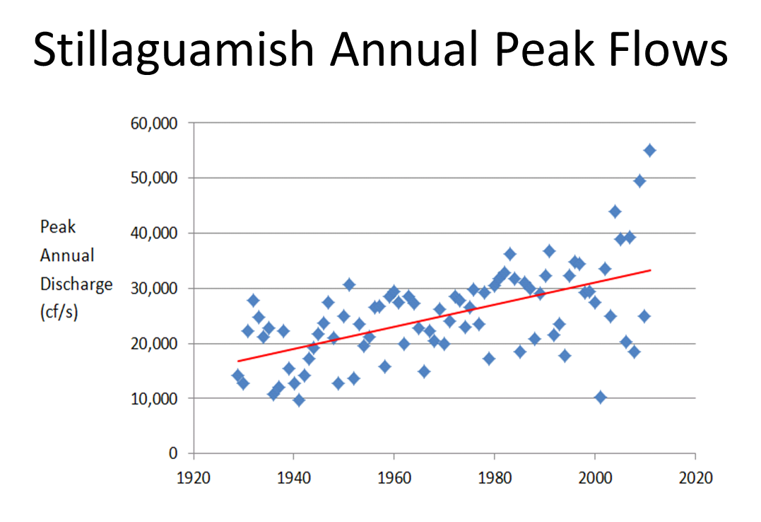
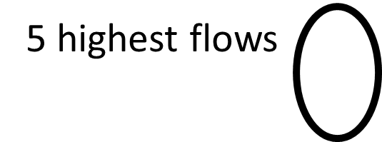
Notes:
Extensive floodplain development and levees doesn’t just have ecological impacts, it has significant human impacts.
And these impacts are growing
As a result of development
And as a result of climate change
This graph shows the peak flows on one sample river – the stillaguamish – where the five largest flows on record have all occurred in the past decade. (note, the is an extreme case)
THE AVERAGE INCREASE IN PEAK RIVER FLOWS IS _____
In addition to increased flows resulting for more and larger extreme weather events…
SLR: SL is expected to increase 1 meter over the next 50 years – a problem when much of the development is on the coast and much of the ag production occurs in already syub-tidal river deltas
Sediment: Is also expected to increase dramatically as a result of more rainfall, less area under snow cover and receding glaciers
Low flows: our summers will become increasing dry even as our population and economic growth increases demands
With levees and bank armoring along our rivers we’ve giving them less floodplain areas to store water and sediment. By reconnecting our floodplains we will increase our ability to store flood waters, recharge groundwater, sequester more nutrients and sediments, and sustain fisheries
We believe there is a way to simultaneously address increases in flooding and declining salmon runs and water quality……..

Slide 6
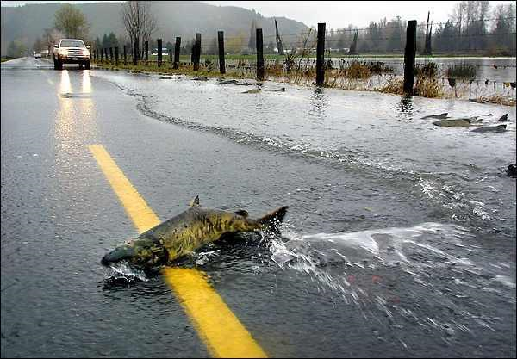
Key Outcomes
Triple bottom line:
Healthier rivers
Resilient communities
Greater ROI
Notes:
We will have succeeded if
green infrastructure is mainstreamed into Puget Sound floodplain management….
and we see fewer instances of this.
Fish have healthy habitat and flood refugia
Human lives and infrastructure are less succestible to flooding
We believe that by aligning resources and mainstreaming natural infrastructure we can achieve a
Triple bottom line:
Rivers healthier - Specifically we will achieve the 15% recovery target (20-30,000 acres)….and PS fisheries will be open
Communities safer and more resilient – the focus is on advancing MB restoration projects that assist people out of harms way or set levees back to reduce risks of overtopping or breaching
Greater ROI – paradigm shift in FP mngt - instead of using conservation dollars to undue things paid for with infrastructrrue funding, integrated, MB project will be norm
This is important to WA and the world because:
The world has been trying to achieve integrated floodplain management for decades with only marginal success. We are laying the groundwork and have the enabling conditions (target; agency support; resources; consciousness, ESA/treaty rights) where we can really lead on this front.
Flooding is the most costly natural disaster in the world and climate change is making it worse and worse.
If we can win even in the face of great econ growth/pressure; we can win not only without hurting the econ prospects of globally significant industry, but by partnering with them and leveraging their leadership; we can show a path to impacts while building global evangelists whose business practices and supply chains span dozens of countries and multiple continents.
In other words, it is a Global Challenge….to the extent that we are well positioned help address that challenge in PS, the lessons may have global applicability

Slide 7
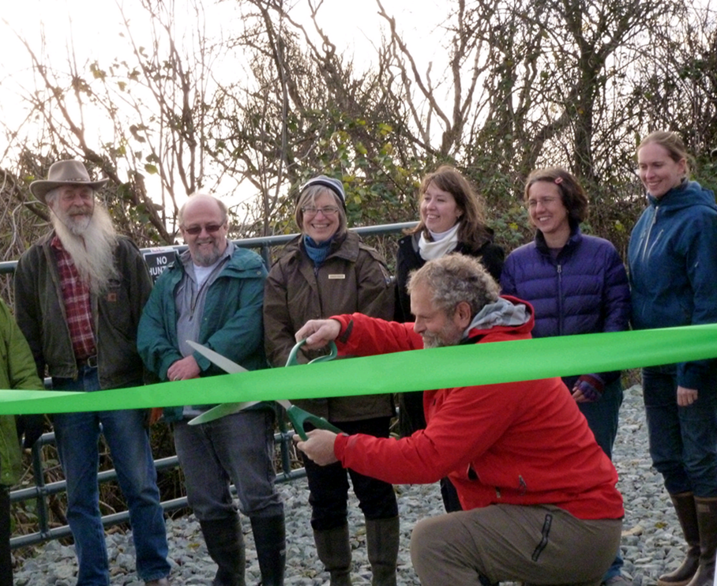
Key Audiences
- Funders
- Implementers
Notes:
There are two main groups of decision-maker we’re focused on:
Those investing in floodplain mngt/infrastructure – the Funders - the state and federal agencies that fund the vast majority of floodplain infrastructure projects:
Federal: US Army Corps, FEMA, EPA, NMFS, DOT
State: EMD, Ecology, WSDOT, local governments and flood districts
2. Those making decisions about what projects to build or how to manage flood/floodplain infrastructure
Local governments and flood districts
(Ultimately need landowners on board, too, but they generally aren’t driving decisions about large scale infrastructure investments)

Slide 8

STRATEGY: Integrate; Coordinate; Build Capacity
FEMA
NOAA
Integrate Objectives
CORPS
DOT
BEFORE: Small, single purpose projects
Coordinate Investments
Build Capacity
AFTER: Large, multiple purpose projects
Notes:
TNC has invested $10 M implementing on-the-ground projects over the last three years that deliver habitat and reduced flood risk; so our job is partly to figure out how to better learn and leverage those
The overall strategy is to influence local, state and federal floodplain decision makers by integrating a multiple benefits framework into project, policy and funding decisions.
Right now we have distinct local stakeholders and project implementers and distinct state and federal agencies focused on singular aspects of floodplain management. We have a
Two complementary strategies – one top-down; one bottom up; the other runs thru
Coordinated investment: Align policies and funding programs (funnel diagram)
enable (PS FP assessment); funding (incentive); network of champions (lead)
Build Capacity in implementers: tools and support to advance multiple benefit projects
DSF (enable); smokejumpers (lead)
And to support both of these…..One overarching support strategy
Integrate: we will build the scientific and economic information and tools to show how and were natural infrastructure makes the most sense…where investments in green or hybrid green-grey infrastructure solutions can meet multiple objectives
(both of these depend on strong science, communications and external relations)
Integrate
Build awareness of advanteges of integrated projects
Create tools of know for where and how these projects can occur on the ground
Coordinate
Align policies and funding programs so that funding decisions are coordinated
This create the intenctive for natural infrastructure solutions

Slide 9
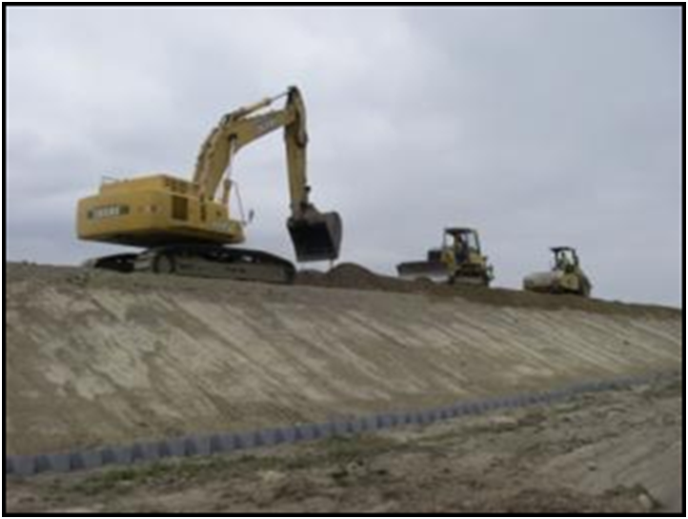
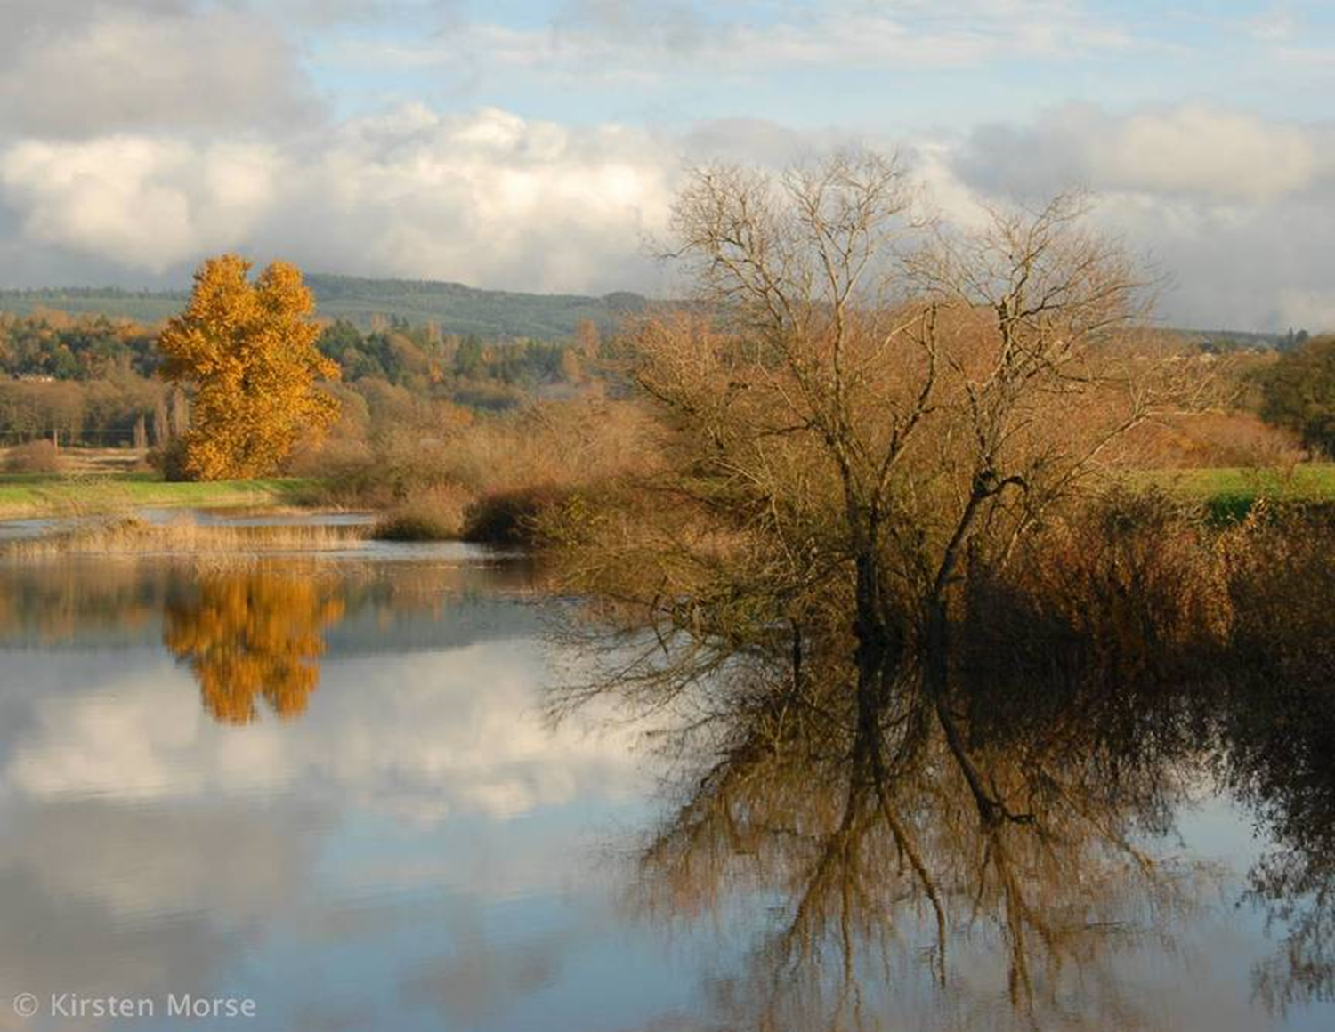
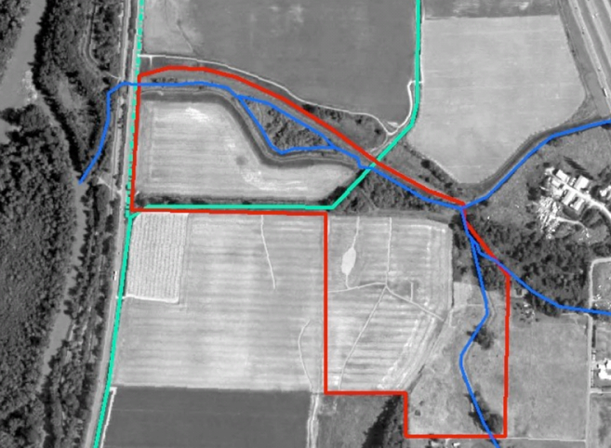
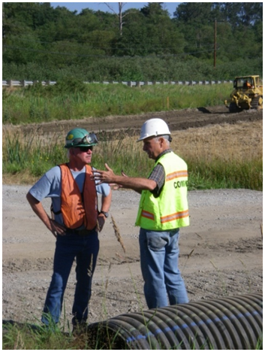
INFORM
Notes:
SHOW IT WORKS
- And show where it can work
What kind of info needed? available:?
In order to mainstream natural infrastructure we need to be able to show conclusively that it makes good sense to incorporate natural infrastructure into floodplain management. Two kinds of info
That it is a viable, practical model (political support secured; funding attained)
That it makes sense economically (that it is actually more cost-effective)
Is info available now? What being done?
Yes: Pilot project implemented successfully – yes, avail now in a couple places – these pictures are from our Fisher Slough project, one of two integrated floodplain projects the Conservancy has implemented in the Skagit region – but also trying to get more on ground
No: Building the Economic Case
in process of evaluating what info most compelling to which audiences (boeing economics work)
TNC-wide strategy mtg on topic thurs night
Ensuring audience getting info
Many of agencies aware of projects
We do not have a robust communications plan to get the info out
Are there good Examples?
Growing number of demonstration projects
Yes, but we want to see more and more natural infrastructure projects in more and more counties/watersheds so that green infrastructure or green-grey infrastructure becomes the status quo throughout Puget Sound

Slide 10
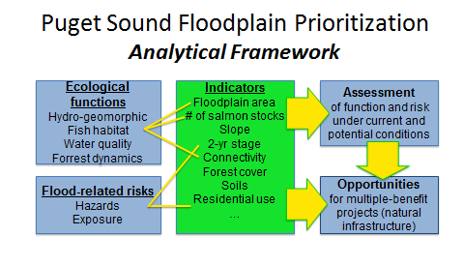
INFORM
Notes:
2. INTEGRATE: Provide the information and tools that help them figure out how and where they can better coordinate their investments – i.e. where they should be doing MB projects
NOTE: THIS IS ESSENTIALLY A PRIORITIZATION OF NATURAL INFRASTRUCTURE PRIORIORITIZATOIN – WHERE LIKLEY TO FIND BIGGEST OPPORTUNITIES TO STORE FLOOD WATER, FILTER WATER AND RESTORE FISHERIES HABITAT
Two tools:
one at regional scale … focused more on agency funders – ID funding priorities (focus)
One at local scale … focused on implementors – ID and prioritize projects
1. COORDINATE:
Convene a multi-agency partnership
And REMOVE POLICY BARRIERS THAT DISINCENTIVIZE GREEN INFRASTRUCTURE SOLUTIONS OR MAKE INTER-AGENCY COORDINATION DIFFICULT
-------------------------
Do the have the capacity?
Short answer no.
They focus their resources through narrow stovepipes
this is inefficient and leads to political and practical conflicts
Issue exists at both funding agency and implementer levels
They are also constrained by narrow policies and planning tools – designed to meet narrow mandates
There is no regional database or tool that can assist regional planners
There is no integrated system or tool for identifying or prioritizing projects
By combining resources through a coordinated approach we can increase capacity
What steps must be taken?
TOOLS:
To move beyond their stovepipes, agencies need support in finding the places and projects where natural infrastructure makes sense – the places were multiple benefit projects make sense
Important to recognize that these technical tools are as important as a convening/collaborating mechanism as they are a technical tool. We’ve got to get flood managers and habitat interests in the same room.
FbD project is doing both these things
It is bringing multiple agencies and interests together in a collaborative way
And it is developing the tools to aid in funding and project decisions
PS FP Assessment:
Across 17 river systems
Places where there is the greatest opportunity to restore natural floodplain infrastructure
Planning to use this to prioritize resource allocation decisions from various state and federal agencies
DSF
At the local level we need a project planning tool – a tool the enables groups focused on restoring salmon habitat or improving WQ to sit in the same room with agencies focused on flood management and identify and prioritize project decisions
which projects best meet multiple community objectives
CHANGE POLICIES:
Some of the stovepipe syndrome is forced or exacerbated by the narrow policies and procedures associated with those programs – e.g. the Corps’ policies that makes setting levees back more difficult and more expensive (PL84-99 versus Orting)
FbD project will
Identify biggest state and federal policy barriers that inhibit multiple objective projects or natural solutions to climate and flood risks
Will include both statutory and non-statutory policies
Craft the policy changes recommendations to reduce these barriers.
SMOKEJUMPERS
Over the last 6 years, we've worked on two major restoration projects: owning, fundraising, designing, implementing. And now we're leveraging that experience. Through our work with NOAA and the CI ask, by September, we'll be supporting as many as 12 projects (think that's the number), and scoping 4 more (Hood Canal) - each an integrated, MB effort that is will be designed to deliver MB and expand stakeholder support for recovery. this thanks to our ability to pivot to the CI/Pipeline strategies
Are there good Examples
FEMA/EMD: willing to incorporate and identify as a priority the forthcoming FbD map of greatest opportunity areas into their state hazard mitigation plan
SLS is one of best examples of integrated management – but while they’re doing hydraulic modeling and the like, the project identification and selection process is more about horse trading: “you give us this; we’ll give you that.” They do not have a systematic way of looking for
King County: “this is what we’re doing.” But flood and salmon programs still managed separately. And there was a major flair up in one city where the city balked at the Counties interest in advancing natural solutions in favor of increasing their level of flood protection through grey infrastructure (bigger levees) because they couldn’t justify the extra construction costs of setback levees.

Slide 11
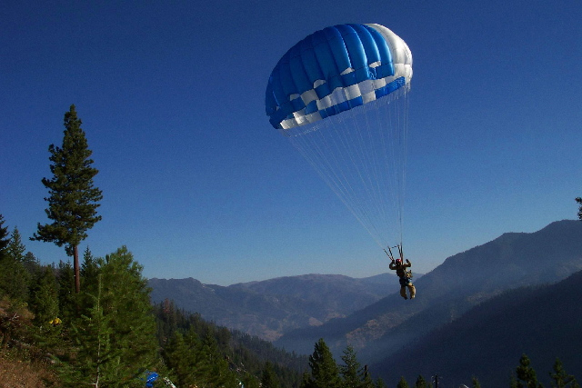
ENABLE
Smokejumpers
Decision Support
Notes:
HELP OTHERS DO IT
Strategies
Enable the Funders:
2 steps – linked directly to our CI strategy
2. INTEGRATE: Provide the information and tools that help them figure out how and where they can better coordinate their investments – i.e. where they should be doing MB projects
NOTE: THIS IS ESSENTIALLY A PRIORITIZATION OF NATURAL INFRASTRUCTURE PRIORIORITIZATOIN – WHERE LIKLEY TO FIND BIGGEST OPPORTUNITIES TO STORE FLOOD WATER, FILTER WATER AND RESTORE FISHERIES HABITAT
Two tools:
one at regional scale … focused more on agency funders – ID funding priorities (focus)
One at local scale … focused on implementors – ID and prioritize projects
1. COORDINATE:
Convene a multi-agency partnership
And REMOVE POLICY BARRIERS THAT DISINCENTIVIZE GREEN INFRASTRUCTURE SOLUTIONS OR MAKE INTER-AGENCY COORDINATION DIFFICULT
-------------------------
Do the have the capacity?
Short answer no.
They focus their resources through narrow stovepipes
this is inefficient and leads to political and practical conflicts
Issue exists at both funding agency and implementer levels
They are also constrained by narrow policies and planning tools – designed to meet narrow mandates
There is no regional database or tool that can assist regional planners
There is no integrated system or tool for identifying or prioritizing projects
By combining resources through a coordinated approach we can increase capacity
What steps must be taken?
TOOLS:
To move beyond their stovepipes, agencies need support in finding the places and projects where natural infrastructure makes sense – the places were multiple benefit projects make sense
Important to recognize that these technical tools are as important as a convening/collaborating mechanism as they are a technical tool. We’ve got to get flood managers and habitat interests in the same room.
FbD project is doing both these things
It is bringing multiple agencies and interests together in a collaborative way
And it is developing the tools to aid in funding and project decisions
PS FP Assessment:
Across 17 river systems
Places where there is the greatest opportunity to restore natural floodplain infrastructure
Planning to use this to prioritize resource allocation decisions from various state and federal agencies
DSF
At the local level we need a project planning tool – a tool the enables groups focused on restoring salmon habitat or improving WQ to sit in the same room with agencies focused on disaster risk reduction and identify and prioritize project decisions
which projects best meet multiple community objectives
CHANGE POLICIES:
Some of the stovepipe syndrome is forced or exacerbated by the narrow policies and procedures associated with those programs – e.g. the Corps’ policies that makes setting levees back more difficult and more expensive (PL84-99 versus Orting)
FbD project will
Identify biggest state and federal policy barriers that inhibit multiple objective projects or natural solutions to climate and flood risks
Will include both statutory and non-statutory policies
Craft the policy changes recommendations to reduce these barriers.
SMOKEJUMPERS
Over the last 6 years, we've worked on two major restoration projects: owning, fundraising, designing, implementing. And now we're leveraging that experience. Through our work with NOAA and the CI ask, by September, we'll be supporting as many as 12 projects (think that's the number), and scoping 4 more (Hood Canal) - each an integrated, MB effort that is will be designed to deliver MB and expand stakeholder support for recovery. this thanks to our ability to pivot to the CI/Pipeline strategies
Are there good Examples
FEMA/EMD: willing to incorporate and identify as a priority the forthcoming FbD map of greatest opportunity areas into their state hazard mitigation plan
SLS is one of best examples of integrated management – but while they’re doing hydraulic modeling and the like, the project identification and selection process is more about horse trading: “you give us this; we’ll give you that.” They do not have a systematic way of looking for
King County: “this is what we’re doing.” But flood and salmon programs still managed separately. And there was a major flair up in one city where the city balked at the Counties interest in advancing natural solutions in favor of increasing their level of flood protection through grey infrastructure (bigger levees) because they couldn’t justify the extra construction costs of setback levees.

Slide 12
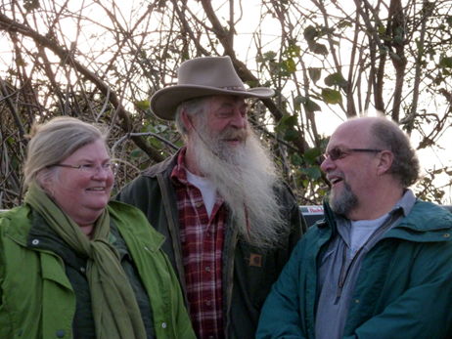
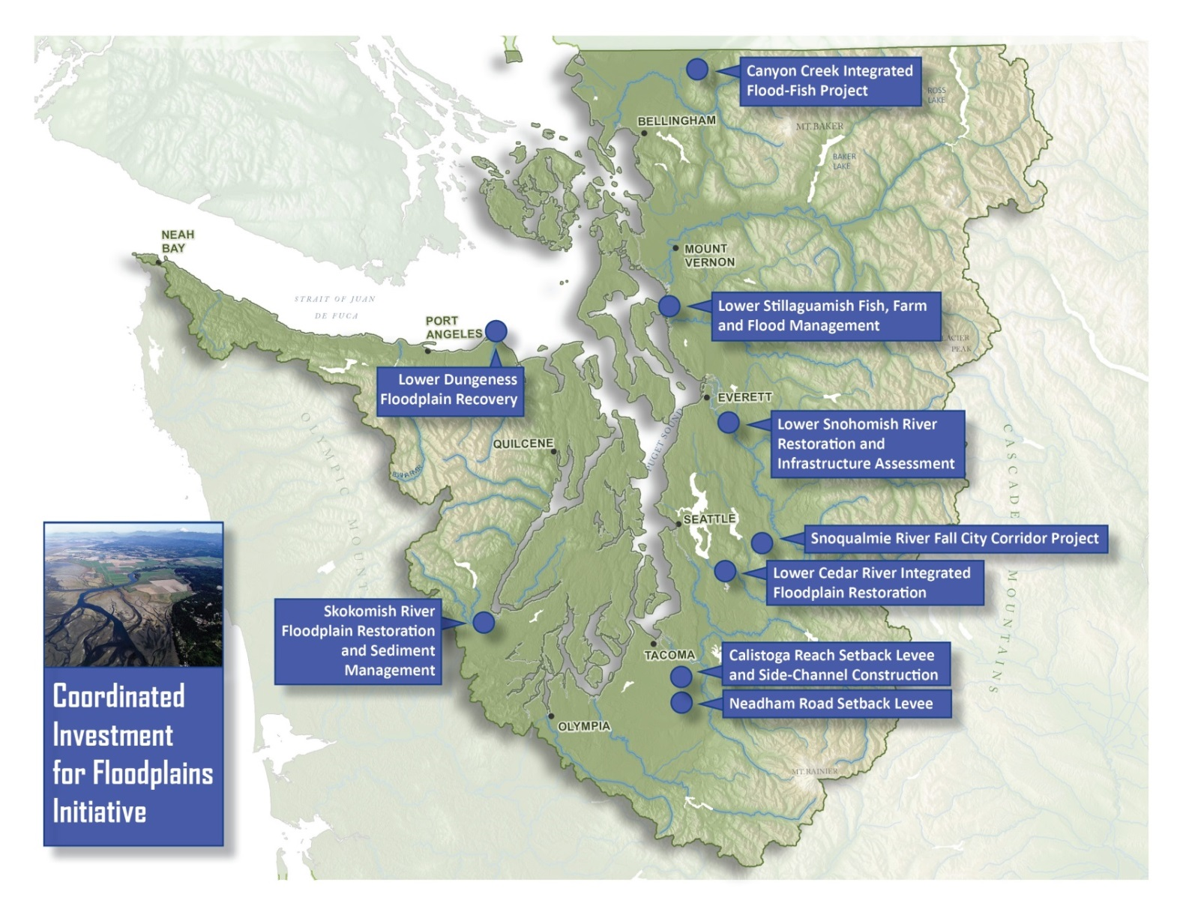
INCENTIVIZE
Align resources
  Funding
  Policy
Leverage new resources
Notes:
DRIVE RESOURCES AND POLICY
Do key audiences want to act?
Yes.
Have gotten very positive response at both state and federal agency level
Locally there is a significant interest in both salmon/habitat recovery and in flood risk (and in some cases climate risk) reduction. (WQ and recreation/public river access also areas of interest)
And no one is securing the funding they need to accomplish their goals
What program doing?
Aligning resources through coordinated investment (show funnel diagram)
Trying to leverage new resources (capital budget request)
Examples
Capital budget request – developed list of 20 projects, totalling $100M; winnowed to $33M project list
Demonstration of
Need for more flexible, MB funding source…that can leverage more traditional funding
Also, starting to change search image of project. History of folks implementing relatively small –scale, single-purpose projects. If we show larger, multiple purpose projects can be funded, project proponents will step up to the challenges
Fisher/PSB
Overcame significant political and financial hurdles

Slide 13
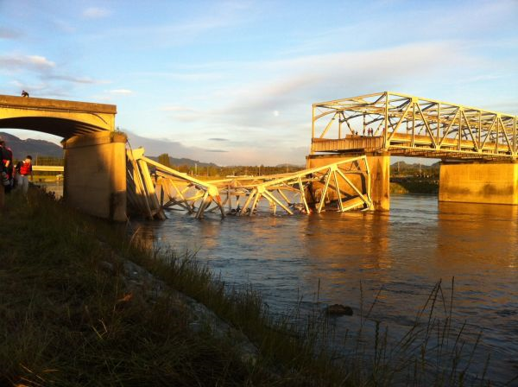
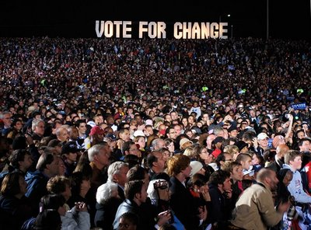
LEAD
State agency leadership
Political champions
Notes:
BUILD POLITICAL WILL
Who needs to lead?
state/fed agencies (the investors)
Local governments/agencies (the implmentors)
What are we doing to encourage them?
Funders
Putting them in same room
Making FbD a partnership….not a TNC project
Putting them in leadership positions; or getting them to incorporate FbD products and MB approach into THEIR plans
The floodplain recovery goal is the State of WA’s goal;
Various agencies are leading certain aspects of project
USGS leading tech work;
FEMA/EMD on state hazard plan;
Corps leading portion of analysis;
WSDOT doing own analysis
Making FbD tool something owned by WDOE, others
Implementers
Smokejumper model; focus on funding
Instead of doing projects; TNC focused on supporting rather than implementing – MAJOR SHIFT IN TNC ROLE
3FI
Hood Canal
SLS
NOAA proposal
Puts local project proponents in drivers seat – we deliver $$, tools and tech support – they own work, learn new approach
Network of champions – Have an explicit strategy to build a political powerhouse to back up our technical, funding and policy goals
We will develop a vision for PS rivers and estuaries that is owned and embraced by local governments
They will be the ones going to bat for policy changes and funding appropriations…and the ones implementing the work
Are there emerging leaders or good examples of how this is happening?
YES
Capital budget request supporters/advocates
Agencies
FEMA/EMD is for the first time ever acknowledging need to incorporate environmental goals in WA State’s flood hazard mitigation plan; have even called out
Corps’ Silver Jackets program has applied for funding to help identify a first round of projects where flood mitigation funding could support multiple objective projects
WSDOT doing analysis of all state highway bridges in Puget Sound to identify those where lengthened bridge spans could facilitate the greatest amount of floodplain restoration

Slide 14
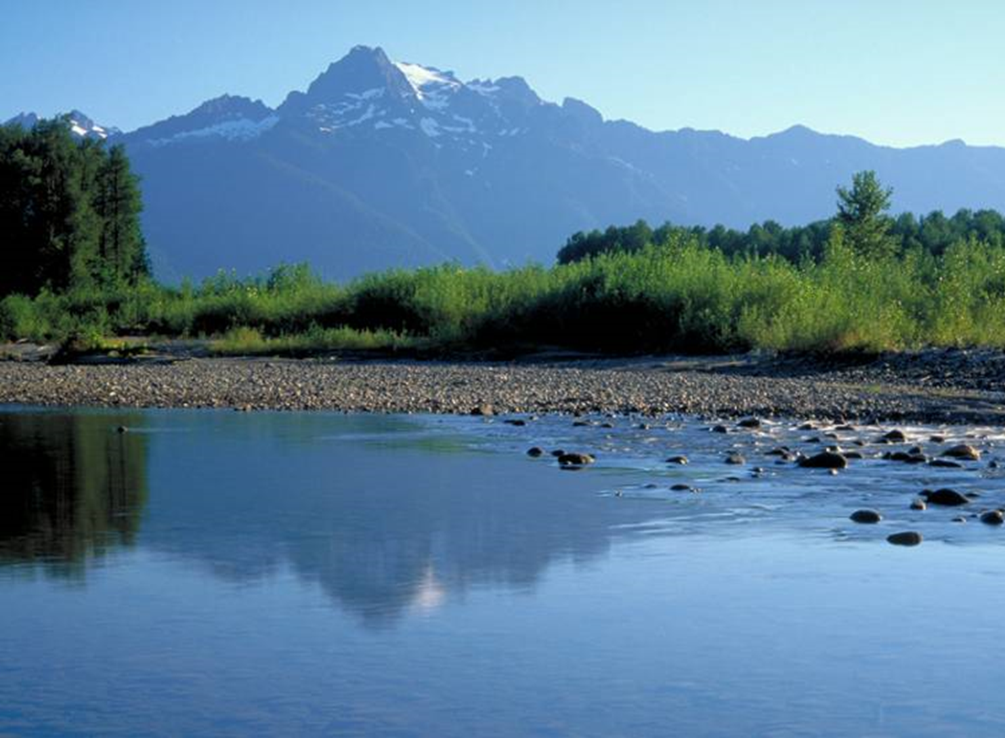
CONCLUSION
“It’s not complicated. More (benefits) is better.”
Notes:
Major Lessons
We’ve gained traction with the multiple benefits approach – incorporating community interests in flood/other infrastructure helped us overcome major political obstacles
Cannot succeed through on the ground work – need far outweighs TNC capacity – although that real world experience is invaluable
Climate change is mixed bag. Some embracing; others still denying
Insights
Complex decision making worlds – not one main decision maker to influence – rather need to influence folks of different persuasions and various levels
We believe the MB floodplain framework works across these realms: public-private; local-regional-national; climate adaptors/deniers; flood/fish managers
Big Thing
Paradigm Shift is needed in order to mainstream natural infrastructure into societies’ floodplain management sysytems
This is about social change
And institutional Change
Accomplishing these two things will take a lot more than good science – but that seems to be where the majority of our efforts our focused. Science, including economics, can help us but only if directly connected to strategies focused on social and institutional change.
Effective external relations strategies (at state and federal levels)
Robust communications/marketing (focused on shifting publid perceptions around natural infrastructure)
(in concl): the great thing here is that this is a place where national and global strategies really make sense. We can only partially succeed if remain focused on our sites
Policy
Social change

